Slide 1


PRESENTATION ON ‘METAVERSE’
Name: Sumit Gautam
Semester: VI
Section: A
University Roll No: 190290140038
Date: 12/03/2022

Slide 2
Table Of Content
What is Metaverse?
Types of Metaverse
Things you can do in Metaverse
Facebook changes its name
Facebook’s Metaverse plans

Slide 3

WHAT IS METAVERSE?
Metaverse is a virtual reality space in which users can interact with computer-generated environment and other users.
The internet will eventually evolve into the Metaverse, which will come to represent the major computing platform.
Combination of augmented, virtual and mixed reality can be Metaverse.

Slide 4
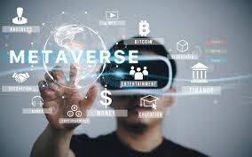
TYPES OF METAVERSE
BLOCKCHAIN BASED
One of them deals with building a Blockchain-based metaverse, using NFTs and Cryptocurrencies. Some of the examples are decentraland and the sandbox, which allow people to purchase virtual parcels of land and build their own environments.
SOCIAL WORLD
While the other one is simple, Virtual world where people can meet and greet each other. Facebook is working towards creating this version of metaverse.

Slide 5
WHAT YOU CAN DO IN METAVERSE?
Make a virtual property
Earn money by investing in NFTs, playing games that earn you money, etc.
Advertise anything
Create an environment customized to yourself
Own digital properties
Buy and sell unique assets

Slide 6
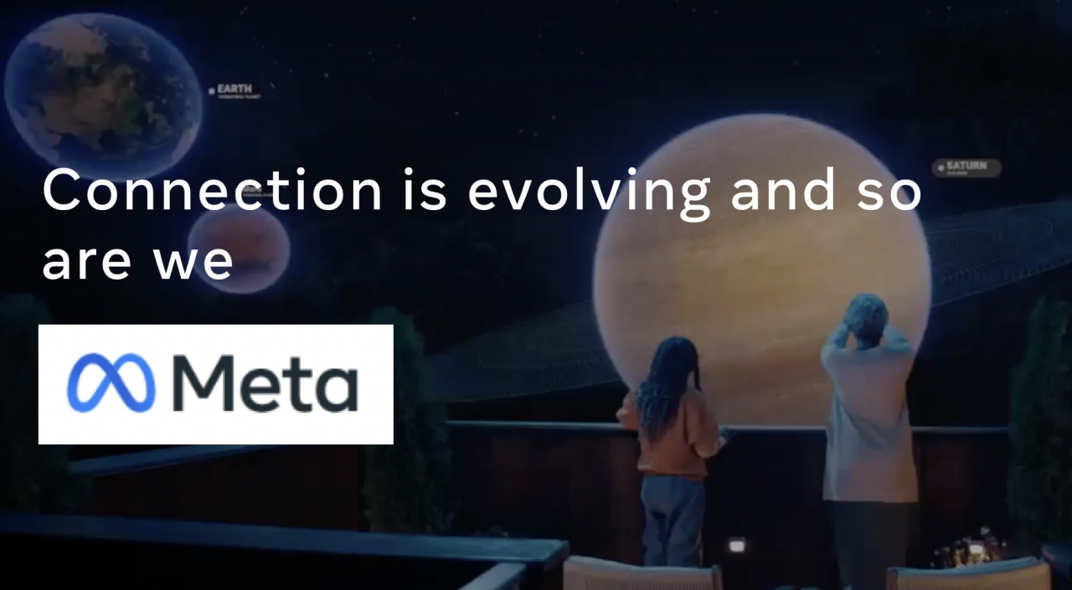
FACEBOOK META
Mark Zuckerberg on October 28 2021 announced the rebranding of Facebook Inc. As “Meta”, to include both the company’s “social experienced and future technology” focus.
Zuckerberg had previously talked about facebook’s shift from a social media company on July 28, during an earnings call.

Slide 7
META’S METAVERSE PLANS
3D spaces in the metaverse will let us socialize, learn, collaborate and play in ways that go beyond what we can imagine.
The metaverse will be collective project that goes beyond a single company. It will be created by people all over the world, and open to everyone.
Wearable technology like smart glasses, virtual reality like Quest and Augmented Reality like Spark AR.

Slide 8
PROS AND CONS OF METAVERSE
PROS
Innovations in Communication for Workplaces and Educational Institutions
Doubling Up the Power of Blockchain
New Opportunities for Branding
Developing and Promoting a Virtual Economy
CONS
Required of Advanced Digital Technologies
Privacy and Security Implications
Reducing the Difference between Real and Virtual

Slide 9
CONCLUSION
Metaverse is the future of internet.
It has its own advantages and disadvantages.
Large companies taking a step toward it.
Two realities will exist.
The matrix movie.

Slide 10
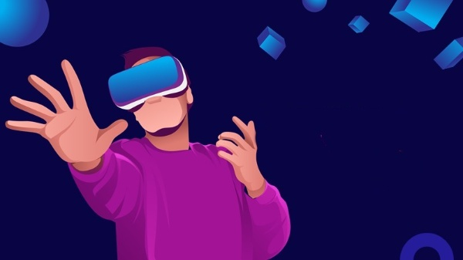
THANK YOU

