Slide 1


KIET Group of Institutions,Delhi-NCR,Ghaziabad Department of Computer Applications
(An ISO – 9001: 2015 Certified & ‘A+’ Grade accredited Institution by NAAC)
PRESENTATION ON
FULL STACK DEVELOPMENT
Submitted By
University roll no. 1900290140023
Name : Prachi Singh
Semester: 6
Section :A
Date:30/04/2022

Slide 2
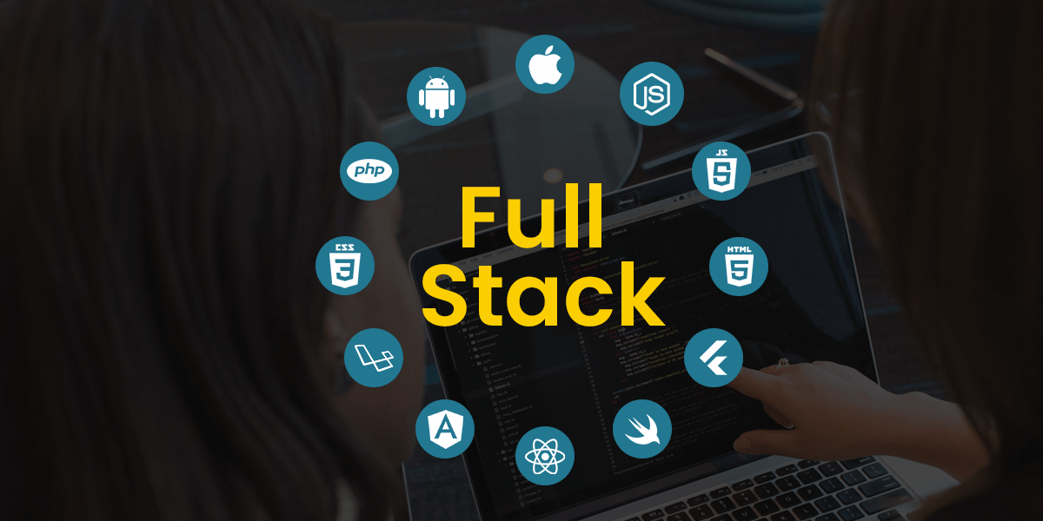
What is Full Stack Development???
Full stack technology refers to the
entire depth of a computer system
application, and full stack developers straddle two separate web development domains: the front end and the back end.
The front end includes everything that a client, or site viewer, can see and interact with. By contrast, the back end refers to all the servers, databases, and other internal architecture that drives the application; usually, the end-user never interacts with this realm directly.

Slide 3
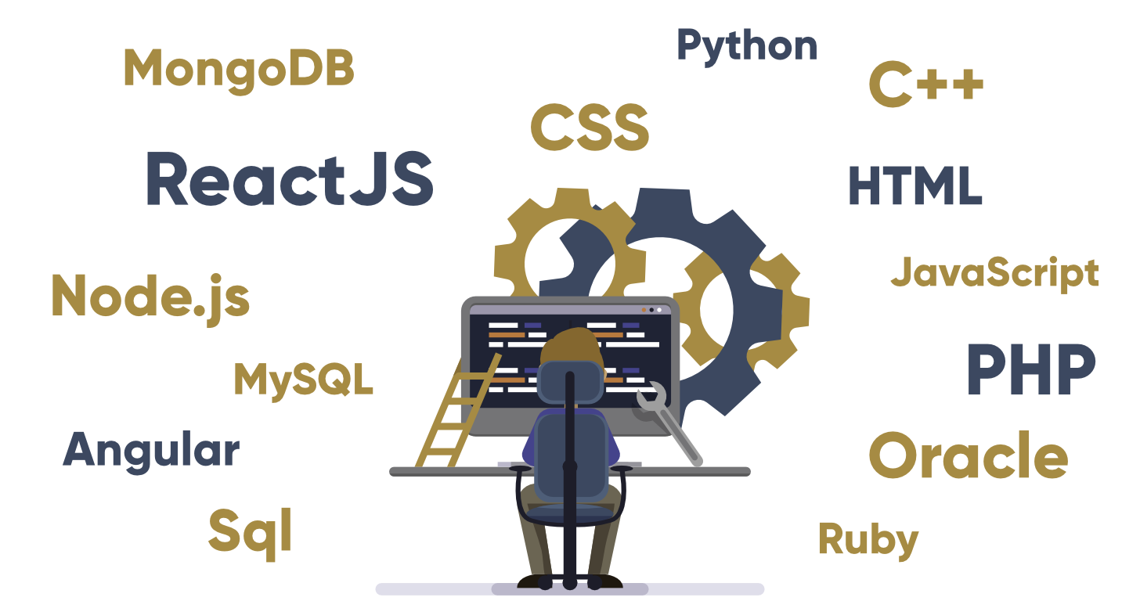
Technology related to full stack development
1.Front end:
HTML
CSS
Javascript
2.Back end:
PHP
C++
Java
Python,etc

Slide 4
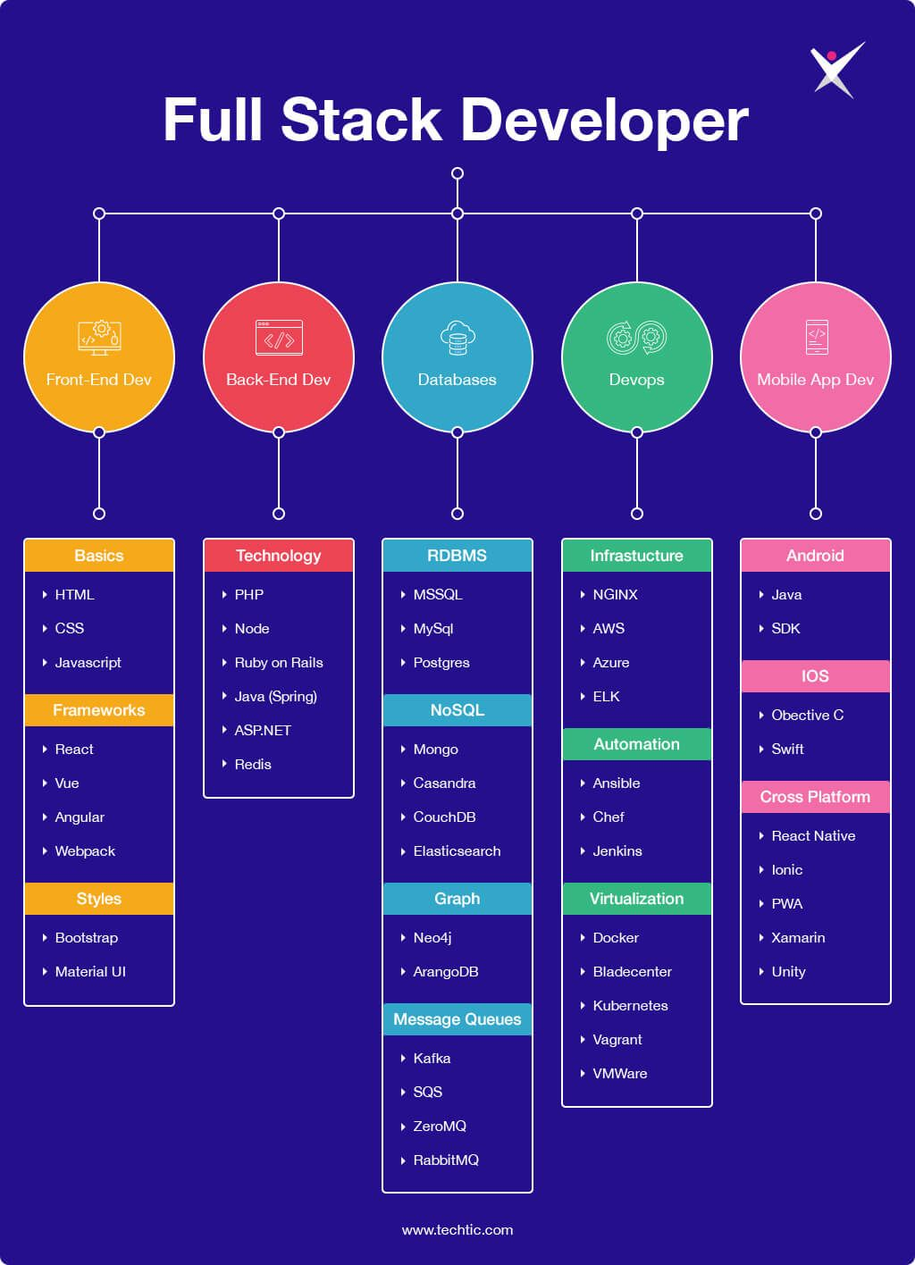

Slide 5
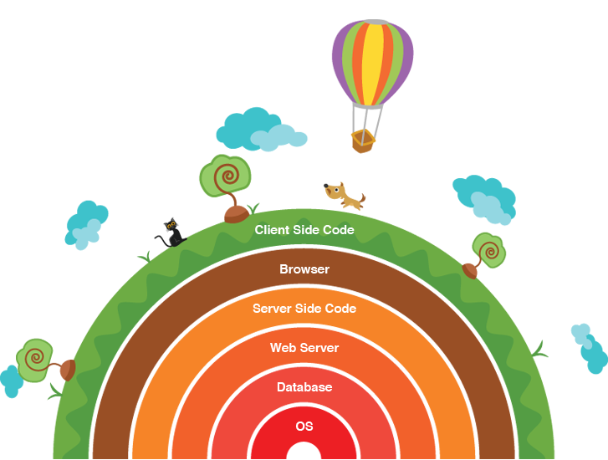
LAYERS IN FULL STACK DEVELOPMENT

Slide 6
Benefits
Time and Money saver
Rounded solution
Higher visibility
Complete ownership
More learning and great opportunity

Slide 7
Application
It is used for design and development of software.
Ensuring cross platform compatibility and optimization.
Designing user interactions on the web application itsel.f
Considering security, maintenance, scalability, and more when developing.
Keeping up with technological advances to optimize their software.

Slide 8
CONCLUSION
Developers are a curious lot, who are always looking for ways and avenues to learn and explore their possibilities.
With full stack development, these avenues become a constant stream of innovation through 2022.
Therefore, such developers have the prospect of vast learning domain.
Likewise, they have the honor of creating powerful and seamless website solutions single-hand.

Slide 9
COMPANIES
ACCENTURE
CAPGEMINI
COGNIZANT
IBM
TCS,ETC

Slide 10
THANK YOU

