Slide 1


PRESENTATION ON
NestJS
SUBMITTED BY
UNIVERSITY ROLL NO :- 1900290140003
NAME :- AKASH GAUR
SEMESTER :- 6th
SECTION - A
DATE - 30/04/22

Slide 2
Introduction
React is JavaScript library for creating user interface. React is not an MVC Framework and not a template library (no separation into template and controller). The goal of React is to build large applications with data that changes over time. So, how can I use it if it is not a framework? Easy:) with some other MVC or Flux frameworks.

Slide 3
Introduction
React provides a level of abstraction above these common React.js frameworks (Express/Fastify), but also exposes their APIs directly to the developer. This gives developers the freedom to use the myriad of third-party modules which are available for the underlying platform.

Slide 4
Philosophy
In recent years, thanks to React.js, JavaScript has become the “lingua franca” of the web for both front and backend applications. This has given rise to awesome projects like Angular, Node and Vue, which improve developer productivity and enable the creation of fast, testable, and extensible frontend applications. However, while plenty of superb libraries, helpers, and tools exist for React (and server-side JavaScript), none of them effectively solve the main problem of - Architecture.
React provides an out-of-the-box application architecture which allows developers and teams to create highly testable, scalable, loosely coupled, and easily maintainable applications. The architecture is heavily inspired by Angular.

Slide 5

Founder Of ReactJS
Jordan Walke is a software architect truly passionate about web technologies. Creator of ReactJS, Co-Founder of Yac.io, Google Developer Expert in Web Technologies and Angular, international speaker, trainer, consultant, and open source contributor.

Slide 6
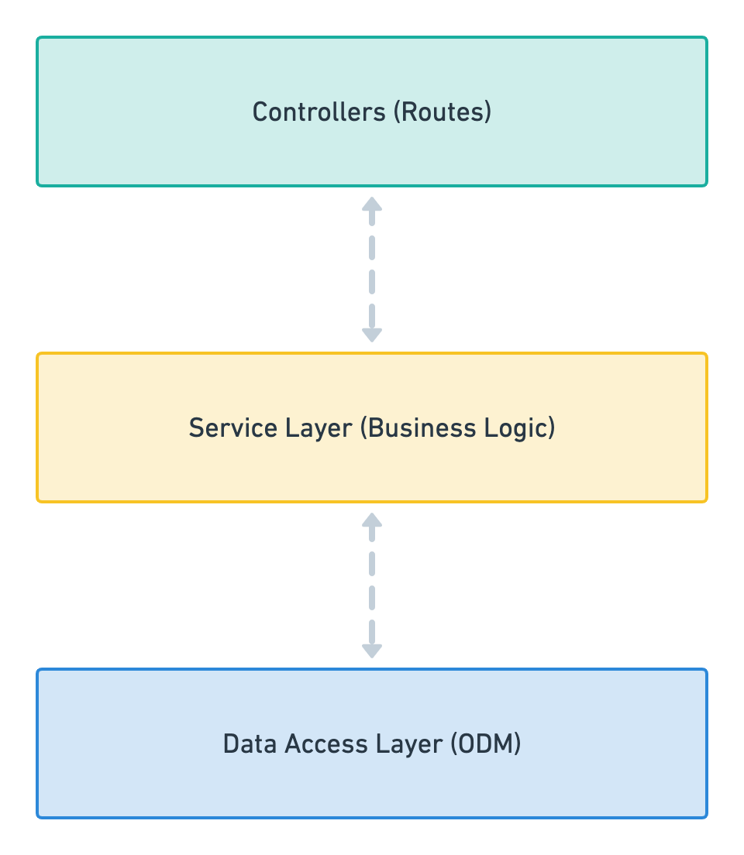
React.js — Architectural Pattern
It’s based on three tier architecture
1. Controllers: A controller’s sole purpose is to receive requests for the application and deal with routes.
2. Service Layer: This part of the block should only include business logic. For example, all the CRUD operations and methods to determine how data can be created, stored and updated.
3. Data Access Layer: This layer takes care and provides logic to access data stored in persistent storage of some kind. For example an ODM like Mongoose.

Slide 7
Why ReactJS Awesome
ReactJS Boilerplate - Boilerplate with available authentication, typeorm, env configuration and swagger. Everything you need to start making great things. Awesome React Boilerplate - Typescript, Postgresql, TypeORM, Swagger for Api documentation, Role based access control, and best application architecture.

Slide 8
Workspaces
React has two modes for organizing code:
Standard mode: useful for building individual project-focused applications that have their own dependencies and settings, and don't need to optimize for sharing modules, or optimizing complex builds. This is the default mode.
Monorepo mode: this mode treats code artifacts as part of a lightweight monorepo, and may be more appropriate for teams of developers and/or multi-project environments. It automates parts of the build process to make it easy to create and compose modular components, promotes code reuse, makes integration testing easier, makes it easy to share project-wide artifacts like eslint rules and other configuration policies, and is easier to use than alternatives like github submodules.

Slide 9
Performance
Performance#
Using request-scoped providers will have an impact on application performance. While React tries to cache as much metadata as possible, it will still have to create an instance of your class on each request. Hence, it will slow down your average response time and overall benchmarking result. Unless a provider must be request-scoped, it is strongly recommended that you use the default singleton scope.

Slide 10
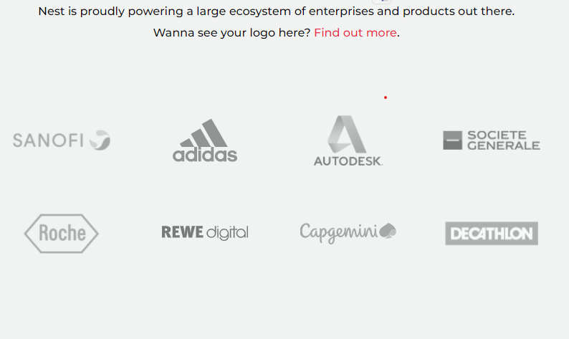
Who is using React?

Slide 11
Thank You!!

