Slide 1
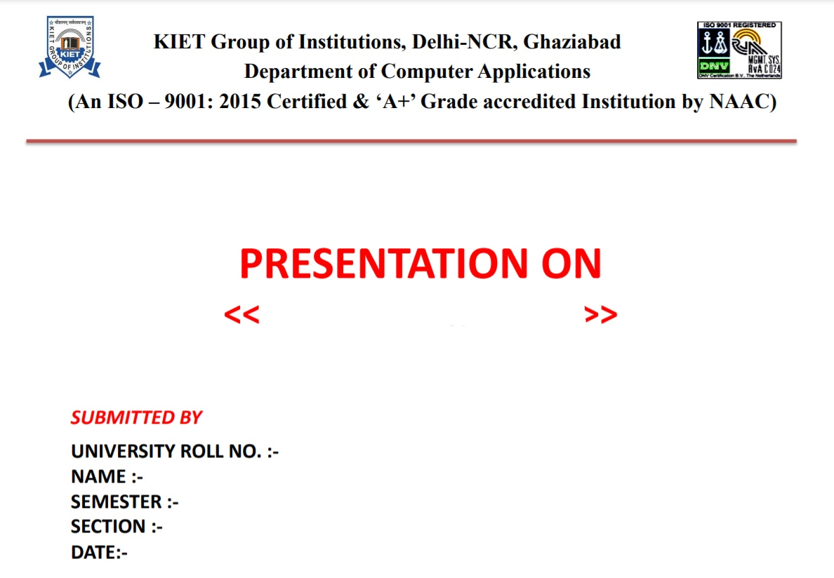
AWS
1900290140036
SHUBHAM KUMAR VISHNOI
6th
A
20/04/2022

Slide 2


Slide 3

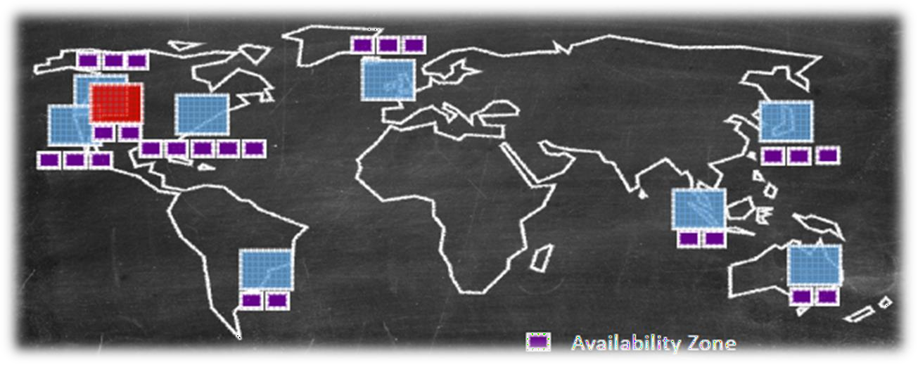


What is Amazon Web Services ?
▪ Amazon Web Services (AWS) is a collection of remote computing services (web services) that together make up a cloud computing platform, offered over the Internet by Amazon.com.
▪ Website: http://aws.amazon.com
▪ AWS is located in 9 geographical 'Regions‘. Each Region is wholly contained within a single country and all of its data and services stay within the designated Region.
▪ Each Region has multiple 'Availability Zones', which are distinct data centers providing AWS services. Availability Zones are isolated from each other to prevent outages from spreading between Zones. However, Several services operate across Availability Zones (e.g. S3, DynamoDB).
3

Slide 4

What is AWS Offering?
▪ Low Ongoing Cost:, pay-as-you-go pricing with no up-front expenses or long-term
commitments.
▪ Instant Elasticity & Flexible Capacity: (scaling up and down) Eliminate guessing on your infrastructure capacity needs.
▪ Speed & Agility: Develop and deploy applications faster Instead of waiting weeks or months for hardware to arrive and get installed.
▪ Apps not Ops: Focus on projects. Lets you shift resources away from data center investments and operations and move them to innovative new projects.
▪ Global Reach: Take your apps global in minutes.
▪ Open and Flexible: You choose the development platform or programming model that
makes the most sense for your business.
▪ Secure: Allows your application to take advantage of the multiple layers of operational and physical security in the AWS data centers to ensure the integrity and safety of your data.
4

Slide 5
















The Amazon Web Services Universe
Cross Service Features
Management
Interface
Platform Services
Infrastructure
Services
5

Slide 6




Management Interface
CLI
http://aws.amazon.com/cli/
Management
Interface
SDK
http://aws.amazon.com/tools/
Web
http://aws.amazon.com/console/
6

Slide 7





Infrastructure Services
EC2
http://aws.amazon.com/ec2/
Infrastructure Services
VPC
http://aws.amazon.com/vpc/
S3
http://aws.amazon.com/s3/
EBS
http://aws.amazon.com/ebs/
7

Slide 8




Amazon Elastic Compute Cloud (EC2)
▪ A web service that provides resizable compute capacity in the cloud.
▪ EC2 allows creating Virtual Machines (VM) on-demand. Pre-configured templated Amazon Machine Image (AMI) can be used get running immediately. Creating and sharing your own AMI is also possible via the AWS Marketplace.
▪ Auto Scaling allows automatically scale of the capacity up seamlessly during demand spikes to maintain performance, and scales down during demand lulls to minimize costs.
▪ Elastic Load Balancing automatically distributes incoming application traffic across multiple Amazon EC2 instances.
▪ Provide tools to build failure resilient applications by launching application
instances in separate Availability Zones.
▪ Pay only for resources actually consume, instance-hours.
▪ VM Import/Export enables you to easily import virtual machine images from your existing environment to Amazon EC2 instances and export them back at any time.
8

Slide 9
EC2 Instances
▪ Micro instances (t1.micro):
– Micro Instance 613 MiB of memory, up to 2 ECUs (for short periodic bursts), EBS storage only, 32- bit or 64-bit platform.
▪ Standard Instances provide customers with a balanced set of resources and a low cost platform.
– M1 Small Instance (Default) 1.7 GiB of memory, 1 EC2 Compute Unit (1 virtual core with 1 EC2 Compute Unit), 160 GB of local instance storage, 32-bit or 64-bit platform
– M1 Medium Instance 3.75 GiB of memory, 2 EC2 Compute Units (1 virtual core with 2 EC2 Compute Units each), 410 GB of local instance storage, 32-bit or 64-bit platform
– M1 Large Instance 7.5 GiB of memory, 4 EC2 Compute Units (2 virtual cores with 2 EC2 Compute Units each), 850 GB of local instance storage, 64-bit platform
– M1 Extra Large Instance 15 GiB of memory, 8 EC2 Compute Units (4 virtual cores with 2 EC2 Compute Units each), 1690 GB of local instance storage, 64-bit platform
– M3 Extra Large Instance 15 GiB of memory, 13 EC2 Compute Units (4 virtual cores with 3.25 EC2 Compute Units each), EBS storage only, 64-bit platform
– M3 Double Extra Large Instance 30 GiB of memory, 26 EC2 Compute Units (8 virtual cores with
3.25 EC2 Compute Units each), EBS storage only, 64-bit platform
One EC2 Compute Unit (ECU) provides the equivalent CPU
capacity of a 1.0-1.2 GHz 2007 Opteron or 2007 Xeon processor.
8

Slide 10
EC2 High Performance Instances
▪ High-Memory Instances:
– High-Memory Extra Large Instance 17.1 GiB memory, 6.5 ECU (2 virtual cores with 3.25 EC2
Compute Units each), 420 GB of local instance storage, 64-bit platform
– High-Memory Double Extra Large Instance 34.2 GiB of memory, 13 EC2 Compute Units (4 virtual cores with 3.25 EC2 Compute Units each), 850 GB of local instance storage, 64-bit platform
– High-Memory Quadruple Extra Large Instance 68.4 GiB of memory, 26 EC2 Compute Units (8 virtual cores with 3.25 EC2 Compute Units each), 1690 GB of local instance storage, 64-bit platform
▪ High-CPU Instances
– High-CPU Medium Instance 1.7 GiB of memory, 5 EC2 Compute Units (2 virtual cores with 2.5 EC2 Compute Units each), 350 GB of local instance storage, 32-bit or 64-bit platform
– High-CPU Extra Large Instance 7 GiB of memory, 20 EC2 Compute Units (8 virtual cores with 2.5 EC2 Compute Units each), 1690 GB of local instance storage, 64-bit platform
▪ High Storage Instances
– High Storage Eight Extra Large 117 GiB memory, 35 EC2 Compute Units, 24 * 2 TB of hard disk drive local instance storage, 64-bit platform, 10 Gigabit Ethernet
▪ High I/O Instances
– High I/O Quadruple Extra Large 60.5 GiB memory, 35 EC2 Compute Units, 2 * 10249 GB of SSD-
based local instance storage, 64-bit platform, 10 Gigabit Ethernet

Slide 11
EC2 Cluster Instances
▪ Cluster Compute Instances provide proportionally high CPU resources with increased network performance and are well suited for High Performance Compute (HPC) applications and other demanding network-bound applications.
– Cluster Compute Eight Extra Large 60.5 GiB memory, 88 EC2 Compute Units, 3370 GB of local instance storage, 64-bit platform, 10 Gigabit Ethernet
▪ High Memory Cluster Instances provide proportionally high CPU and memory resources with increased network performance, and are well suited for memory- intensive applications including in-memory analytics, graph analysis, and scientific computing.
– High Memory Cluster Eight Extra Large 244 GiB memory, 88 EC2 Compute Units, 240 GB of local instance storage, 64-bit platform, 10 Gigabit Ethernet
▪ Cluster GPU Instances provide general-purpose graphics processing units (GPUs) with proportionally high CPU and increased network performance for applications benefitting from highly parallelized processing, including HPC, rendering and media processing applications.
– Cluster GPU Quadruple Extra Large 22 GiB memory, 33.5 EC2 Compute Units, 2 x NVIDIA Tesla
“Fermi” M2050 GPUs, 1690 GB of local instance storage, 64-bit platform, 10 Gigabit Et¹h⁰ernet.

Slide 12
EC2 Payment methods
▪ On-Demand Instances let you pay for compute capacity
by the hour with no long-term commitments.
▪ Reserved Instances give you the option to make a low, one-time payment for each instance you want to reserve and in turn receive a significant discount on the hourly charge for that instance.
▪ Spot Instances allow customers to bid on unused Amazon EC2 capacity and run those instances for as long as their bid exceeds the current Spot Price.

Slide 13


Amazon Simple Storage Service (S3)
▪ Amazon S3 provides a simple web services interface that can be used to store and
retrieve any amount of data, at any time, from anywhere on the web.
▪ Write, read, and delete objects containing from 1 byte to 5 terabytes of data each. The
number of objects you can store is unlimited.
▪ Each object is stored in a bucket and retrieved via a unique, developer-assigned key.
– A bucket can be stored in one of several Regions.
– You can choose a Region to optimize for latency, minimize costs, or address regulatory requirements.
– Objects stored in a Region never leave the Region unless you transfer them out.
▪ Authentication mechanisms are provided to ensure that data is kept secure from unauthorized access.
– Objects can be made private or public, and rights can be granted to specific users.
▪ S3 charges based on per GB-month AND per I/O requests AND per data modification requests.

Slide 14










Platform Services
EMR
http://aws.amazon.com/elasticmapreduce/
RDS
http://aws.amazon.com/rds/
Platform Services
DynamoDB
http://aws.amazon.com/dynamodb/
Beanstalk
http://aws.amazon.com/elasticbeanstalk/

Slide 15
SQL Databases
▪ In relational databases (SQL Databases), ACID (Atomicity, Consistency, Isolation, Durability) is a set of properties that guarantee that database transactions are processed reliably.
– Atomicity requires that each transaction is "all or nothing": if one part of the transaction fails, the entire transaction fails, and the database state is left unchanged.
– The consistency property ensures that any transaction will bring the database from one valid state to another.
– The isolation property ensures that the concurrent execution of transactions results in a system state that would be obtained if transactions were executed serially,.
– Durability means that once a transaction has been committed, it will remain so, even in the event of power loss, crashes, or errors.

Slide 16
NoSQL Databases
▪ A NoSQL database provides a mechanism for storage and retrieval of data that employs less constrained consistency models than traditional relational databases.
▪ NoSQL databases only support Eventual Consistency which is a consistency model used in distributed computing that informally guarantees that, if no new updates are made to a given data item, eventually all accesses to that item will return the last updated value.
▪ NoSQL databases are often highly optimized key–value stores intended for simple retrieval and appending operations, with the goal being significant performance benefits in terms of latency and throughput.
▪ Key–value stores allow the application to store its data in a schema-less way.
– The data could be stored in a datatype of a programming language or an object. Because of this, there is no need for a fixed data model.

Slide 17




Amazon Elastic Beanstalk
▪ AWS Elastic Beanstalk provides a solution to quickly deploy and manage applications in
the AWS cloud.
▪ You simply upload your application, and Elastic Beanstalk automatically handles the deployment details of capacity provisioning, load balancing, auto-scaling, and application health monitoring.
▪ Elastic Beanstalk leverages AWS services such as Amazon EC2, Amazon S3, ….
▪ To ensure easy portability of your application, Elastic Beanstalk is built using familiar software stacks such as:
– Apache HTTP Server for Node.js, PHP and Python
– Passenger for Ruby,
– IIS 7.5 for .NET
– Apache Tomcat for Java.
▪ There is no additional charge for Elastic Beanstalk - you pay only for the AWS resources
needed to store and run your applications.

Slide 18


