Slide 1


Data Modeling and Data Warehouse Project
CHINOOK Digital Media Store
California State Polytechnic University, Pomona
GBA 6220
PROFESSOR HUI SHI
GROUP 1: CECE NGUYEN, KIET NGUYEN, AILIEN DANG, IVY NGUYEN

Slide 2
MOTIVATION
About the Chinook database
  The Chinook data model represents a digital media store, including tables for artists, albums, media tracks, invoices, and customers.
  Media-related data was created using real data from an Apple iTunes library.
  Customer and employee information was created using fictitious names and addresses that can be located on Google maps, and other well formatted data (phone, fax, email, etc.)
  Sales information was auto generated using random data for a four- year period.
WHY DO WE SELECT THIS DATASET?
  Industry Relevance: The Chinook database models a digital media store, aligning with key industry trends in digital sales and content distribution. It offers a practical insight into e-commerce operations.
  Educational Tool: Ideal for educational purposes, it helps develop SQL and database management skills through a realistic business environment.
WHERE AND HOW?
  The dataset was collected from Kaggle
  The description of the dataset was collected from YugabyteDB website

Slide 3
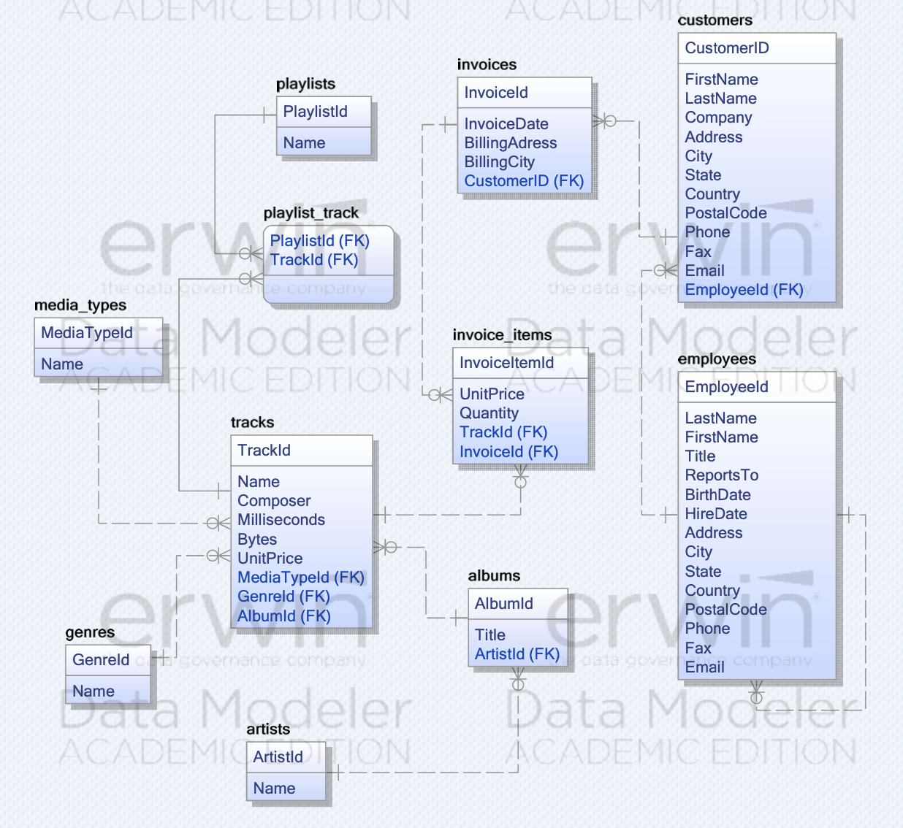
ER DATA MODEL
ENTITY
The ER diagram displays 11 primary entities which are essential to the database:
Customers
Employees
Invoices
Invoice_Items (Invoice_Line)
Tracks
Albums
Artists
Genres
Media Types
Playlists
Playlist_Track

Slide 4
RELATIONSHIPS
ENTITY | RELATIONSHIP | ENTITY
Customer | 1:M | Invoice
Employee | 1:M | Customer
Employee | 1:M | Employee
Invoice | 1:M | InvoiceItem
Track | 1:M | InvoiceItem
Album | 1:M | Track
Artist | 1:M | Album
Genre | 1:M | Track
MediaType | 1:M | Track
Track | 1:M | Playlist_Track
Playlist | 1:M | Playlist_Track

Slide 5
CONSTRAINTS
FOREIGN
KEY
ONE-TO-MANY
RELATIONSHIP
CASCADING
DELETION
NULLABILITY

Slide 6
BUSINESS
RULES

Slide 7
Business Rules
One-to-Many
One customer can have multiple invoices.
One invoice can have multiple invoice items.
One track can be part of multiple invoice items and playlists.
One album can contain many tracks.
One artist can produce many albums.
One genre can include many tracks.
One media type can be associated with many tracks.
Many-to-Many
One playlist can include many tracks, and one track can be included in many playlists. This relationship is managed by the playlist_track join table.

Slide 8
DATABASE
SQL Statements
DDL (Data Definition Language): Used to create and modify the database structure (CREATE TABLE, CREATE DATABASE).
DML (Data Manipulation Language): Manipulates data within tables (INSERT INTO, SELECT).
Utility Commands: Facilitate database operations (\i to run scripts, \l to list databases, \c to connect to a database, \d to list tables).
Tables
The Chinook database includes 11 primary tables:
Album, Artist, Customer, Employee, Genre, Invoice, InvoiceLine, MediaType, Playlist, PlaylistTrack, Track
Columns
Columns are tailored to the specific data each table holds, such as TrackId, Name, Composer in the Track table, which store the track’s ID, name, and composer respectively.
Constraints
Primary Key Constraints: Ensure each record is uniquely identifiable (e.g., TrackId, AlbumId).
Foreign Key Constraints: Maintain referential integrity between tables (e.g., AlbumId in Track links to Album).
Not Null Constraints: Guarantee essential fields are always filled (e.g., Name in Track cannot be NULL).

Slide 9
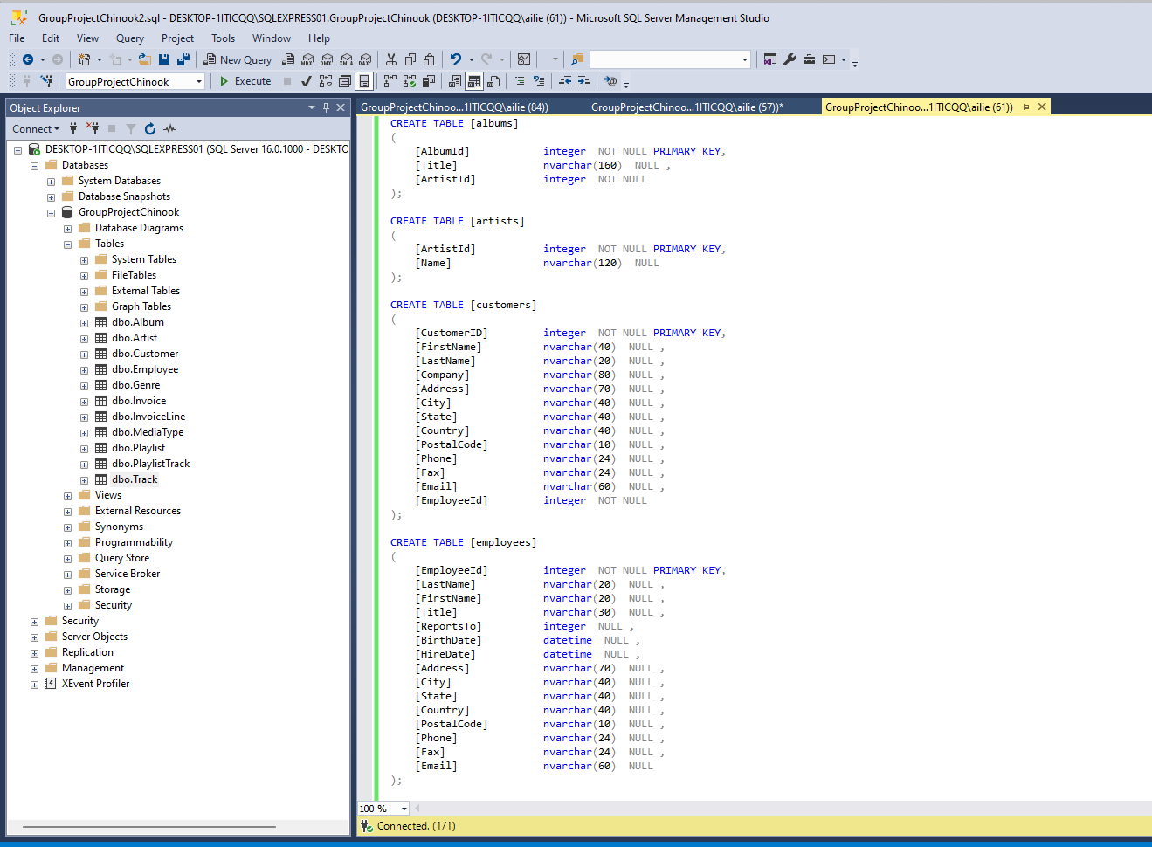
DATABASE SQL

Slide 10
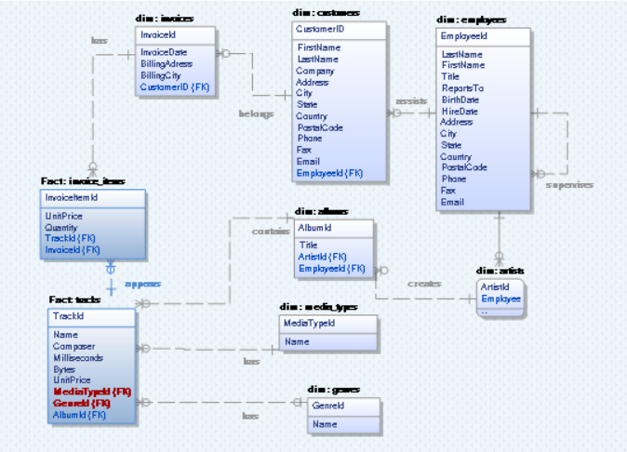
DATA WAREHOUSE
This is a Special Star Schema (Snow-Flake Schema)
2 Central Fact Tables:
  FactInvoiceLine - Contains transactional data, linking each invoice line item to specific tracks and including financial details such as unit price and quantity.
  FactTrack - Holds information about each track, including its relation to albums, media types, and genres, plus attributes like composer, duration, and price.
7 Dimension Tables:
  DimInvoice - Details about invoices, including references to the customers and employees involved, billing information, and total invoice amounts.
  DimCustomer - Information about customers, such as name, contact details, and geographic location.
  DimEmployee - Data on employees, including personal details, hierarchy (reports to), and contact information.
  DimAlbum - Album details, including the title and the artist.
  DimArtist - Information about the artists, primarily their names.
  DimMediaType - Types of media in which tracks are available.
  DimGenre - Musical genres.
This setup is optimal for handling complex queries related to sales transactions, customer behavior, and track popularity, as it allows for fast data retrieval across a simplified relational structure.

Slide 11
DATA WAREHOUSE
Fact Tables
Fact: InvoiceLine
  Primary Key: InvoiceLineID
  Foreign Keys: InvoiceID, TrackID
  Attributes: UnitPrice, Quantity
Fact: Track
  Primary Key: TrackID
  Foreign Keys: AlbumID, MediaTypeID, GenreID
  Attributes: Composer, Milliseconds, UnitPrice
Dimension Tables
Dim: Invoice
  Primary Key: InvoiceID
  Foreign Keys: CustomerID, EmployeeID
  Attributes: InvoiceDate, BillingAddress, BillingCity, BillingState, BillingCountry, BillingPostalCode, Total
Dim: Customer
  Primary Key: CustomerID
  Attributes: FirstName, LastName, Company, Address, City, State, Country, PostalCode, Phone, Email
Dim: Employee
  Primary Key: EmployeeID
  Attributes: LastName, FirstName, Title, ReportsTo, BirthDate, HireDate, Address, City, State, Country, PostalCode, Phone, Fax, Email
Dim: Album
  Primary Key: AlbumID
  Foreign Key: ArtistID
  Attributes: Title
Dim: Artist
  Primary Key: ArtistID
  Attributes: Name
Dim: MediaType
  Primary Key: MediaTypeID
  Attributes: Name
Dim: Genre
  Primary Key: GenreID
  Attributes: Name

Slide 12
Business Insights
Using a data warehouse structured around the Chinook database, lots of business insights can be derived, for instances:
Customer Purchasing Behavior
Sales Trends
Employee Performance
Product Performance

Slide 13
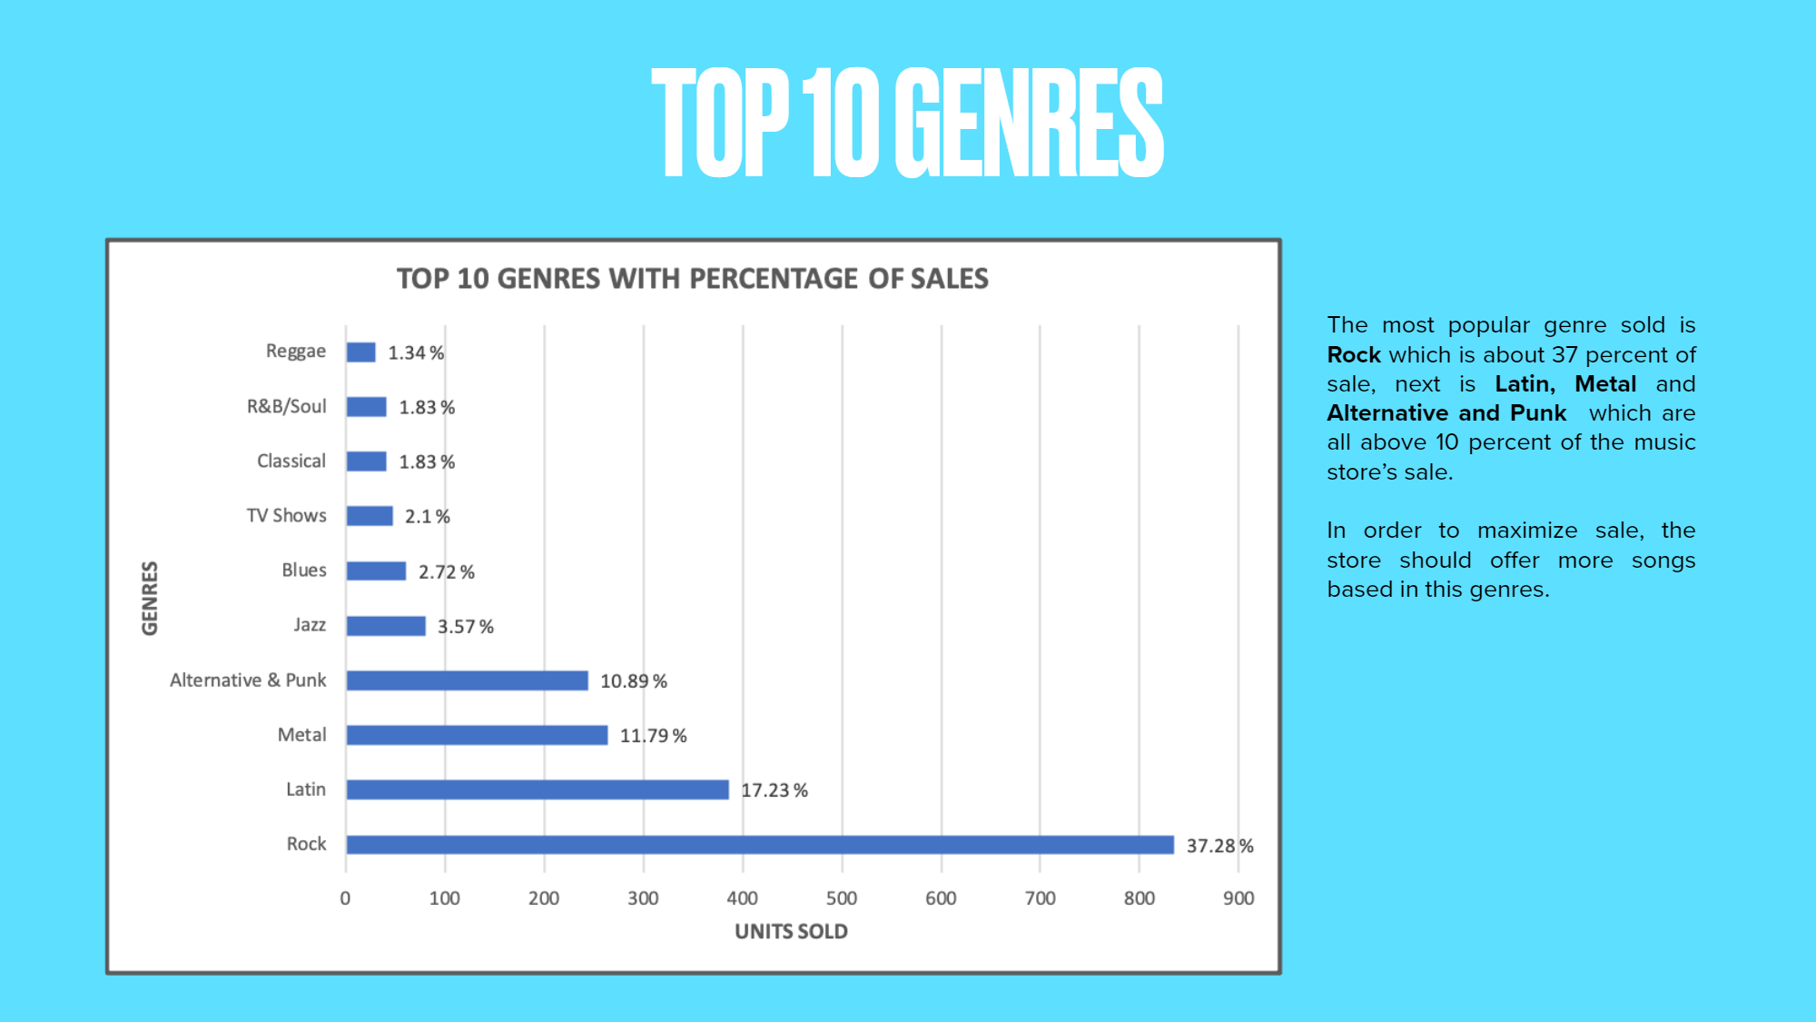
Business Insights

Slide 14
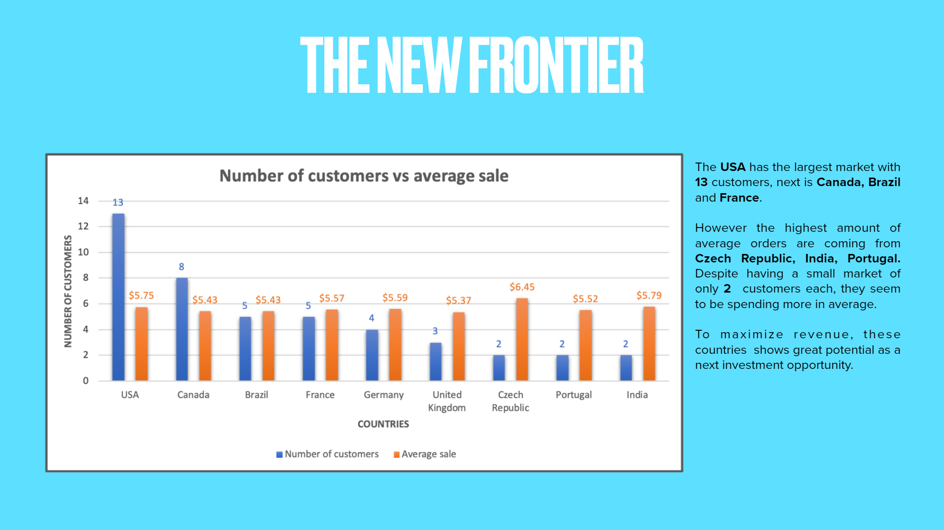
Business Insights

Slide 15

FUTURE WORK
Integration with External Data:
  Social Media and Web Analytics: Combine social media insights and web usage data to enrich customer profiles and improve marketing strategies.
Advanced Analytics and Machine Learning:
  Predictive Modeling: Develop models to forecast sales trends and customer behavior.
  Customer Segmentation: Apply machine learning to segment customers more effectively based on their purchasing patterns.
Market Expansion:
  New Markets and Products: Explore opportunities for geographic and product line expansion, such as adding merchandise or event tickets.
Real-Time Data Processing:
  Stream Processing: Adopt technologies for instant data processing to support dynamic pricing and immediate inventory updates.

Slide 16

REFERENCES
PROFESSOR’S LECTURES
KAGGLE: https://www.kaggle.com/datasets/anurag629/chinook-csv-dataset
YugabyteDB: https://docs.yugabyte.com/preview/sample-data/chinook/

Slide 17

Thank you

