Slide 1
KAFKON
ScribeBA
The Business Analyst that lives in your Slack thread
スクライブ・ビーエー · 議論を仕様へ
AI Tinkerers Da Nang · Agents, Everywhere · 12 September 2026

Slide 2
THE PROBLEM
Requirements are not written in Jira. They are argued in Slack.
A security lead sets a constraint
"restrict authentication strictly to @acmecorp.com"
A DBA commits to a migration
"sso_provider and external_sub_id, unique, zero-downtime"
Someone asks about session expiry
asked twice. Answered by nobody.
Then a ticket gets written from memory
and the constraints that were agreed never make it in
A chatbox cannot fix this. It has to be handed a transcript, stripped of who holds which role.

Slide 3
THE LOOP
Detect · Analyze · Resolve · Validate
DETECT
ANALYZE
RESOLVE
VALIDATE
Mention it in the thread
Reads the whole argument, labels every claim
Asks the channel instead of guessing
Files the ClickUp ticket with provenance
Every claim carries its status
Verified
Inferred
Assumed
Blocked
quoted from the thread
reasoned from a verified claim
convention, not confirmed
nobody answered
A field nobody answered becomes Blocked. It is never invented.

Slide 4
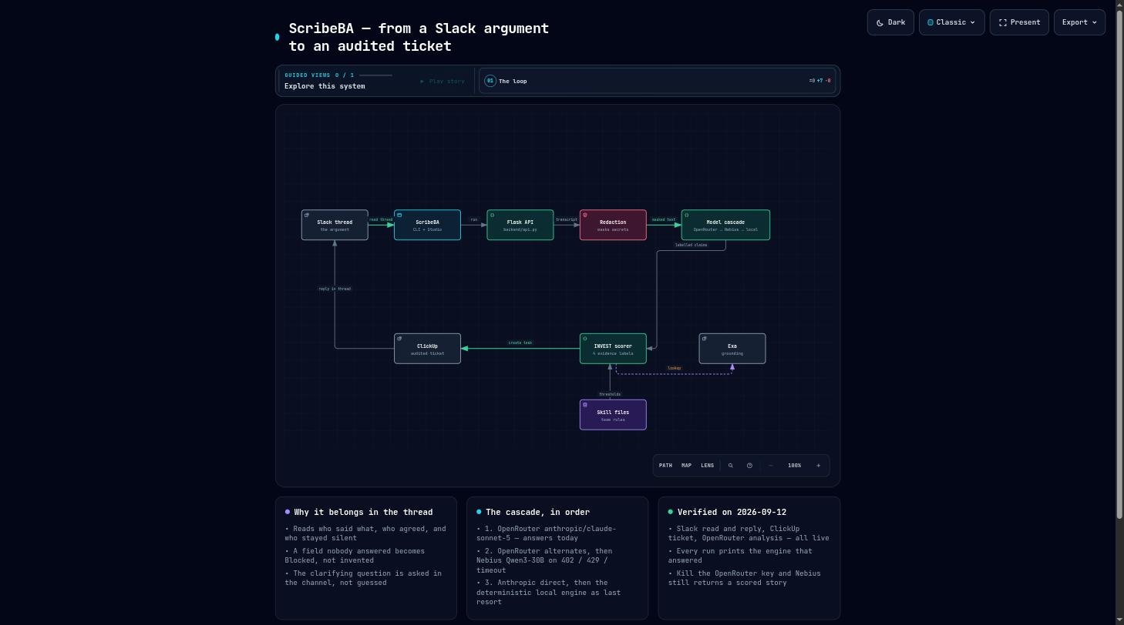
ARCHITECTURE
One run, end to end

Slide 5
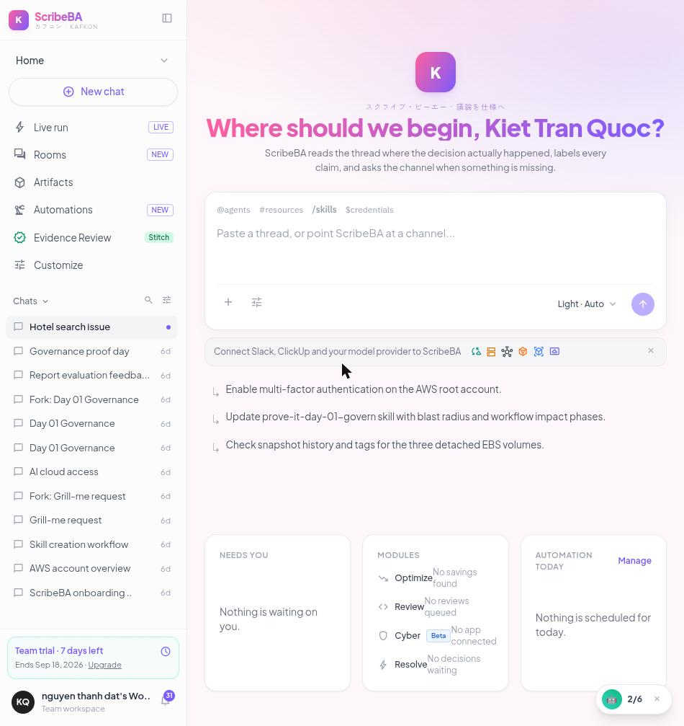
THE PRODUCT
ScribeBA Studio
Live run
Pick a channel and a thread, press one button
Engine badge
Says which model actually answered the run
Evidence Review
Labelled claims from runs really performed
Starter prompts
A button to press instead of an empty box

Slide 6
EVIDENCE
What is live, measured today
Slack read + in-thread reply
Live
8 messages read, Block Kit reply posted
ClickUp ticket
Live
task 86eywa26d, carries the Slack permalink
Analysis
Live
anthropic/claude-sonnet-5 via OpenRouter, INVEST 88/100
Failover
Live
kill the key — Nebius Qwen3-30B still scores the story
Secret redaction
Live
tokens, cards, IPs, phones masked before egress
Tests
Live
19 tests, 0.17 s, offline, no key required
Telegram / Discord
Not exercised
code present, no token configured
Rest of the dashboard
Sample data
only Live run and Evidence Review are wired
The README carries this same table. A claim a judge can disprove costs more than an honest line.

Slide 7
WHY IT HOLDS
It does not die on stage, and the rules are the team’s
Model cascade
Same thread, different team rules
1. OpenRouter claude-sonnet-5
startup_lean
[MVP] Google Workspace SSO & Auto-Provisioning
2. OpenRouter alternates
mvp · lean · fast-follow · INVEST 91
3. Nebius Qwen3-30B
4. Anthropic direct
agency_detailed
[Feature-Spec] Google Workspace OAuth 2.0 Enterprise SSO
5. Local engine
client-deliverable · contract-scope · audited · INVEST 83
The behaviour comes from a Skill file the team owns, not from our prompt.

Slide 8
CLOSE
Run it yourself
github.com/kietoichoiDXD/KAFKON
python demo/seed_slack_thread.py <CHANNEL_ID>
python -m backend.cli slack-run --channel <CHANNEL_ID> --ts <TS> --tier low
python -m backend.cli web # API on :8000, studio on :3000
Built during the event. First commit 12:51, 12 September 2026.
ScribeBA · KAFKON

