Slide 1
BAD 2014
ANALYSIS AND DESIGN
OF E-COMMERCE SYSTEMS
Lesson – 1
Introduction to system Design Environment

Slide 2
Introduction to
System Analysis and Design
The Learning outcome of this lesson is to :
  Introduce to System analysis and design approaches
  Understanding systems concepts
  Explain the organization structure for information systems
  Stress upon the role of System analysts and their skills
  Learn various type of Information systems

Slide 3
Need for System Analysis and Design
  For taking efficient decision and to plan effectively the management needs Information, so today information is considered to be one of the critical organization resource.
  Thus key to success in business is its ability to gather, organize and interpret information.
  This resource information is provided by various Information Systems.
  System Analysis and Design is proven methodology that helps business to build its Information Systems and reap the rewards of utilizing information to its full capacity. Companies make use of systems analysis and design methods to build, update and maintain information systems.

Slide 4
What is Information System Analysis and Design
System analysis and design is a step-by-step process for developing high-quality information systems.
The organizations IT team or consultants form outside will plan, develop and maintain information Systems.
The success of analysis and design of Information Systems will be based on
  the team’s understanding of the organizations objectives, structures and processes and
  their knowledge of how to exploit IT for advantage.
To be successful in this, you should follow a structured System analysis and designing approach – what is this approach is going to be objective of our study.

Slide 5
  In this course we are going to learn about System Analysis and Design and how this methodology could be used to build a proper information system, which will provide accurate, relevant and timely information.

Slide 6
System analysis and Design
Approaches

Slide 7
Organizations approach to System Analysis and Design
In this slide we will try to understand what are the important components of a Information System.
In addition to Application Software the Total Information Systems includes:
  Hardware and system software
  Documentation and training materials
  Job roles associated with the system
  Controls to prevent theft or fraud
  The people who use the software to perform their jobs

Slide 8
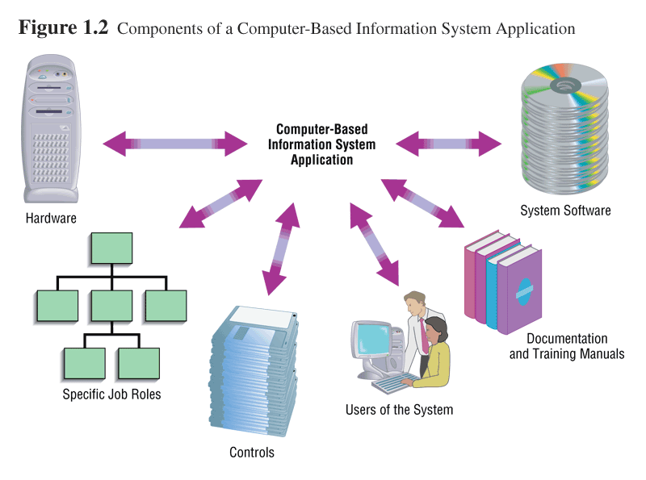

Slide 9
Organizations approach to System Analysis and Design
Although we will be learning all these dimensions, the emphasis will be on application software development – the primary responsibility of a System Analysis Analyst.
The Application software is designed to support a specific organizational function or process, such as Inventory Management or Payroll or Market Analysis.

Slide 10
Software Engineering Process
Two decades back building systems or writing programmes were considered to an art. But now software development makes use of sound engineering principles so that we can obtain information systems economically, which is also reliable and works efficiently when implemented.
In this course we will develop the knowledge and skills needed to understand and follow such software engineering processes.
Basis of this development processes involves various methodologies, techniques and tools that has been developed, tested and widely used over the years to assist people involved in System Analysis and Design.

Slide 11
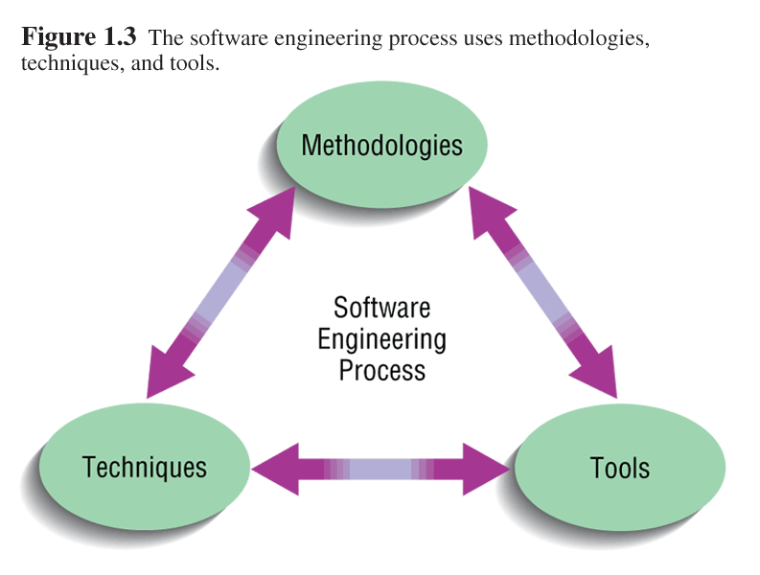
Software Engineering Process
Methodologies
    provide the technical ‘know how’ for building software which includes requirement analysis, design, program construction, testing and maintenance. Most methodologies incorporate several development techniques, such as direct observation and interviews with users.
Techniques
    are processes you will follow to ensure that, work is well thought-out, complete and comprehensible to others on your project team. Such as, diagramming how the system will function and designing the reports.
Tools
    are computer programs, such as computer aided software engineering (CASE) tools, that make it easy to use specific techniques.

Slide 12
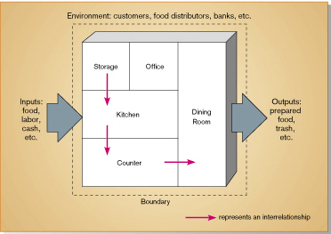
System
Before getting further into systems analysis and designing let us try to understand the basis of the word “Systems” and learn about the approaches to systems development. We will also identify types of information systems.

Slide 13
System
A system is an interrelated set of business procedures used within one business unit working together for a purpose
A system exists within an environment
A boundary separates a system from its environment
Computer based Information System is a set or arrangement of elements that are organized to accomplish some pre-defined goal by processing information. The goal may be to support some business function.

Slide 14
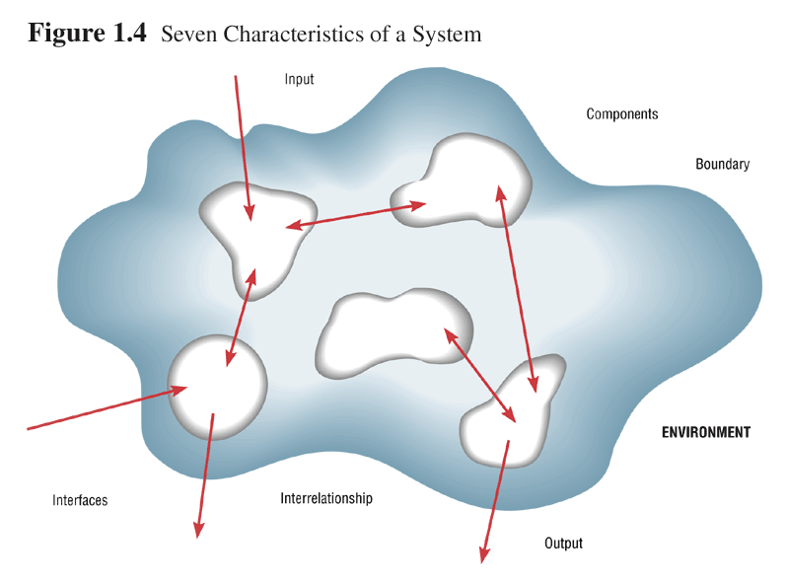
SYSTEMS characteristics
Components
Interrelation
Boundary
Purpose
Environment
Interfaces
Constraints
Input
Output

Slide 15
1- COMPONENTS of a system are either an irreducible which is also called a sub-system. The basis of components is that we can repair or upgrade the system by changing individual components without having to make changes throughout the entire system.
2 – The components are INTERRELATED : that is the function of one sub-system is somehow tied to the functions of the others. Ex: Date wise reporting of sales data can not be done until the work of another component is finished, such as sorting sales Invoices by date.
3 – The systems has a BOUNDARY, within which all the components are contained and separating it from other systems. The features which define the extent of a system are its boundaries
4 – All the components work together to achieve some overall PURPOSE for the larger systems. They all work towards the organization objectives.
5 – The points at which the system interact with its environment are called INTERFACES, and there are also interfaces between sub-systems.
6 - A system must face CONSTRAINTS in its functioning because there are limits, in terms of capacity, and speed. Some of these constrains are imposed inside the systems (example: capability of the staff to handle the new technology, availability of computer and financial resource) and others are imposed by the environment (government stipulated due dates or regulations).

Slide 16
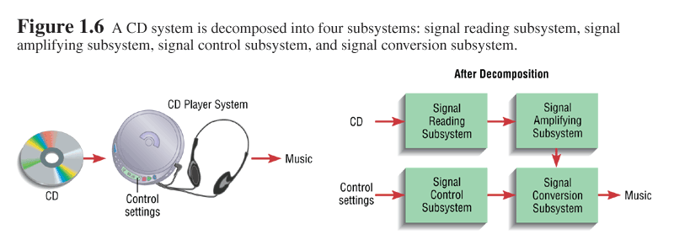
Important System Concepts
1. Open Vs Closed System
2. Decomposition
  The process of breaking down a system into smaller components

Slide 17
Decomposition
  Allows the systems analyst to:
    Break a system into small, manageable subsystems
    Focus on one area at a time
    Concentrate on component pertinent to one group of users
    Build different components at independent times

Slide 18
Important System Concepts (cont…)
3. Modularity
  Process of dividing a system into modules of a relatively uniform size
  Modules simplify system design
4. Coupling
  Subsystems that are dependent upon each other are coupled
5. Cohesion
  Extent to which a subsystem performs a single function

Slide 19
A Modern Approach to
Systems Analysis and Design
Systems Integration
  Allows hardware and software from different vendors to work together
  Enables procedural language systems to work with visual programming systems
  Visual programming environment uses client/server model

Slide 20
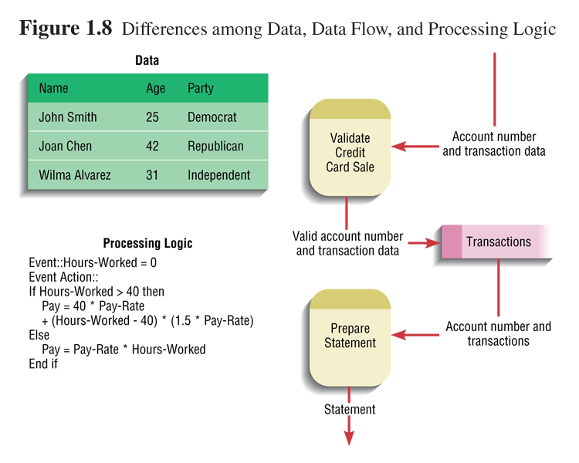
Data and Processes
Three key components of an information system
  Data (Raw facts)
  Data Flows
  Processing Logic
  Information

Slide 21
Data and Processes
Data
  Understanding the source and use of data is key to good system design
  Various techniques are used to describe data and the relationship amongst data
Data Flows
  Groups of data that move and flow through the system
  Include description of sources and destination for each data flow
Processing Logic
  Describe steps that transform data and events that trigger the steps

Slide 22
Approaches to Systems Development
Process-Oriented Approach
  Focus is on flow, use and transformation of data in an information system
  Involves creating graphical representations such as data flow diagrams and charts
  Data are tracked from sources, through intermediate steps and to final destinations
  Natural structure of data is not specified
  Disadvantage: data files are tied to specific applications

Slide 23
Approaches to Systems Development
Data-Oriented Approach
  Depicts ideal organization of data, independent of where and how data are used
  Data model describes kinds of data and business relationships among the data
  Business rules depict how organization captures and processes the data

Slide 24
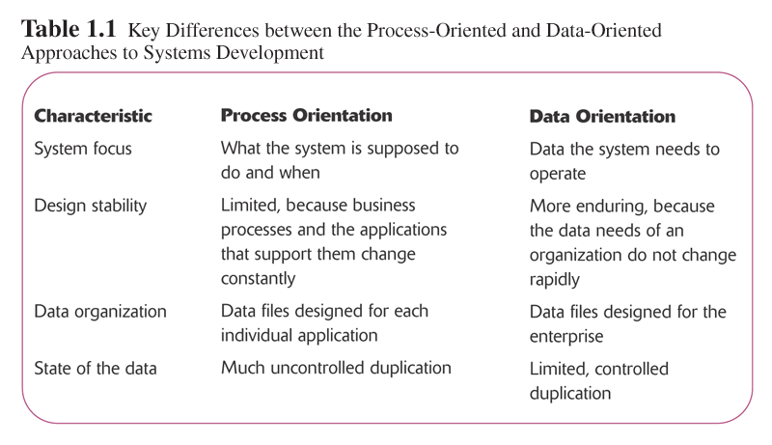

Slide 25
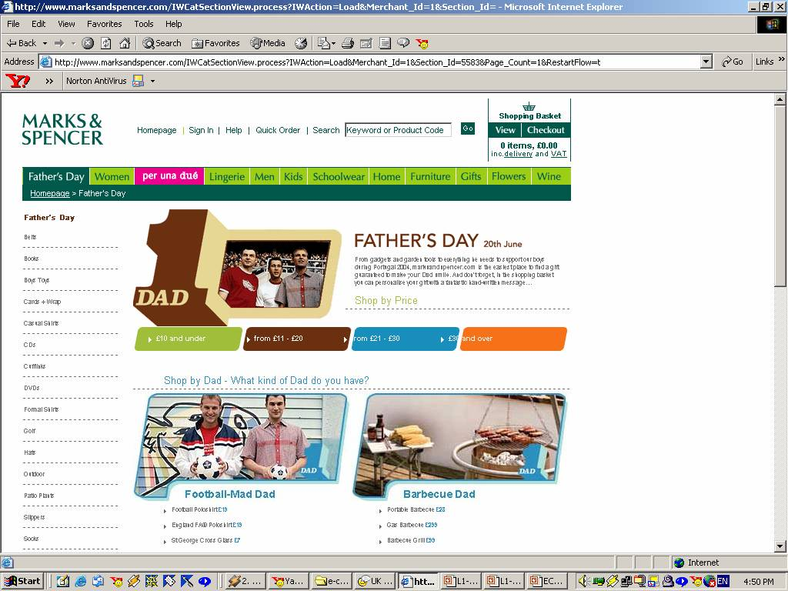
SYSTEMS ANALYSIS AND DESIGN with reference to e-Commerce.

Slide 26
SYSTEMS ANALYSIS AND DESIGN with reference to e-Commerce.
As the business world changes, systems analysts can expect to work in new kinds of companies that require innovative IT solutions, including Web-based systems that serve customers and carry out online transactions with other businesses.

Slide 27
SYSTEMS ANALYSIS AND DESIGN with reference to e-Commerce.
Internet based commerce is called e-Commerce. Electronic Commerce is where business transactions (buying and selling of products, services, and information) conducted via telecommunications networks, especially the Internet.
Internet-based systems involves various hardware and software designs, but a simple model is a series of web pages that provides a user interface, which communicates with one or more levels of data management software and web-based database server.
Designing, analyzing, and developing successful Web-based systems turned out to be very critical and important as the demand for secure, reliable, user-friendly ecommerce sites continues to rise, yet a high percentage of these projects fail. In order to meet the challenges of creating a successful ecommerce site, developers must be able to effectively design and analyze their systems.
The analyst should work through all phases of ecommerce development, covering everything from user analysis to the installation and testing of complex transactions. in our subsequent modules we will also be looking into the skills and approaches one will need to develop an ecommerce system.

