Slide 1
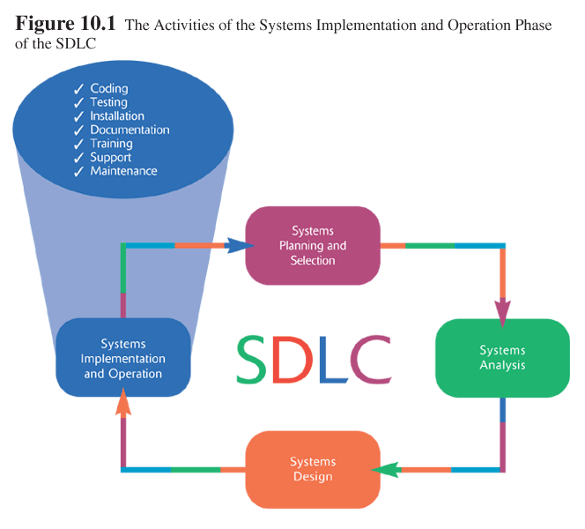
BAD 2014
ANALYSIS AND DESIGN
OF E-COMMERCE SYSTEMS
10
SYSTEM IMPLEMENTATION AND OPERATION
1

Slide 2
BAD 2014
ANALYSIS AND DESIGN
OF E-COMMERCE SYSTEMS
Lesson – 10
System Implementation
(Chp 10)

Slide 3
Learning Objectives
Systems Implementation and Operation
  The Process and outcomes of Coding, Testing and Installation
  The Process and outcomes of Documenting the System and Training.
  The Process and outcomes of Maintaining Systems
Software Application Testing
  Seven Different Types of Tests
  The Testing Process
  Acceptance Testing by Users
Installation
  Planning Installation
Documenting the System
  User Documentation
  Preparing User Documentation
Training and Supporting Users
Conducting Systems Maintenance
  Types of Maintenance and Cost of Maintenance
  Measuring Maintenance Effectiveness
  Controlling Maintenance Requests.
2

Slide 4
‘implementation and operation’
In Software Development Life Cycle, the ‘implementation and operation’ phase considered to be most expensive and time-consuming phase of the entire life cycle.
This phase is expensive because so many people are involved in the process.
It is time consuming because of all the work that has to be completed through the entire life of the system.
During implementation and operation, physical design specifications must be turned into working computer code. Then the code is tested until most of the errors have been detected and corrected, the system is installed, user sites are prepared for the new system, and users must come to rely on the new system rather than the existing one to get their work done.
Even once the system is installed, new features are added to the system and corrections are made as flaws are identified from use of the system in new circumstances.
2

Slide 5
Major activities involved in System Implementation and Maintenance
Seven major activities
  1.Coding,
  2.Testing,
  3.Installation
  4.Documentation,
  5.Training
  6.Support,
  7.Maintenance

Slide 6
System Implementation and Maintenance
These activates can be grouped as
  Activates that lead to the system going into operation – coding, testing and installation.
  Activates that are necessary for successful system operation – documenting the system and training and supporting users.
  Activates that are on going and needed to keep the system working and up-to-date.

Slide 7
  coding, testing and installation.

Slide 8
Code : Managing Programming
Programming or coding is the process whereby the physical design specifications created by the design team are turned into working computer code by the programming team.
Assigning Programmers:
  The first step in programming is assigning modules to the programmers. The project manager break the project into a series of smaller modules that can be developed as independently as possible and then these modules will be assigned to the programmers. Further the size of programming team is very important, when project are so complex that they require a large team, otherwise the best size is the smallest possible programming team.
Coordinating Activities :
  The simplest approach is to have a weekly project meeting to discuss any changes to the system that have arisen during the past week, or any issues that have come up. Regular meetings, even if they are brief, encourage the widespread communication and discussion of issues before they become problems. Another important way to improve coordination is to create and follow standards that can range from formal rules for naming files to forms that must be completed when goals are reached. When a team forms standards and then follows them, the project can be completed faster because task coordination is less complex.

Slide 9
  coding, testing and installation.

Slide 10
Software Testing
During analysis phase itself you develop a system test plan. During implementation, these plans are put into effect and the actual testing is performed.
Software application testing is an umbrella term that covers several types of tests. Tests can be done with or without executing the code and they may be manual or automated. We can categorize types of test as listed below,

Slide 11
Software Testing
Manual Test Methods
  Inspection
    A testing technique in which participants examine program code for predictable language-specific errors
  Walkthrough
    A peer group review of any product created during the systems development process; also called a structured walkthrough
  Desk Checking
    A testing technique in which the program code is sequentially executed manually by the reviewer.
Automated Test Methods
  Unit Testing
    Each module is tested alone in an attempt to discover any errors in its code, also called module testing
  Integration Testing
    The process of bringing together all of the modules that a program comprises for testing purposes. Modules are typically integrated in a top-down, incremental fashion
  System Testing
    Is similar, but instead of integrating modules into programs for testing, you integrate programs into systems.
  Stub Testing
    A technique used in testing, especially where modules are written and tested in a top-down fashion, where a few lines of code are used to substitute for subordinate modules.

Slide 12
Software Testing
Acceptance Testing by Users
Once the system tests have been satisfactorily completed, the system is ready for acceptance testing, which is testing the system in the environment where it will eventually be used. Acceptance refers to the fact that users typically sign off on the system and ‘accept’ it once they are satisfied with it. The purpose of acceptance testing is for users to determine whether the system meets their requirements.
Alpha testing : The most complete acceptance testing will include alpha testing, where simulated but typical data are used for testing. The types of tests performed during alpha testing include the following,
  Recovery testing
  Security testing
  Stress testing
  Performance testing
Beta Testing : In beta testing, intended users run the system in their own environments using their own data. The idea of beta test is to determine whether the software work as intended. Problems uncovered in alpha and beta testing in any of these must be corrected before users can accept the system.

Slide 13
  coding, testing and installation.

Slide 14
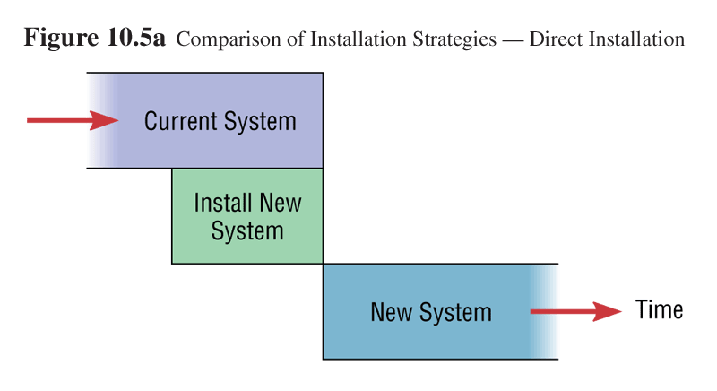
Installation
The organizational process of changing over from the current information system to a new one
Four approaches
  Direct Installation
    Changing over from the old information system to a new one by turning off the old system when the new one is turned on

Slide 15
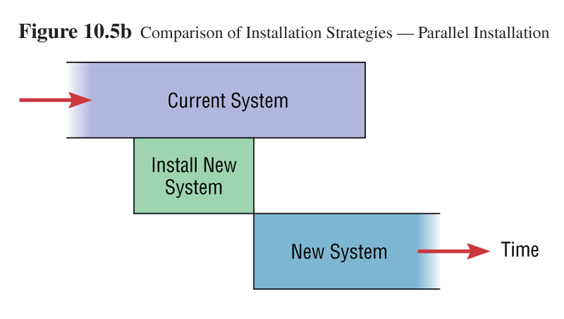
  Parallel Installation
    Running the old information system and the new one at the same time until management decides the old system can be turned off

Slide 16
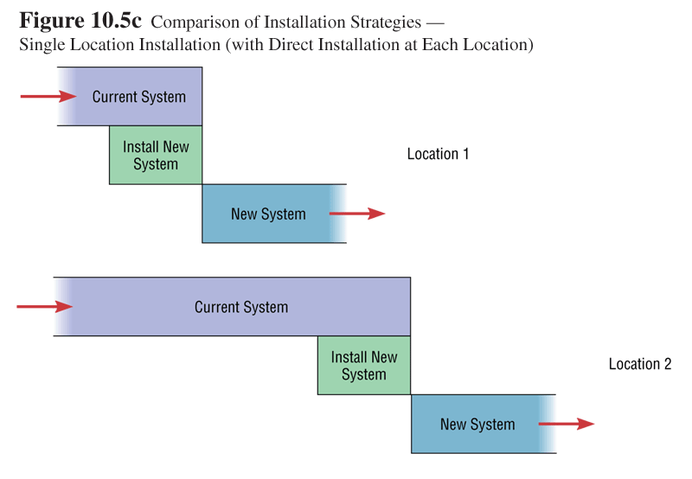
  Single location installation
    Trying out an information system at one site and using the experience to decide if and how the new system should be deployed throughout the organization

Slide 17
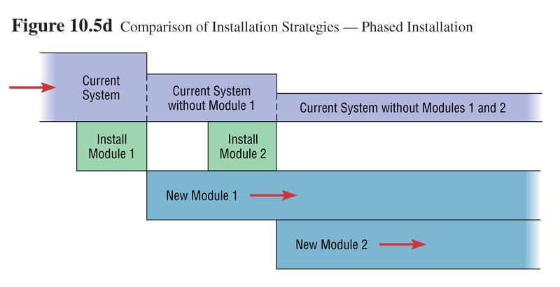
  Phased Installation
    Changing from the old information system to the new one incrementally, starting with one or a few functional components and then gradually extending the installation to cover the whole new system

Slide 18
Four types of installation.
The four types of installation are direct, parallel, single location, and phased.
Changing over from the old information system to a new one by turning off the old system as the new one is turned on is called direct installation.
Parallel installation involves running the old information system and the new one at the same time until management decides the old system can be turned off.
Single location installation involves trying out a new information system at one site and using the experience to decide if and how the new system should be deployed throughout the organization.
Changing over from the old information system to a new one incrementally, starting with one or a few functional components and then gradually extending the installation to cover the whole new system is commonly called phased installation

Slide 19
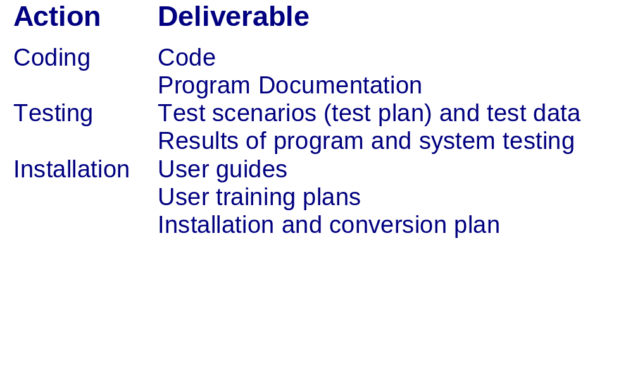
The Process of Coding,
Testing and Installation:
Deliverables

Slide 20
  Documenting the system and training and supporting users

Slide 21
Documenting the System
The process of documentation will be carried out throughout the life cycle, however it receives formal attention in this phase because once system is installed the analysis team’s involvement in system development usually ceases.
Thus the project team need to prepare documents that reveal all of the important information learned during the development and implementation.
Further each and every project will be unique one and in turn they generate there own unique documentation. The final documentation generally targeted towards two group of users,
  the first group is the information system personnel who will maintain the system throughout its productive life, and
  the other group is the people who will use the system as part of their daily lives.
In simple terms they are termed as System Documentation and User Documentation, we will discuss each one of them.

Slide 22
Documenting the System
System documentation
  Detailed information about a system’s design specifications, its internal workings and its functionality
  Internal documentation
    System documentation that is part of the program source code or is generated at compile time
  External documentation
    System documentation that includes the outcome of structured diagramming techniques such as data flow and entity relationship diagrams

Slide 23
Documenting the System
User Documentation
  Written or other visual information about an application system, how it works, and how to use it
Preparing user documentation
  Traditional source has been information systems department
  Application-oriented documentation is now often supplied by vendors and users themselves

Slide 24
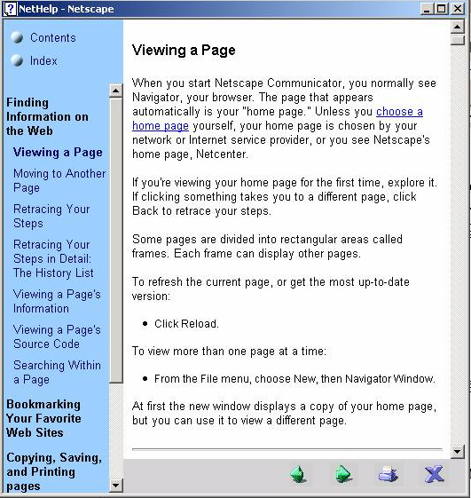

Slide 25
Types of User Documentation
The Quick reference guide
User’s Guide
Release Description
System Administrator’s guide
Acceptance sign-off

Slide 26
  Documenting the system and training and supporting users

Slide 27
Training Information System Users
Potential training topics
  Use of the system
  General computer concepts
  Information system concepts
  Organizational concepts
  System management
  System installation

Slide 28
Training Information System Users
Training methods
  Resident expert
  Computer-aided instruction
  Formal courses
  Software help components
  Tutorials
  Interactive training manuals
  External sources, such as vendors

Slide 29
The Process of Maintaining Information Systems
  Activates that are on going and needed to keep the system working and up-to-date

Slide 30
The Process of Maintaining Information Systems
Process of returning to the beginning of the SDLC and repeating development steps focusing on system change until the change is implemented
Four major activities
  1. Obtaining maintenance requests
  2. Transforming requests into changes
  3. Designing changes
  4. Implementing changes

Slide 31
The Process of Maintaining Information Systems
System maintenance is the process of refining the system to make sure it continues to met business needs.
A significant portion of an organization’s budget for information systems goes towards the maintenance of existing systems., simply because a system continues to change and evolve as it is used.
Most beginning systems analysts and programmers work first on maintenance project; usually only after they have gained some experience, they will be assigned to new development projects.

Slide 32
Types of Maintenance
Maintenance actually means fixing or enhancing of an information system. There are several types of maintenance that you can perform on an information system.
They are briefed as follows,
  Corrective maintenance refers to changes made to a system to repair flaws in its design, coding, or implementation.
  Adaptive maintenance refers to the changes made to a system to evolve its functionality to changing business needs or technologies .
  Perfective maintenance refers to the changes made to a system to add new features or to improve performance.
  Preventive maintenance refers to the changes made to a system to avoid possible future problems.

Slide 33
The Process of Maintaining Information Systems
Deliverables and Outcomes
  Development of a new version of the software, new versions of all design documents and training materials created or modified during the maintenance effort

Slide 34
Project Close Down

Slide 35
Project Close Down
Evaluate team
  Reassign members to other projects
Notify all affected parties that the development project is ending and that you are switching to operation and maintenance mode
Conduct post-project reviews
Close out customer contract
  Formal signoff

Slide 36

Thank you very much
&
All the Best
T. Subramanian

