Slide 1
BAD 2014
ANALYSIS AND DESIGN
OF E-COMMERCE SYSTEMS
Lesson – 2
Introduction to system Design Environment

Slide 2
Introduction to system Design Environment
System analysis and Design Approaches
Role and Responsibilities of an organization in System design
System Analysts and their Skills
Types of Information Systems

Slide 3
ICT ORGANIZATION
Organizations can take two directions while building their information systems, one is to develop in-house, the other direction is to buy or build through out sourcing. Some time organization will also use the combination of both options. Under all these situations several job types are involved.
In an organization that develops its own information systems internally, there are several types of jobs involved, there will be a separate IS department. IS department may be independent unit having its own top manager, or may be part of another functional department, such as finance, or there may be even an IS department in several major business units.
Systems development team normally includes ICT Manager. System Analyst, Programmer, Technicians.
In this lesson we will focus on the role and functions of System Analyst.

Slide 4
System Analysts and their Skills

Slide 5
System Analyst
are the people who can UNDERSTAND
both
Business Computing
They study the Business
Problems
Opportunities
They find out -
What are the Information requirement
1) to solve the problem or
2) to take advantage of the opportunities
Then transforms into
the Computer Based Information System

Slide 6
Role of the Systems Analyst
Study problems and needs of an organization
Determine best approach to improving organization Information technology
Identifies business information requirements
Transform business information requirements into the computer based information systems.
They are Change Agents. They change and improve the ways the organization does business

Slide 7
Skills of a Successful Systems Analyst
Analytical
  Understanding of organizations
  System thinking
    Ability to see organizations and information systems as systems
  Problem identification & solving skills
Technical
  Understanding of potential and limitations of technology
  Constant re-education is necessary as technology changes rapidly.

Slide 8
Skills of a Successful Systems Analyst
Managerial
  Ability to manage resources, projects, risk and change
Interpersonal
  Effective written and oral communication skills

Slide 9
Skills of a Successful Systems Analyst
1. ANALYTICAL SKILLS : will help System Analyst understand organization goals, policies and its function, so that he can bring out the opportunities and problems involved. This will help him to frame the objective and scope of the system.
2. TECHNICAL SKILLS : as he will be responsible for developing computer based systems, he should have complete understanding of hardware, software and network concepts. He should have complete knowledge about the strength and weakness of various available and upcoming technologies.
3. MANAGEMENT SKILLS : System Analyst should have leadership skills as he will leading a team of developers and managing the project. His management capabilities will include skills like resource-management, project-management, risk-management, and change management.
4. INTERPERSONAL SKILLS: System Analyst will be extensively coordinating with end users as well as with the development team involved in the projects. System Analyst should develop good written and oral communication skills, including competence in leading meetings, and interviewing.

Slide 10
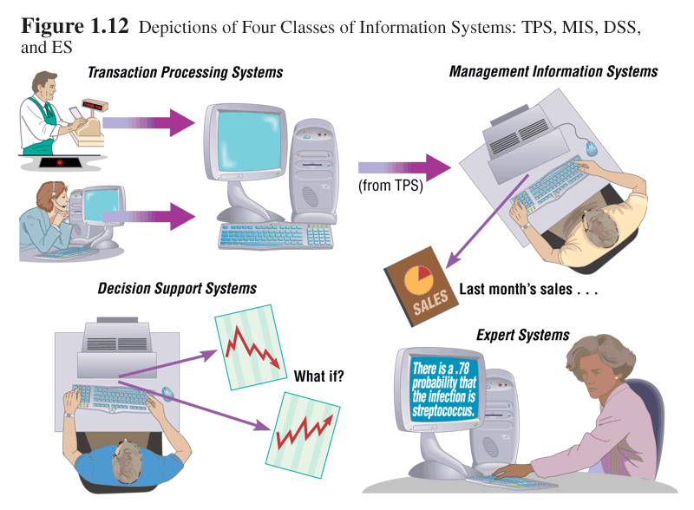

Slide 11
Types of Information Systems

Slide 12
Types of Information Systems
and Systems Development
So far we are looking into information systems generally but Information systems could be distinguished from each other on the basis of what the system does or by the technology used to construct the systems or based on user position in a organization.
Based on the points highlighted above the information systems may be classified as various types of information systems as listed in next slide,

Slide 13
Types of Information Systems
and Systems Development
Transaction Processing Systems (TPS)
  Automate handling of data about business activities (transactions)
Management Information Systems (MIS)
  Converts raw data from transaction processing system into meaningful form
Decision Support Systems (DSS)
  Designed to help decision makers
  Provides interactive environment for decision making
Expert Systems (ES)
  Replicates decision-making process
  Knowledge representation describes the way an expert would approach the problem

Slide 15
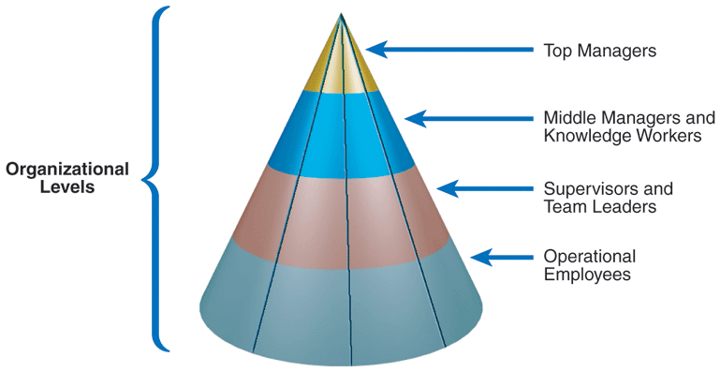

Slide 16
Transaction Processing Systems (TPS)
  Automate handling of data about business activities (transactions)
The analysis and design requires to focus on the firm’s current procedures for processing transactions.
How does the organization track, capture, process and output data.
The goal of TPS development is to improve transactions processing by speeding it up, using fewer people, and integrating it with other organizational information systems.

Slide 17
Management Information Systems (MIS)
Converts raw data from transaction processing system into meaningful form.
Where as TPS keeps track of sales, a MIS can pinpoint which items are selling slowly and which are selling quickly.
Developing MIS calls for a good understanding of what kind of information required by managers and how managers use information in their jobs.
MIS often require data from several TPS
draw on data from various subject areas, developing a comprehensive and accurate model of data is essential in building an MIS

Slide 18
Decision Support Systems (DSS)
Designed to help decision makers
Provides interactive environment for decision making
The analysis and design for DSS often concentrates on
concentrates on the three main DSS components: database, model base and user dialogue.
As with an MIS, a data orientation is most often used for understanding user requirements.
The system analysis and design project will carefully document the mathematical rules that define inter relationships among different data.
Decision logic must be carefully understood and documented

Slide 19
Expert Systems (ES)
The ES asks questions (which an expert would ask) and the end users supplies the answers. The answers are then used to determine which rules apply and the ES provides a recommendation based on the rules.
The focus on developing an ES is acquiring the knowledge of the expert in particular problem domain.
Knowledge engineers perform knowledge acquisition; they are similar to System Analyst but are trained to use different techniques.

Slide 20
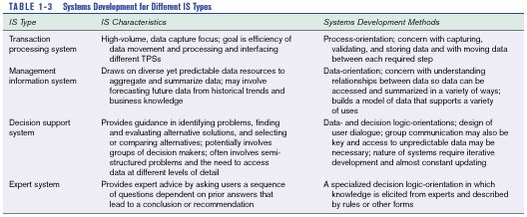

Slide 21
Summary
In this module we have learned, what is Systems, systems analysis, concepts of systems. We also went through various analysis and design approaches. Further we had a brief idea on organization structure of information function, and within that the role of systems analyst. Finally we understood various classifications or types of information systems with in a organization.

