Slide 1
BAD 2014
ANALYSIS AND DESIGN
OF E-COMMERCE SYSTEMS
Lesson – 3
PREPARATION FOR SYSTEM DESIGN

Slide 2
PREPARATION FOR SYSTEM DESIGN
System Development life cycle
Managing an Information system Project
Using CASE tools for automation of
System Design

Slide 3
System Development life cycle

Slide 4

Systems Development Life Cycle
Organization use a standard set of steps, called system development methodology, to develop and support their information systems.
Like many process, the development of information system often follows a life cycle. created – tested – introduced to the market. Its sales increase, peak, and decline.
Finally, the product is removed from the market and replaced by something else.

Slide 5
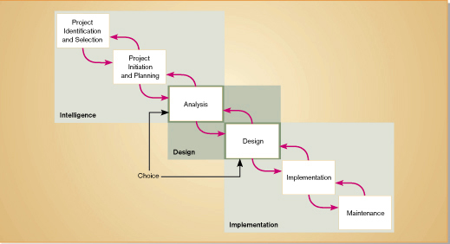
SDLC marks the phases or steps of information system development as show in a figure below. The specific steps and their sequences are meant to be adapted as required for a project.

Slide 6
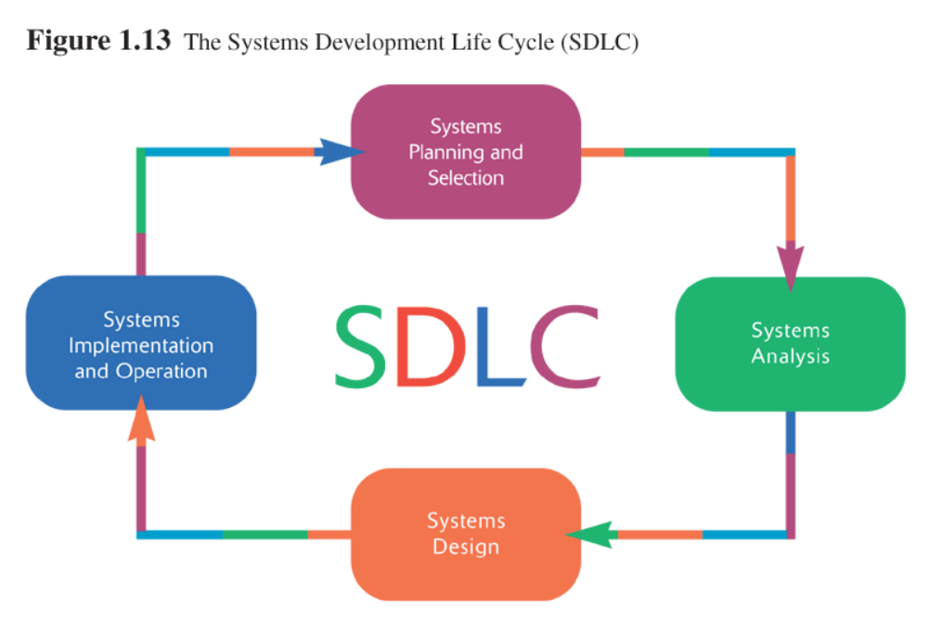
SDLC used in an Organization is an orderly set of activities conducted for each development project
In SDLC each phase has specific outcomes and deliverables that feed important information to other phases. At the end of each phase, a system development project reaches a mile stone.

Slide 7
Phases of the Systems Development Life Cycle
Systems Planning and Selection
  Two Main Activities
    Identification of need
    Investigation and determination of scope
Systems Analysis
  Study of current procedures and information systems
    Determine requirements
    Generate alternative designs
    Compare alternatives
    Recommend best alternative

Slide 8
Systems Development Life Cycle
System Design
  Logical Design
    Not tied to any specific hardware /sys.sw platform
    Concentrates on business aspects of the system
  Physical Design
    Technical specifications
    Decides which programming languages to be used
    Decides which HW platform, which OS to be used
    The final product of the design phase is presented in a form such as diagram or written report ready to turned over to programmers and other system builders for construction.

Slide 9
Implementation and Operation
  Implementation
    Hardware and software installation
    Programming
    testing
    User Training
    Documentation
  Operation
    System changed to reflect changing conditions
    System obsolescence

Slide 10
Detailed Notes on SDLC

Slide 11
System planning and selection Phase:
This phase has two important activities.
  The first activity involves in identifying the need for a new or enhanced system. Information needs of the organization are examined and system to meet these needs are identified. Then the Analyst evaluates priorities and brings out the needs into a written plan.
  During this phase, based on the feasibility study, the management determines whether to take up the systems development.
Once decided to take up, a specific plan will be produced for the proposed project. The plan specifies the time and resources needed for its execution of the project.

Slide 12
System Analysis Phase:
In this phase, the systems analyst understands the organizations existing procedures and then suggest an information system as solution. This Analysis phase has several sub phases,
  Involves determining the requirements of the system. System analyst work with the users to determine what the users want from the proposed system.
  Study the requirements and structure them.
  Generate alternative information system based solutions
  Compare these alternatives to determine which is best in satisfying the requirement – considering the cost, labour and technical levels the organization is willing to commit.
  Select a solution.

Slide 13
System Design Phase:
During design phase the recommended solution is converted into logical and then physical system specifications. The designing team will design all aspects of the system such as input & output screens, reports, databases and computer processes.
Logical design is not tied to any specific hardware and systems software platform. Conceptually, the system design could be implemented on any hardware and system software. Logical design concentrates on the business aspects of the system, that is how the system will impact the functional units with in the organization.
As the next stage, the logical design will be converted into physical design. The team will design the various parts of the system to perform physical operations necessary to facilitate data capture, processing and information output. Then during this part, the analyst decides on the programming languages and database system, hardware platforms, and network environment. The final product of the design phase is the physical system specification, presented in a form such as diagram or written report, ready to be turned over to programmers for construction.

Slide 14
Implementation Phase:
Implementation and operation Phase, is the final phase and it involves, implementation and operation.
During this phase system specifications are turned out to a working system, tested and put into use.
Implementation includes coding, testing and installation.
  During coding, programmers write the programs that make up the system.
  During testing, programmers and analysts test individual programs and the entire system in order to find and correct errors.
  During installation, the new system becomes a part of the daily activities of the organization. System implementation activities also include initial user support such as the finalization of documentation, training programs and ongoing user assistance.

Slide 15
Implementation Phase:
Once the system has been installed, the analyst team establishes a support plan. This is second part of the fourth phase of the SDLC is operation.
  After installation, users sometime find problems with systems and often request for improvements.
  During operation, programmers make changes that users ask for and modify the system to reflect changing business conditions. These changes are necessary to keep the system running and useful. The amount of time and effort devoted to system enhancements during operation depends a great deal on the performance of the previous phases of the life cycle.
After few years, when the business environment changes, the system is no longer performing as desired, and the costs of keeping a system running become prohibitive, the systems will need a total change over. These problems indicate that it is time to begin designing the system’s requirement, there by completing the loop and starting the life cycle over again.
x-x-x-x-x-x-x-x-x-x-x-x-x

Slide 16
Approaches to Development

Slide 17
Spiral approach of system development.
Approaches to Development
The circular nature of the life cycle diagram illustrates how the end of the useful life of one system leads to the beginning of another project that will replace the existing system altogether.
This concept is clearly brought out with the diagram shown next. Each of these phase has specific outcomes and deliverables that feed important information to other phases. At the end of each phase, the systems development reaches a mile stone.

Slide 18
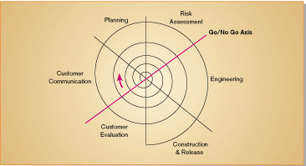

Slide 19
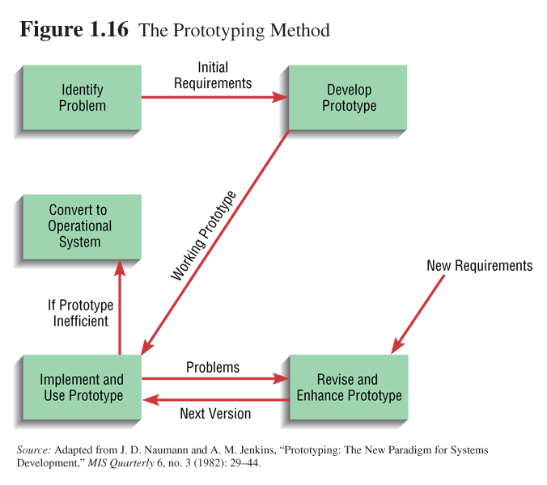
Approaches to Development
Prototyping
  Building a scaled-down working version but working version of a desired system
  Advantages:
    Users are involved in design
    Captures requirements in concrete form

Slide 21
Approaches to Development
Rapid Application Development (RAD)
  Utilizes prototyping to delay producing system design until after user requirements are clear
Joint Application Design (JAD)
  Users, Managers and Analysts work together for several days
  System requirements are reviewed
  Structured meetings

Slide 22
Managing an Information system Project

Slide 23
Reasons for Information systems projects
In this topic we will try to understand systems project and discuss reasons that will initiate a systems project.
Systems development typically starts with a systems request, which is the formal way of asking for IT support.
A systems request may be requesting for enhancement for an existing systems, or may be to a solve a problem or to bring out a totally new information systems.
  That is the primary initiatives for systems requests may be – improved services to customers, better performance, more information, efficient controls and reduced cost.
Thus focus of the project management is to assure that system development projects meet the request generated and are delivered with in budget and time constraints.
In the next few slides we will learn, what is a project, who will be managing the project and, tools available to manage the project.

Slide 24
Managing the Information Systems Project
Focus of project management
  To ensure that information system projects
    meet customer expectations
    Delivered in a timely manner
    Meet constraints and requirements
Project
  Planned undertaking of related
  activities to reach an objective
  that has a beginning and an end

Slide 25
Managing the Information Systems Project
Project Manager
  Systems Analyst responsible for
    Project initiation
    Planning
    Execution
    Closing down
  Requires diverse set of skills
    Management
    Leadership
    Technical
    Conflict management
    Customer relations

Slide 26
Project Management Process
Four Phases
  Initiation
  Planning
  Execution
  Closing down

Slide 27
Initiating the Project
Establish project initiation team
Establish relationship with customer
Establish project initiation plan
Establish management procedures
Establish project management environment and workbook

Slide 28
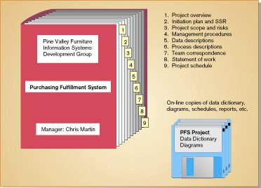

Slide 29
Planning the Project
Describe project scope, alternatives and feasibility
  Scope and Feasibility
    Understand the project
    What problem is addressed
    What results are to be achieved
    Measures of success
    Completion criteria

Slide 30
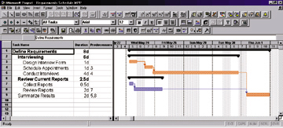
Divide the project into manageable tasks
    Work breakdown structure
    Gantt chart
Estimate resources and create a resource plan
Develop a preliminary schedule
    Utilize Gantt Charts and Network Diagrams

Slide 31
Develop a communication plan
  Outline communication processes among customers, team members and management
  Types of reports
  Frequency of reports

Slide 32
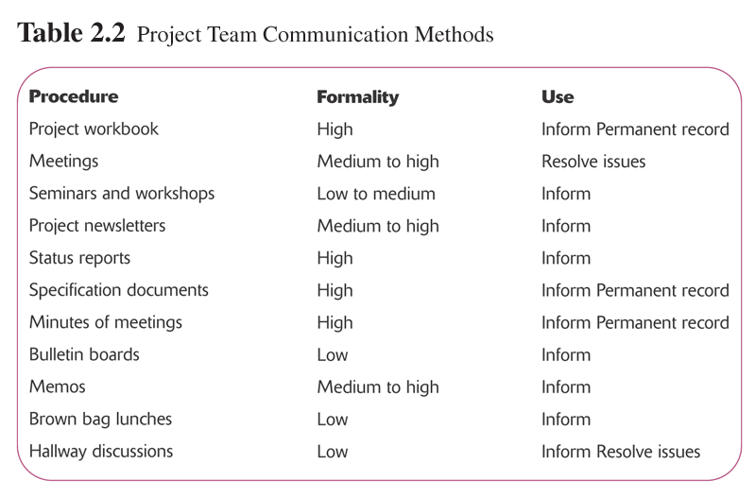

Slide 33
Determine project standards and procedures
  Specify how deliverables are tested and produced
Identify and assess risk
  Identify sources of risk
  Estimate consequences of risk
Create a preliminary budget
Develop a statement of work
  Describe what the project will deliver
Set a baseline project plan
  Estimate of project’s tasks and resources

Slide 34
Executing the Project
Execute baseline project plan
  Acquire and assign resources
  Train new team members
  Keep project on schedule
Monitor project progress
  Adjust resources, budget and/or activities

Slide 35
Manage changes to baseline project plan
  Slipped completion dates
  Changes in personnel
  New activities
Maintain project workbook
Communicate project status

Slide 36
Closing Down the Project
Termination
  Types of termination
    Natural
      Requirements have been met
    Unnatural
      Project stopped
  Documentation
  Personnel Appraisal

Slide 37
Closing Down the Project
Conduct post-project reviews
  Determine strengths and weaknesses of:
    Project deliverables
    Project management process
    Development process
Close customer contract

Slide 38
Representing and Scheduling Project Plans
Gantt Charts
  Useful for depicting simple projects or parts of large projects
  Show start and completion dates for individual tasks
Network Diagrams
  Show order of activities

Slide 39
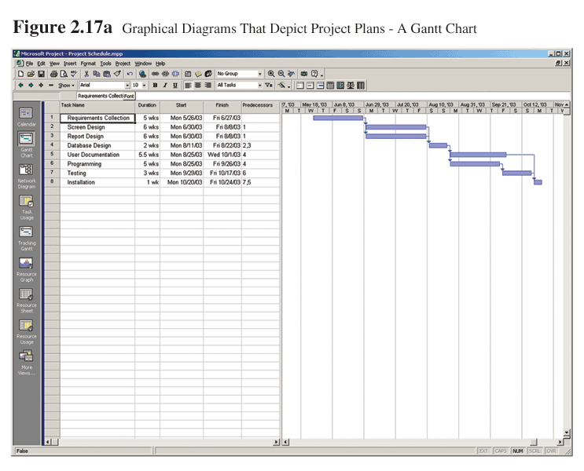

Slide 40
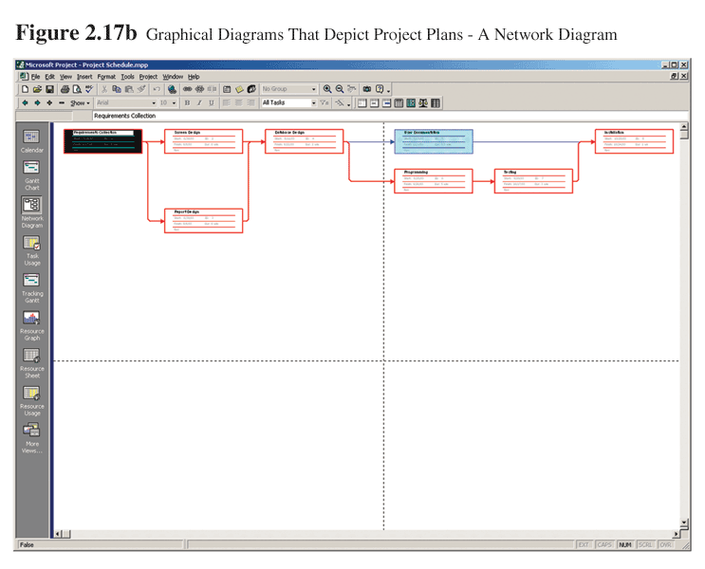

Slide 41
Comparison of Gantt Charts and Network Diagrams
Gantt Charts
  Visually shows duration of tasks
  Visually shows time overlap between tasks
  Visually shows slack time
Network Diagrams
  Visually shows dependencies between tasks
  Visually shows which tasks can be done in parallel
  Shows slack time by data in rectangles

Slide 42
Using CASE tools for automation of
System Design

Slide 43
CASE – computer-aided software engineering evolved as automated tool to support the information system development process.
It helps to enact a single design philosophy within an organization with many projects, systems and people.
CASE can support most of the system development activities and helps to provide an engineering-type discipline to software development and to the automation of the entire software life cycle process.
In general CASE assists the system builders in managing the complexities of information system projects and helps assure that high-quality systems are constructed on time and within budget.

Slide 44
CASE can be defined as software tools that provide automated support for some portion of the systems development process.
Upper CASE tools are designed to support the information planning and the project identification and selection, project initiation and planning, analysis, and design phases of the systems development life cycle.
Lower CASE tools support the implementation and maintenance phases of the systems development life cycle.
Cross life-cycle CASE tools are designed to support activities that occur across multiple phases of the systems development life cycle.
I-CASE refers to an automated systems development environment that provides numerous tools to create diagrams, forms, and reports; provides analysis, reporting, and code generation facilities; and seamlessly shares and integrates data across and between tools.

Slide 45
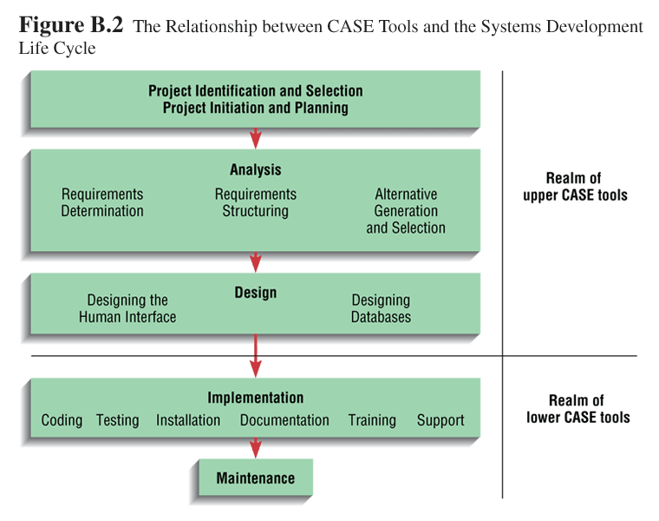

Slide 46
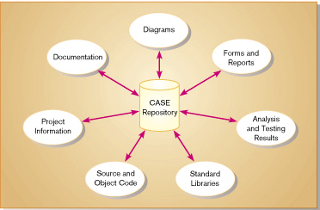
The general types of CASE tools are

Slide 47
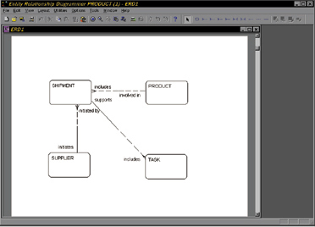
Diagramming tools

Slide 48
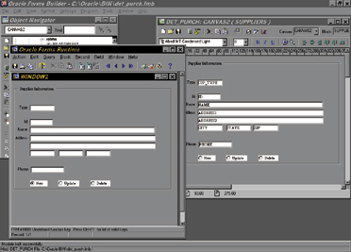
Computer display and report generators

Slide 49
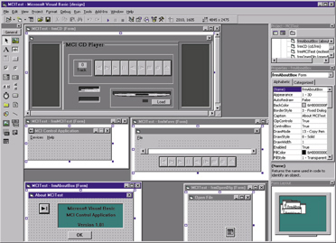
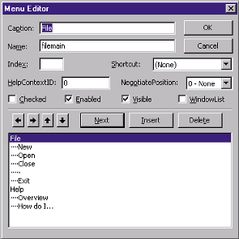
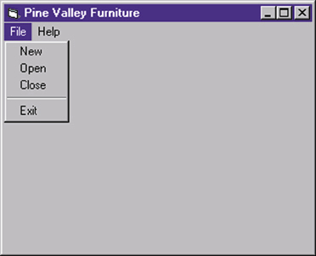
Visual Development Tool Visual development tools are a relatively new and extremely powerful way to rapidly develop systems.

Slide 50
“breathing new life” into existing systems
Categories of such CASE products referred to as
Reverse Engineering refers to the process of creating design specifications for a system or program module from program code and data definitions.
Reengineering tools are similar to reverse engineering tools but include analysis features that can automatically, or interactively with System Analyst, alter an existing system in an effort to improve its quality or performance

