Slide 1
BAD 2014
ANALYSIS AND DESIGN
OF E-COMMERCE SYSTEMS
Lesson – 4
SYSTEM PLANNING AND SELECTION

Slide 2
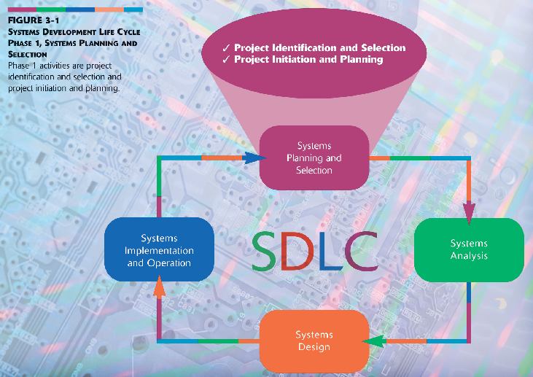
System Planning and Selection

Slide 3
Learning Objectives
Learn the process involved in identifying and selecting project
Initiating and planning systems development projects
Accessing Project Feasibility
Building Systems Request - the baseline project plan

Slide 4
Systems Planning, which is the first phase in systems development life cycle
System planning is the point at which an organization identifies the expectations for a new system and typically starts with a systems request.
There are two primary activities in this phase,
  1. one is project identification & selection and
  2. the second one is Project initiation & planning.

Slide 5
1) PROJECT IDENTIFICATION AND SELECTING.

Slide 6
PROJECT IDENTIFICATION AND SELECTING.
During this activity,
  as a first step, a senior user manager or information System manager or a steering committee identifies all possible system development Projects that a business unit could undertake.
  Then in the next step those Projects deemed most likely to yield significant organizational benefits, given the available resources, will be selected.

Slide 7
PROJECT IDENTIFICATION AND SELECTING.
Select development projects
  Factors:
    Perceived needs of the organization
    Existing systems and ongoing projects
    Resources available
    Evaluation criteria
    Current business conditions
    Perspectives of the decision makers
3.<number>

Slide 8
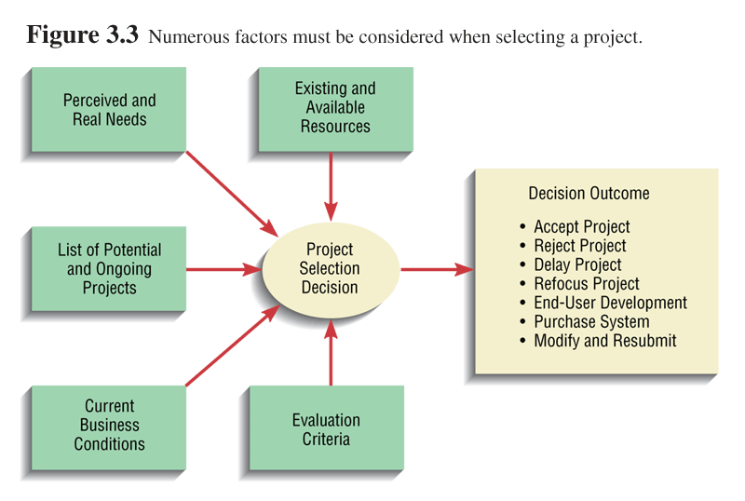
PROJECT IDENTIFICATION AND SELECTING.

Slide 9
PROJECT IDENTIFICATION AND SELECTING.
Deliverables and Outcomes
  The primary deliverable, from the project identification and selection phase is a schedule of specific IS development projects, and once selected they move into the second activity within this SDLC phase – project initiation and planning.

Slide 10
  2. THE SECOND ONE IS PROJECT INITIATION & PLANNING.

Slide 11
INITIATING AND PLANNING SYSTEMS DEVELOPMENT PROJECTS
The objective of Project initiation and planning is to transform a vague system request document into a tangible
Vague System Request | System Analyst | Tangible Project Description
 | Technical Staff
Customers of the Proposed System

Slide 12
INITIATING AND PLANNING SYSTEMS DEVELOPMENT PROJECTS
Deliverables and Outcomes
  Baseline Project Plan (BPP)
    The BPP becomes the foundation for the reminder of the development project. It is an internal document used by the development team but not shared with customers.
  Statement of Work (SOW)
    The SOW is a short document prepared for the customer that describes what the project will deliver and outlines all the work required to complete the Project. The SOW is a useful communication tool that assures that both you and your customer have a common understanding of the Project.

Slide 13
INITIATING AND PLANNING SYSTEMS DEVELOPMENT PROJECTS
The Baseline Project Plan and the Statement of Work are the major outcomes and deliverables for the project initiation and planning phase. All information collected and analyzed during this phase is contained in the BP. This plan reflects the best estimate of the project’s scope, benefits, costs, risks, and resource requirements. It also specifies detailed project activities for the following phase and more general specifications for the remaining phases. The BPP can be used by the project selection committee to determine the project worth--accept, reject, or modify.
The Statement of Work is a document prepared for the customer during project initiation and planning that describes what the project will deliver and outlines generally at a high level all work required to complete the project. The SOW consists of a high-level summary of the BP. While the actual role of the SOW can vary, the SOW can be used by the analyst and the customer to gain an understanding of the project.

Slide 14
ACCESSING Project FEASIBILITY

Slide 15
Assessing Project Feasibility
Feasibility analysis guides the organization in determining whether to proceed with a project. Assessing Project feasibility requires you to evaluate a wide range of factors. Although the specifics of a system project will dictate which factors are most important, most feasibility factors fall into the following three categories.
  Technical : Can we build it – Size, complexity and risks will be considered.
  Economic : Should we build it – Cost Vs Benefits factors will be considered
  Operational : If we build it, will it be sustainable – Organizational, Legal and Political factors

Slide 16
Assessing Project Feasibility
Technical Feasibility
The goal of this study is to assess the technical feasibility of the project understand the organization’s ability to successfully design, develop and install the proposed system.
This analysis should include an assessment of the development team’s familiarity and understanding of the possible target hardware, software, and operating environments to be used as well as project size, complexity and the group’s experience with similar systems.
The team also should consider the compatibility of the new systems with the technology that already exists in the organization.

Slide 17
Assessing Project Feasibility
Economic Feasibility
The second important factor of feasibility analysis is to perform an economic feasibility analysis.
The objective of assessing economic feasibility is to identify the financial benefits and cost associated with the development of a Project, assigning values to them, and then calculating the cash flow and return on investment for the project.
The more expensive the project, the more rigorous and detailed the analysis. Economic feasibility is also called as Cost-benefit analysis.

Slide 18
Assessing Project Feasibility
Economic Feasibility
The first task when developing an economic feasibility analysis is to identify the kinds of costs and benefits the systems will have and list them systematically.
An information system can provide many benefits to an organization. For example, a new or renovated IS can automate monotonous jobs, reduce errors, provide innovative services to customers and suppliers, and improve the organizational efficiency, speed, flexibility and morel.
These benefits are both tangible and intangible.

Slide 19
Assessing Economic Feasibility
Cost – Benefit Analysis
Determine Benefits
  Tangible Benefits - can be measured easily
      Examples
        Cost reduction and avoidance
        Error reduction
        Increased flexibility
        Increased speed of activity
        Increased management planning and control
  Intangible Benefits - cannot be measured easily
    Examples
      Increased employee morale
      Competitive necessity
      More timely information
      Promotion of organizational learning and understanding

Slide 20
Assessing Economic Feasibility
Determine Cost
  Tangible Costs
    Can easily be measured in dollars
      Example: Hardware
  Intangible Costs
    Cannot be easily measured in dollars
    Examples:
      Loss of customer goodwill
      Loss of employee morale

Slide 21
cost-benefit analysis techniques.
Assessing Economic Feasibility
As we understood the types of benefits and cost categories associated with an information system Project, we can now address the relationship between time and money.
The Time Value of Money: Most techniques used to determine economic feasibility encompass the concept of the time value of money (TVM). TVM refers to comparing present cash outlays to future expected returns.

Slide 22
Three commonly used economic cost-benefit analysis techniques.
1) NPV – Net Present Value
Net Present Value is the current value of future cash flow. Net present value (NPV) uses a discount rate to determine the company’s cost of capital to establish the present value of a project.
2) Return on investment (ROI)
Return on investment (ROI) is the ratio of the net cash receipts of the project divided by the cash outlays of the project. A tradeoff analysis can be made among competing projects.

Slide 23
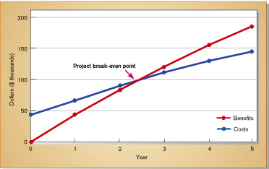
3) Break-even analysis (BEA)
Break-even analysis (BEA) is to identify at what point cumulative benefits equal costs (ie. When break-even occurs).

Slide 24
BUILDING OF SYSTEMS REQUEST - THE BASELINE PROJECT PLAN

Slide 25
Building the Baseline Project Plan
Various Information will be generated during Project initiation and planning, and
based on these details a Systems Request which is also known as Baseline Project Plan will be prepared.
The framework of such baseline Project Plan will consists four major sections as listed below
Four Sections
  Introduction
  System Description
  Feasibility Assessment
  Management Issues

Slide 26
Building the Baseline Project Plan
Introduction
  Brief overview
  Recommended course of action
  Project scope defined
    Units affected
    Interaction with other systems
    Range of system capabilities

Slide 27
Building the Baseline Project Plan
System Description
  Outline of possible alternative solutions
  Narrative format
Feasibility Assessment
  Project costs and benefits
  Technical difficulties
  High-level project schedule

Slide 28
Building the Baseline Project Plan
Management Issues
  Outlines concerns that management may have about the project
  Team composition
  Communication plan
  Project standards and procedures

Slide 29
Reviewing the Baseline Project Plan
Objectives
  Assure conformity to organizational standards
  All parties agree to continue with project
  BPP being very important deliverable or outcome of the first phase of our SDLC, thus BPP has to thoroughly reviewed by the development team. This review should be done before submitting to the top management team or to the steering committee. The guide lines for this review is to make sure that the proposed systems confirms to organizational standards and to make sure all parties involved agrees to it.

Slide 30
Reviewing the Baseline Project Plan
A common method for performing this review is called a structured walkthrough
Walkthrough
  Peer group review
  Participants
    Coordinator
    Presenter
    User
    Secretary
    Standards Bearer
    Maintenance Oracle
  Activities
    Walkthrough review form
    Individuals polled
    Walkthrough action list
  Advantages
    Assures that review occurs during project

Slide 31
In general systems planning and selection process involved for a Internet based e-commerce application follows same procedures what we have discussed in this module.
However, while developing e-commerce or e-collaboration applications, the development team should first understand who is going to uses the systems, what are required by the users. Further we should understand various types of network and communication technologies on which the application is going to be built. The project team has to deal with several unknowns while designing and building e-commerce based applications.
Following are the factors developers should keep in mind while planning a e-commerce application,
  USERS : Who is the user, where is the user located, what is their experience and expectations.
  Network & Communication : What will the speed of the connection and how information consists of text, images, audio and video elements can be effectively transmitted and displayed.
  Access Method : What is going to be the Internet access method, that could be used by the users. What web-browser, such as IE4 or IE6 or Netscape, user will be employing at his client side.

