Slide 1
BAD 2019
ANALYSIS AND DESIGN
OF E-COMMERCE SYSTEMS
Lesson – 5
System analysis
a. System requirement determination
(Chp 4 )

Slide 2
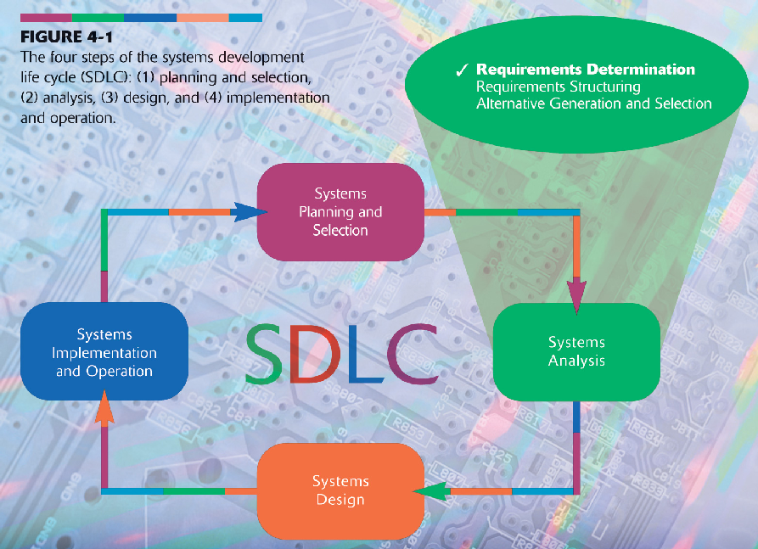
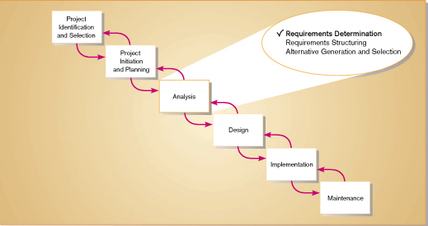
BAD 2014
ANALYSIS AND DESIGN
OF E-COMMERCE SYSTEMS
5

Slide 3
Learning Objectives
Describe options for designing and conducting interviews
Discuss planning an interview
Discuss using questionnaires to determine system requirements
Explain advantages and disadvantages of observing workers and analyzing business documents to determine requirements

Slide 4
Learning Objectives
Learn about Joint Application Design (JAD) and Prototyping
Discuss appropriate methods to elicit system requests
Explain Business Process Reengineering (BPR)
Examine requirements determination for Internet applications

Slide 5
Performing Requirements Determination
Gather information on what the system should do from many sources
  Users
  Reports
  Forms
  Procedures

Slide 6
Performing Requirements Determination
Characteristics for gathering requirements
  Impertinence
    Question everything
  Impartiality
    Find the best organizational solution
  Relaxation of constraints
  Attention to detail
  Reframing
    View the organization in new ways

Slide 7
Deliverables and Outcomes
Types of deliverables:
  Information collected from users
  Existing documents and files
  Computer-based information
  Understanding of organizational components
    Business objective
    Information needs
    Rules of data processing
    Key events

Slide 8
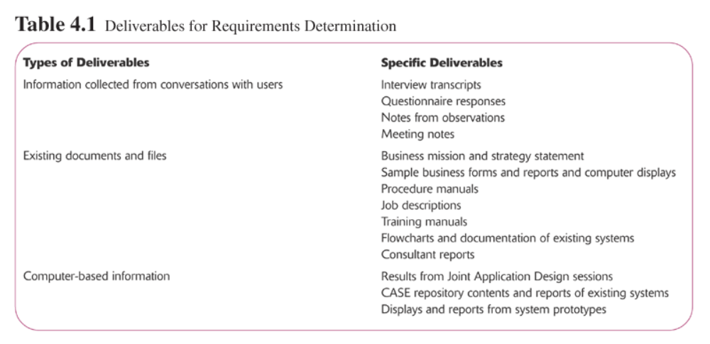
Deliverables and Outcomes

Slide 9
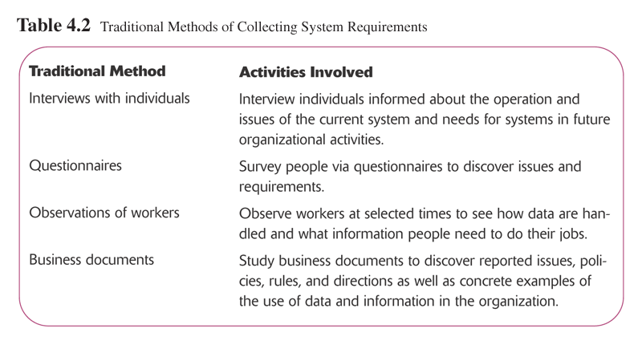
Traditional Methods for Determining Requirements

Slide 10
Traditional Methods for Determining Requirements
Interviewing and Listening
  Gather facts, opinions and speculations
  Observe body language and emotions
  Guidelines
    Plan
      Checklist
      Appointment
    Be neutral
    Listen
    Seek a diverse view

Slide 11
Traditional Methods for Determining Requirements
Interviewing (choosing method)
  Interview Questions
    Open-Ended
      No pre-specified answers
    Close-Ended
      Respondent is asked to choose from a set of specified responses

Slide 12
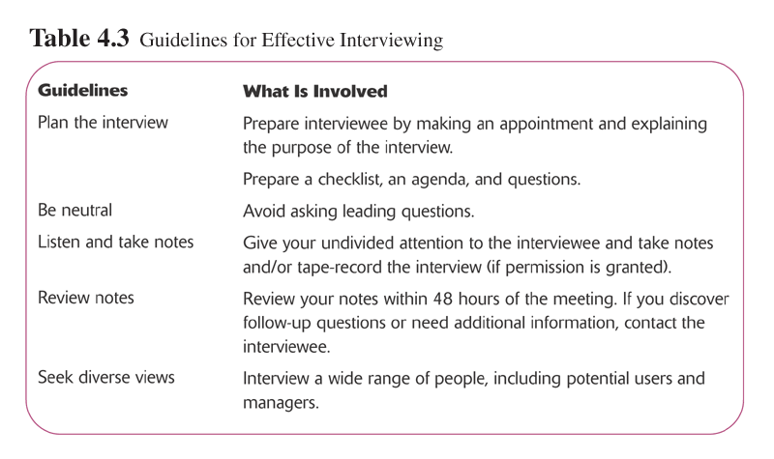

Slide 13
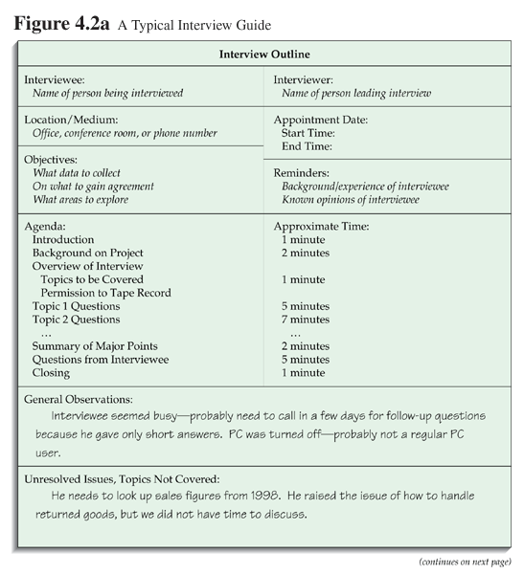

Slide 14
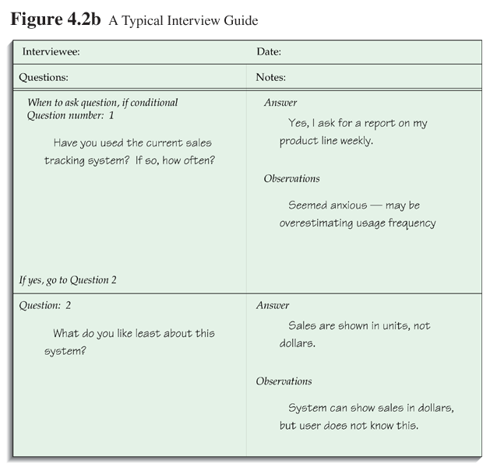

Slide 15
Traditional Methods for Determining Requirements
Administering Questionnaires
  More cost-effective than interviews
  Choosing respondents
    Should be representative of all users
    Types of samples
      Convenient
      Random sample
      Purposeful sample
      Stratified sample

Slide 16
Traditional Methods for Determining Requirements
Questionnaires
  Design
    Mostly closed-ended questions
    Can be administered over the phone, in person or over the Internet or company intranet
  Vs. Interviews
    Interviews cost more but yield more information
    Questionnaires are more cost-effective
    See table 4-4 for a complete comparison

Slide 17
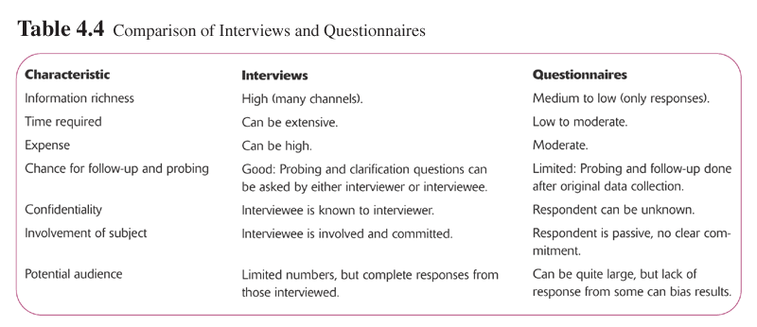

Slide 18
Traditional Methods for Determining Requirements
Directly Observing Users
  Serves as a good method to supplement interviews
  Often difficult to obtain unbiased data
    People often work differently when being observed

Slide 19
Analyzing Procedures and Other Documents
Types of information to be discovered:
  Problems with existing system
  Opportunity to meet new need
  Organizational direction
  Names of key individuals
  Values of organization
  Special information processing circumstances
  Rules for processing data

Slide 20
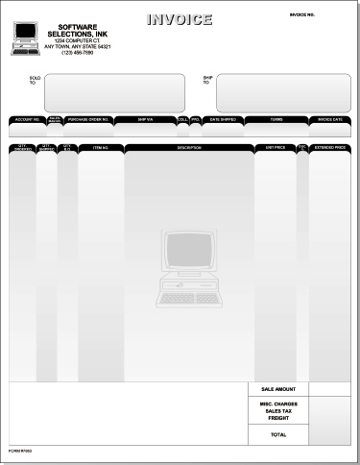

Slide 21
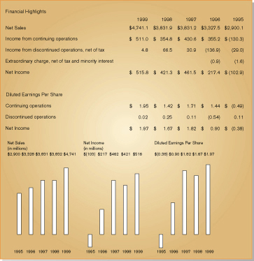

Slide 22
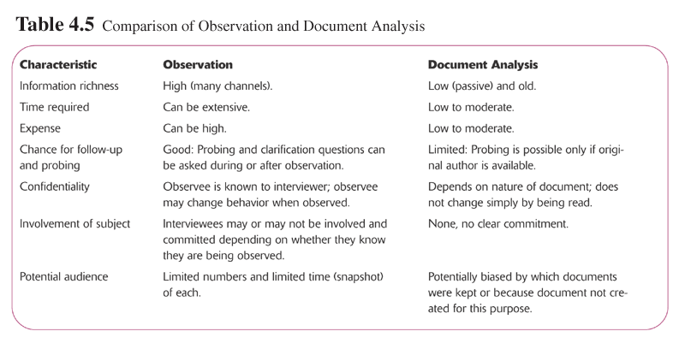

Slide 23
Modern Methods for Determining Requirements
Joint Application Design (JAD)
  Brings together key users, managers and systems analysts
  Purpose: collect system requirements simultaneously from key people
  Conducted off-site
Prototyping
  Repetitive process
  Rudimentary version of system is built
  Replaces or augments SDLC
  Goal: to develop concrete specifications for ultimate system

Slide 24
Joint Application Design (JAD)
Participants
  Session Leader
  Users
  Managers
  Sponsor
  Systems Analysts
  Scribe
  IS Staff
End Result
  Documentation detailing existing system
  Features of proposed system

Slide 25
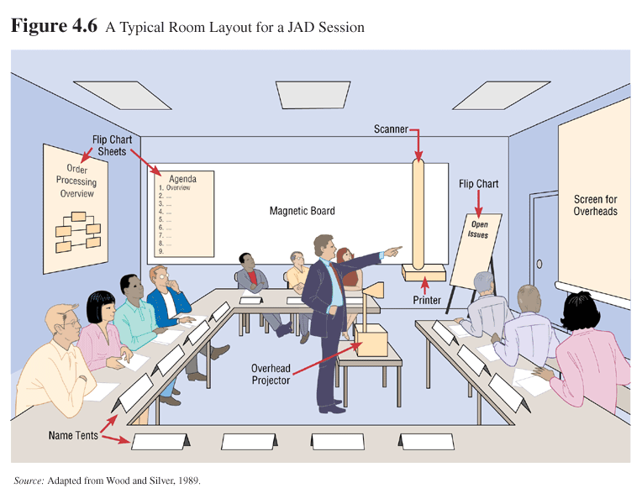

Slide 26
Prototyping
Quickly converts requirements to working version of system
Once the user sees requirements converted to system, will ask for modifications or will generate additional requests
Most useful when:
  User requests are not clear
  Few users are involved in the system
  Designs are complex and require concrete form
  History of communication problems between analysts and users
  Tools are readily available to build prototype

Slide 27
Prototyping
Drawbacks
  Tendency to avoid formal documentation
  Difficult to adapt to more general user audience
  Sharing data with other systems is often not considered
  Systems Development Life Cycle (SDLC) checks are often bypassed

Slide 28
Business Process Reengineering (BPR)
Search for and implementation of radical change in business processes to achieve breakthrough improvements in products and services
Goals
  Reorganize complete flow of data in major sections of an organization
  Eliminate unnecessary steps

Slide 29
Business Process Reengineering (BPR)
Goals (Continued)
  Combine steps
  Become more responsive to future change
Identification of processes to reengineer
  Key business processes
    Set of activities designed to produce specific output for a particular customer or market
    Focused on customers and outcome
    Same techniques are used as were used for requirements determination

Slide 30
Business Process Reengineering (BPR)
Identify specific activities that can be improved through BPR
Disruptive technologies
  Technologies that enable the breaking of long-held business rules that inhibit organizations from making radical business changes

Slide 31
