Slide 1
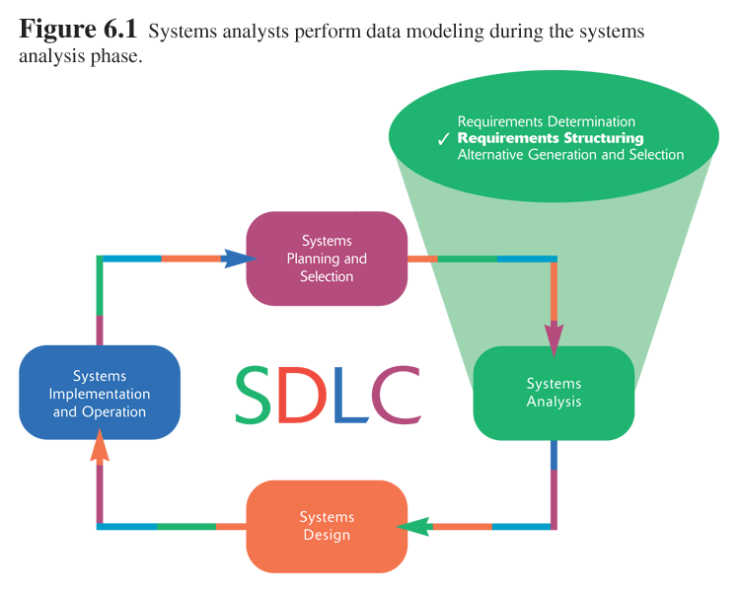
BAD 2019
ANALYSIS AND DESIGN
OF E-COMMERCE SYSTEMS
7
System analysis

Slide 2
BAD 2019
ANALYSIS AND DESIGN
OF E-COMMERCE SYSTEMS
Lesson – 7
System analysis
c. Structuring System Requirements:
Conceptual Modeling
(Chp 6)

Slide 3
Learning Objectives
Describe different sources of software
Learn to assemble the various pieces of an alternative design strategy
Learn how to generate at least three alternative design strategies
Discuss selecting the best design strategy using both qualitative and quantitative methods
Learn how to use the results of the analysis phase to update a Baseline Project Plan (BPP)

Slide 4
Conceptual Modeling
In the previous lesson we have learned how to model and analyze the flow of data (data in motion), process and data stores in a data flow diagram. Now the next activity is Data modeling which will show the definition, structure and relation ship within data.

Slide 5
Conceptual Modeling
In the previous lesson we have learned how to model and analyze the flow of data, process and data stores in a data flow diagram. Now the next activity is Data modeling which will show the definition, structure and relation ship within data.
A conceptual data model is a representation of organizational data.
Entity Relationship (E-R) data models are commonly used diagrams that show how data are organized in an information system.
The main goal of conceptual data modeling is to create accurate E-R diagrams

Slide 6
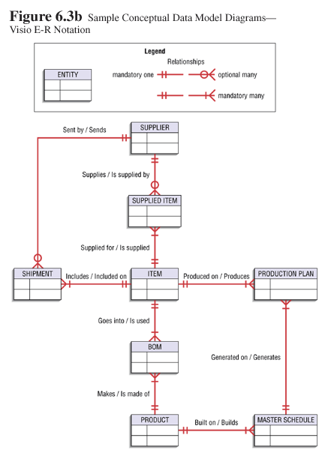

Slide 7
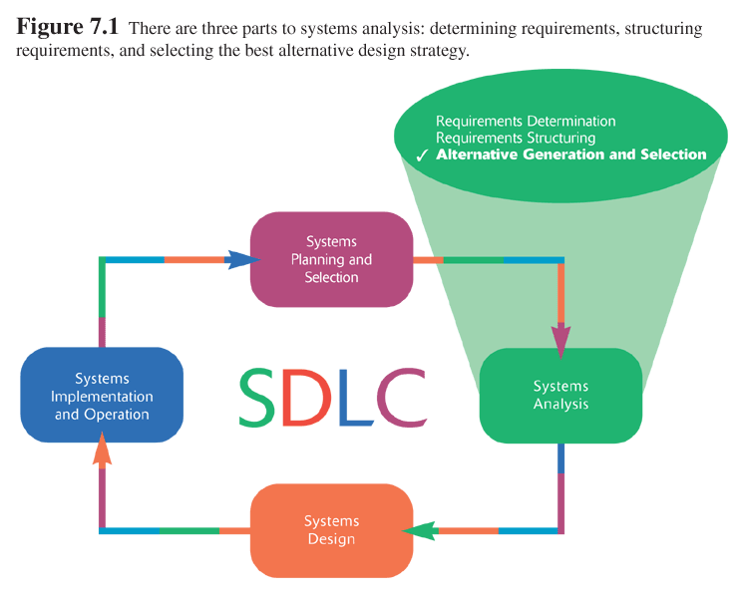
Selecting the Best Alternative Design Strategy
(Chp 7)

Slide 8
Design Strategy - Selecting the Best Alternative Design Strategy

Slide 9
Selecting the Best Alternative Design Strategy
In this chapter we will be learning the need to come up with alternative design strategies and about guidelines for generating alternatives.
We will see the different issues that must be addressed for each alternative.
Once we have generated alternatives, we will have to choose the best design strategy to pursue.

Slide 10
Selecting the Best Alternative Design Strategy
A system design strategy represents a particular approach to developing the system. Selecting the best alternative system strategy involves at least two basic steps:
  Generating a comprehensive set of alternative design strategies and
  Selecting the one that is most likely to result in the desired information system, given all of the organizational, economic and technical constraints that limit what can be done.

Slide 11
Selecting the Best Alternative Design Strategy
Shaping alternative strategy involves the following processes
  Dividing requirements into different sets of capabilities, ranging from the bare minimum that users would accept to the most elaborate and advance system the company could afford to develop
  Enumerate different potential implementation environments (hardware, system software, and network platforms) that could be used to deliver the different sets of capabilities
  Propose different ways to source or acquire the various sets of capabilities for the different implementation environments.
  Selecting the best alternative is usually done with the help of a quantitative procedure

Slide 12
Selecting the Best Alternative Design Strategy
Deliverables
  At least three substantially different system design strategies for building the replacement information system
  A design strategy judged most likely to lead to the most desirable information system
  A Baseline Project Plan (BPP) for turning the most likely design strategy into a working information system

Slide 13
Generating Alternative Design Strategies

Slide 14
Generating Alternative Design Strategies
Best to generate three alternatives
  At least three substantially different system design strategies should be generated for building the replacement information system
  Low-end
    Provides all required functionality users demand with a system that is minimally different from the current system
  High-end
    Solves problem in question and provides many extra features users desire
  Midrange
    Compromise of features of high-end alternative with frugality of low-end alternative

Slide 15
Major considerations
Minimum Requirements
  Mandatory features versus desired features
  Forms of features
    Data
    Outputs
    Analyses
    User expectations on accessibility, response time and turnaround time
Constraints on System Development
  Time
  Financial
  Legal and contractual restrictions
  Dynamics of the problem

Slide 16
Issues to Consider in Generating Alternatives
Outsourcing
  The practice of turning over responsibility of some to all of an organization’s information systems applications and operations to an outside firm
  Can provide a cost-effective solution
  management may feel its core mission does not involve managing an information systems unit.

Slide 17
Issues to Consider in Generating Alternatives
Sources of Software
  Hardware manufacturers
  Packaged software producers
  Custom software producers
  Enterprise solution software
  In-house development

Slide 18
Criteria for Choosing
Off-the-Shelf Software
Cost
  In-house versus purchased
Functionality
  Mandatory, essential and desired features
Vendor Support
  Installation
  Training
  Technical Support
Viability of Vendor

Slide 19
Criteria for Choosing
Off-the-Shelf Software
Flexibility
  Ease of customization
Documentation
  User documentation
  Technical documentation
Response Time
Ease of Installation

Slide 20
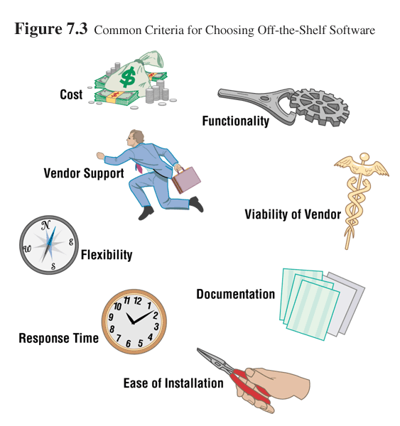

Slide 21
Validating Purchased Software Information
Information from vendor
Software evaluation period
Customer references from vendor
Independent software testing service
Trade publications

Slide 22
Hardware and Software Issues
Existing Platform
  Lower costs
  Information system staff is familiar with operation and maintenance
  Increased odds of successfully integrating system with existing applications
  No added costs of converting old systems to new platform or transferring data
New Hardware and System Software
  Some software components will only run on new platform
  Developing system for new platform gives organization opportunity to upgrade technology holdings
  New requirements may allow organization to radically change its computing operations

Slide 23
Hardware and Software Issues
Request for Proposal (RFP)
  A document provided to vendors to ask them to propose hardware and system software that will meet the requirements of your new system

Slide 24
Implementation Issues
Technical and social aspects of implementation need to be addressed
Training
Disruption of work

Slide 25
Hoosier Burger’s New Inventory Control System
Replacement for existing system
Figure 7-4 ranks system requirements and constraints

Slide 26
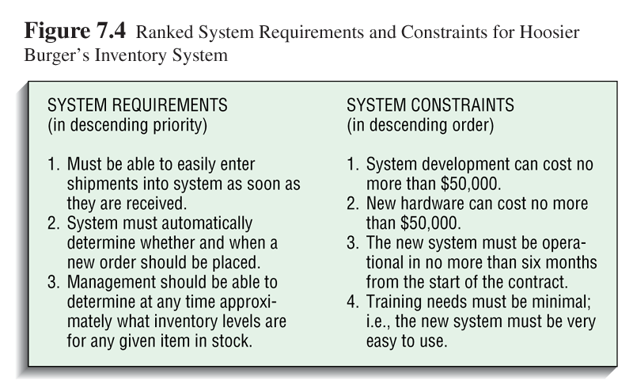

Slide 27
Hoosier Burger’s New Inventory Control System
When proposing alternatives, the requirements and constraints must be considered
Figure 7-7 lists 3 alternatives
  Alternative A is a low-end proposal
  Alternative C is a high-end proposal
  Alternative B is a midrange proposal

Slide 28
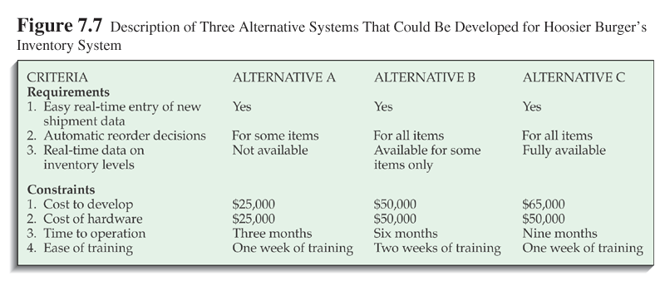

Slide 29
Hoosier Burger’s New Inventory Control System
Selecting the most likely alternative
  Weighted approach can be used to compare the three alternatives
  Figure 7-8 shows a weighted approach for Hoosier Burger
  Left-hand side of table contains decision criteria
    Constants and requirements
    Weights are arrived at by discussion with analysis team, users and managers
  Each requirement and constraint is ranked
    1 indicates that the alternative does not match the request well or that it violates the constraint
    5 indicates that the alternative meets or exceeds requirements or clearly abides by the constraint

Slide 30
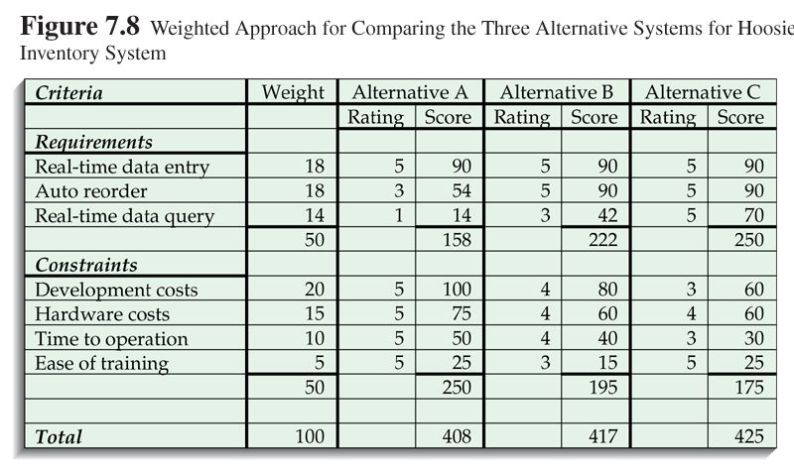

Slide 31
Hoosier Burger’s New Inventory Control System
Selecting the most likely alternative
  According to the weights used, alternative C appears to be the best choice

Slide 32
Updating the Baseline Project Plan (BPP)
The Baseline Project Plan (BPP) was developed during systems planning and selection phase
Baseline Project Plan (BPP) can be used as an outline of a status report at analysis phase
Schedule will be updated to reflect actual activities and durations
An oral presentation of project status is typically made at this phase

