Slide 1
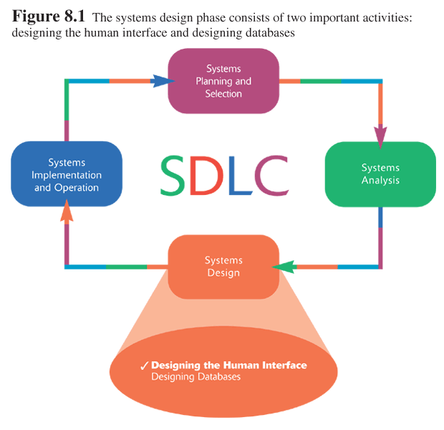
BAD 2014
ANALYSIS AND DESIGN OF
E-COMMERCE SYSTEMS
8
LOGICAL DESIGN
(Chp 8)

Slide 2
LEARN GUIDELINES TO FOLLOW WHEN DESIGNING THE HUMAN-COMPUTER INTERFACE
Explain the process of designing forms and reports and the deliverables for their creation
Explain the process of designing interfaces and dialogues and the deliverables for their creation
Discuss the design of human-computer dialogues and the use of dialogue diagramming
Explain interface design guidelines unique to the design of Internet-based electronic commerce systems
8.2

Slide 3
Systems Design
In our previous phase, systems analysis, we have developed a conceptual model of the systems and considered various development strategies, now on we are going to learn Designing of Systems.
The purpose of analysis phase is to figure out what the business needs. The purpose of the design phase is to decide how to build it.
Systems design phase can be organized as Logical designing and Physical design - covers user interface design, data design and systems architecture.
This lesson will be devoted for Logical Designing and the next module will deal with Physical Designing.

Slide 4
Logical Designing
‘Logical Designing’ will be arranged into topics as noted below,
  Input forms and output reports designing,
  Designing interface and dialogue

Slide 5
Input forms and output reports designing

Slide 6
Designing Forms and Reports
In fact the forms and reports were identified even during the analysis stage as systems input and outputs. Now during this systems design phase, we will be building them with precise appearance.
Form
  A business document that contains some predefined data and may include some areas where additional data are to be filled in
  An instance of a form is typically based on one database record
Report
  A business document that contains only predefined data
  A passive document for reading or viewing data
  Typically contains data from many database records or transactions
8.<number>

Slide 7
PRINCIPLES OF INPUT DESIGN
PRINCIPLES OF INPUT DESIGN
There are two general formats for entering inputs into a computer system:
  With online processing, each input item (customer order) is entered into the systems individually, usually at the same time as the event or transaction prompting the input (airline reservation)
  With batch processing, all the inputs collected over some time period are gathered together and entered into the system at one time in a batch. Some business processes naturally generate information in batches.

Slide 8
PRINCIPLES OF INPUT DESIGN –
1. Capture Data at the Source
The most important principle of input design is to capture the data in an electronic format at the original source or as close to original source as possible, without requiring anyone to type it.
Stores commonly use bar-code readers that automatically scan products and that enter data directly into the computer systems, similar technologies include optical-character-recognition, which can read printed numbers and text (bank checks); magnetic stripe reader, which can read information encoded on a stripe of magnetic material (credit cards) and smart cards that contain micro processors, memory chips.
These systems apart from reducing errors they will also reduce the time and cost of data entry. Further portable computers with scanners allow data to be captured at the source even in mobile sitting.

Slide 9
PRINCIPLES OF INPUT DESIGN –
2. Capture Data by Data Entry
But certain information cannot be collected by these automatic systems, they has to be captured from source using a trained entry operator. Many airline & hotel reservations and loan applications are entered into computers system while the customer provides the operator with answers to questions.
The input forms for capturing information (on screen or paper) should well support the data source. The order of the information on the form should match the natural flow of information from the data source, and data-entry forms should match paper forms used to initially capture the data.
  Minimize Keystrokes Keystrokes cost time and money, whether they are performed by a customer, user, or trained data-entry operator
  Input Control : Input control includes the necessary measures to ensure that input data is correct, complete and secure. The analyst must focus on input control during every stage of input design - audit trail

Slide 10
Principles of Output Designing
The objective of the output mechanism is to present information to users so they can accurately understand it with the least effort.
Outputs are the reports that the system produces, whether on the screen, on paper, or in other media, such as the web. Outputs are perhaps the most visible part of any system, because a primary reason for using an IS is to access the information that it produces.
A Report is a business document containing predefined data; it is a passive document used solely for reading and viewing. Examples of reports are invoices, weekly sales summaries by region wise or product-category wise or based on sales person.

Slide 11
PRINCIPLES OF OUTPUT DESIGN –
1. Understand Report Usage
In some case complete information will be printed as full report, but in most cases, reports are used to identify specific items or used as references to find information.
Web reports that are intended to display full-report could use scrollable page, as against the reports that are used to find specific information should be broken into multiple pages, each with a specific link.
The frequency of the report may play an important role in its design and distribution.
  Real-time reports provide data that are accurate to the second on minute at which they are produced.
  Batch Reports are those that report historical information that may be months, days old.

Slide 12
PRINCIPLES OF OUTPUT DESIGN –
2. Manage Information Load. good report will provide just what the users decide they needs to perform their jobs.
3. Minimize Bias. Analysts can design a biased report unintentionally. Bias can be introduced by the way in which lists of data are stored because entries that appear first in a list may receive more attention than those later in the list.

Slide 13
TYPES OF OUTPUTS
Detail Report
  Lists ‘detailed’ information about all the items requested
  When user needs ‘full’ information about the items
Summary Report
  Lists ‘summary’ information about all items
  When user needs ‘brief’ information on many items
Turnaround documents
  Outputs that ‘turn around’ and become inputs
  When a user needs to ‘return’ an Output to be processed as Input
Exception Report
  Outputs that displays only those records that meet a specific condition or conditions
  when user want to focus his efforts on particular problem area
Graphs
  Charts used in addition to and instead of tables of numbers
  When the user wants information only on records that might require action, but does not need to know the details.

Slide 14
Deliverables and Outcomes
In the case of designing forms and reports, design specifications are the major deliverables and are inputs to the systems implementation and operation phase. Design specification have three sections:
Narrative overview, The overview will explains the tasks supported by the form, where and when the form is used, characteristics of the people using the form, the technology delivering the form and other pertinent information.
In the second section of the specification, a sample design of the form or report is shown. This design may be hand written using a coding sheet, or developed using CASE tools
The final section of the specification provides all testing and usability assessment information.

Slide 15
Designing Interface and Dialogue
8.<number>

Slide 16
DESIGNING INTERFACE AND DIALOGUE
Interfaces and dialogue design is the process of defining how the system will interact with users.
The design of interfaces and dialogues involves defining the manner in which humans and computers exchange information.
A good human-computer interface provides a uniform structure for finding, viewing, and invoking the different components of a system
In many ways, user interface design is an art. The goal is to make the interface pleasing to the eye and simple to use, while minimizing the effort the users need to accomplish their work.
8.<number>

Slide 17
PRINCIPLES OF
DESIGNING INTERFACE AND DIALOGUE
Layouts :
  The first element of design is the basic layout of the screen, form or report. In today context most software designed for personal computers follows the standard Windows approach for screen design
Content Awareness
  Content awareness refers to the ability of an interface to make the user aware of the information it contains with the least amount of effort on the user’s part.
Aesthetics
  Aesthetics refers to designing interfaces that are pleasing to the eye. Interfaces do not have to be works of art, but they do need to be functional and inviting to use.
User Experience
  User experience, can be broken into two levels: those with experience, and those without experience.
Minimize User Effort
  Interfaces should be designed to minimize the amount of effort needed to accomplish tasks
Providing Feedback
  When designing system interfaces, providing appropriate feedback is an easy way to make a user’s interaction more enjoyable;
Providing Help
  Finally, designing a help systems is one of the most important interface design issues you will face.

Slide 18
Designing Web Layouts and Human Interfaces for an e-commerce application is considered to be a very important and critical design activity.
As this is where a customer or a user will interact with a company, thus much care must be put into these design activities.
Specifically prototyping design process is most appropriate when designing the human interfaces for an e-Commerce system.
While discussing about Interface Designing for a e-Commerce applications, we should first understand certain constraints involved in this area.
    Limited capabilities of most web-browsers to support finely grained user interactivity
    Limited agreed-upon standards for encoding web content and control mechanisms
    Lack of maturity of web scripting and programming languages as well as limitations in commonly used web GUI components libraries.

Slide 19
General Guidelines for Designing Web Layouts and Human Interfaces are,
  Using menu-driven navigation with cookies ensures that users can easily understand and navigate a system.
  Using light-weight graphics ensures that web pages load quickly.
  Ensuring data integrity means that customer information is processed quickly, accurately, and securely. Using common templates ensures a consistent interface that is easy to maintain.

Slide 20
  Menu-Driven Navigation with Cookie : Placing a menu in the same location on every page will help customers to become familiar with the site more quickly and therefore navigate through the site more rapidly. Researchers point out that, the quicker customer can reach a specific destination at a site, the quicker they can purchase the product they are looking for or get the information they set out to find. Another web-design feature, Cookie crumbs is a technique used for showing users where they are in the site by placing “tabs” on a web page that remind users where they are and where they have been. These tabs are hypertext links that can allow users to move backward quickly in the site.
  Lightweight Graphics : Light weight graphics is the use of small simple images that allow a page to load as quickly as possible. Using lightweight graphics allows pages to load as quickly and helps users to reach their final location in the site as quickly as possible.
  Forms and Data Integrity : For most of the Web-Stores, the primary goal is to have users place orders for products, all forms that request information should be clearly labeled and provide adequate room for input. If a field requires a specific input format such as ‘Date’, it should provide a clear example for the user so that data errors can be reduced. Further, the site must clearly designate which fields are optional, which are required, and which have a range of values.

Slide 21
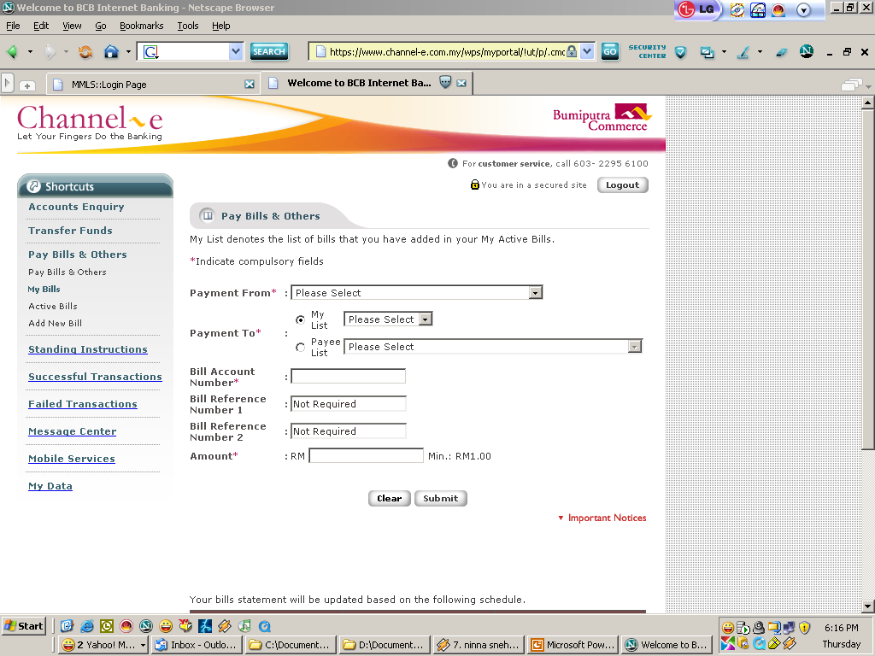

Slide 22
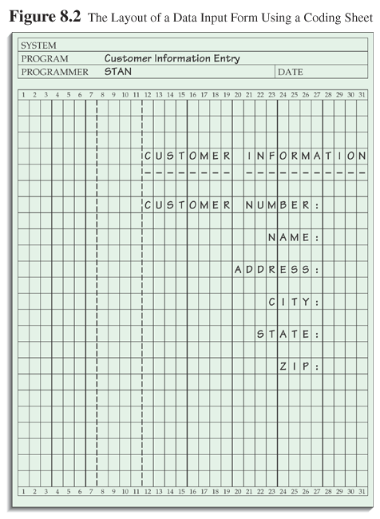
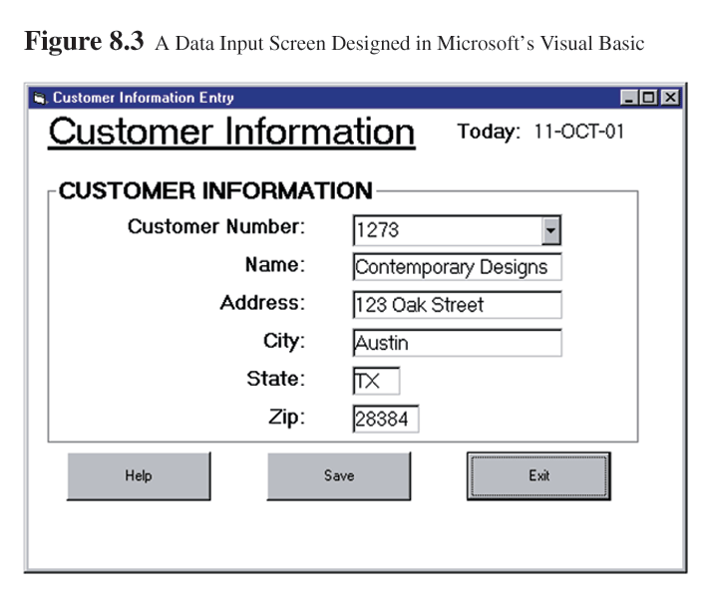

Slide 23
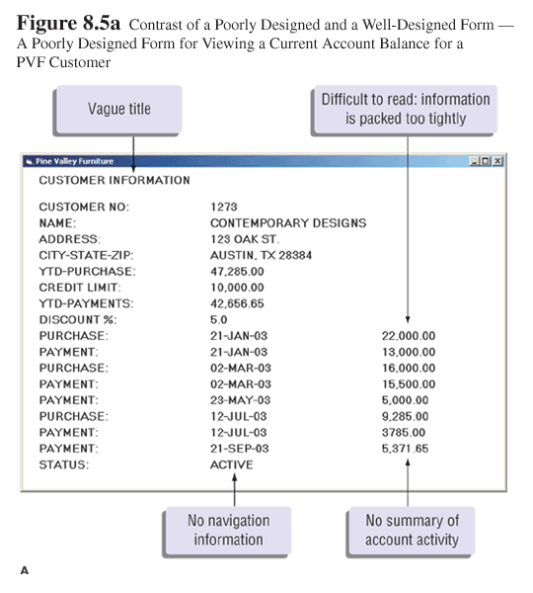
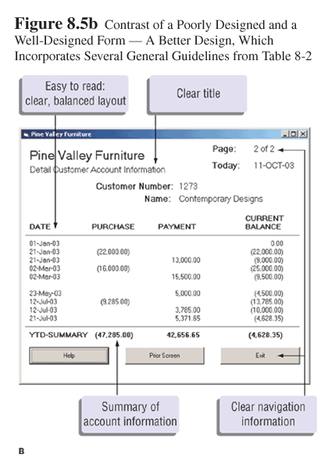

Slide 24
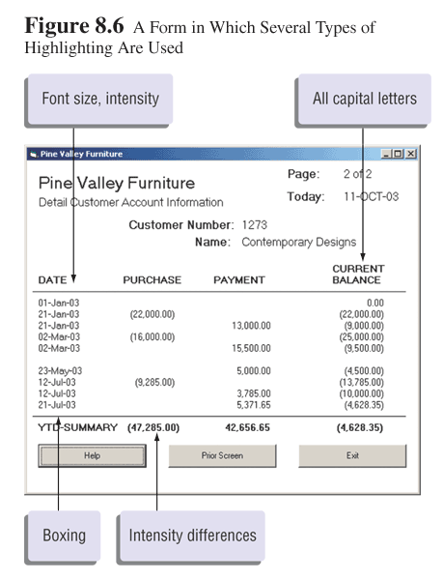
8.<number>

Slide 25
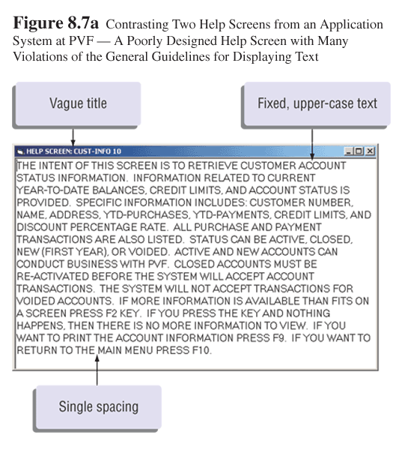
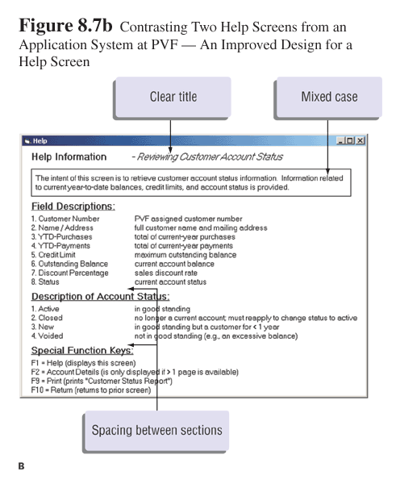

Slide 26
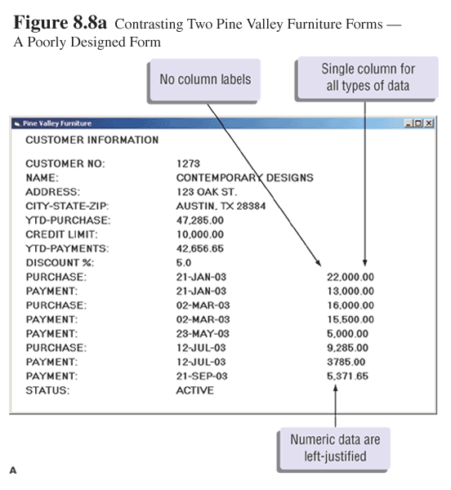
8.<number>

Slide 27
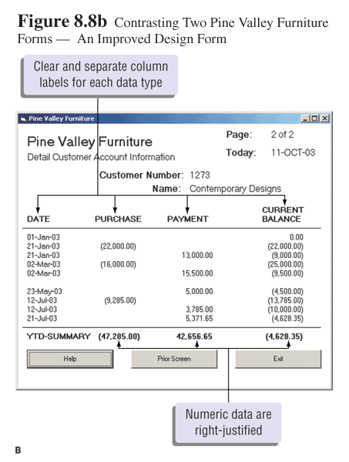
8.<number>

Slide 28
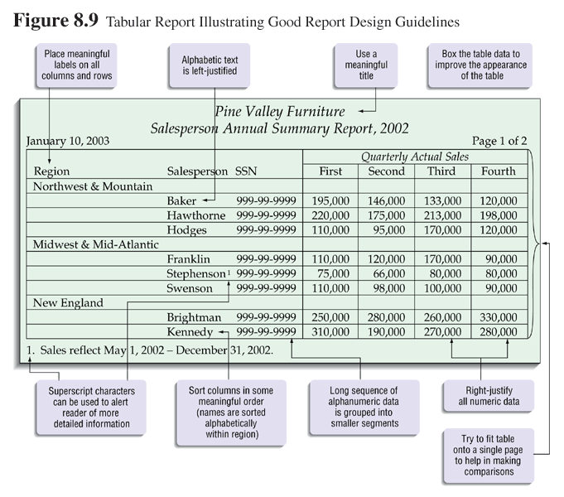
8.<number>

Slide 29
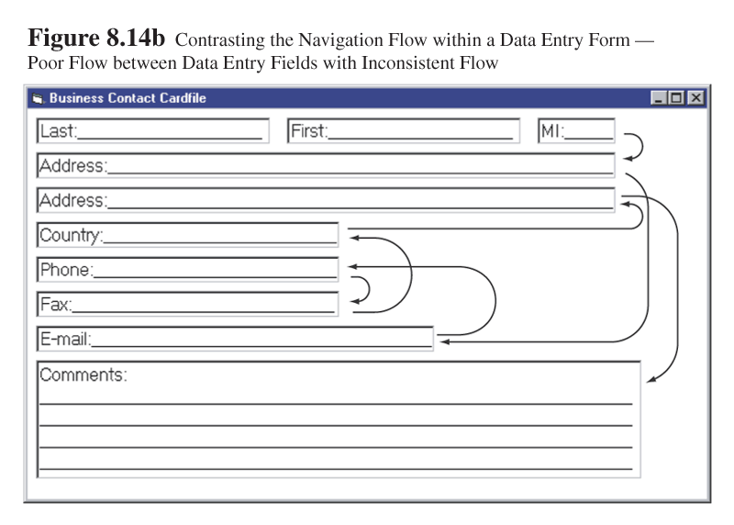
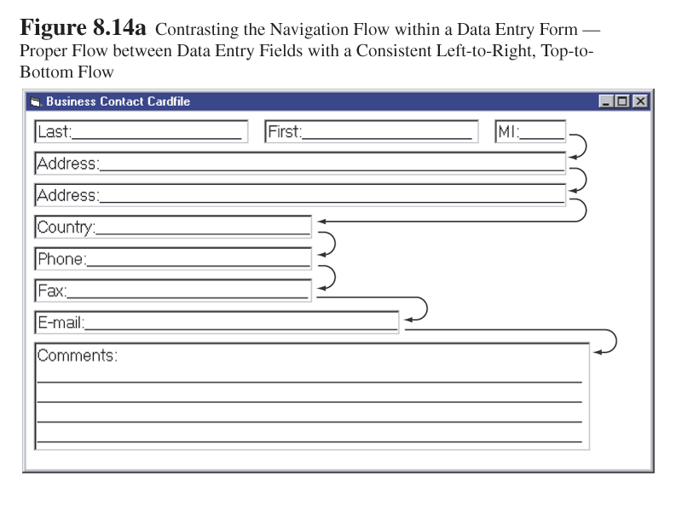

Slide 30
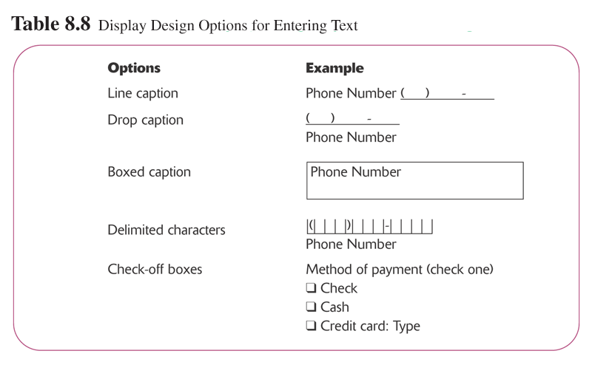
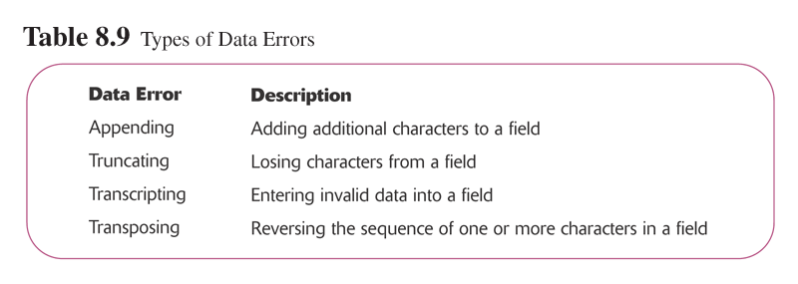
8.<number>

Slide 31
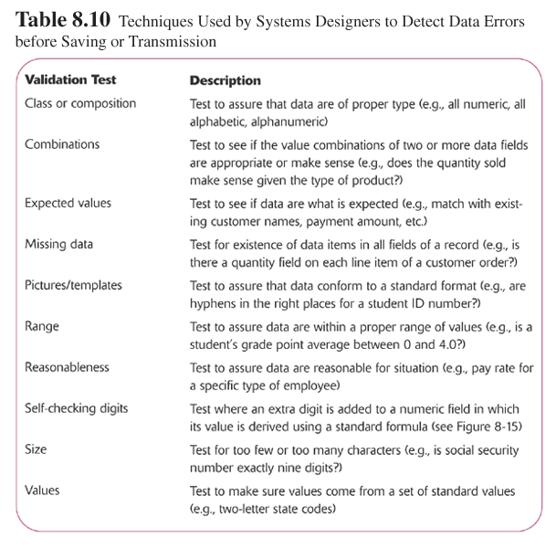
8.<number>

Slide 32
