Slide 1
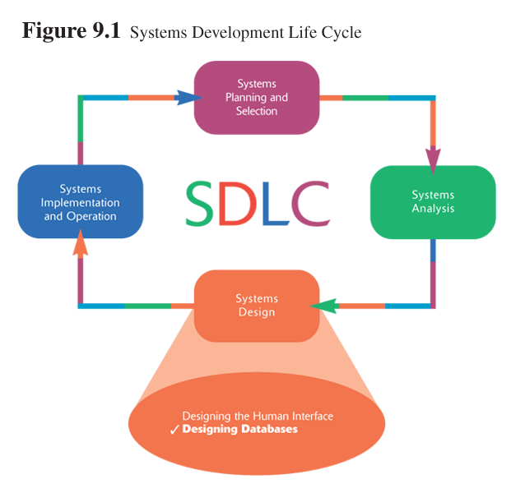
BAD 2014
ANALYSIS AND DESIGN
OF E-COMMERCE SYSTEMS
9
PHYSICAL DESIGN
9.1

Slide 2
Learning Objectives
Discuss the role of designing databases in the analysis and design of an information system
Learn how to transform an entity-relationship (ER) Diagram into an equivalent set of well-structured relations
9.<number>

Slide 3
Process of Database Design
Physical Design
  Based upon results of logical database design
  Key decisions
    Choosing storage format for each attribute from the logical database model
    Grouping attributes from the logical database model into physical records
    Arranging related records in secondary memory (hard disks and magnetic tapes) so that records can be stored, retrieved and updated rapidly
    Selecting media and structures for storing data to make access more efficient
9.<number>

Slide 4
DATA STORAGE FORMAT

Slide 5
DATA STORAGE FORMAT
Legacy databases
  The legacy databases (e.g. hierarchical database and network databases) use older sometime outmoded technology and are rarely used to develop new applications
Relational database
  The relational database is the most popular kind of database for application development today. A relational database is based on collections of tables, each of which has a primary key, a field or a group of fields, whose value is different for every row of the table (unique). The tables are related to each other by placing the primary key from one table into the related table as a foreign key. This is shown in the figure given below.
Object Databases
  The basic concept of object orientation is that all things should be treated as objects and both data and processes are encapsulated into the object.
Multidimensional Databases
  One of the newest members in the database arena is the multidimensional database, which has been driven in large part by the rise of data warehousing.

Slide 6
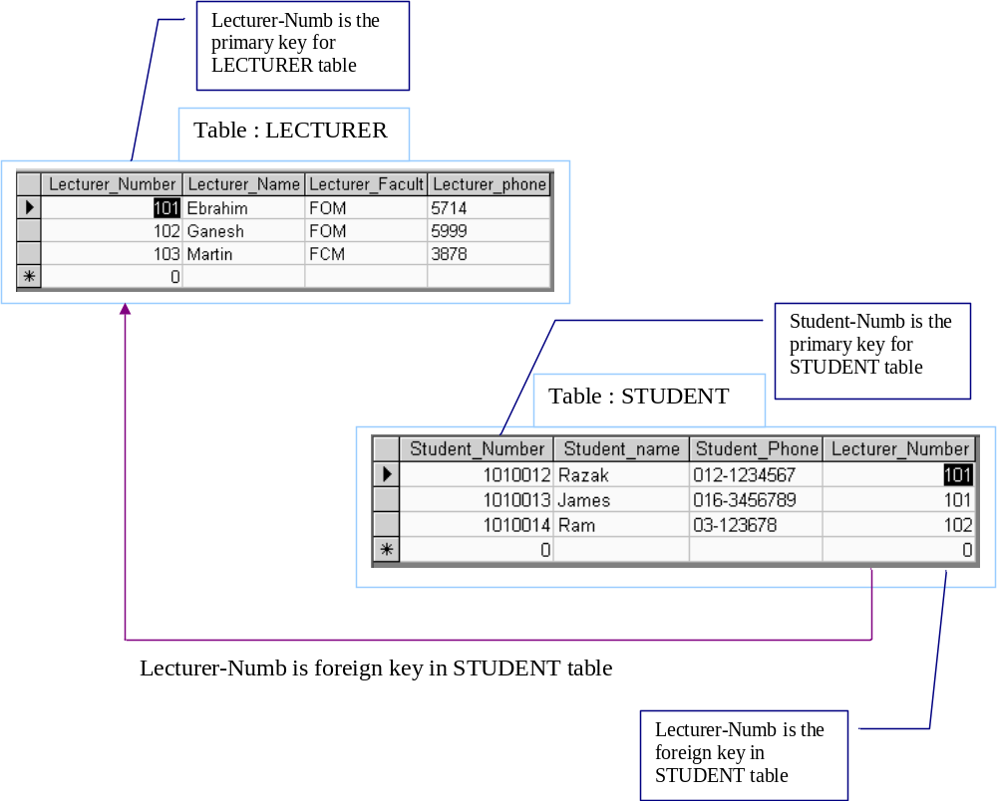
Relational database

Slide 7
SELECTING A STORAGE FORMAT
Each of the file and database data storage formats has its strengths and weaknesses and no one format is inherently better than the others are. Sometimes a Analyst will choose multiple data storage formats – a relational database for one data store and a multidimensional database for a third. Generally the following factors will be considered while selecting storage formats.

Slide 8
SELECTING A STORAGE FORMAT
Generally the following factors will be considered while selecting storage formats.
Data Types
  Most applications need to store simple data types, such as text, dates and numbers, and all DBMSs are equipped to handle this kind of data. The best choice for simple data storage, usually is the relational database because the technology has matured over time and has continuously improved to handle simple data very effectively. Some applications are incorporating complex data, such as video, images or audio, and object databases are best able to handle data of this type. Multidimensional databases are specially designed to store data so that they can be “sliced and diced” and examined across important business dimensions. If the system is being built for analytical decision support, then this option likely will be most appropriate.
Types of Application System
  In our first module we have learned about different kinds of application systems that can de developed, TPS, MIS, DSS, ES etc. Transaction processing and DSSs thus have very different data storage needs. Transaction processing systems need data storage formats that are turned for a lot of data updates and fast retrieval of predefined questions. Files, relational databases and object databases can all support these kinds of requirements. By contrast, systems that support decision making usually require relational database and multidimensional databases.
Existing Storage Formats, as well as Future Needs
  The data storage formats primarily should be selected on the basis of the kind of data and application system being developed. However, project teams should consider the existing data storage formats in the organization when making design decisions, some times use of the existing storage format will make use of the technical skills that are already exist and reduce the training cost. But not only should a project team consider the data storage technology within the company but they also should aware of current trends and technologies that are being used by other organizations.

Slide 9
ARCHITECTURE DESIGN

Slide 10
ARCHITECTURE DESIGN
An information system requires hardware, software, data, procedures and people to accomplish a specific set of functions. An effective system combines those elements into an architecture that is flexible, cost effective, technically sound, and able to support the information needs of the business.
System architecture translates the logical design of the information system into a physical structure that includes hardware, software, network support, and processing methods.
The basic objective of architecture design is to determine what parts of the application software will be assigned to what hardware.
The deliverable from architecture design covers the architecture design and the hardware and software specification. Based on this document the next phase construction and implementation will be carried out.
9.2

Slide 11
The three primary hardware components of a system are client computers, servers, and the network that connects them.
Client computers are the input/output devices employed by the user and are usually desktop, laptop computers as well as mobile devices like handheld devices and handphones.
Servers are typically larger computers that are used to store software that can be accessed by users who has permission. Servers can be any system ranging from mainframe, minicomputers or micro systems.
The network consists of communication mediums (like telephone lines, fiber-optic cables, wireless connectivity) and communication processors (Modem, routers etc), it also includes special communication software

Slide 12
Client-Server Architecture
Client-Server Architecture, in this architecture, the client is responsible for the presentation logic, whereas the server is responsible for the data access logic and data storage. The application logic may either reside on the client, reside on the server, or be split between both. The client-server architecture has many advantages such as, it is scalable, can support many types of clients and servers, it makes use of Internet standards and there is no central point of failure.
A three-tiered architecture uses three sets of computers, the software on the client is responsible for presentation logic, an application server is responsible for the application logic, and a separate database server is responsible for the data access logic and data storage, as shown in the figure given below. An n-tired architecture uses more than three sets of computers.

Slide 13
Three tier architectures.
  In the three tier architecture, a middle tier was added between the user system interface client environment and the database management server environment.
  There are a variety of ways of implementing this middle tier, such as transaction processing monitors, message servers, or application servers.
  The middle tier can perform queuing, application execution, and database staging.. In addition the middle layer adds scheduling and prioritization for work in progress.
  The three tier client/server architecture has been shown to improve performance for groups with a large number of users (in the thousands) and improves flexibility when compared to the two tier approach.

Slide 14
WAN USING RAS
64 KBPS LEASED LINE
SWITCH
1 MBPS MLLN
ETHERNET
PSTN LINE
SWITCH
CATALYST
SWITCH
ROUTER
FIRE WALL
ROUTER
SWITCH
BACKUP
SERVER
RAS
CENTRAL COMPUTER CENTRE
LAN
TELEPHONE EXCHANGE
Branch-1
ROUTER
ROUTER
ROUTER
ROUTER
ROUTER
ROUTER
SWITCH
SWITCH
SWITCH
SWITCH
SWITCH
SWITCH
RAS
RAS
RAS
RAS
RAS
RAS
LAN
LAN
LAN
LAN
LAN
LAN
PSTN USERS

