Slide 1
FINAL PROJECT
FOUNDATION TRAINING PROGRAM
Student’s Name : Trần Kiều Anh
Mentor : Nguyễn Công Trạng
Front End Development Internship

Slide 2
Timeline
Source Code (Git)
Agile-Scrum
HTML/CSS
Angular – Component
Angular – Template
Angular – Directive
……
Angular Practice
Final Project
Review Requirement
Final Project
Report/Feedback
1
3
5
7
2
4
6
RESTFUL API
Database
Typescript
Angular Tour Heroes
Angular – HTTP Client
Angular – Routing
Angular – Services
Angular Practice
Final Project
Report/Feedback

Slide 3



Source Code Management
Github / Bitbucket
Create repository
Create branch / switch branch
Clone source code
Add, commit, push code Command Line / Sourcetree

Slide 4
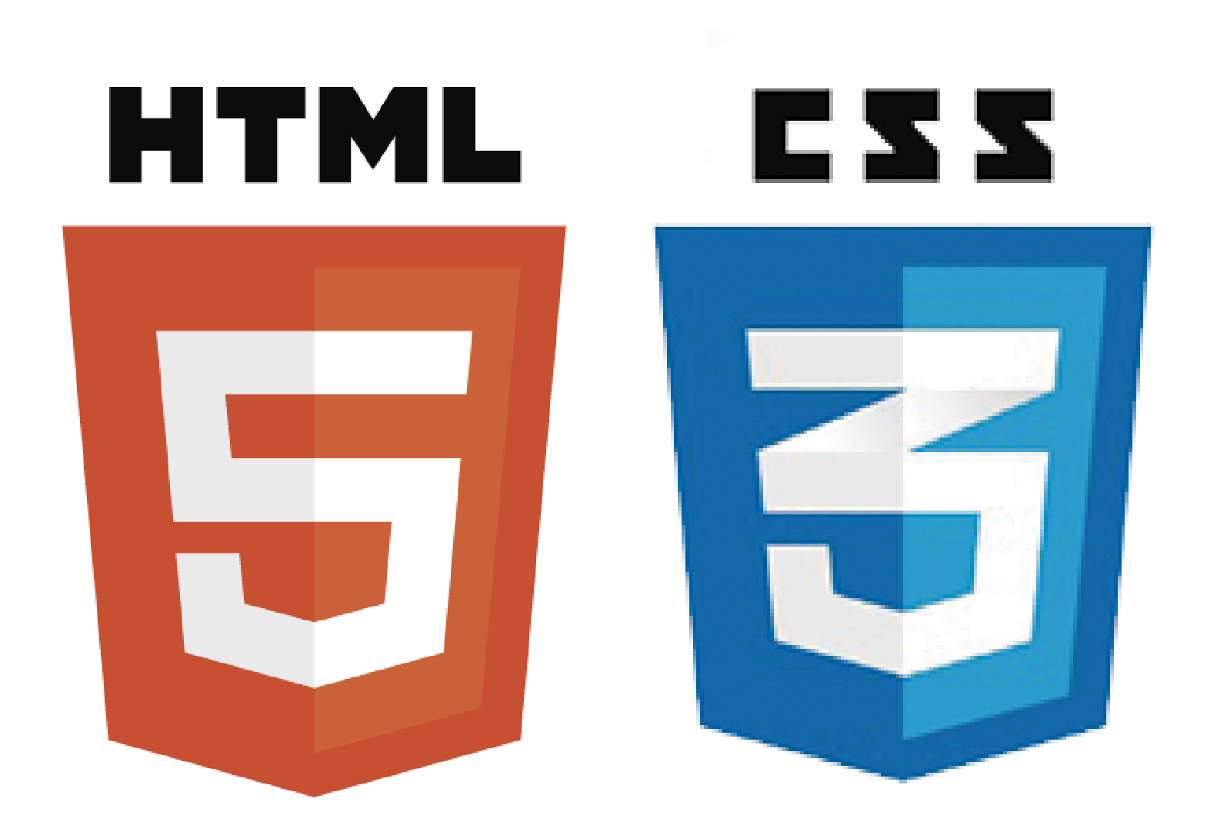
HTML / CSS
HTML tags
CSS Priority Rankings
Type group
Background group
Block group
Border group
List group
…..

Slide 5
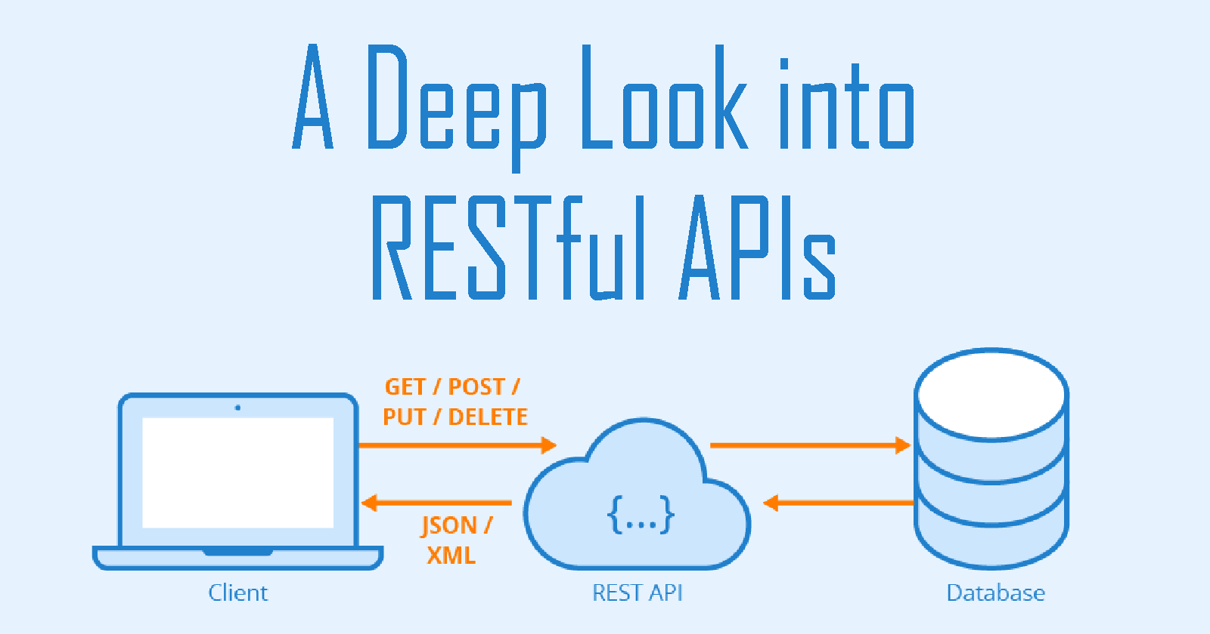
RESTFUL API
API (Application Programming Interface)
Là một tập các quy tắc và cơ chế mà theo đó, một ứng dụng hay một thành phần sẽ tương tác với một ứng dụng hay thành phần khác. API có thể trả về dữ liệu như JSON hay XML.
REST (Representational State Transfer)
Là một dạng chuyển đổi cấu trúc dữ liệu, một kiểu kiến trúc để viết API. Sử dụng phương thức HTTP đơn giản để tạo cho giao tiếp giữa các máy. REST gửi một yêu cầu HTTP như GET, POST, DELETE,… đến một URL để xử lý dữ liệu.

Slide 6

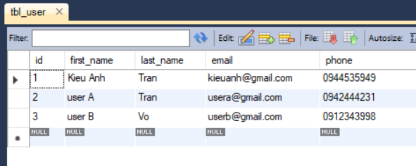
RESTFUL API
Configure the application to connect to database
Use Postman's API client to send requests

Slide 7
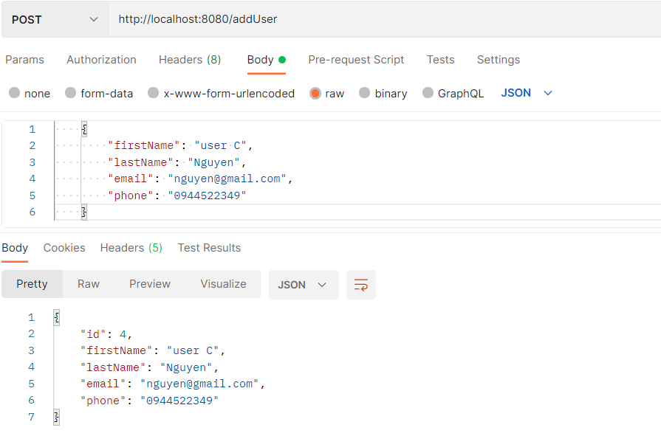
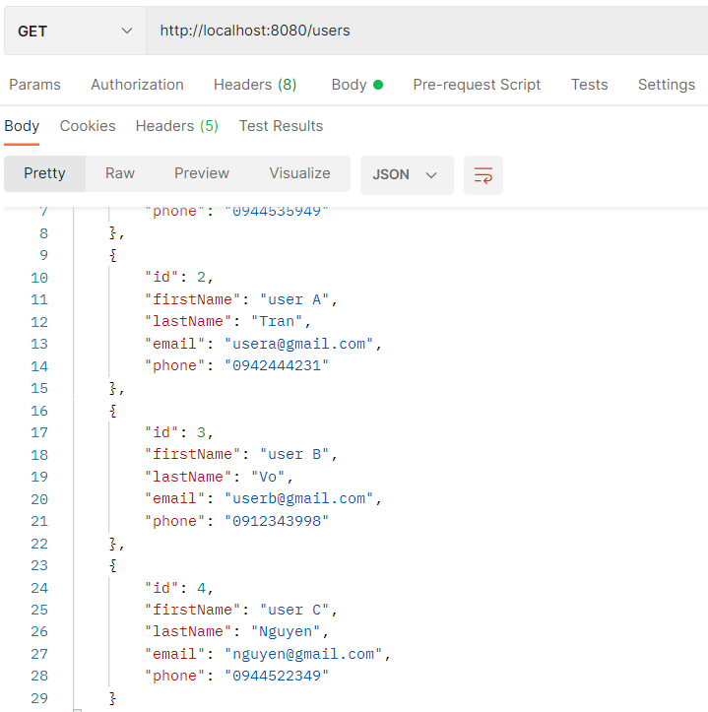

CRUD – Create / Read
Get list user with GET method
Create user with POST method

Slide 8
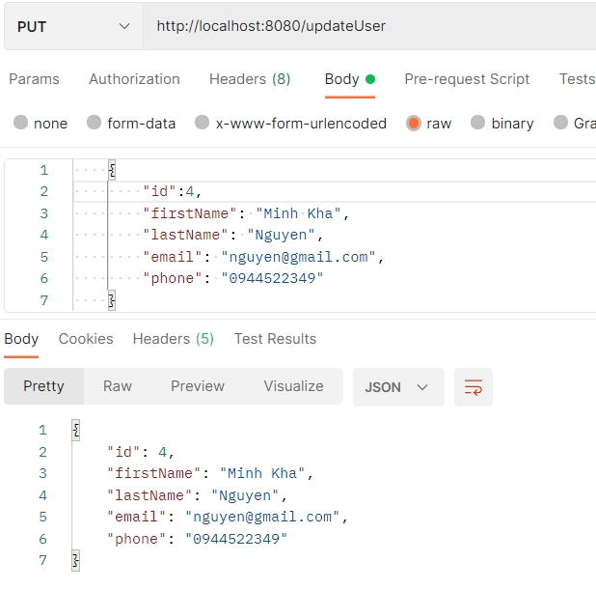
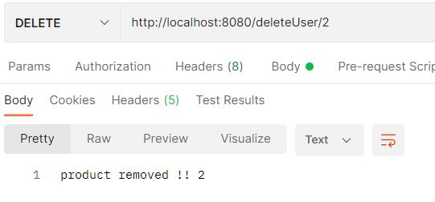
CRUD – Update / Delete
Update user with PUT method
Delete user with DELETE method

Slide 9

ANGULAR
Tour of Heroes

Slide 10
What is Angular ?
Angular là một Javascript Framework
Thường được sử dụng để tạo ra các ứng dụng SPA
Single Page Application - SPA
Hoạt động dựa trên việc mở rộng thêm các thuộc tính (attribute) cho các thẻ của HTML

Slide 11

Installation and Configuration

Slide 12


Install Node
Node.js là 1 nền tảng phía server mã nguồn mở và miễn phí, cho phép dịch và chạy các Web Server sử dụng JavaScript
NPM (node package manager) được sử dụng để quản lý các gói thông tin của Node.js.
Kiểm tra npm version bằng lệnh : npm -v

Slide 13
Install Angular CLI
Angular CLI là một công cụ được phát triển để chạy trên giao diện cửa sổ ứng dụng nhằm giúp đỡ việc tạo dự án, quản lý tập tin trong dự án và thực hiện nhiều tác vụ khác nhau như test (kiểm thử) và deploy dự án một cách nhanh chóng và hiệu quả.
Để cài đặt Angular CLI ta có thể chạy lệnh:
(sudo) npm install @angular/cli –g
Sau khi cài đặt, kiểm tra version qua lệnh:
ng version

Slide 14
Angular Project
Angular project is created using command:
ng new project-name
Assuming project name is “angular-document”
ng new angular-document
Running the project
Run following command inside of project folder:
npm run start
It will start angular server at default port number #4200 and make application accessible using http://localhost:4200

Slide 15
Angular Component

Slide 16
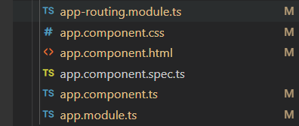
Angular - Component
Angular is based on components
There is already the main component called app.component that shows the “Wellcome to App” page when you access localhost:4200

Slide 17
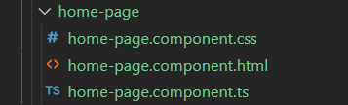
Angular - Component
Angular component is created using command:
ng g c component-name
Angular component have 3 basics parts:
home-page.component.html (the html code of component)
home-page.component.css (css style of component)
home-page.component.ts (the typescritp of component)

Slide 18
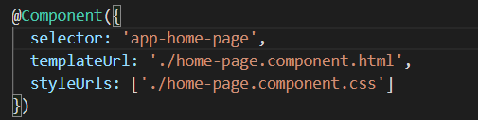

Angular - Component
Each component has a selector in the typescript class that identify the component
Put my component selector in the order of the components will be shown

Slide 19

Angular Data Binding
One-way binding
Event binding
Two-way binding

Slide 20
Data Binding
It is data synchronization between View and Controller
sign-in.component.ts
Data binding
sign-in.component.html

Slide 21
Data Binding
Data Binding can be One-way, where data change in controller is reflected at view, or Two-way, where data changes are reflected in both directions; controller and view.
The following types of bindings are supported by Angular:
One-way binding
Interpolation - {{attribute-name}}
Property Binding - [attribute-name]
Event Binding - (event)
Two-way binding - [(attribute-name)]

Slide 22


Interpolation
One-way data binding is done by directive {{}}, called interpolation
Attributes defined in controller can be displayed in html using {{}}
For example, message attribute defined in SignInComponent is displayed at login html using interpolation.

Slide 23

Property Binding
Property binding is used for one-way data binding
It binds controller attribute with DOM property of HTML elements
For example

Slide 24
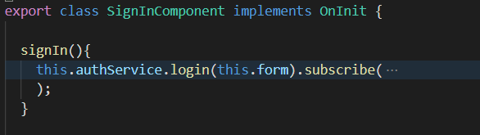

Event Binding
HTML form events can be bound with component class methods using (event) directive.
Followings are form event to be bind :
(click) : called on button click event
For example, signIn() method in SignInComponent is bound with click event of submit button in login form.

Slide 25
Two-way Data Binding
In two-way data binding, data will be changed in both directions; controller and view
If you change data at view then controller will be changed. If you change data at controller then view will be changed
Two-way data binding is done by directive [(ngModel)]
It is used to bind html form input elements with controller class attributes

Slide 26
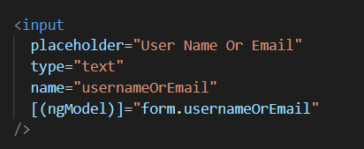
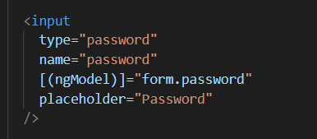
Two-way Data Binding
For example sign in form elements are bound with [(ngModel)] :

Slide 27

Angular Directives

Slide 28
Angular Directives
Attribute Directives
Changes the appearance or behavior of a DOM element
Structural Directives
Change the DOM's structure, typically by adding, removing, or manipulating elements.

Slide 29
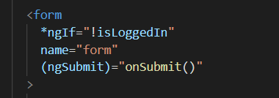

Angular Directives
Directive *ngIf is used to conditionally display an html DOM element.
Directive *ngFor is used to iterate and print list in html page.

Slide 30

Angular Routing

Slide 31
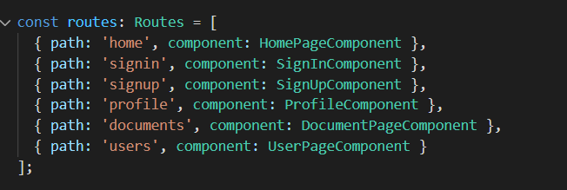
Routing
Routing is used to define paths to navigate to the components
One component has one or more routes
Routes may contain URL variables
Access pages using following URL : http://localhost:4200/home

Slide 32
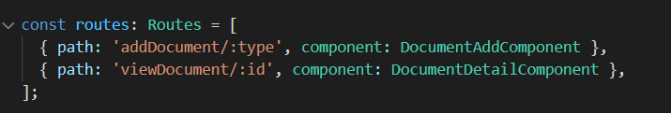
Route Parameters
You can define parametrized routes for a component
Route parameter is defined by colon (:) character and placeholder name
Here :id, :type are router parameter

Slide 33
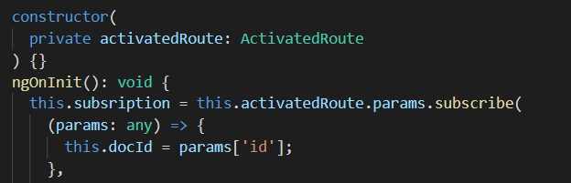
Read Route Parameters
Path variables are read by ActivatedRoute service
Service is injected into component constructor
Parameters read buy registering callback with activatedRoute.params.subscribe method

Slide 34

Angular Pipe

Slide 35
Pipe
Pipes are used to format the data.
Pipes can be used to change data from one format to another.
For example
{{ name | uppercase }}
{{ name | lowercase }}
For example date pipe :
mediumDate change data to 'MMM d, y' (Aug 10, 2021)

Slide 36

Angular Service

Slide 37
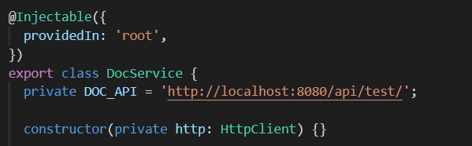
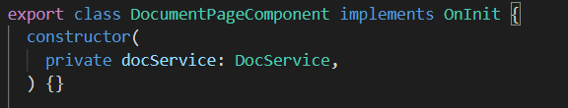
Service
Services communicate with Rest Web APIs and perform CRUD operations
A service can be created by following CLI command:
ng g service DocService
Service class is decorated by @Injectable decorator
Service is injected to component using constructor

Slide 38
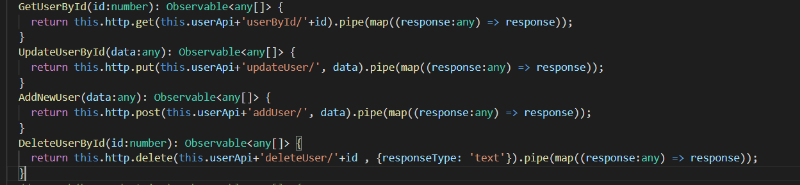
HttpClient Service
HttpClient service is used to communicate with http server
HttpClient contains get(), post(), put(), delete() methods to make http calls to the server
Methods get(url) and delete(url) receive one parameter;whereas put(url,data), post(url,data) receive two parameters; url and data.
Data is added to the request body. Usually data is a JSON object.

Slide 39

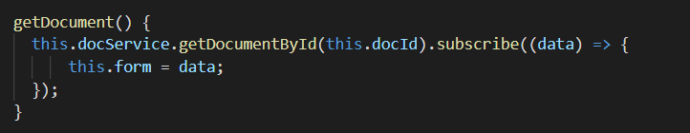
Observable Object
All methods return Observable object
Observable object subscribes to a callback method. Callback method receives response JSON object.

Slide 40

FINAL PROJECT
Review project requirement

Slide 41
FINAL PROJECT
Project Name: Documents Management System
Purpose: This project will help users generate documents based on defined templates and help them manage their created documents
Resources: This project must support managing multiple templates. At this time, we provide 2 templates:
Document Type | Document Name | Document Template
COM-CA-TPL | Configuration Audit Report | COM-CA-TPL Configuration Audit Report.docx
COM-CAR-TPL | Causal Analysis and Resolution Report | COM-CAR-TPL CAR Report 5-Why.docx

Slide 42
DOCUMENT PAGE
Create a new document
View a document
Update a document
Delete a document
Export a document
USER PAGE
Display all users register on the system
DOCUMENT PAGE
View a document
Confirm a document
Export a document
PROFILE PAGE
Display information of logged user
PROFILE PAGE
Display information of logged user
USER
ADMIN

Slide 43
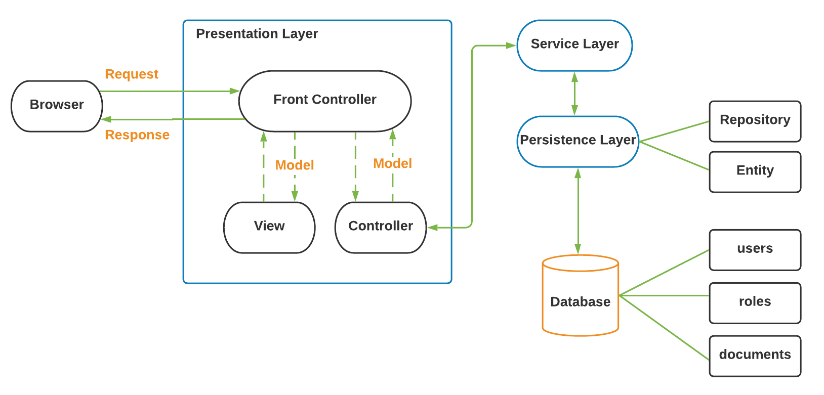
FINAL PROJECT

Slide 44

DEMO FINAL PROJECT
Let’s start with Document Management

Slide 45
THANKS!
Any questions?

