Slide 1

U.S. Crime Activities Analytics
– iTeam – Stefan Jurack, Cuong Kieu, Yoshinobu Nakahashi, Naveen Swaminathan
20/04/2018
Notes:
Several alternative tit
le slide layouts are available toward the end of this template deck.
Q

Slide 2

Agenda
Motivation
Key Questions
Analytics Approach
Data Sources
Milestones
Notes:
Q

Slide 3
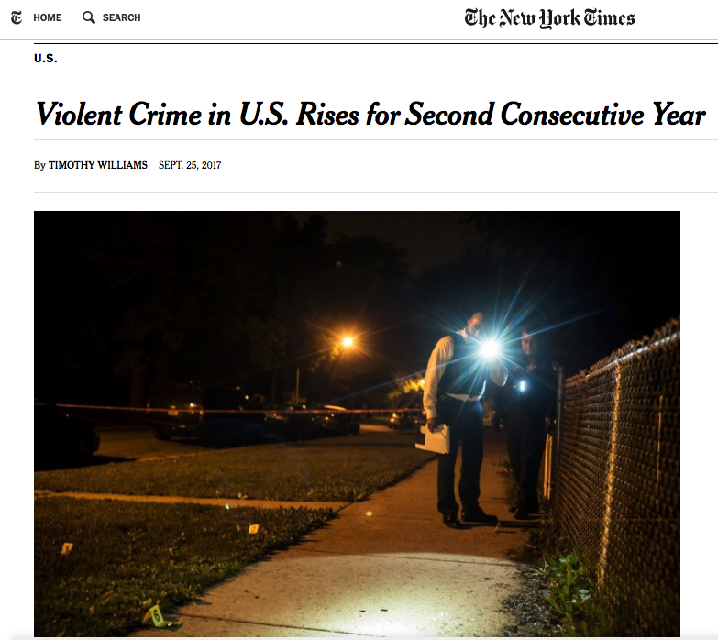
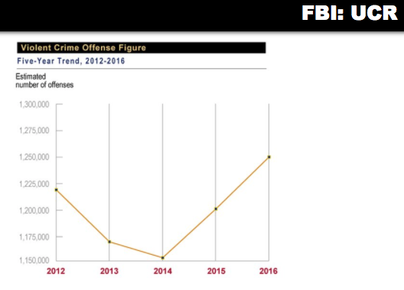
Motivation
Notes:
US. Gov. plans long-term investigation and investments
Optimal placement of human and money resources
Deserves:
Identifying and thwarting sources of crime
Find correlative patterns promoting crime
Identify relationship networks enabling or feeding crime
→ Intelligently allocate ressources to fight against crime
SJ

Slide 4
Key Questions
Where are the high crime areas?
What is the distribution of crime types?
What factor correlates with crime activities?
Optional: Is the development of crime predicable?
Notes:
SJ

Slide 5
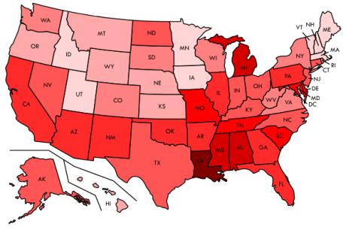
Analytics Approach
Crime rate
Ranking (State and County)
Distribution of crime types
Correlations with
Educational factors
Population Components
Income
Employment status
Others
Predication Model
County Focus on California
Notes:
Yoshi

Slide 6
Data Sources
Uniform Crime Reporting Statistics
https://www.ucrdatatool.gov/
Up to 2014, annually
States, PoliceDepts
Local Area Unemployment Statistics
https://www.bls.gov/lau/
Up to 2016, annually
Counties
County Population Totals and Components of Change
https://www.census.gov/data/datasets/2017/demo/popest/counties-total.html
Up to 2017, annually
States, Counties
Small Area Income and Poverty Estimates
https://www.census.gov/programs-surveys/saipe/data/datasets.html
States, annually
Notes:
* https://www.ucrdatatool.gov/Search/Crime/Local/RunCrimeOneYearofData.cfm
* 19xx - 2014
* State-based, with a change to map PoliceDepts to County (manually)
* Particularly crime data e.g. property crime, violemnt crime
* Needs download by year
* file pattern:
* Labor force data
* County based
* Employment, unemployment (level and rate),
* 1990 - 2016
* Download per year
* County population totals and components of change
* County based
* 2011-2017
* deaths, births, migrations (domestic, internat)
* Download per State and year
* Population
* County based
* 2011 - 2017
* no differentiation of religion, sexes etc.
* Download per State and year

Slide 7
Notes:
Naveen

