Slide 1
MyBatis

Slide 2
1. Library
2. Config DataSource, SqlSession, SqlSessionTemplate,
TransactionManager (in root.xml).
3. Define Entity/VO class
4. Config MyBatis
5. Define Mapper Files

Slide 3
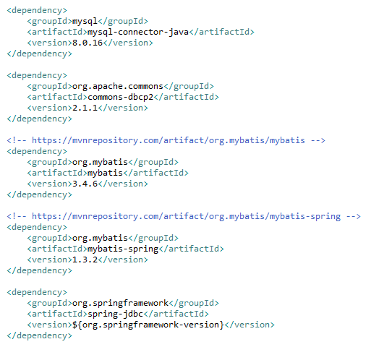
1. Library

Slide 4
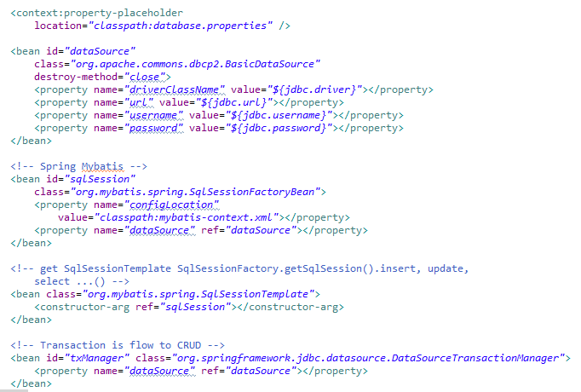
2. Config root.xml

Slide 5
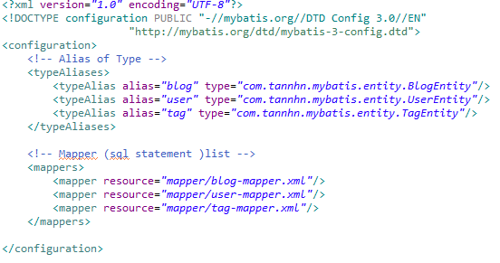
4. Config MyBatis (src/main/resources/mybatis-context.xml)

Slide 6
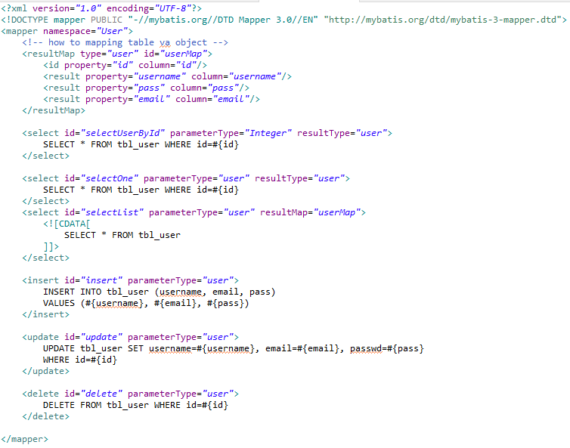
5. Define Mapper file (in folder Mapper)

Slide 7
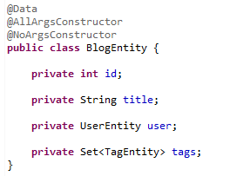

Slide 8
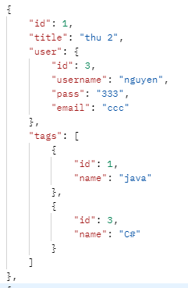

Slide 9
Mapper XML Files
1. Result Maps
a. association (has-one)
- Nested Select
- Nested Results
b. collection (has-many)
- Nested Select
- Nested Results

Slide 10




a. association: (has-one)
- Nested Select
first select
second select

Slide 11

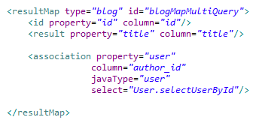
a. association: (has-one)
- Nested Select
first select (blog-mapper.xml)

Slide 12
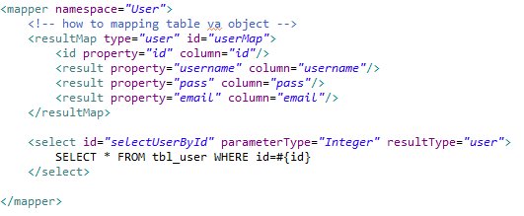
a. association: (has-one)
- Nested Select
second select (user-mapper.xml)

Slide 13


b. collection: (has-many)
- Nested Select
first select
second select (select tags by blog id)

Slide 14
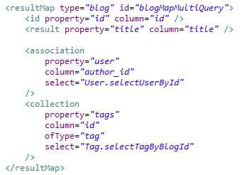
b. collection: (has-many)
- Nested Select
first select (blog-mapper.xml)

Slide 15
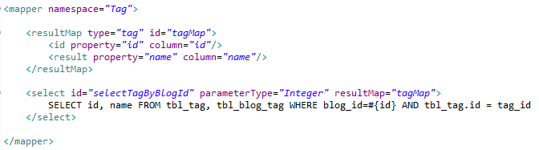
b. collection: (has-many)
- Nested Select
second select (tag-mapper.xml - select tags by blog id )

Slide 16


a. association: (has-one)
- Nested Results

Slide 17
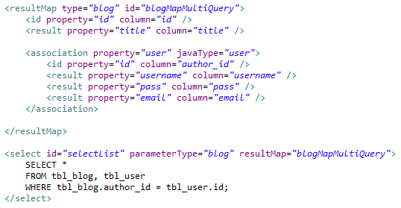
a. association: (has-one)
- Nested Results

Slide 18
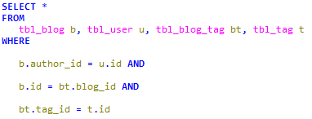
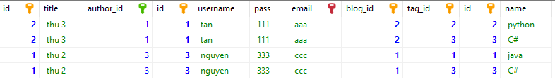
b. collection: (has-many)
- Nested Results

Slide 19
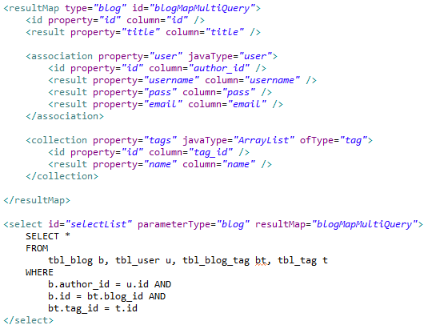
b. collection: (has-many)
- Nested Results

