Slide 1
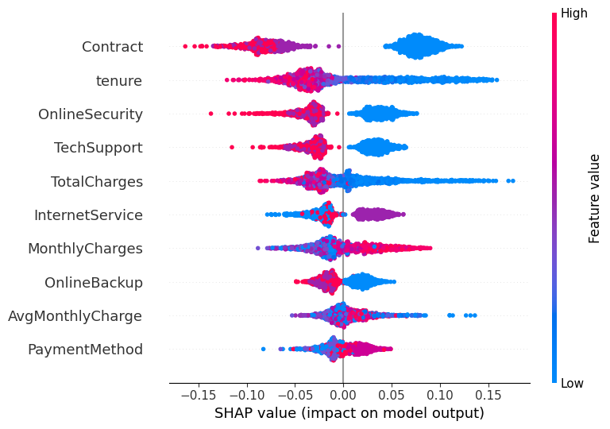
Explainable AI for Telecom Churn
Prediction and Retention Personas
Global SHAP evidence
Random Forest, SHAP, and SHAP theme clustering turn churn scores into retention actions.
Vũ Trung Kiên • IS6502.CH201 • Final paper and presentation
7,043
8
5
customers
models
personas
Telco dataset
compared
retention groups
1

Slide 2
The pipeline links prediction, explanation, and action
The goal is not only to score churn risk, but to understand why customers leave and what retention offer fits each group.
01
26.54%
80/20
5
Predict
churn rate
train/test split
persona clusters
Compare multiple models on the same Telco churn split and keep the best-performing benchmark in view.
1,869 of 7,043 customers
stratified by churn
theme-level SHAP space
02
Why the workflow matters
Explain
A churn score alone is not enough for retention planning. The paper is designed to answer three questions in sequence: who is likely to leave, what drives that decision, and which offer should be used for that customer group.
Use SHAP to rank the strongest churn drivers and interpret them in business terms.
03
Act
Cluster the SHAP themes into personas and turn them into specific retention actions.
2

Slide 3
Logistic Regression led the benchmark,
but Random Forest stayed in the paper for explainability
The numerical gap is small enough that interpretability becomes the deciding factor for the final pipeline.
Accuracy benchmark
What the benchmark says
LogReg
0.7903
XGB
0.7854
Best accuracy and AUC
RF
0.7846
Logistic Regression reached 0.7903 accuracy and 0.8359 AUC.
Ada
0.7832
Selected base model
SVM
0.7839
Random Forest reached 0.7846 accuracy and was kept because TreeExplainer works naturally on it.
KNN
0.7697
NB
0.7562
Practical reading
DT
0.7257
The benchmark is close enough that the paper favors the model that produces the most useful explanation layer.
3

Slide 4
Contract is the strongest signal because it captures customer commitment
SHAP shows that commitment and service quality dominate the churn decision, with contract type leading the ranking.
Top feature
Contract is the most important feature in the paper, with mean |SHAP| of 0.0794.
Retention meaning
Month-to-month customers churn at 0.427, versus 0.113 for one-year plans and 0.028 for two-year plans.
Secondary signals
OnlineSecurity, TechSupport, TotalCharges, and tenure fill out the rest of the top five. Together they describe commitment, service quality, and price pressure.
4

Slide 5
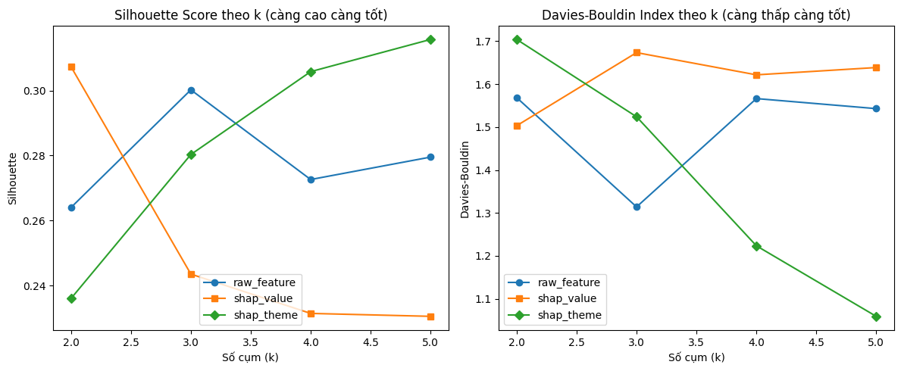
Grouping SHAP by theme gives the cleanest cluster structure
Theme aggregation improves separability because it reduces overlap among correlated drivers such as Contract and tenure.
Ablation result
0.3002
0.3073
raw_feature
shap_value
best silhouette
+2.36% vs raw
0.3157
shap_theme
+5.16% vs raw_feature
Why it matters
The best clustering space is also the one that gives the most interpretable business themes, so the paper uses shap_theme as the official persona space.
5

Slide 6
Five personas translate the SHAP themes into retention actions
The clusters are statistically separable and each one maps to a clear business response.
Persona 0
Persona 1
Persona 2
Service Quality
Commitment
Service Quality
230
customers
582
customers
237
customers
Distinctive feature: OnlineSecurity
Distinctive feature: Contract
Distinctive feature: InternetService
Strengthen technical support, improve network quality, and provide post-sales care.
Offer long-term contract incentives and staged retention programs.
Strengthen technical support, improve network quality, and provide post-sales care.
Persona 3
Persona 4
Lifestyle Bundle
Cost Pressure
225
customers
133
customers
Distinctive feature: -
Distinctive feature: TotalCharges
Offer discounted bundles for streaming and multiple-line services.
Provide fee reductions, vouchers, or flexible plans.
Kruskal-Wallis testing shows that all four themes differ significantly across the personas.
6

Slide 7
The paper turns churn prediction into a retention playbook
Prediction, explanation, and action are now one pipeline instead of three disconnected outputs.
What the paper shows
How to use it next
1. Commitment matters most
Target the largest persona first
Contract is the strongest SHAP driver, and month-to-month customers churn much more often than longer-term customers.
The commitment-sensitive group is the biggest cluster, so contract incentives and staged retention should be the first business test.
2. Service quality and price pressure matter next
Then tailor the service-quality groups
OnlineSecurity, TechSupport, TotalCharges, and tenure complete the main explanation story.
Two separate personas point to service issues, so technical support and network improvement should be tested next.
3. Themes produce action-ready personas
Extend the dataset before the next iteration
Theme-level SHAP clustering gives five statistically distinct groups that can be matched to retention offers.
More behavioral data would likely sharpen persona separation and make the action layer even more precise.
Final message: explain the churn signal before deciding what retention action to take.
7

