Slide 1
High Performance Python : Beyond Numpy
Jérôme Kieffer
Online Data Analysis

Slide 2
Layout
No optimization without profiling
Cython: Python binary modules in Python
PyOpenCL: GPU programming

Slide 3
Only optimize profiled code !
Use the profiler from python:
  python -m cprofile -o log my_prog.py
Visualization :
  Using pstats module
  Or better : visualize with runsnake
Or simply use timeit (with ipython)

Slide 4
Exercise 0: Profile the code
Check if a point is inside a polygon :
  Code is in 0_Python
  Profile the code considering :
    24-edges polygon
    1024x1024 pixels in image to check
Execution time on a bi-Xeon5520 (2.27GHz):
Based on tuples: 37s
Based on numpy: 157s

Slide 5
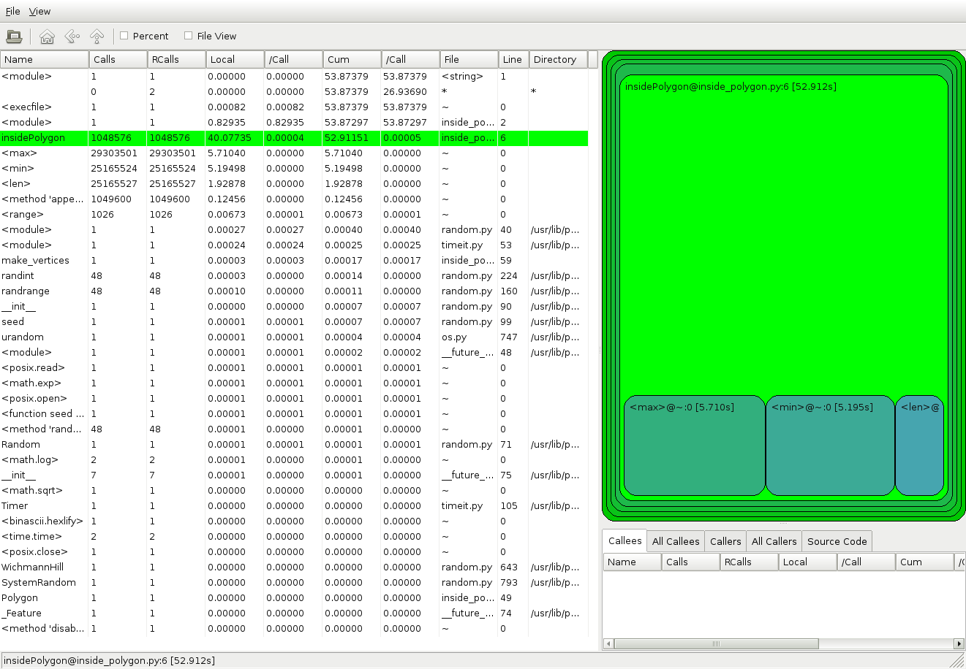
Visualization with runsnake

Slide 6
1. Cython
Python binary extension written in Python
  Translates python code to C/C++
  Provides speed but needs compilation
  Built-in support of numpy arrays
  Can interface with C/C++ libraries (wrapping)
Cython is getting mainstream for many projects:
  Lxml, pyzmq, h5py, scikit image and learn,

Slide 7
Extension to python
Cython modules have .pyx extensions
  Just copy your python file with another extension
  Convert your code to C using cython -a prog.pyx
  option -a produces a webpage with annotation

Slide 8
Building a Cython module
Using a setup.py is recommended:
  #!/usr/bin/python
  from distutils.core import setup
  from Cython.Distutils import build_ext
  from distutils.extension import Extension
  cy_mod=Extension("inside_polygon",
  sources= ["inside_polygon.pyx"])
  setup(ext_modules = [cy_mod],
  cmdclass = {'build_ext': build_ext})
Build module using:
$ python setup.py build_ext -i

Slide 9
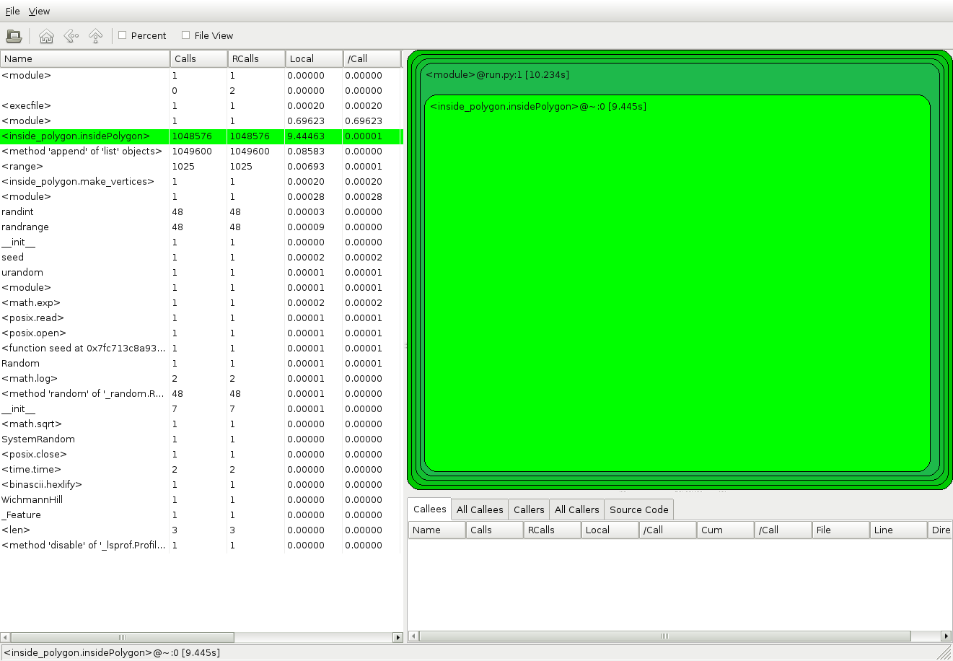
Exercise: Compile a binary module
Speed-up: 4x just by compiling !

Slide 10
Cython optimization
Benchmark your code
inspect the annotated page (option -a)
  Remove the yellow in the critical part
Use cdef to enforce the type of variables
  Will prevent the type checking which slows down Python

Slide 11
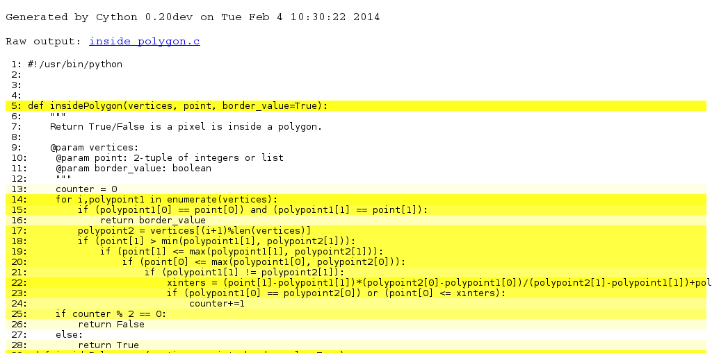
Annotated file
The lighter, the better / faster
Click on a line to see the generated code

Slide 12
Python or Cython classes

Slide 13
Wrapping C library
C libraries can declared:
  cdef extern from "InsidePolygonWithBounds.h":
    void PointsInsidePolygon(double *, int , \
    double *, int , int ,\ unsigned char *) nogil
Cython offers a set of cimport libraries:
  from libc.stdlib cimport malloc, free
  from libc.string cimport memset, memcpy
Include files can be merged into a .pxd
  from InsidePolygon cimport PointsInsidePolygon

Slide 14
Exercise: Compile a binary module
Speed-up: 4x just by compiling !

Slide 15
Exercise: use a cython class

Slide 16
Wrap C++ library
Directly inline:

Slide 17
Use an external include and pxd

Slide 18
Use OpenMP to parallelize
With nogil

Slide 19
Summary of speed-ups
 | Execution time | Speed-up
Python with tuples | 36 s | 1
Python with numpy | 157s | 0.23
Cython with tuples | 9 s | 4
Cython with numpy+Opt | 3.6 | 10
Cython_class + Opt | 0.46 | 80
Cython with OpenMP | 0.11 | 327
Measured on a dual-quadcore @2.27 GHz Xeon 5520

Slide 20
2. OpenCL
An overview of OpenCL
Programming GPU using PyOpenCL
Next slides come from:
https://github.com/HandsOnOpenCL/Lecture-Slides/releases

Slide 21
It’s a Heterogeneous world
A modern computing platform includes:
One or more CPUs
One of more GPUs
DSP processors
Accelerators
… other?
E.g. Samsung® Exynos 5:
Dual core ARM A15 1.7GHz, Mali T604 GPU
E.g. Intel XXX with IRIS
OpenCL lets Programmers write a single portable program that uses ALL resources in the heterogeneous platform

Slide 22
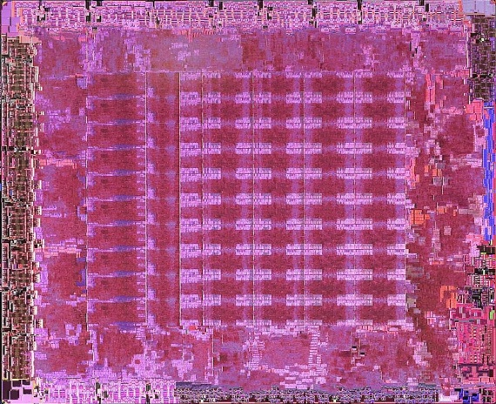
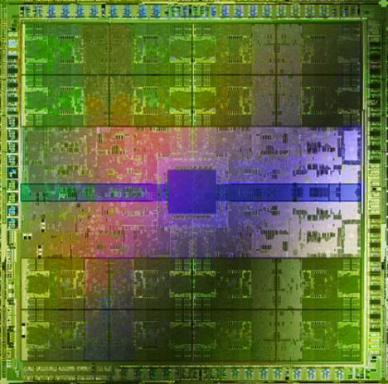
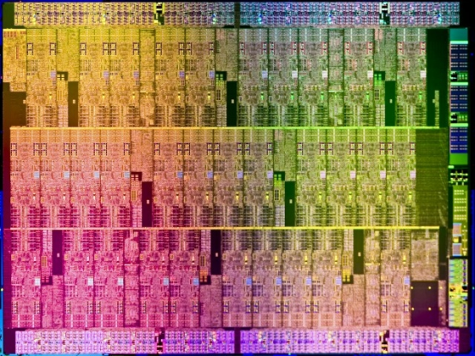
Microprocessor trends
Individual processors have many (possibly heterogeneous) cores.
10 cores
16 wide SIMD
61 cores
16 wide SIMD
16 cores
32 wide SIMD
ATI™ RV770
Intel® Xeon Phi™ coprocessor
NVIDIA® Tesla® C2090
The Heterogeneous many-core challenge:
How are we to build a software ecosystem for the
Heterogeneous many core platform?
Third party names are the property of their owners.

Slide 23

Industry Standards for Programming Heterogeneous Platforms
GPUs
Increasingly general purpose data-parallel computing
CPUs
Multiple cores driving performance increases
Emerging
Intersection
Graphics APIs and Shading Languages
Multi-processor programming – e.g. OpenMP
Heterogeneous
Computing
OpenCL – Open Computing Language
Open, royalty-free standard for portable, parallel programming of heterogeneous parallel computing CPUs, GPUs, and other processors

Slide 24
The origins of OpenCL
ARM
AMD
Nokia
Merged, needed commonality across products
IBM
ATI
Sony
Wrote a rough draft straw man API
Qualcomm
GPU vendor – wants to steal market share from CPU
Imagination
NVIDIA
TI
+ many more
Khronos Compute group formed
CPU vendor – wants to steal market share from GPU
Intel
Was tired of recoding for many core, GPUs.
Pushed vendors to standardize.
Apple
Third party names are the property of their owners.

Slide 25




























OpenCL Working Group within Khronos
Diverse industry participation
  Processor vendors, system OEMs, middleware vendors, application developers.
OpenCL became an important standard upon release by virtue of the market coverage of the companies behind it.
Third party names are the property of their owners.

Slide 26
OpenCL Timeline
Launched Jun’08 … 6 months from “strawman” to OpenCL 1.0
Rapid innovation to match pace of hardware innovation
  18 months from 1.0 to 1.1 and from 1.1 to 1.2
  Goal: a new OpenCL every 18-24 months
  Committed to backwards compatibility to protect software investments
During 2H09
Multiple conformant implementations ship across a diverse range of platforms.
Dec08
Jun10
Nov11
Khronos publicly releases OpenCL 1.0 specification
Khronos publicly releases OpenCL 1.1 specification. Conformant implementations available shortly thereafter
Release of OpenCL 1.2

Slide 27

OpenCL: From cell phone to supercomputer
OpenCL Embedded profile for mobile and embedded silicon
  Relaxes some data type and precision requirements
  Avoids the need for a separate “ES” specification
Khronos APIs provide computing support for imaging & graphics
  Enabling advanced applications in, e.g., Augmented Reality
OpenCL will enable parallel computing in new markets
  Mobile phones, cars, avionics
A camera phone with GPS processes images to recognize buildings and landmarks and provides relevant data from internet

Slide 28
OpenCL Platform Model
…
…
…
…
…
…
…
Processing Element
…
…
Host
…
…
…
…
…
…
Compute Unit
OpenCL Device
One Host and one or more OpenCL Devices
  Each OpenCL Device is composed of one or more
  Compute Units
  Each Compute Unit is divided into one or more Processing Elements
Memory divided into host memory and device memory

Slide 29
OpenCL Platform Example
(One node, two CPU sockets, two GPUs)
CPUs:
GPUs:
Treated as one OpenCL device
  One CU per core
  1 PE per CU, or if PEs mapped to SIMD lanes, n PEs per CU, where n matches the SIMD width
Remember:
  the CPU will also have to be its own host!
Each GPU is a separate OpenCL device
Can use CPU and all GPU devices concurrently through OpenCL
CU = Compute Unit; PE = Processing Element

Slide 30
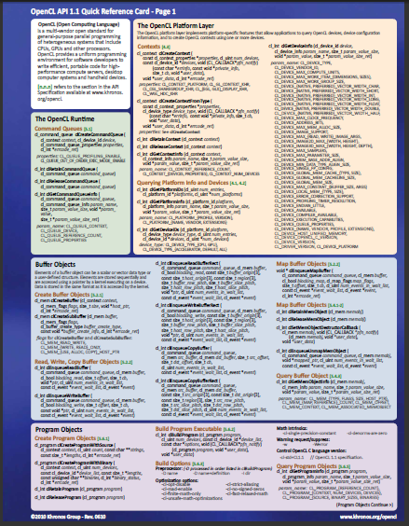
Course materials
In addition to these slides, C++ API header files, a set of exercises, and solutions, it is useful to have:
OpenCL 1.1 Reference Card
This card will help you keep track of the API as you do the exercises:
https://www.khronos.org/files/opencl-1-1-quick-reference-card.pdf
The v1.1 spec is also very readable and recommended to have on-hand:
https://www.khronos.org/registry/cl/specs/opencl-1.1.pdf

Slide 31
Important OpenCL concepts
Lecture 3

Slide 32
OpenCL Platform Model
…
…
…
…
…
…
…
Processing Element
…
…
Host
…
…
…
…
…
…
Compute Unit
OpenCL Device
One Host and one or more OpenCL Devices
  Each OpenCL Device is composed of one or more
  Compute Units
  Each Compute Unit is divided into one or more Processing Elements
Memory divided into host memory and device memory

Slide 33
The BIG idea behind OpenCL
Replace loops with functions (a kernel) executing at each point in a problem domain
  E.g., process a 1024x1024 image with one kernel invocation per pixel or 1024x1024=1,048,576 kernel executions
Traditional loops
Data Parallel OpenCL
void
mul(const int n,
const float *a,
const float *b,
float *c)
{
int i;
for (i = 0; i < n; i++)
c[i] = a[i] * b[i];
}
__kernel void
mul(__global const float *a,
__global const float *b,
__global float *c)
{
int id = get_global_id(0);
c[id] = a[id] * b[id];
}
// many instances of the kernel,
// called work-items, execute
// in parallel

Slide 34

An N-dimensional domain of work-items
Global Dimensions:
  1024x1024 (whole problem space)
Local Dimensions:
  128x128 (work-group, executes together)
1024
Synchronization between work-items possible only within work-groups:
barriers and memory fences
1024
Cannot synchronize between work-groups within a kernel
Choose the dimensions that are “best” for your algorithm

Slide 35
OpenCL N Dimensional Range (NDRange)
The problem we want to compute should have some dimensionality;
  For example, compute a kernel on all points in a cube
When we execute the kernel we specify up to 3 dimensions
We also specify the total problem size in each dimension – this is called the global size
We associate each point in the iteration space with a work-item

Slide 36
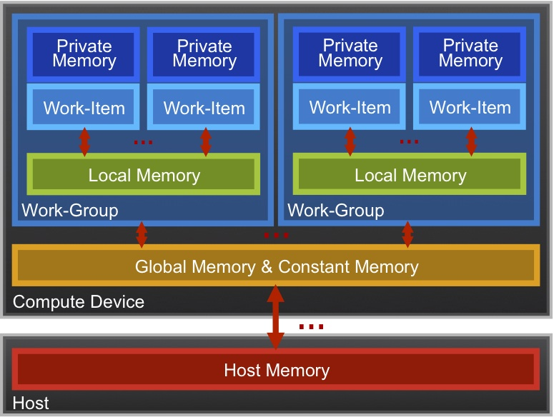
OpenCL Memory model
Private Memory
  Per work-item
Local Memory
  Shared within a
work-group
Global Memory /Constant Memory
  Visible to all
work-groups
Host memory
  On the CPU
Memory management is explicit:
You are responsible for moving data from
host → global → local and back

Slide 37

Context and Command-Queues
Context:
  The environment within which kernels execute and in which synchronization and memory management is defined.
The context includes:
  One or more devices
  Device memory
  One or more command-queues
All commands for a device (kernel execution, synchronization, and memory transfer operations) are submitted through a command-queue.
Each command-queue points to a single device within a context.
Device
Device Memory
Queue
Context

Slide 38
Execution model (kernels)
OpenCL execution model … define a problem domain and execute an instance of a kernel for each point in the domain
__kernel void times_two(
__global float* input,
__global float* output)
{
int i = get_global_id(0);
output[i] = 2.0f * input[i];
}
get_global_id(0)
10
Input
0 | 1 | 2 | 3 | 4 | 5 | 6 | 7 | 8 | 9 | 10 | 11 | 12 | 13 | 14 | 15 | 16 | 17 | 18 | 19 | 20 | 21 | 22 | 23 | 24 | 25
Output
0 | 2 | 4 | 6 | 8 | 10 | 12 | 14 | 16 | 18 | 20 | 22 | 24 | 26 | 28 | 30 | 32 | 34 | 36 | 38 | 40 | 42 | 44 | 46 | 48 | 50

Slide 39
Building Program Objects
The program object encapsulates:
  A context
  The program kernel source or binary
  List of target devices and build options
The C API build process to create a program object:
  clCreateProgramWithSource()
  clCreateProgramWithBinary()
OpenCL uses runtime compilation … because in general you don’t know the details of the target device when you ship the program
__kernel void
horizontal_reflect(read_only image2d_t src,
write_only image2d_t dst)
{
int x = get_global_id(0); // x-coord
int y = get_global_id(1); // y-coord
int width = get_image_width(src);
float4 src_val = read_imagef(src, sampler,
(int2)(width-1-x, y));
write_imagef(dst, (int2)(x, y), src_val);
}
GPU
code
Compile for GPU
Compile for CPU
CPU
code

Slide 40
Example: vector addition
The “hello world” program of data parallel programming is a program to add two vectors
C[i] = A[i] + B[i] for i=0 to N-1
For the OpenCL solution, there are two parts
  Kernel code
  Host code

Slide 41
Vector Addition - Kernel
__kernel void vadd(__global const float *a,
__global const float *b,
__global float *c)
{
int gid = get_global_id(0);
c[gid] = a[gid] + b[gid];
}

Slide 42
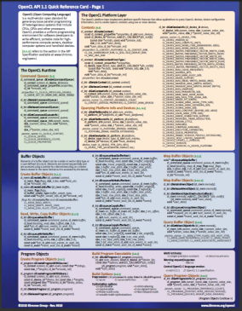
Vector Addition – Host
The host program is the code that runs on the host to:
  Setup the environment for the OpenCL program
  Create and manage kernels
5 simple steps in a basic host program:
  Define the platform … platform = devices+context+queues
  Create and Build the program (dynamic library for kernels)
  Setup memory objects
  Define the kernel (attach arguments to kernel functions)
  Submit commands … transfer memory objects and execute kernels
As we go over the next set of slides, cross reference content on the slides to the reference card. This will help you get used to the reference card and how to pull information from the card and express it in code.

Slide 43
The basic platform and runtime APIs in OpenCL (using C)
CPU
GPU
Context
Programs
Kernels
Memory Objects
Command Queues
Programs
dp_mul
Buffers
Images
__kernel void
dp_mul(global const float *a,
global const float *b,
global float *c)
{
int id = get_global_id(0);
c[id] = a[id] * b[id];
}
dp_mul
CPU program binary
arg [0] value
In
Order
Queue
Out of
Order
Queue
arg [0] value
In
Order
Queue
Out of
Order
Queue
arg[0] value
arg [1] value
arg [1] value
dp_mul
GPU program binary
arg[1] value
arg [2] value
arg [2] value
arg[2] value
GPU
Compute Device

Slide 44
1. Define the platform
Use PyOpenCL to manage devices from Python
  import pyopencl
In interactive mode one can immediately create a context:
  ctx = pyopencl.create_some_context()
Create a simple command-queue to feed our device:
queue = pyopencl.CommandQueue(ctx)
Inspect the device:
device = ctx.devices[0]
platform = device.platform
print(dir(device),dir(platform))

Slide 45
Command-Queues
Commands include:
  Kernel executions
  Memory object management
  Synchronization
The only way to submit commands to a device is through a command-queue.
Each command-queue points to a single device within a context.
Multiple command-queues can feed a single device.
  Used to define independent streams of commands that don’t require synchronization
CPU
GPU
Queue
Queue
Context

Slide 46

Command-Queue execution details
Command queues can be configured in different ways to control how commands execute
In-order queues:
  Commands are enqueued and complete in the order they appear in the program (program-order)
Out-of-order queues:
  Commands are enqueued in program-order but can execute (and hence complete) in any order.
Execution of commands in the command-queue are guaranteed to be completed at synchronization points
  Discussed later
CPU
GPU
Queue
Queue
Context

Slide 47
2. Create and Build the program
Define source code for the kernel-program as a string literal (great for toy programs) or read from a file (for real applications).
src = '''__kernel void vadd(__global const float *a,
__global const float *b,
__global float *c)
{
int gid = get_global_id(0);
c[gid] = a[gid] + b[gid]; }'''
Build the program object:
prg = pyopencl.Program(ctx, src)
Compile the program to create a “dynamic library” from which specific kernels can be pulled:
prg = prg.build()

Slide 48
Error messages
Fetch and print error messages:
if (err != CL_SUCCESS) {
size_t len;
char buffer[2048];
clGetProgramBuildInfo(program, device_id,
CL_PROGRAM_BUILD_LOG, sizeof(buffer), buffer, &len);
printf(“%s\n”, buffer);
}
Important to do check all your OpenCL API error messages!
Easier in C++ with try/catch (see later)

Slide 49
3. Setup Memory Objects
For vector addition we need 3 memory objects, one each for input vectors A and B, and one for the output vector C.
Create input vectors and assign values on the host:
import numpy
h_a = numpy.random.random(LENGTH).astype(numpy.float32)
h_b = numpy.random.random(LENGTH).astype(numpy.float32)
h_c = numpy.empty((LENGTH,),dtype=numpy.float32)
Define OpenCL memory objects:
import pyopencl.array
d_a = pyopencl.array.to_device(queue , h_a)
d_b = pyopencl.array.to_device(queue , h_b)
d_c = pyopencl.array.empty(queue,(LENGTH,), dtype='float32')

Slide 50
What do we put in device memory?
Memory Objects:
A handle to a reference-counted region of global memory.
There are two kinds of memory object
Buffer object:
  Defines a linear collection of bytes (“just a C array”).
  The contents of buffer objects are fully exposed within kernels and can be accessed using pointers
Image object:
  Defines a two- or three-dimensional region of memory.
  Image data can only be accessed with read and write functions, i.e. these are opaque data structures. The read functions use a sampler.
Used when interfacing with a graphics API such as OpenGL. We won’t use image objects in this tutorial.

Slide 51
Creating and manipulating buffers
Buffers are declared on the host as type: cl_mem
Arrays in host memory hold your original host-side data:
float h_a[LENGTH], h_b[LENGTH];
Create the buffer (d_a), assign sizeof(float)*count bytes from “h_a” to the buffer and copy it into device memory:
cl_mem d_a = clCreateBuffer(context,
CL_MEM_READ_ONLY | CL_MEM_COPY_HOST_PTR,
sizeof(float)*count, h_a, NULL);

Slide 52
Conventions for naming buffers
It can get confusing about whether a host variable is just a regular C array or an OpenCL buffer
A useful convention is to prefix the names of your regular host C arrays with “h_” and your OpenCL buffers which will live on the device with “d_”

Slide 53
Creating and manipulating buffers
Buffers are declared on the host as type: cl_mem
Arrays in host memory hold your original host-side data:
float h_a[LENGTH], h_b[LENGTH];
Create the buffer (d_a), assign sizeof(float)*count bytes from “h_a” to the buffer and copy it into device memory:
cl_mem d_a = clCreateBuffer(context,
CL_MEM_READ_ONLY | CL_MEM_COPY_HOST_PTR,
sizeof(float)*count, h_a, NULL);

Slide 54
4. Define the kernel
Create kernel object from the kernel function “vadd”:
kernel = clCreateKernel(program, “vadd”, &err);
Attach arguments of the kernel function “vadd” to memory objects:
err = clSetKernelArg(kernel, 0, sizeof(cl_mem), &d_a);
err |= clSetKernelArg(kernel, 1, sizeof(cl_mem), &d_b);
err |= clSetKernelArg(kernel, 2, sizeof(cl_mem), &d_c);
err |= clSetKernelArg(kernel, 3, sizeof(unsigned int), &count);

Slide 55
5. Enqueue commands
Write Buffers from host into global memory (as non-blocking operations):
err = clEnqueueWriteBuffer(commands, d_a, CL_FALSE,
0, sizeof(float)*count, h_a, 0, NULL, NULL);
err = clEnqueueWriteBuffer(commands, d_b, CL_FALSE,
0, sizeof(float)*count, h_b, 0, NULL, NULL);
Enqueue the kernel for execution (note: in-order so OK):
err = clEnqueueNDRangeKernel(commands, kernel, 1,
NULL, &global, &local, 0, NULL, NULL);

Slide 56
5. Enqueue commands
Write Buffers from host into global memory (as non-blocking operations):
err = clEnqueueWriteBuffer(commands, d_a, CL_FALSE,
0, sizeof(float)*count, h_a, 0, NULL, NULL);
err = clEnqueueWriteBuffer(commands, d_b, CL_FALSE,
0, sizeof(float)*count, h_b, 0, NULL, NULL);
Enqueue the kernel for execution (note: in-order so OK):
err = clEnqueueNDRangeKernel(commands, kernel, 1,
NULL, &global, &local, 0, NULL, NULL);

Slide 57
Exercise 2: Running the Vadd kernel
Goal:
  To inspect and verify that you can run an OpenCL kernel
Procedure:
  Take the provided Vadd program. It will run a simple kernel to add two vectors together.
  Look at the host code and identify the API calls in the host code. Compare them against the API descriptions on the OpenCL reference card.
  There are some helper files which time the execution, output device information neatly and check errors.
Expected output:
  A message verifying that the vector addition completed successfully

Slide 58
N = 1024
# create context, queue and program
context = cl.create_some_context()
queue = cl.CommandQueue(context)
kernelsource = open(‘vadd.cl’).read()
program = cl.Program(context, kernelsource).build()
# create host arrays
h_a = numpy.random.rand(N).astype(float32)
h_b = numpy.random.rand(N).astype(float32)
h_c = numpy.empty(N).astype(float32)
# create device buffers
mf = cl.mem_flags
d_a = cl.Buffer(context, mf.READ_ONLY | mf.COPY_HOST_PTR, hostbuf=h_a)
d_b = cl.Buffer(context, mf.READ_ONLY | mf.COPY_HOST_PTR, hostbuf=h_b)
d_c = cl.Buffer(context, mf.WRITE_ONLY, h_c.nbytes)
# run kernel
vadd = program.vadd
vadd.set_scalar_arg_dtypes([None, None, None, numpy.uint32])
vadd(queue, h_a.shape, None, d_a, d_b, d_c, N)
# return results
cl.enqueue_copy(queue, h_c, d_c)
assert h_a+h_b == h_c

