Slide 1
Parallax
A journey in sensor physics
Jérôme Kieffer
ADA-group

Slide 2
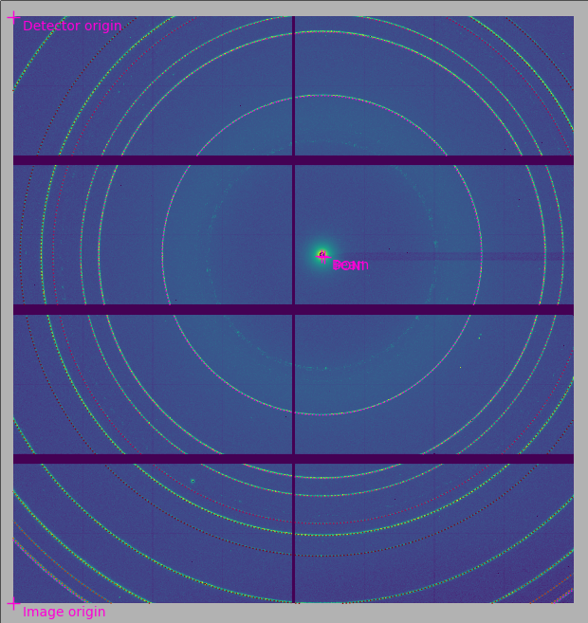
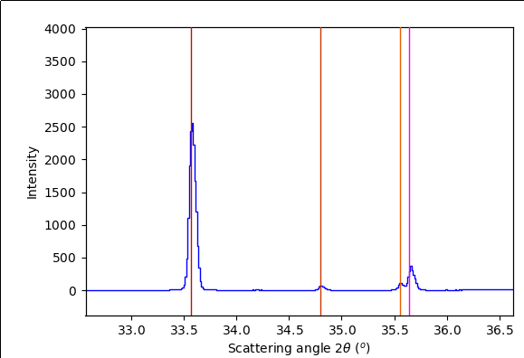
Effect on ID13
Eiger 4M detector 75µm pixel size
Silicon sensor 450µm thick
Sample : alpha Al2O3 @13,4keV

Slide 3
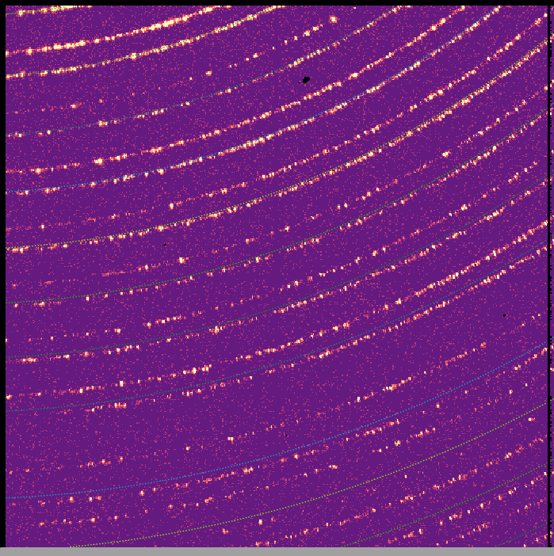
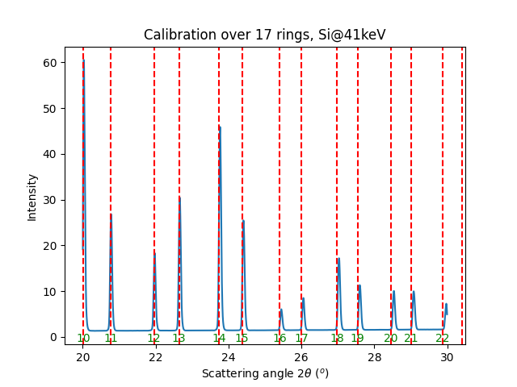
Effect on ID11
Eiger2 4M detector, 75µm pixel size
CdTe sensor 750µm,
sample: Si@41keV

Slide 4
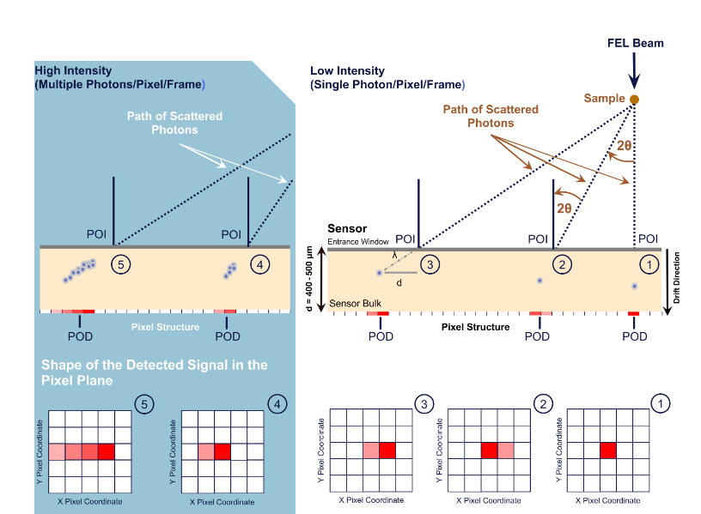
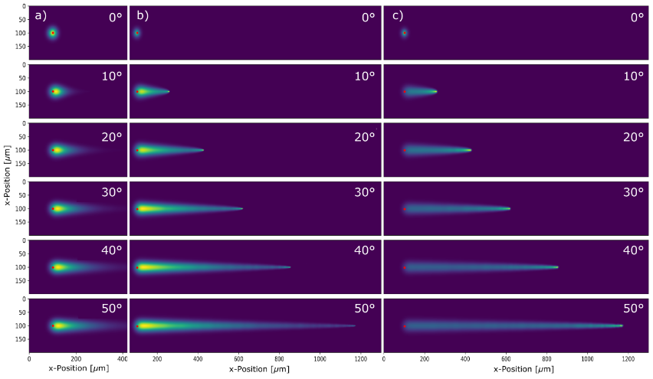
Parallax in photon detection
8 keV
12 keV
20 keV
doi:10.1088/1742-6596/3010/1/012135

Slide 5
Thick sensor approximation
    All photons are caught
    Does not depend on the sensor thickness !
α
Air
POI
Sensor
x
z
https://doi.org/10.1107/S2053273321007506

Slide 6
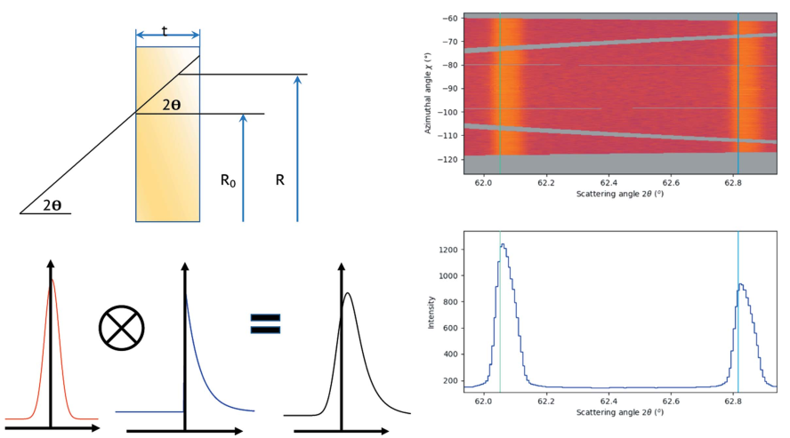
Thin-sensor convoluted with beam profile
http://www.silx.org/doc/pyFAI/dev/usage/tutorial/ThickDetector/Parallax_model.html

Slide 7
Thin-sensor without beam profile
Beer-Lambert
α
POI
Ep = e
x
z

Slide 8
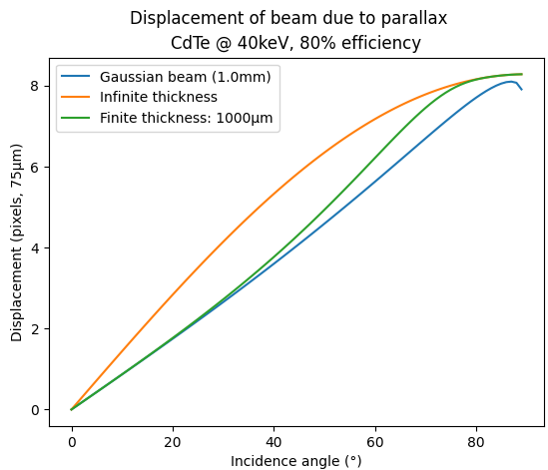
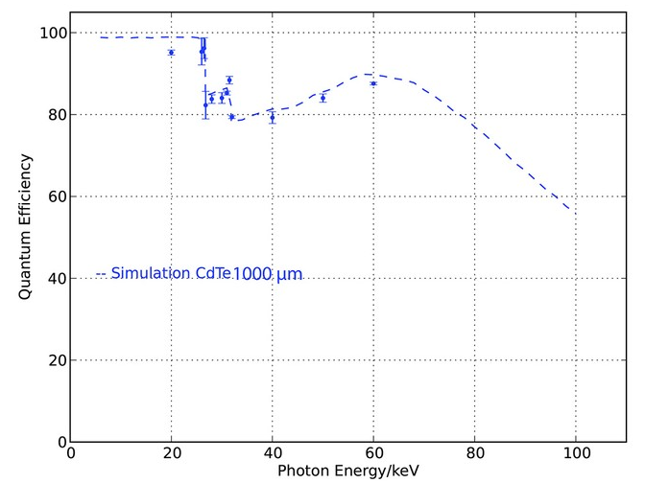
Comparison of models:
80
Dectris advertisement for CdTe Pilatus :
http://dx.doi.org/10.1017/S0885715617001191

Slide 9
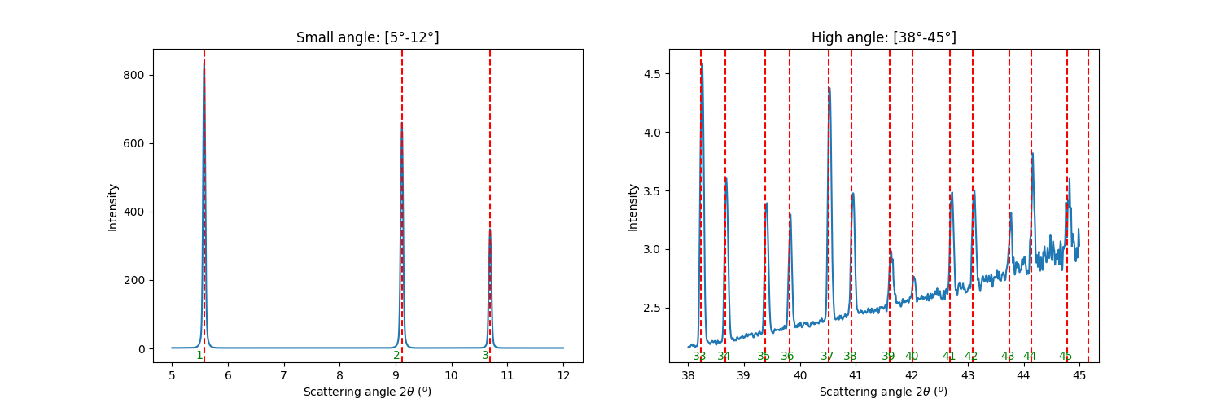
Calibration with parallax correction
Data from ID11,
Eiger2 CdTe 4M, 750µm
Si sample @41keV
Calibration on ring 1→35
Possible from dev’ version of pyFAI
(2025-09) and only in notebook version

Slide 10
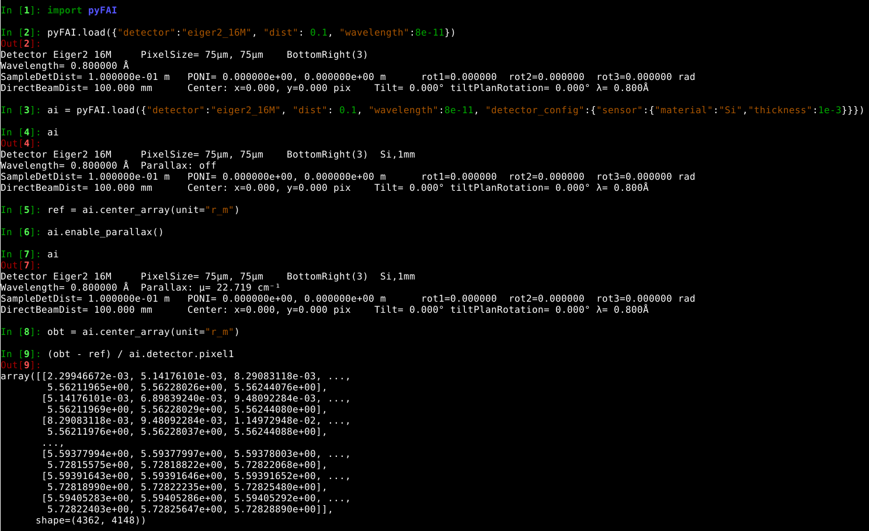
Usage in pyFAI

