Slide 1
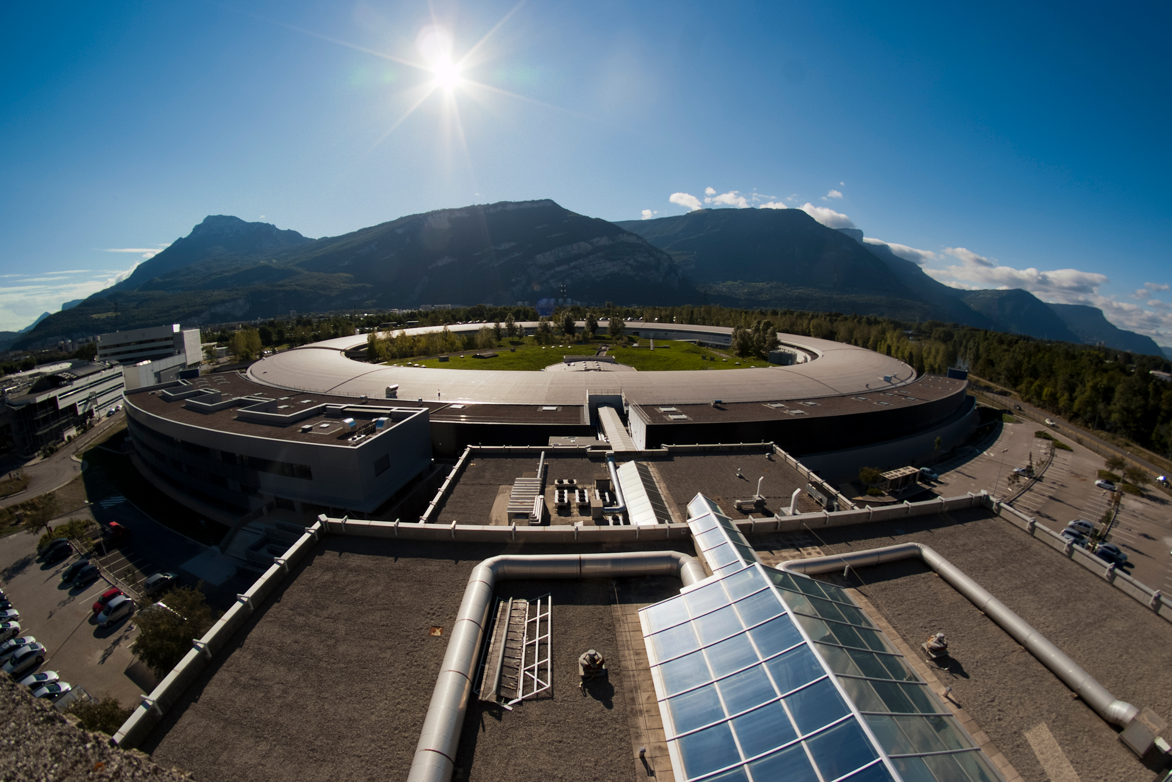
Parallax:
A journey in sensor physics
J. Kieffer, G. Lotze, V. Poline, M. Ruat, P-A Douissard, …

Slide 2
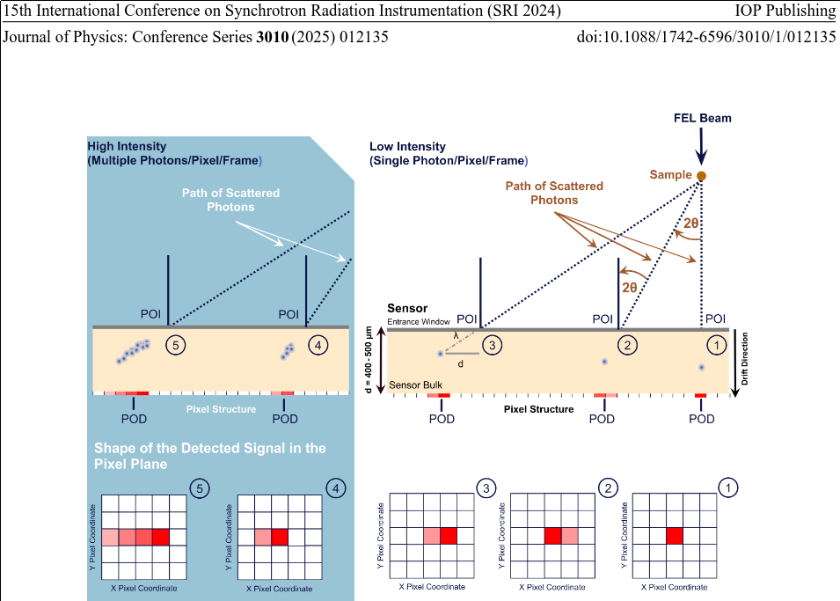
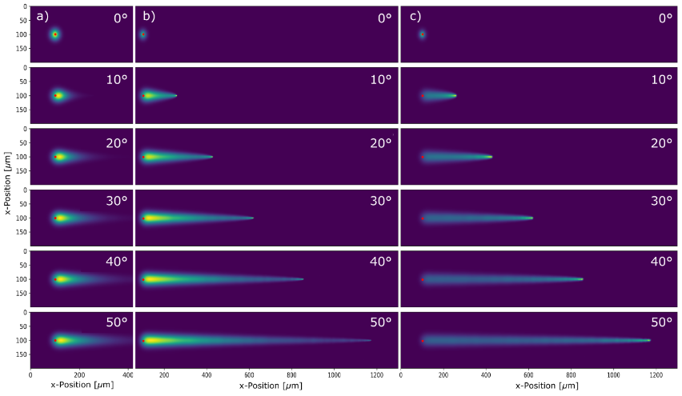
Parallax in photon detection
Parallax in detectors has several effects:
Decrease of signal intensity
Peak broadening at larger q-values
Peak shift to higher q-value
Flatfield
Beer–Lambert law:
Fitted in Rietveld refinement
Compensated by energy change
in calibration
Silicon sensor at:
8 keV
12 keV
20 keV
On the Influence of Parallax Effects in Thick Silicon
Sensors in Coherent Diffraction Imaging
doi:10.1088/1742-6596/3010/1/012135

Slide 3
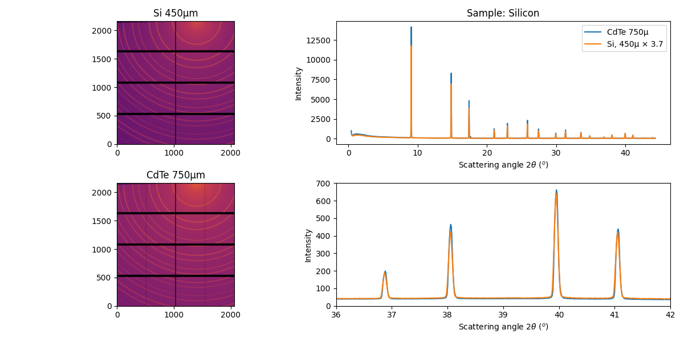
Experimental observation at D2AM (ESRF-BM02)
Eiger 4M detector 75µm pixel size with Si (450µm) or CdTe (750µm) sensor
Sample: Silicon (SRM640) and CeO2 (SRM674) @ 25 keV
Silicon sensor 450µm thickness: µ= 6,87 cm⁻¹ ; η = 27%
CdTe sensor 750µm thickness: µ= 75 cm⁻¹ ; η = 99%
3.7x intensity
Profile through images
No displacement !

Slide 4
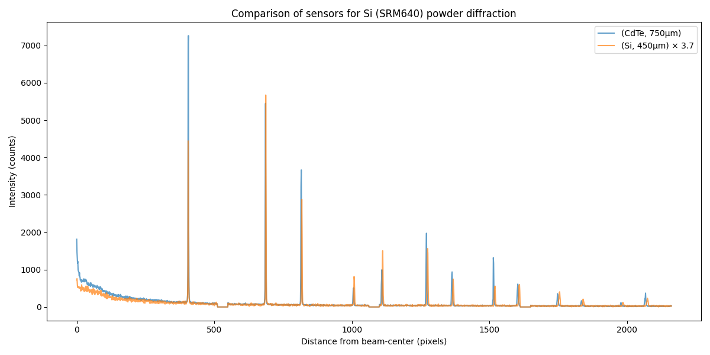
Profile through the image: without calibration
No displacement
Large displacement !

Slide 5
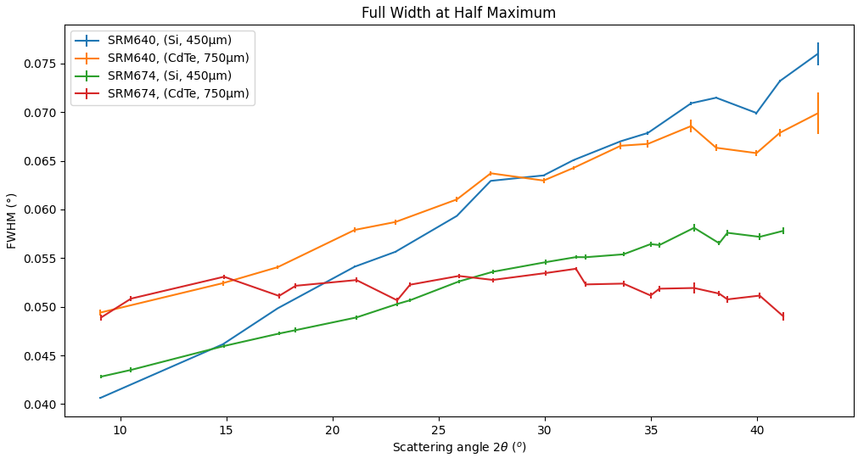
Evolution of the peak-width

Slide 6
Simulation of the parallax effect:
Ray-tracing

Slide 7
Ray-tracing of absorption in pixel depth
Sample
Pixels:
  A→Length→Deposited energy
  B→Length→Deposited energy
  C→Length→Deposited energy
Throw thousands of rays per pixel
Build a (sparse) matrix with for each input pixel
provides the contribution to output pixels
  Similar to a convolution but where the the kernel size
  changes from pixel to pixel
  Matrix construction takes seconds to minutes
Possible to invert the effect using iterative methods
  Using scipy.sparse.linalg.lsmr
  MLEM for poissonian data.
Not taking into account the integrating/counting nature of the detector
A
B
C
Ray
⚠ artifacts

Slide 8
Practically:
Load a geometry and create integrators with & without parallax correction:
import pyFAI, copy
ai = pyFAI.load(“geometry.poni”)
ai.enable_parallax(True, "Si", 450e-6)
ai_np = copy.deepcopy(ai)
ai_np.enable_parallax(False)
Create a calibrant:
from pyFAI import calibrant
si = pyFAI.calibrant.get_calibrant(“Si”)
si.wavelength = ai.wavelength
Simulate a powder diffraction image:
fake_img = si.fake_calibration_image(ai_np)
Perform the raytracing for the detector:
from pyFAI.ext.parallax_raytracing import Raytracing
from scipy.sparse import csc_array
rt_si = Raytracing(ai)
sparse_si = csc_array(rt_si.calc_csr(32))
Blur the image:
fake_parallax = sparse_si.dot(fake_img.ravel()).reshape(fake_img.shape)
Integrate the images and observe the effect:
res1 =ai_np.integrate1d(fake_img, **kwags)
res2 =ai_np.integrate1d(fake_parallax, **kwags)
res3 =ai.integrate1d(fake_parallax, **kwags)

Slide 9
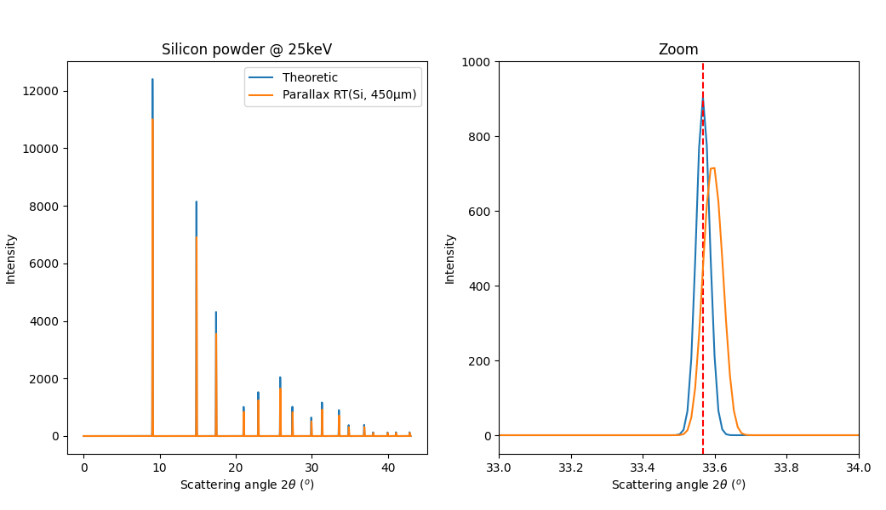
Simulation of the parallax effect using Raytracing:
https://github.com/silx-kit/pyFAI/blob/main/doc/source/usage/tutorial/ThickDetector/raytracing.ipynb

Slide 10
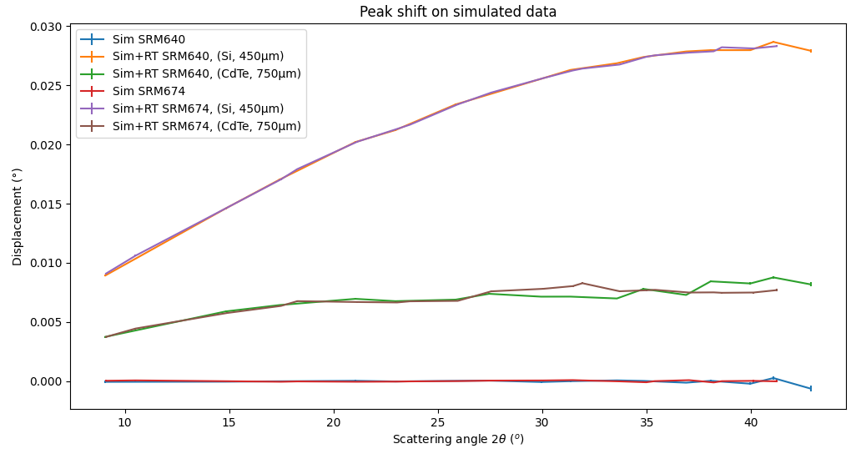
Displacement of peaks due to parallax effect:

Slide 11
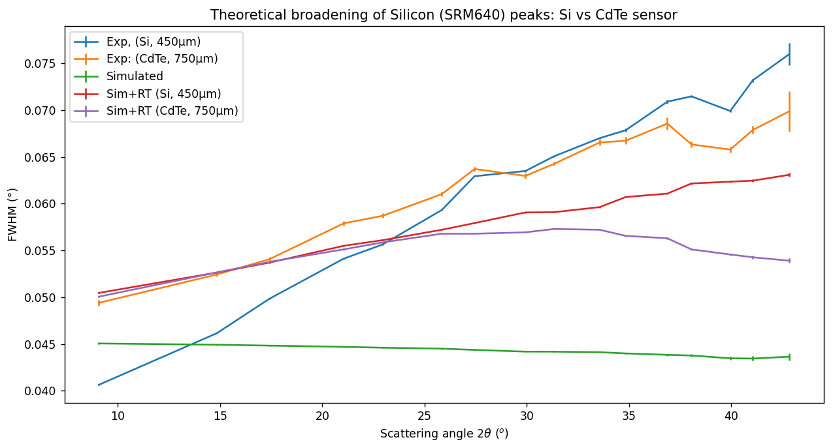
Broadening

Slide 12
Correction of the parralax effect ?
Different strategies to correct the effect:
Pseudo-inversion (LSMR, MLEM, …)
Take into account the effect in peak-position
artifacts

Slide 13
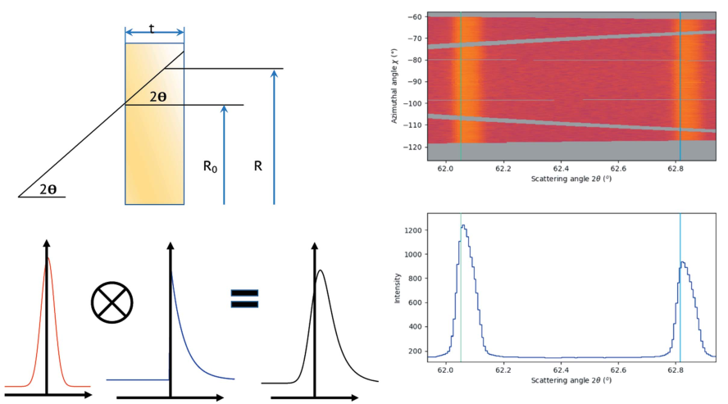
Sensor absorption convoluted with beam profile in 1d
Beam Profile
Beer-Lambert
⚠ diffracted beam not isotropic ⚠
On the resolution function for powder diffraction with area detectors
https://doi.org/10.1107/S2053273321007506
https://github.com/silx-kit/pyFAI/blob/main/doc/source/usage/tutorial/ThickDetector/Parallax_model.ipynb

Slide 14
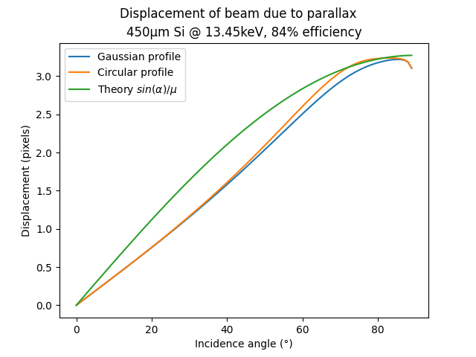
Thin-sensor convoluted with beam profile (1d), quantification
Inflection point
around 30°
Linear at lower angles
Issues:
* Requires the beam profile
* Numerical convolution
Search for a solution independent of the profile
http://www.silx.org/doc/pyFAI/dev/usage/tutorial/ThickDetector/Parallax_model.html

Slide 15
Thick sensor approximation: ⚠️ math ⚠️
Average value of an observable:
Geometrically, one has:
P(z) follows Beer-Lambert law:
Normalization:
Which leads to:
α
Air
POI
Sensor
x
z

Slide 16
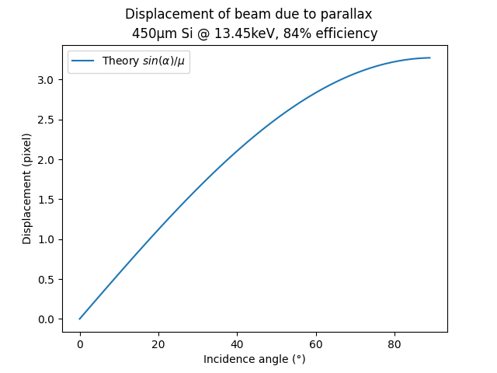
Thick-sensor model: quantification
All photons are caught
Does not depend on the sensor thickness !
Does not match observation !
→ Displacement decreases
with incident angle
No inflection point !
On the resolution function for powder diffraction with area detectors
https://doi.org/10.1107/S2053273321007506

Slide 17
Thin-sensor without beam profile: ⚠️ math ⚠️
Average value of an observable:
Geometrically, one has:
P(z) follows Beer-Lambert law:
With:
, A constant
Since we have signal,
a photon has interacted:
α
Which leads to:
POI
After integration ...
Ep = e
x
z

Slide 18
Trajectory of X-ray
α
Point of incidence
x
z
Ep = t
Sensor
Point of interaction
δx

Slide 19
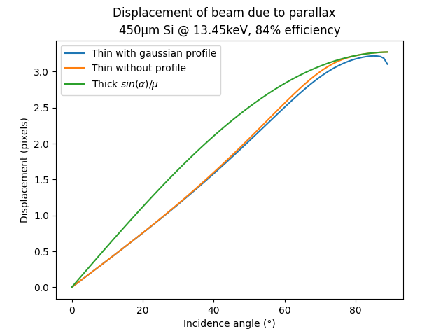
Comparison of models:
Same behavior at large angle
without numerical noise
Inflection point
around 30°
Linear at lower angles

Slide 20
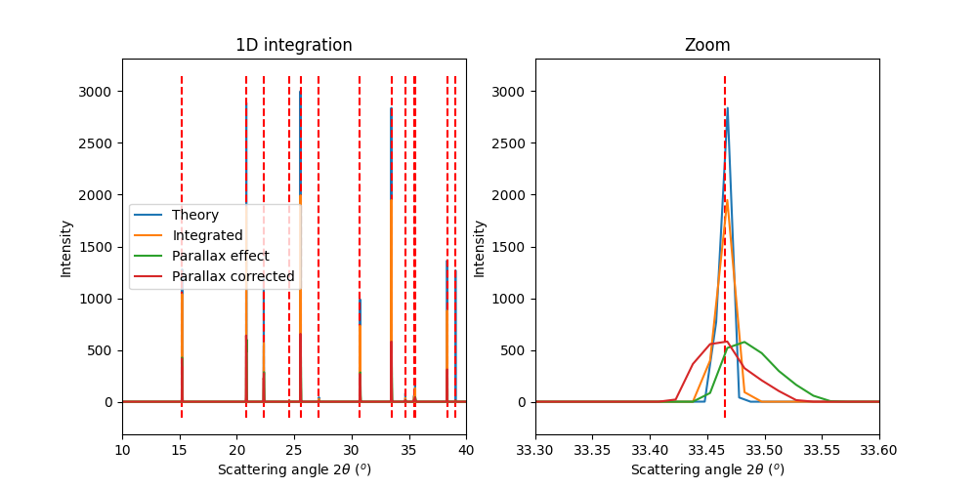
Mitigation of the parallax effect:
Implementation in geometry engine of pyFAI
Makes the geometry engine of pyFAI slower for now …
→ rough edges still present & bugs probable !

Slide 21
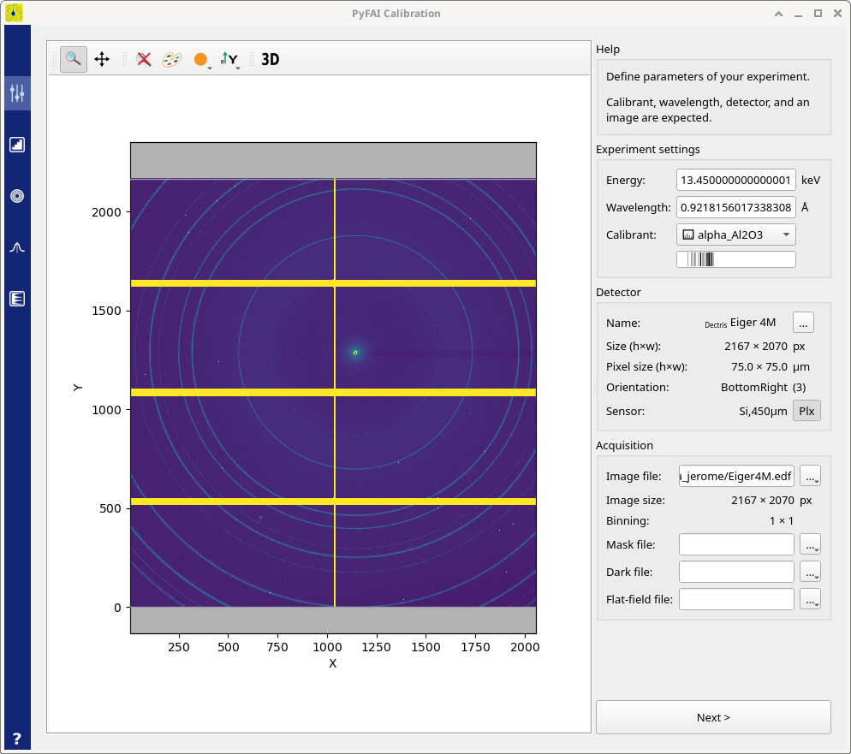
Change of PONI-file format to cope for parallax corrections
With pyFAI v2025.12+ there is a new PONI-file version:
  Version 2.1 (when the parallax is disabled, backwards compatible)
  Version 3.0 (when the parallax is enabled, backwards incompatible)
New button to activate
parallax correction
Some limitations:
Refinement does not always
converge better.
Calculation are slower for now.

Slide 22
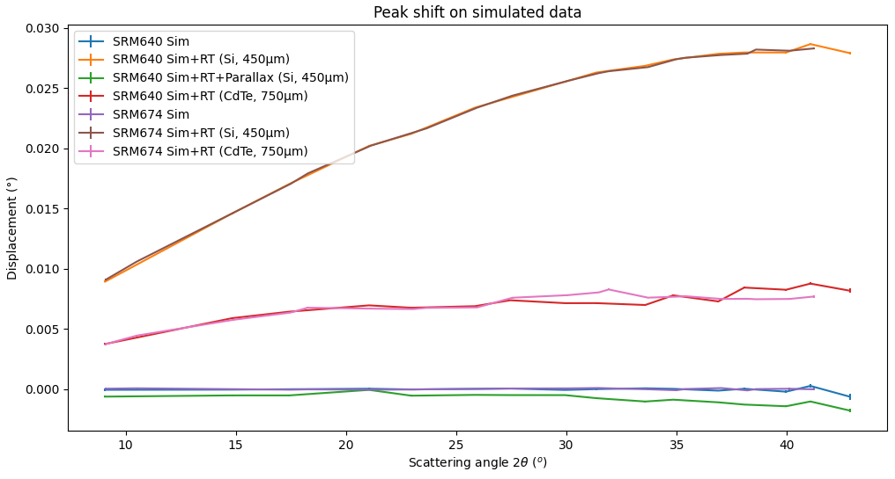
Displacement of peaks due to parallax: effect of mitigation
Decrease of the peak shift

Slide 23
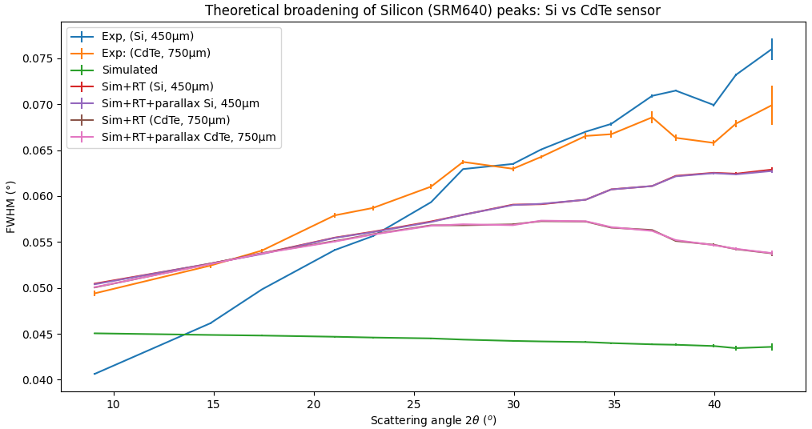
Broadening of peaks due to parallax: effect of mitigation
No broadening

Slide 24
Conclusions
PyFAI offers several ways to deal with parallax correction:
  Calculate the blurring effect via raytracing then de-smear with iterative algorithm (slow)
  Integrate the effect in the geometry engine
Sensor compositions and thickness were all tabulated:
  300 detectors !
  Thanks to:
    Help of all detector manufacturers
    Detector group (Marie & Paul-Antoine)
    Integration work by Gudrun.

Slide 25
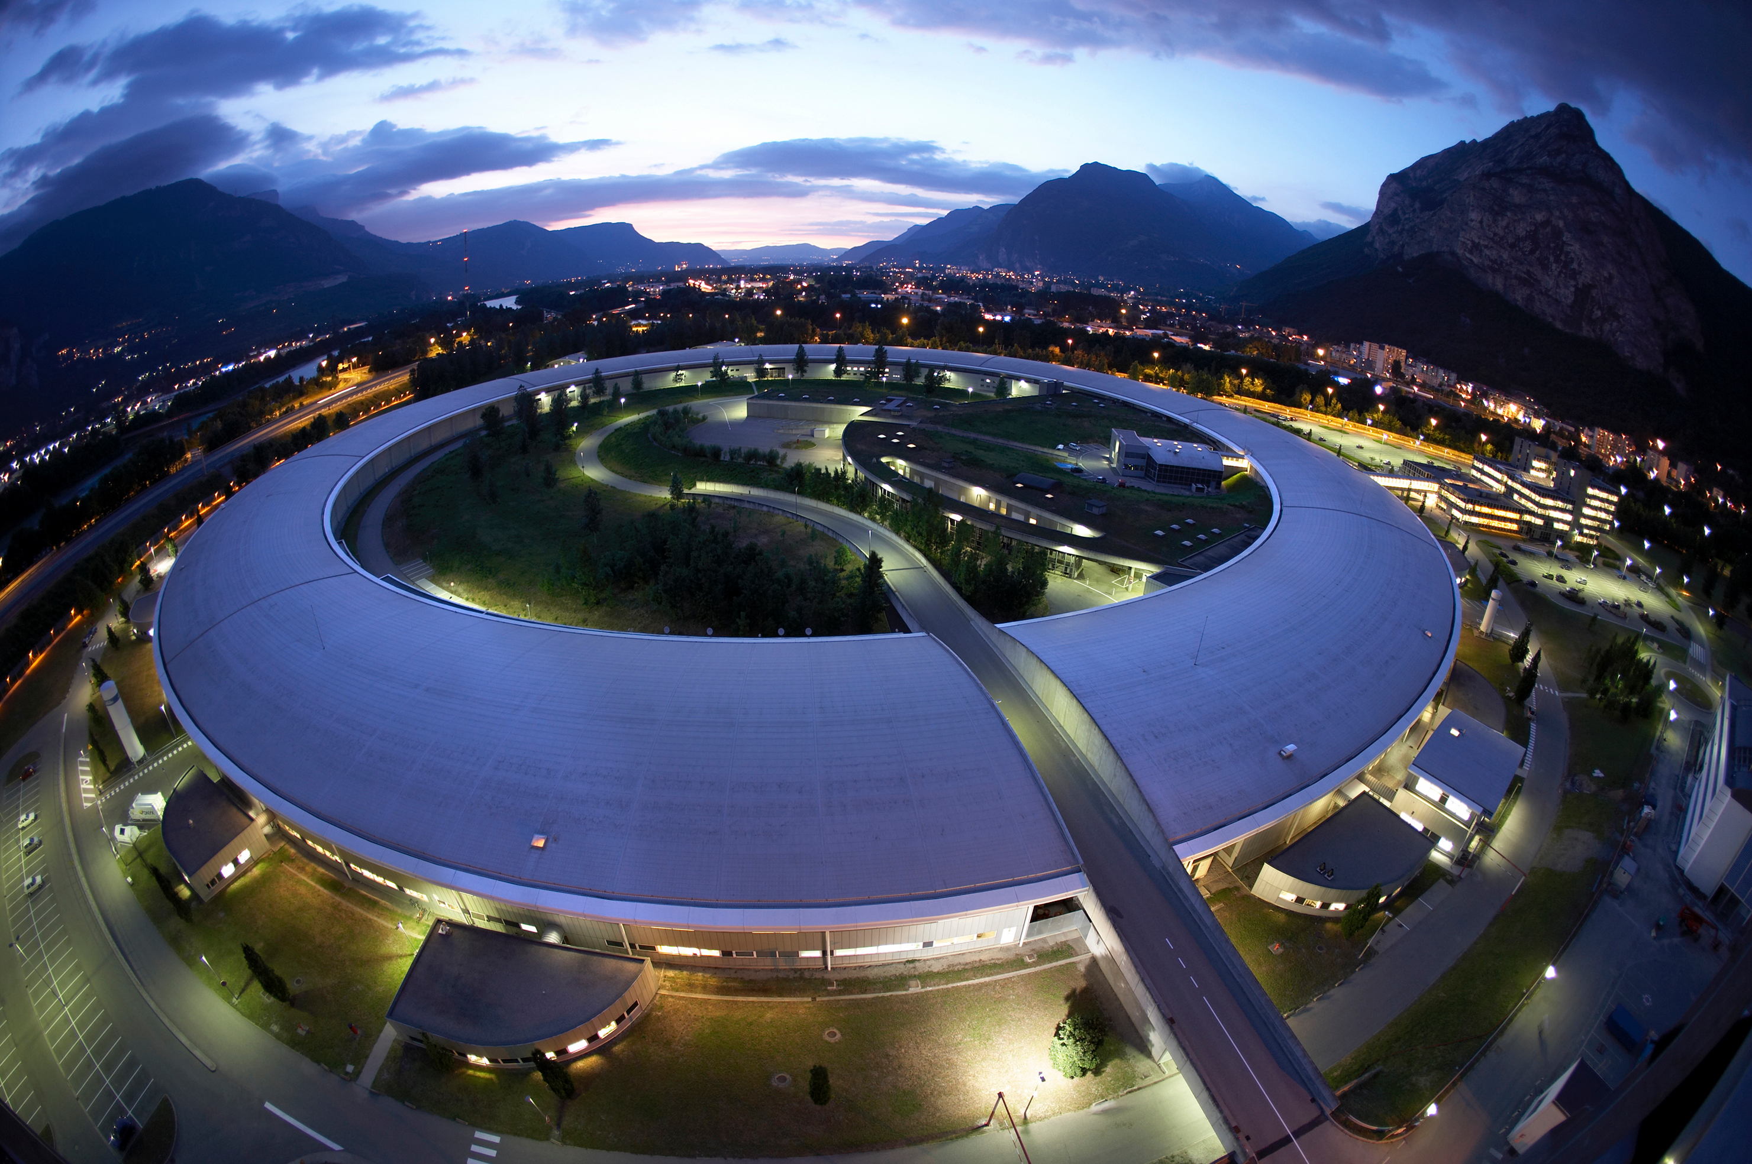
Questions ?

