Slide 1
DATA MINING PROJECT 4&5
RIJU GEORGE PHILIP – 1001224475
VINEETH XAVIER - 1001169649

Slide 2
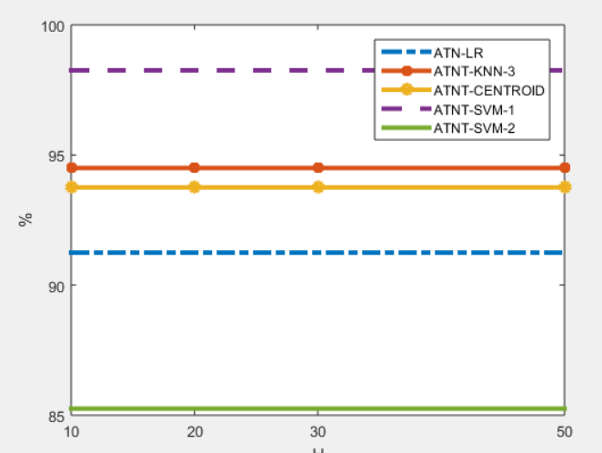
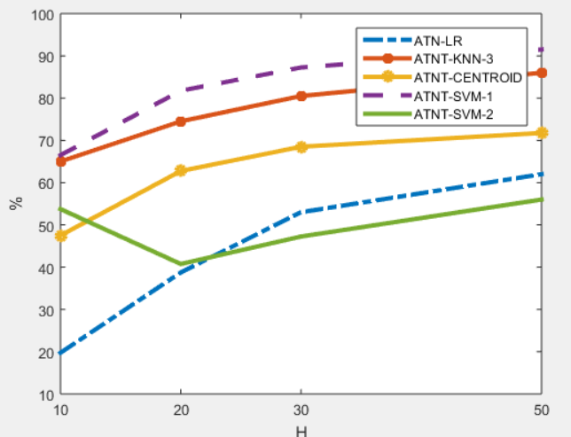
FSTATS- ATNT

Slide 3
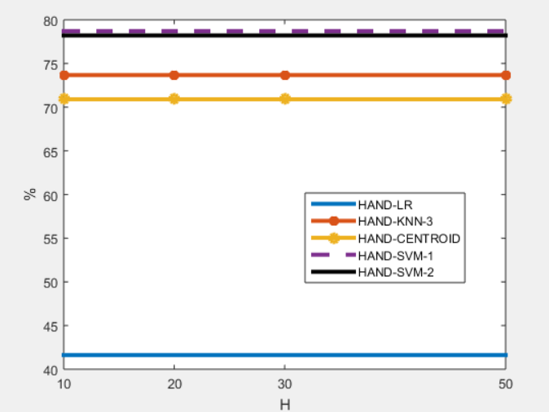
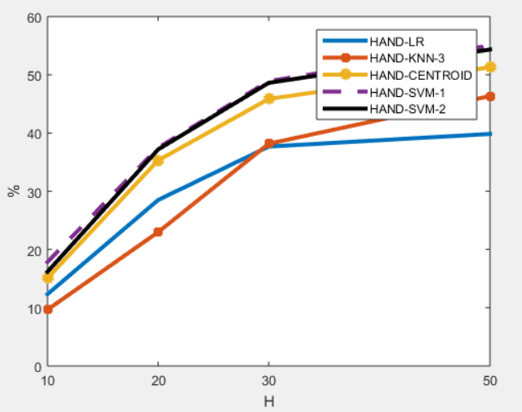
FSTATS- HANDWRITTEN

Slide 4
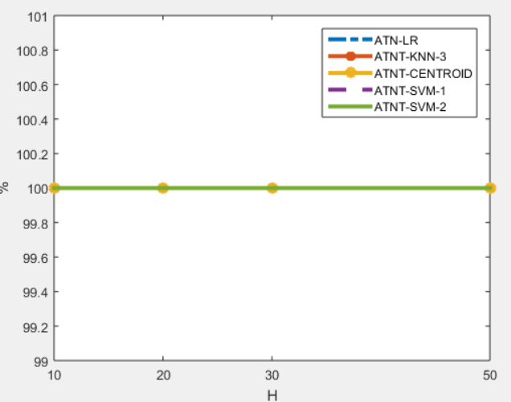
LDA- ATNT

Slide 5
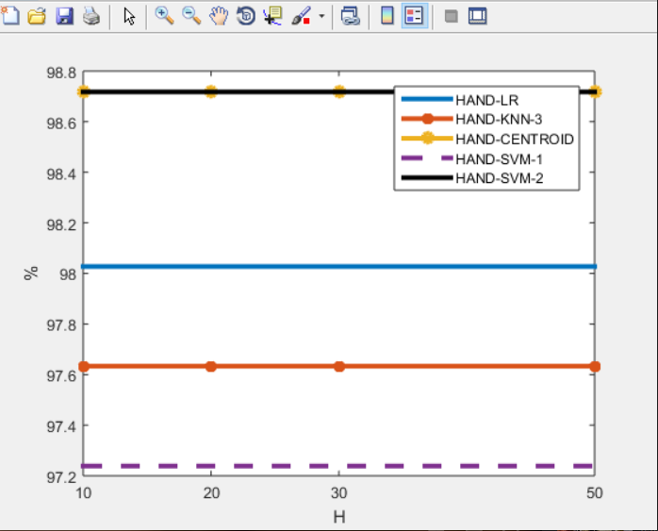
LDA- HANDWRITTEN

Slide 6
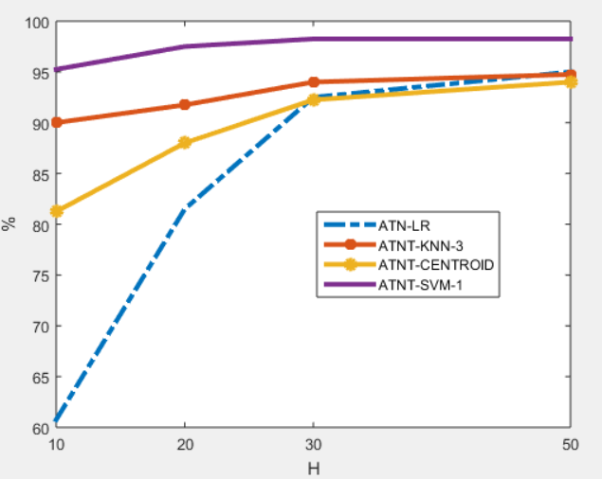
PCA- ATNT

Slide 7
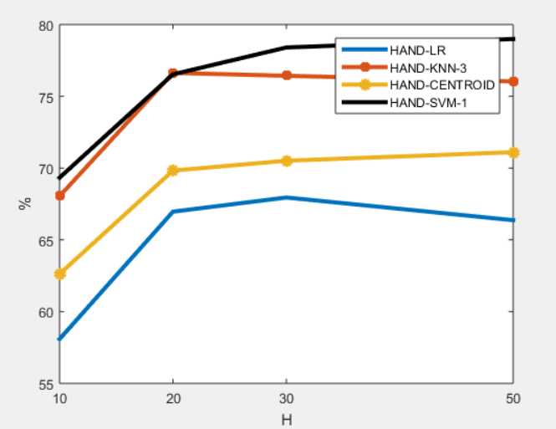
PCA- HANDWRITTEN

Slide 8
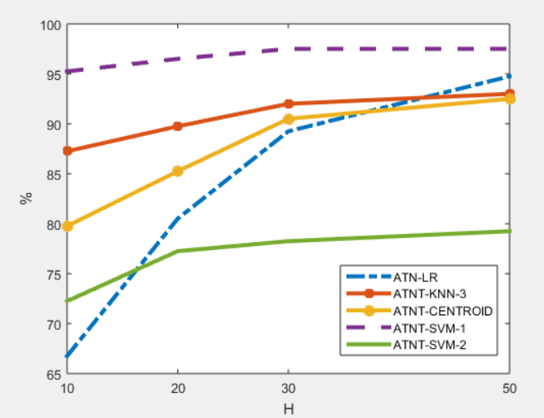
MSD- ATNT

Slide 9
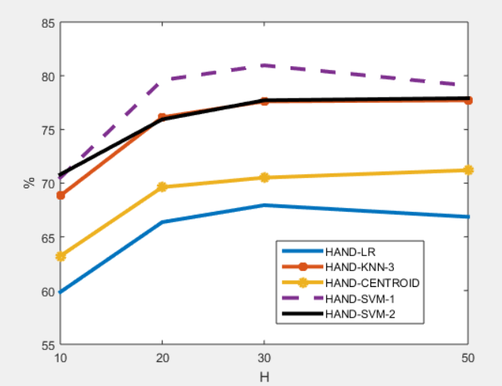
MSD- HANDWRITTEN

Slide 10
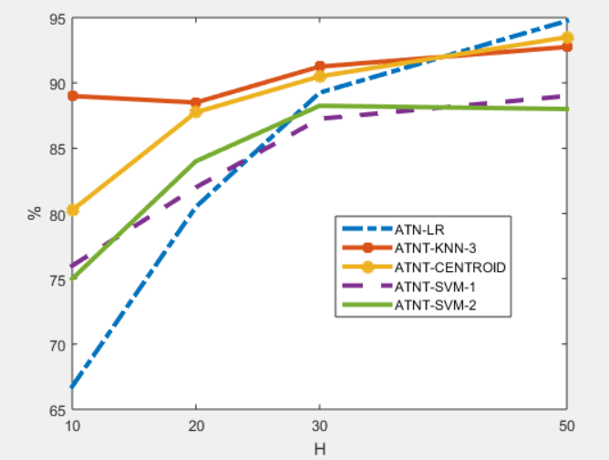
LAPLACE- ATNT

Slide 11
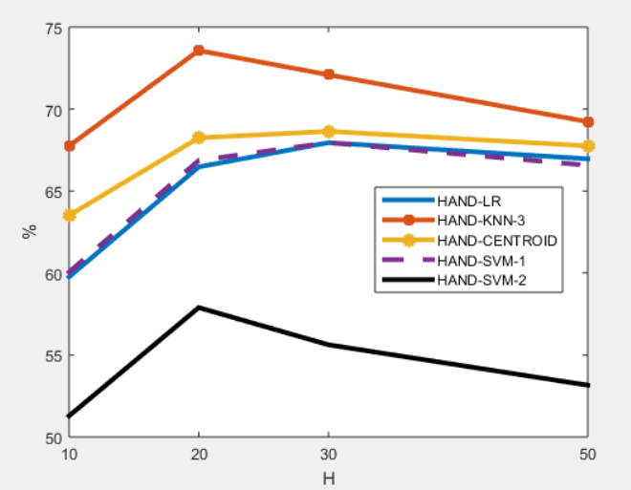
LAPLACE- HANDWRITTEN

Slide 12
Thank You

