Slide 1
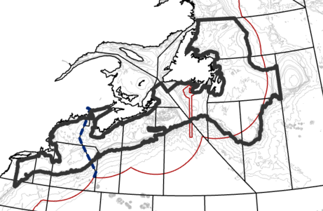
Model Input and parameterization
Data: Years 1990- 2023, Spring, Summer, Fall
NEFSC- Clipped ~-73.34 longitude by BNAM data extent
DFO Maritimes
DFO Newfoundland:
Removed winter because it was the only one with and the count was relatively low.
Included data from 3KLMNOP.
3Pn (noise with GSL) and 3L (data too sparse) not included in extrapolation grid
Extrapolation grid:
Formula:
~ season + bs(Depth, degree = 2, intercept = FALSE) + bs(Bottom temp, degree = 2, intercept = FALSE)
+ bs(Surface temp, degree = 2, intercept = FALSE)
Parameters:
Year= Factor
Season= Categorical variable
Survey=factor (using catchability formula)
Cell size for extrapolation grid ~25km2
Knots= 400
Delta-GLMM:
First: probability of presence using a binomial logistic regression with zero inflation
Second: positive catch rates (number/tow) using a zero-inflated poisson negative binomial distribution
Method: Barrier model

Slide 2
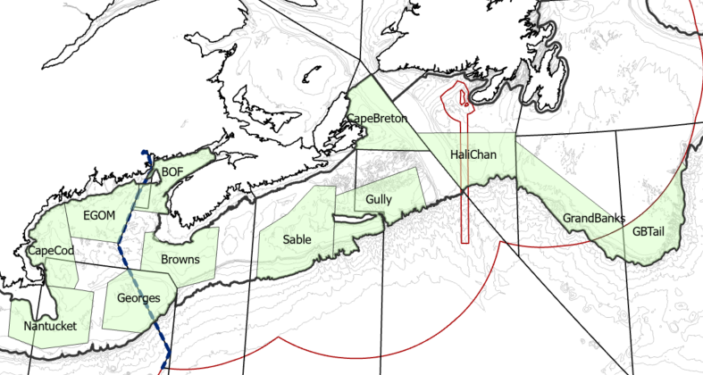
Core Areas

Slide 3
Model Parameterization
Four models of increasing complexity: Field: selects which spatial and spatiotemporal effects are allowed. Capture residual variation not explained by covariates Rho: sets the autocorrelation structure of the model, controlling temporal and spatial autocorrelation in both fixed and random effects (independent, shared, temporally correlated)
Null | Beta1=2 (Rho) Beta2=4 (Rho) | Random walk in spatial structure of fixed effects/covariates, captures drifts, and allows persistent spatial trends across years. (can reflect long-term ecological trends) AR1, autoregressive structure on yearly intercepts, to allow temporal correlation in fixed effects, and overall abundance to evolve smoothly across time, each year’s pattern is correlated with the previous.
Environmental | + Covariate data | Incorporates habitat covariates specified by formula. Covariates fully explain spatial patterns.
Spatial Enviornmenal | + Omegas=1 (Field) | Allows spatial variability in encounter probability and positive catch rates (Spatial random fields capture variation that is not explained by the fixed effects )
SpatioTemporal Spatial Environmental model | + Epsilons=1 (Field) Epsilon1=2 (Rho) Epsilon2=4 (Rho) | Field: Includes Spatiotemporal variability in encounter probability and positive catch rates in the Rho: Controls how the effects vary over time. 1= random walk describes correlation over time in spatial random effects (allowing spatial patterns to drift and/or persist from year to year) 2= Ar1 allowing spatiotemporal fields to evolve and accumulate over time through correlation, the pattern in a timeframe depends on previous time steps Covers all interactions between space and time

Slide 4
Diagnostics
Model | AIC | AUC | RMSe
Null | 31481.99 | 0.69
Env | 29035.9 | 0.79
Sp + Env | 24793.84 | 0.87
St + Sp +Env | 24346.6 | 0.88
From the sd report, t-test (Estimate / SE) flags which parameters are more likely to be statistically significant (higher values)
Beta_mean1_c : spatial structure of fixed effects
Beta_rho2_f : temporal correlation in fixed effects, each year’s pattern is correlated with the previous
L_omega1_z : probability of presence, spatial correlation between observations
L_omega2_z : positive catch rates, spatial correlation between observations
L_epsilon1_z : Spatiotemporal variation in probability of presence
L_epsilon2_z : Spatiotemporal variation in positive catch rates
Gamma1_cp (5) : first spline Bottom Temp
Gamma2_cp (8) : second spline ST
Logkappa1 : Range: spatial correlation becomes small at 280km
Logkappa2 : Decay: correlation decreases faster at 55km
= √8 3
​exp(logκ)
Notes:
Gamma
Spring is in the intercept of the model 1= summer, 2=fall, ¾= 5/6, 7/8

Slide 5
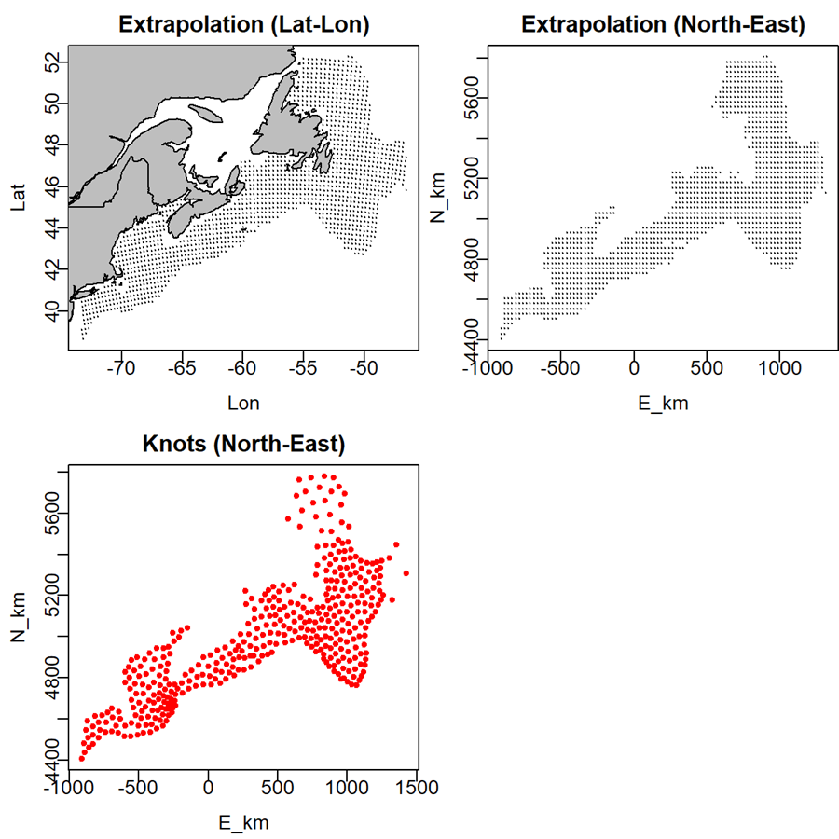
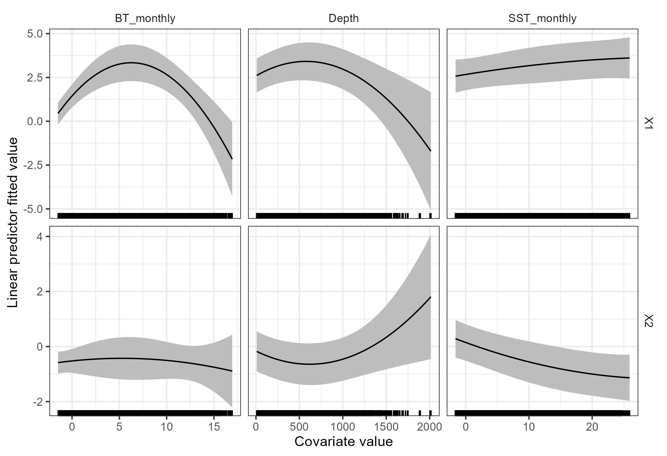
Diagnostics
Co-variate effects (SPST model)
Notes:
Depth was maxed at 1300, why does it have up to 2000 here ( first check a summary on the model data

Slide 6
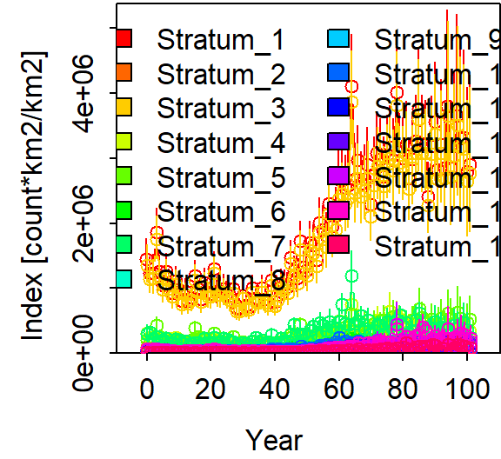
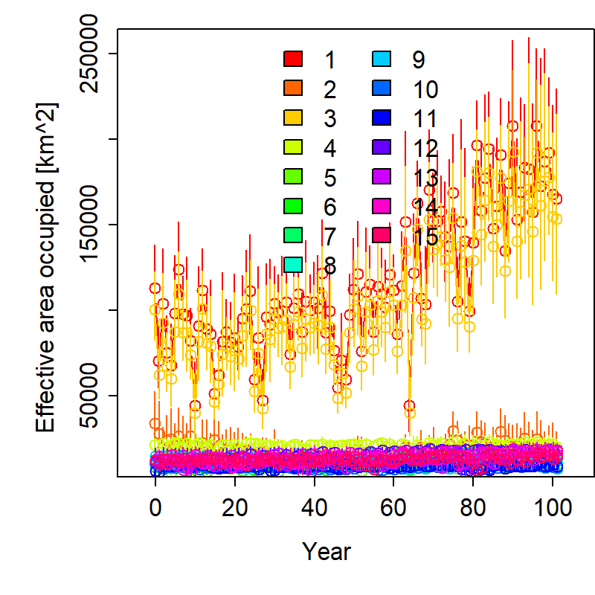
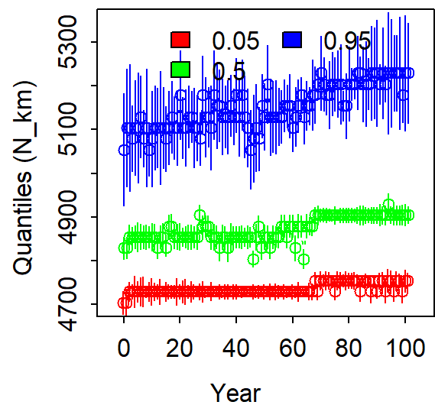
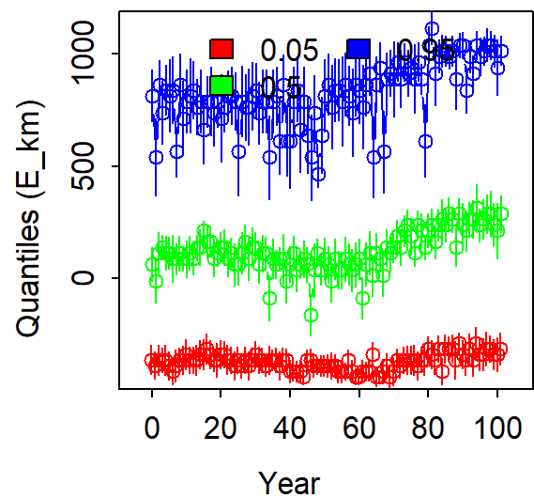
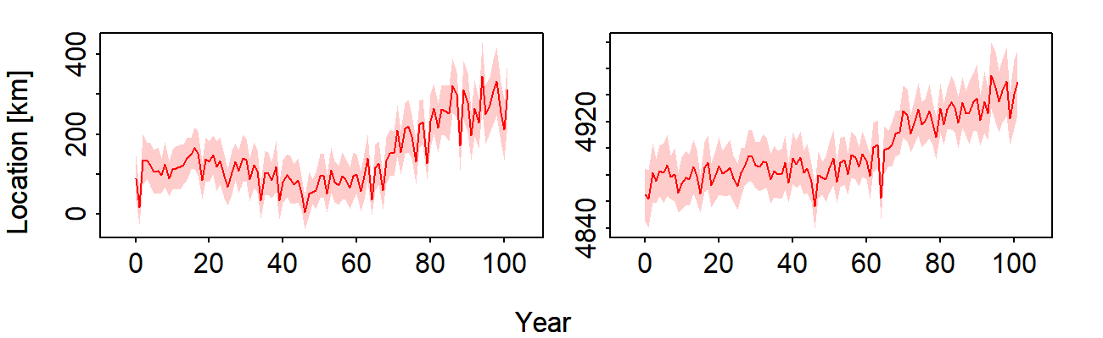
Default plots for SPST
Abundance Indices
Effective Area Occupied
Range Edge
Centre of Gravity

Slide 7
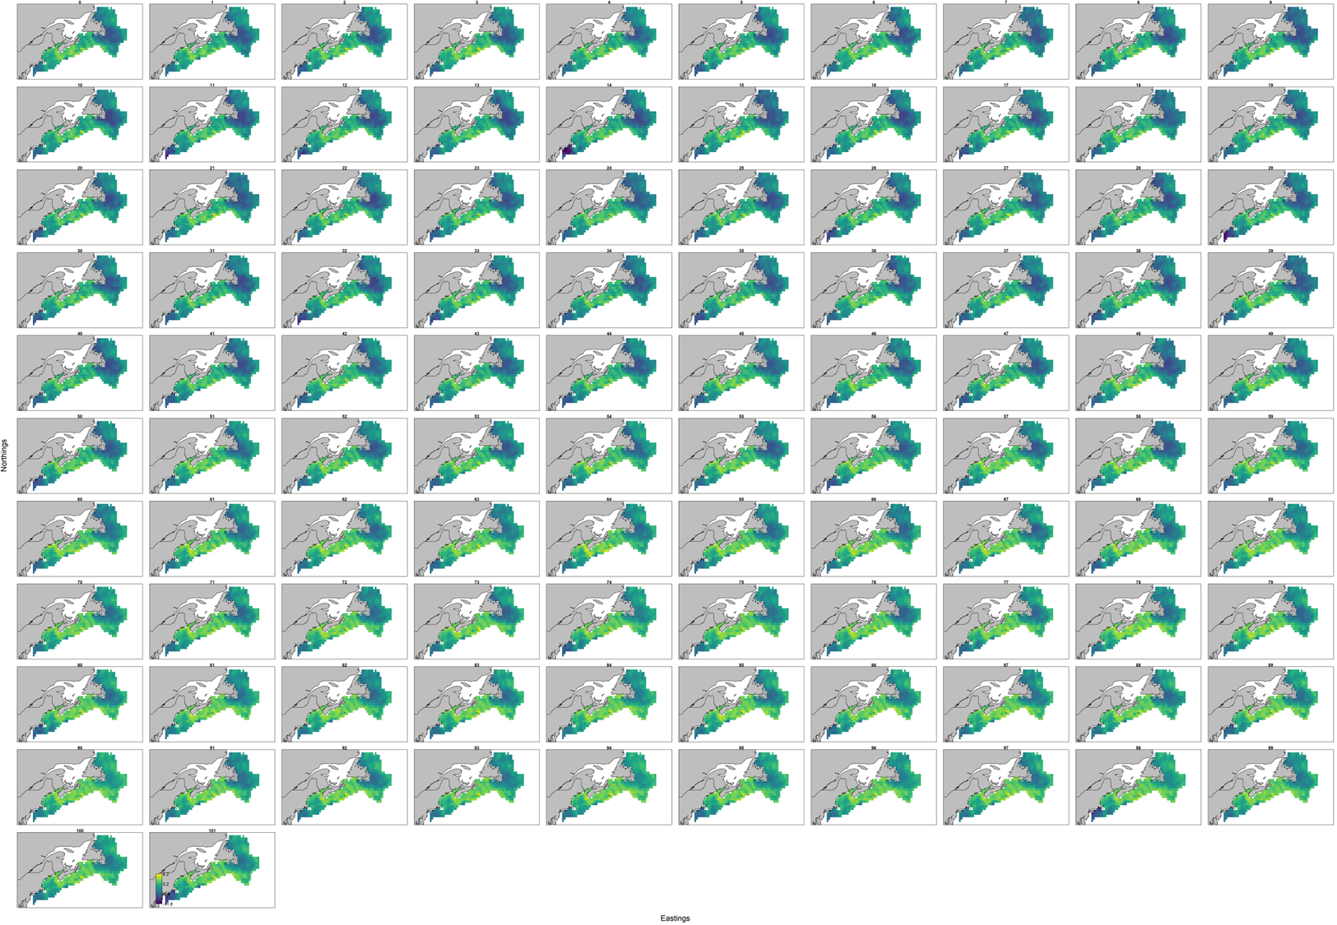
Output

Slide 8
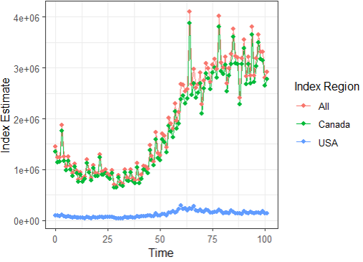
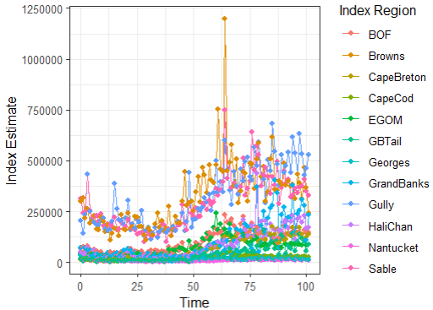
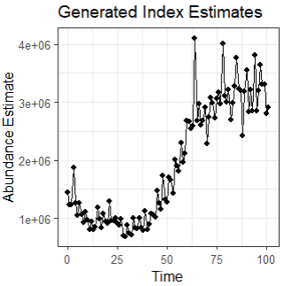
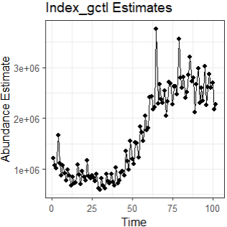
Abundance Indices
Above are Estimates generated by model functions, but they come aggregated at the regional level.
The statistic that can access these data at the scale of the extrapolation grid is Index_dgcl(far Right). This value multiplies the two linear predictor components (encounter model X positive density) to get density (count per km²) and then multiplies that by the aggregated site and area weight used in the model.
These values are much closer than the method I was using before (D_gct*cell area) summed across year

Slide 9
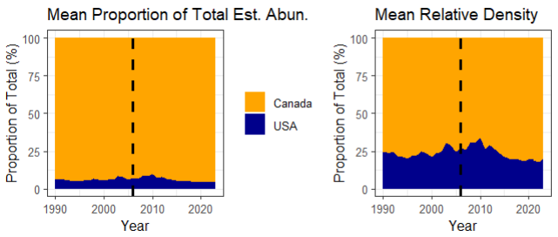
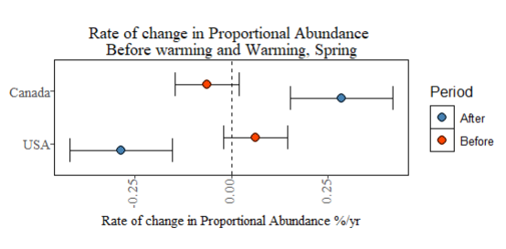
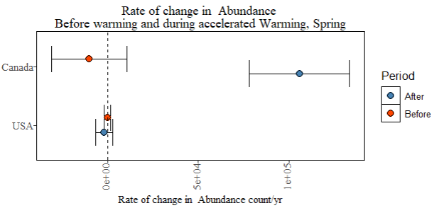
Plotting Abundance Indices

Slide 10
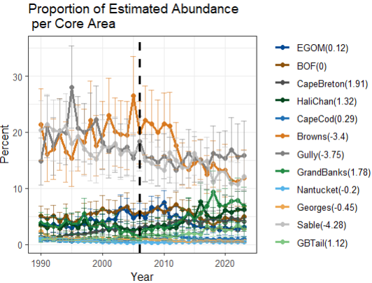
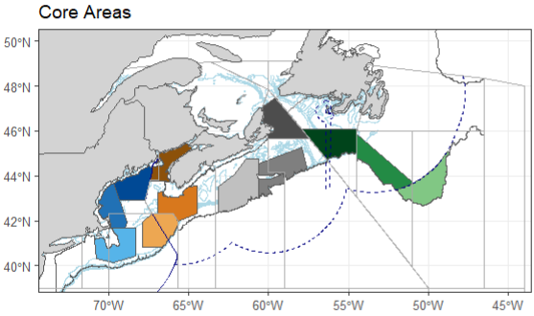
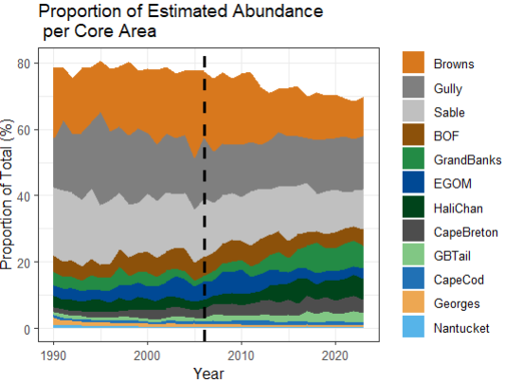
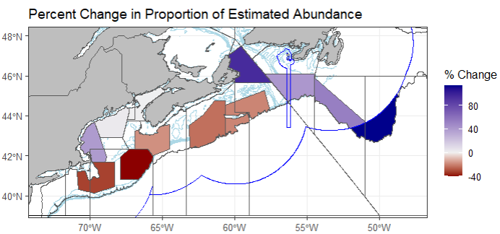
Plotting Abundance Indices

Slide 11
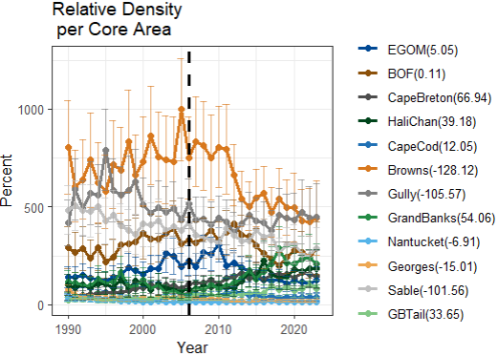
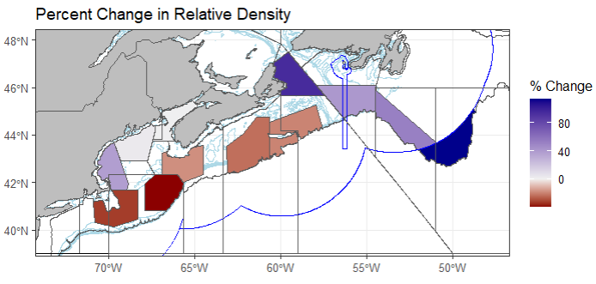
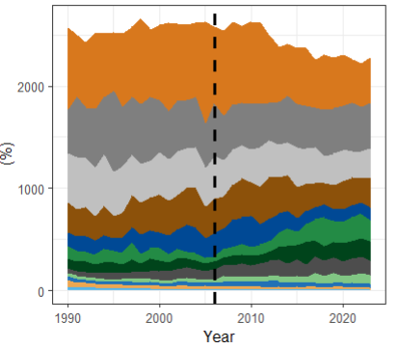
Shift Indicators

Slide 12
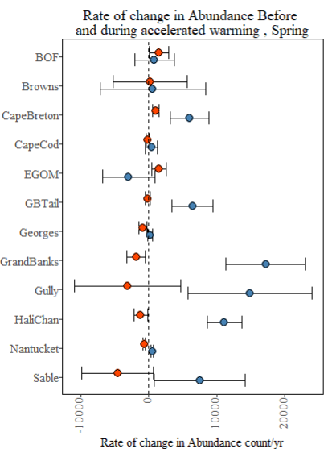
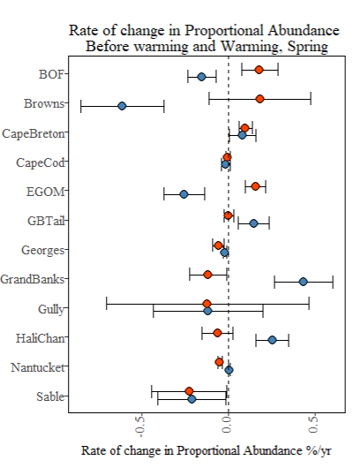
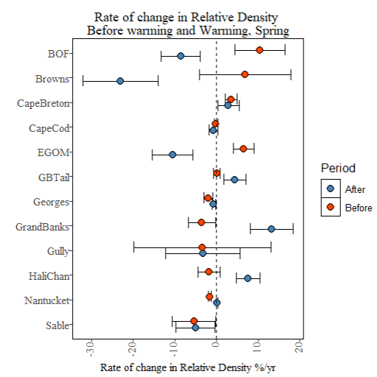
Shift Indicators: Abundance trend
Proportional abundance = Total regional estimate/ Total overall estimate
Relative density = Regional density / overall density

Slide 13
Shift Indicators

Slide 14
To Do
Questions
https://link.springer.com/article/10.1007/s41060-024-00517-w
We need a conceptual presentation with not real data
Edits to Paper:
Data: BNAM temperature data
Want to get temperature signal included (plot/text/ refs).. Significance of bottom temperature
See supplements and list of figs
Up to this point, similar work on th pacific coast sees deepinging, but not really an impact on borders (sdmTMB)
Discussion: next steps and policy

Slide 15
Future
Transfer to sdmTMB

