Slide 1
IPO Analysis: Questions 5 & 6
SPAC vs Non-SPAC Returns and Index Inclusion Performance

Slide 2
Analysis Overview
Question 5: Examining SPAC vs Non-SPAC IPO Returns
• Day 0 return analysis with abnormal return flagging
• Multi-window return comparison (5-day, 22-day, 91-day, 252-day)
Question 6: Index Inclusion Performance Analysis
• S&P 500 inclusion impact on 1-year returns
• Russell 1000 inclusion impact on 1-year returns
Dataset: 3,681 IPOs (251 SPACs, 3,430 Non-SPACs)

Slide 3
Question 5(i): Day 0 Return Analysis - Code
# Flag abnormal returns (>= 100%)
stock_ipos['day0_lvl'] = np.where(
stock_ipos['sym_day0_OTC'] < 1,
'normal',
'abnormal'
)
# Summary statistics by level and SPAC status
day0_summary = stock_ipos.groupby(
['day0_lvl', 'spac']
)['sym_day0_OTC'].agg([
'mean', 'median', 'std', 'count', 'min', 'max'
])

Slide 4
Question 5(i): Day 0 Return Statistics
Category | Mean | Median | Std Dev | Count
Abnormal, Non-SPAC | 2.918 | 2.245 | 3.010 | 30
Normal, Non-SPAC | -0.005 | 0.000 | 0.127 | 3,400
Normal, SPAC | -0.009 | 0.000 | 0.070 | 251

Slide 5
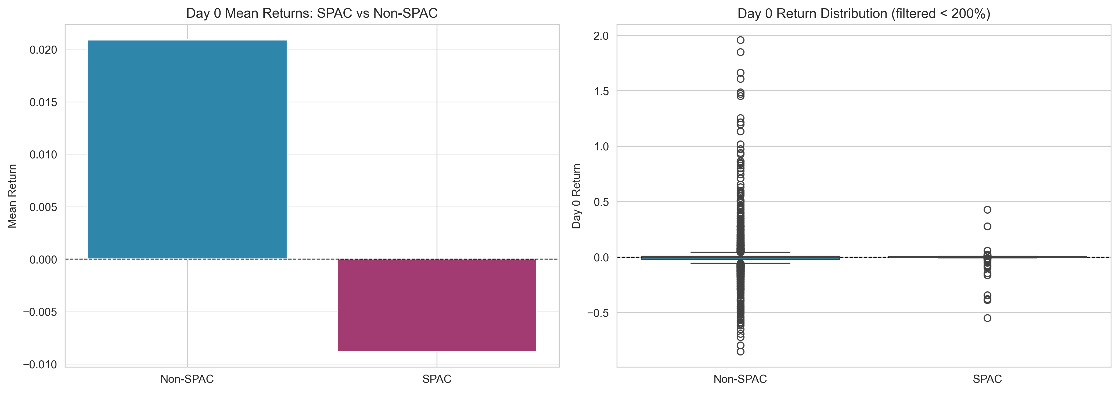
Question 5(i): Day 0 Returns - Visual Comparison
SPACs show lower but more stable Day 0 returns compared to Non-SPACs

Slide 6
Question 5(i): Key Findings
SPACs have lower and negative mean Day 0 returns:
• SPACs: -0.88% vs Non-SPACs: +2.09%
SPACs show significantly lower volatility:
• SPAC std dev: 0.070 vs Non-SPAC: 0.408
Abnormal returns (≥100%) only occur in Non-SPACs:
• 30 cases with mean return of 292%
Both groups have median returns of 0%:
• Suggests many IPOs trade at offer price on Day 0

Slide 7
Question 5(ii): Multi-Window Analysis - Code
# Analyze returns across multiple windows
windows = ['sym_5day_ret', 'sym_22day_ret',
'sym_91day_ret', 'sym_252day_ret']
for window in windows:
summary = stock_ipos.groupby('spac')[window].agg([
'mean', 'median', 'std', 'count'
])
print(f"{window} Statistics:")
print(summary)

Slide 8
Question 5(ii): Mean Returns & Volatility by Window
Window | Non-SPAC Mean | SPAC Mean | Non-SPAC Std | SPAC Std
5-day | 0.034 | 0.021 | 1.252 | 0.276
22-day | 0.047 | 0.030 | 1.344 | 0.377
91-day | 0.061 | 0.030 | 2.007 | 0.477
252-day | 0.043 | 0.013 | 2.968 | 0.157

Slide 9
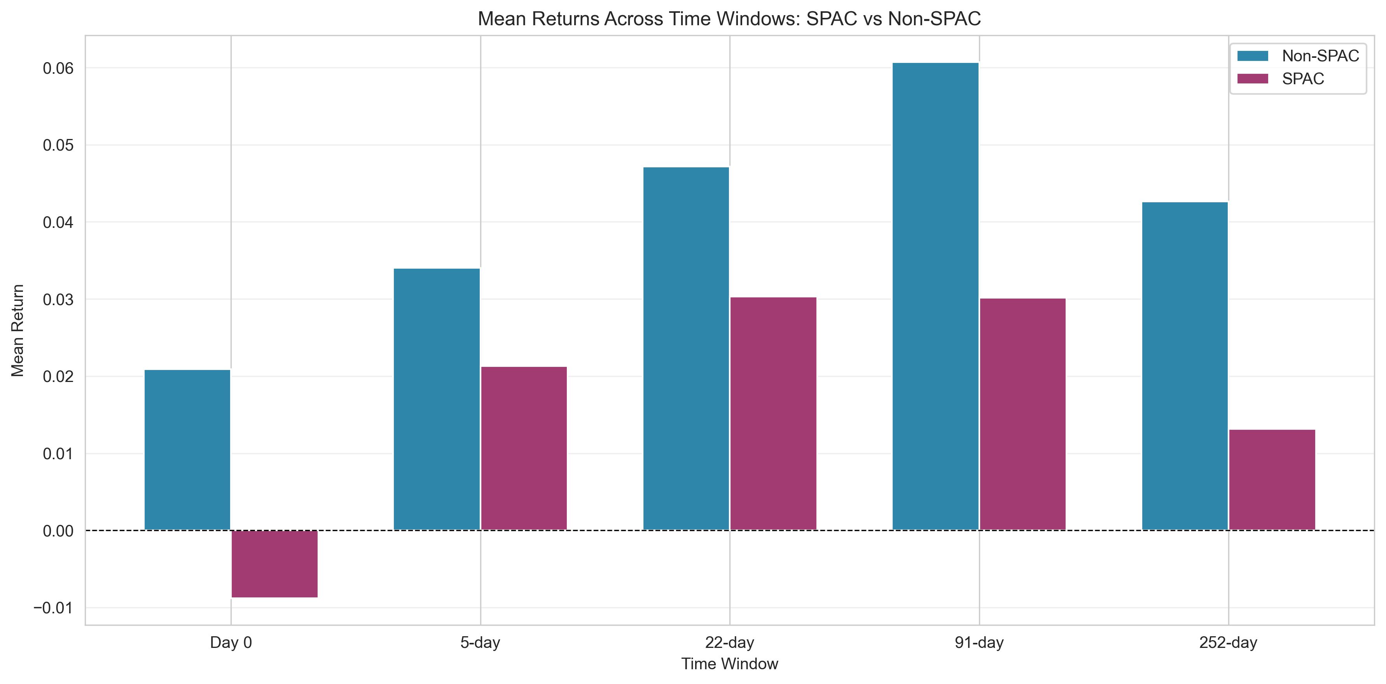
Question 5(ii): Mean Returns Across Time Windows
Non-SPACs consistently outperform SPACs across all time horizons

Slide 10
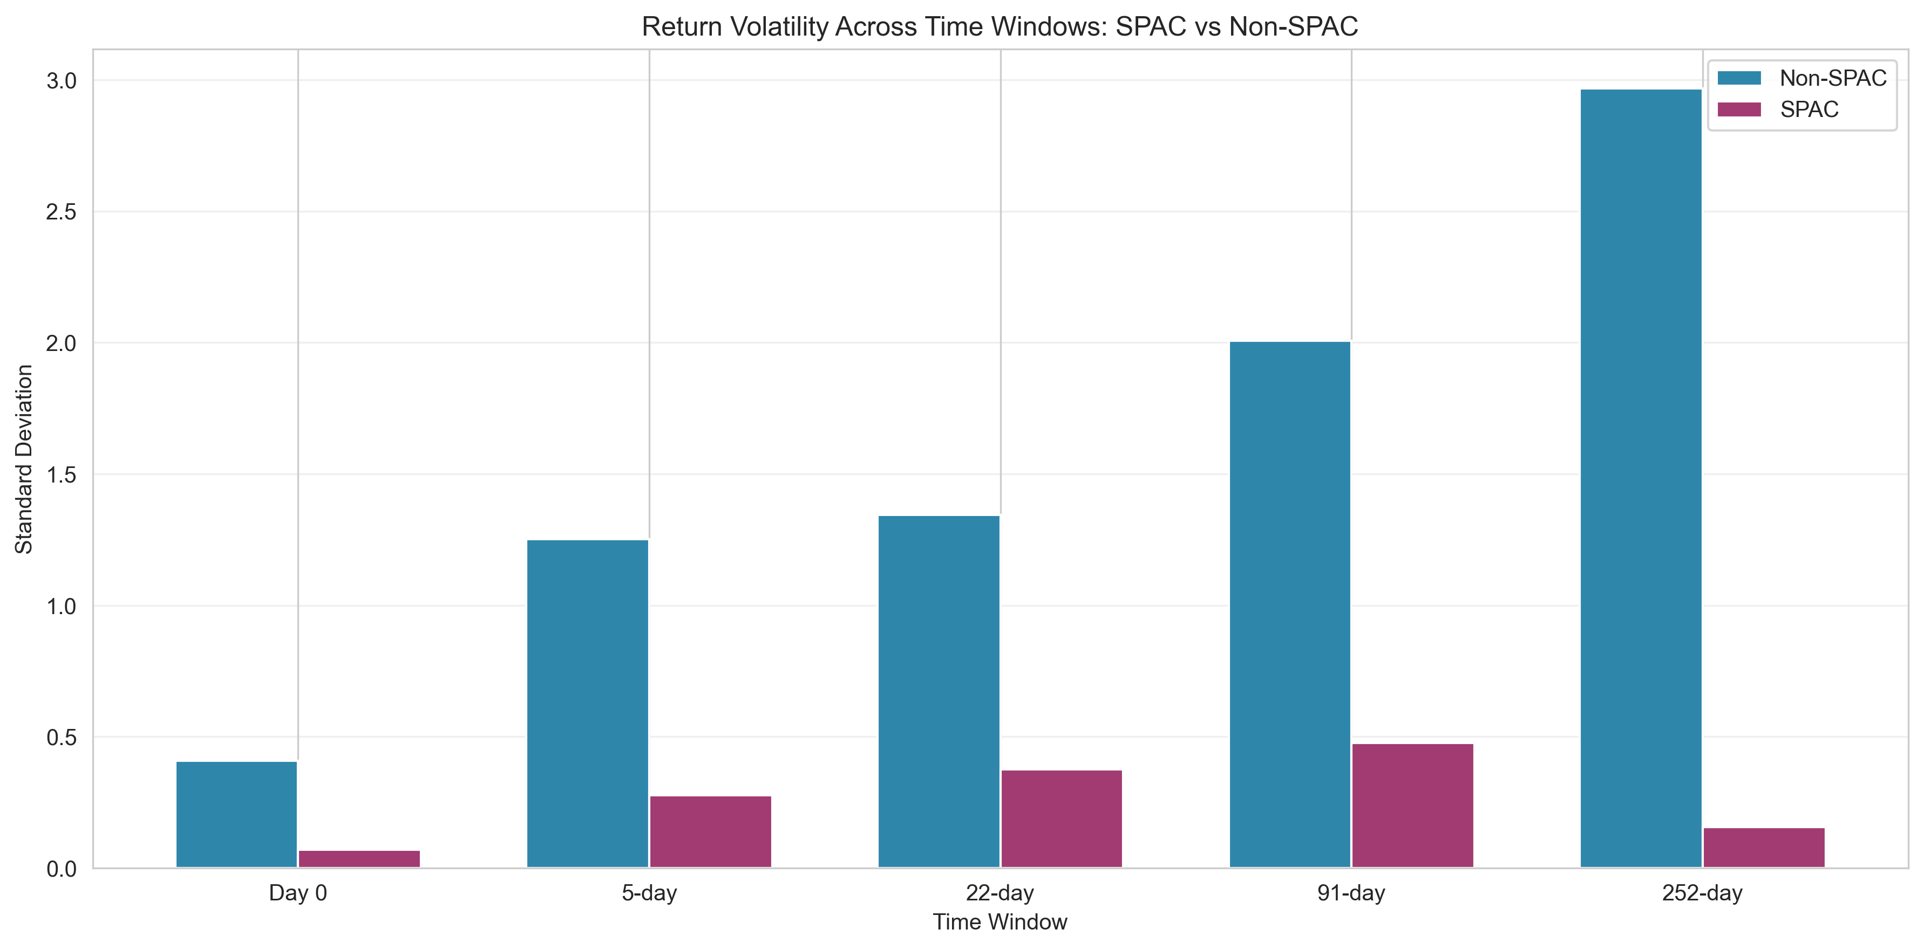
Question 5(ii): Return Volatility Comparison
SPACs demonstrate consistently lower volatility than Non-SPACs

Slide 11
Question 6: Index Inclusion Analysis - Code
# S&P 500 inclusion performance
sp_performance = stock_ipos.groupby('sp')[
'sym_252day_ret'
].agg(['mean', 'median', 'std', 'count'])
# Russell 1000 inclusion performance
russell_performance = stock_ipos.groupby('russell')[
'sym_252day_ret'
].agg(['mean', 'median', 'std', 'count'])

Slide 12
Question 6: Index Inclusion Performance (1-Year Returns)
Category | Mean Return | Median Return | Count
Not in S&P 500 | 0.037 | 0.000 | 3,630
In S&P 500 | 0.293 | 0.171 | 51
Not in Russell 1000 | 0.031 | -0.001 | 3,538
In Russell 1000 | 0.282 | 0.134 | 143

Slide 13
Key Conclusions
Question 5 - SPAC vs Non-SPAC Performance:
• SPACs underperform across all time horizons
• SPACs offer lower volatility and more stable returns
• Non-SPACs have extreme outliers (both positive and negative)
Question 6 - Index Inclusion Impact:
• Index inclusion strongly predicts superior performance
• S&P 500 included: 29.3% vs 3.7% mean 1-year return
• Russell 1000 included: 28.2% vs 3.1% mean 1-year return
• Included stocks show lower volatility despite higher returns
• Very selective: only 1.4% achieve S&P 500, 3.9% Russell 1000

