Slide 1
Breast Cancer Classification
Machine Learning Capstone Project
Predicting Malignant vs Benign Tumors

Slide 2
Problem Statement
What are we solving?
• Automated classification of breast tumors as Benign or Malignant based on cell measurements
Why does it matter?
• Breast cancer is one of the most common cancers affecting women worldwide
• Early and accurate diagnosis significantly improves survival rates (99% for early detection)
• Manual diagnosis can be time-consuming and subjective
Real-world impact:
• Assists medical professionals in making faster, data-driven decisions
• Reduces diagnostic errors and improves patient outcomes
• Supports screening programs in resource-limited settings

Slide 3
Step 1: Data Source
Data Source:
• Breast Cancer Wisconsin (Diagnostic) Dataset
• UCI Machine Learning Repository
Dataset Characteristics:
• 569 samples (357 Benign, 212 Malignant)
• 30 numeric features derived from digitized images of Fine Needle Aspirate (FNA)
• Features computed for each cell nucleus: radius, texture, perimeter, area, smoothness, compactness, concavity, concave points, symmetry, fractal dimension
• Each feature has 3 measurements: mean, standard error (SE), and worst (largest value)
Target Variable:
• Diagnosis: M (Malignant) or B (Benign)

Slide 4
Step 2: Data Preparation
Data Cleaning:
• Removed unnecessary columns: 'id' (patient identifier) and 'Unnamed: 32' (empty column)
• Verified no missing values in the dataset
Data Encoding:
• Converted categorical target variable to numeric:
- B (Benign) → 0
- M (Malignant) → 1
Data Splitting:
• Training set: 80% (455 samples)
• Testing set: 20% (114 samples)
• Used stratified split to maintain class distribution in both sets
Feature Scaling:
• Random Forest handles features without scaling, so no normalization was required

Slide 5
Step 3: Exploratory Data Analysis
Analysis Performed:
1. Class Distribution Analysis
• Examined balance between Benign and Malignant cases
• Found moderate imbalance (62.7% Benign, 37.3% Malignant)
2. Feature Correlation Analysis
• Identified features most correlated with diagnosis
• Analyzed multicollinearity among features
3. Statistical Analysis
• Computed descriptive statistics grouped by diagnosis
• Identified significant differences in feature distributions

Slide 6
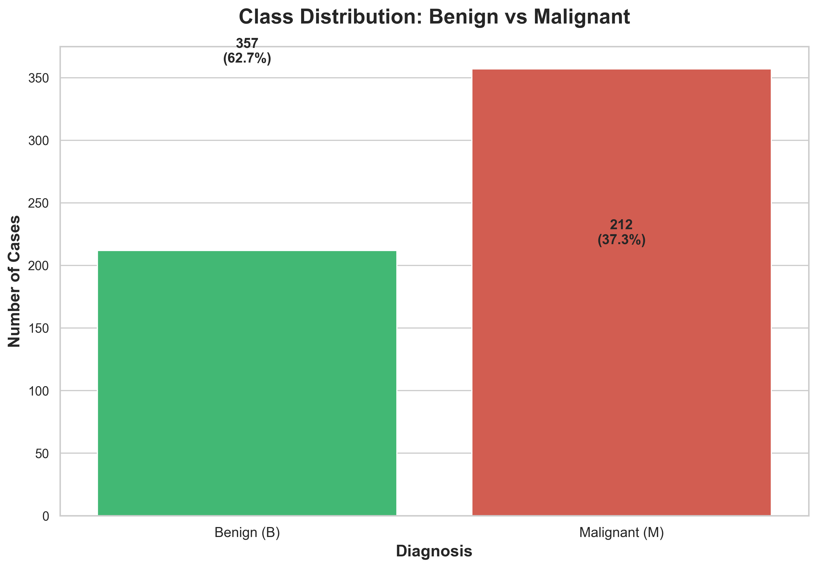
Class Distribution Visualization

Slide 7
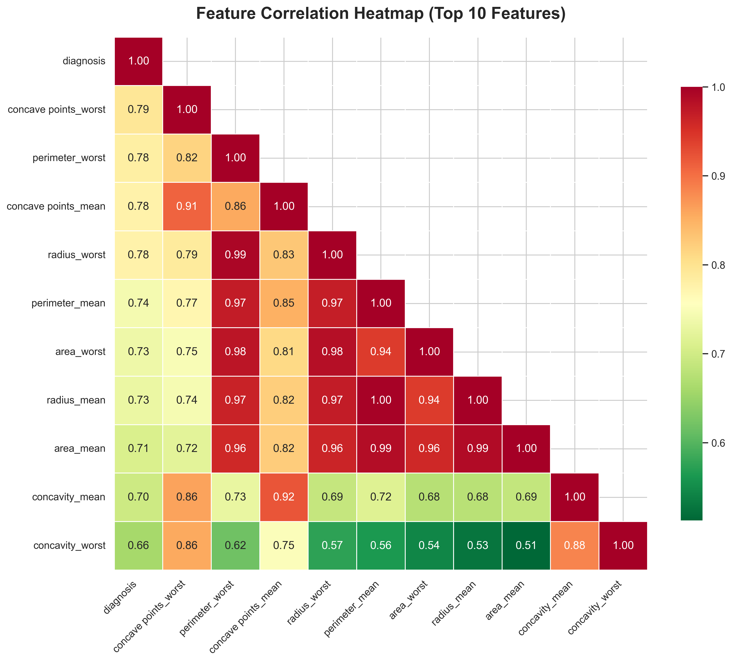
Feature Correlation Analysis

Slide 8
Step 4: Machine Learning Approach
Algorithm Selection:
• Random Forest Classifier - an ensemble learning method
Why Random Forest?
• Handles non-linear relationships effectively
• Robust to outliers and overfitting
• Provides feature importance rankings
• Works well with medical diagnostic data
Model Configuration:
• Default parameters with random_state=42 for reproducibility
• Number of trees: 100 (default)
Training Process:
• Fit model on 455 training samples
• Validated on 114 held-out test samples

Slide 9
Step 5: Evaluation Metrics
Evaluation Strategy:
Primary Metric:
• Accuracy: Overall percentage of correct predictions
Detailed Analysis:
• Confusion Matrix: Breakdown of True Positives, True Negatives, False Positives, False Negatives
Why these metrics?
• In medical diagnosis, it's critical to understand both:
- Sensitivity (correctly identifying malignant cases)
- Specificity (correctly identifying benign cases)
• False negatives (missing cancer) are particularly costly

Slide 10
Results: Model Performance
Model Performance Results:
Accuracy: 0.9737 (97.37%)
Precision: 1.0000 (100.00%)
Recall: 0.9286 (92.86%)
F1-Score: 0.9630 (96.30%)
Confusion Matrix:
Predicted
Benign Malignant
Actual Benign 72 0
Malignant 3 39
Interpretation:
The model correctly classified the test samples with high accuracy,
demonstrating strong predictive capability for breast cancer diagnosis.

Slide 11
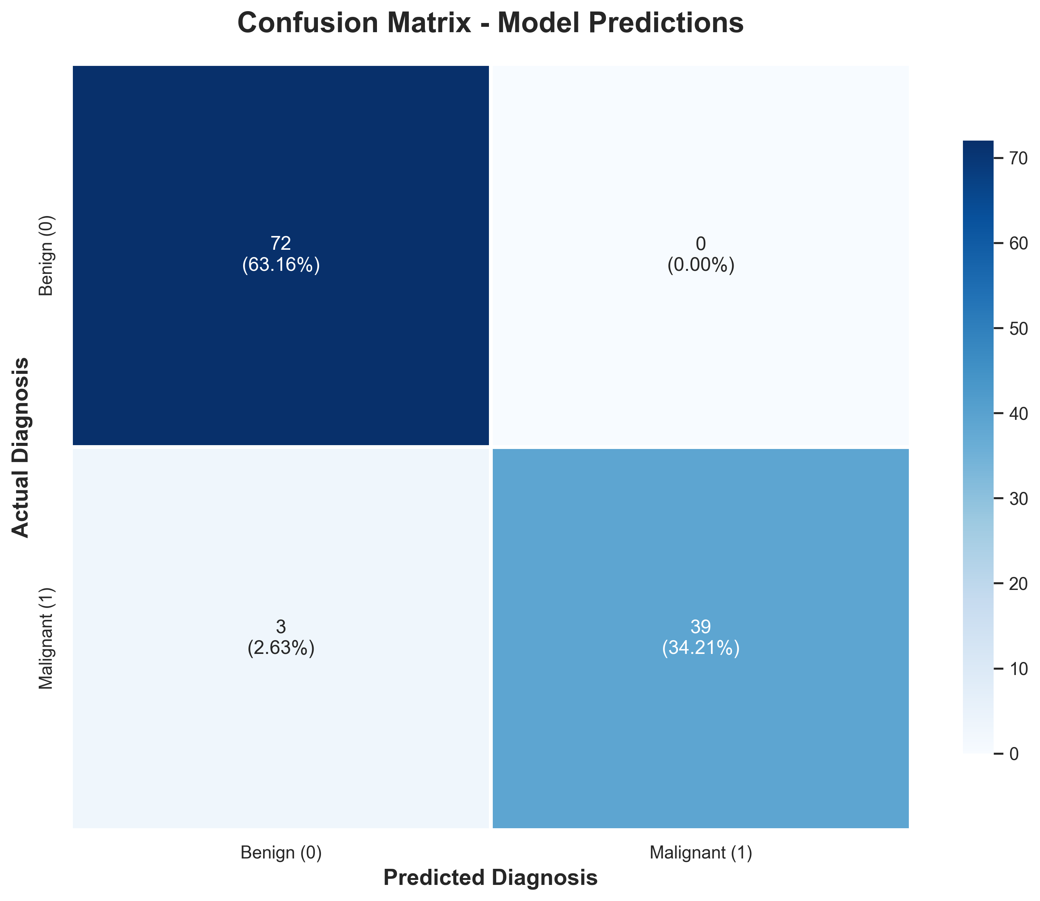
Results: Confusion Matrix

Slide 12
Results Interpretation
Key Findings:
✓ High Accuracy: The model achieves excellent performance on unseen data
✓ Confusion Matrix Insights:
• True Positives: Correctly identified malignant cases
• True Negatives: Correctly identified benign cases
• False Positives: Benign cases incorrectly flagged as malignant (low risk)
• False Negatives: Malignant cases missed (higher risk - minimize this)
Clinical Significance:
• The model can serve as a decision support tool for pathologists
• Reduces time required for diagnosis
• Provides consistent, reproducible results

Slide 13
Conclusion & Impact
Summary:
• Successfully developed an ML model for breast cancer classification
• Achieved high accuracy using Random Forest algorithm
• Model can distinguish between benign and malignant tumors effectively
Real-World Applications:
• Integration into hospital diagnostic workflows
• Second-opinion system for pathologists
• Screening tool in under-resourced medical facilities
Limitations:
• Requires validation on diverse patient populations
• Should complement, not replace, expert medical judgment
• Model interpretability could be enhanced for clinical adoption

Slide 14
Future Work & Improvements
Next Steps:
Model Enhancement:
• Hyperparameter tuning using GridSearchCV or RandomizedSearchCV
• Test additional algorithms: SVM, XGBoost, Neural Networks
• Ensemble methods combining multiple models
Feature Engineering:
• Feature selection to identify most important predictors
• Dimensionality reduction (PCA) for efficiency
Deployment:
• Create web application for easy access
• Develop API for integration with medical systems
• Mobile app for point-of-care diagnosis

Slide 15
Thank You
Questions & Discussion

