Slide 1
Breast Cancer Classification
Presented by Team blue
Analysis and Prediction using Machine Learning
ANDERSON MTAWALI AND PETER KIGANYA MBURU

Slide 2
Introduction
Objective: To predict whether a breast mass is benign or malignant based on cell nuclei measurements.
Importance: Early diagnosis significantly improves survival rates.
Approach: Machine Learning Classification (Random Forest).

Slide 3
Dataset Overview
Source: Breast Cancer Wisconsin (Diagnostic) Data Set.
Features: 30 numeric features (radius, texture, perimeter, area, smoothness, etc.) computed from digitized images of fine needle aspirate (FNA).
Target: Diagnosis (M = Malignant, B = Benign).

Slide 4
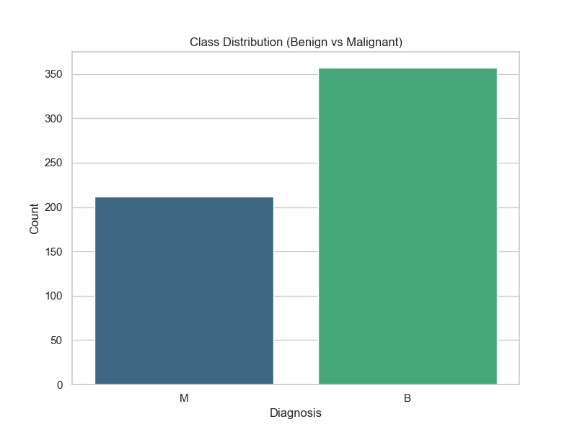
Class Distribution

Slide 5
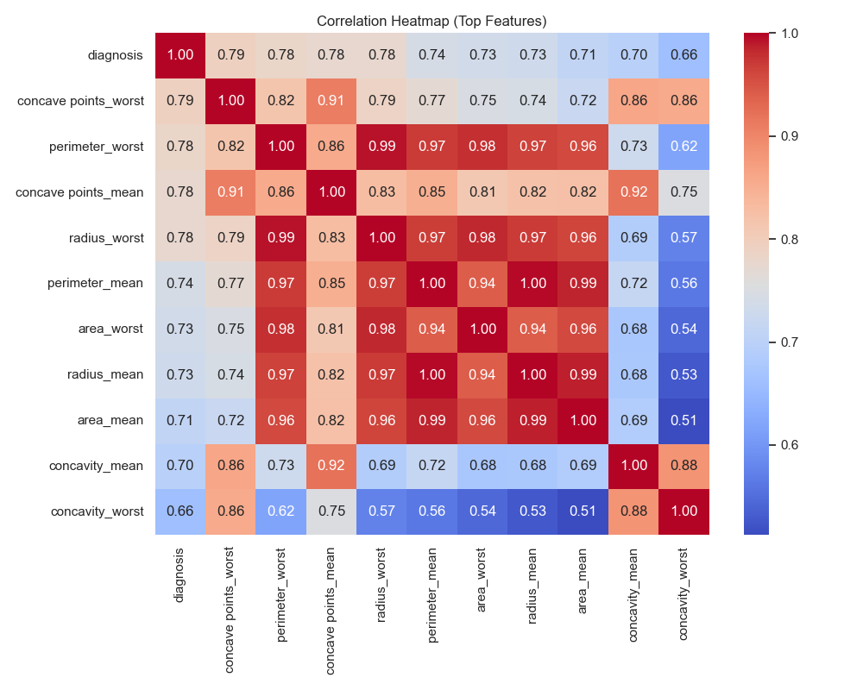
Feature Correlation

Slide 6
Methodology
Model: Random Forest Classifier.
Split: 80% Training, 20% Testing.
Stratification: Used to maintain class balance in splits.
Metric: Accuracy and Confusion Matrix.

Slide 7
Model Performance
Results:
Accuracy: 0.9737
Confusion Matrix:
[[72 0]
[ 3 39]]

Slide 8
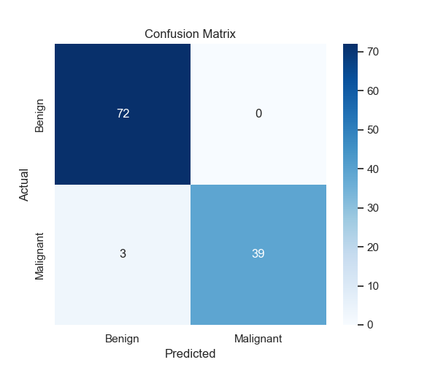
Confusion Matrix

Slide 9
Conclusion
Summary: The Random Forest model achieved high accuracy in classifying breast cancer tumors.
Future Work:
- Hyperparameter tuning.
- Testing other algorithms (SVM, XGBoost).
- Feature selection to reduce dimensionality.

