Slide 1
DAQ tutorial
Xiao Wang
Advisor: Prof. Daisuke Kihara

Slide 2
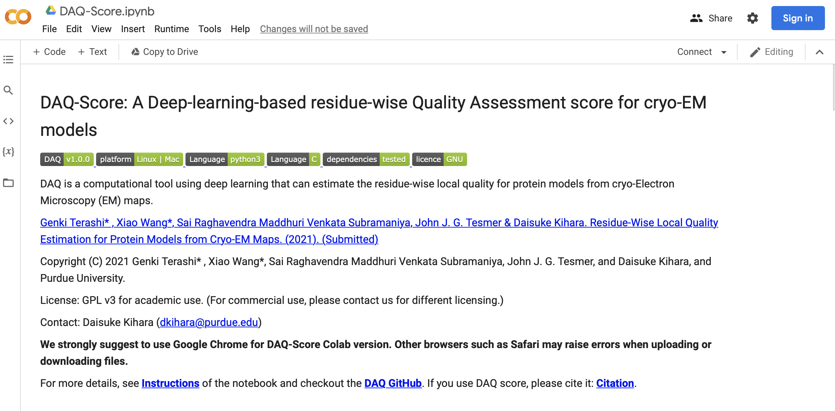

Code and Platform
Code:
https://github.com/kiharalab/DAQ
Platform:
https://bit.ly/daq-score
We suggest to use the
Chrome Browser

Slide 3
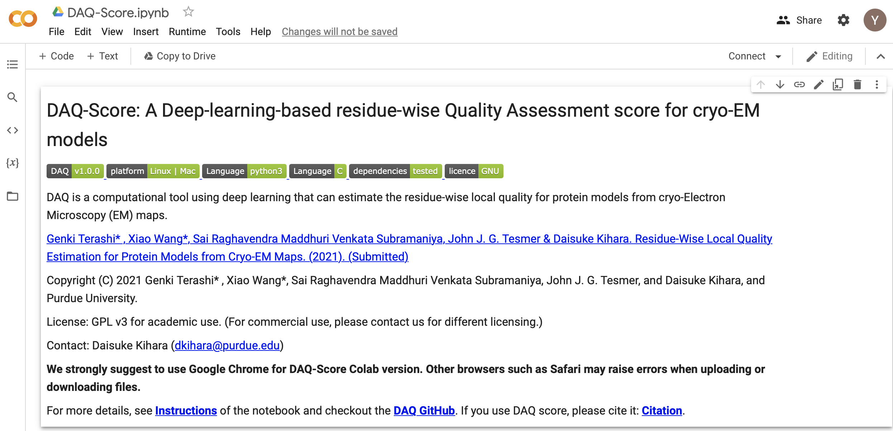
1st step: Log in Colab with your google account
Check here to make sure the login is successful

Slide 4
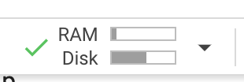
2nd step: Connect to Colab machine.
Check here to connect to an online machine

Slide 5
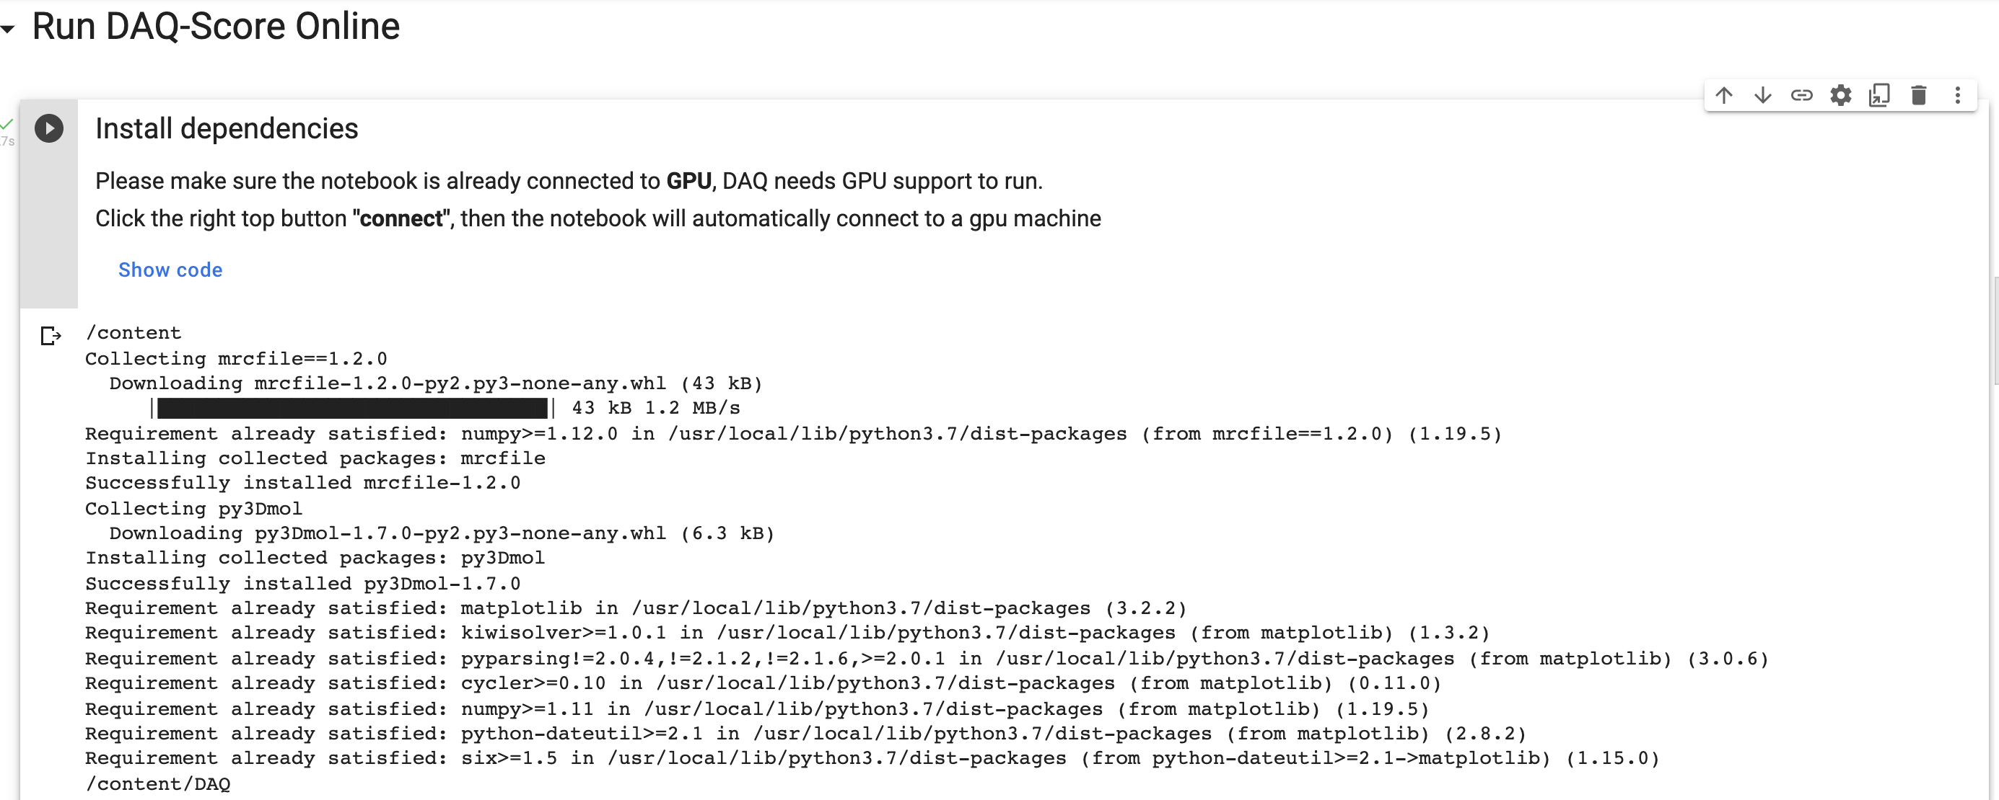
3rd step: Install dependencies
Check here to run
Once you see this, it indicates installment is successful.

Slide 6
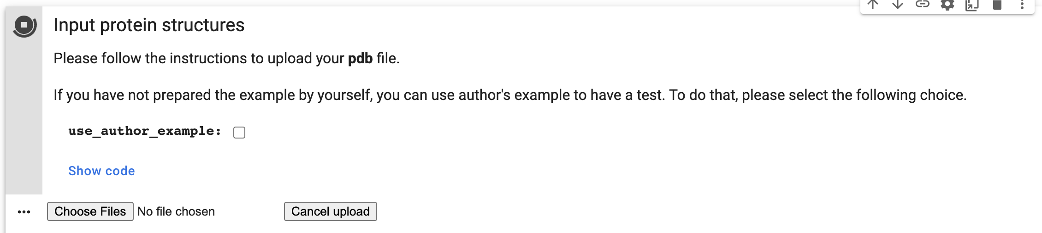
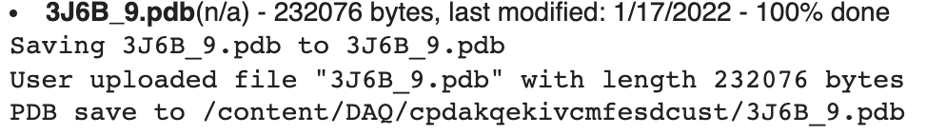
4th step: upload your structures with PDB format
2 Click this to run
1. If you want to test with our example, click this first. Otherwise, skip it.
3 Click this to upload your local files.
Then you will see the following.
When you see this, it indicates the uploading is successfully finished.

Slide 7
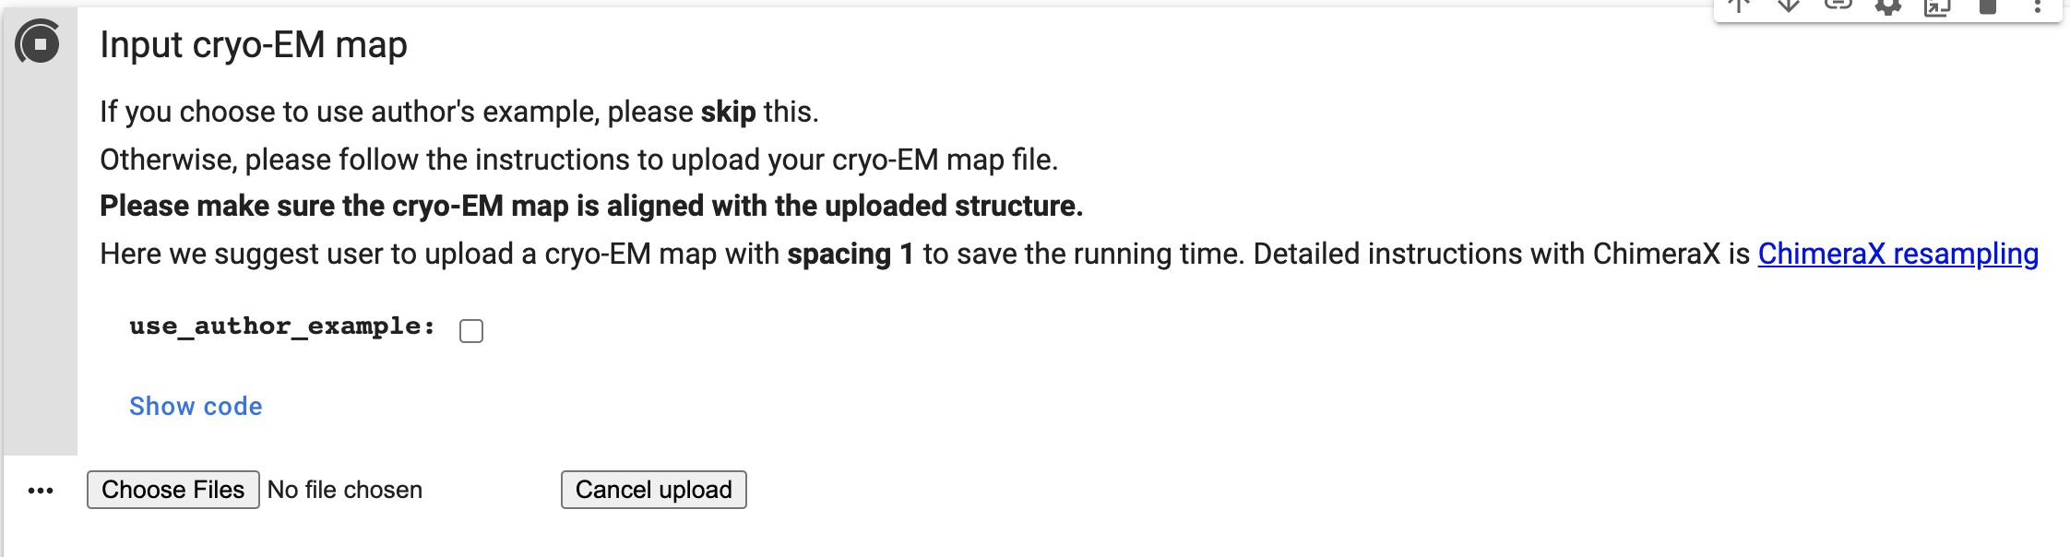
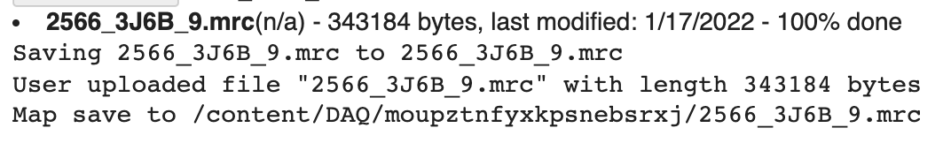
5th step: upload your cryo-EM map.
If you choose use_auther_example in last step , please skip this step.
1 Click here to run
3 Click this to upload your local files.
Then you will see the following.
When you see this, it indicates the uploading is successfully finished.

Slide 8
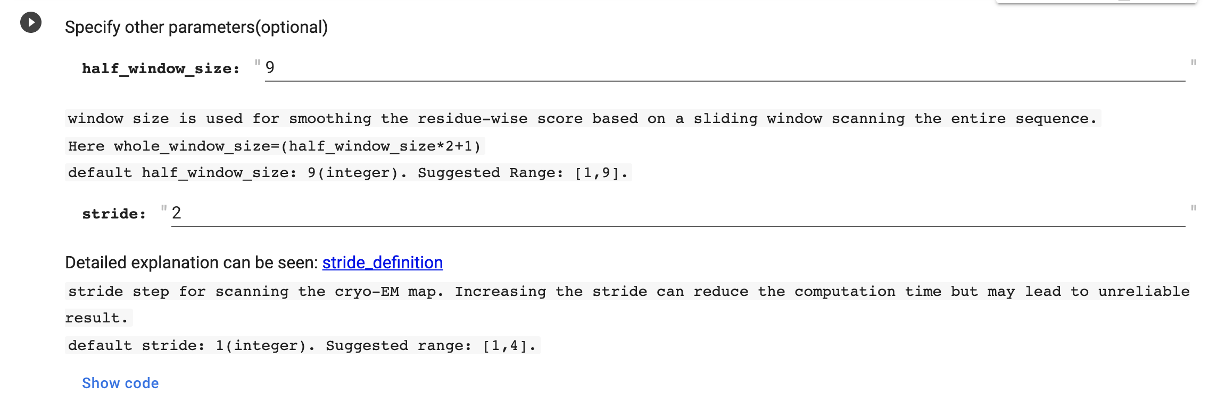
6th step: Confirm your parameters.
2 Click here to run to confirm parameter into the program
1. If you want to change parameters, change it. We suggest to use the default.

Slide 9
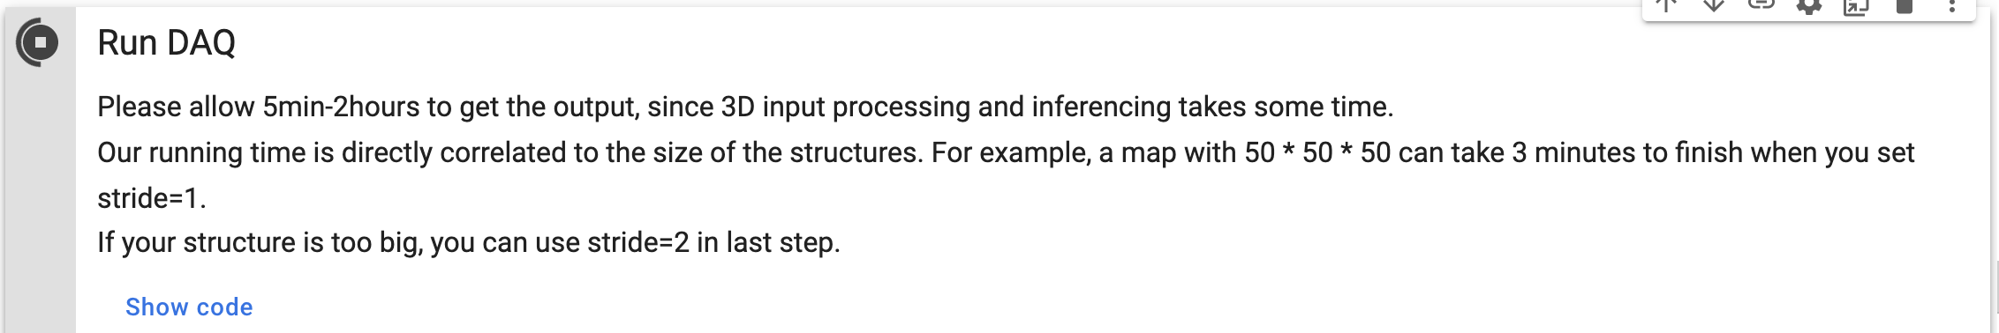
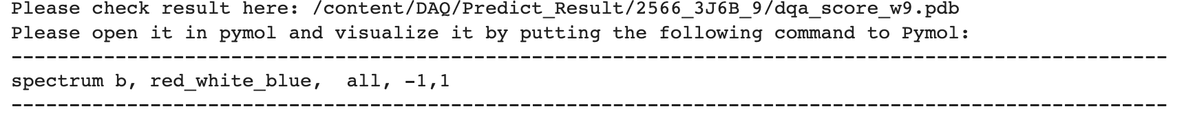
7th step: Run DAQ
Click here to run
Successful running message:

Slide 10
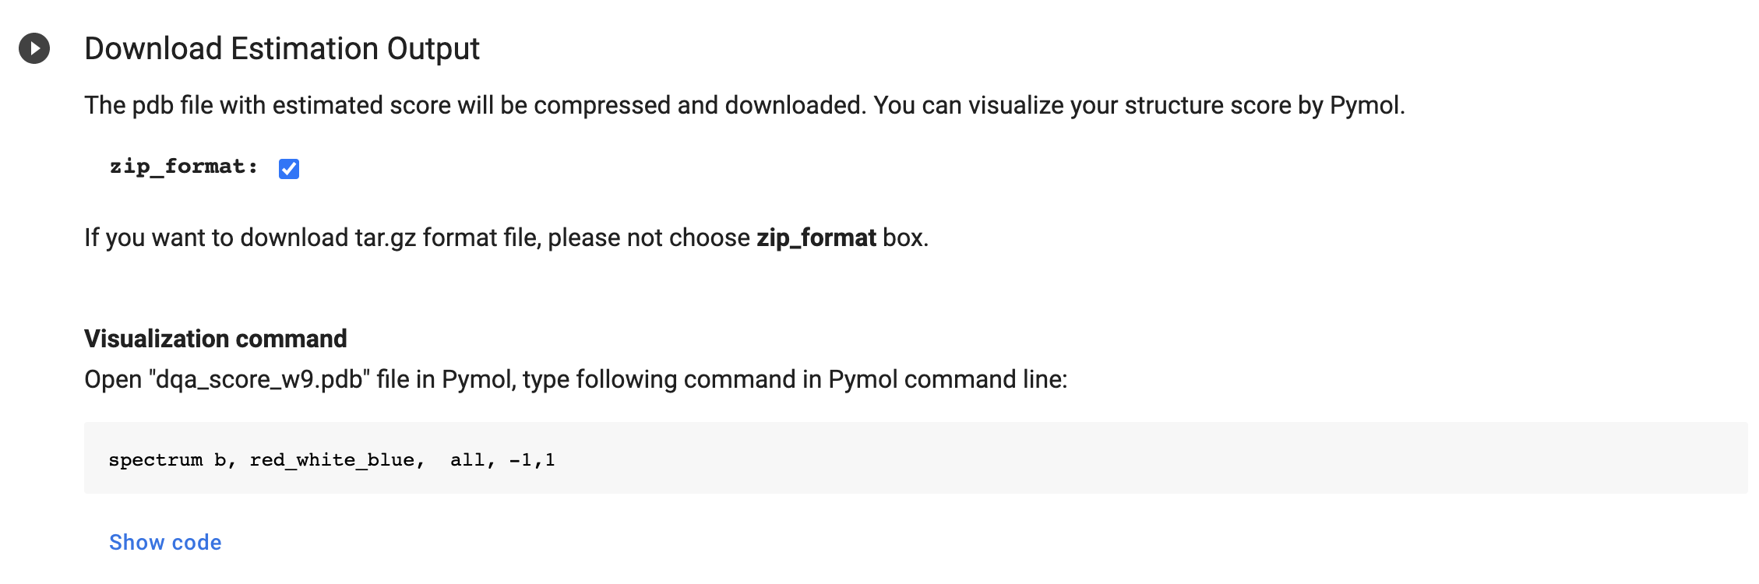
8th step: Download score files and visualize locally
Click here to download

Slide 11
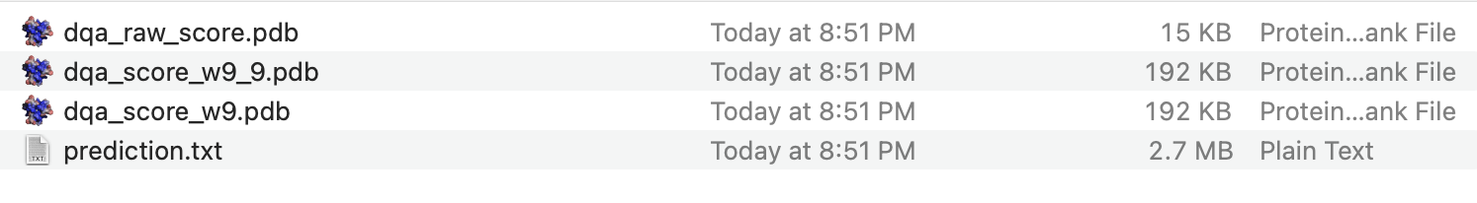
Files in the Downloaded zip file
1 dqa_raw_score.pdb: pdb file that records each residue score directly from DAQ
2 dqa_raw_score_w9.pdb: pdb file that records smoothed residue score (final DAQ score)
3 prediction.txt: records probability values for each locations
(includes amino acid score, atom score, secondary structure score)

Slide 12
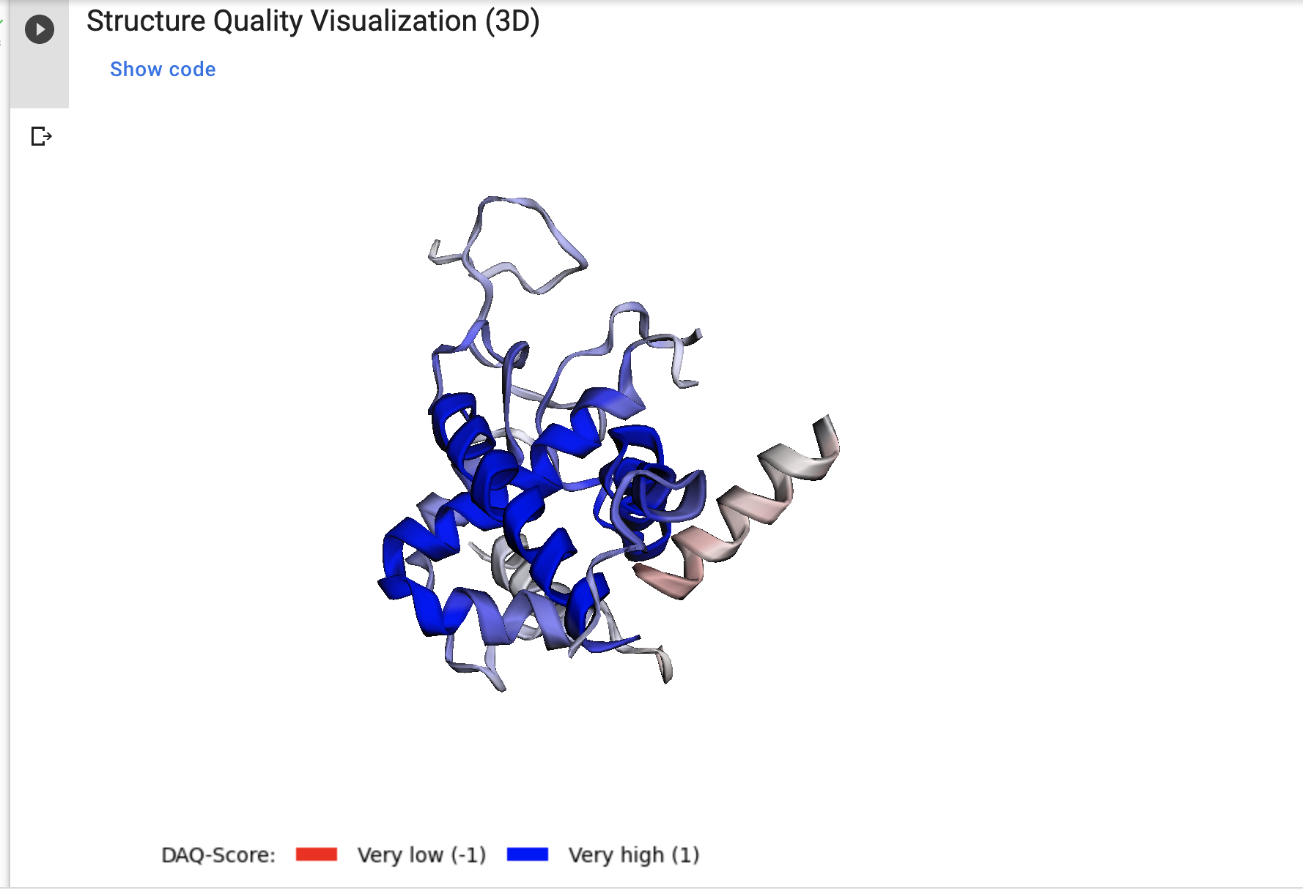
9th Structure Quality Visualization
Click here to visualize
The structure with low quality will show in red color

Slide 13
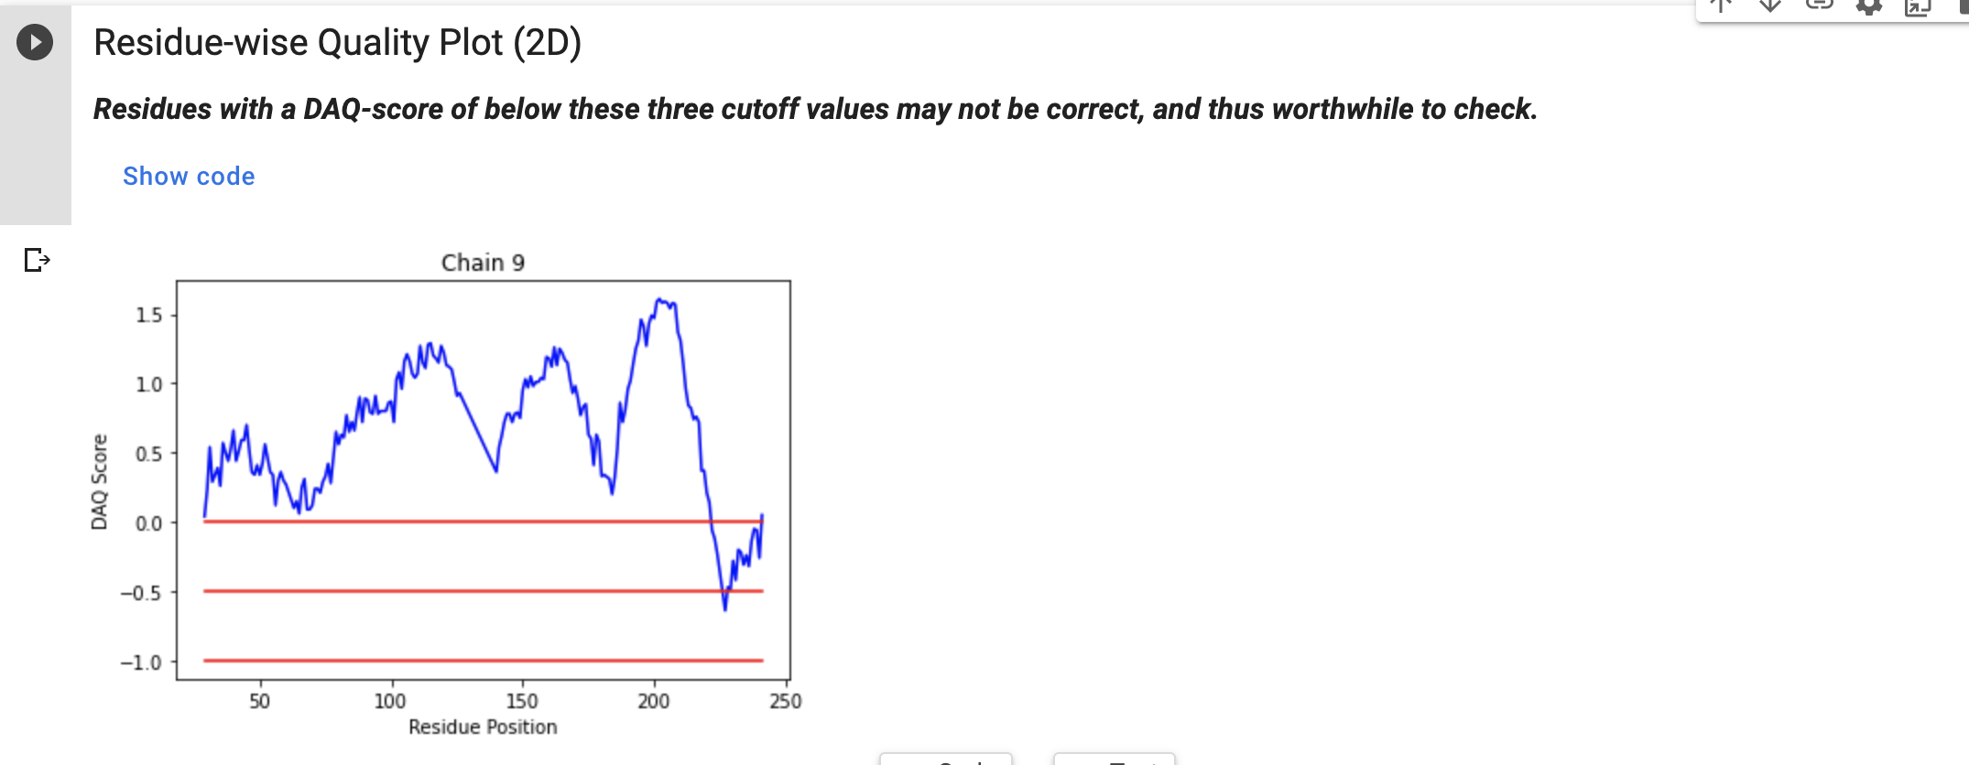
10th Residue-wise score plot
Click here to run
Structures quality may be low
Structures quality is highly likely to be low

Slide 14
Contact
Professor:
Daisuke Kihara (dkihara@purdue.edu)
Developer:
Genki Terashi (gterashi@purdue.edu)
Xiao Wang (wang3702@purdue.edu)

Slide 15
Thank You!

