Slide 1
DECORATOR
PATTERN
GROUP 3

Slide 2
OBSERVATION

Slide 3
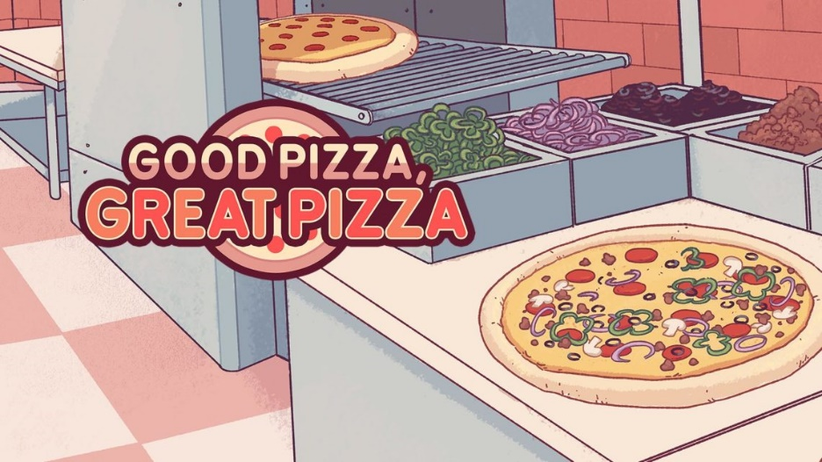
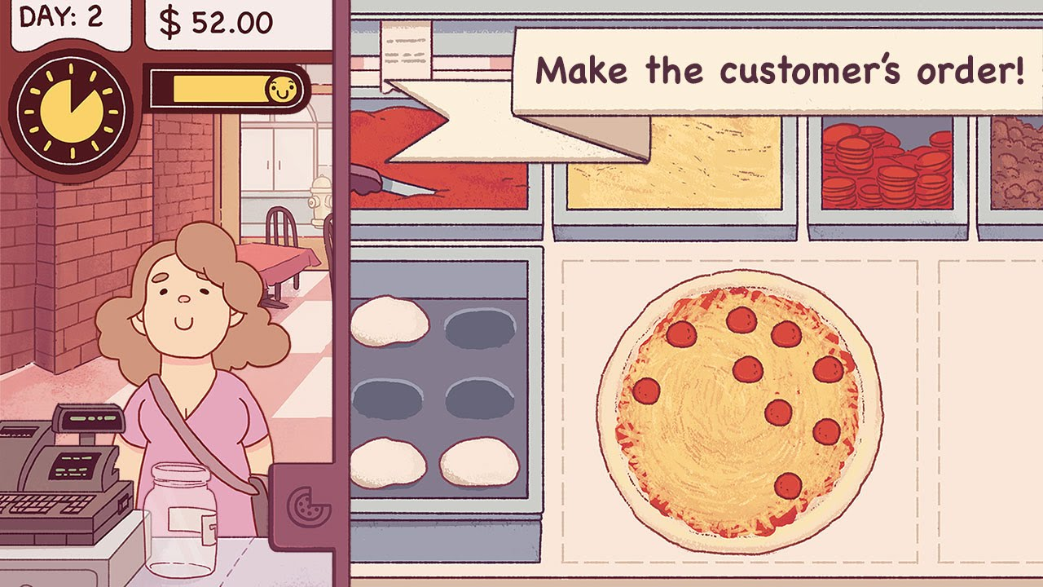
PROBLEM
Imagine a scenario where you are working for a Pizza store, and your store has made TOMATO PIZZA and CHEESE PIZZA. Then you need to put a few more ingredients on the top of the cake due to your customers ‘ flavor like chicken or pepper .
Basically you have some pizza types like: tomato chicken pizza, pepper tomato pizza, chicken cheese pizza, pepper tomato pizza and pepper chicken cheese.

Slide 4
SOLUTION

Slide 5
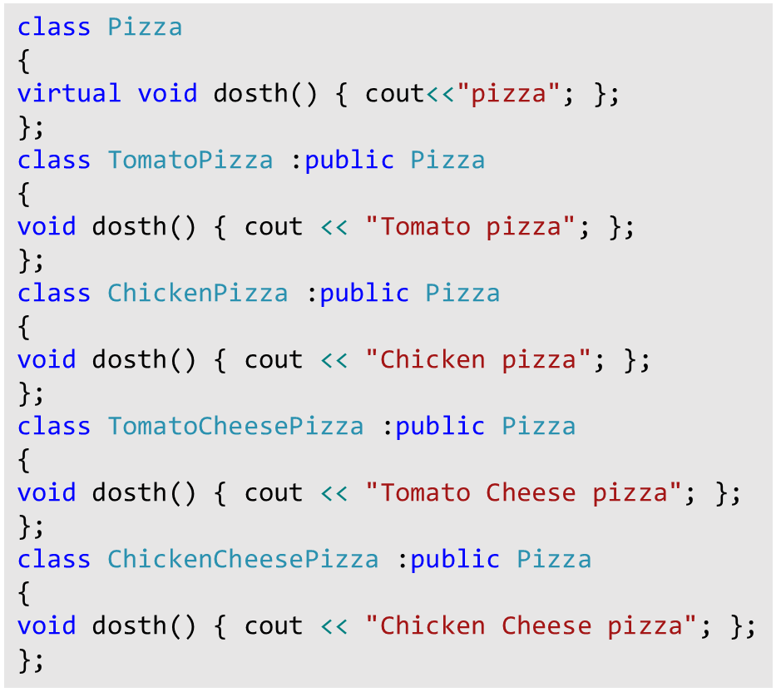
OLD WAY
Need a
convenient way
01
There will be a large number of combinations add in to get what the customer wants. And there will be many layers that you need to install.
02
03
04

Slide 6
INTRODUCTION

Slide 7
DECORATOR PATTERN
Design pattern
“
“
Wrapping a gift, putting it in a box, and wrapping the box

Slide 8
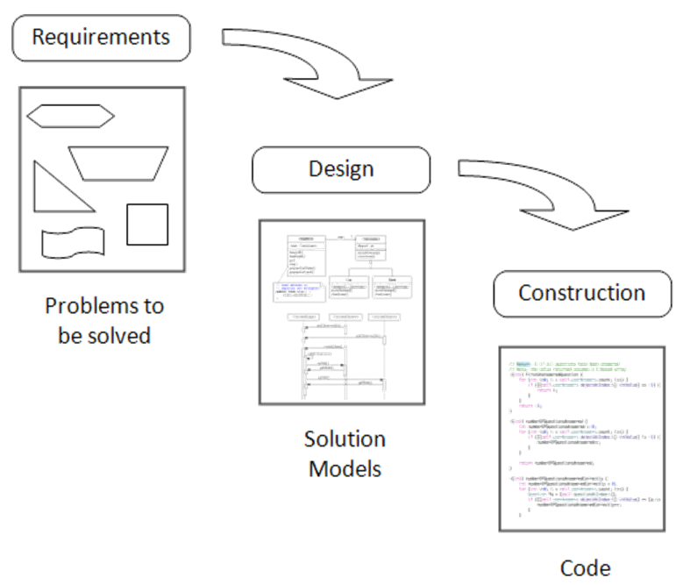
Design Pattern
A general repeatable solution to a commonly occurring problem in software design. A design pattern isn't a finished design that can be transformed directly into code. It is a description or template for how to solve a problem that can be used in many different situations

Slide 9
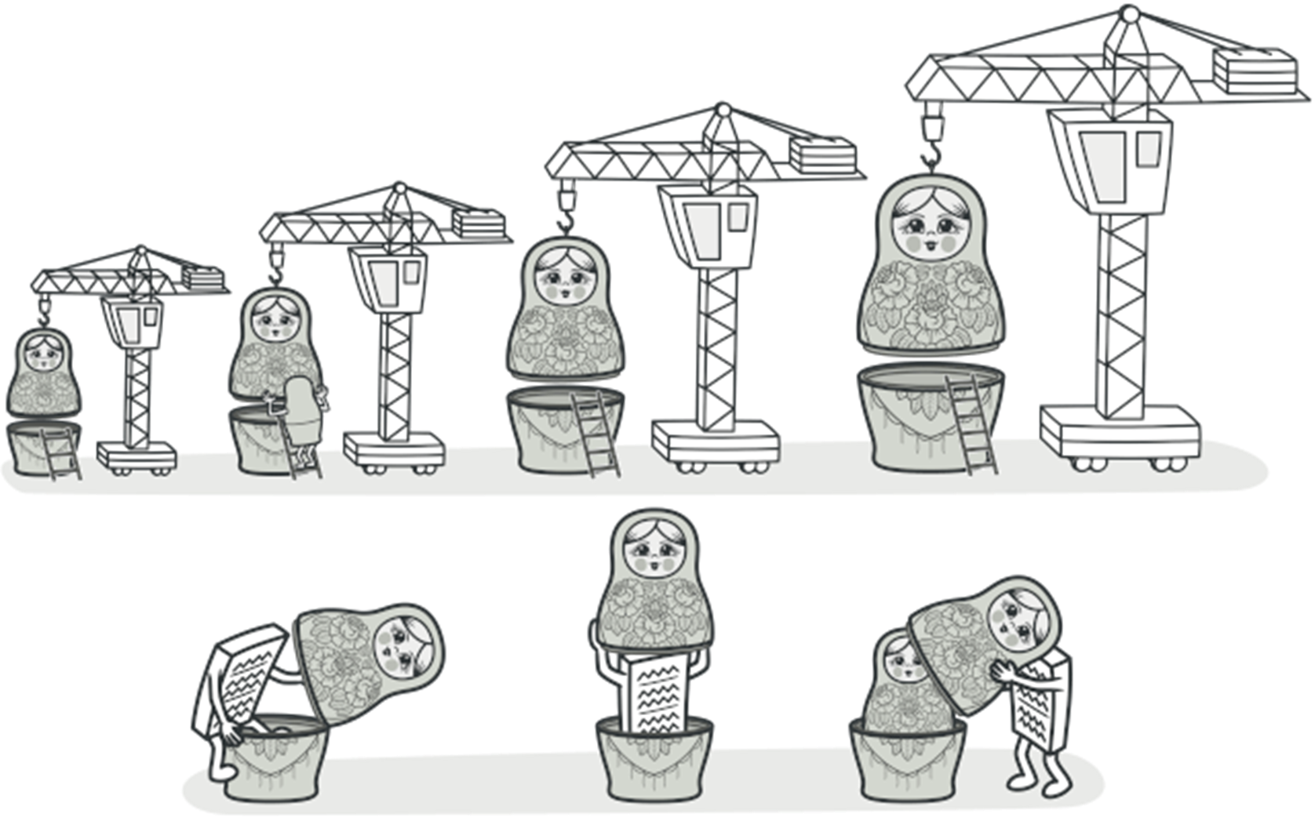
Decorator Pattern
A structural design pattern
Let you attach new behaviors to objects by placing these objects inside special wrapper objects that contain the behaviors.
This pattern creates a decorator class which wraps the original class and provides additional functionality keeping class methods signature intact.

Slide 10
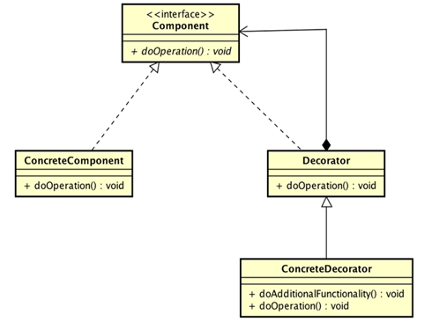

Component: A common interface for objects that need additional function during runtime
ConcreteComponent: A setting for the Component interface that defines an object that needs additional functions during runtime
Decorator: An abstract class used to maintain a reference of a component object and install components of the interface.
ConcreteDecorator: A setting of Decorator, which installs at the beginning of the component objects.
Diagram

Slide 11
APPLICATION

Slide 12
PROBLEM
Imagine a scenario where you are working for a Pizza store, and your store has made TOMATO PIZZA and CHEESE PIZZA. Then you need to put a few more ingredients on the top of the cake due to your customers ‘ flavor like chicken or pepper .
Basically you have some pizza types like: tomato chicken pizza, pepper tomato pizza, chicken cheese pizza, pepper tomato pizza and pepper chicken cheese.

Slide 13
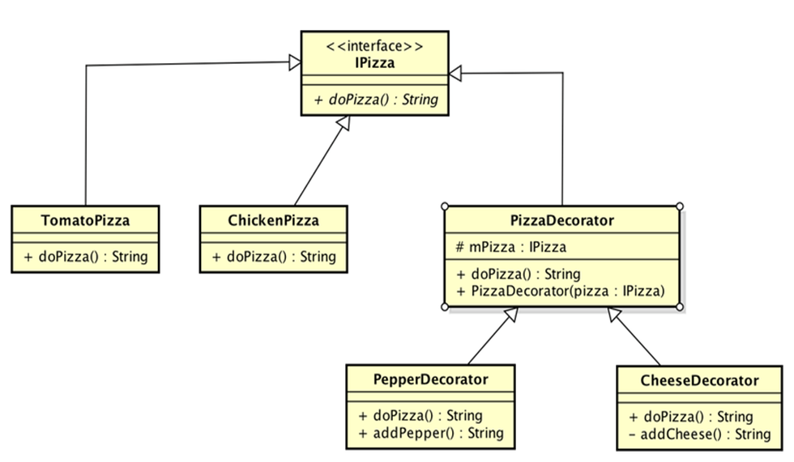
DIAGRAM

Slide 14
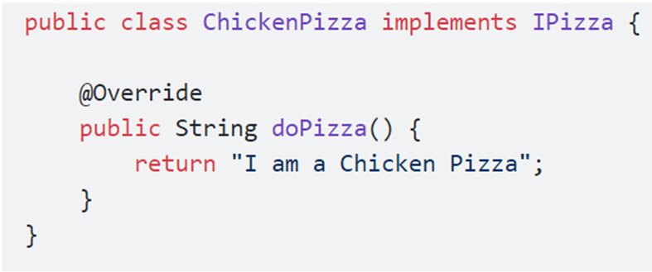
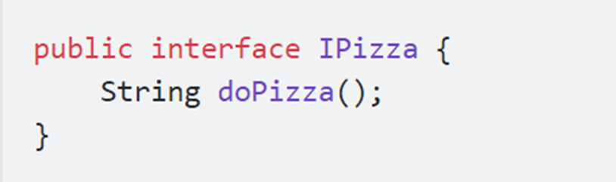
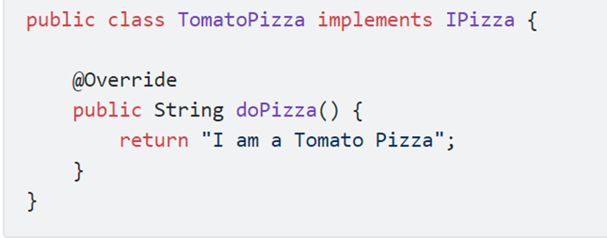
Source Code
TomatoPizza and ChickenPizza are settings and implementations of IPizza. They provide specific class instances that we need to extend while the program is running.

Slide 15
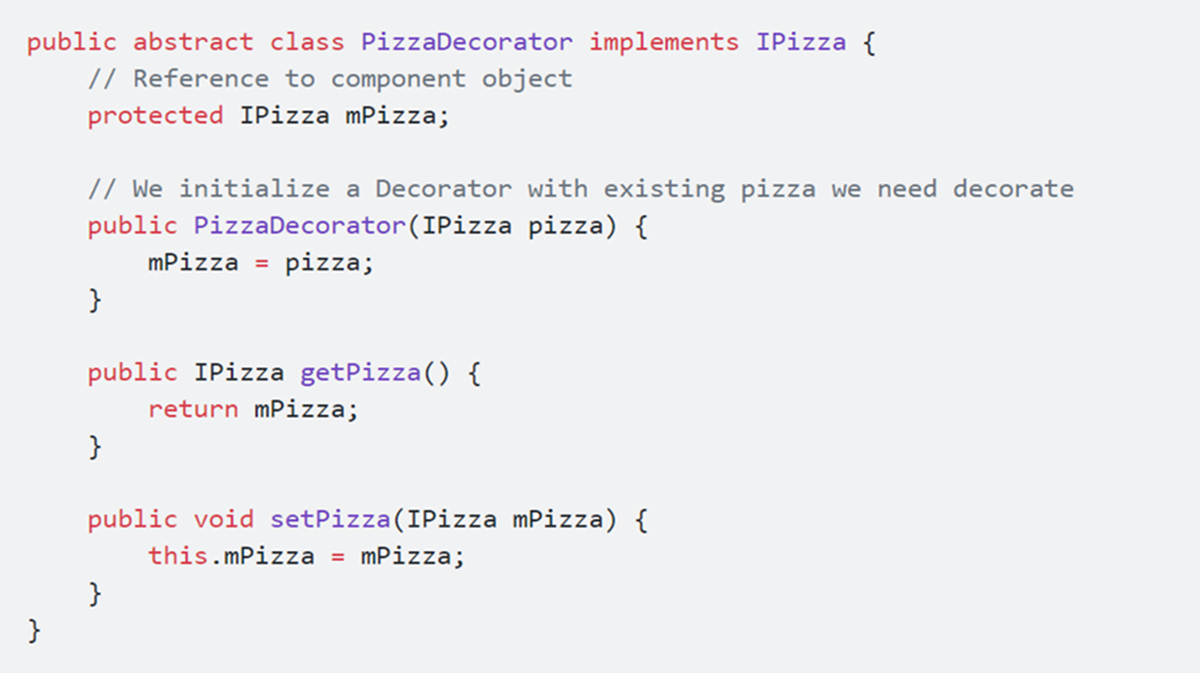
Source Code
PizzaDecorator is the heart of the design diagram. It holds an existing instance of a pizza like TomatoPizza or ChickenPizza. This property will be set via the create method, and it is extended while the program is running.

Slide 16
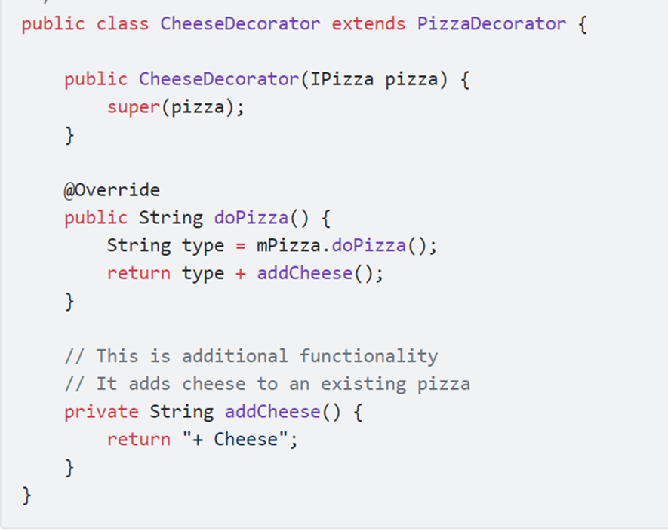
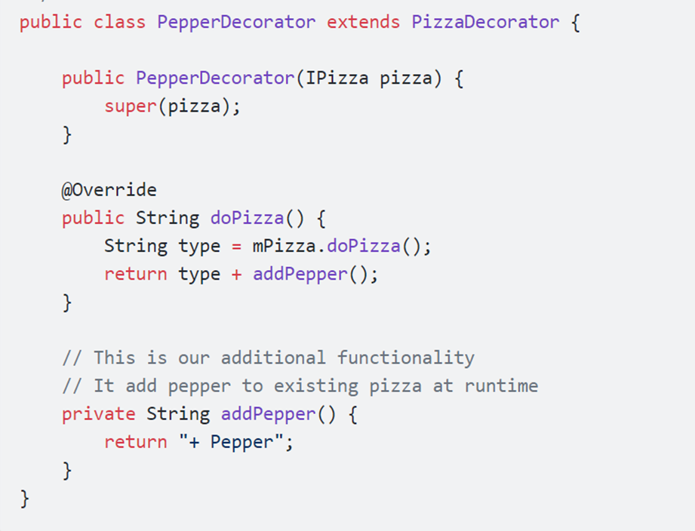
Source Code
PepperDecorator and CheeseDecorator implement extension methods, in this example, PepperDecorator will add pepper to an existing pizza. The extended feature is installed in the addPepper () method.

Slide 17
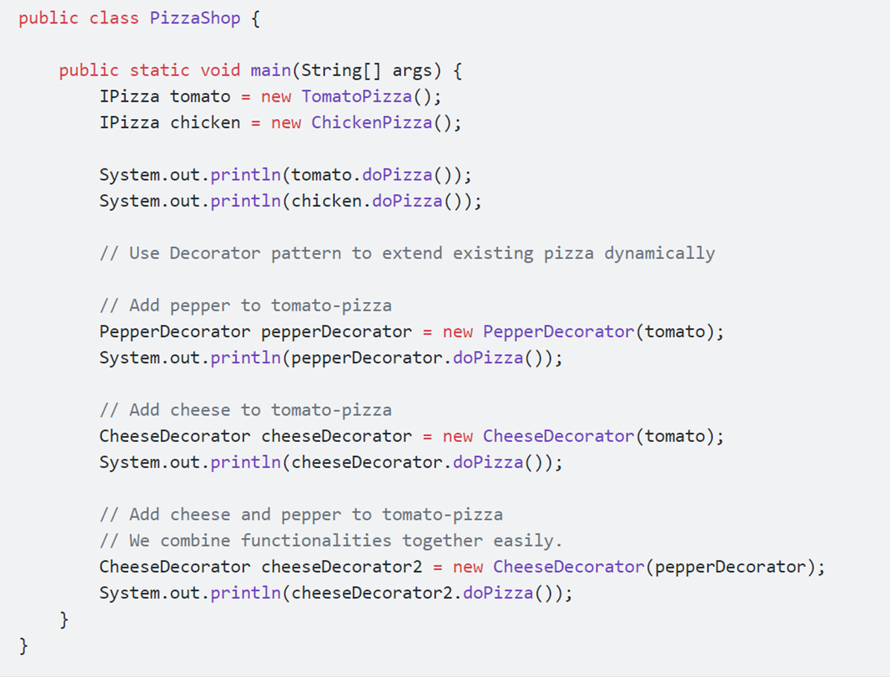
Source Code
And finally we need to write the class to run the above settings, which is the PizzaShop class

Slide 18
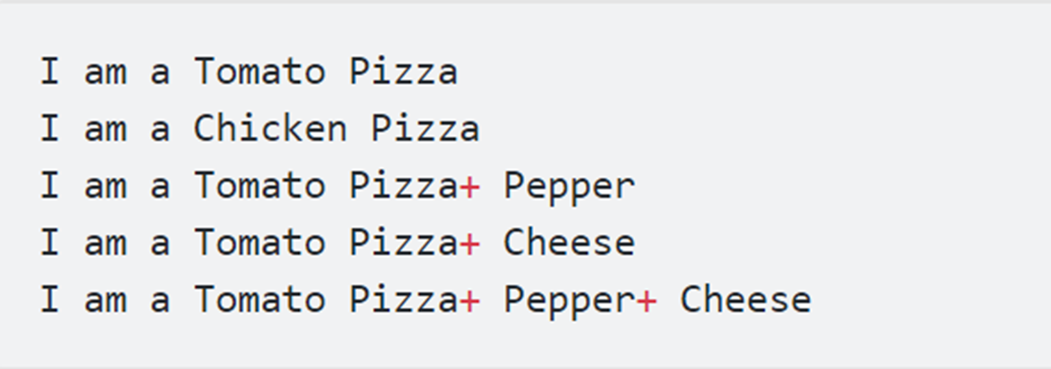
Result

Slide 19
PROS & CONS

Slide 20
DECORATOR PATTERN
ADVANTAGE
DISADVANTAGE
Extend an object’s behavior without making a new subclass.
Hard to remove a specific wrapper from the wrappers stack.
Hard to implement a decorator in such a way that its behavior doesn’t depend on the order in the decorators stack.
Add or remove responsibilities from an object at runtime.
Combine several behaviors by wrapping an object into multiple decorators.
The initial configuration code of layers might look ugly.

Slide 21
GAME TIME

Slide 22

GAME TIME
https://play.kahoot.it/v2/?quizId=a8ee5921-7bf3-427e-924e-133630be3807

Slide 23
EXCERCISE

Slide 24
“Use Decorator Pattern to solve these problems below.”
Construct a Beverage class and “decorate” it with some ingredients (Mocha, Cheese, …) Then calculate the total payment for these drinks.
01
Suppose we have a Christmas tree object and we want to decorate it. We're adding some decoration items like garland, tinsel, tree-topper, bubble lights,
02
Suppose we want to implement different kinds of cars – we can create interface Car and then we can have a Basic car, further more we can extend it to Sports car and Luxury Car.
03
04
Create a Shape interface and concrete classes implementing the Shape interface. Then create an abstract decorator class ShapeDecorator implementing the Shape interface and having Shape object as its instance variable.

Slide 25
Thank you
Feel free to ask us for more information

