Slide 1
Collections
ArrayList

Slide 2
The ArrayList Class
ArrayList is a class in the standard Java libraries
Unlike arrays, which have a fixed length once they have been created, an ArrayList is an object that can grow and shrink while your program is running
In general, an ArrayList serves the same purpose as an array, except that an ArrayList can change length while the program is running.

Slide 3
Using the ArrayList Class
In order to make use of the ArrayList class, it must first be imported from the package java.util
An ArrayList is created and named in the same way as object of any class, except that you specify the base type as follows:
ArrayList<BaseType> aList = new ArrayList<BaseType>();

Slide 4
Using the ArrayList Class
An initial capacity can be specified when creating an ArrayList as well.
The following code creates an ArrayList that stores objects of the base type String with an initial capacity of 20 items
ArrayList<String> list = new ArrayList<String>(20);
Specifying an initial capacity does not limit the size to which an ArrayList can eventually grow
Note that the base type of an ArrayList is specified as a type parameter

Slide 5
Using the ArrayList Class
The add method is used to set an element for the first time in an ArrayList
list.add("something");
There is also a two argument version that allows an item to be added at any currently used index position or at the first unused position

Slide 6
Using the ArrayList Class
The size method is used to find out how many indices already have elements in the ArrayList
int elements = list.size();
The set method is used to replace any existing element, and the get method is used to access the value of any existing element
list.set(index, "something else");
String thing = list.get(index);

Slide 7
Methods in the Class ArrayList
ArrayLists come with a selection of powerful methods that can do many of the things for which code would have to be written in order to do them using arrays.

Slide 8
Methods in the ArrayList Class
boolean add(<T> element)
Adds a new element to the end of the ArrayList; the return value is always true.
void add(int index, <T> element)
Inserts a new element into the ArrayList before the position specified by index.
<T> remove(int index)
Removes the element at the specified position and returns that value.
boolean remove(<T> element)
Removes the first instance of element, if it appears; returns true if a match is found.
void clear()
Removes all elements from the ArrayList.
int size()
Returns the number of elements in the ArrayList.
<T> get(int index)
Returns the object at the specified index.
<T> set(int index, <T> value)
Sets the element at the specified index to the new value and returns the old value.
int indexOf(<T> value)
Returns the index of the first occurrence of the specified value, or -1 if it does not appear.
boolean contains(<T> value)
Returns true if the ArrayList contains the specified value.
boolean isEmpty()
Returns true if the ArrayList contains no elements.

Slide 9
The "For Each" Loop
The ArrayList class is an example of a collection class
Starting with version 5.0, Java has added a new kind of for loop called a for-each or enhanced for loop
This kind of loop has been designed to cycle through all the elements in a collection (like an ArrayList)

Slide 10
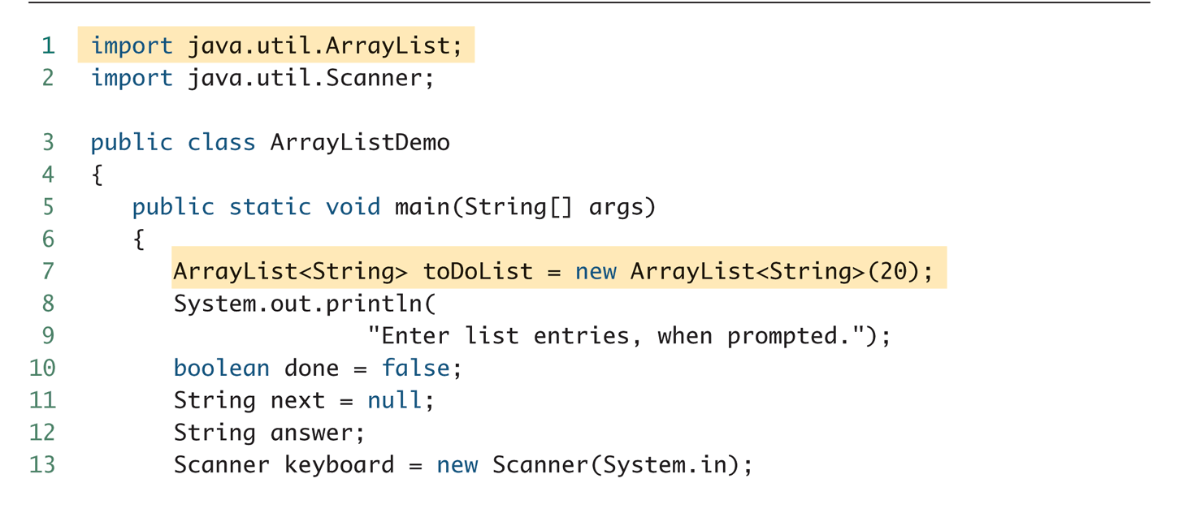
A for-each Loop Used with an ArrayList

Slide 11
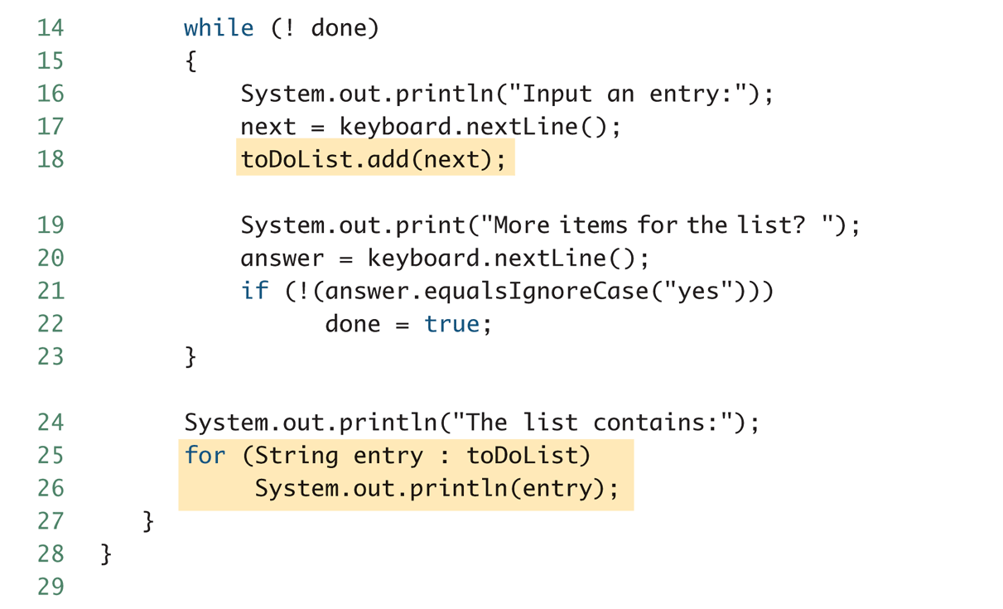
A for-each Loop Used with an ArrayList

Slide 12
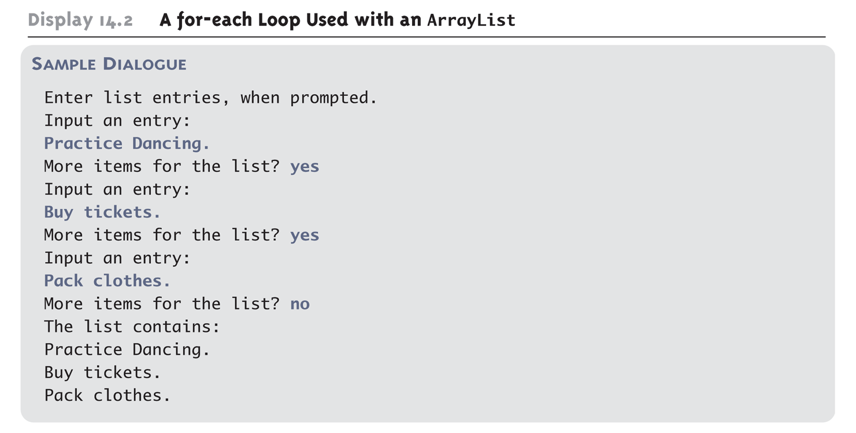
A for-each Loop Used with an ArrayList

