Slide 1
IEC 61850-7-1

Slide 2
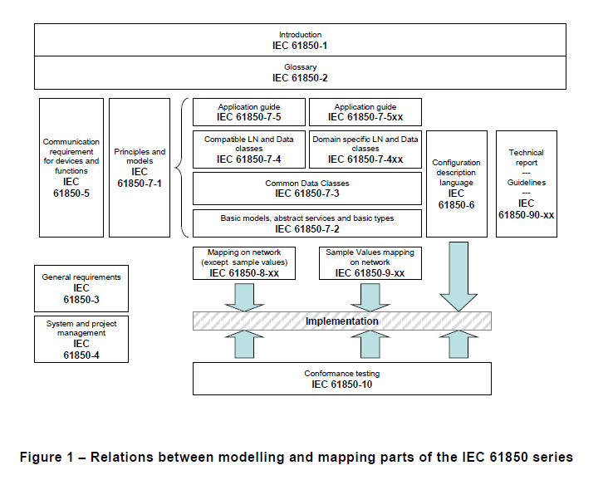
5.1 Objective

Slide 3
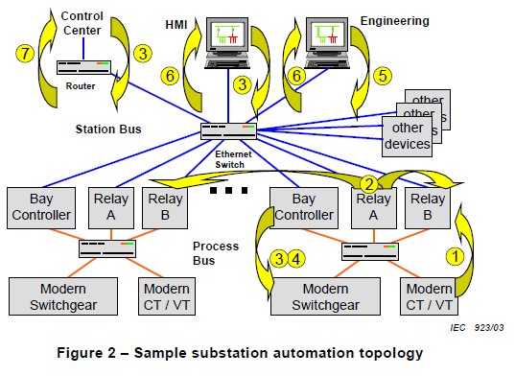
5.2 Topology and communication functions of substation automation systems
– sampled value exchange for CTs and VTs (1),
– fast exchange of I/O data for protection and control (2),
– control signals (3),
– trip signals (4),
– engineering and configuration (5),
– monitoring and supervision (6),
– control-center communication (7),
– time-synchronisation,
– etc.

Slide 4
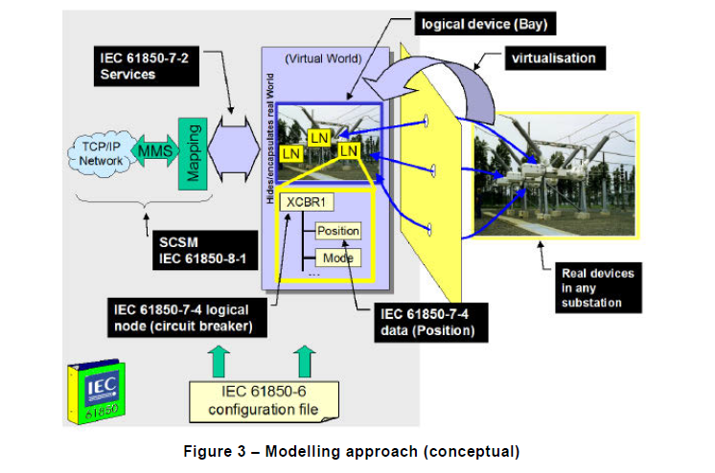
5.3 The information models of substation automation systems

Slide 5
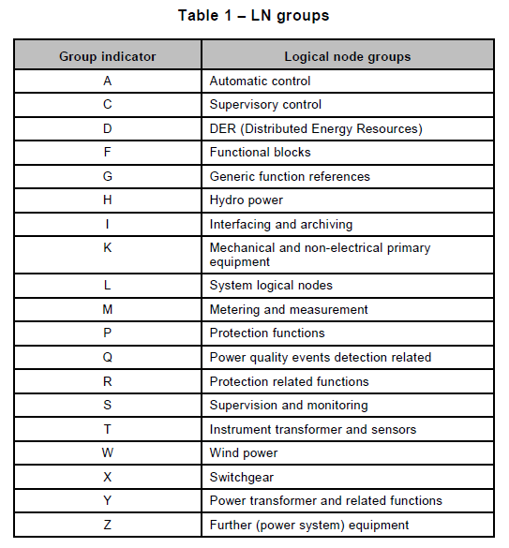
5.4 Applications modelled by logical nodes defined in IEC 61850-7-4

Slide 6
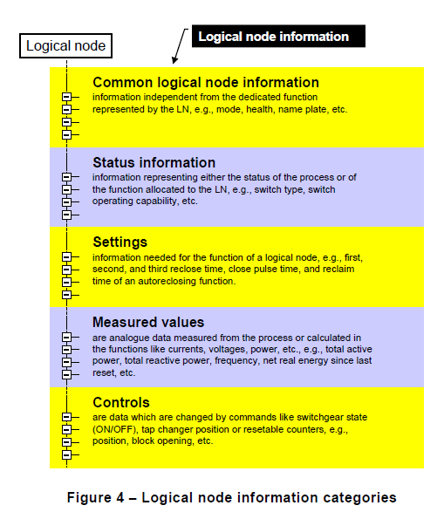
5.4 Applications modelled by logical nodes defined in IEC 61850-7-4

Slide 7
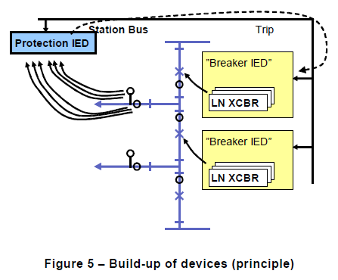
5.4 Applications modelled by logical nodes defined in IEC 61850-7-4

Slide 8
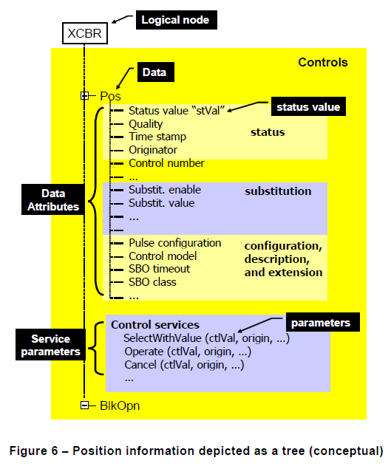
5.5 The semantic is attached to data

Slide 9
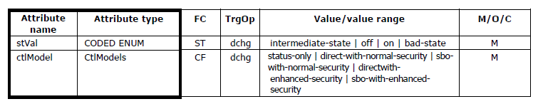
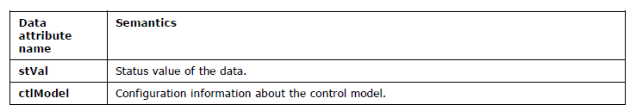
5.5 The semantic is attached to data
All data attrubute names is defined at the end of IEC 61850-7-3

Slide 10
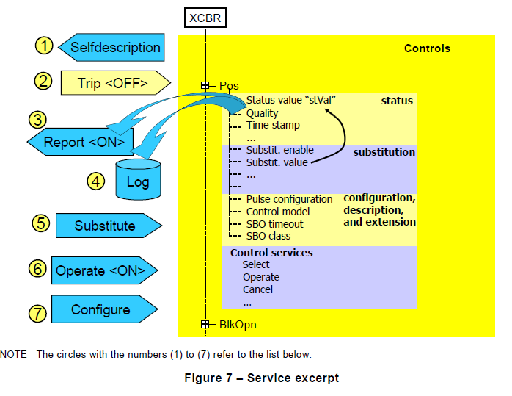
5.6 The services to exchange information

Slide 11
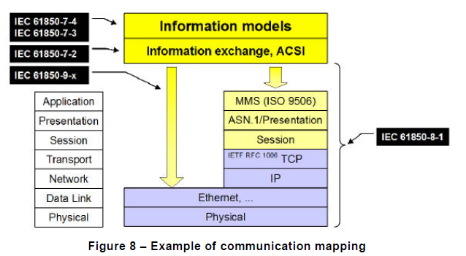
5.7 Services mapped to concrete communication protocols

Slide 12
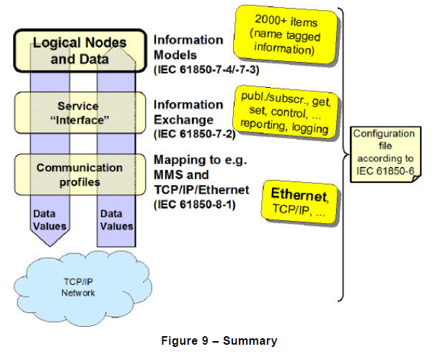
Summary

Slide 13
6. Modelling approach of the IEC 61850 series

Slide 14
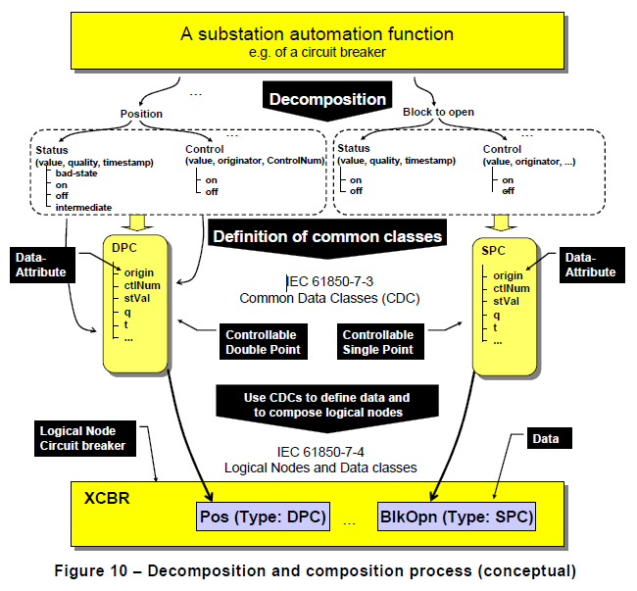
6.1 Decomposition of application functions and information

Slide 15
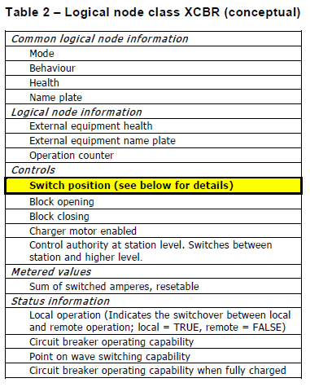
6.2 Creating information models by stepwise composition

Slide 16
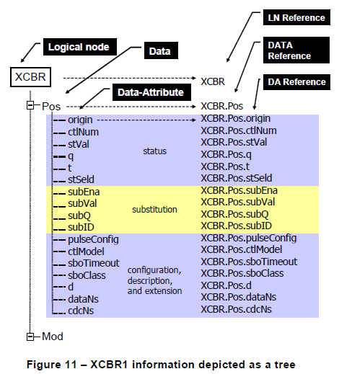
6.2 Creating information models by stepwise composition

Slide 17
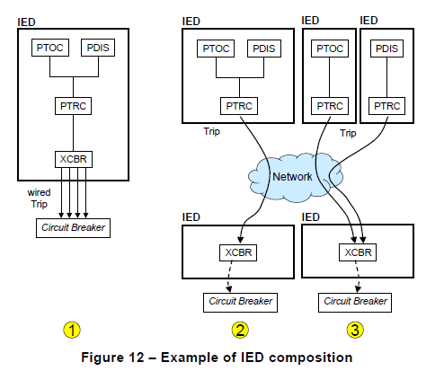
6.3 Example of an IED composition
PTOC : time overcurrent protection
PDIS : distance protection
PTRC : trip conditioning
XCBR : circuit breaker

Slide 18
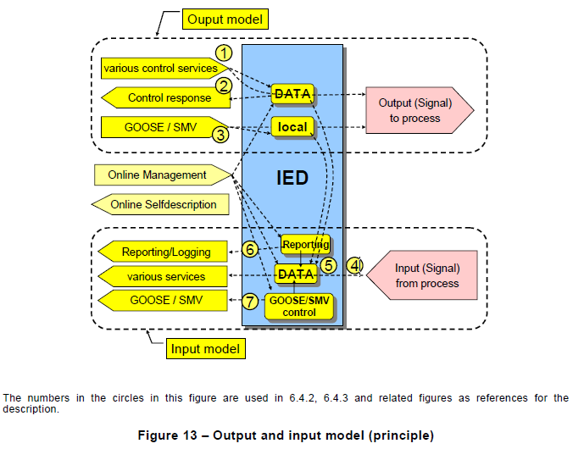
6.4 Information exchange models ( 6.4.1 General)
3 categories
Output model
Input model
Model for online management and self-description

Slide 19
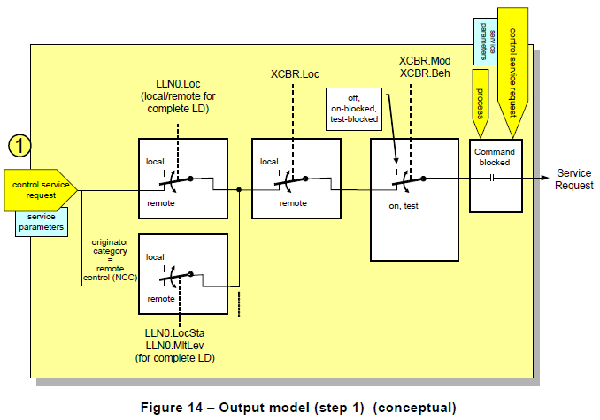
6.4.2 Output model ( 6.4.2.1 Control model concept )

Slide 20
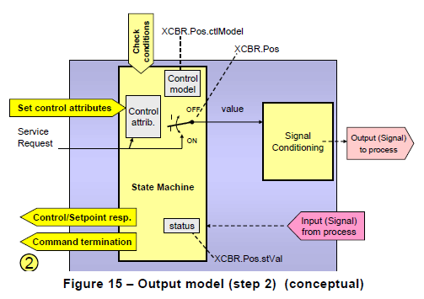
6.4.2 Output model ( 6.4.2.1 Control model concept )

Slide 21
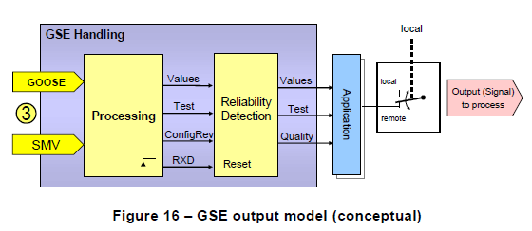
6.4.2 Output model ( 6.4.2.2 GSE and SMV model concept )

Slide 22
6.4.2 Output model ( 6.4.2.3 Attributes of data and control blocks)
Many data attributes of the hierarchical information model can be set with a Set-service
data attribute들의 값을 설정하는 것은 보통 application에 의해 제한된다.
이런 attribute들을 설정하기 위한 service들은 61850-7-2 에 control blocks에 정의되어있다.
Control block 속성의 값을 설정하는 것은 corresponding control block의 state machinie에 의해 제한된다.
Control block들은 attribute set의 값에 따라 행동하고 SCL 파일 또는 다른 local 수단들로 구성되어있다. 또한, 다른 IED에 의해 읽어질수 있다.

Slide 23
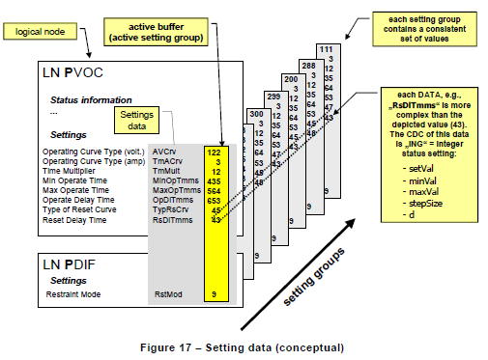
6.4.2 Output model ( 6.4.2.4 Setting data and setting group control block)

Slide 24
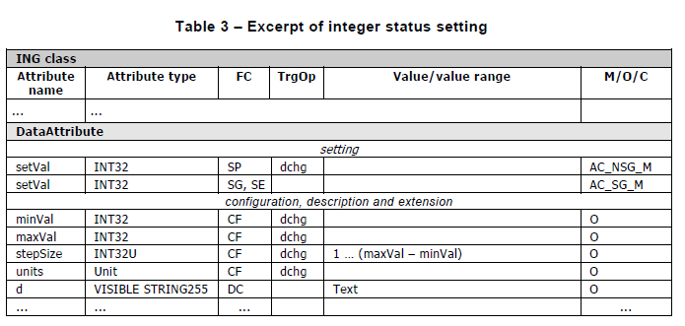
6.4.2 Output model ( 6.4.2.4 Setting data and setting group control block)

Slide 25
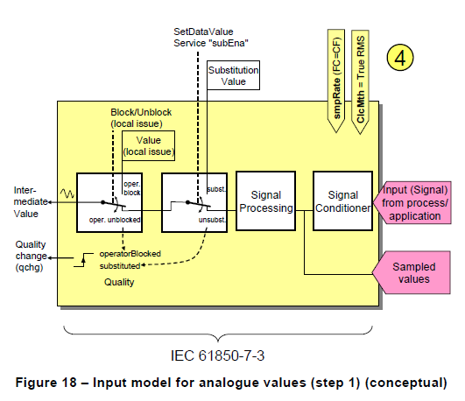
6.4.3 Input model ( 6.4.3.1Input analogue signal acquisition )

Slide 26
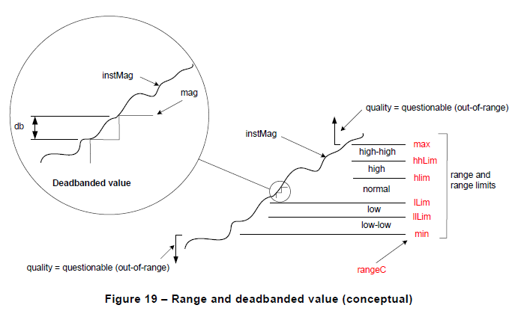
6.4.3.2 Data attribute value processing, monitoring and event detection

Slide 27
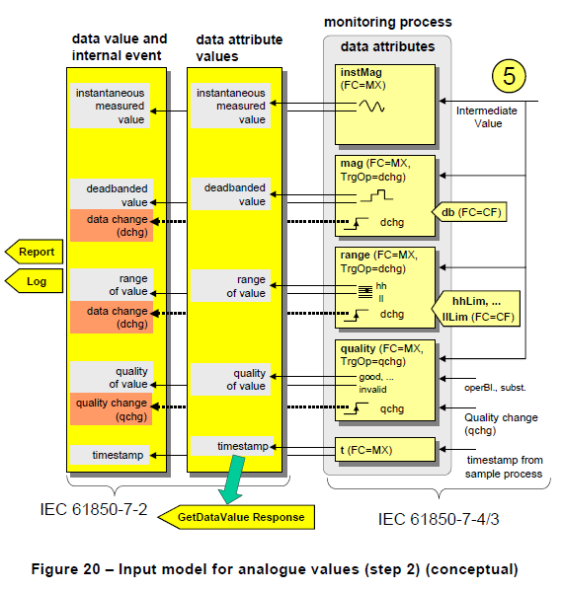
6.4.3.2 Data attribute value processing, monitoring and event detection

Slide 28
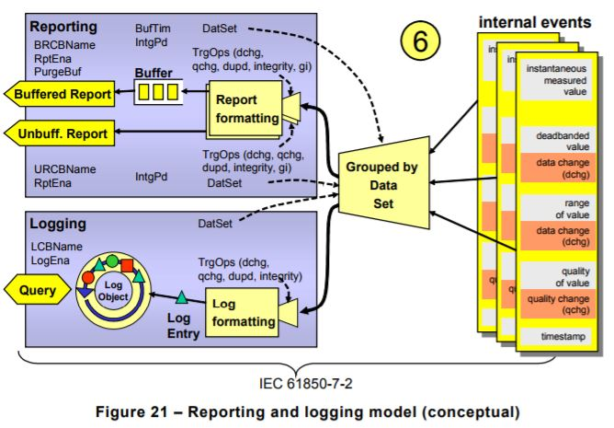
6.4.3.3 Data reporting and logging
General

Slide 29
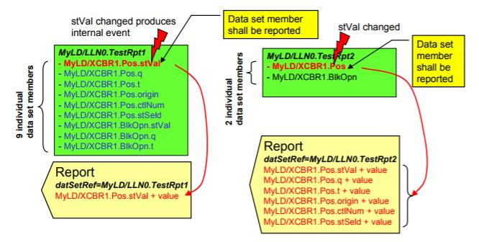
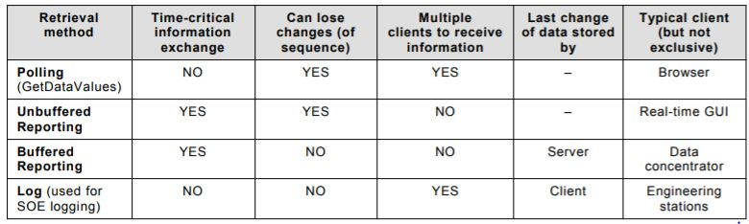
6.4.3.3.2 Data reporting
Date set members and reporting
Comparison of the access methods

Slide 30
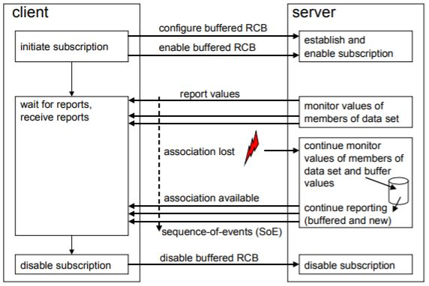
Buffered report control block

Slide 31
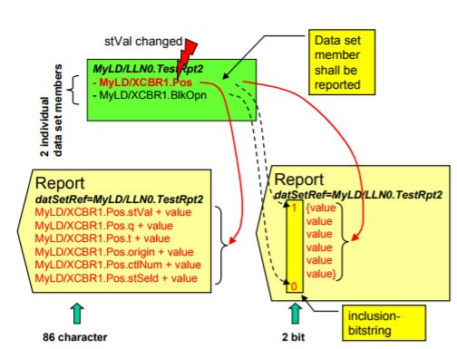
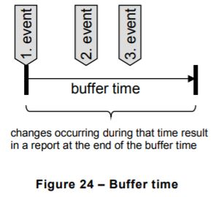
Data set members and inclusion-bitstring

Slide 32
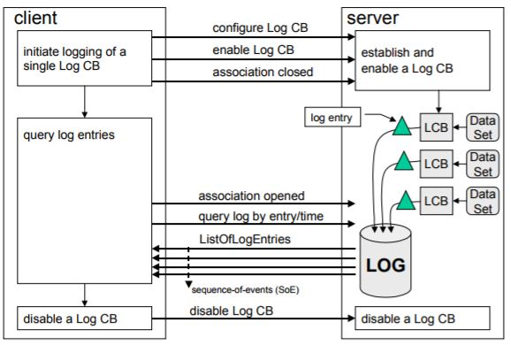
6.4.3.3.2 Data reporting
Log control block

Slide 33
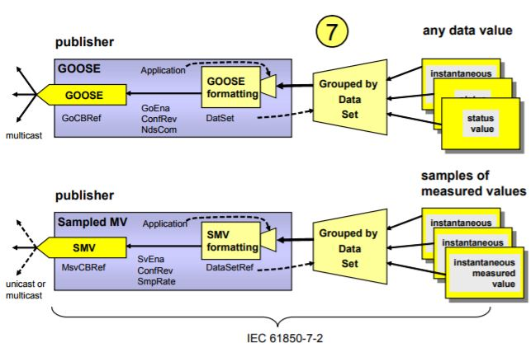
6.4.3.4 Peer-to-peer data value publishing
Peer-to-peer data value publishing model

Slide 34
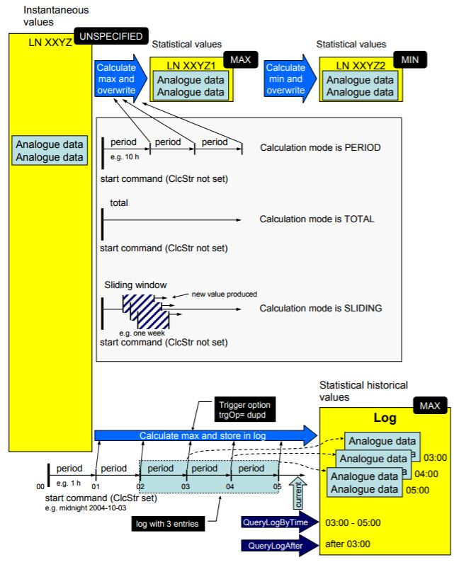
6.4.4 Model for statistical and historical statistical data

Slide 35
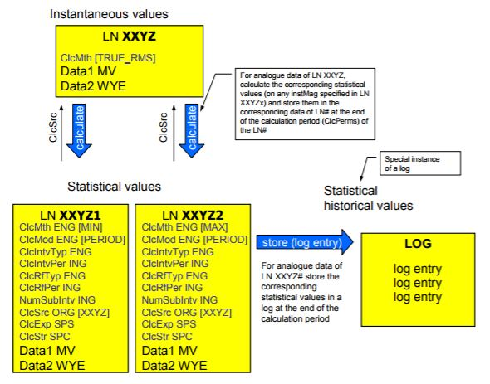
Conceptual model of statistical and historical statistical data

Slide 36
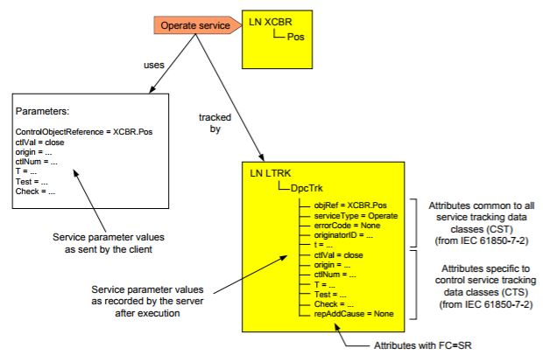
6.4.5 Model for system functions
6.4.5.1 General
6.4.5.2 Time synchronization
6.4.5.3 Time management
6.4.5.4 Time supervision
6.4.5.5 GOOSE and SMV supervision
6.4.5.6 Service tracking

Slide 37
감사합니다

