Slide 1
IEC 61850-7-1

Slide 2
8 Device view ( 8.1 General )
Real devices host mainly:
- logical nodes and data
- information about real devices
- communication services and mapping to specific
communication systems

Slide 3
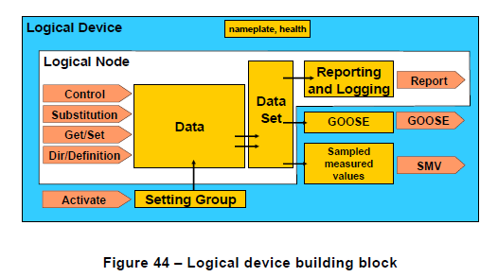
8.2 Second modelling step – logical device model

Slide 4
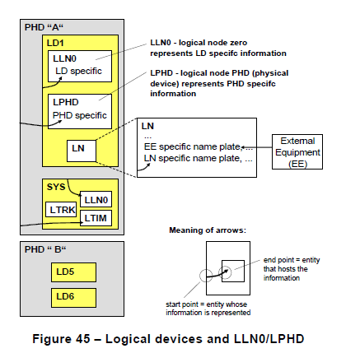
8.2 Second modelling step – logical device model

Slide 5
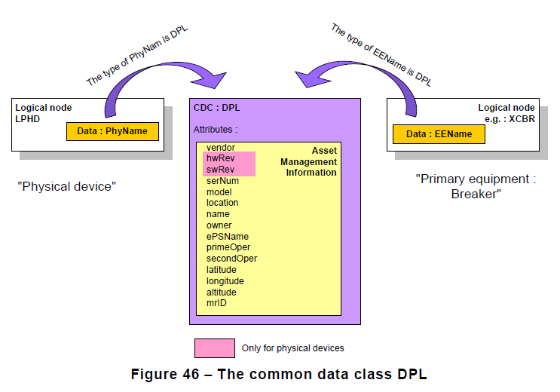
8.2.2 The device nameplate

Slide 6
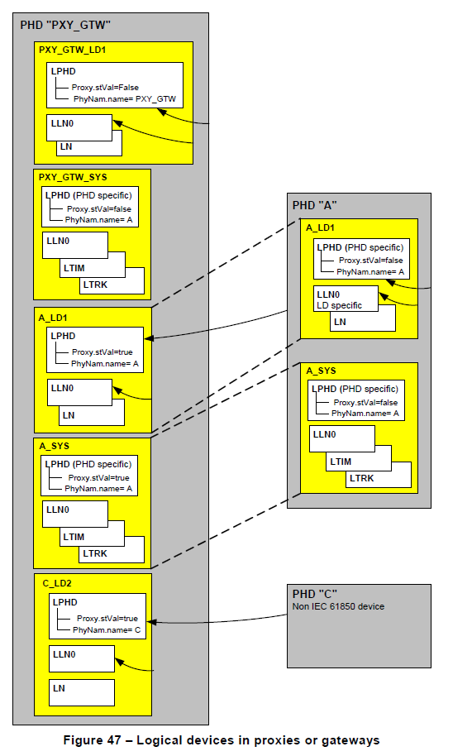
8.2.3 Gateways and proxies

Slide 7
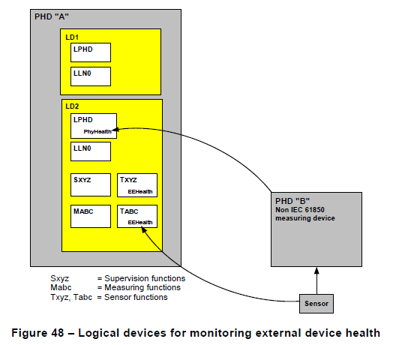
8.2.4 Logical devices for monitoring external device health

Slide 8
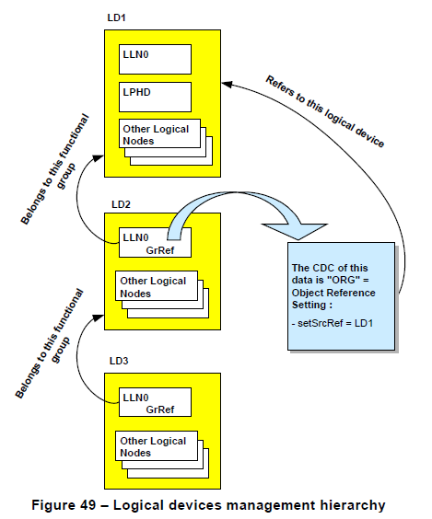
8.2.5 Logical devices management hierarchy

Slide 9
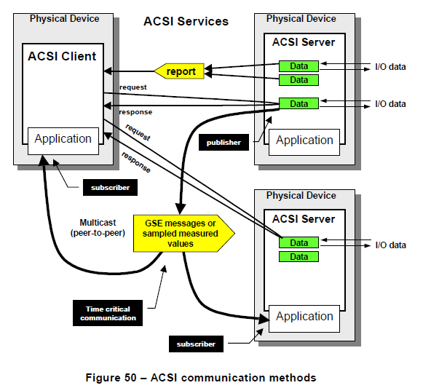
9 Communication view ( 9..1 General )

Slide 10
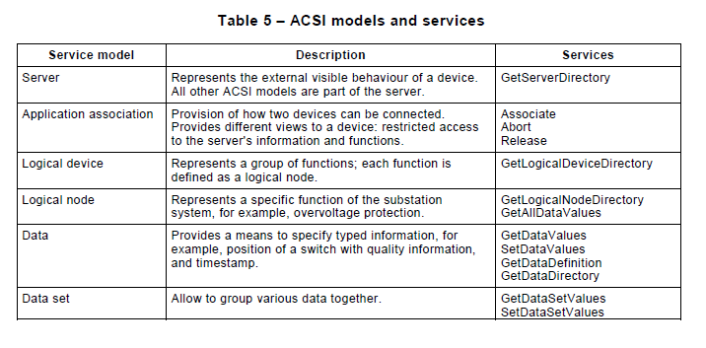
5.6 The services to exchange information

Slide 11
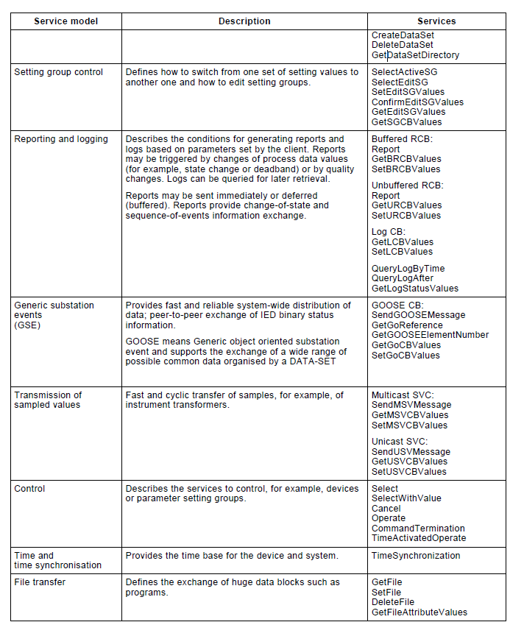

Slide 12
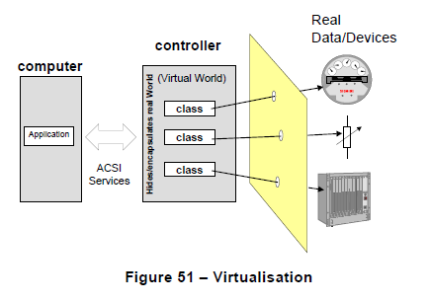
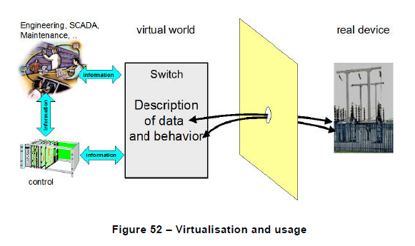
9.3 The virtualisation

Slide 13
감사합니다

