Slide 1
IEC 61850-7-1

Slide 2
13.4 Attribute for references to name space ( 13.4.1 General)
Attribute logical device name space (ldNs)
Attribute logical node name space (lnNs)
Attribute data name space (dataNs)
Attribute common data class name space (cdcNs)

Slide 3
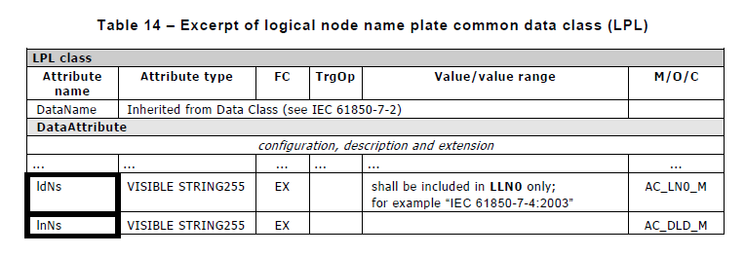
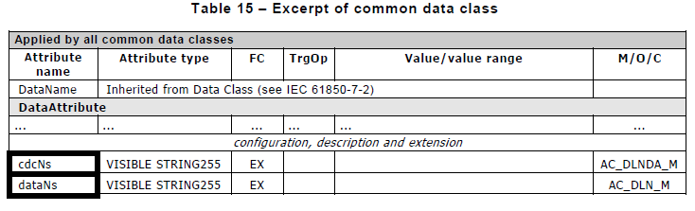
13.4 Attribute for references to name space ( 13.4.1 General)

Slide 4

13.4.2 Attribute for logical device name space (ldNs)
The domain application name space used as the prime name space for the whole logical device
It is available in every instance of the logical node class LLN0

Slide 5

13.4.3 Attribute for logical node name space (lnNs)
the used name space for a specific logical node
It is available in a LN instance if its value differs from the ldNs value.
- lnNs와 ldNs는 61850-7-3의 LPL에 정의

Slide 6

13.4.4 Attribute for data name space (dataNs)
The used name space for a specific data
It is available when the data class is added by extension to standardized LNs.

Slide 7

13.4.5 Attribute for common data class name space (cdcNs)
Common data class name space used for the creation of a specific data
cdc shall only be made by the owner of the name space.
dataNs와 cdcNs는 61850-7-3의 common data classes에 정의

Slide 8
14 Common rules for new version of classes and for extension of classes (14.1 General)
LN classes, data classes and CDC shall be used for defining new versions of classes and for making extensions to existing classes
Classes which are part of a owner name space are called standardized classes.

Slide 9
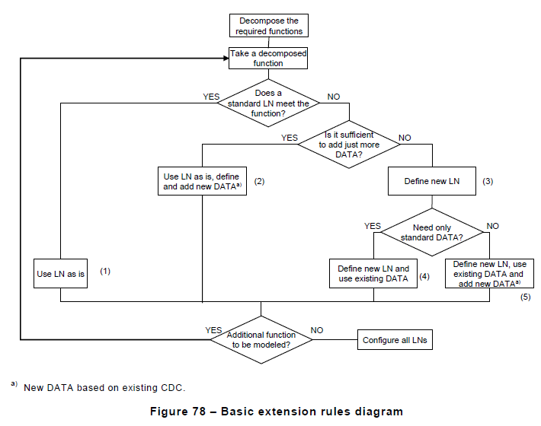
14.2 Basic rules

Slide 10
14.3 Rules for LN classes ( 14.3.1 Use of standardized LN classes )
모델화 하려는 기능에 맞는 logical node class가 있다면 mandatory data에 사용한다.
모델화 하려는 기능에 맞는 logical node class가 있다면 그것도 optional data로 사용한다.
같은 Data를 여러 번 instance화 하려면 14.6에 나와있는 number extension에 관련된 rule에 맞춰서 사용함
If there are dedicated versions of the function to be modelled with the same basic data, different instances of this logical node class shall be used

Slide 11
14.3.2 Extensions to standardized LN classes made by third parties
Only be the addition of new optional data
The new data object class name shall follow the naming conventions defined in 61850-7-2
The abbreviated terms of 61850-7-4 shall be used
Only one of the common data classes defined in 61850-7-3 or by other domains like 61850-7-410 or 61850-7-420
It is marked by a namespaceID different from the owner’s namespaceID
It is added to the IEC documentation of the provided specific system or customer specific project

Slide 12
14.3.3 New LN classes
Only be defined by the owner of the name space
Third parties expand owner LN class set by defining new LNs outside the owner’s name space
LN class는 61850-7-2에 정의된 naming conventions과 61850-7-4의 LN group을 따름
Third party 에 의해 정의된 data object class name들은 61850-7-4에 정의된 LN data object class name들 중 하나를 사용하거나 new data object class name을 쓴다 ( step (4) or step (5) )
61850-7-4에 정의된 약어로 new object class name 지음
It is added to the IEC documentation of the provided specific system or customer specific project

Slide 13
14.3.4 New versions of standardized LN classes made by name space owners
The owner should not change the namespaceID for new versions.
New data shall be added as optional data.
Existing data which are no longer required, shall not be removed
Changing the semantics of existing LNs and data shall not be allowed.

Slide 14
14.4 Rules for common data classes and control block classes (14.4.1 New common data classes and control block classes)
Common data classes와 control block classes은 오직 the owner of the name space 에 의해 정의된다.
Common data class 의 name에 대한 naming convention들과 control block classes에 대한 notation은 IEC 61850-7-2에 정의되어있다.

Slide 15
14.4.2 New versions of standardized common data classes
The owner should not change the namespaceID for new versions.
New attributes shall be added as optional attributes
Existing attributes which are no longer required, shall not be removed
Changing the semantics of existing common data classes and attributes is not allowed.

Slide 16
14.4.3 New versions of control block classes
New attributes shall be added as optional attributes
Existing attributes which are no longer required, shall not be removed
Changing the semantics of existing control block classes attributes is not allowed.

Slide 17
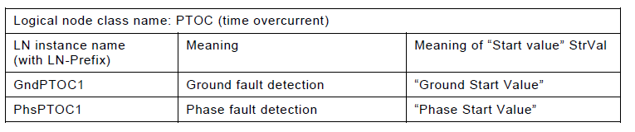
14.5 Multiple instances of LN classes for dedicated and complex functions (14.5.1 Example for time overcurrent)
- The semantics of the different instance may be given in the description attribute “d” of data NamPlt

Slide 18
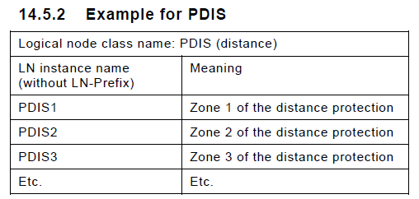
14.5.2 Example for PDIS
- The semantics of the different instance may be given in the description attribute “d” of data NamPlt .

Slide 19
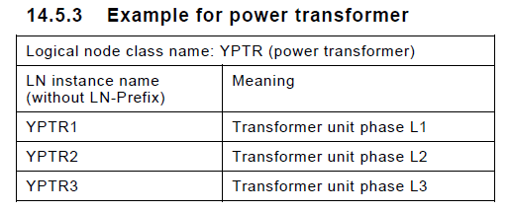
14.5.3 Example for power transformer
- The semantics of the different instance may be given in the description attribute “d” of data NamPlt.

Slide 20
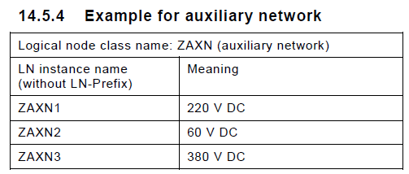
14.5.4 Example for auxiliary network
- The semantics of the different instance may be given in the description attribute “d” of data NamPlt .

Slide 21
14.6 Specialization of data by use of number extensions
같은 data를 여러 번 정의하는 것이 필요할 때 number extention을 사용하여 data를 추가
Number extension에 대한 rules는 61850-7-2 의 naming convention에 정의
The number extension shall be done by adding the number extension 1 to a data object name
Data with no number extension shall not be extended by third parties
Data with the number extension 1 can be extended
만약에 extendable data의 instance가 한 개 밖에 없으면 number extension “1” 을 가진다.

Slide 22
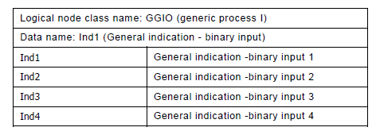
14.6 Specialization of data by use of number extensions

Slide 23
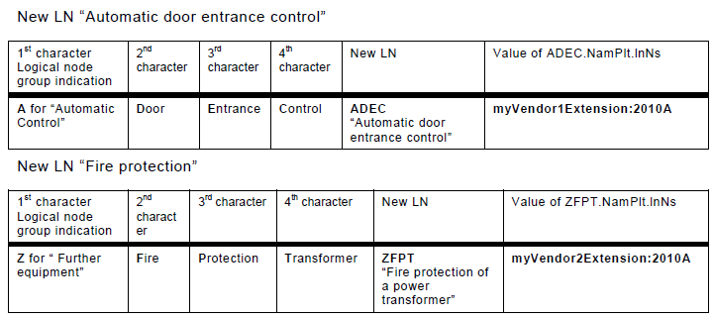
14.7 Examples for new LNs

Slide 24
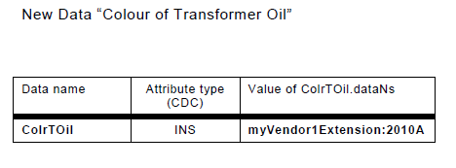
14.8 Example for new Data

Slide 25
감사합니다

