Slide 1

MOBILE MARKET OVERVIEW

Slide 2
Outline
Mobile search market
Content accessed from smartphone
Mobile market compared to other technologies
Mobile OS market share
Some new products-ideas for 2024-2025

Slide 3
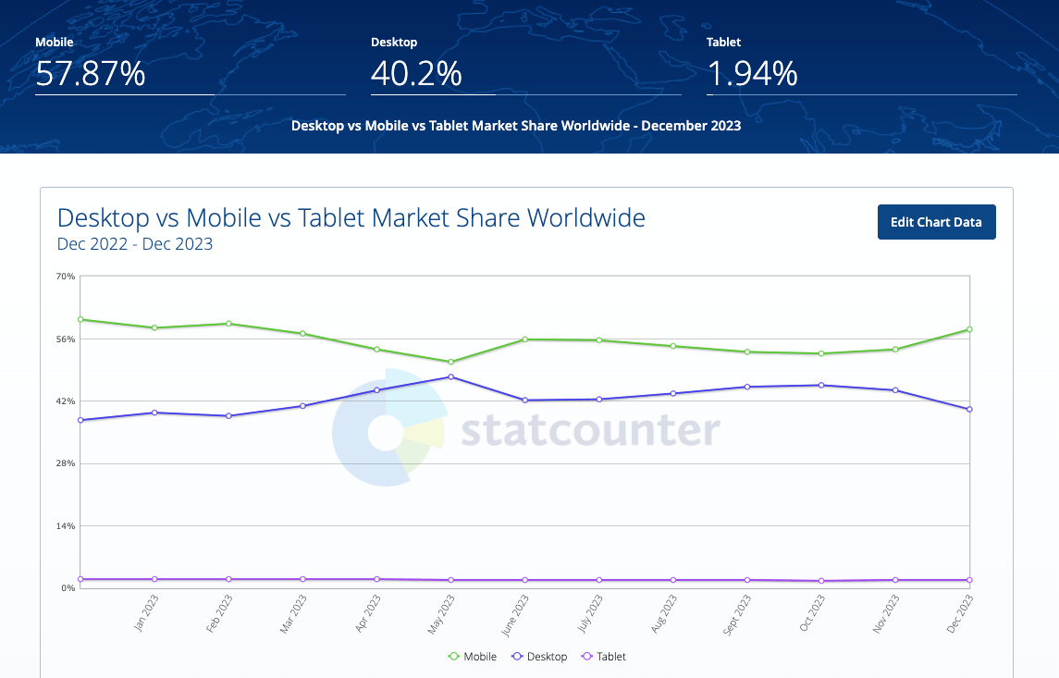
MOBILE SEARCH MARKET
By device
58% queries originate from mobile devices compared to about 40% from desktop
https://www.smartinsights.com/search-engine-marketing/search-engine-statistics/ (01/10/2025)

Slide 4
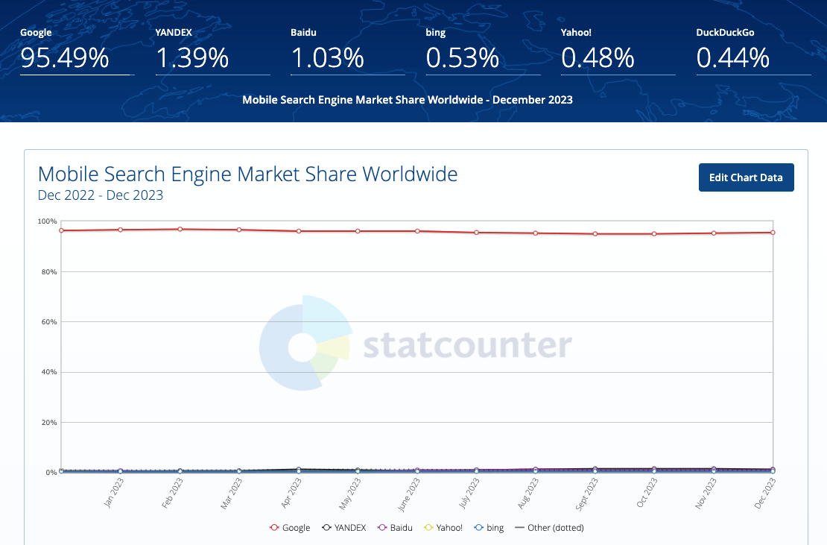
MOBILE SEARCH MARKET
By search engine
Google dominates other tools with nearly 96% user
https://www.smartinsights.com/search-engine-marketing/search-engine-statistics/ (01/10/2025)

Slide 5
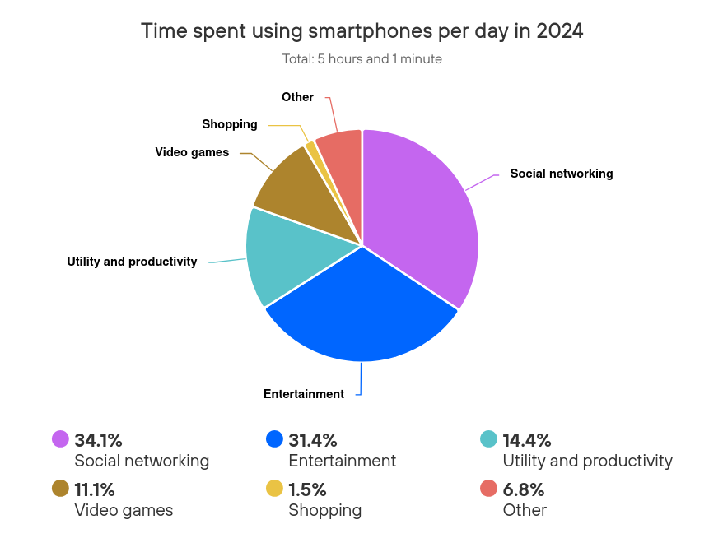
CONTENT ACCESSED FROM SMARTPHONE
The average time user spend on using smartphone is about 5 hours per day,
Dominated by social and entertainment activities
https://www.telefonica.com/en/communication-room/blog/smartphones-2024/ (01/10/2025)

Slide 6
MOBILE MARKET COMPARED TO OTHER TECHNOLOGIES
Factor | Mobile Software | Traditional Software (webm /desktop, ...)
Market size | Global mobile app revenue is projected to reach $190 billion by 2025 (up ~14% from 2024) | The overall software market (all platforms) was valued at ~$736.96 billion in 2024
Share of Total Software Revenue | Significant but not dominant — with ~$190 billion out of ~$737 billion, mobile accounts for ~25–30% of total software revenue | Web/desktop software plus enterprise, embedded, and systems software account for the remaining majority
Revenue Models | One-time purchases, in-app purchases, subscriptions, advertising (in-app ads) | Software licensing, SaaS (web apps, cloud services), desktop programs, enterprise software (ERP/CRM)
Growth Rate | Rapid growth — many apps gaining users, shifting to subscription & service model | Also growing, especially in SaaS/cloud, but overall expansion is slower compared to the consumer-focused mobile app segment
Risks / Limitations | Highly competitive, frequent update requirements, risk of quick user churn if experience isn’t maintained | Enterprise software has higher entry barriers, more stable client relationships, and higher switching costs

Slide 7
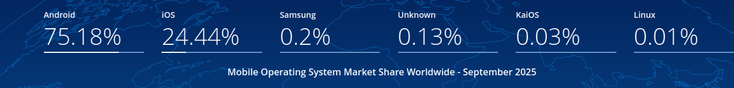
MOBILE OS MARKET SHARE
Android’s dominance enables Chrome’s browser dominance, since Chrome ships by default on nearly all Android devices
Despite its smaller global share, iOS users spend significantly more per user on apps compared to Android users — on average $12.77 vs $6.19 per app.
Minor OS (Samsung, KaiOS, others) together account for less than 1 %, serving niche or legacy device segments
https://gs.statcounter.com/os-market-share/mobile/worldwide (02/10/2025)

Slide 8


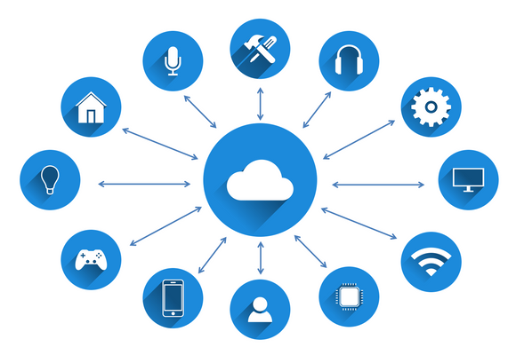
NEW MOBILE PRODUCT IDEAS AND INNOVATIONS (2024–2025)
AI / ML INTEGRATION
5G AND REAL-TIME FEATURES
Apps embed predictive models, on-device inference, smarter assistants, personalized content, serve as an personal agent
Lower latency and higher throughput allow real-time collaboration, AR, streaming, live features.
AR / VR / IMMERSIVE EXPERIENCES
IOT & SMART-DEVICE INTEGRATION
AR features (virtual try-ons, interactive overlays) and mixed-reality tie-ins in apps (beyond games) are expanding
Apps that control or interact with smart home, wearables, and connected devices.

Slide 9
THANK YOU FOR YOUR ATTENTION

