Slide 1
Game Asset Manager
Ferdinand Majerech <kiithsacmp@gmail.com>

Slide 2
Intro
System to manage game assets (sounds, 3D models, VA...)
Web-based frontend
Cross-platform backend (Java)
Using existing technologies to avoid reinventing the wheel

Slide 3
Ease of use
Made for artists, translators, composers...
Not for programmers
Customizable, potentially usable by modders
No need to understand VCS or issue tracking
These can be handled in background

Slide 4
Workflow
Asset owner (e.g art director):
  Specifies assets, dependencies, milestones
  Assigns asset creators to assets
  Reviews assets
Asset creator (e.g. graphics artist):
  Submits asset files
Any user can download files, view if possible

Slide 5
VCS integration
Bridging the gap between artists and programmers
DVCS-style workflow with one "official" repo but
Local changes possible
Git backend
Extensions possible (Other VCSs, databases)

Slide 6
Asset dependency management
Assets might depend on other assets (e.g. 3D model - textures)
Dependencies must be met before an asset is complete.
Milestones (finishing a campaign, DLC, etc.)

Slide 7
Game asset packaging
Packaging assets into game data archives
Generating VFS hierarchy
Game(mod) archives from milestones
Patch(delta) archives
Preprocessing for various platforms
  Textures: S3TC/PVRTC
Package review (release manager).

Slide 8
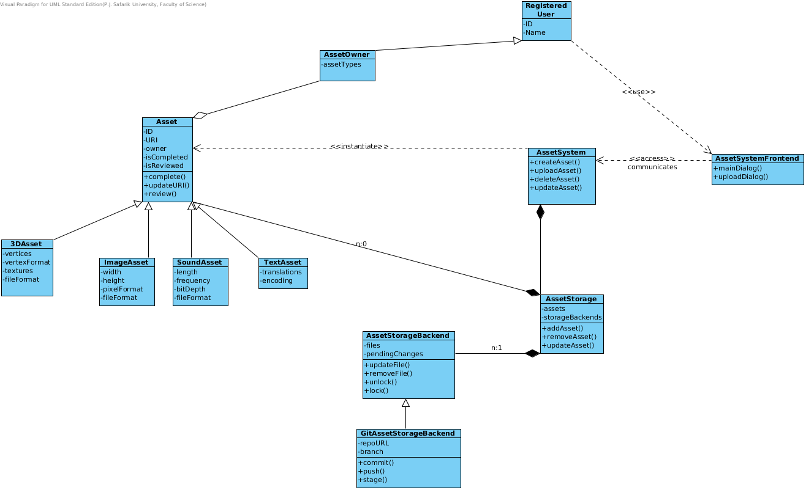
Asset management class diagram

Slide 9
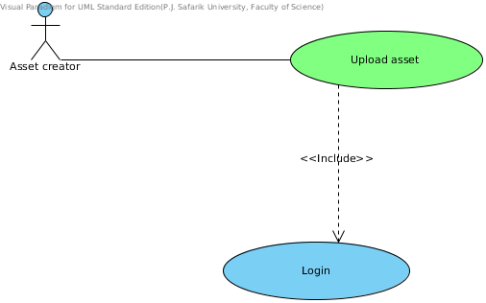
Asset upload use case

Slide 10
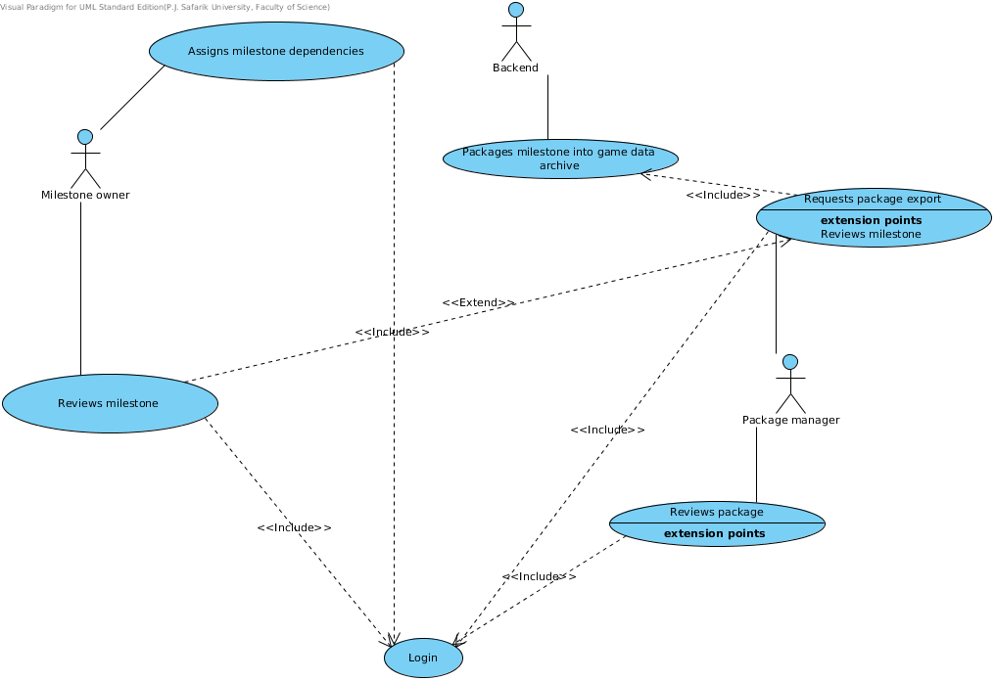
Milestones/packaging use case

Slide 11
SWOT analysis
Strengths:
  Artist-centric
  Specialized for game assets
Weaknesses:
  Lack of legacy support up front (Perforce, SVN)
Opportunities:
  Modder access
  Support based business model
Threats:
  Existing project management solutions

