Slide 1
Face Recognition Based Student Attendance System
Presenters : Aman Baghel (2018kucp1123)
Ashutosh Paliwal(2018kucp1125)
Kunal Khandelwal(2018kucp1126)
Sajal Rastogi (2018kucp1132)

Slide 2
Problem:
The use of ID cards or manually calling out attendance and writing it down on sheets is not productive and efficient as it take lot of time.

Slide 3
Goal:
By our project we aim to simplify the regular attendance method by automating it with the help of face recognition and saving the precious time of student and faculty.

Slide 4
Machine Learning:
Supervised Learning :
Supervised learning is a machine learning approach that’s defined by its use of labeled datasets. These datasets are designed to train or “supervise” algorithms into classifying data or predicting outcomes accurately.
Unsupervised learning:
Unsupervised learning uses machine learning algorithms to analyze and cluster unlabeled data sets. These algorithms discover hidden patterns in data without the need for human intervention

Slide 5
Face Detection:
The definition of face detection refers to computer technology that is able to identify the presence of people’s faces within digital images.
In order to work, face detection applications use machine learning and formulas known as algorithms to detecting human faces within larger images.

Slide 6
How does it Work ?
Face detection algorithms often begin by searching for human eyes. Eyes constitute what is known as a valley region and are one of the easiest features to detect.
Once eyes are detected, the algorithm might then attempt to detect facial regions including eyebrows, the mouth, nose, nostrils and the iris.
Once the algorithm surmises that it has detected a facial region, it can then apply additional tests to validate whether it has, in fact, detected a face.

Slide 7
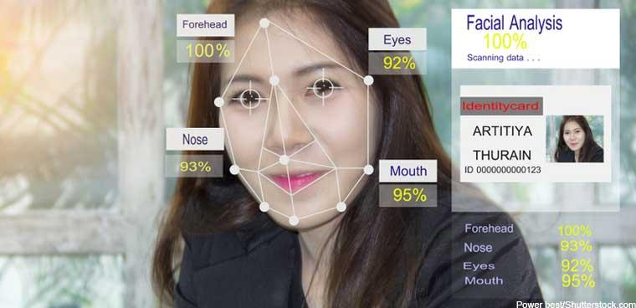
Face Recognition:
A facial recognition system is a technology capable of matching a human face from a digital image or a video frame against a database of faces, typically employed to authenticate users through ID verification services, works by pinpointing and measuring facial features from a given image.

Slide 8
Face Detection VS Face Recognition:
FACE DETECTION
Face Detection differs from Facial Recognition is that Face Detection only involves the detection of a face within a digital image or video. It simply means that the face detection system can identify that there is a human face present in an image of video – it cannot identify that person.
FACE RECOGNITION
Facial Recognition on the other hand takes this to the next level and is able to recognise and identify the detected face based on a match stored on a database.

Slide 9
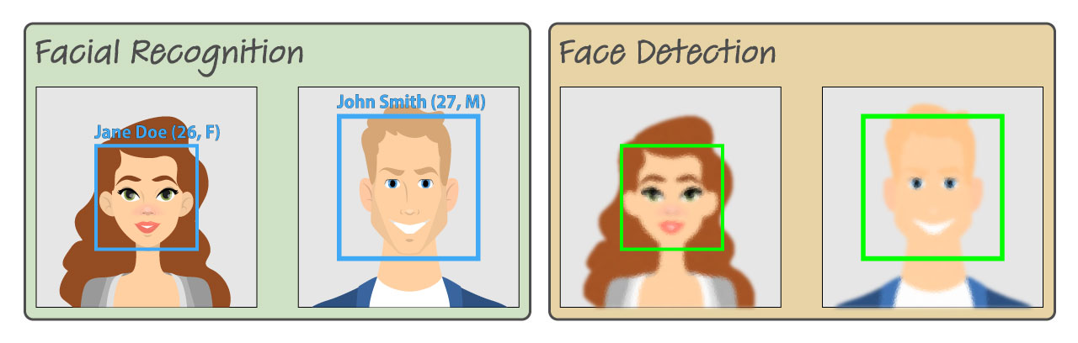
Face Detection VS Face Recognition:

Slide 10
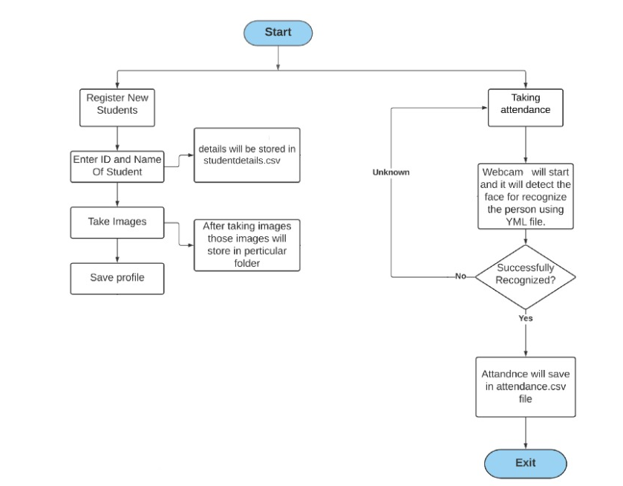
Framework:
Our System

Slide 11
Features of Our System
Check Camera
Capture Faces
Train Faces
Recognize Faces & Attendance

Slide 12
Modules Used
OpenCV
Pillow
Numpy
Pandas
Shutil

Slide 13
Student Registration
For carrying out pattern analysis and face recognition we require a model and dataset to train our model.
In this problem we are giving user freedom to create dataset of their own.
Student registration is done using following step:
Input ID and name of Student
Capture images from the webcam and store them to folder
Detect the face (using haarcascade xml)
Crop the face of individual
And create a csv file

Slide 14
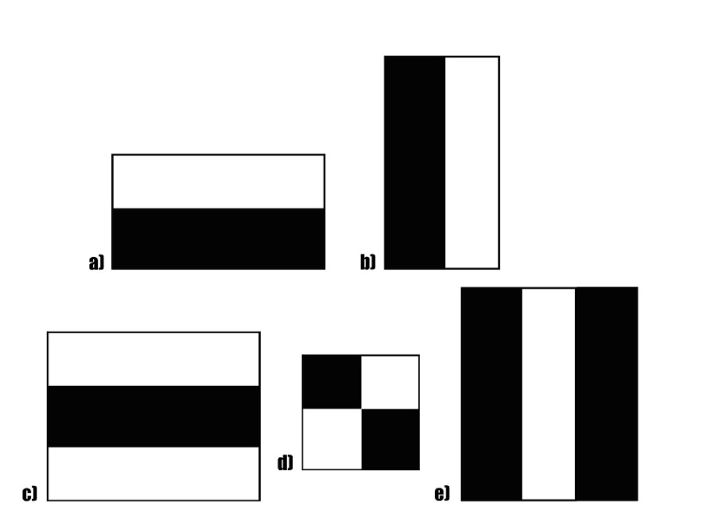
Haar cascade (Viola Jones Face Detection)
It is a machine learning based approach where a cascade function is trained from a lot of positive (images with faces) and negative (images without face) images. It is then used to detect objects in other images.
Haar Cascade works by :
Extracting Haar Features from the image
Cascade Classification to detect location of face
Haar Features:
These are binary matrices of different shapes and sizes representing two colors - black(-1) and white (1).
Majorly used for detecting and calculating edges and line features.

Slide 15
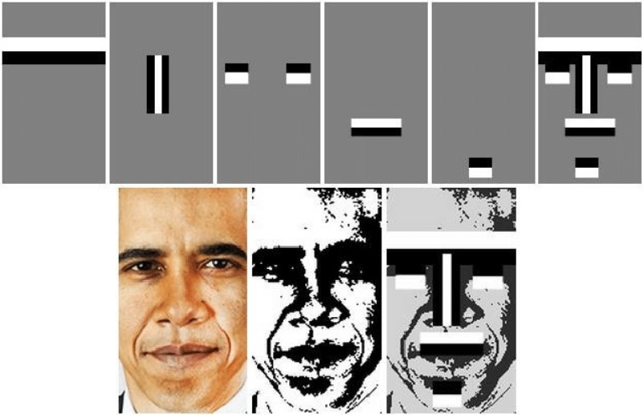
Haar cascade (Viola Jones Face Detection)

Slide 16
Haar cascade (Viola Jones Face Detection)
Algorithm:
Take a sliding window of fixed size (24x24) and calculate haar features over each of these windows.
There was a issue with approach as it would create a large number of features (180,000+ features as claimed by paper).
CascadeClassifier →
To counter this issue paper also proposed a new approach of using cascaded classifier. Where some these features will be divided into stages and these stages will be connected in linear fashion.
They had a total of 38 stages for something around 6000 features. The number of features in the first five stages are 1, 10, 25, 25, and 50, and this increased in the subsequent stages
The initial stages with simpler and lesser number of features removed most of the windows not having any facial features.

Slide 17
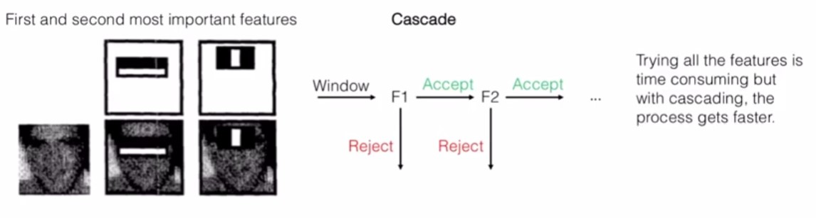
Cascading Classifier (Viola Jones Face Detection)
Src: https://www.youtube.com/watch?v=p9vq90NYHMs

Slide 18
Image Training
Create LBPH Face recognizer
Create Haar cascade detector
Get training image labeled as face and id
Train LBPH recognizer Model
Save the trained model

Slide 19
LBPH Algorithm
LBPH (Local Binary Pattern Histogram) is a Face-Recognition algorithm, It is known for its performance and how it is able to recognize the face of a person from both front face and side face.
Local Binary Pattern (LBP) is a simple yet very efficient texture operator which labels the pixels of an image by thresholding the neighborhood of each pixel and considers the result as a binary number.
Using the LBP combined with histograms we can represent the face images with a simple data vector.

Slide 20
LBPH Algorithm (STEP BY STEP)
Parameters: Radius, Neighbors, Grid X, Grid Y
Training the Algorithm
Applying the LBP operation
Extracting the Histograms
Performing the face recognition

Slide 21
LBPH Algorithm
1. Parameters: the LBPH uses 4 parameters:
Radius: the radius is used to build the circular local binary pattern and represents the radius around the central pixel.
Neighbors: the number of sample points to build the circular local binary pattern.
Grid X: the number of cells in the horizontal direction.
Grid Y: the number of cells in the vertical direction.
2. Training the Algorithm: First, we need to train the algorithm. To do so, we need to use a dataset with the facial images of the people we want to recognize. We need to also set an ID for each image, so the algorithm will use this information to recognize an input image and give you an output.

Slide 22
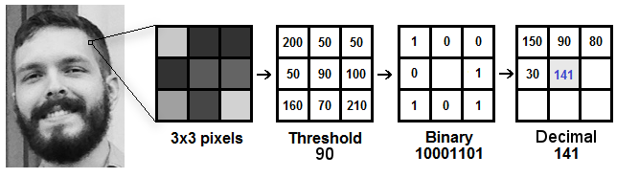
LBPH Algorithm
3. Applying the LBP operation: We create an intermediate image that describes the original image in a better way, by highlighting the facial characteristics.
the algorithm uses a concept of a sliding window, based on the parameters radius and neighbors.

Slide 23
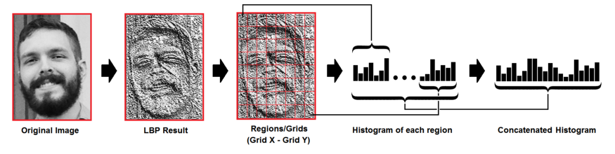
LBPH Algorithm
4. Extracting the Histograms: the image generated in the last step, we can use the Grid X and Grid Y parameters to divide the image into multiple grids, as can be seen in the following image:
each histogram will contain only 256 positions (0~255) representing the occurrences of each pixel intensity.
we need to concatenate each histogram and he final histogram represents the characteristics of the image original image.

Slide 24

LBPH Algorithm
5. Performing the face recognition: In this step,Each histogram created is used to represent each image from the training dataset.
So to find the image that matches the input image we just need to compare two histograms and return the image with the closest histogram.
We compare two histogram using euclidean distance.
We can then use a threshold value which confirms that the algorithm has successfully recognized if the euclidean distance is lower than the threshold defined.

Slide 25
Taking Attendance
Initialize Recognizer
Initialize haarcascade detector
Read studentdetails.csv
Detect face and create bounding box around it.
Crop the face and apply recognizer
Predict the face
Enter details [ name,id,date,time] to csv.

Slide 26


Results

Slide 27
THANK
You!

