Slide 1
eMatch GUI Presentation
Leonardo Monteiro
2022/03/30

Slide 2
Overview
Menu
Dashboard
Bookmarks
Export Methods
Grid features
Sql Requester
summary

Slide 3
Overview
1

Slide 4
Overview
1
How the Menu in eMatch is organized
What information is displayed in the Dashboard, how to customize it
What is a Bookmark and how to create them
What methods are available in eMatch to export data
What are the main grid features in eMatch
What can be done in the SQL Requester screen

Slide 5
Menu
2

Slide 6
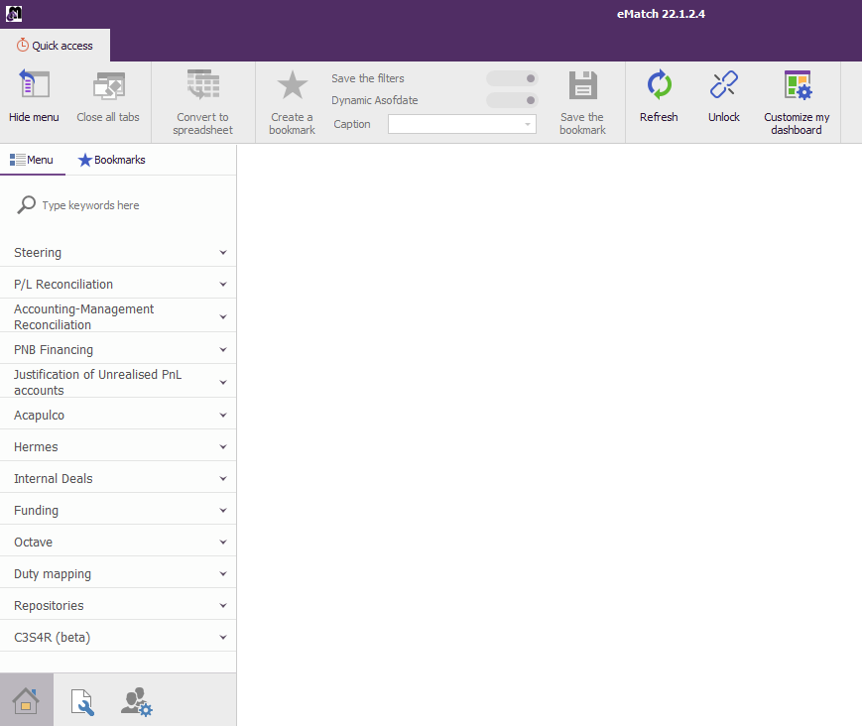



Menu
2
Show/Hide
Menu button
Close All Tabs
Main Menu
Search Field
Your
Bookmarks
The will give you acess to the main modules
The will give you access to the administration screens
The is reserved for options and tools
You can use the search field to find your screens
Administration Page
Modules Page
Options Page

Slide 7
Dashboard
3

Slide 8
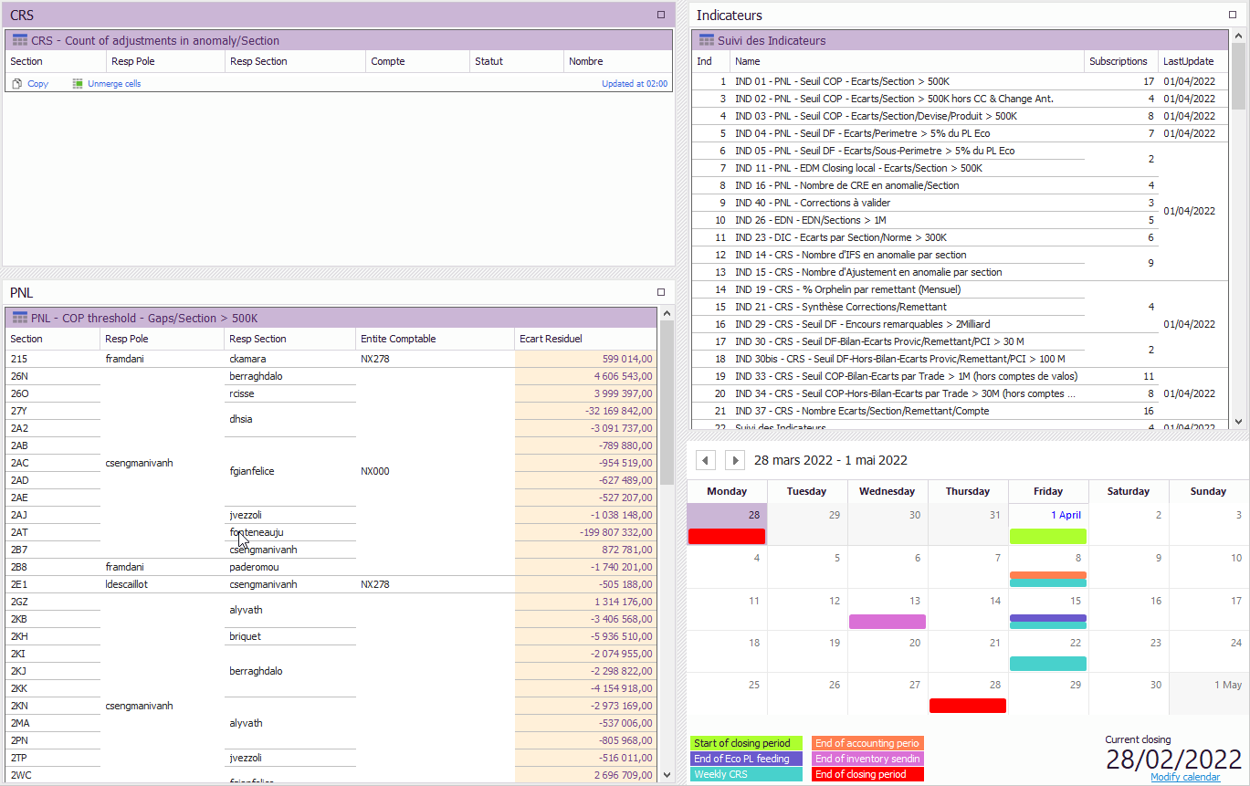
Dashboard
Overview
3
The dashboard
is divided in 4 categories:
CRS
PNL
Indicators
Calendar Widget

Slide 9
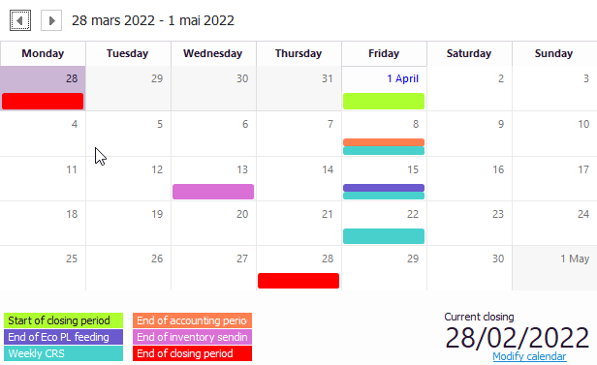
Dashboard
Calendar Widget
3
Important
Dates
Current
closing date
Legend
For admins only, access the calendar setup from here

Slide 10

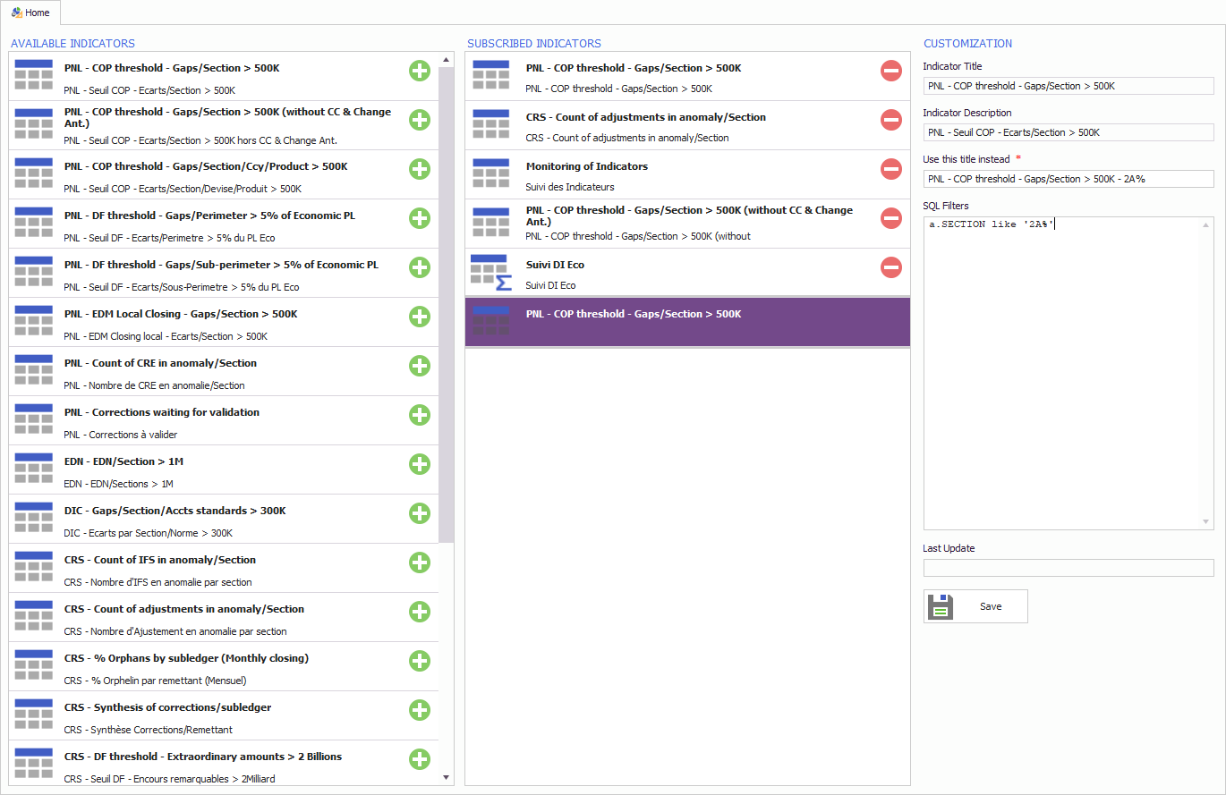
Dashboard
Subscribe Indicators
3
Click on Customize to subscribe / unsubscibe indicators
Enter your own title that will appear in the dashboard
Modify the filters of your subscribed indicator

Slide 11

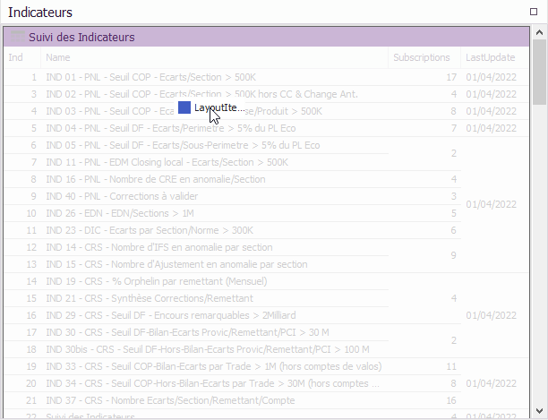
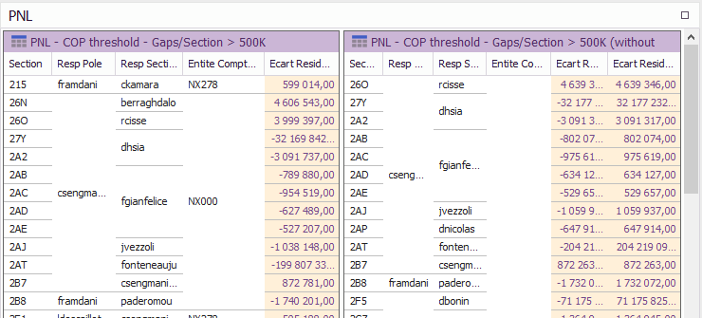
Dashboard
Customize the layout
3
Click on Unlock to modify the layout
Click on Lock when you have finished
Drag the title of the indicator and drag and drop it where you want to re-order the indicators
You can also put the indicators side by side

Slide 12
BOOKMARKS
4

Slide 13
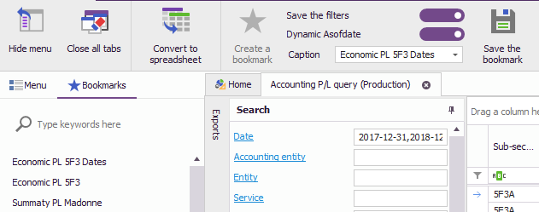
Bookmarks
How to create and open a bookmark
4
Access to your
bookmarks
Click to bookmark
the current screen
Chose if eMatch must update
the asofdate automatically
Chose if you want
to save the filters
Save Bookmark
Enter the name
of the bookmark
Search for a
bookmark

Slide 14
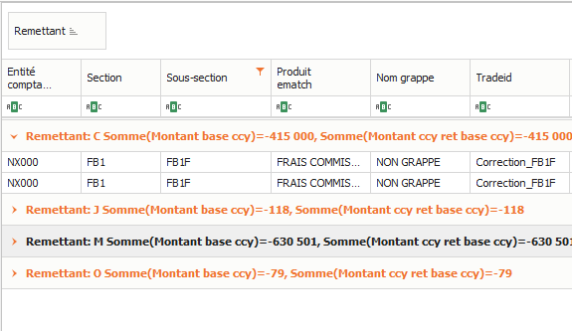

Bookmarks
What is persisted
4
The position of each column
The grouped columns
The filters inside each column
The sort of each column

Slide 15
Export methods
5

Slide 16
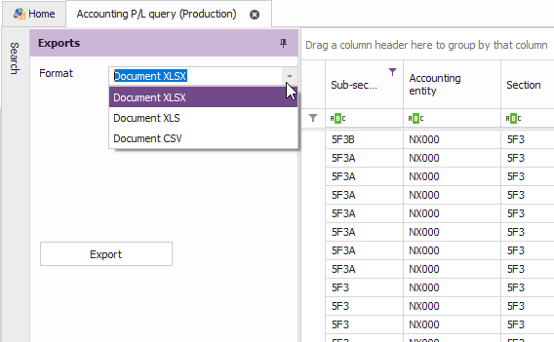
Export Methods
Export to XLS, XLSX or CSV
5
Access
exports toolbar
Chose the
export format
Confirm the
export

Slide 17
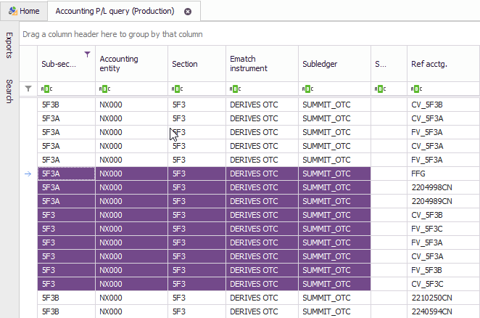
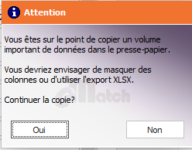
Export Methods
Copy & Paste
5
Using Ctrl + C eMatch will copy to the clipboard the selected cells to paste in Excel
eMatch will automatically detect when you
try to copy a large amount of data and
you will be asked a confirmation
If chosen “Yes/Oui” eMatch will display an overlay to let you now that it’s copying the data to the cilpboard

Slide 18
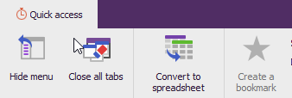
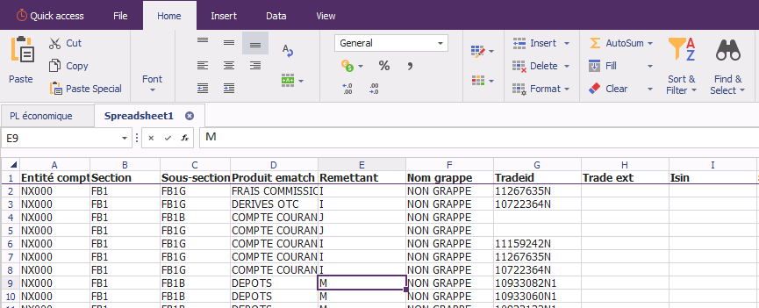
Export Methods
Convert to Excel Spreadsheet
5
Use the button to copy the data inside a spreadsheet, inside eMatch
Access most Excel functionalities inside eMatch, by using the new toolbars

Slide 19



Export Methods
Excel Spreadsheet functionalities
5
You can benefit from many Excel functionalities:
Change the style, the layout, and add filters as you are used to doing via Excel
Create pivot tables and charts
You can also Open and Save your documents as XLSX from eMatch or into eMatch
You can also use formulas

Slide 20
Grid Features
6

Slide 21
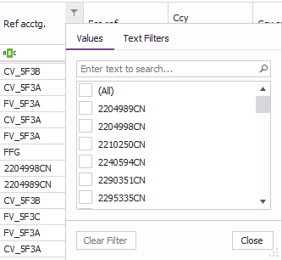
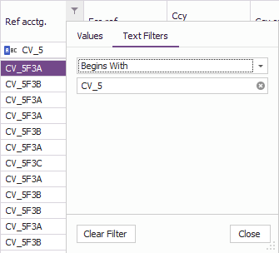
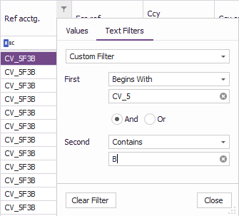
Grid features
Column filters
6
Access
filters
Filter by value
Searching or selection results
Use one Text Filter
Select “Custom Filter” to apply two distinct Text Filters

Slide 22
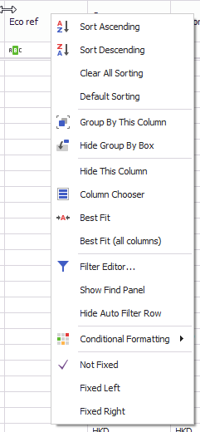
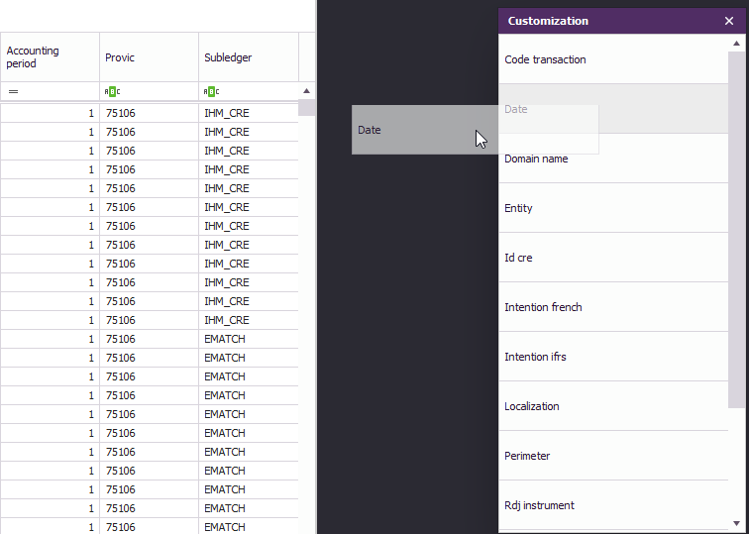
Grid features
Column chooser
6
Can drag & drop columns to and from the grip to add or remove them
Right-Click on column to open the context menu
Select “Column Chooser” option

Slide 23
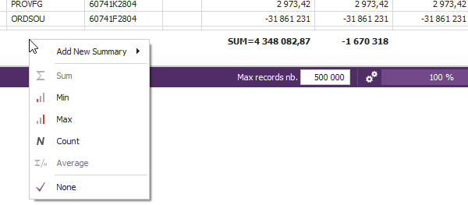
Grid features
Column summary options
6
Right-Click in the bottom part of the columns to access the summary options
The type of summary selected will be shown

Slide 24
SQL Requester
7

Slide 25
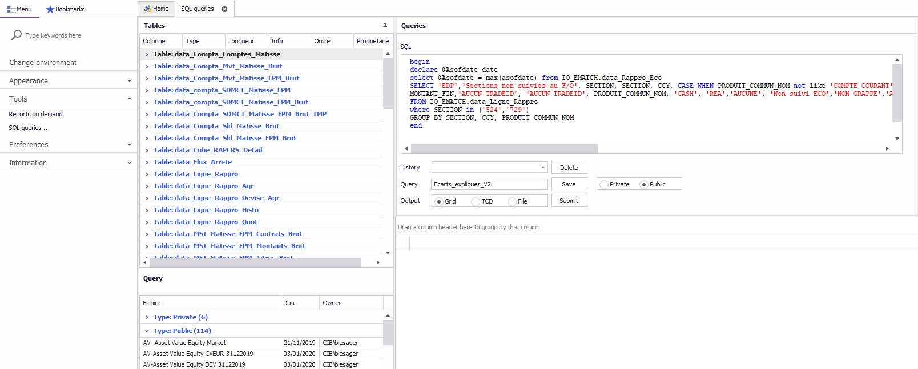
SQL Requester
7
SQL query
Access
from the menu
Save your queries
as public or private
Access
public queries
Select output
of the SQL request

Slide 26
Q&A

