Slide 1
Excess mortality estimation

Slide 2
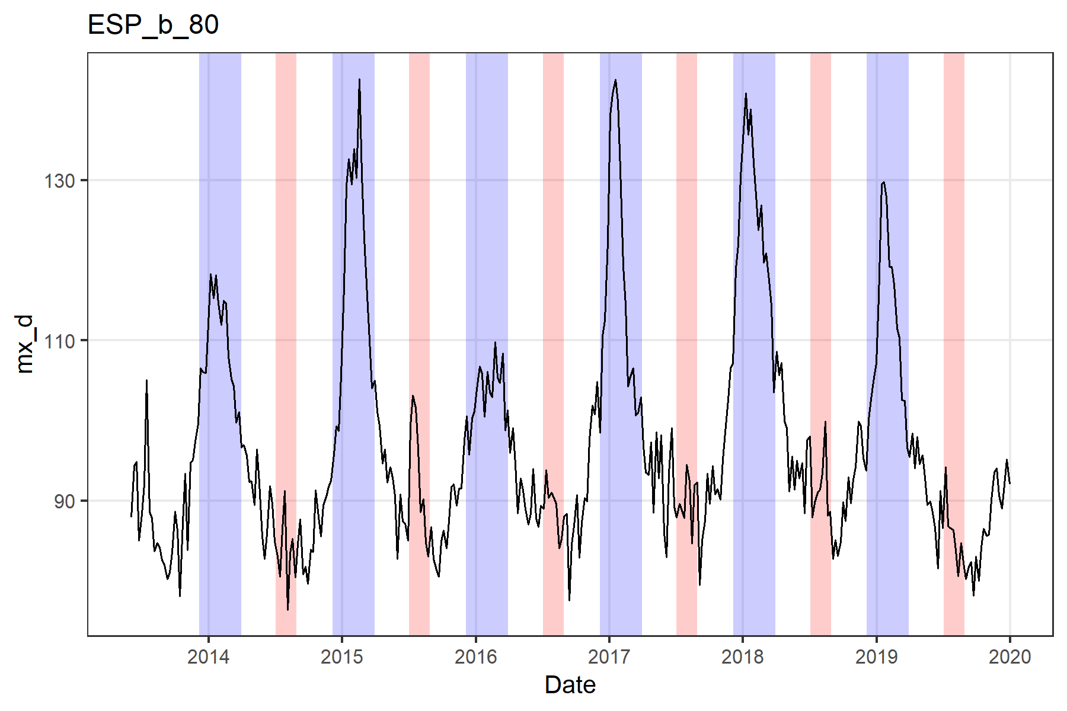
Model for baseline mortality
Counterfactual scenario of mortality without COVID-19
GLM model
Adapted from the Serfling model (influenza mortality estimation)
Poisson or Negative Binomial (overdispersion) models
Excluding
winter weeks (influenza mortality)
some summer weeks (heat wave mortality)
Pandemic period (all 2020)

Slide 3
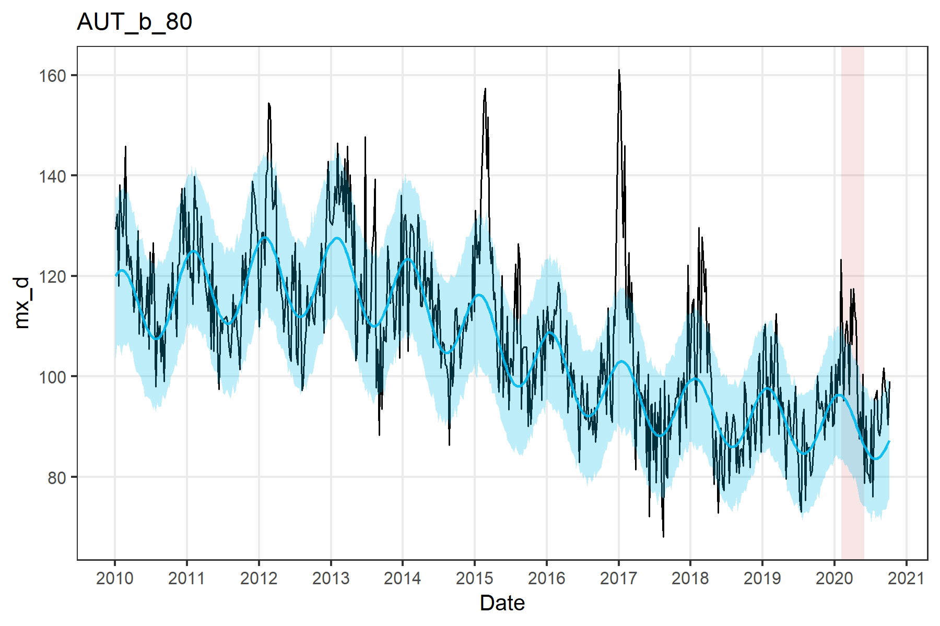
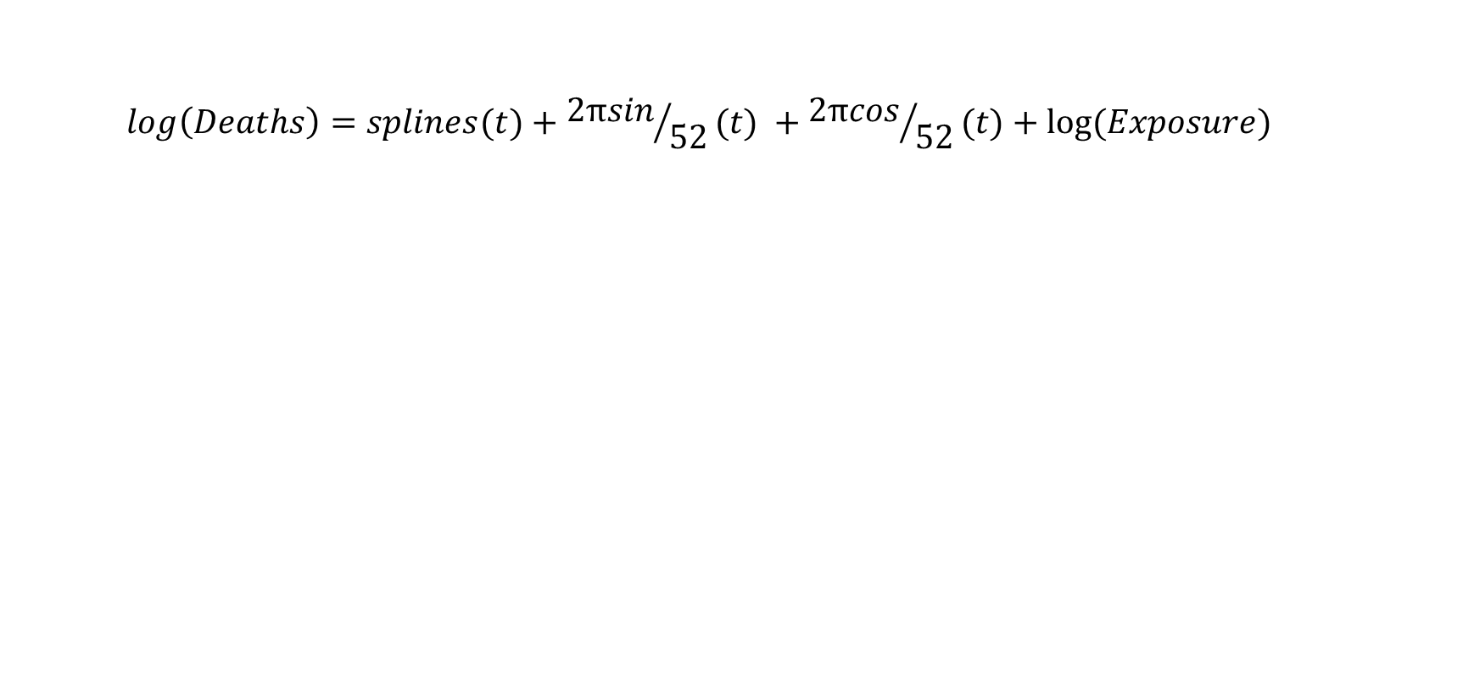
GLM model
$$log\left(Deaths\right)=splines(t)+{2πsin}/{52}(t) +{2πcos}/{52}(t)+log⁡(Exposure)$$
Secular change of mortality
Seasonality
Population
Excess = Observed –Baseline mortality

Slide 4
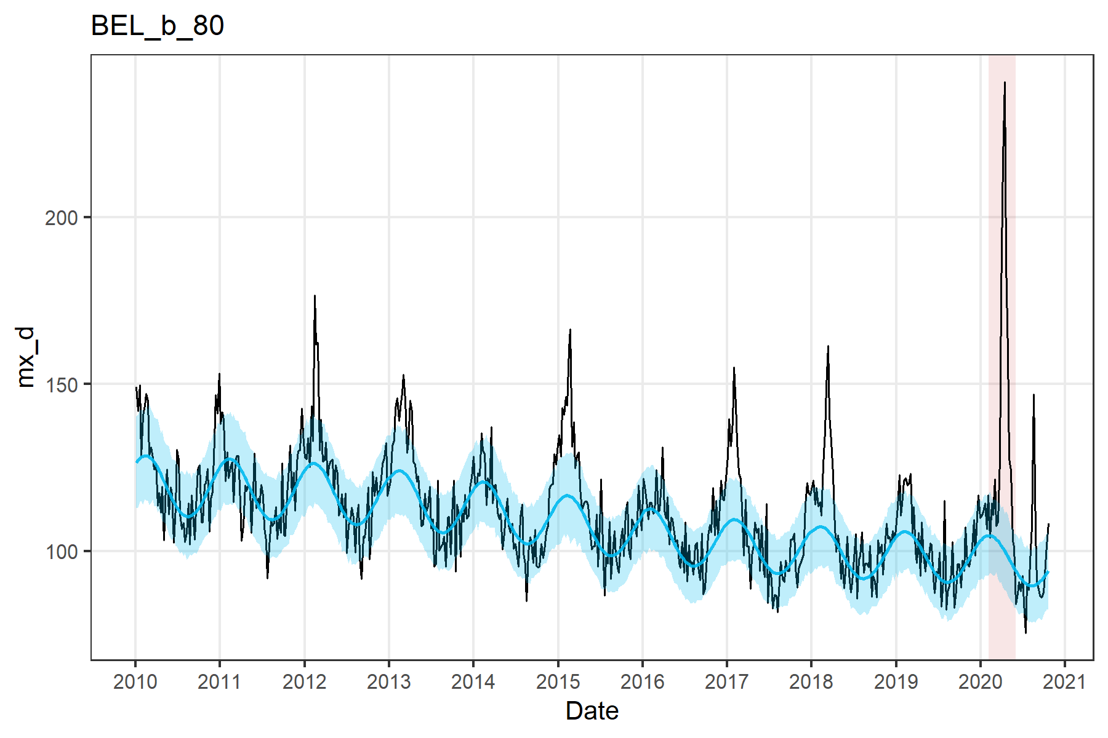
Some results
Some examples

Slide 5
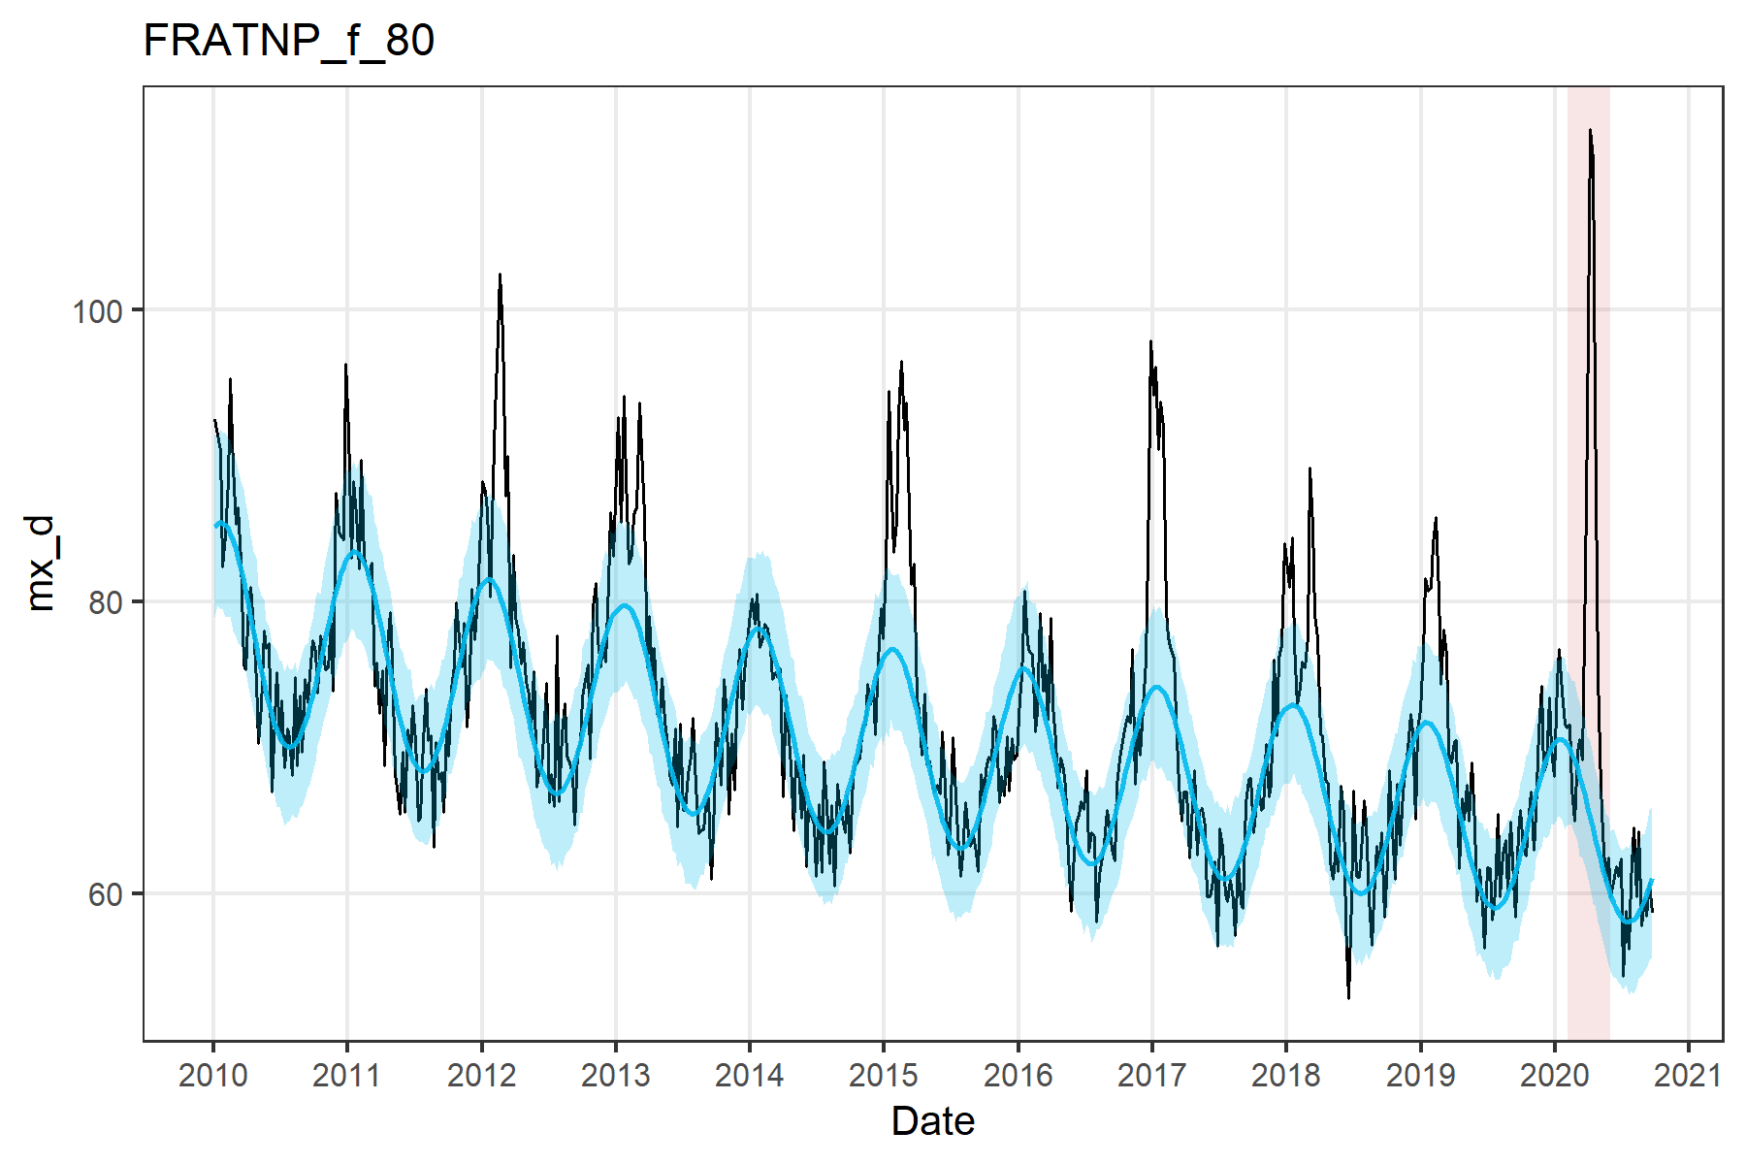
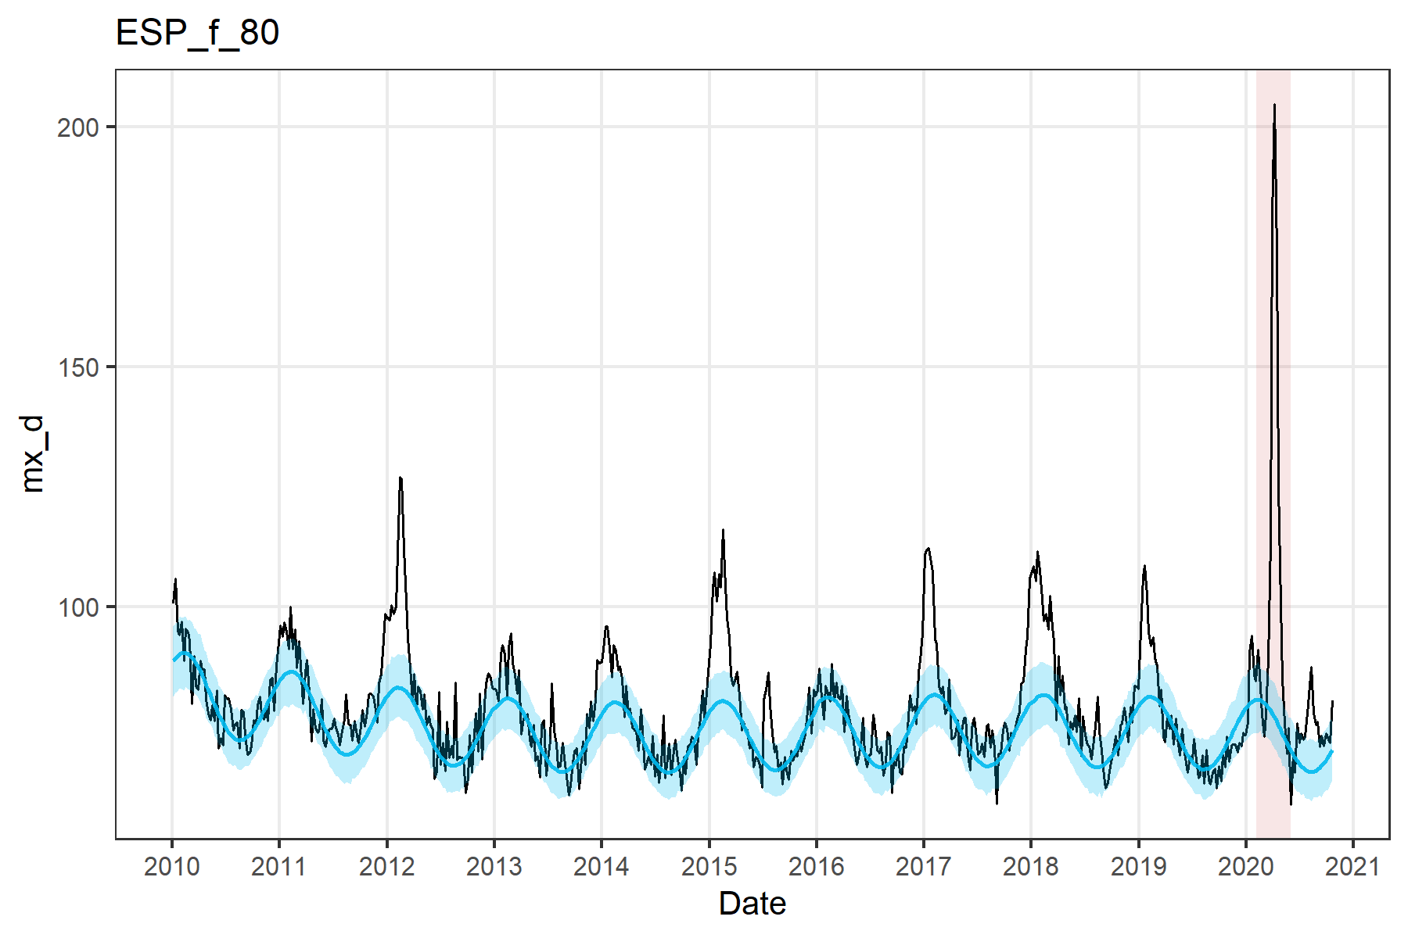
Some results
Some examples

Slide 6
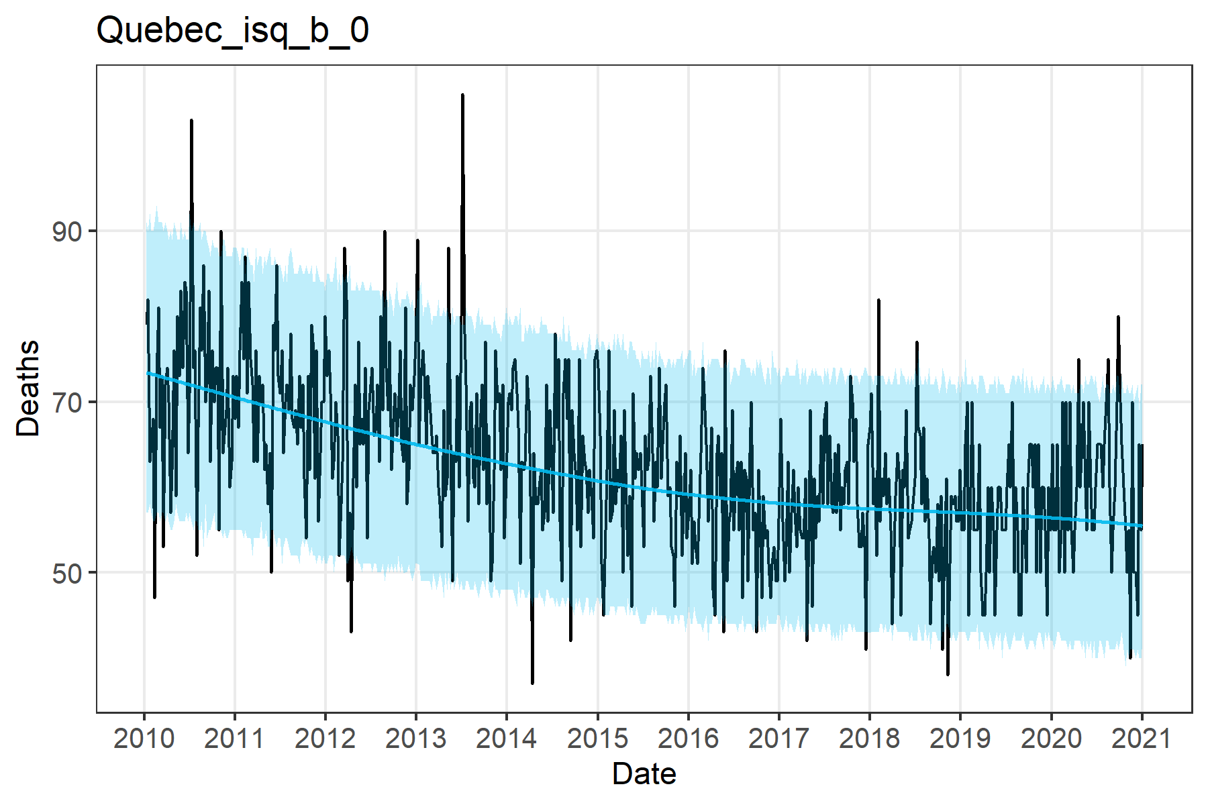
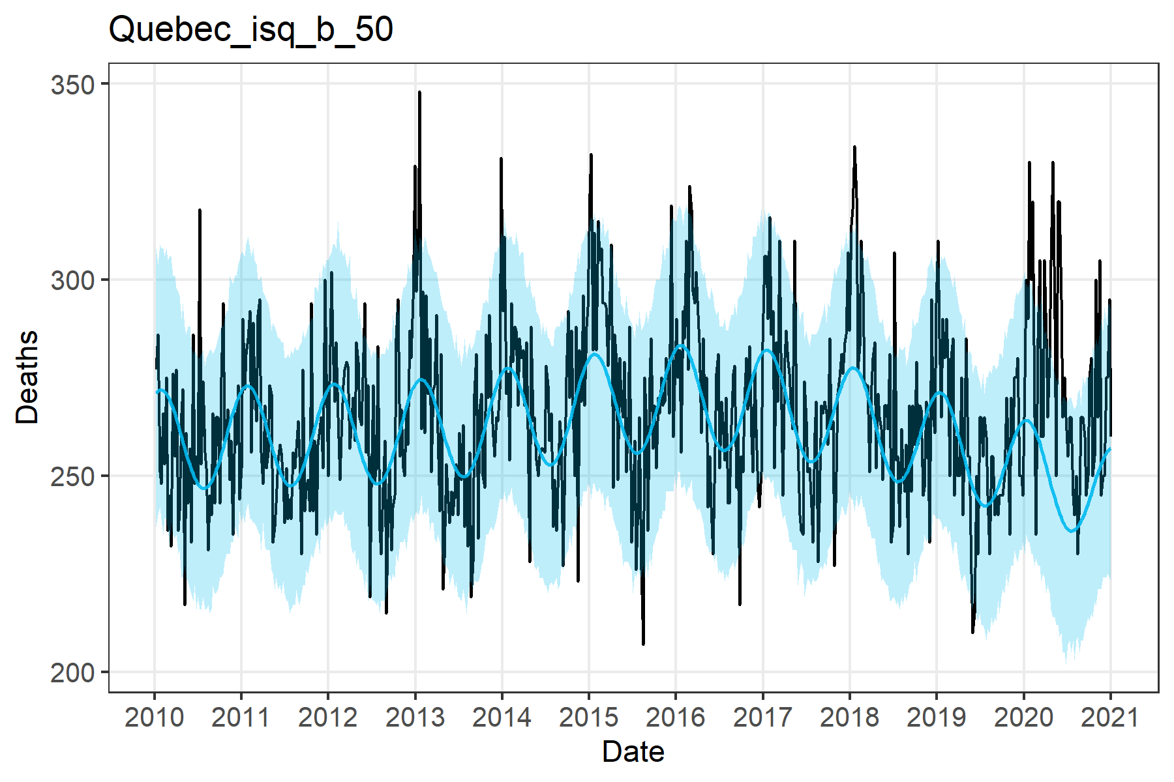
Québec

Slide 7
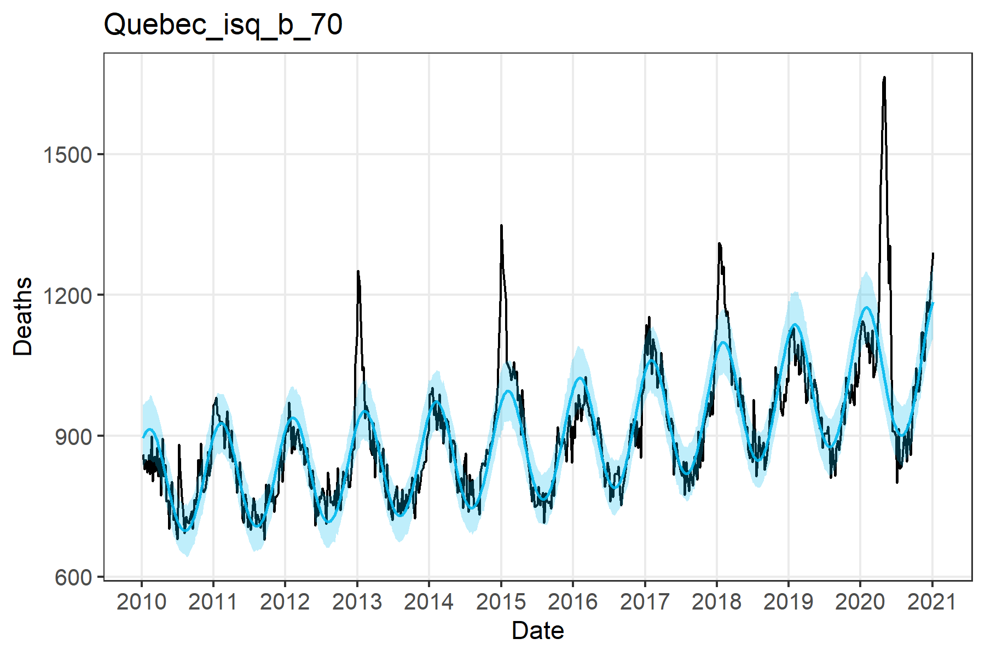
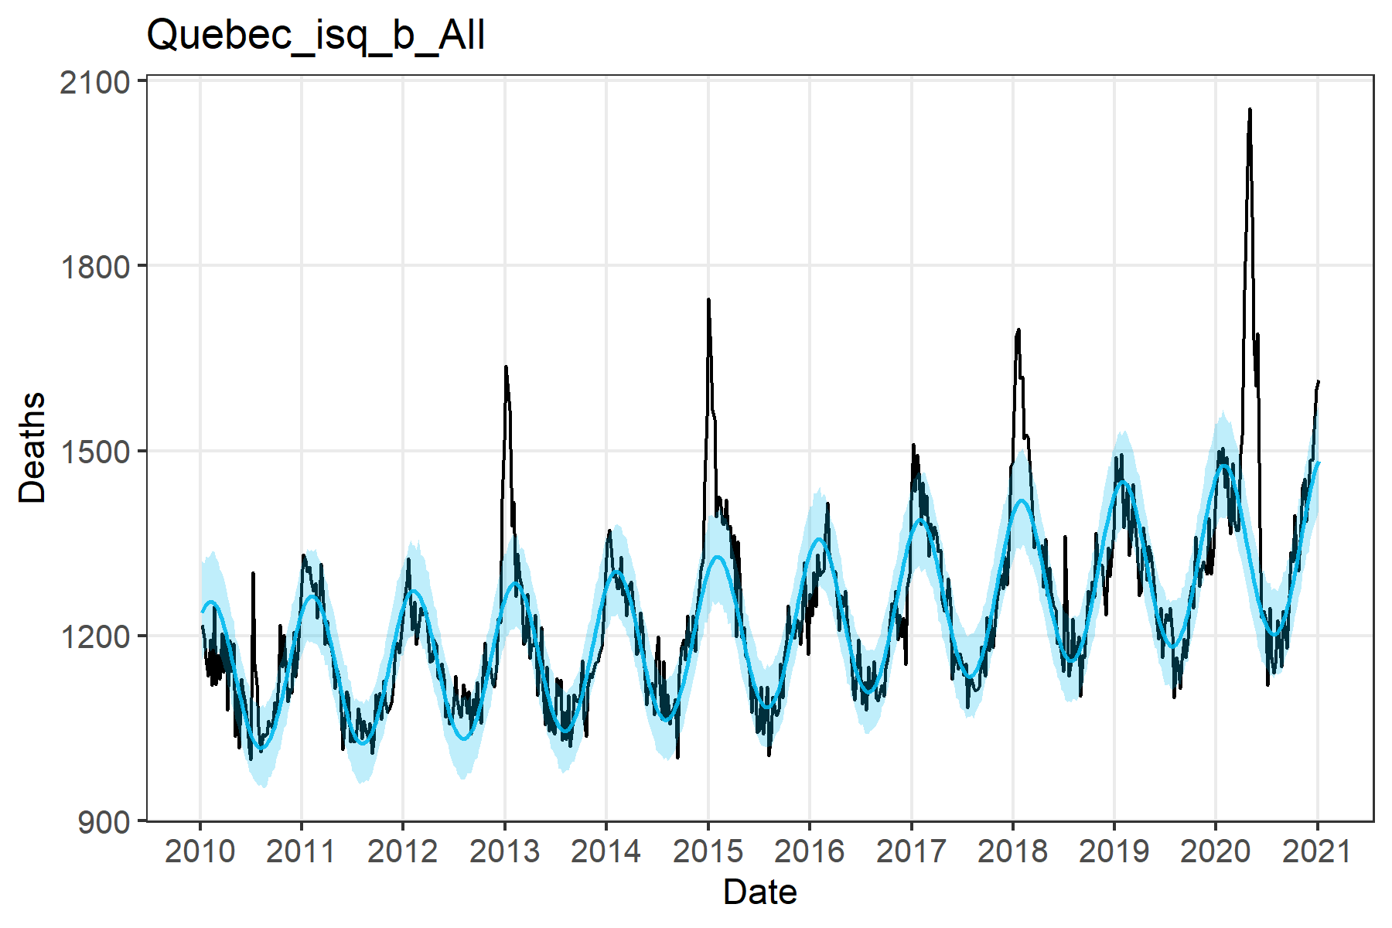
Québec

