Slide 1
LABORATORY OF FERTILITY AND WELL-BEING
Sub-national Fertility and the Covid-19 Pandemic in Colombia and Brazil, 2010-2021
Castro T, A.*, Sacco, N.** Pardo, I.***, Urdinola, B.****, Acosta, E.*
Max Planck Institute for Demographic Research*, Pennsylvania State University**, Universidad de la República****, Universidad Nacional de Colombia****

Slide 2
CONTEXT
There are several questions about the potential consequences of the Covid-19 pandemic for countries’ demographics.
There are rising concerns as to how the pandemic will (or will not) exacerbate pre-existing demographic and socioeconomic inequalities.
Countries’ responses to the pandemic have been very diverse, not unified, and uncoordinated, including data collection andreport practices.
Notes:
This context make it likely to observe differentiated consequences between and within countries, and therefore suggests we should analyze (more tan ever) sub-national demographic measures

Slide 3
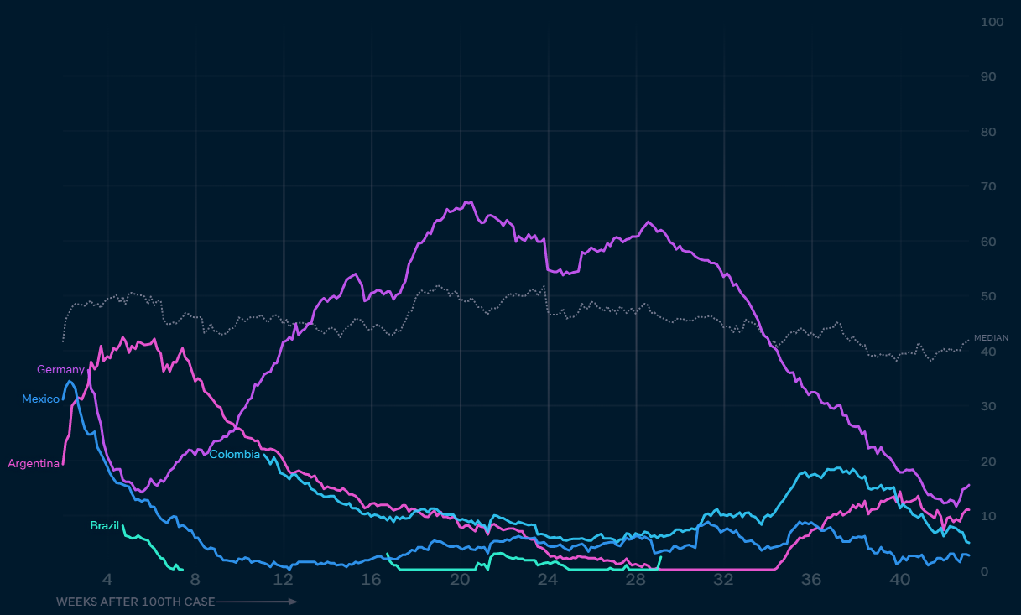
CONTEXT
Covid Performance Index
Shared contextual characteristics
Ongoing fertility decline. Teenage fertility higher in Colombia than Brazil
Poor governmental response to Covid-19
High levels of socioeconomic inequality
Source: https://interactives.lowyinstitute.org/features/covid-performance/

Slide 4
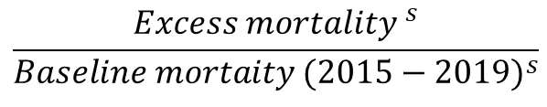
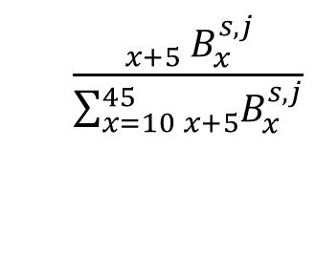
RESEARCH QUESTIONS
What are the associations between sub-national Covid-19 intensity and the distribution of births by age groups of the mother across educational attainment groups (low, medium, and high)
$$\frac{{}_{x+5}^{}{ B_{x}^{s,j}}}{\sum_{x=10}^{45}{{}_{x+5}^{ }{B_{x}^{s,j}}}}$$
$$\frac{{Excess mortality }^{s}}{{Baseline mortaity (2015−2019)}^{s}}$$
Where s indexes countries’ states, j indexes educational attainment groups, and x indexes five-year age groups.

Slide 5
DATA AND METHODS
Official birth records (micro- and aggregated data)
Brazil (26/27 federal units): 32.5 million births
2010-2019: R-package datasus{} (Counts by federal unit, education of the mother, and age group of the mother).
2020-2021: Sistema de Informações sobre Nascidos Vivos (micro-data, until: 31.03.2021)
Colombia (32 departments): 7.6 million births
2010-2019: National Data Archive – National Statistics Bureau, DANE (micro-data)
2020-2021: Preliminary reports on live births reported until 31.07.2021 (Counts by department, education of the mother, age group of the mother)

Slide 6
DATA AND METHODS
We use the differences in data disaggregation to develop two hypotheses:
H1: Associations should be stronger for 2021 than 2020.
H2: Associations should be stronger for Brazil than Colombia
Notes:
We are agnostic as to the dirección of the associations

Slide 7
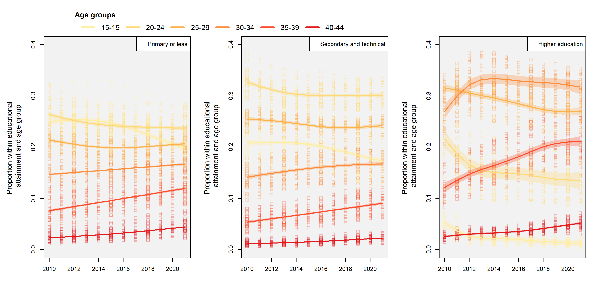
RESULTS

Slide 8
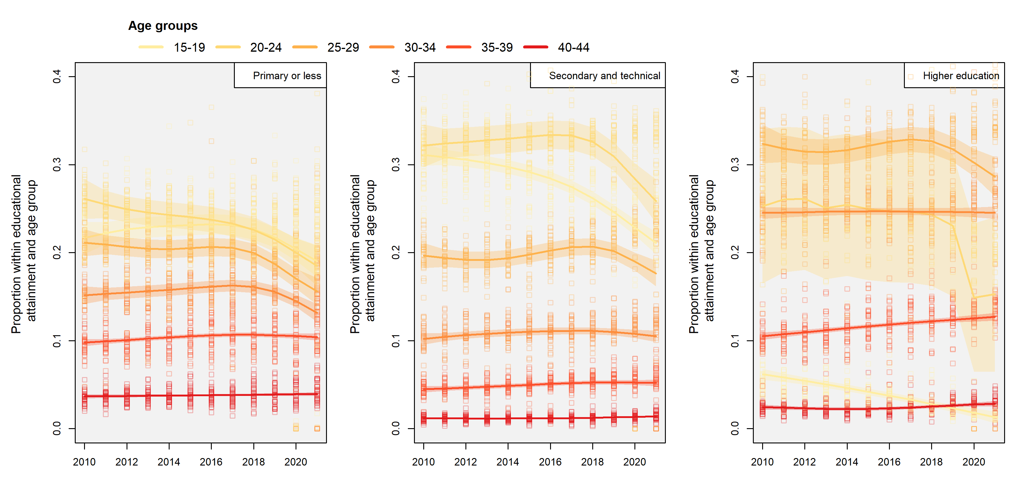
RESULTS

Slide 9
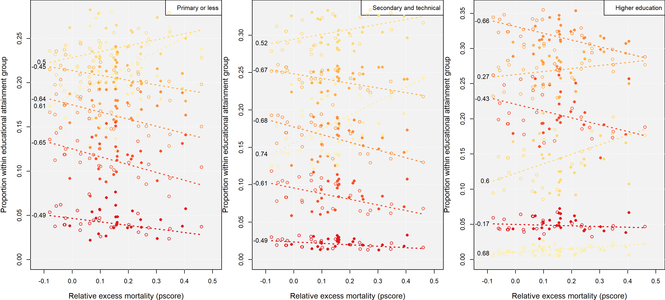
RESULTS - BRAZIL
2020 2021

Slide 10
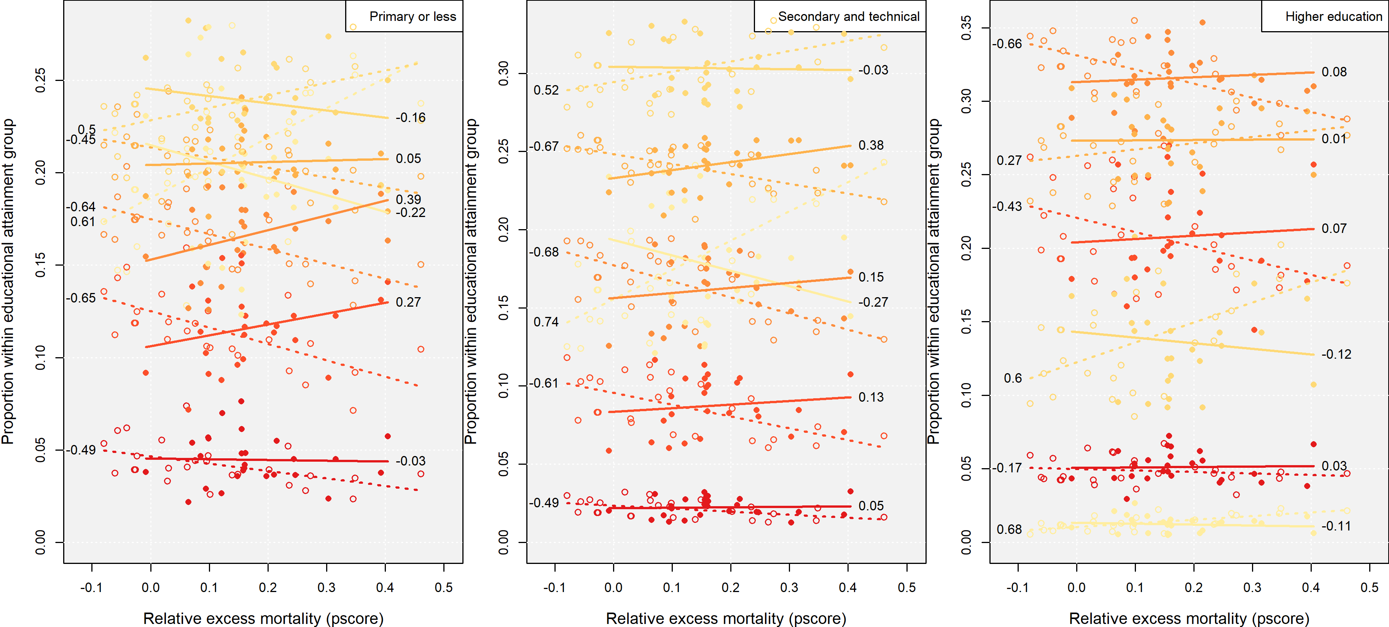
RESULTS - BRAZIL
2020 2021

Slide 11
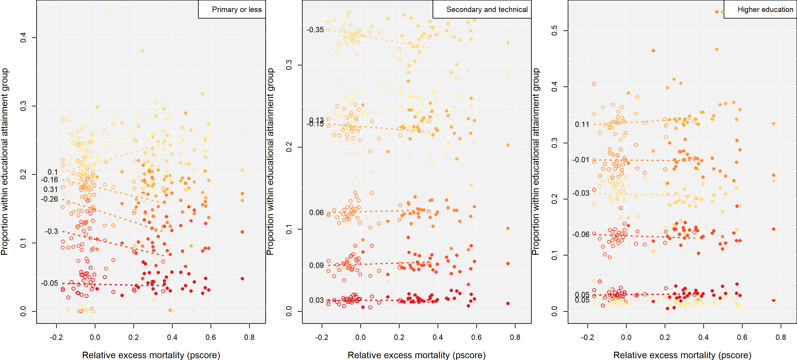
RESULTS - COLOMBIA
2020 2021

Slide 12
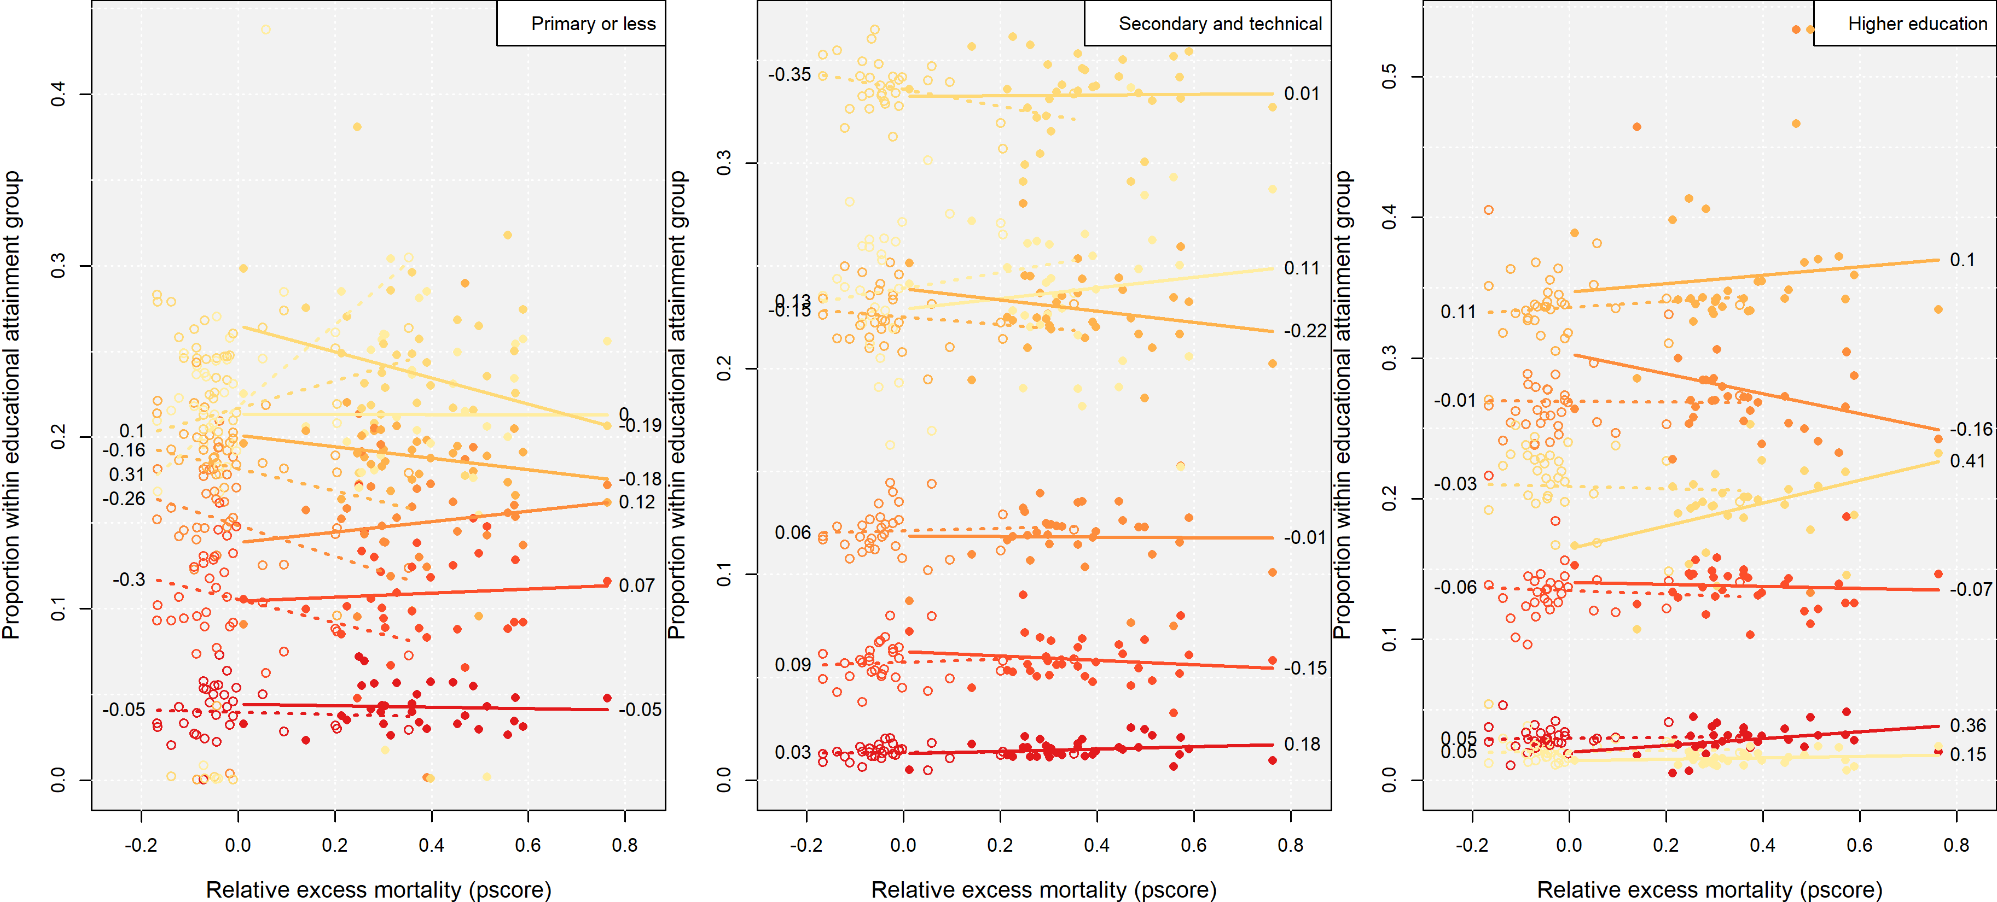
RESULTS - COLOMBIA
2020 2021

Slide 13
Thank you!

Slide 14
Colors for Charts
Basis
Shades
R: 100
G: 100
B: 100
R: 8
G: 68
B: 95
R: 0
G: 94
B: 94
R: 142
G: 32
B: 59
R: 142
G: 32
B: 59
R: 8
G: 68
B: 95
R: 136
G: 188
B: 171
R: 0
G: 177
B: 235
R: 10
G: 120
B: 120
R: 200
G: 200
B: 200
R: 7
G: 96
B: 134
R: 10
G: 120
B: 120
R: 180
G: 55
B: 70
R: 192
G: 39
B: 45
R: 224
G: 224
B: 224
R: 14
G: 123
B: 172
R: 0
G: 157
B: 160
R: 192
G: 112
B: 124
R: 216
G: 54
B: 26
R: 18
G: 183
B: 181
R: 18
G: 155
B: 181
R: 34
G: 180
B: 115
R: 0
G: 88
B: 105
R: 241
G: 241
B: 241
R: 20
G: 168
B: 235
R: 0
G: 183
B: 181
R: 181
G: 145
B: 154
R: 239
G: 125
B: 0
R: 8
G: 68
B: 95
R: 142
G: 32
B: 59
R: 239
G: 125
B: 0
R: 62
G: 44
B: 81
R: 241
G: 241
B: 241
R: 60
G: 190
B: 250
R: 50
G: 220
B: 220
R: 148
G: 145
B: 151
R: 250
G: 175
B: 59

Slide 15
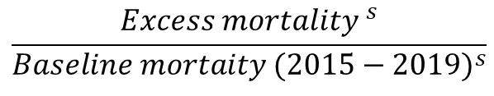
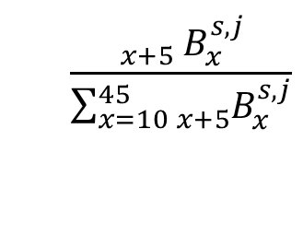
RESEARCH QUESTIONS
Is there a significant change in the country-level age specific fertility rates and total fertility rate for 2020 and 2021 in Brazil and Colombia?
What are the associations between sub-national Covid-19 intensity and the distribution of births by age groups of the mother across educational attainment groups (low, medium, and high)
$$\frac{{}_{x+5}^{}{ B_{x}^{s,j}}}{\sum_{x=10}^{45}{{}_{x+5}^{ }{B_{x}^{s,j}}}}$$
$$\frac{{Excess mortality }^{s}}{{Baseline mortaity (2015−2019)}^{s}}$$
Where s indexes countries’ states, j indexes educational attainment groups, and x indexes five-year age groups.

Slide 16
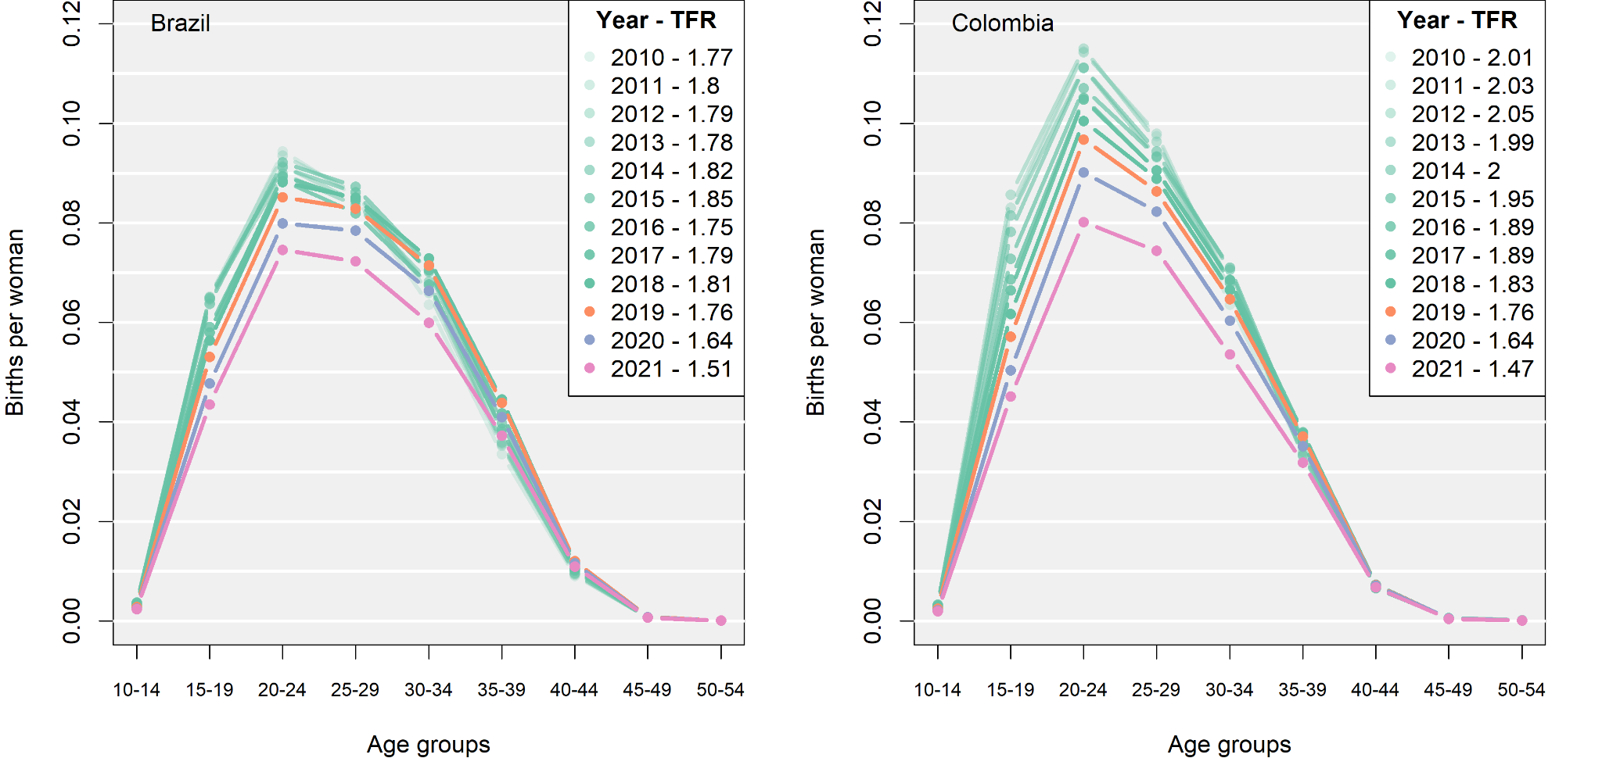
RESULTS

Slide 17
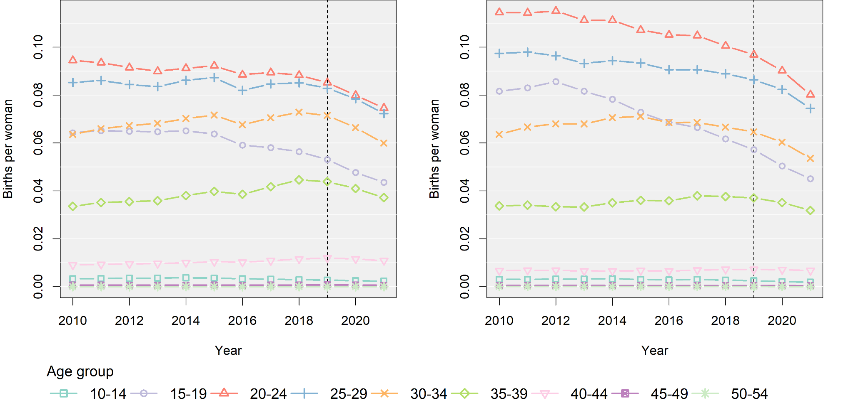
RESULTS
Brazil Colombia

