Slide 1

Mortality disturbances: Age-Period-Cohort modeling and visualization
EDSD Program 2023
CED
Enrique Acosta
18.05.2023

Slide 2
Before starting today…
One answer that I want to improve, another that I forgot to give:
Philip: Can cohort effects from early life exposures be fully counterbalanced during the life course through lifestyle and decisions?
It is possible that counterbalance mechanisms are at place, but on average we should be able to recognize those cohorts that suffered a systematic disadvantage.
See Hayward & Gorman (2004) “The Long Arm of Childhood: The Influence of Early-Life Social Conditions on Men's Mortality.” Demography.
Sahar: Can we see the period effects that were at the origin of cohort effects?
Depends:
If the mechanisms that are rooted as cohort effects are also related with mortality, we may be able to see them sometimes when analyzing mortality. E.g., wars, famines, pandemics, etc., at the origin of a adverse cohort effect.
If the mechanisms are not strictly related with mortality, they are not noticeable when looking at death rates. E.g., contraction of the labor market when a cohort is entering in adulthood. We migh see only the outcomes here, but maybe the contraction did not have a short term impact on mortality, only a long term one…

Slide 3
Lecture IV. Introduction to excess mortality estimation (bonus track)

Slide 4
Excess mortality
What is excess mortality?
What is the reference or “normal” mortality?
Who defines it?
Requires to build a counterfactual scenario (baseline)
A conceptual and subjective definition
As mortality deviations, relative to expected levels
Usually refers to period shocks
E.g., wars, epidemics, pandemics, heat waves, natural disasters
Excess mortality considered as the “Gold standard” method for mortality in these contexts
As mortality deviating from an hypothetical trend
Usually refers to a more elaborated counterfactual scenario, in several cases completely inexistent
E.g., Young hump excess mortality, cohort excess mortality, etc.
More a methodological tool for analyzing mortality trends

Slide 5
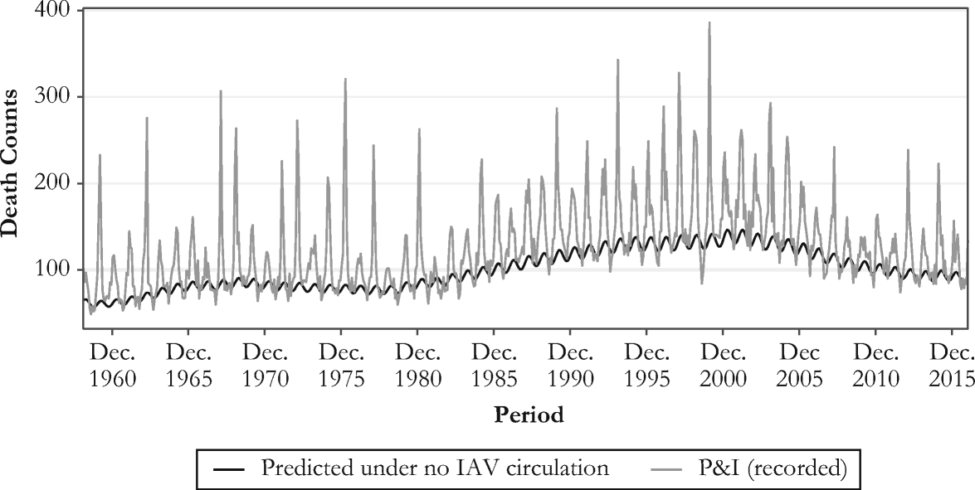
Excess mortality in the context of period shocks
Originally, excess mortality methods were proposed to measure and analyze influenza mortality
Influenza is most of the times misclassified as pneumonia, cardiovascular, or respiratory diseases
Need of a model that captures influenza deaths from seasonal variations
Serfling model (1963)
Strong assumption: influenza does not circulate during summer, and most increases during winter are due to influenza infections
Simple model: a linear regression that accounts for seasonality
Different variations and improvements since its original formulation

Slide 6
Excess mortality in the context of COVID-19
As in the case of influenza, high risk of misclassification of cause of death
Even worse than for influenza because SARS-CoV-2 was a new virus
Predominance of simplistic methods for excess mortality estimation
Because Serfling-like models have some complexity, very simplistic approaches have dominated official estimates… ones much worse than others!
E.g., weekly-average and week-specific average approaches
Limitations
Yearly average-week ignore within-year seasonality
Particularly problematic in populations living in temperate climate
Both approaches ignore secular changes in mortality
Particularly problematic in ageing populations

Slide 7
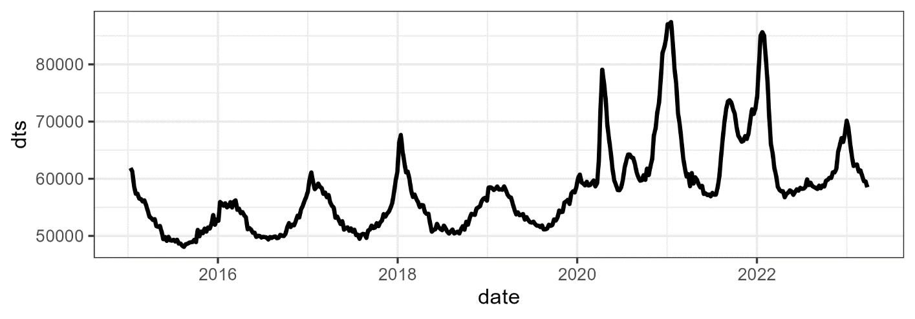
Excess mortality in the context of COVID-19
Practical example: COVID-19 in the US
Weekly deaths from the STMF between 2015 and 2022 for all sexes and ages

Slide 8
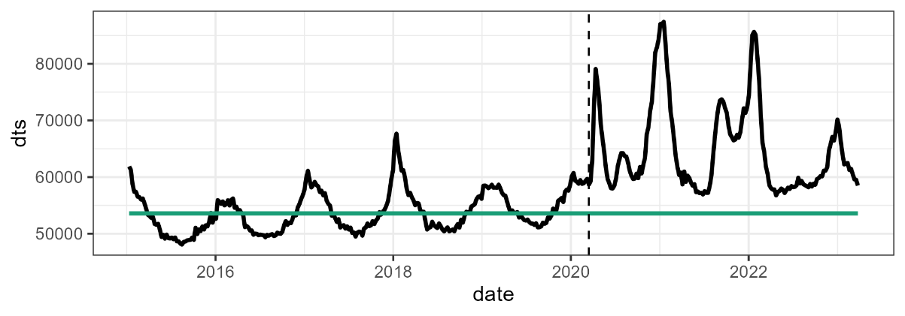
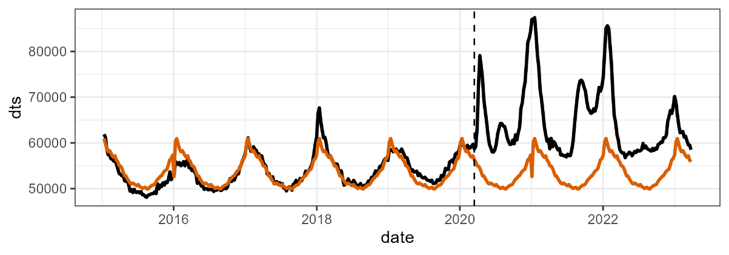
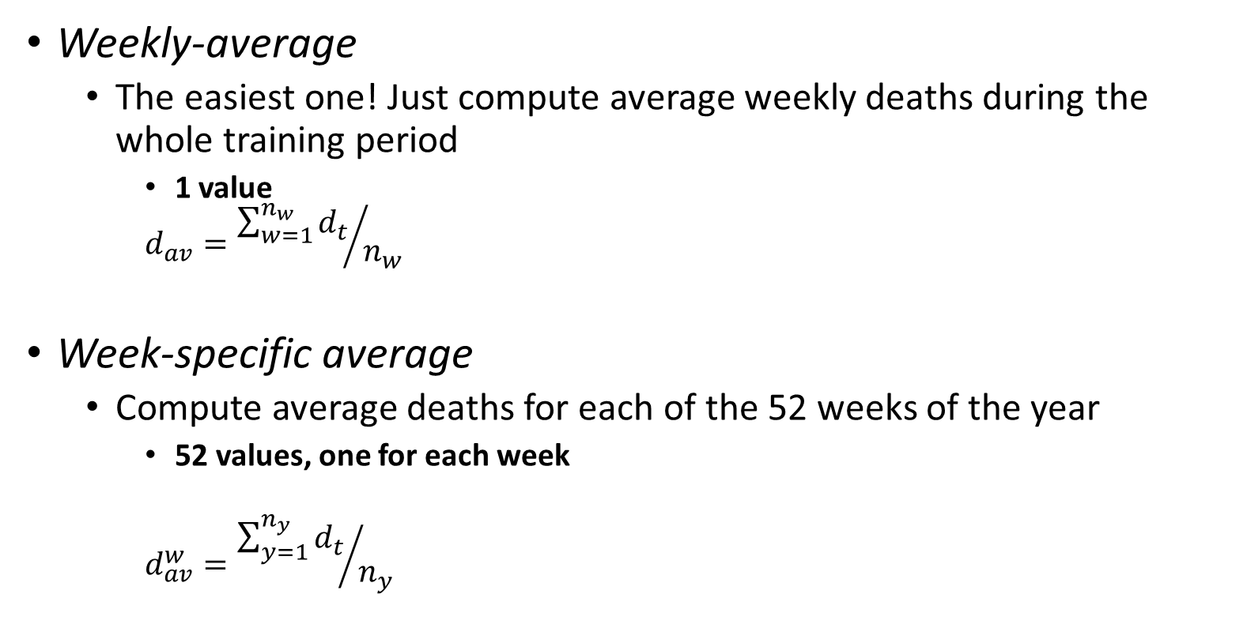
A few approaches for excess mortality estimation
Weekly-average
The easiest one! Just compute average weekly deaths during the whole training period
1 value
$$d_{av}={\sum_{w=1}^{n_{w}}{d_{t}}}/{n_{w}}$$
Week-specific average
Compute average deaths for each of the 52 weeks of the year
52 values, one for each week
$$d_{av}^{w}={\sum_{y=1}^{n_{y}}{d_{t}}}/{n_{y}}$$

Slide 9
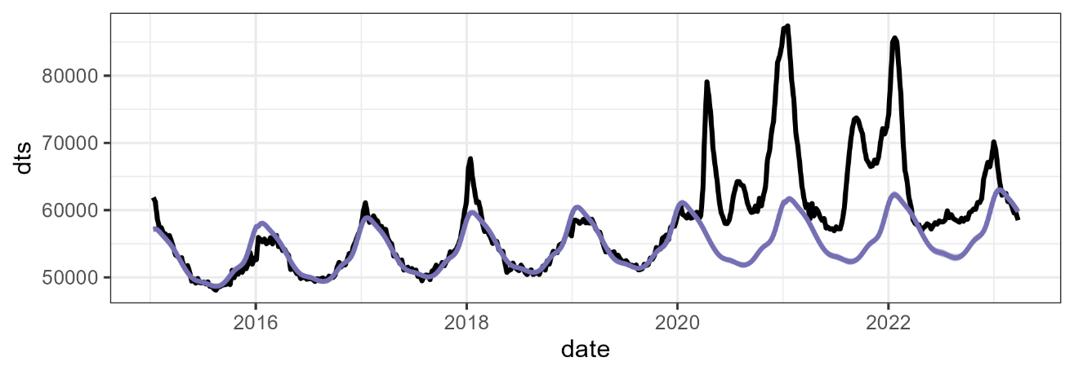
A few approaches for excess mortality estimation
Serfling-like models
Fitting weekly deaths in a Poisson model that accounts for secular trends, seasonality, and changes in exposures over time
As many values as weeks to predict (e.g., 156 values for 2020-2022)
$$log⁡({deaths}_{t})=β_{0}+β_{1}(t)+CS(w)+log⁡({exposure}_{t})$$
Secular trend comp.
Seasonal comp.
Population comp.

Slide 10
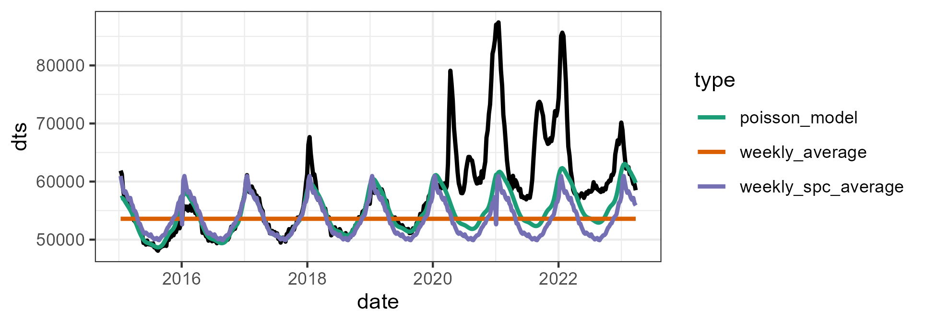
Excess mortality in the context of COVID-19
Practical example: COVID-19 in the US
Fitting the three types of baselines: average mortality, weekly-specific averages, and the Poisson model
How do these baseline differences translate in excess differences?

Slide 11
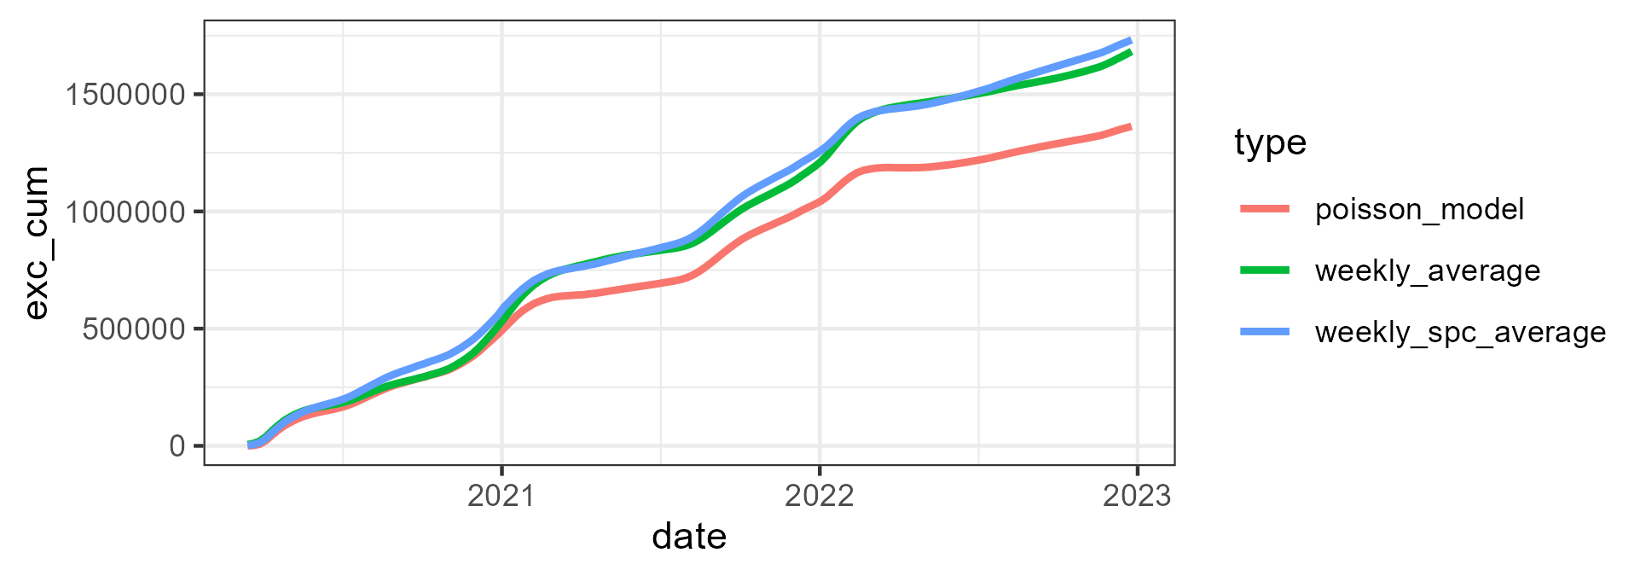
Excess mortality in the context of COVID-19
Practical example: COVID-19 in the US
Cumulative excess by approach

Slide 12
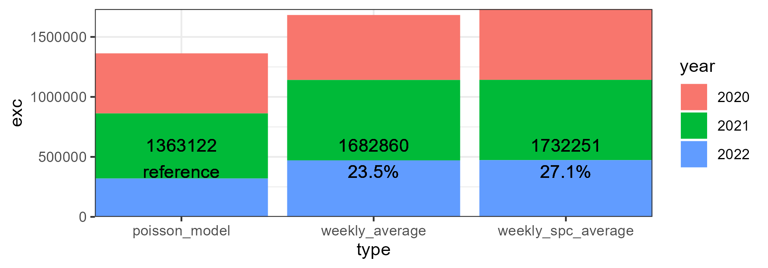
Excess mortality in the context of COVID-19
Practical example: COVID-19 in the US
Total by year

Slide 13
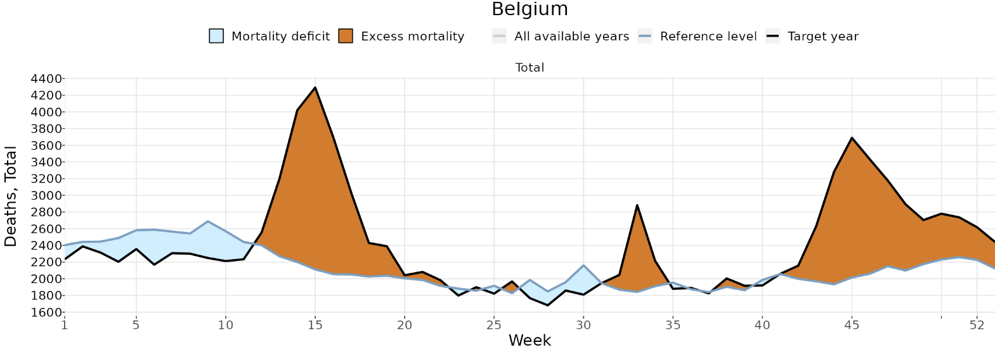
A few conceptual challenges in measuring excess mortality
Avoided mortality:
Expected deaths that did not occur
During the pandemic, influenza circulation was very low. However, the baseline is built under “normal” circumstances, which include typical influenza mortality.
Should we include influenza deaths in the baseline?
Example: Belgium excess estimates in 2020
Source: STMF

Slide 14
A few conceptual challenges in measuring excess mortality
Avoided mortality:
Question: How would you consider the baseline mortality? As a “typical” period, or would you adjust for exceptional characteristics?
Possible adjustment: remove influenza deaths from previous years before estimating the baseline
Example: Belgium excess estimates in 2020
Source: STMF

Slide 15
A few conceptual challenges in measuring excess mortality
Mortality displacement:
Deaths of frail or sick people that were expected to occur during the observation period, but were brought forward by COVID-19 (aka., harvesting effect)
Result in a temporary surplus in mortality followed by a deficit
Issue: These deaths are ignored when calculating cumulative excess deaths!!
Example: Belgium excess estimates in 2020
Source: STMF

Slide 16
A few conceptual challenges in measuring excess mortality
Mortality displacement:
Question: How would you consider cancer terminal patients that were supposed to die in April but died from COVID in March? Should these be considered COVID deaths or not?
Possible adjustment: Do not include the negative excess deaths in the cumulative count
Example: Belgium excess estimates in 2020
Source: STMF

Slide 17
A few conceptual challenges in measuring excess mortality
Accounting or not for processes as avoided mortality and mortality displacement?
Not straightforward answer… it depends:
Do we aim to measure COVID-related mortality?
Important to know if we are interested in known the severity and fatality of the disease
Do we aim to measure mortality changes relative to a “regular” year?
Important to know if we are interested in adjusting mortality and population estimates
Most available “COVID mortality estimates” follow the second approach

Slide 18
A few methodological challenges in measuring excess mortality
Time resolution
Does it make a difference to use annual, monthly, weekly mortality?
Not too much, unless you want to adjust for avoided and displaced mortality
Training period
How many years to take in consideration for constructing the baseline?
Estimates are highly sensitive to this, depending in the trend, of course
Cross-validation of the model is sensible
Exposures
How exposures to risk change over the course of a long period shock of mortality as the COVID-19 pandemic? How do we account for excess deaths in the denominator? Kind of circularity… (?)

Slide 19
A few methodological challenges in measuring excess mortality
Parameterization of the model
What type of parameter use for modeling the secular trend? Is it preferable a more rigid (exponential curve) or flexible (spline) parameter?
When interpolating (e.g., pandemics in the past), splines offer a great fitting and less arbitrary impositions
When extrapolating (e.g., pandemics in development) splines are highly volatile, and might be preferable to constrain them strongly or impose a parametric shape for the secular trend
What about the seasonality?
When building a baseline without influenza, preferable to impose more rigid parameter (e.g., sinusoidal curve)
When building a baseline for a typical year, preferable to use a more flexible approach (e.g., cyclic splines)

Slide 20
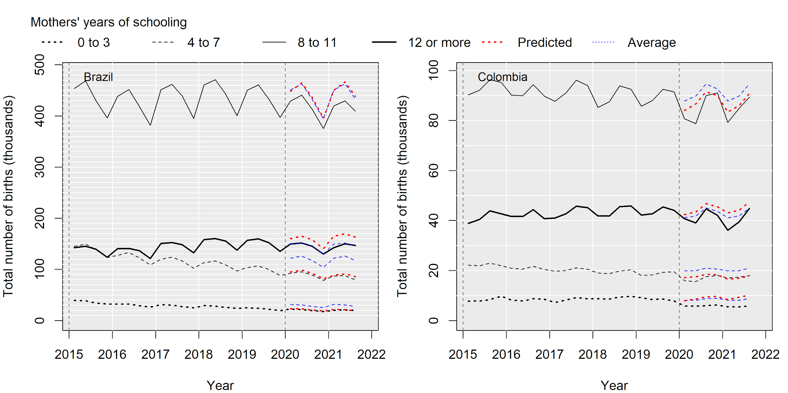
Other potential applications
Not limited to mortality
Extendible to other demographic phenomena
E.g., analysis of the pandemic impact on fertility in Brazil and Colombia by socioeconomic status (Castro et al., 2023).
● predicted births based on trimester averages
● predicted births based on Poisson model

Slide 21
Excess mortality estimation
Let’s see an example in R!

