Slide 1

Mortality disturbances: Age-Period-Cohort modeling and visualization
EDSD Program 2023
CED
Enrique Acosta
17.05.2023

Slide 2
Lecture III. Introduction to statistical analysis of APC effects

Slide 3
APC Analysis
Decomposition of changes into APC components
Highly controversial
More than 100 years of development and still far from consensus
Identification problem
Perfect multicollinearity: Age = Period – Cohort
If we know 2 of these variables, the third one is defined implicitly
E.g., someone who dies at 90 in 2000, was born in…
Implications: You cannot fix an age and a cohort, and vary periods, unless you travel in time (Susuki, 2000)
Infinite number of solutions, all with
All with same fit (maximum likelihood, AIC, BIC, Deviance, etc.)
All with identical predicted rates
How to chose the right answer?

Slide 4
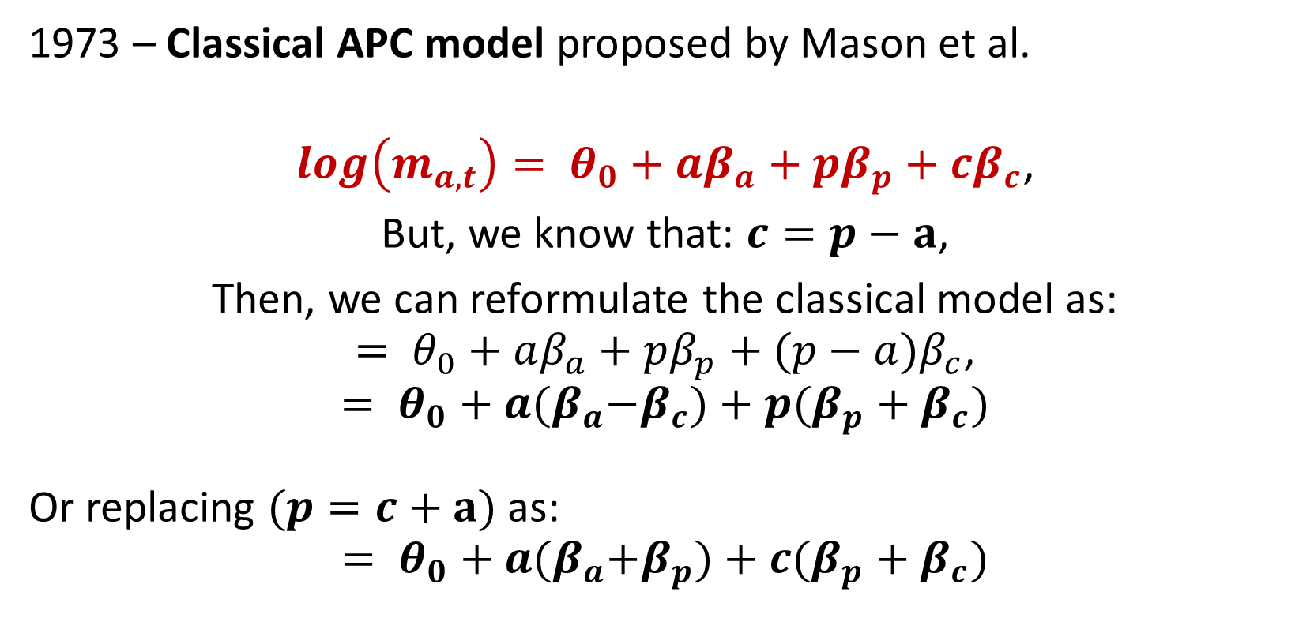
APC identification problem
1973 – Classical APC model proposed by Mason et al.
$$log\left(m_{a,t}\right)= θ_{0}+aβ_{a}+pβ_{p}+cβ_{c}\text{,}$$
But, we know that: $c=p−a\text{,}$
Then, we can reformulate the classical model as:
$$= θ_{0}+aβ_{a}+pβ_{p}+(p−a)β_{c}\text{,}$$
$$= θ_{0}+a{(β}_{a}−β_{c})+p(β_{p}+β_{c})$$
Or replacing $(p=c+a)$ as:
$$= θ_{0}+a{(β}_{a}+β_{p})+c(β_{p}+β_{c})$$

Slide 5
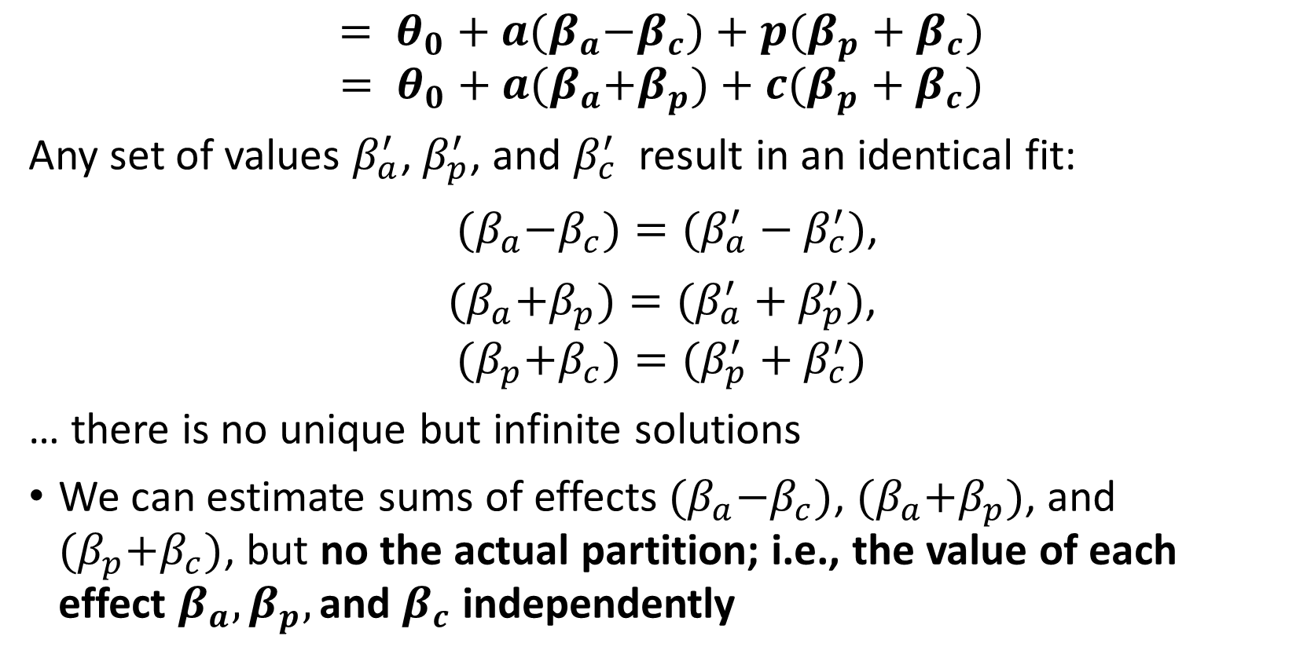
APC identification problem
$$= θ_{0}+a{(β}_{a}−β_{c})+p(β_{p}+β_{c})$$
$$= θ_{0}+a{(β}_{a}+β_{p})+c(β_{p}+β_{c})$$
Any set of values $β_{a}^{′}$, $β_{p}^{′}$, and $β_{c}^{′}$ result in an identical fit:
${(β}_{a}−β_{c})=(β_{a}^{′}−β_{c}^{′})$,
${(β}_{a}+β_{p})=(β_{a}^{′}+β_{p}^{′})$,
$${(β}_{p}+β_{c})=(β_{p}^{′}+β_{c}^{′})$$
… there is no unique but infinite solutions
We can estimate sums of effects ${(β}_{a}−β_{c})$, ${(β}_{a}+β_{p})$, and ${(β}_{p}+β_{c})$, but no the actual partition; i.e., the value of each effect $β_{a},β_{p},\text{and} β_{c}$ independently

Slide 6
Partition of APC effects into linear and nonlinear components
Fienberg and Mason (1979) – Acknowledge that APC effects can be decomposed into linear and nonlinear components
Linear effects: overall linear trends
Nonlinear effects: divergences/departures from this linear trend; curvatures
The identification problem is exclusive to the linear components
Divergences from the linear trends (nonlinear effects, curvatures) are identical, independently of the slopes and constraints
Fully identifiable
This partition is a useful way of reducing the number of parameters involved in the collinearity

Slide 7
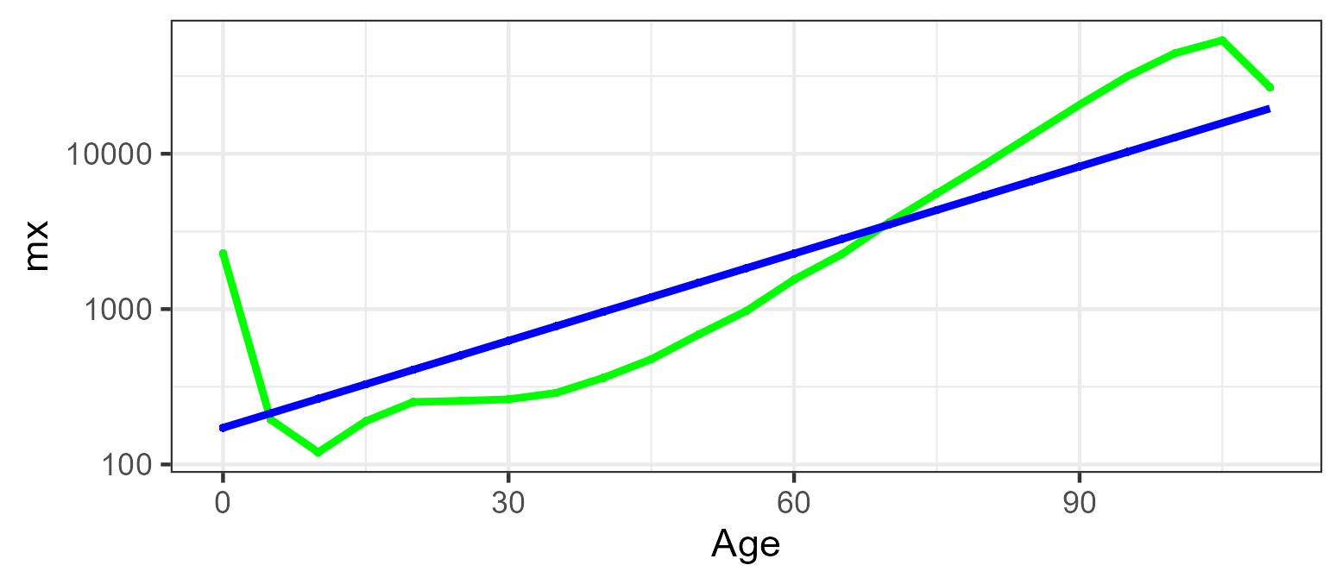
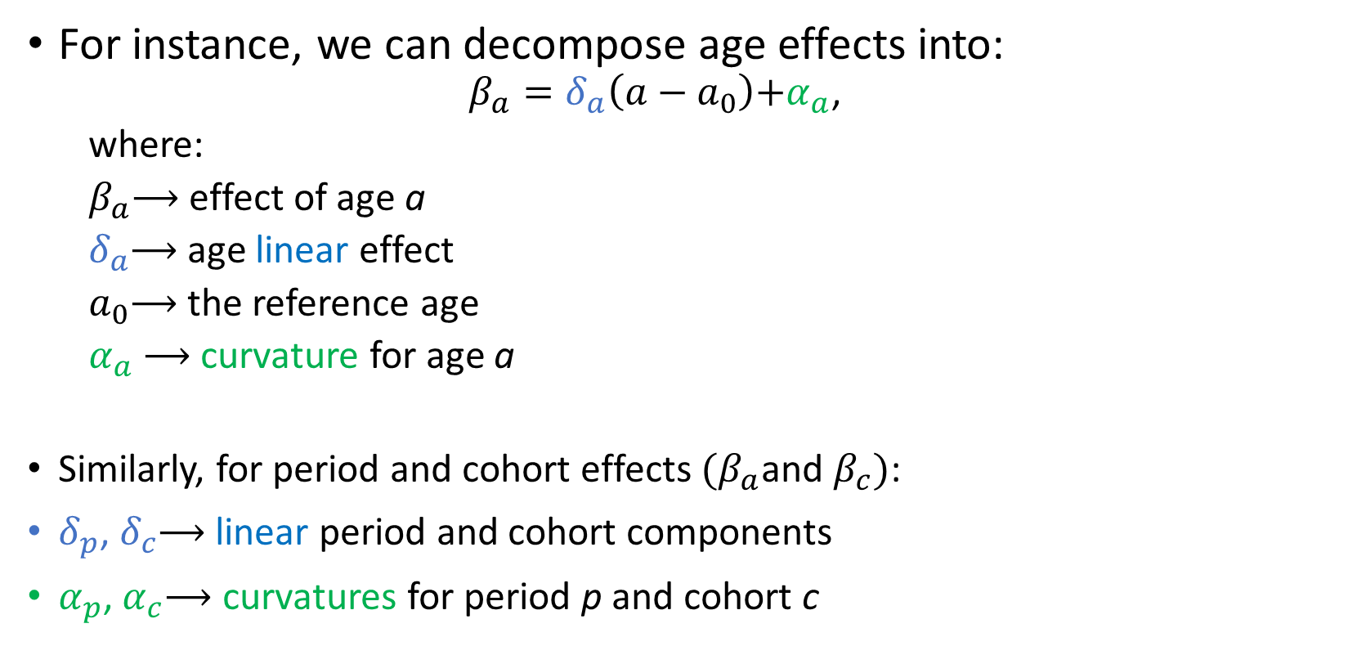
Partition of APC effects into linear and nonlinear components
For instance, we can decompose age effects into:
$$β_{a}=δ_{a}\left(a−a_{0}\right)\text{+}α_{a}\text{,}$$
where:
$β_{a}$⟶ effect of age a
$δ_{a}$⟶ age linear effect
$a_{0}$⟶ the reference age
$α_{a}$⟶ curvature for age a
Similarly, for period and cohort effects ${(β}_{a}$and $β_{c})$:
$δ_{p}$, $δ_{c}$⟶ linear period and cohort components
$α_{p}$,$α_{c}$⟶ curvatures for period p and cohort c

Slide 8
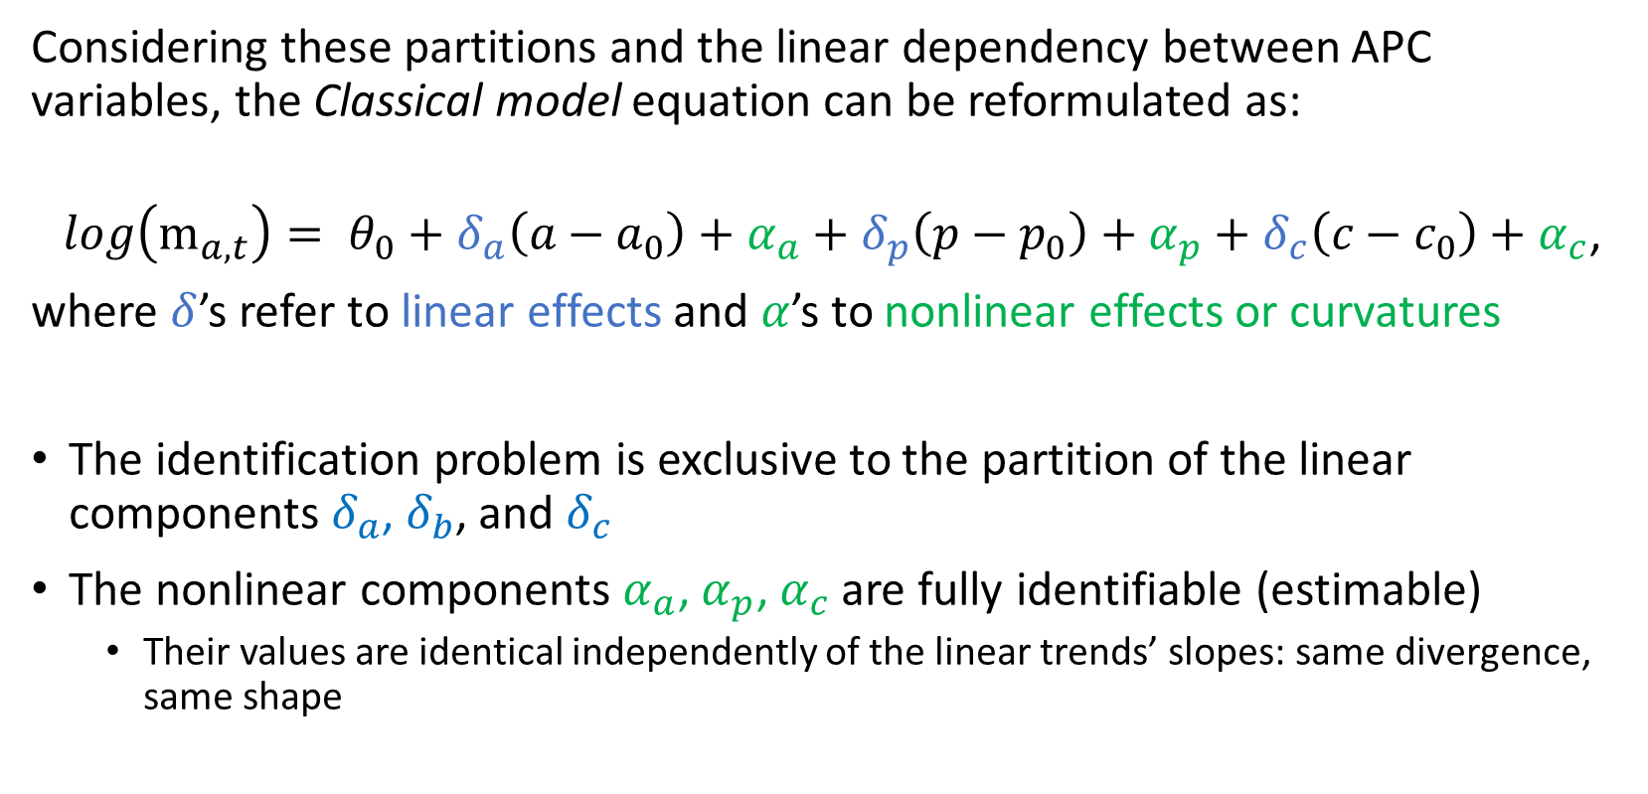
APC Statistical Analysis
Considering these partitions and the linear dependency between APC variables, the Classical model equation can be reformulated as:
$$log\left(m_{a,t}\right)= θ_{0}+{δ_{a}\left(a−a_{0}\right)+α}_{a}+δ_{p}\left(p−p_{0}\right)+α_{p}+δ_{c}\left(c−c_{0}\right)+α_{c}\text{,}$$
where $δ$’s refer to linear effects and $α$’s to nonlinear effects or curvatures
The identification problem is exclusive to the partition of the linear components $δ_{a}$, $δ_{b}$, and $δ_{c}$
The nonlinear components $α_{a}$,$α_{p}\text{,}{ α}_{c}$ are fully identifiable (estimable)
Their values are identical independently of the linear trends’ slopes: same divergence, same shape

Slide 9
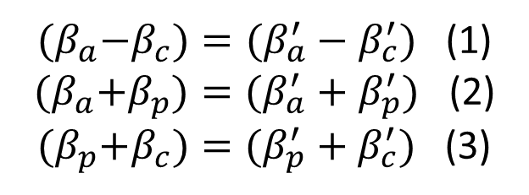
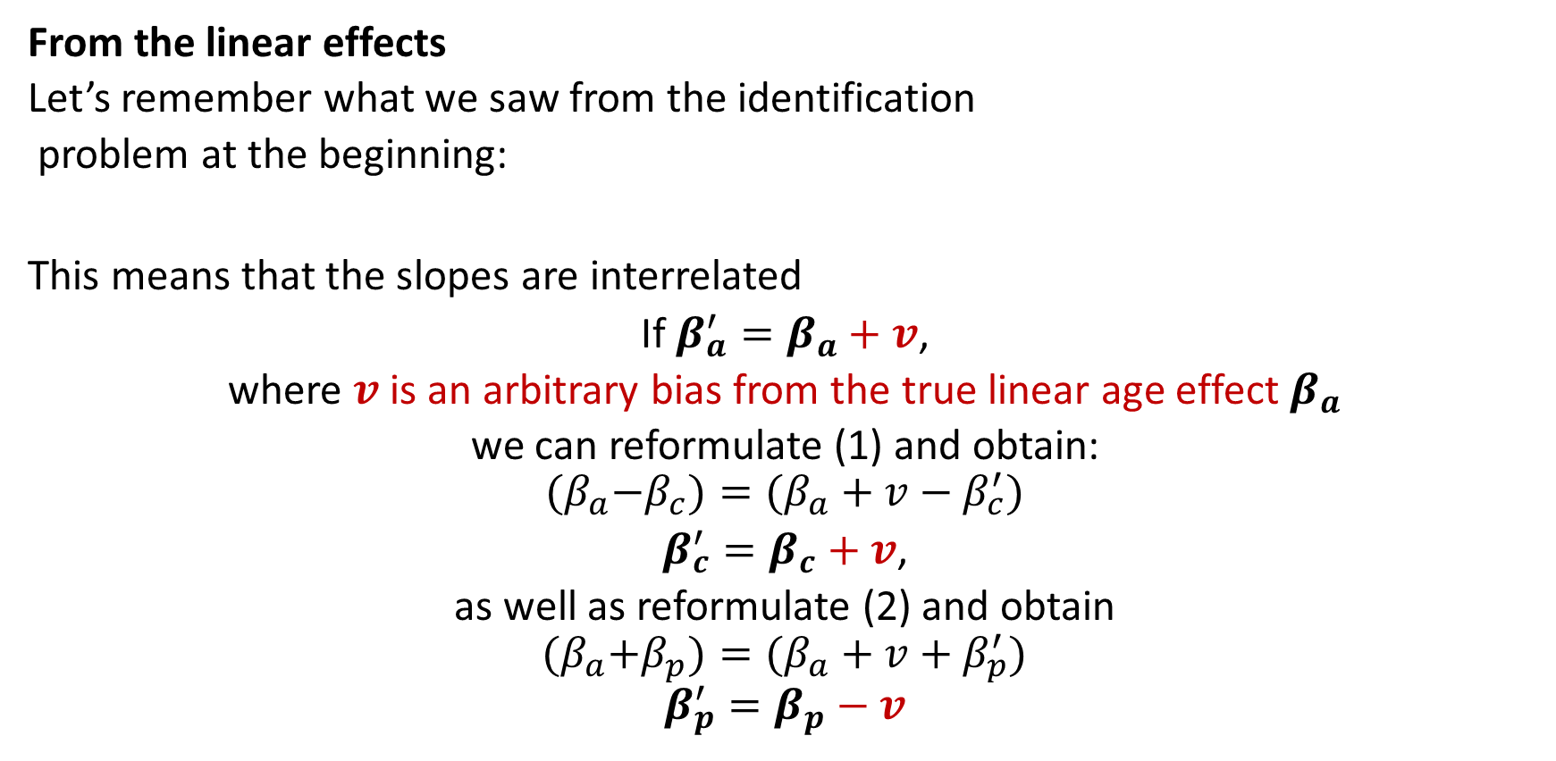
What is identifiable, then?
From the linear effects
Let’s remember what we saw from the identification
problem at the beginning:
This means that the slopes are interrelated
If $β_{a}^{′}=β_{a}+v$,
where $v$ is an arbitrary bias from the true linear age effect $β_{a}$
we can reformulate (1) and obtain:
$${(β}_{a}−β_{c})=(β_{a}+v−β_{c}^{′})$$
$β_{c}^{′}=β_{c}+v$,
as well as reformulate (2) and obtain
$${(β}_{a}+β_{p})=(β_{a}+v+β_{p}^{′})$$
$$β_{p}^{′}=β_{p}−v$$
${(β}_{a}−β_{c})=(β_{a}^{′}−β_{c}^{′})$ (1)
${(β}_{a}+β_{p})=(β_{a}^{′}+β_{p}^{′})$ (2)
${(β}_{p}+β_{c})=(β_{p}^{′}+β_{c}^{′})$ (3)

Slide 10
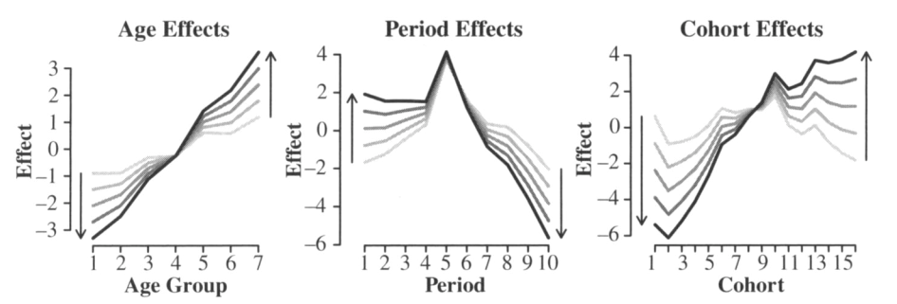
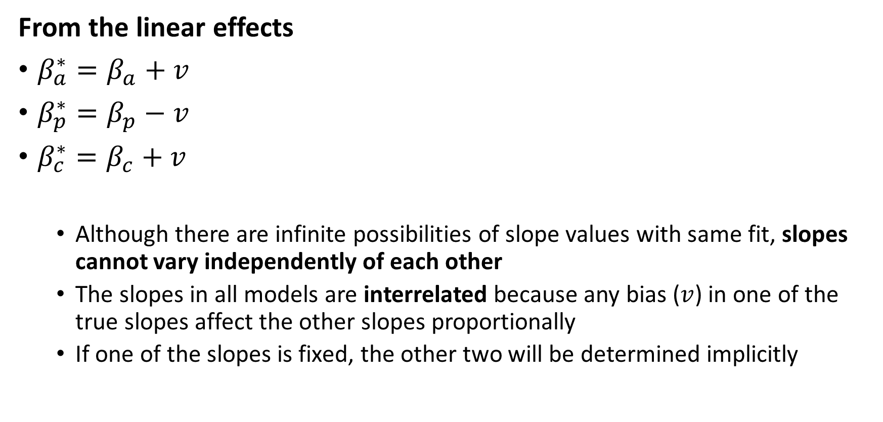
What is identifiable, then?
From the linear effects
$β_{a}^{∗}=β_{a}+v$
$β_{p}^{∗}=β_{p}−v$
$β_{c}^{∗}=β_{c}+v$
Although there are infinite possibilities of slope values with same fit, slopes cannot vary independently of each other
The slopes in all models are interrelated because any bias ($v$) in one of the true slopes affect the other slopes proportionally
If one of the slopes is fixed, the other two will be determined implicitly

Slide 11
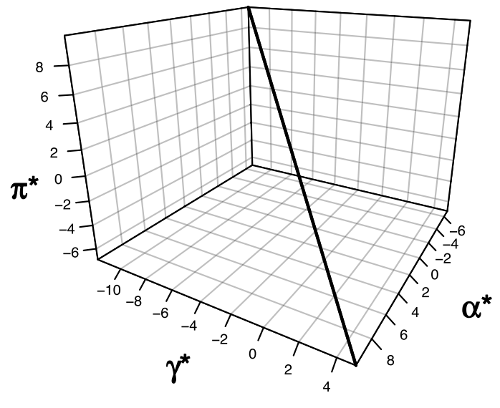
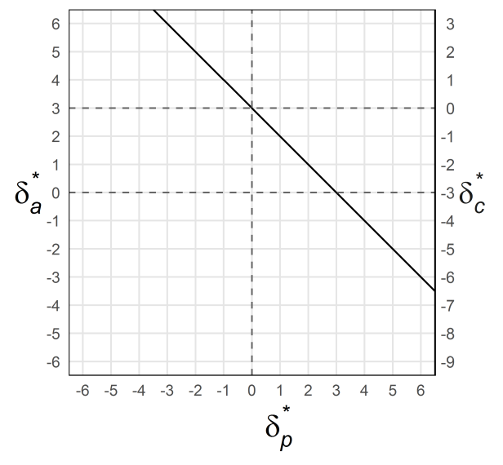
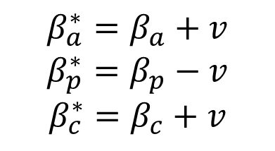
What is identifiable, then?
From the linear effects
Solution line
A clear way to visualize the identification problem is the solution line (Holford 1991)
$$β_{a}^{∗}=β_{a}+v$$
$$β_{p}^{∗}=β_{p}−v$$
$$β_{c}^{∗}=β_{c}+v$$
2D-APC graph (Fosse & Winship 2019)
Implication: This allows us to constrain the model from theoretical background
E.g., equalizing two effects would fix a unique value for the slope (Fosse & Winship approach)
E.g., discarding unrealistic age effects would limit the range of values that the period and cohort slopes can have (Fosse & Winship approach)

Slide 12
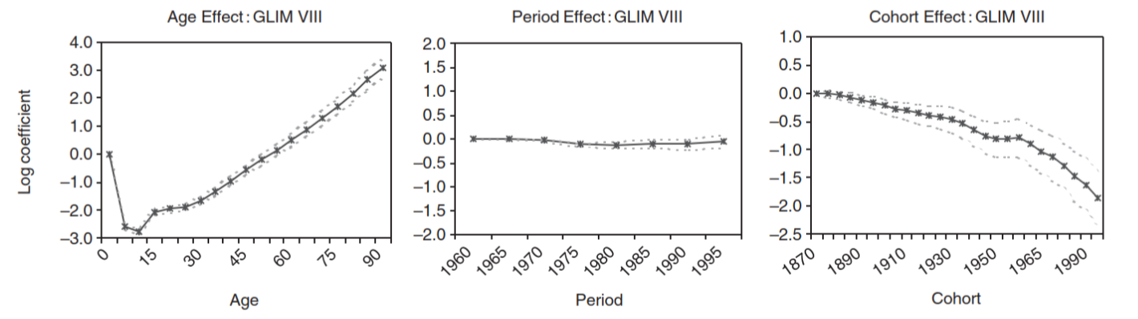
What is identifiable, then?
From the linear effects
Solution line
Explicit constrains as solution
Equate two effects (e.g., two first periods have the same effect)
Based on prior theoretical knowledge
If any of the slopes is fixed, the other two are determined
Limitation: Too sensitive to the researcher criteria
Source:
Yang et al. (2004)

Slide 13
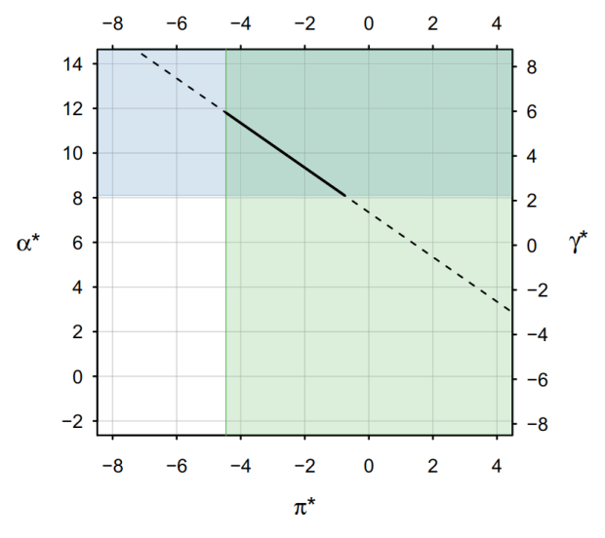
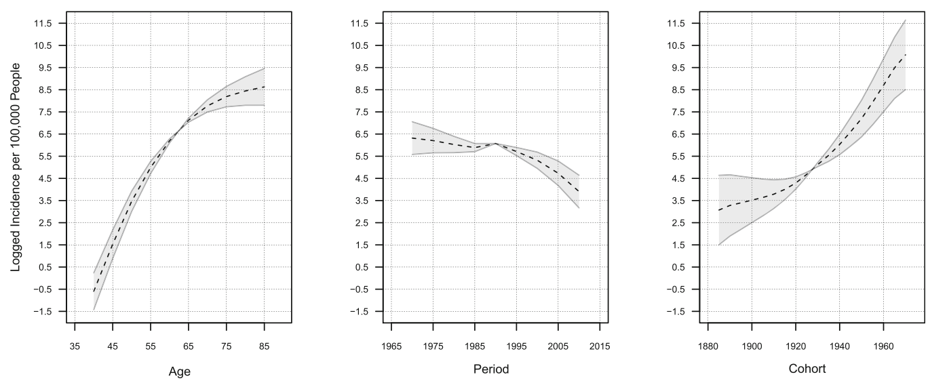
What is identifiable, then?
From the linear effects
Solution line
Solution interval approach: AKA restricted ranges (Wickramaratne et al. 1989) or bounding APC models (Fosse and Winship 2019)
Based on social and biological theory: e.g., prostate cancer incidence: the overall age effect is monotonically increasing from ages 40 to 85 and the overall period effect is not monotonically decreasing (Fosse and Winship 2019)

Slide 14
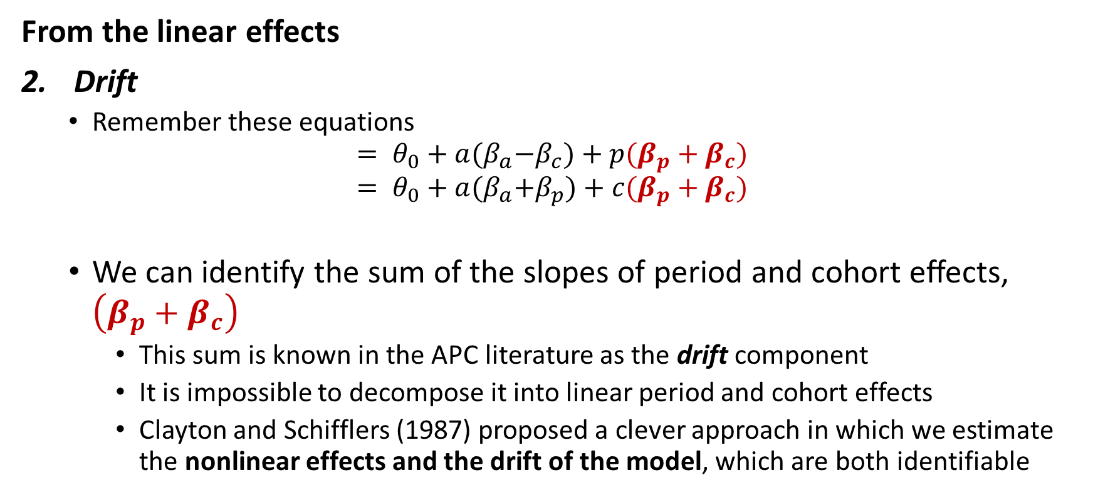
What is identifiable, then?
From the linear effects
Drift
Remember these equations
$$= θ_{0}+a{(β}_{a}−β_{c})+p(β_{p}+β_{c})$$
$$= θ_{0}+a{(β}_{a}+β_{p})+c(β_{p}+β_{c})$$
We can identify the sum of the slopes of period and cohort effects, $\left(β_{p}+β_{c}\right)$
This sum is known in the APC literature as the drift component
It is impossible to decompose it into linear period and cohort effects
Clayton and Schifflers (1987) proposed a clever approach in which we estimate the nonlinear effects and the drift of the model, which are both identifiable

Slide 15
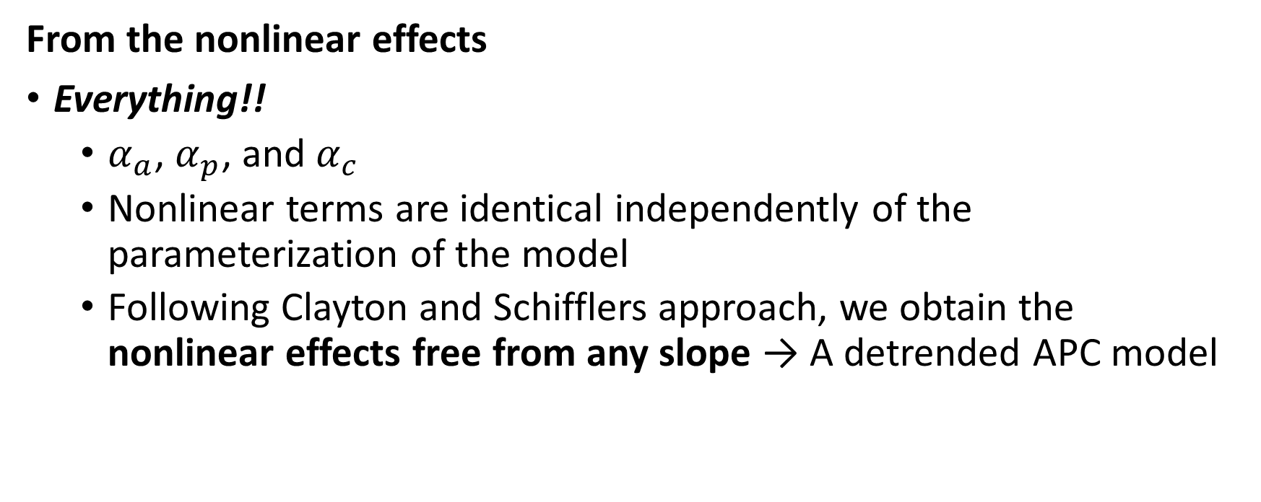
What is identifiable, then?
From the nonlinear effects
Everything!!
$α_{a}$, $α_{p}$, and $α_{c}$
Nonlinear terms are identical independently of the parameterization of the model
Following Clayton and Schifflers approach, we obtain the nonlinear effects free from any slope → A detrended APC model

Slide 16
Best possible approach?
Focus on nonlinear effects
Without neglecting the linear effects (drift)
Combine visual and statistical approaches
Take advantages of what each approach has to offer
One quick example analyzing excess mortality among baby boomers in the US, using APC curvature plots

Slide 17
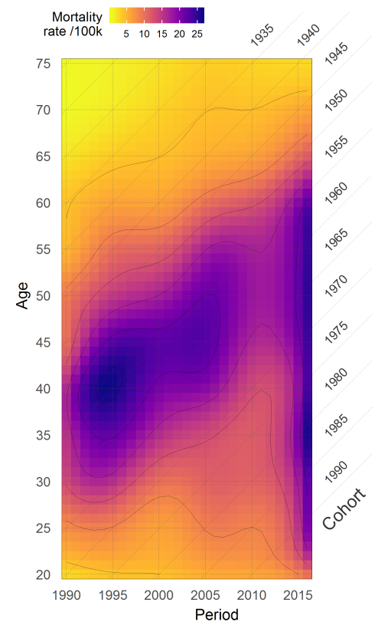
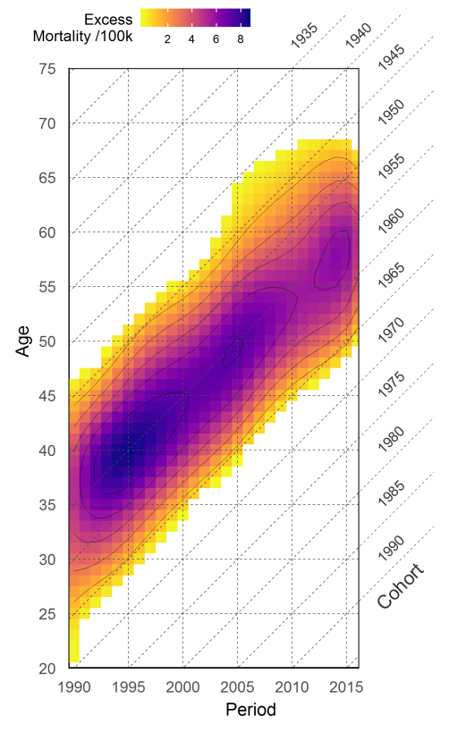
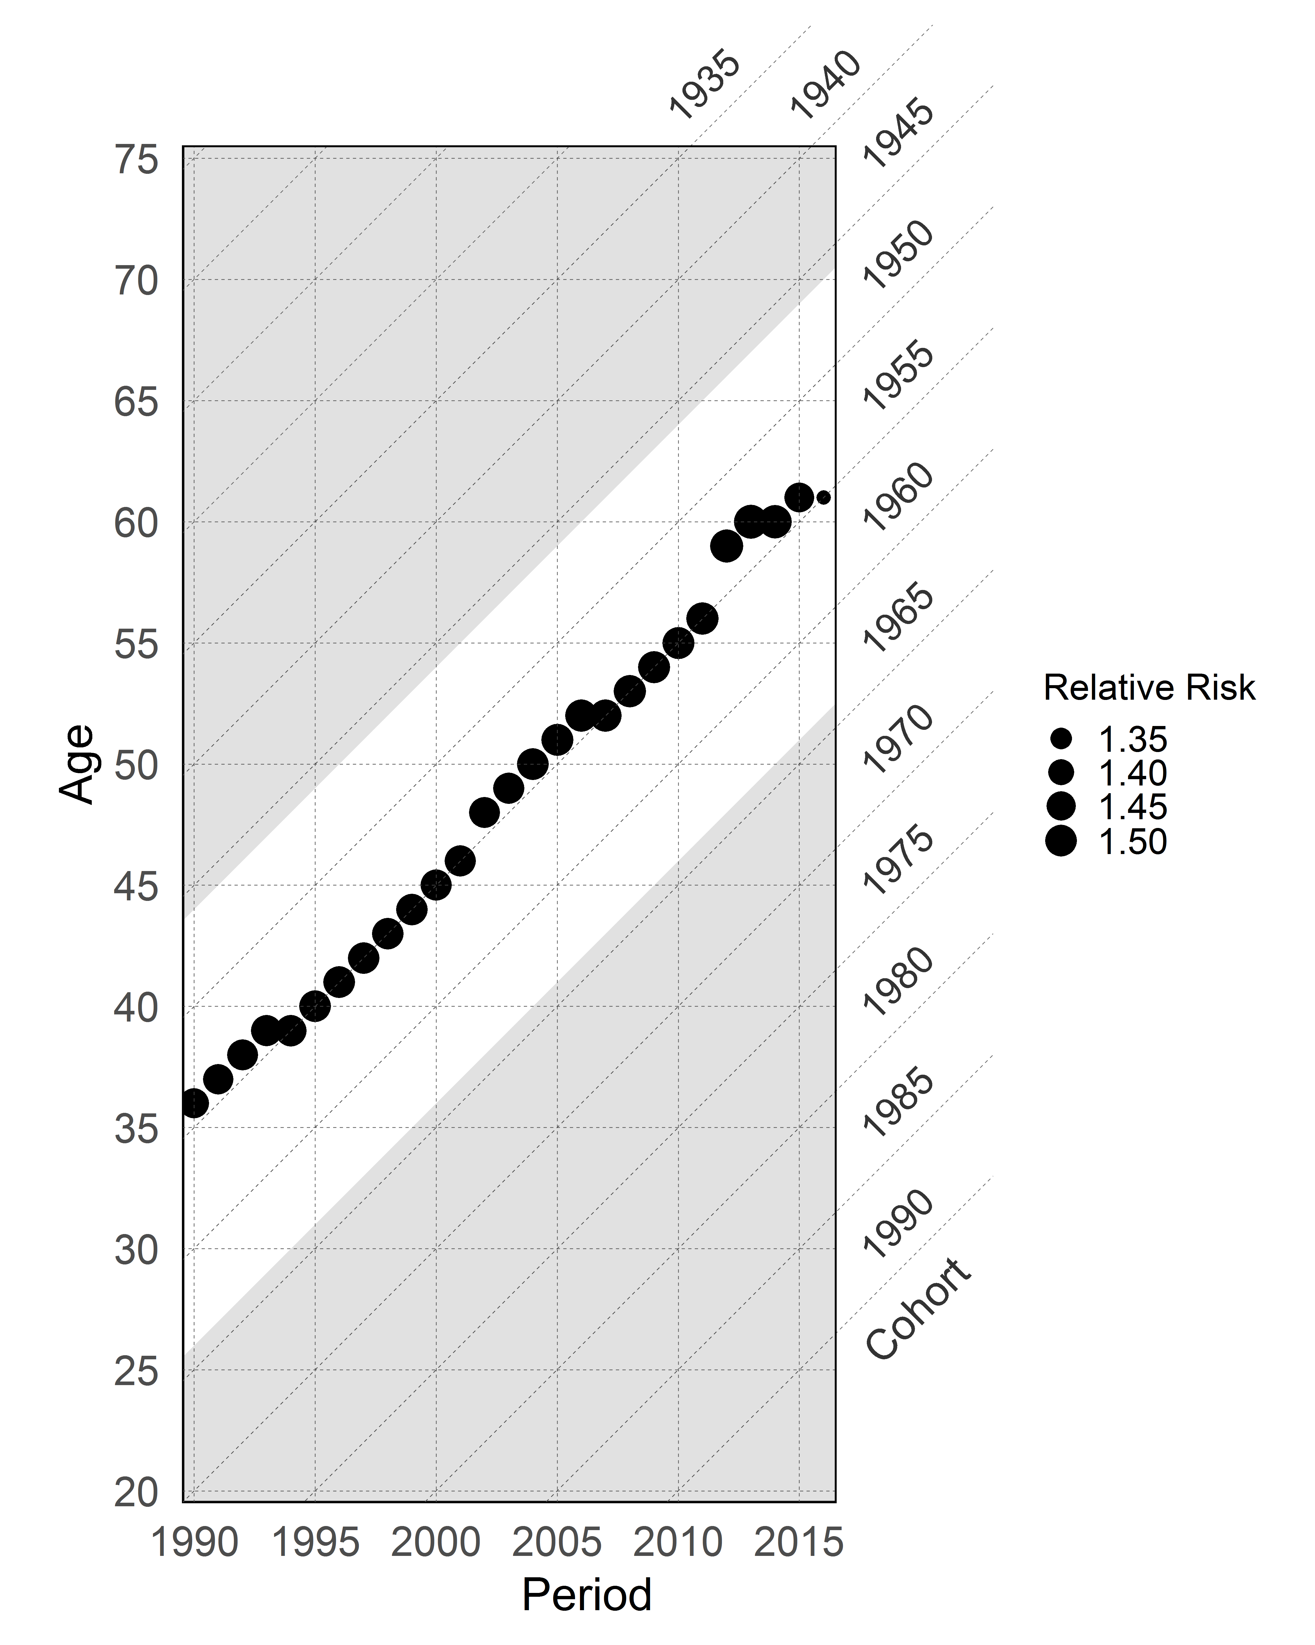
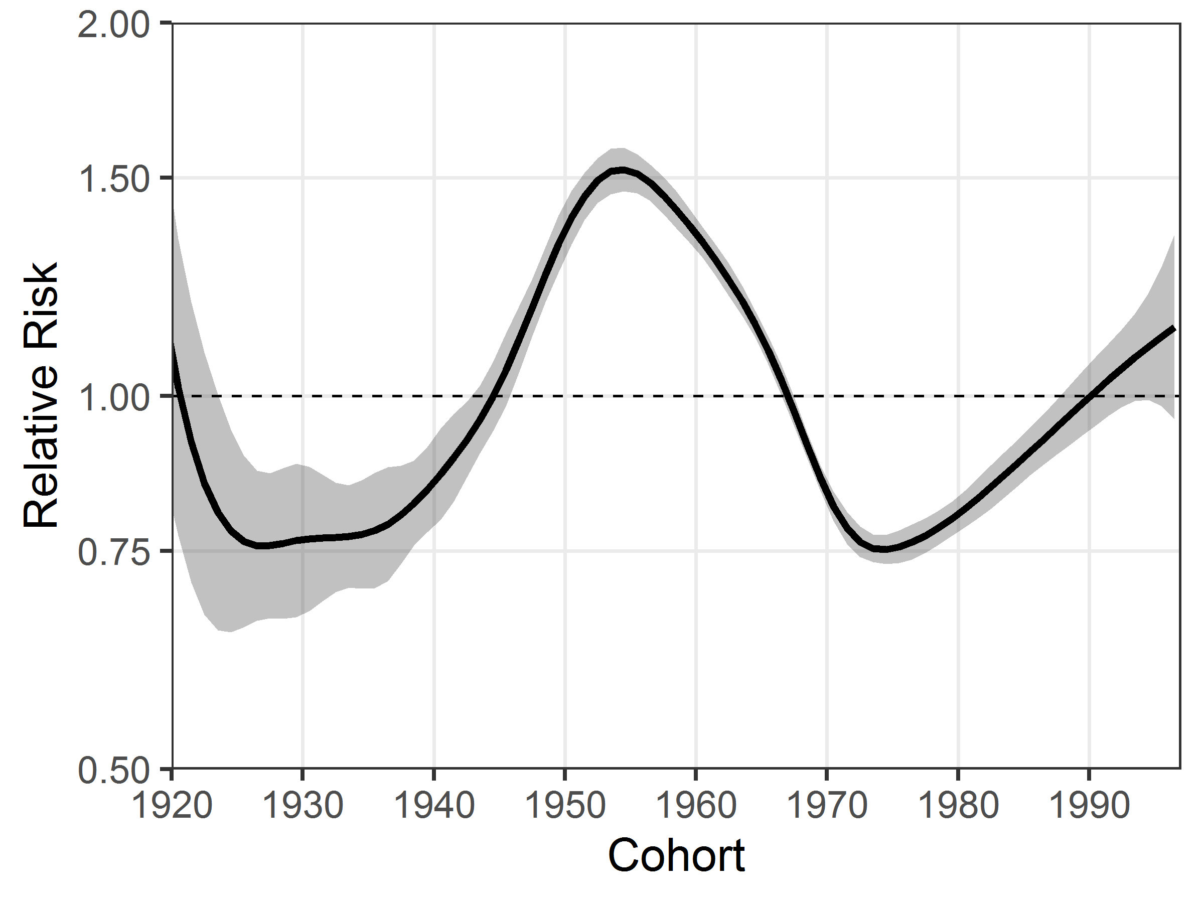
APC curvature plots
Example: Drug-related mortality in Hispanic baby-boomer males in the U.S.
Rates
Excess mortality
Detrended cohort effects
Several options for obtaining the “excess”
Interpolating with p-splines
Residuals of an Age-Period model → Cohort effects + residuals

Slide 18

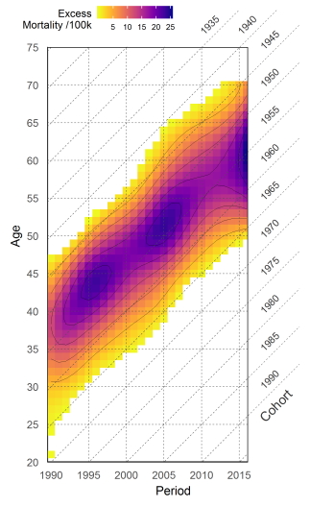
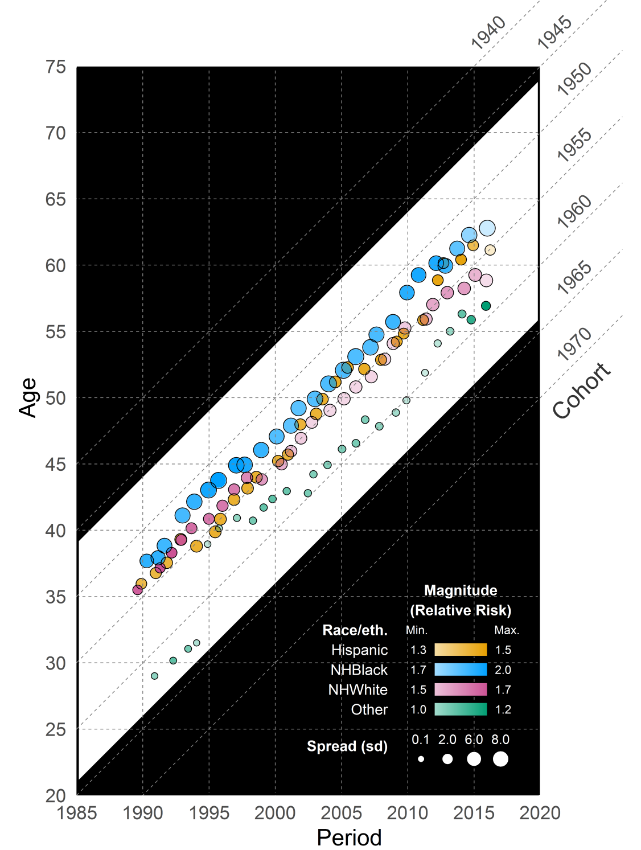
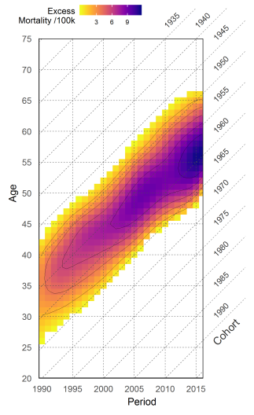
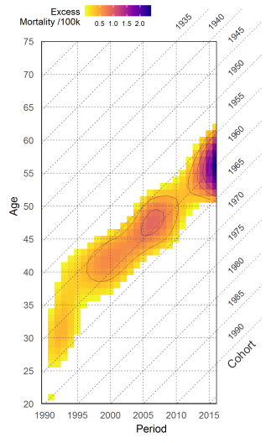
Nonlinear Effects
APC curvature plot
(Acosta & van Raalte 2019)
drug-related mortality
Hispanic
NH-Black
NH-White
Other

Slide 19
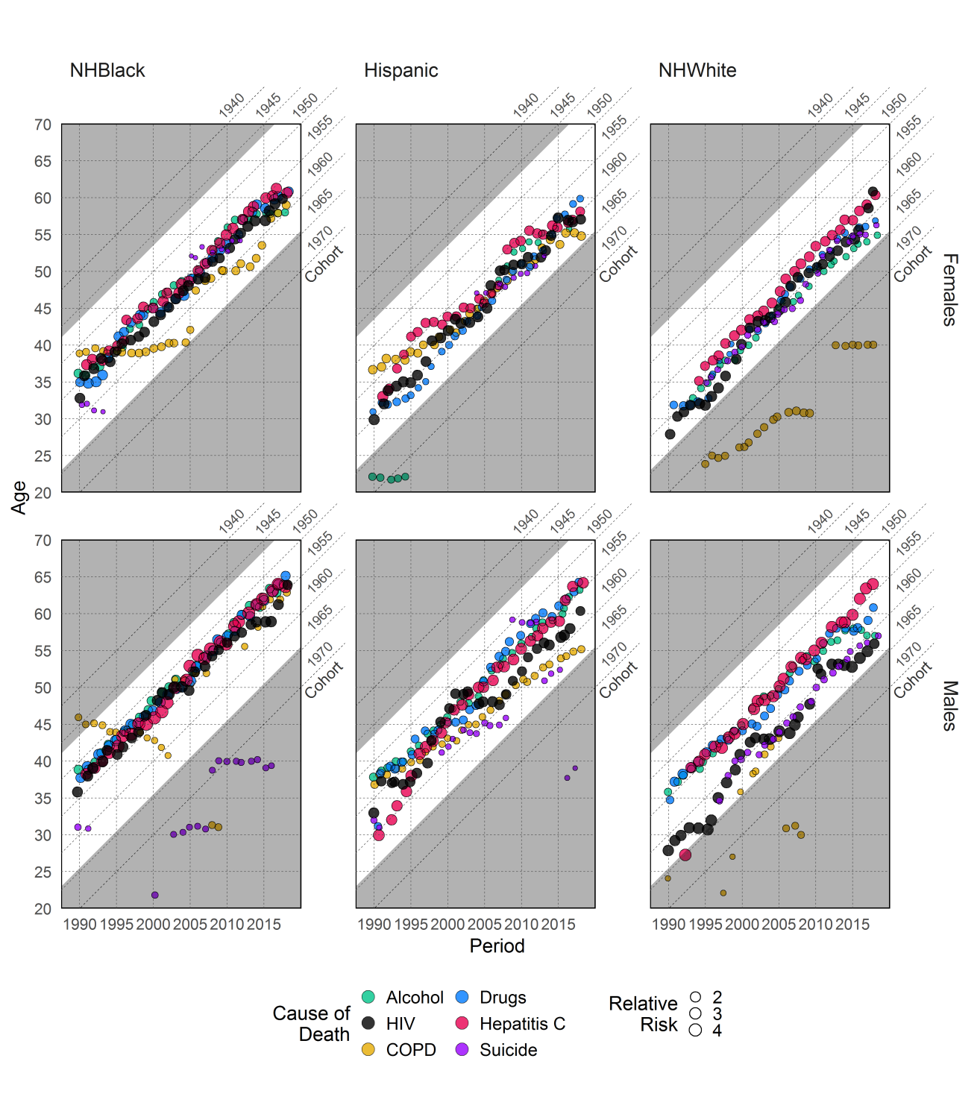
Nonlinear Effects
Source: Acosta et al. The Boomer Penalty (2020)

Slide 20
A few aspects to consider (1/2)
Always keep in mind APC is not a causal analysis
Age, period, and cohorts have no real effects, are proxies of unobserved phenomena
Possible to analyze any vital event (fertility, family formation, migration), but also any variable that is captured in APC configuration (political orientation, religious affiliation, etc.)
Always important to analyze visually the data
Nonlinear effects are averages
In this model we cannot see if the divergences from the linear trend:
Have the same magnitude over time
Are centered in the same category
We can have the most of APC analyses by complementing visual and statistical analyses!!

Slide 21
A few aspects to consider (2/2)
The model is additive within the Poisson framework (log()) but it becomes multiplicative outside
That is why nonlinear effects can be interpreted as relative risks
In other words, nonlinear effects (exp(coefficients)) indicate the divergence from the linear trend in relative terms
Important to analyze how justifiable is the inclusion of the three temporal parameters (APC) in the model
Possible to evaluate the contribution of each parameter to explain the observed variation by measuring the deviance, and also the improvement of the fitting by looking at AIC and BIC measures, among others
Highly useful for analyzing mortality by causes
Potential mechanisms are more specific

Slide 22
Fitting an APC model
Let’s see how things work in R!

Slide 24
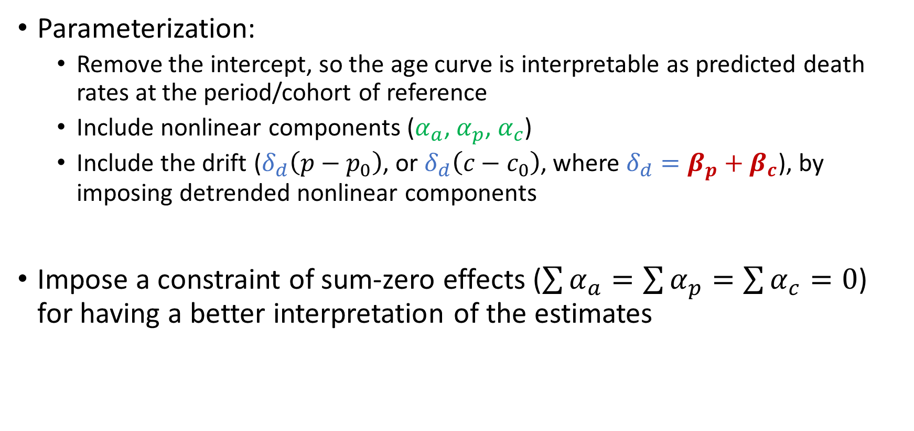
Fitting an APC model
Parameterization:
Remove the intercept, so the age curve is interpretable as predicted death rates at the period/cohort of reference
Include nonlinear components ($α_{a}$,$α_{p}\text{,}{ α}_{c}$)
Include the drift ($δ_{d}\left(p−p_{0}\right)$, or $δ_{d}\left(c−c_{0}\right)$, where $δ_{d}=β_{p}+β_{c}$), by imposing detrended nonlinear components
Impose a constraint of sum-zero effects ($\sum{α_{a}}=\sum{α_{p}}=\sum{α_{c}}=0$) for having a better interpretation of the estimates

Slide 25
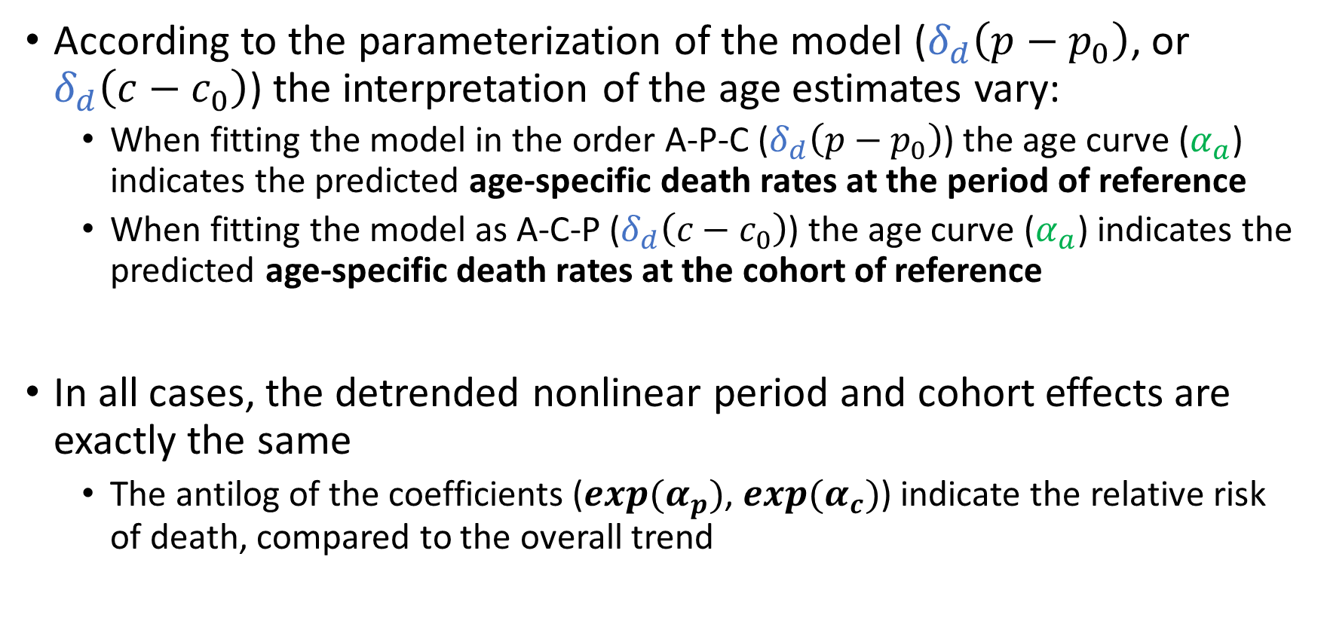
Fitting an APC model
According to the parameterization of the model ($δ_{d}\left(p−p_{0}\right)$, or $δ_{d}\left(c−c_{0}\right)$) the interpretation of the age estimates vary:
When fitting the model in the order A-P-C ($δ_{d}\left(p−p_{0}\right)$) the age curve ($α_{a}$) indicates the predicted age-specific death rates at the period of reference
When fitting the model as A-C-P ($δ_{d}\left(c−c_{0}\right)$) the age curve ($α_{a}$) indicates the predicted age-specific death rates at the cohort of reference
In all cases, the detrended nonlinear period and cohort effects are exactly the same
The antilog of the coefficients ($exp⁡(α_{p})$, $exp⁡(α_{c})$) indicate the relative risk of death, compared to the overall trend

Slide 26
After fitting?
Decomposition of linear effects
Relax assumptions
Based on social and biological theory
Solution interval approach (instead of unique solution)
Focus on identifiable estimates
Divergences from the linear trends (nonlinear effects / curvatures)

Slide 27
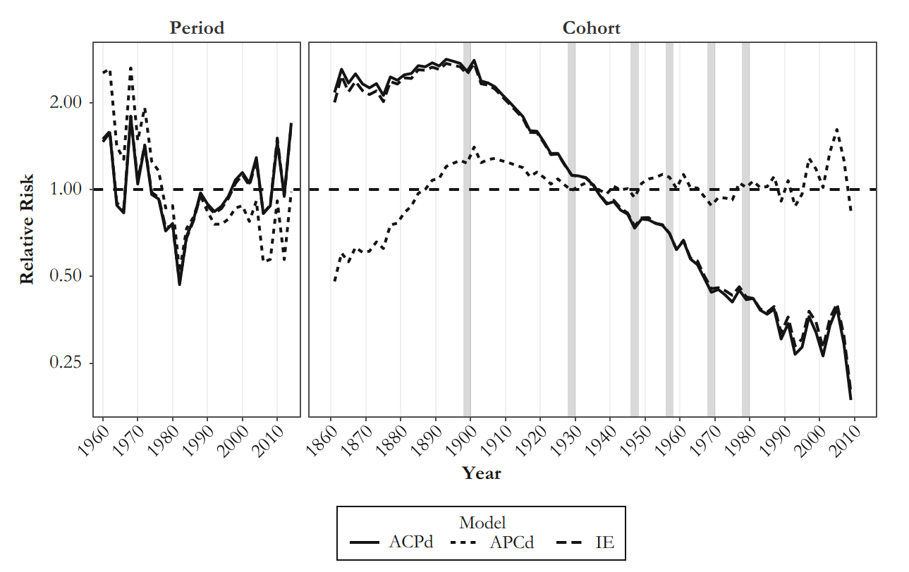
Drift to period and cohort approach
Change over time alternatively fully attributed to period and cohort variations
Assumption: True partition somewhere in between
Influenza mortality trends in the U.S. (Acosta et al. 2019)
Mortality decreased on average 2.02 % per year between 1959 and 2016 (drift = –0.02)
ACPd → All change over cohorts (Period detrended)
APCd → All change over periods (Cohort detrended)
Common aspects from both counterfactuals:
Mortality deteriorated over cohorts 1870-1900
Mortality improved over cohorts 1900-1930
Same lowest and highest period shocks

Slide 28
Nonlinear APC effects
Identification of breakpoints periods and cohorts in which the risk increases or decreases
Second order changes
Differences between slopes in each APC dimension
Identifiable → Invariant to the model constraint
Contrasts analysis (Tarone and Chu 1996) allows for statistical test of the rupture in the trend
h
k+n
Coefficient
h+n
k
Cohort

Slide 29
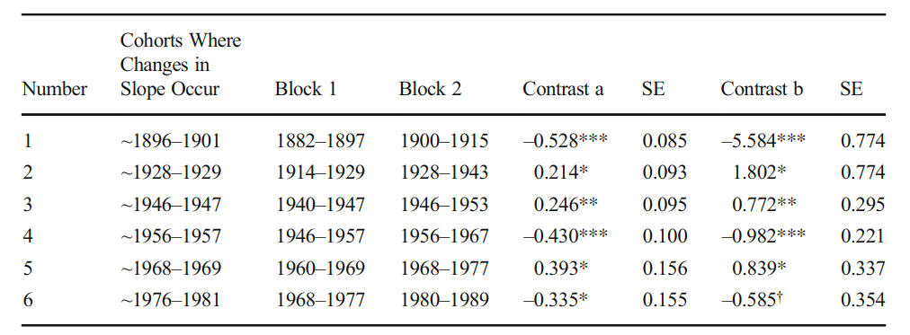
Nonlinear APC effects
Contrasts example: Influenza mortality in the US
Source: Acosta et al. 2019

Slide 30
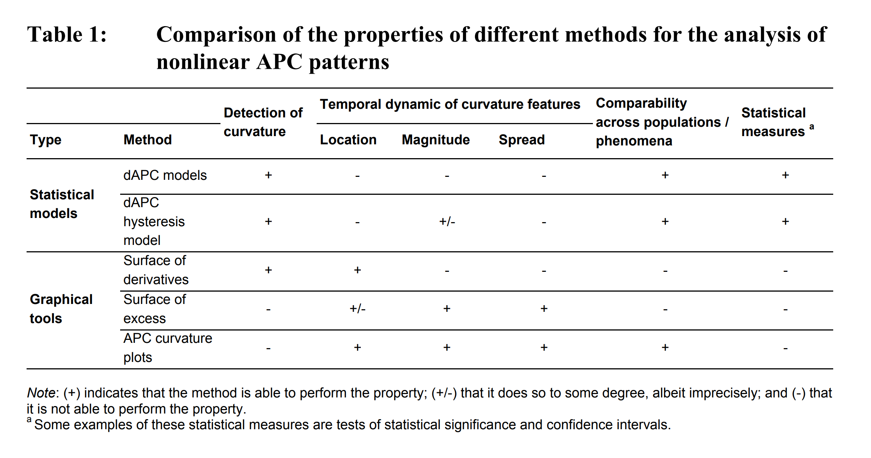
Visual analysis of Nonlinear Effects
Offer complementary information to statistical methods
Offers more flexibility and is less susceptible to statistical artifacts
(Acosta & van Raalte 2019)

