Slide 1


Mortality disturbances: Age-Period-Cohort modeling and visualization
EDSD Program 2025
INED
Enrique Acosta
Centre for Demographic Studies (CED)
11.06.2025

Slide 2
Lecture III. Introduction to excess mortality estimation (bonus track)

Slide 3
Excess mortality
What is excess mortality?
What is the reference or “normal” / “expected” mortality?
Who defines it?
Requires to build a counterfactual scenario (baseline)
A conceptual and subjective definition
Mortality deviations, relative to a counterfactual scenario
Usually refers to period shocks
E.g., wars, epidemics, pandemics, heat waves, natural disasters
Excess mortality considered as the “Gold standard” method for mortality in these contexts

Slide 4
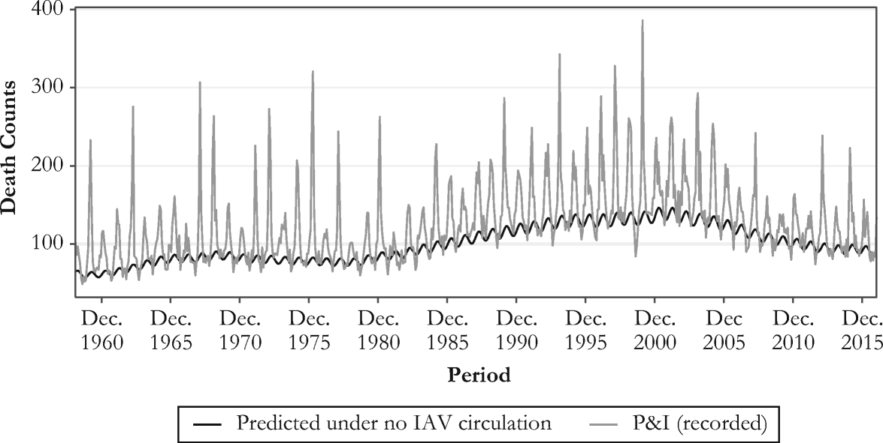
Excess mortality in the context of period shocks
Originally, excess mortality methods were proposed to measure and analyze influenza mortality
Influenza is most of the times misclassified as pneumonia, cardiovascular, or respiratory diseases
Need of a model that captures influenza deaths from seasonal variations
Serfling model (1963)
Strong assumption: influenza does not circulate during summer, and most increases during winter are due to influenza infections
Simple model: a linear regression that accounts for seasonality
Different variations and improvements since its original formulation

Slide 5
Excess mortality in the context of COVID-19
As in the case of influenza, high risk of misclassification of cause of death
Even worse than for influenza because SARS-CoV-2 was a new virus
Predominance of simplistic methods for excess mortality estimation
Because Serfling-like models have some complexity, very simplistic approaches have dominated official estimates… ones worse than others!
E.g., weekly-average and week-specific average approaches
These approaches ignore secular changes in mortality
Particularly problematic in ageing populations

Slide 6
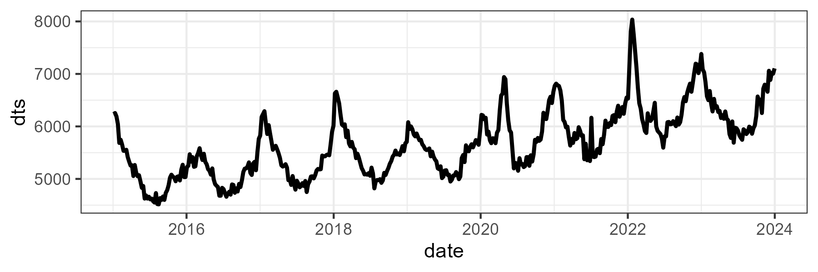
Excess mortality in the context of COVID-19
Practical example: COVID-19 in Canada
Weekly deaths from the STMF since 2015 for all sexes and ages

Slide 7
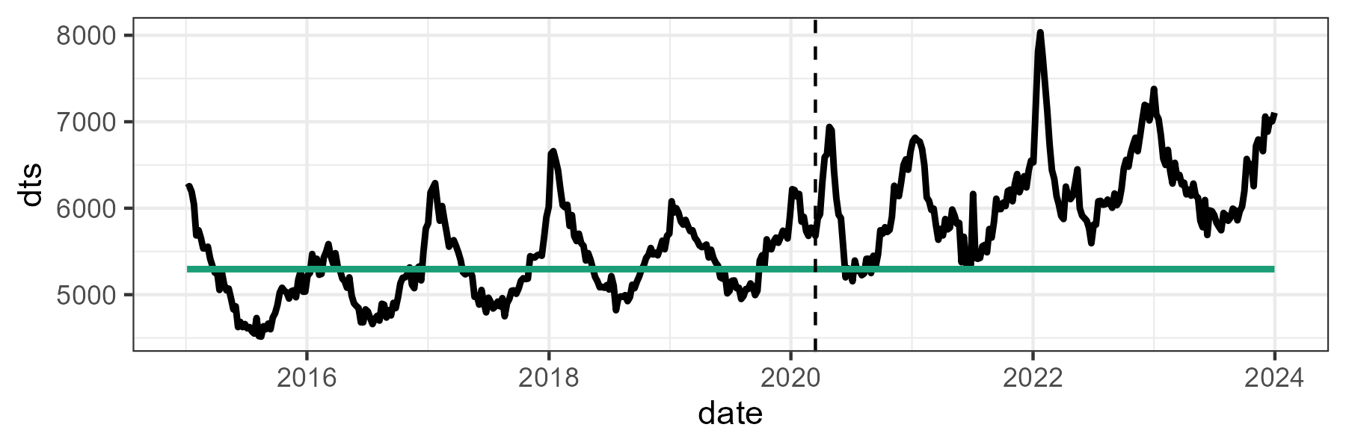
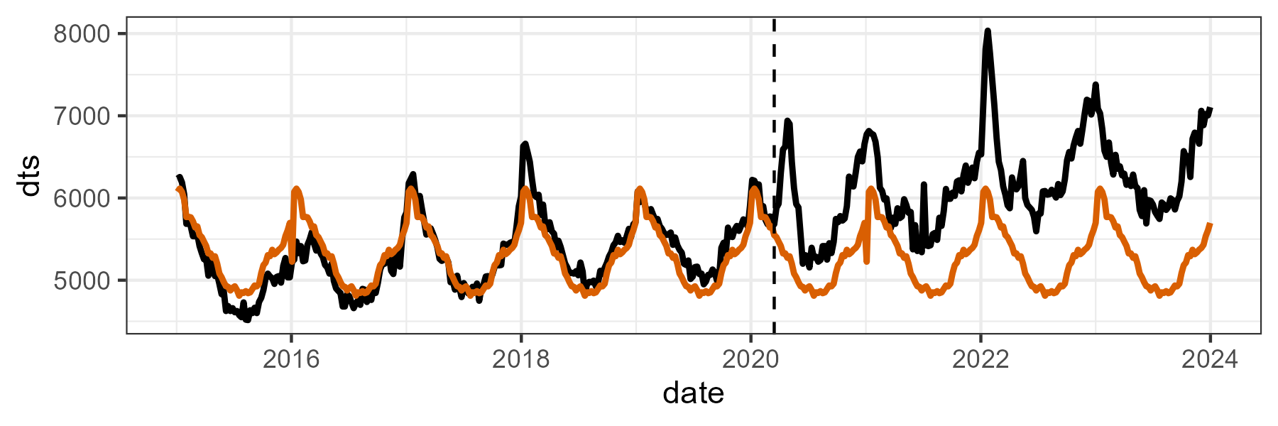

A few approaches for excess mortality estimation
Weekly-average
The easiest one! Just compute average weekly deaths during the whole training period
1 value
$$d_{av}={\sum_{w=1}^{n_{w}}{d_{t}}}/{n_{w}}$$
Week-specific average
Compute average deaths for each of the 52 weeks of the year
52 values, one for each week
$$d_{av}^{w}={\sum_{y=1}^{n_{y}}{d_{t}}}/{n_{y}}$$

Slide 8
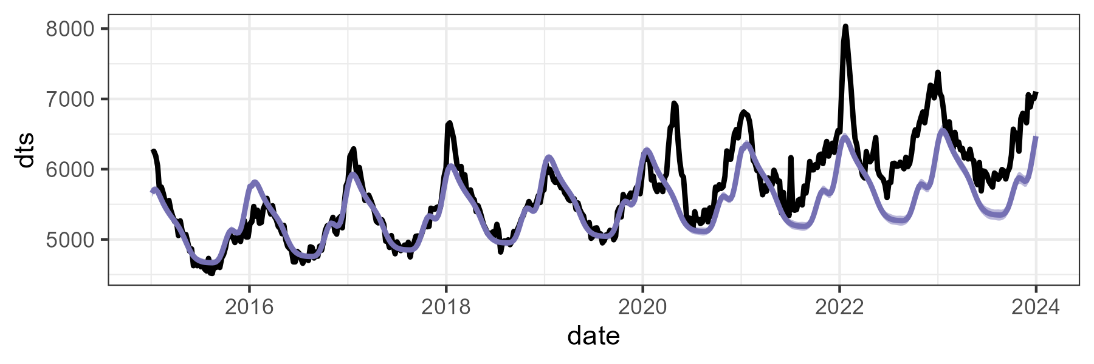
A few approaches for excess mortality estimation
Serfling-like models
Fitting weekly deaths in a Poisson model that accounts for secular trends, seasonality, and changes in exposures over time
As many values as weeks to predict (e.g., 156 values for 2020-2022)
$$log⁡({deaths}_{t})=β_{0}+β_{1}(t)+CS(w)+log⁡({exposure}_{t})$$
Secular trend comp.
Seasonal comp.
Population comp.

Slide 9
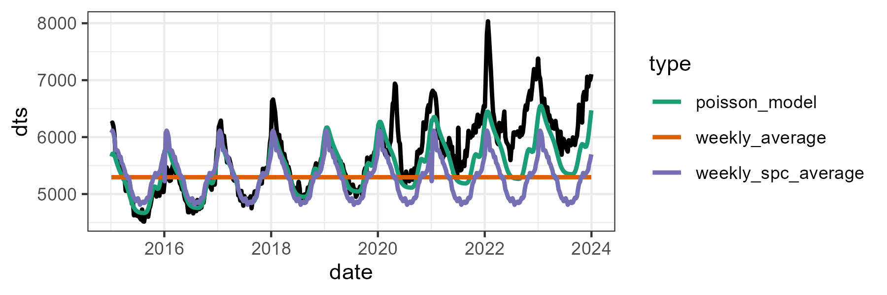
Excess mortality in the context of COVID-19
Practical example: COVID-19 in Canada
Fitting the three types of baselines: average mortality, weekly-specific averages, and the Poisson model
How do these baseline differences translate in excess differences?

Slide 10
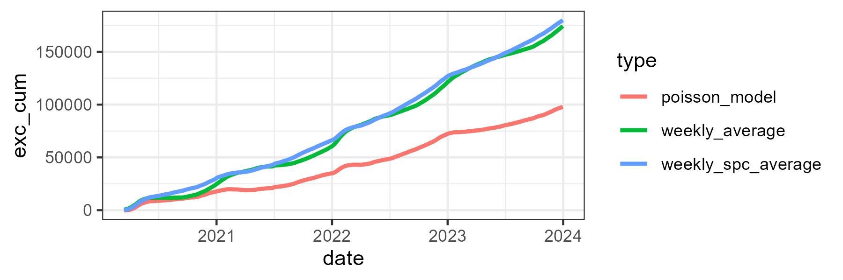
Excess mortality in the context of COVID-19
Practical example: COVID-19 in Canada
Cumulative excess by approach

Slide 11
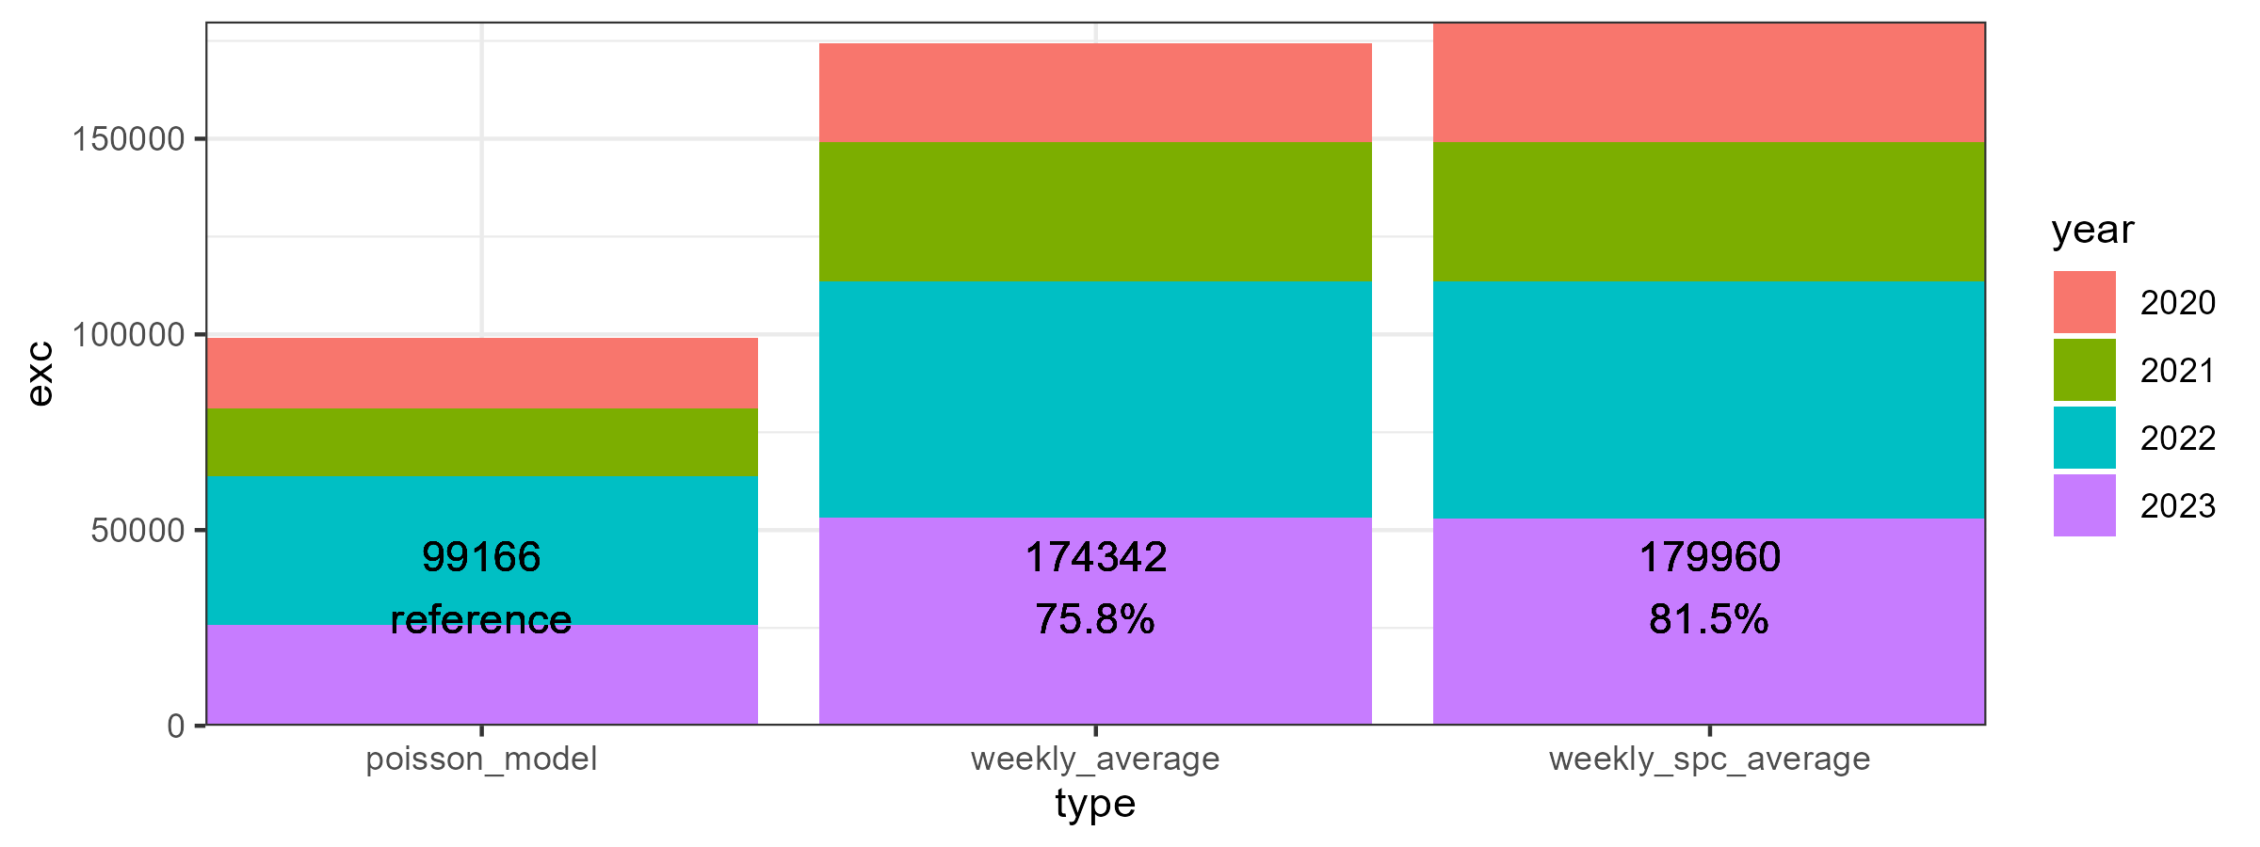
Excess mortality in the context of COVID-19
Practical example: COVID-19 in Canada
Total by year

Slide 12
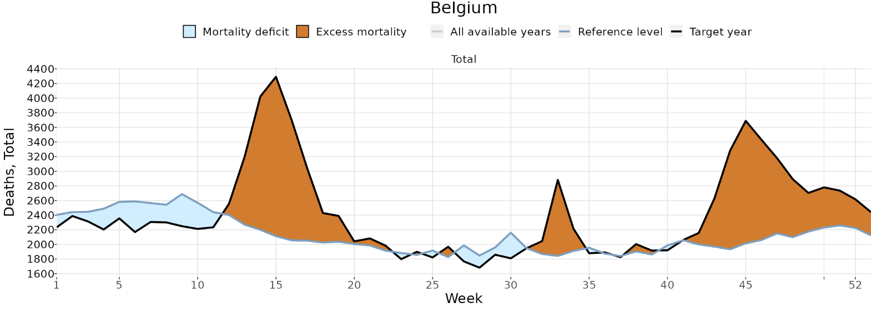
A few conceptual challenges in measuring excess mortality
Avoided mortality:
Expected deaths that did not occur
During the pandemic, influenza circulation was very low. However, the baseline is built under “normal” circumstances, which include typical influenza mortality.
Should we include influenza deaths in the baseline?
Example: Belgium excess estimates in 2020
Source: STMF

Slide 13
A few conceptual challenges in measuring excess mortality
Mortality displacement (aka., harvesting effect):
Deaths of frail or sick people that were expected to occur during the observation period, but were brought forward by COVID-19
Result in a temporary surplus in mortality followed by a deficit
Issue: These deaths are ignored when calculating cumulative excess deaths!!
Example: Belgium excess estimates in 2020
Source: STMF

Slide 14
A few conceptual challenges in measuring excess mortality
Accounting or not for processes as avoided mortality and mortality displacement?
Not straightforward answer… it depends what we want to measure:
COVID-related mortality?
Possible solution: remove/ignore negative excess estimates
If we are interested in knowing the severity and fatality of the disease
Mortality changes relative to a “regular” year?
If we are interested in looking at mortality disturbances or adjusting population estimates
Most of the available “COVID mortality estimates” in literature follow the second approach

Slide 15
A few methodological challenges in measuring excess mortality
Time resolution
Does it make a difference to use annual, monthly, weekly mortality?
Not too much, unless you want to adjust for avoided and displaced mortality
Training period
How many years to take in consideration for constructing the baseline?
Estimates are highly sensitive to this, depending in the trend, of course
Cross-validation of the model is sensible
Exposures
How exposures to risk change over the course of a long period shock of mortality as the COVID-19 pandemic? How do we account for excess deaths in the denominator? Kind of circularity… (?)

Slide 16

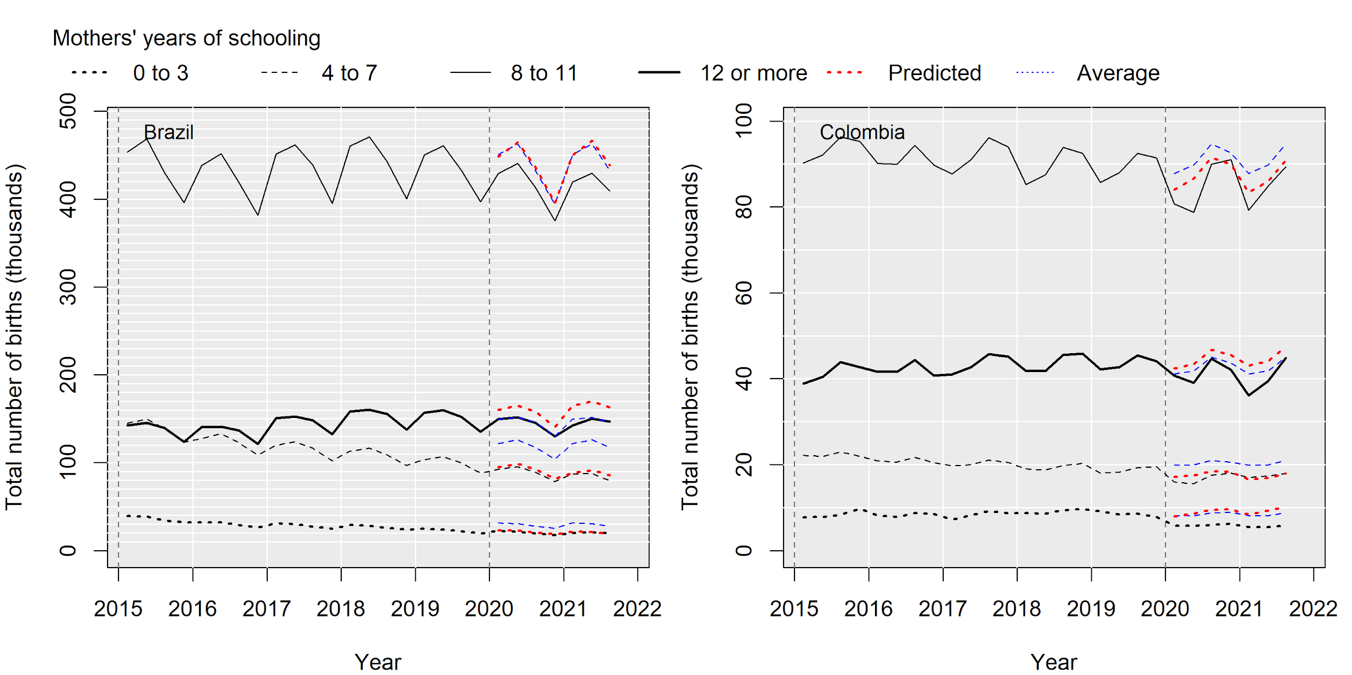
Other potential applications
Not limited to mortality
Extendible to other demographic phenomena, like fertility
● predicted births based on trimester averages
● predicted births based on Poisson model

Slide 17
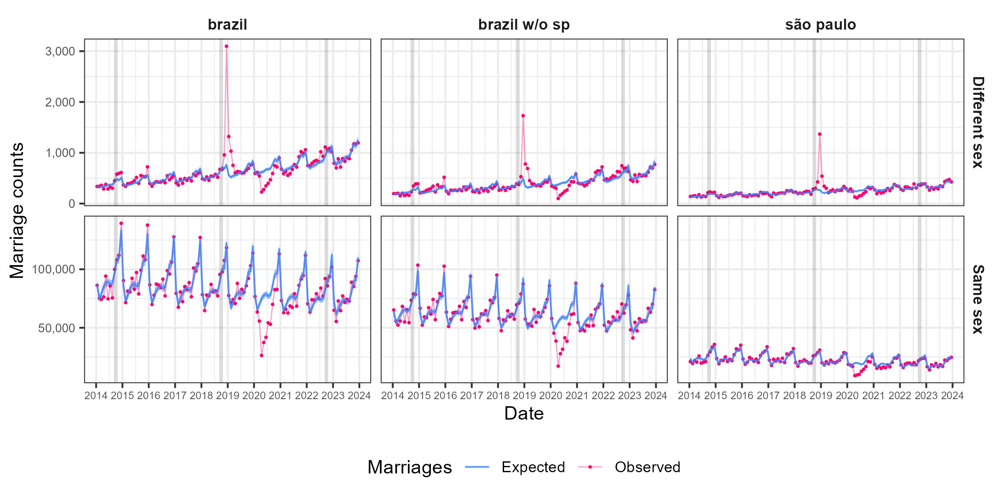
Other applications
Hetero- and same-sex marriages in Brazil
Bolsonaro effect
● predicted monthly marriages based on Poisson model
Fortes et al. (2025)

Slide 18
Excess mortality estimation
Let’s play in R!

