Slide 1


Mortality disturbances: Age-Period-Cohort modeling and visualization
EDSD Program 2025
INED
Enrique Acosta
Centre for Demographic Studies (CED)
11.06.2025

Slide 2
Lecture II. Temporal Dimensions of Mortality Change

Slide 3
Period and cohort perspectives
Causes of mortality change in Epidemiologic and Health Transition theories
Socioeconomic factors, agricultural technology, sanitary conditions, germen theory, medical innovations, lifestyle, etc.
Most of these factors show a predominance of a period perspective in mortality changes
Not always the same approach has been predominant
Mortality improvements at the turn of 20th century for England and Wales seemed dominated by changes over cohorts
Derrick (1927) & Kermack et al. (1934)
~demographic metabolism?

Slide 4
Period and cohort perspectives
Life course theories in mortality analysis
“… how later-life mortality is impacted by events set into motion in early life or other critical periods” (van Raalte 2021)
Conceptualization of cohort effects on mortality
Four mechanisms behind cohort effects (Preston, 1998)
Scarring: Exposure to adverse events during critical periods might lead to mortality disadvantages (+)
Correlated environments: Adverse experience in early life produces limited access to opportunities, increasing the risk of death (+)
Immunity: Early exposure to infections can lead to advantages from acquired immunity (-)
Selection effect: harsh conditions might select the most robust individuals, decreasing the risk of death at the aggregate level (-)

Slide 5
Period and cohort perspectives
Demographic metabolism
Society and population change not as the result of changes at the individual level, but through generational replacement. The successive birth and death of new generations
Seminal works by Karl Mannheim (1928) and Norman Ryder (1965), and more recently, Wolfgang Lutz (2012)
Mortality change as a demographic metabolism process
If early life conditions have an effect on adult mortality, and these have changed so much in the recent history, it is possible that mortality changes result from differences in survival across cohorts

Slide 6
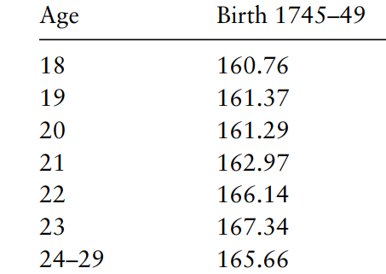
Period and cohort perspectives
… cohort effects in mortality through scarring mechanisms
Fetal origins of degenerative diseases hypothesis (Barker et al. 1986)
Nutrition in-utero has important influences on the onset of cardiovascular diseases and diabetes later in life (age >50y)
Cohort morbidity phenotype (Finch & Crimmins 2004)
Infections and inflammation in early life are determinant of morbidity and mortality at old age → correlated infant and elderly mortality in cohorts
Technophysio evolution theory (Fogel & Costa 1997)
Intergenerational transmission and accumulation of improvements
Gradual improvements in early life experience lead to progressive physiological improvements for new cohorts
Virtuous cycle → more physiological robustness over generations
More physiological changes in the last 300 years than in all human history: e.g., body size increased over 50% in this period!
Still controversial (Barbi & Vaupel 2004; Gagnon & Mazan 2009; Murphy 2010; Myrskyla 2010)
Height
Poll time!!: which population do you think would have on average these heights by age?

Slide 7
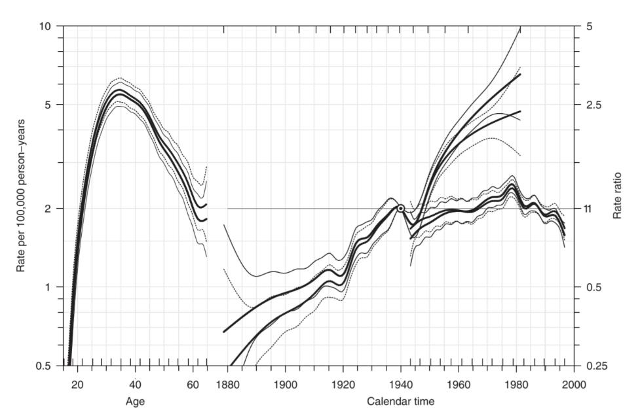
Age-Period-Cohort effects
Rates of testis cancer, Denmark 1943–1997, ages 15–64.
Carstensen (2007)
What are age-period-cohort effects?
Age, period, or cohort dimensions do not have effects by themselves
Proxies of (unobserved) factors underlying the dynamics of any populational process
Demographic, social, epidemiologic, economic…

Slide 8
Age-Period-Cohort effects
If age, period, or cohort do not have any effect on mortality by themselves, why APC effects are important?
‘refer to a set of [not directly observed] underlying causal processes that are indexed by the three APC variables’ (Fosse and Winship 2019)
If all causal processes are observable → There is no reason to bother with APC analyses (Hobcraft 1982)
Since that is not the case → APC provide important clues about non- observable causal mechanisms
Clues about age-, period-, and cohort-based factors that we don not observe but are modulating mortality risks

Slide 9
Age-Period-Cohort effects
Effects | Marker of | Examples
Age | Biological changes in the organism | Degenerative diseases
 | Social and psychological stages | Accidents and violence at young ages
 | Gradual accumulation of exposures to risk factors | Alcohol abuse leading to cirrhosis
Period | Contemporary epidemiological, social, and historical events | Deaths from natural disasters, wars, pandemics
Cohort | Epidemiological, social, and historical events lived in the past, leading to different outcomes across cohorts | Lingering effects of epidemics or famines

Slide 10
Age-Period-Cohort effects
“Why most young demographers use R?”
Age effect: “you know, young people love free stuff and visualizations, they will grow up soon and will pay for Stata or SAS”
Period effect: “I think it is because it is trendy nowadays, before everybody used Stata, later everybody will use Python”
Cohort effect: “maybe is because they learned R at the beginning of their career, and they will continue to use it for a long time”

Slide 11
Age-Period-Cohort effects
Work in groups (5 mins)
Discussion in groups to identify potential age, period, and cohort effects that explain changes in mortality from:
Cancer
Cardiovascular diseases
Suicide
Drowning
COVID-19

Slide 12
APC Analysis
Decomposition of changes into APC components
Highly controversial
More than 100 years of development and still far from consensus
e.g., Demography (2013) and Social Science & Medicine (2015) special issues
Identification problem
Perfect multicollinearity
Age = Period – Cohort
Infinite number of solutions with same fit
4 waves of theoretical and methodological developments

Slide 13
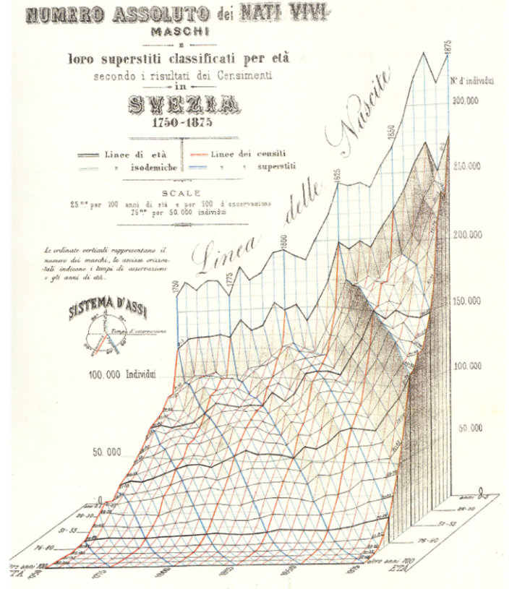
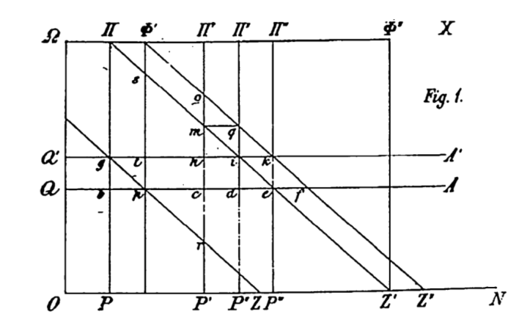
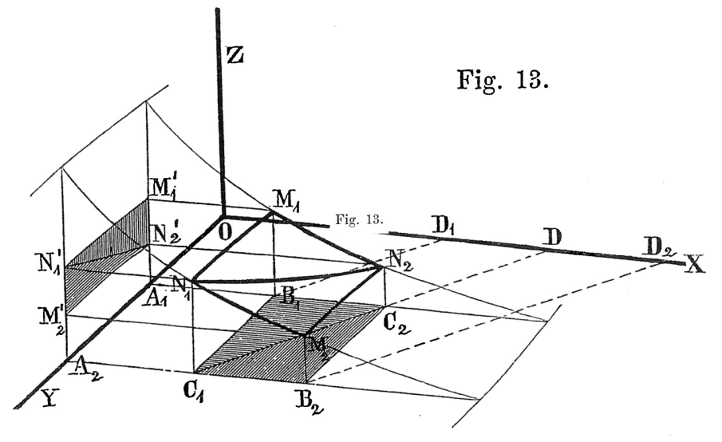
APC Analysis
1st: 1870s – First graphical and mathematical approaches (Keiding 2011)
Perozzo (1880)
Lexis (1875)
Zeuner (1869)

Slide 14
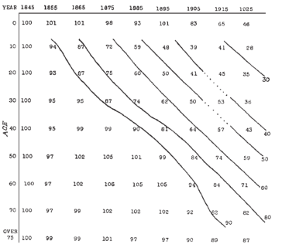
APC Analysis
2nd: 1920s – Graphical analyses of mortality change at the turn of the 20th century
Analysis of all-cause mortality in England & Wales + Scotland + Sweden (Derrick 1927; Kendrick et al. 1934)
Tuberculosis (Andvord 1920, 1930; Frost 1939)
Kendrick et al. (1934)
Mortality changes in E&W all cause mortality

Slide 15
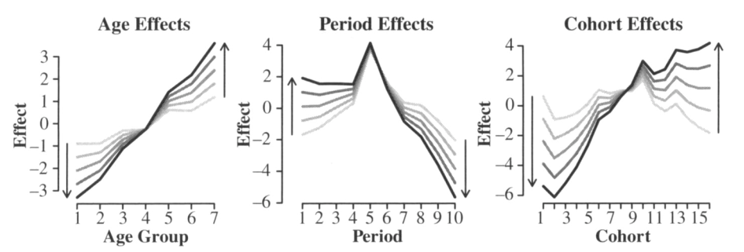
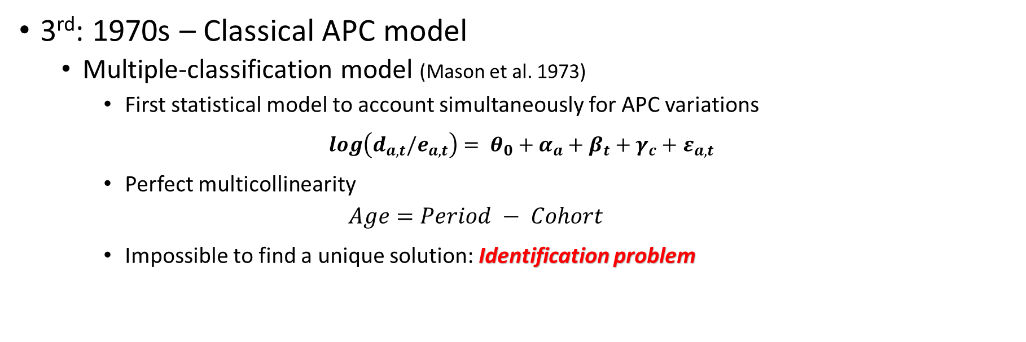
APC Analysis
3rd: 1970s – Classical APC model
Multiple-classification model (Mason et al. 1973)
First statistical model to account simultaneously for APC variations
$log\left(d_{a,t}/e_{a,t}\right)= θ_{0}+α_{a}+β_{t}+γ_{c}+$ $ε_{a,t}$
Perfect multicollinearity
$$Age=Period − Cohort$$
Impossible to find a unique solution: Identification problem
Source: Held and Riebler (2013)

Slide 16
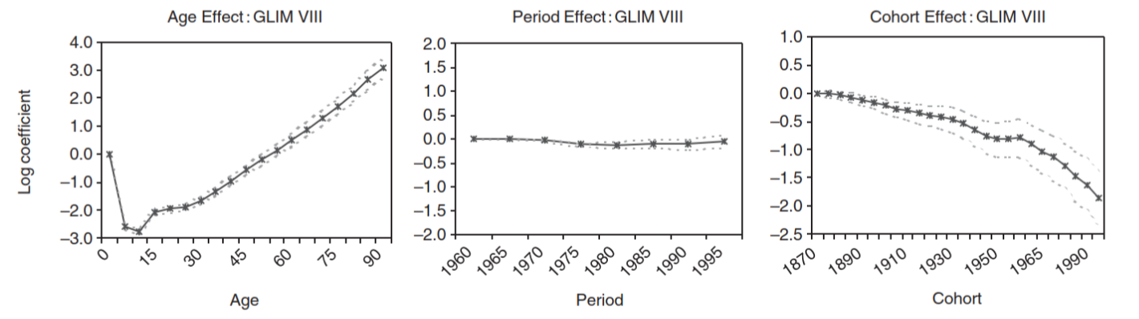
APC Analysis
3rd: 1970s – Explicit constrains as solution
Equate two effects (e.g., two first periods have the same effect)
Based on prior theoretical knowledge
If any of the slopes is fixed, the other two are determined
Limitation: Too sensitive to the researcher criteria
Source:
Yang et al. (2004)

Slide 17
APC Analysis
4th: 2000s – Mechanical constraints
Constraint determined by data itself
Supposedly “less subjective” because it is not chosen by the researcher
Moore–Penrose Estimators: Ridge estimator (Fu 2000), Intrinsic estimator (Yang et al. 2004), Orthogonal estimator (Fosse & Winship 2018)
Limitations:
No proof of underlying assumptions in the actual processes (e.g., mortality)
No theoretically-based, but from a mathematical/statistical property
Sensitive to data configuration
“No sophistication of method can create information where that information is lacking” (Clayton and Schifflers 1987)

Slide 18
Should we avoid applying APC approach for the analysis of mortality trends?
Source: Held and Riebler (2013)
The slope is the problem → continuous changes
linear effects, overall linear trend…
The divergence from the slope does not change → disruptive changes
nonlinear effects, curvatures
“The identification problem is a linear effects problem” (Fienberg 2013)
Nonlinear effects are identifiable → we could focus on these effects

Slide 19
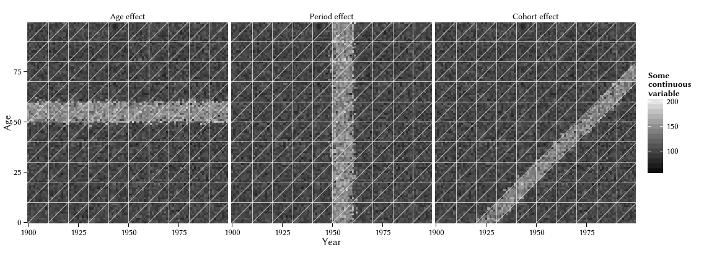
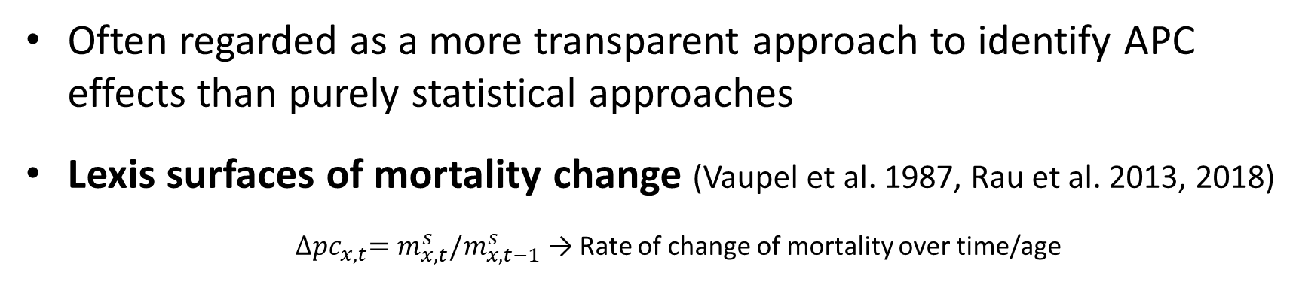
Visual Analysis of Nonlinear Effects
Often regarded as a more transparent approach to identify APC effects than purely statistical approaches
Lexis surfaces of mortality change (Vaupel et al. 1987, Rau et al. 2013, 2018)
${∆pc}_{x,t}=m_{x, t}^{s}/m_{x, t−1}^{s}$ → Rate of change of mortality over time/age
Horizontal traces → age effects
Vertical traces → period effects
Diagonal traces → cohort effects
Source: Schöley & Willekens (2014)

Slide 20
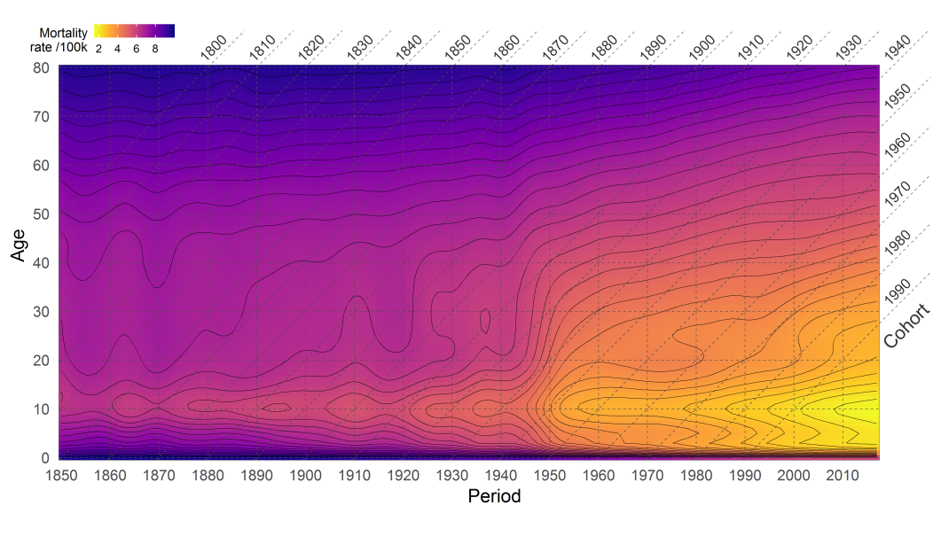
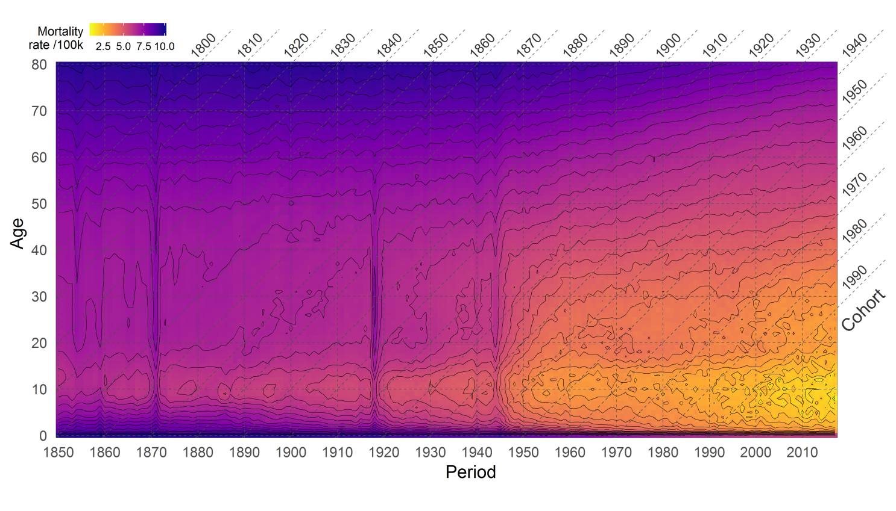
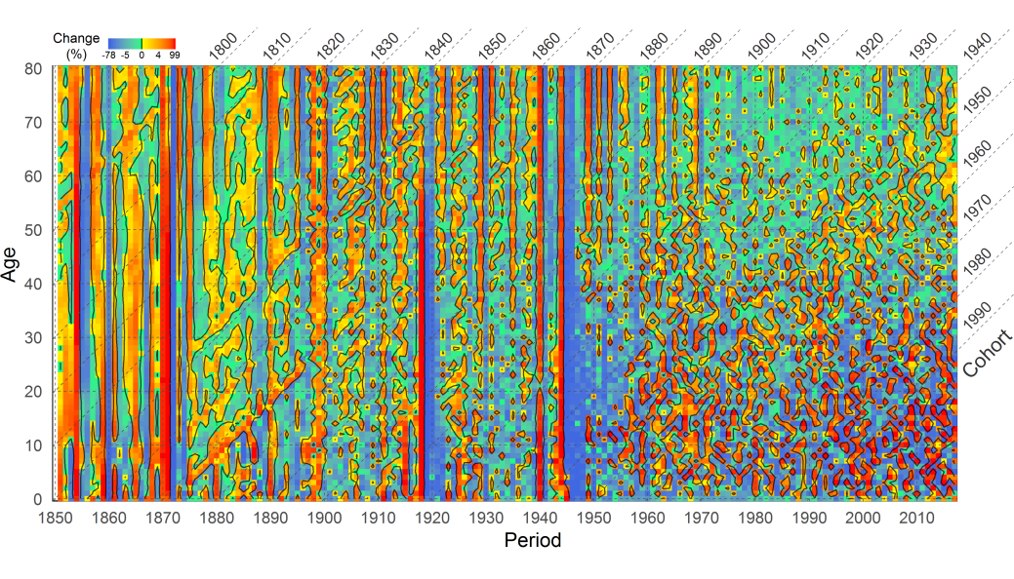
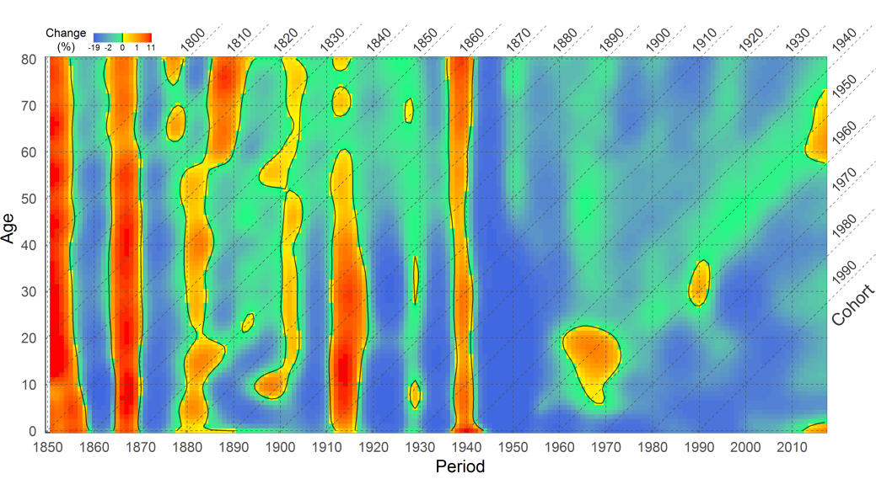

Lexis surfaces of mortality change
Lexis surface of French female mortality 1850-2017
Smoothed rates
$${∆pc}_{x,t}=m_{x, t}^{s}/m_{x, t−1}^{s}$$
Lexis surface of mortality
change over periods/cohorts
● → ● decreases
● → ● increases

Slide 21
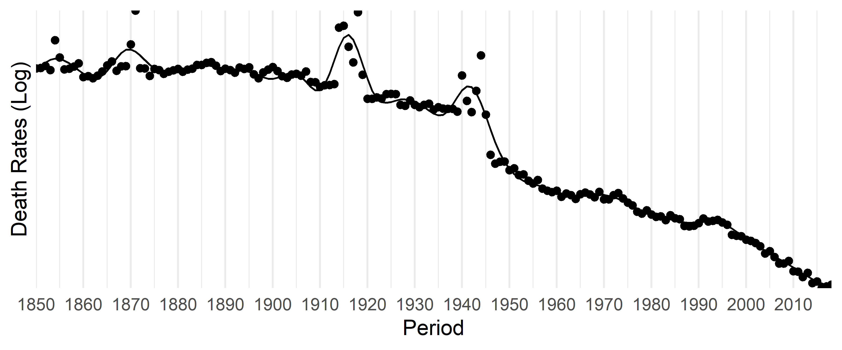
Visual Analysis of Nonlinear Effects
At age 40

Slide 22
Enough for now, let’s have a break!

