Slide 1


Mortality disturbances: Age-Period-Cohort modeling and visualization
EDSD Program 2026
INED
Enrique Acosta
Centre for Demographic Studies (CED)
9.06.2026

Slide 2
Course outline
Day 1: Tuesday (today)
Morning lecture (9:30 – 11:00)
Presentation of concepts and methods
Coffee break (11:00 – 11:15)
Lab session (11:15 – 12:30)
Application of methods for APC analysis and excess mortality estimation in R

Slide 3
Course outline
Days 2-4: Wednesday - Friday
Morning lectures (9:00 – 10:15)
Presentation of concepts and methods
Coffee break (10:15 – 10:30)
Lab sessions (10:30 – 12:00)

Slide 4
Course outline
Lectures
Day 1: Introduction to mortality trends
Trends in all-cause mortality
Mortality partition by causes of death
Theories of Epidemiological and Health transitions
Day 2 morning: Introduction to APC part 1: basic concepts and visual analyses
Conceptual definition of Age-Period-Cohort (APC) effects
Period and cohort perspectives of mortality change
Visual analysis of APC effects
Day 3: Introduction to APC part 2: basic statistical modeling
Identification problem in APC modelling
Different approaches
Analysis of nonlinear APC effects
Day 4: Introduction to excess mortality estimation
Conceptualization of excess mortality
Methods for excess mortality estimation

Slide 5
Course outline
Lab sessions in R
Session 1: Introduction to mortality visualization
Colors, scales, and Lexis diagrams and surfaces
Session 2: Visual analyses of APC effects
Construction and interpretation of Lexis surfaces of mortality change
Session 3: Statistical analyses of APC effects
Introduction to fitting APC models
Session 4: Excess mortality estimation
Fitting baseline mortality and challenges

Slide 6
Course outline
Evaluation option 1
The evaluation of the course is based on the participation during the lectures and lab sessions (20%)
There is a final assignment to work after the course (80%)
Evaluation option 2
The evaluation of the course is based on the participation during the lectures and lab sessions (80%)
There is a final assignment that will be worked and presented in groups during the last day (20%)

Slide 7
Lecture I. Introduction to mortality trends

Slide 8
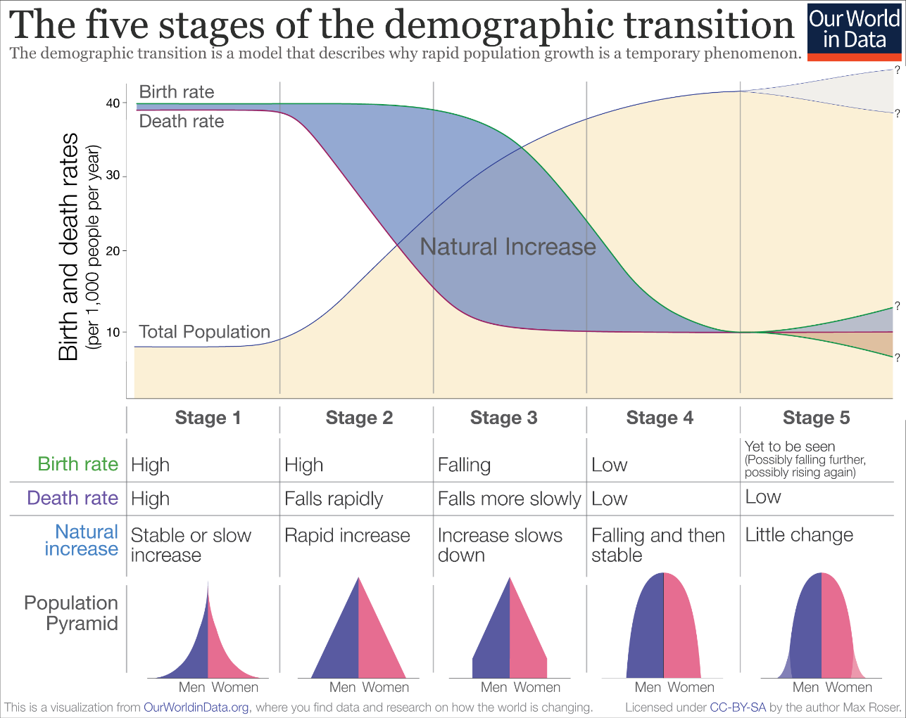
Demographic transition and mortality change
Transition from one regime with high levels of mortality and fertility to another with low levels.
Decrease in mortality, followed by fertility
But…
Why and how?
Who is affected?
Which are the causes of death?
Where are we going now?

Slide 9
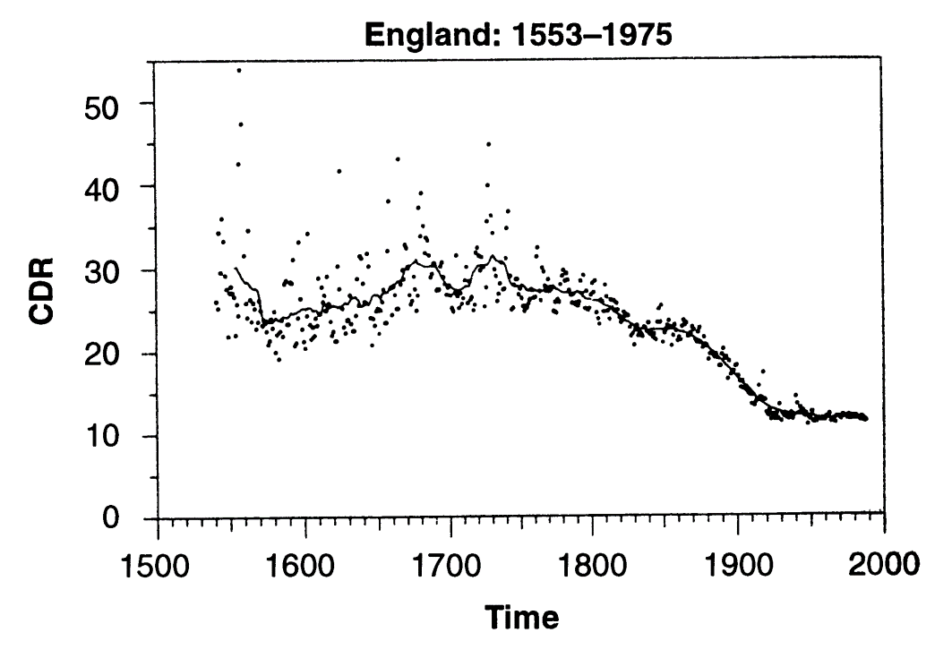
Changes in all-cause mortality
Source:
Fogel and Costa (1997)
Substantial improvements in the last 200 years
Larger changes than during previous millenniums

Slide 10
Changes in all-cause mortality
Life expectancy (e0)
One of the best indicators of mortality change over time
More than doubled in 170 years (1850 - 2024)
from < 35 to > 73.8 years on average (WPP)
More than double increase!
“Most important achievement in human history”
But… still large divergence between populations (WPP 2024)
54.6y (Nigeria)
86.5y (Monaco)
= 32 years gap
On average, one person lives 58% longer in Monaco than in Nigeria!!

Slide 11
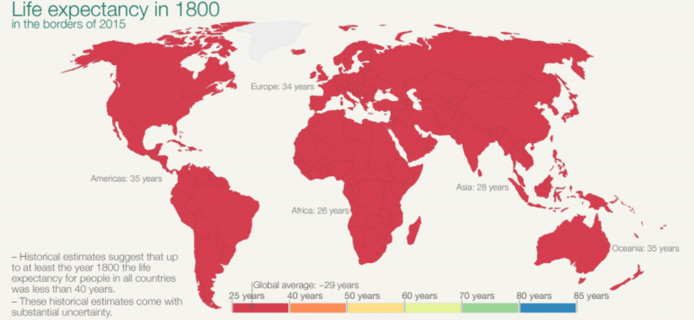
Changes in all-cause mortality
Substantial reduction in the last 200 years
Source: Our World in Data

Slide 12
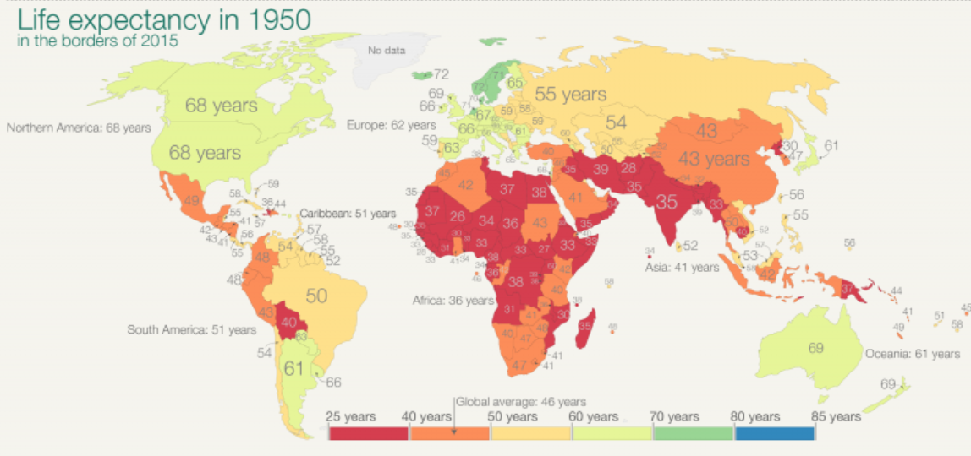
Changes in all-cause mortality
Substantial reduction in the last 200 years
Source: Our World in Data

Slide 13
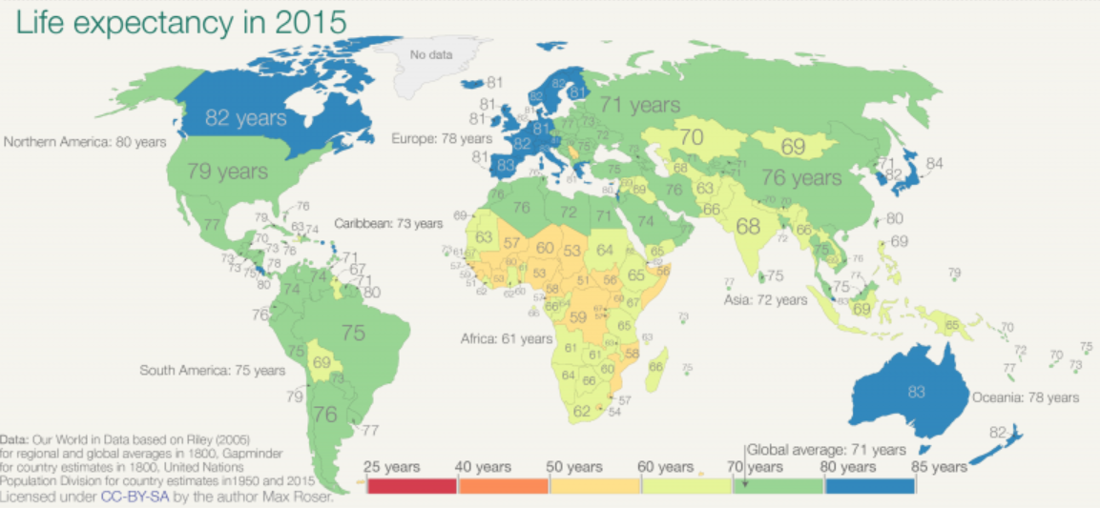
Changes in all-cause mortality
Substantial reduction in the last 200 years
Source: Our World in Data
Source: Our World in Data

Slide 14
Changes in all-cause mortality
Substantial reduction in the last 200 years
But an increase in inequality
Source: Our World in Data
Source: Our World in Data

Slide 15
Changes in all-cause mortality
Poll time: what do you think will be the limit of human life expectancy?

Slide 16
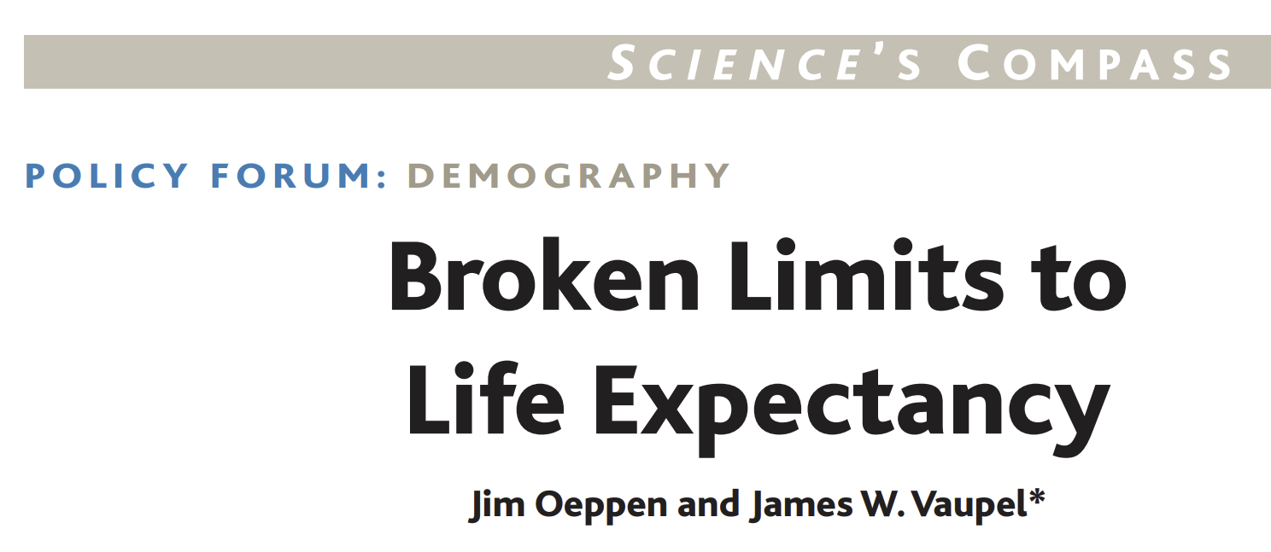
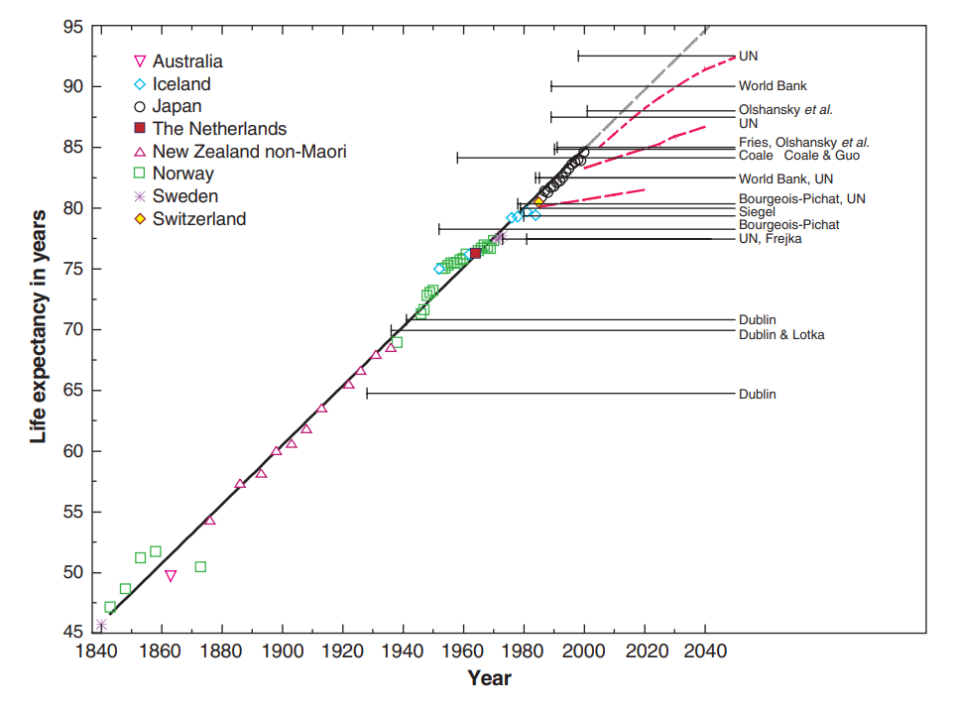
Changes in all-cause mortality
Limits of Life expectancy (e0)
Record female life expectancy since 1840
“Female life expectancy in the record-holding country has risen for 160 years at a steady pace of almost 3 months per year”
Oeppen & Vaupel (2002)
Limits broken on average 5 years after publication
Dong et al. (2016) → 115
De Grey → 1,000 years
Transhumanism??

Slide 17
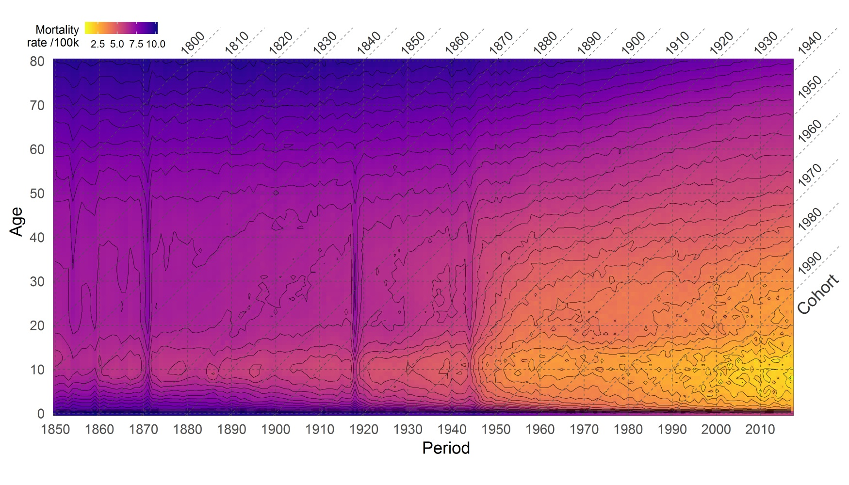
Changes in all-cause mortality
13 608 age-specific death rates (ASDR) in one Lexis surface
France
ASDRs
1850-2017

Slide 18
Mortality partition
Conceptual partitions for more than 200 years
Biologist, actuaries, and demographers
To improve understanding mortality trends and for mathematical modeling
Gompertz (1825)’s “law of mortality”
Mortality from deterioration and chance
Makeham (1860)
First one to include the conceptual partition of mortality into the Gompertz mathematical model
Age-dependency
gradual “diminution of vital power” with age
accidental completely independent of age

Slide 19
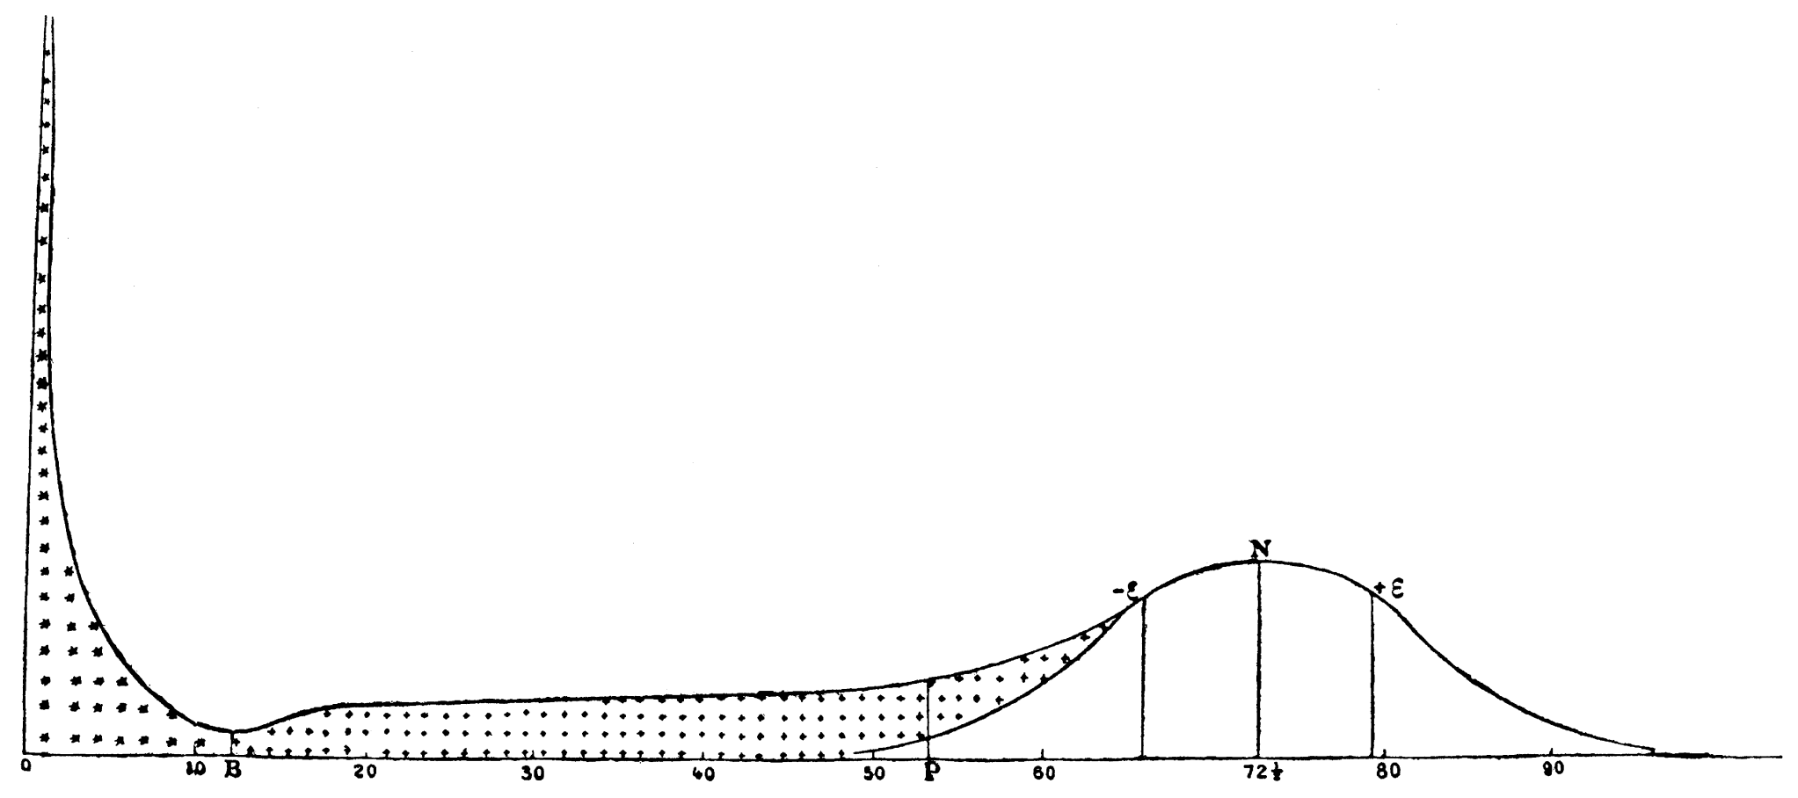
Mortality partition
Lexis (1860)
Juvenile, premature, and normal mortality
Source: Lexis (1860)
On the Theory of Mass Phenomena in Human Society

Slide 20
Mortality partition
Conceptual partition of mortality challenged several times
deterioration/chance (Gompertz 1825)
normal/premature (Lexis 1877)
senescent/anticipated (Clarke 1950)
endogenous/exogenous (Shryock et al. 1973)
senescent/background (Bongaarts 2005)
intrinsic/extrinsic (Carnes and Olshansky 1997, 2006)

Slide 21
Mortality partition
Intrinsic and extrinsic (Carnes and Olshansky 1997, 2006)
Intrinsic mortality: either initiated or caused from inside the body, due to failure of the organism function
Extrinsic mortality: either initiated or caused from outside the body, due to environmental factors
Grey area: fails to recognize the interaction between intrinsic and extrinsic stressors in any death
For instance, most of COVID-19 deaths or Hepatitis C infections
“No sense in partitioning mortality, rather the stressors causing it” (Koopman et al. 2015)
“Imperfect partition offers better insights in mortality and better modeling fit than the proposed analyses on all-cause mortality without partition” Carnes and Olshansky

Slide 22

Mortality transitions theories
Omran (1971)’s Epidemiological transition theory (ET)
Epidemiological profile of populations
3 stages
“The Age of Pestilence and Famine”
High and fluctuating
Infectious diseases, famines, violence
e0 <30y
“The Age of Receding Pandemics”
Increased control over environment: < infections, < famines
Massive reduction of mortality at young ages
e0 from < 30y → > 50y
“The Age of Degenerative and [hu]Man-Made Diseases”
Degenerative diseases as main killers
Expansion of [hu]man-made diseases
Alcohol, drugs, sexually transmitted, etc.
Stagnation of mortality improvements
e0 > 50y

Slide 23
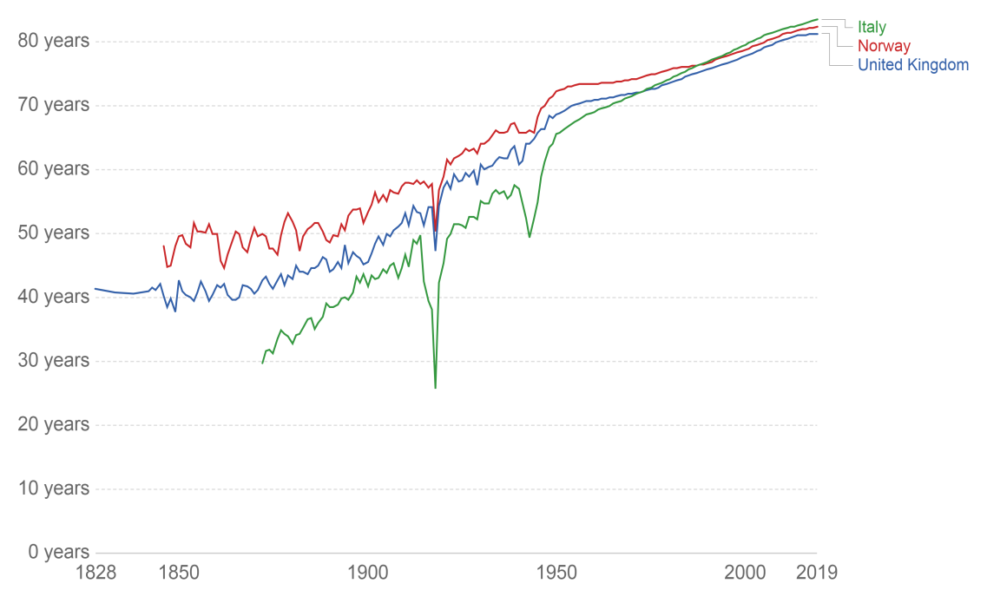
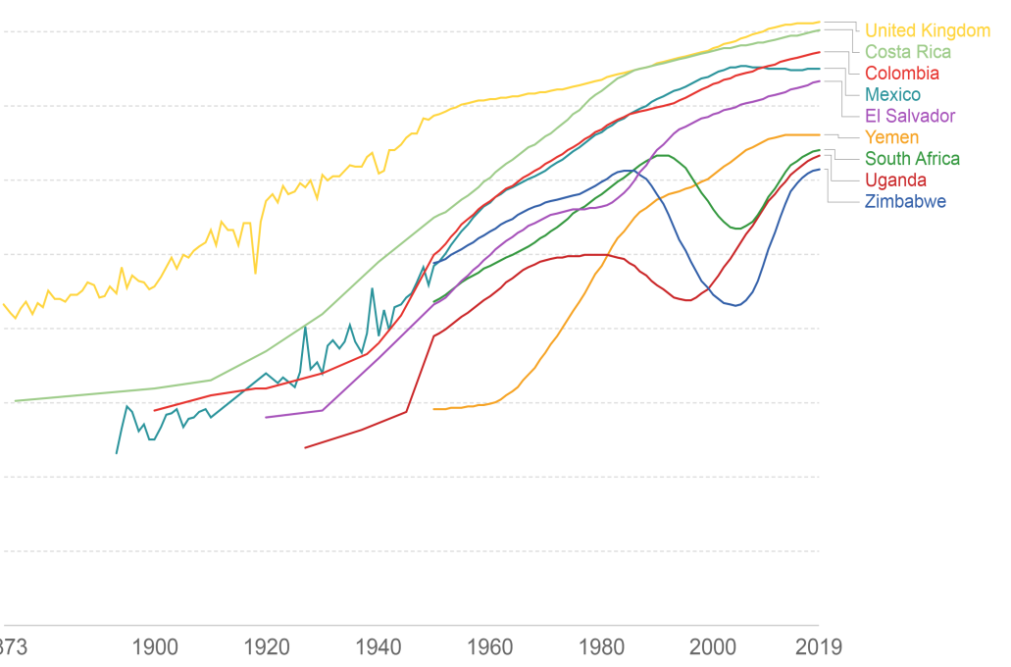
Mortality transitions theories
Omran (1971)’s Epidemiological transition theory (ET)
Factors: industrial and scientific revolutions, socioeconomic conditions, the sanitary revolution, and the medical and public health progress
Different paces around the World
e0
Sources
- Data: Riley (2005), Clio Infra (2015), UNPD (2019)
- Plots: Our World in Data

Slide 24
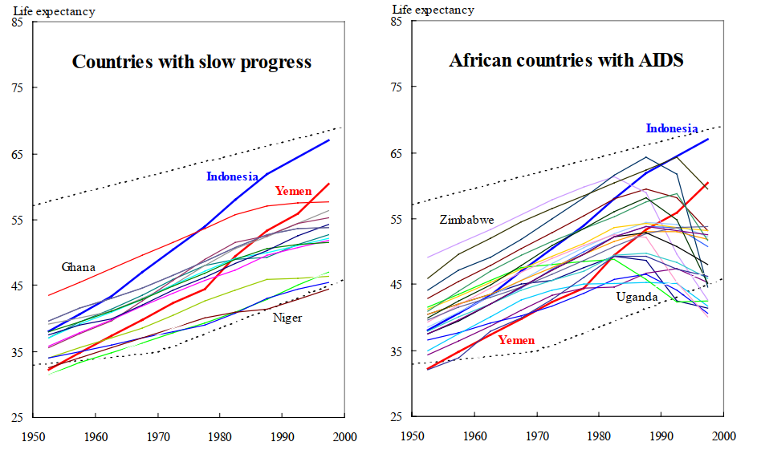
Mortality transitions theories
Omran (1971)’s Epidemiological transition theory (ET)
Different paces around the World
Long-term trends in female life expectancy for sub-Saharan Africa
Source
Vallin and Mesle (2004)

Slide 25
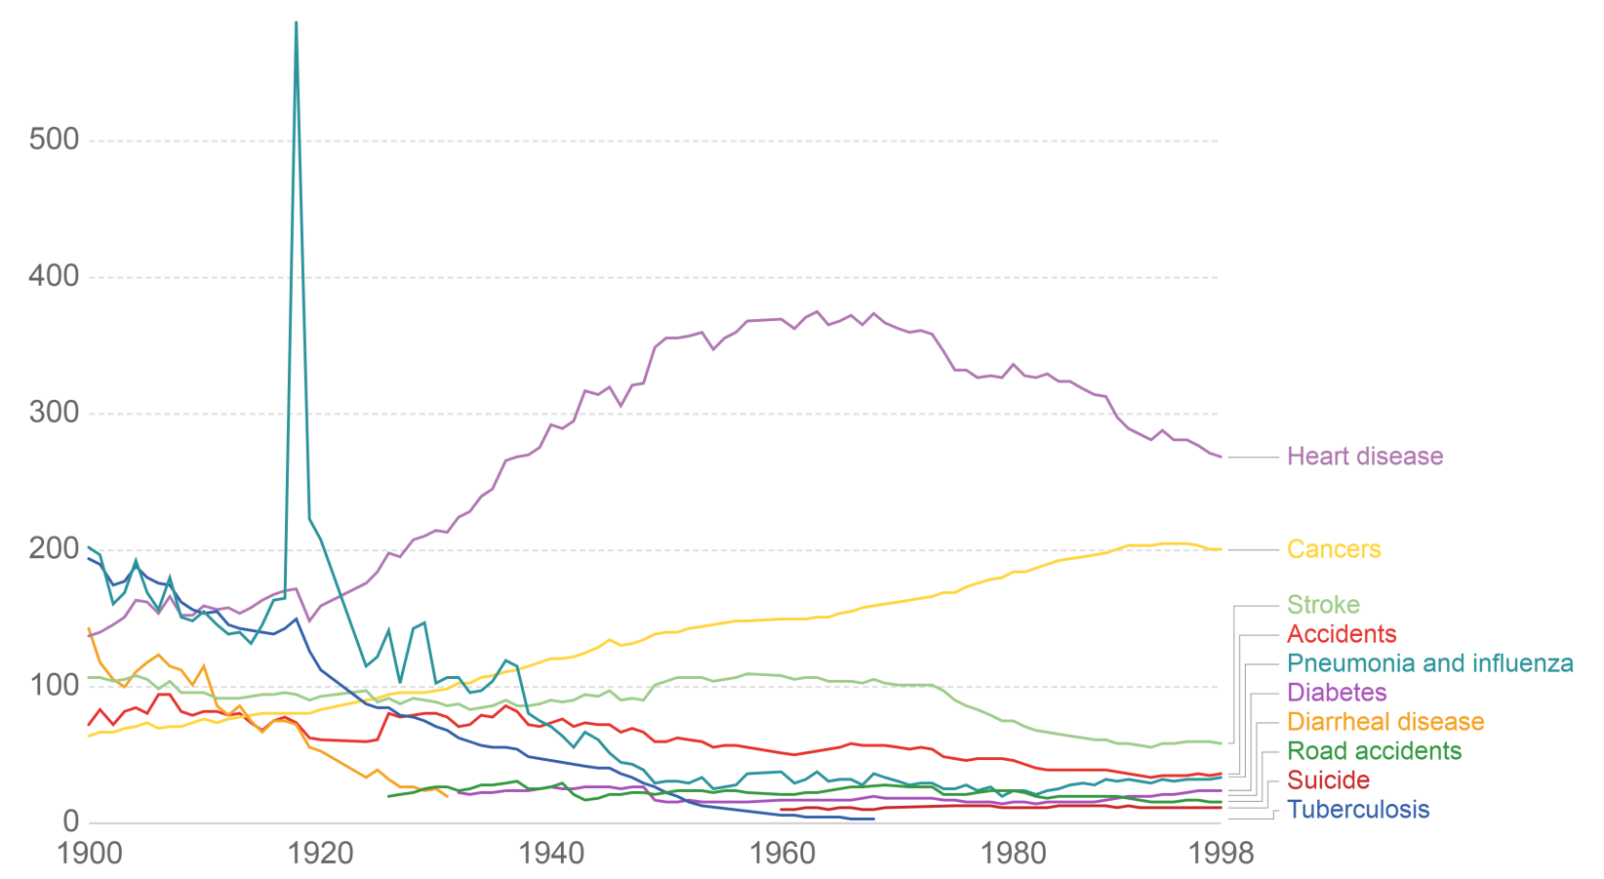
Mortality transitions theories
ET → Transition from extrinsic to intrinsic mortality as the main killer
Consistent until the late 1960s
Mortality improvements stalled as stated by Omran in the ET
But… cardiovascular revolution happened
US death rates by cause
Sources
- Data: CDC
- Plot: Our World in Data

Slide 26

Mortality transitions theories
4th stage: “The Age of Delayed Degenerative Diseases” (Olshansky and Ault, 1986)
Ranking of the principal causes of death was not modified
Risk of dying from degenerative diseases shifted to older ages
Gradual reduction of deaths from [hu]man-made diseases

Slide 27
Omran’s world
4th stage

Slide 28
Mortality transitions theories
5th stage: “The Re-emergence Infectious and Parasitic Diseases” (Olshansky et al., 1998)
Rapid spread of new and preexistent infectious and parasitic diseases since the last quarter of the 20th century
HIV, Hepatitis C, Measles, Malaria, Ebola, Yellow fever, Influenza, Corona, multi-drug-resistant organisms (superbugs)
Most of them preventable with the available technology
Limitations are related mostly to
Inequality (in sanitation and access to medical services)
Demographic factors (population ageing, growth and movement)
Industrial processes (massive (mis)use of antibiotics in food production), and deterioration of the environment

Slide 29
Mortality transitions theories
Revision of the Epidemiological Transition (Frenk et al. 1991)
Health transition
Transition of health conditions = epidemiological
Transition of health attention = social response
Epidemiological transition from different perspectives
From high-risk short-term diseases (acute events) toward those that people have to live with (chronic processes)
From predominance of mortality to morbidity
Not necessarily progress
Several emergent diseases as consequence of “deficient modes of industrialization, urbanization and mass consumerism…”
Do not have to be repeated by other countries

Slide 30
Mortality transitions theories
Epidemiologic transition in Latin America (Frenk et al. 1991)
Critic to the modernist approach of transition
Lineal and unidirectional process (stages)
Although Omran acknowledges different models, they refer to differences in the when but not in the how
Latin America as example
Huge heterogeneity between and within countries
3 main groups
Advanced stage of transition (e.g., Cuba, Costa Rica, and Chile)
Initial stage of transition (e.g., Haití, Bolivia, and Perú)
New experiences of transition, that do not follow the ET model: Extended polarized model (e.g., Mexico and Colombia)

Slide 31
Mortality transitions theories
Epidemiologic transition in Latin America (Frenk et al. 1991)
Extended polarized model
Stage overlapping
High incidence of pre- and post transition diseases
Prolonged transition
Stagnation in mixed morbidity processes
Counter-transition
Resurgence of infectious diseases previously under control (e.g., measles)
Epidemiologic polarization
Huge inequalities within and between countries
Not the same group suffering from mixed morbidity, but very unequal groups in different stages of transition...
Rural-urban opposition

Slide 32
Mortality transitions theories
Health transition theory (Meslé and Vallin and 2000, 2004)
Based on Frenk’s revision of the Epidemiological Transition
Integrates:
Epidemiological profile of populations
Response of populations to the health situation
Factors behind increases in e0 – gradual “control” of health risk factors
Transitions as a sequence of divergence-convergence processes
For each new potential improvement, the most favored segments of the population benefit the most of it, giving start to a divergence process
Then, when the rest of the population access to that improvement, a convergence process starts
Similar perspective proposed by Angus Deaton 10 years later (The Great Escape, 2013)

Slide 33
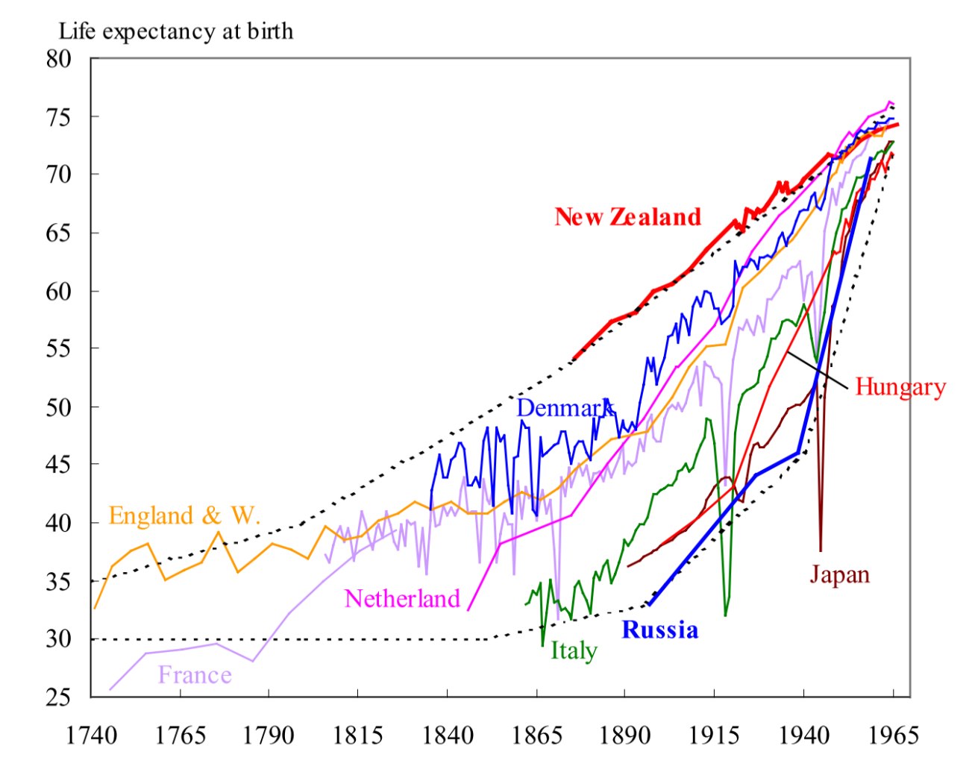
Mortality transitions theories
Health transition theory (Meslé and Vallin and 2000, 2004)
Integrates Omran’s original Epidemiological Transition theory as the first health transition
Vanquishing famines and infectious diseases
First divergence-convergence process
Consistent in industrialized countries until the 1960s
Source
Vallin and Mesle (2004)

Slide 34
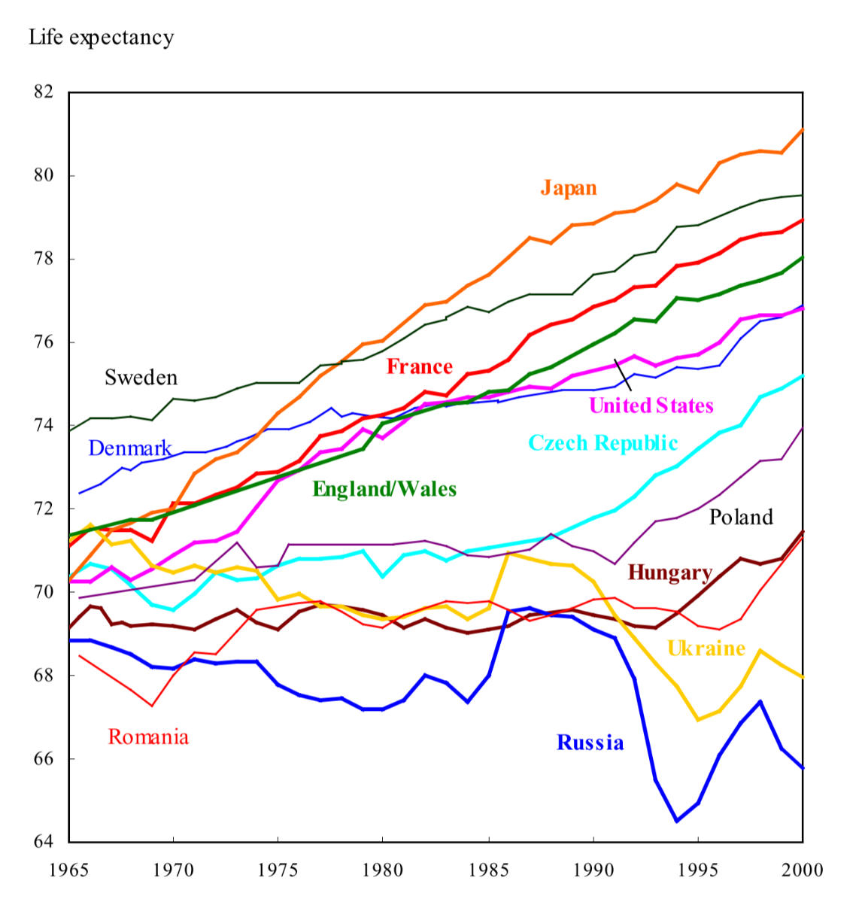
Mortality transitions theories
Health transition theory (Meslé and Vallin and 2000, 2004)
Source
Vallin and Mesle (2004)
Two additional sanitary transitions
Cardiovascular revolution
Mostly driven by changes in lifestyle factors, such as diet, smoking, and alcohol abuse
Former eastern communist states not successful at fighting against cardiovascular diseases
Fight against aging
New improvements mostly taking place at the oldest ages (85+)
Mostly mental and cerebrovascular diseases

Slide 35
Mortality transitions theories
Health transition theory (Meslé and Vallin and 2000, 2004)
Not necessary to finish one stage to enter into the next one
Low-income countries → Have started the cardiovascular revolution without fully controlling infectious diseases
Scotland and USA → Entered into the third stage without gaining control of human-made diseases
Not necessarily a linear process
It is possible that the order of stages vary in some countries

Slide 36
Mortality transitions theories
Update for low- and middle-income countries as of 2019 (Castro et al., 2025)
55% of LMICs have reached e0 of 70 years
Only 2 sub-Saharan African countries
54% reached the “cardiovascular revolution”
Adult (30-60) mortality improvements improved e0
49% reached the “slowing ageing process”
Old age (65+) mortality improvements surpassed those of adults
Divergence not limited to High-income vs Rest, but also between Middle- and Low-income countries

Slide 37
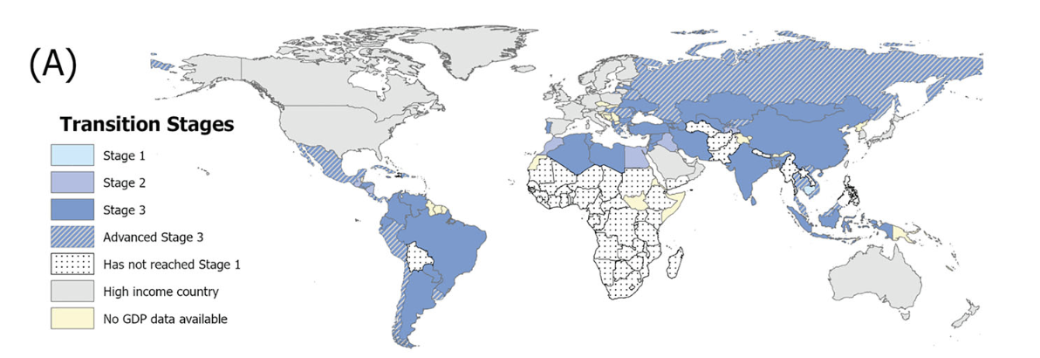
Mortality transitions theories
Update for low- and middle-income countries as of 2019 (Castro et al., 2025)

Slide 38
Mortality transitions theories
Update for high-income countries (Dowd et al., 2025)
Slowdown in mortality improvements since 2010
The US under high scrutiny because of deterioration
But also, slowdowns in the UK, Canada, the Netherlands, Greece, and Germany
Increases in CVD mortality and external causes in young and midlife
Challenges for C19 lingering effects and obesity epidemic
“While biological limits to increased life expectancy may eventually dominate long-term trends, human-made social factors are currently holding many countries back”

Slide 39
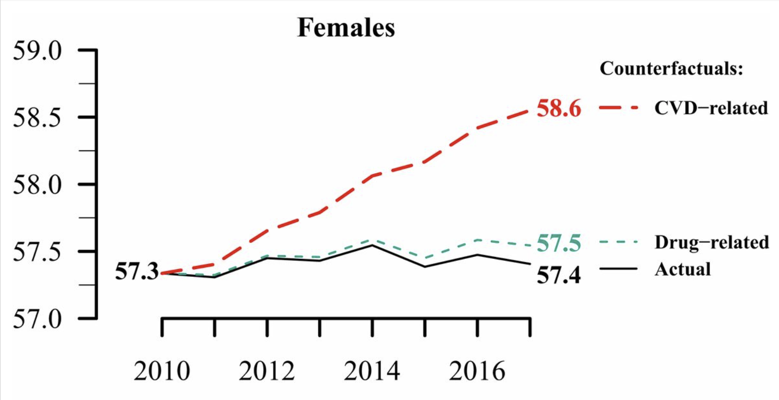
Mortality transitions theories
Deterioration in Cardiovascular mortality
Drug-related counterfactual fixed at its 2010
CVD counterfactual average age-specific changes from 2000 to 2009 forward to 2017
Long-term change instead of a temporal shock
e25
Mehta et al. (2020)
US life expectancy stalls due to cardiovascular disease, not drug deaths

Slide 40
Contemporary and future mortality trends
Focus the attention on intrinsic mortality (Bongaarts 2006)
Until recently, extrinsic mortality was neglected because it was not supposed to have an impact on life expectancy changes
However
Several Western countries experienced decreases in e0 in 2014-2015, and in the US decreased for three consecutive years
Important role of influenza mortality in 2015 and 2018 (Ho & Hendy 2018)
Drug overdose epidemic in several countries since 2000
COVID-19 pandemic in 2020
Could be more fluctuations than a new trend in mortality
… but it demonstrates that extrinsic causes should not be neglected and still can have a considerable impact in mortality trends

Slide 41
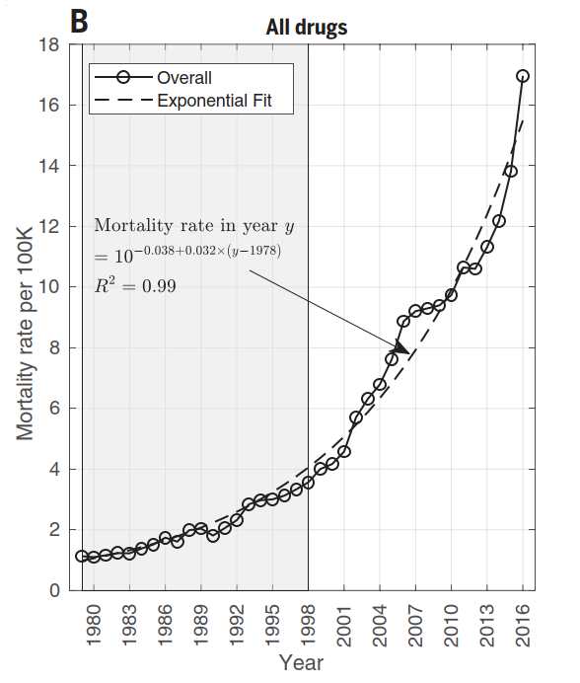
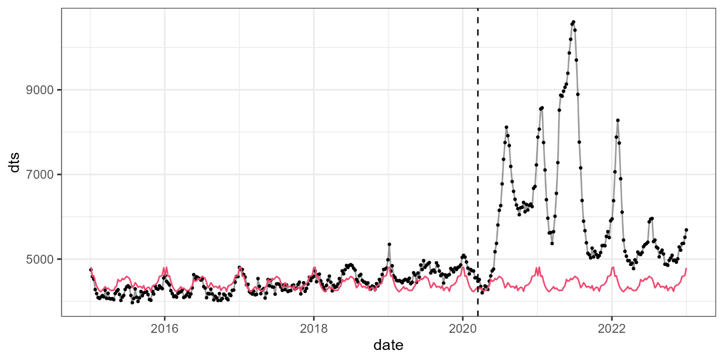
Mortality transitions theories
Some examples of the importance of extrinsic mortality in the current mortality trends
Drug epidemic in the US since 1980s
(Jalal et al. 2018)
Influenza and COVID-19 mortality
(Colombia, all sexes and ages)

Slide 42
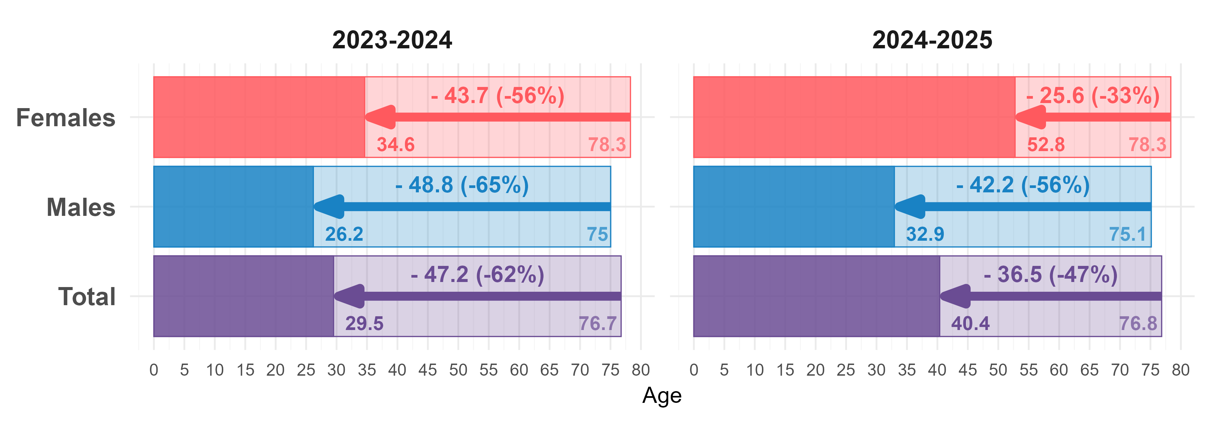
Mortality transitions theories
Some examples of the importance of extrinsic mortality in the current mortality trends
The war on Gaza 2023-2025
Acosta et al (2026) War, So Much War... Death, How Much Death: Two Years of Demographic Collapse in Gaza

Slide 43
Visualizing transitions

Slide 44
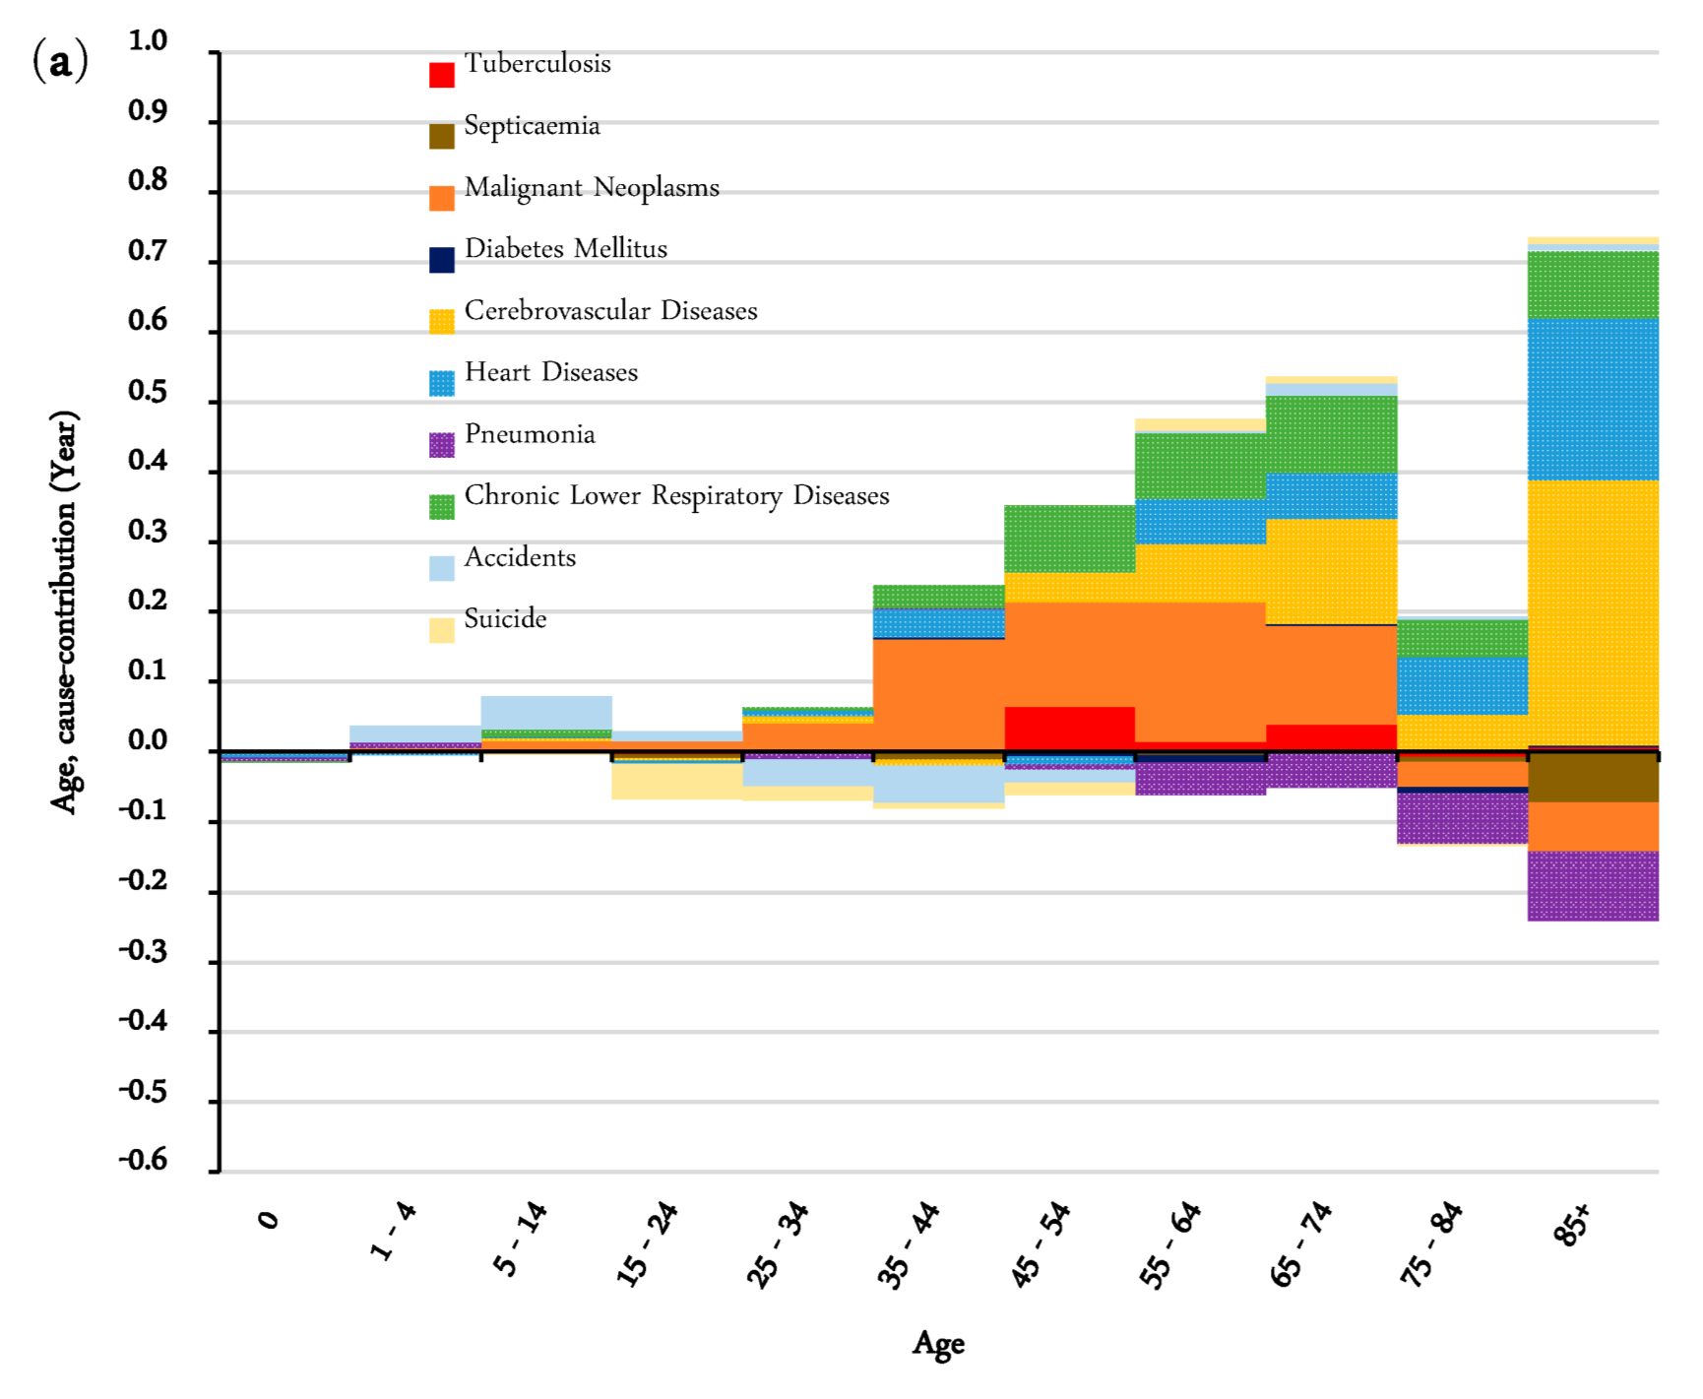
Visualizing transitions
Hong Kong 1986-1995
Arriaga’s decomposition of the change in life expectancy by age group and major causes of death
Source: Zheng et al. (2019)

Slide 45
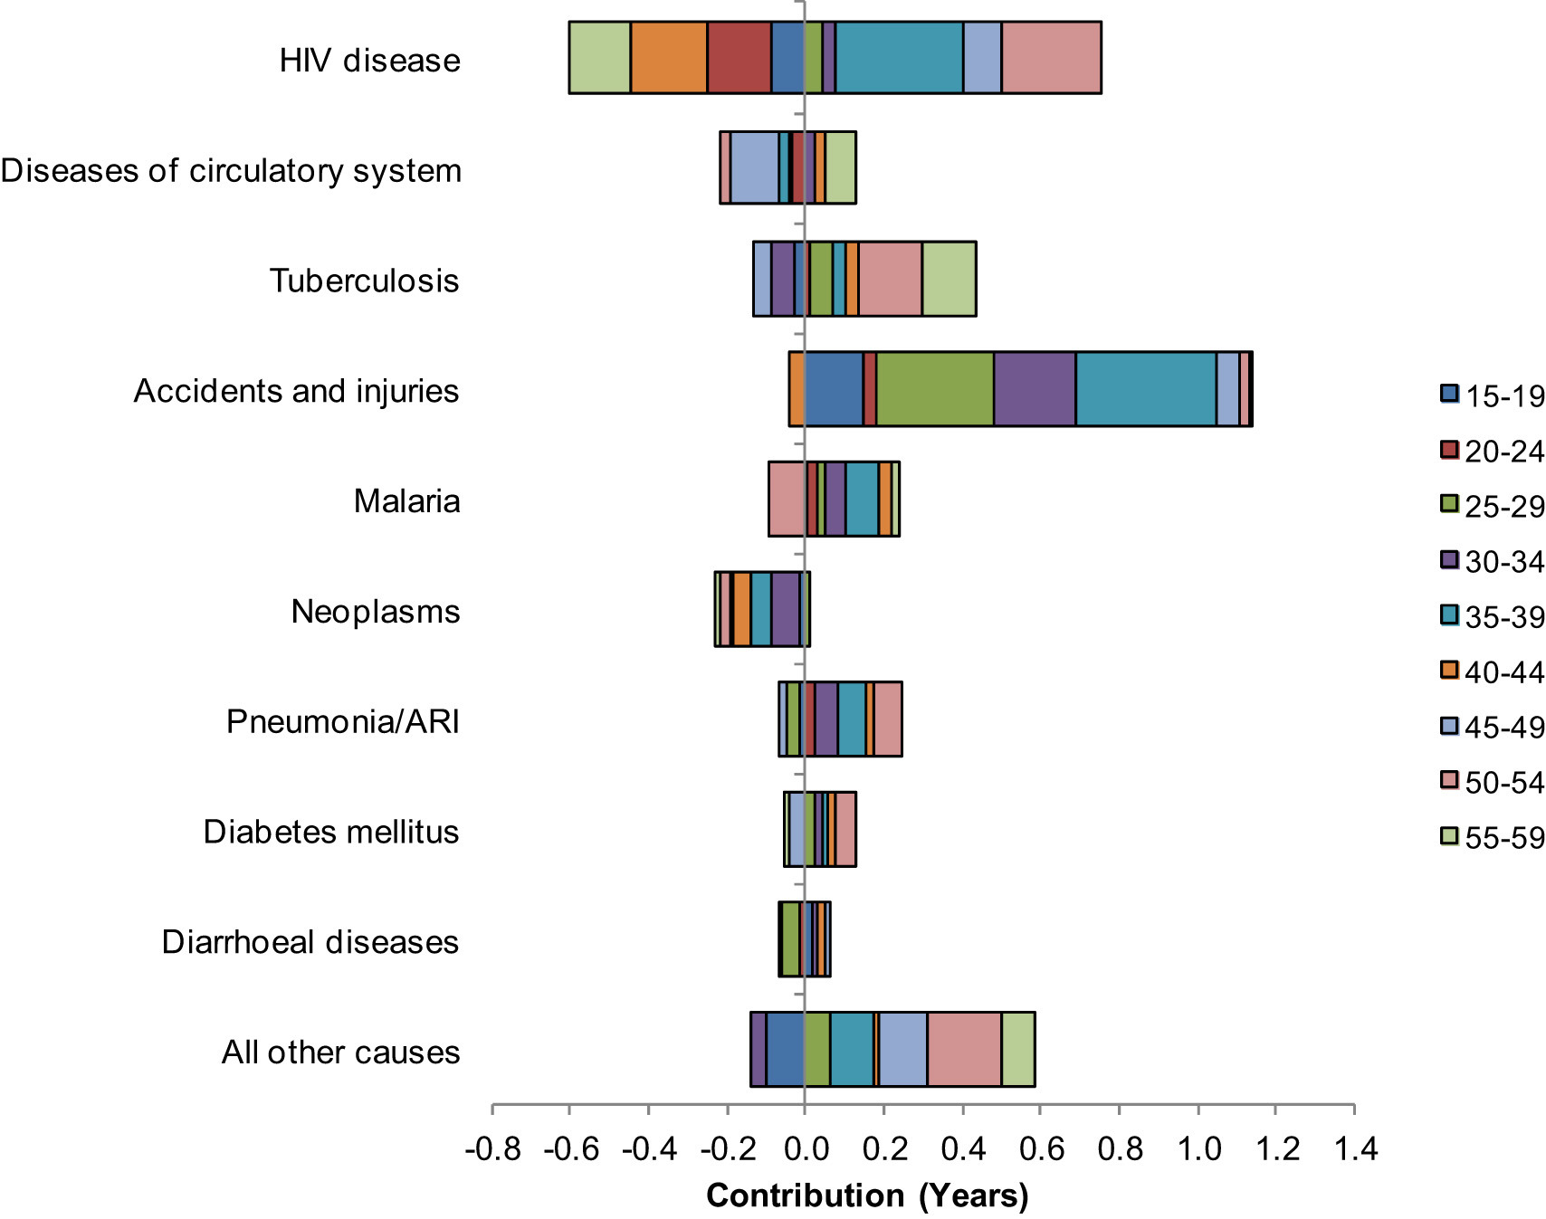
Visualizing transitions
Zambia, 2010-2012
Arriaga’s decomposition of the change in life expectancy by age group and major causes of death
Source: Chisumpa et al. (2018)

Slide 46
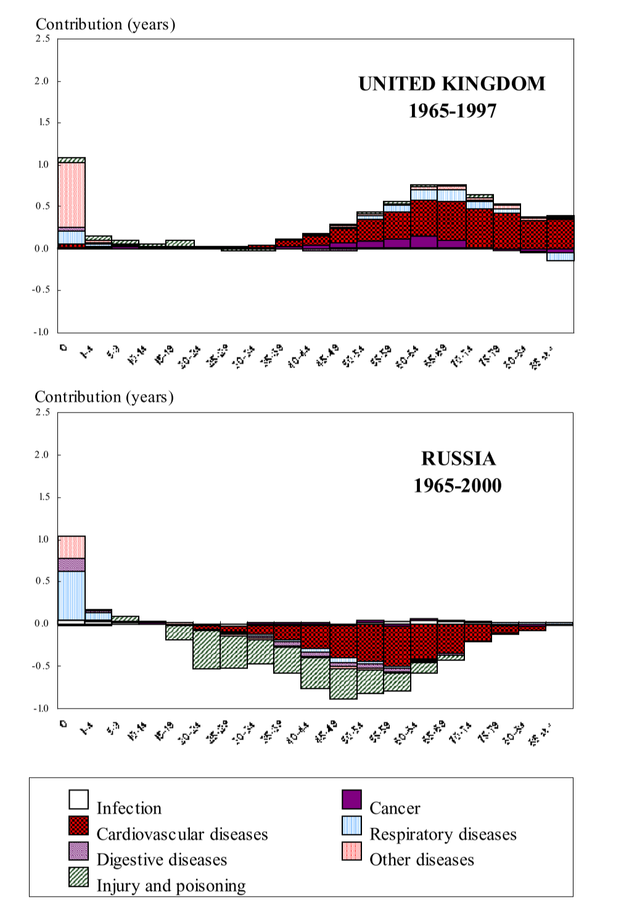
Visualizing transitions
Example of divergence process during the cardiovascular revolution
the UK and Russia, 1965 to 2000
Arriaga’s decomposition of the change in life expectancy by age group and major causes of death
Source: Vallin and Mesle (2004)

Slide 47
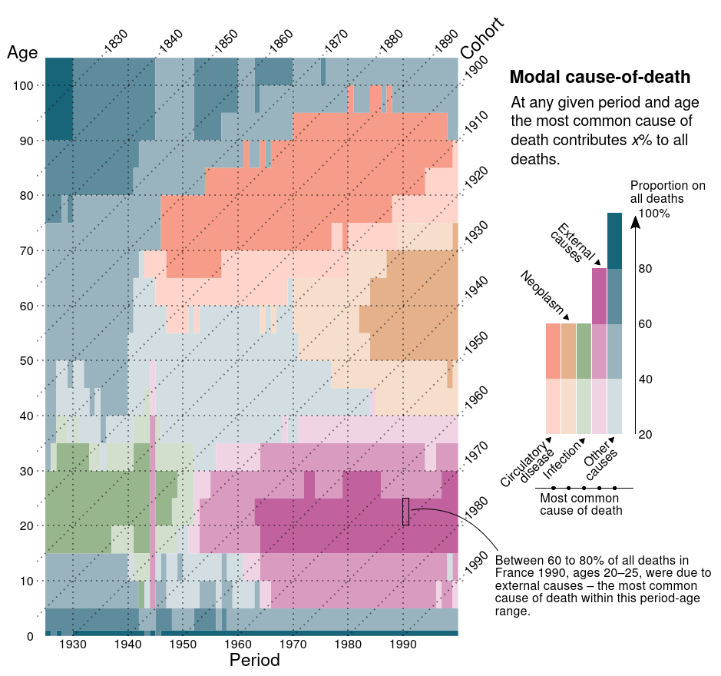
Visualizing transitions
French cause-of-death 1925–1999
The most common cause of death and its proportion on all deaths, total population
Source: Schöley & Willekens (2017)

Slide 48
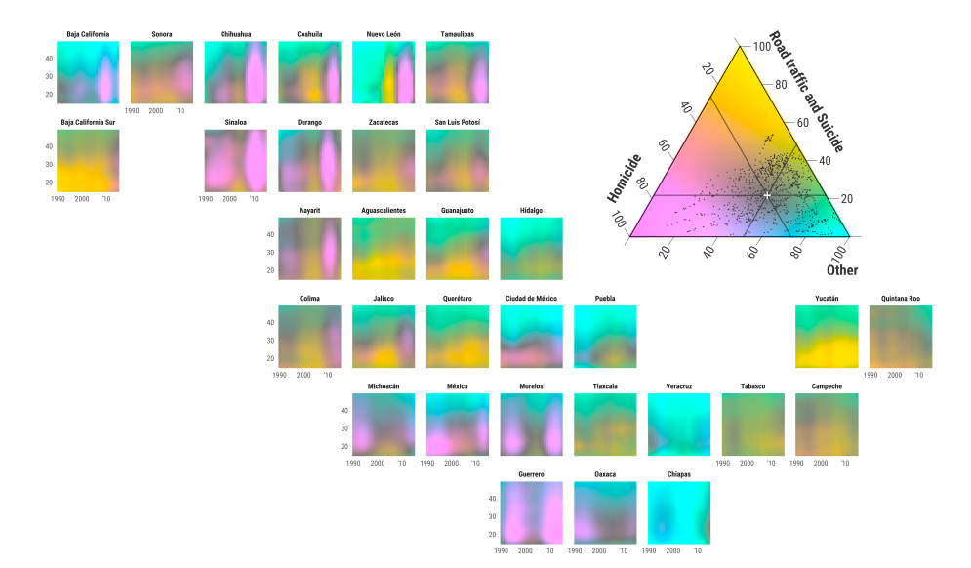
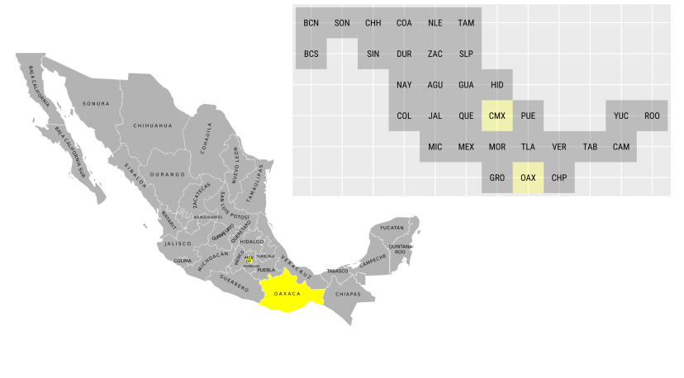
Visualizing transitions
Geofacet of Mexican cause-of-death 1990–2015
Color-coded ternary compositions of the
three leading groups of causes of death by age (15–49)
Source: Kashnitsky & Aburto (2019)

Slide 49
Mortality change
Summary
Very fast mortality change in the two previous centuries
e0 more than doubled
But… very unequally!! (concerningly unequal)
Mortality partition theories
Extrinsic and intrinsic causes
Transition theories
From a predominance of extrinsic to intrinsic causes
Current emphasis on intrinsic causes as the main killers
But:
Huge heterogeneity worldwide
Extrinsic still very important everywhere…

Slide 50
Mortality change
Remaining questions:
How these changes occurred within the population?
Described changes mostly based on either external environment (extrinsic) or in internal biology (intrinsic)…
What about interactions: e.g., extrinsic factors affecting internal processes?
Lasting scars after early life exposures
Gradual changes in bodies physiology over generations
Different generation identities

Slide 51
Let’s have a break!!!

Slide 53
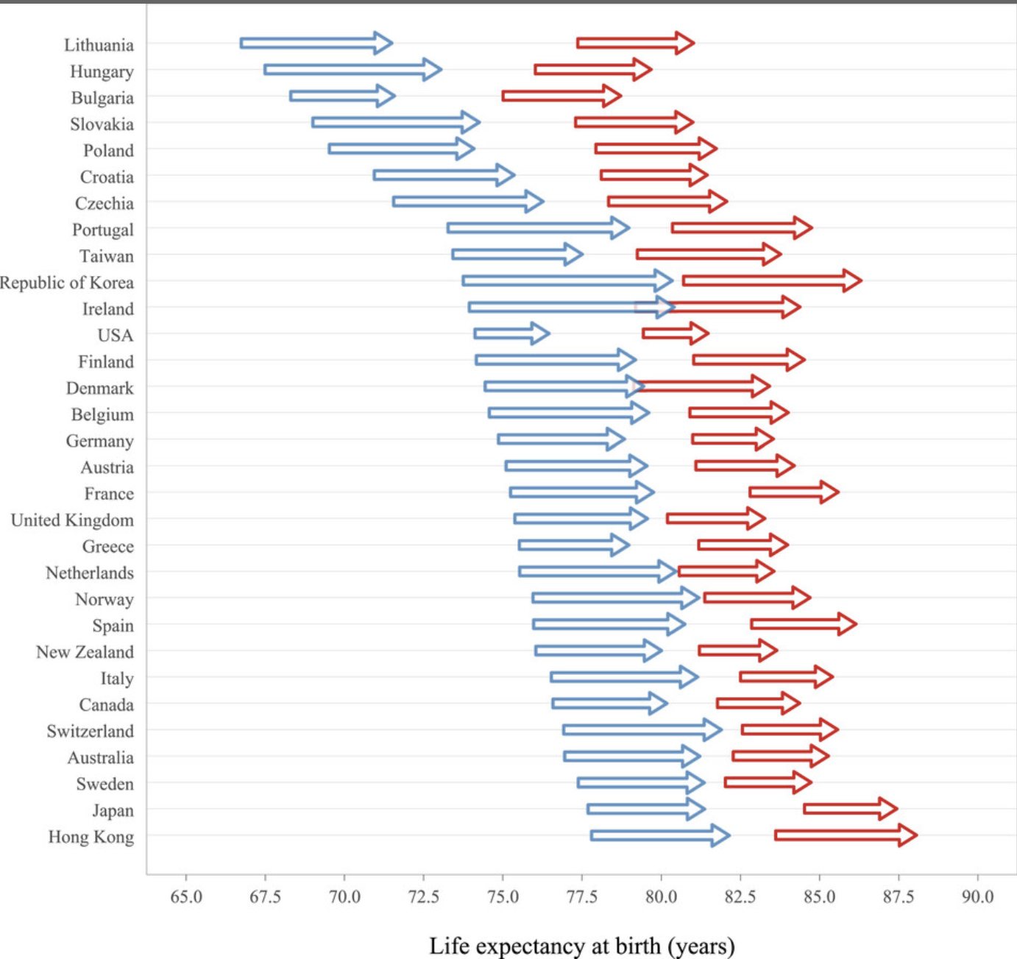
Mortality transitions theories
males
females
Update for high-income countries (Dowd et al., 2025)
Changes in e0 between 2000 and 2019
Inequalities in levels
Inequalities in changes
Stall in most since 2010

