Slide 1


Mortality disturbances: Age-Period-Cohort modeling and visualization
EDSD Program 2026
INED
Enrique Acosta
Centre for Demographic Studies (CED)
12.06.2026

Slide 2
Lecture IV. Introduction to excess mortality estimation (bonus track)

Slide 3
Excess mortality
What is excess mortality?
What is the reference or “normal” / “expected” mortality?
Who defines it?
Requires to build a counterfactual scenario (baseline)
A conceptual and subjective definition
Mortality deviations, relative to a counterfactual scenario
Usually refers to period shocks
E.g., wars, epidemics, pandemics, heat waves, natural disasters
Excess mortality considered as the “Gold standard” method for analyzing mortality impacts/changes/disturbances in these contexts

Slide 4
Excess mortality
Counterfactual scenario
Aka: baseline, expected, typical, etc.
How is it defined?
Needs a training period: data from which the baseline is constructed
Usually, the periods in which we consider the phenomena under analysis behaves “normally”
Aspects to consider:
Time resolution: days, weeks, months, years?
How many periods: 5, 7 years? What about in months?
When?: before the period under evaluation? Also, after? In between?
What else to exclude? Only the shock in which we are interested? What about other disturbances?

Slide 5
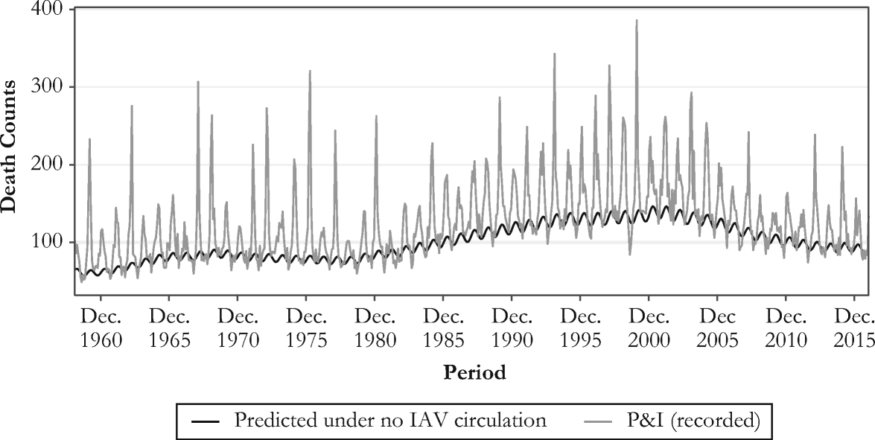
Excess mortality in the context of period shocks
Originally, excess mortality methods were proposed to measure and analyze influenza mortality
Influenza is most of the times misclassified as pneumonia, cardiovascular, or respiratory diseases
Need of a model that captures influenza deaths from seasonal variations
Serfling model (1963)
Strong assumption: influenza does not circulate during summer, and most increases during winter are due to influenza infections
Simple model: a linear regression that accounts for seasonality
Different variations and improvements since its original formulation

Slide 6
Excess mortality in the context of COVID-19
As in the case of influenza, high risk of misclassification of cause of death
Even worse than for influenza because SARS-CoV-2 was a new virus
Predominance of simplistic methods for excess mortality estimation
Because Serfling-like models have some complexity, very simplistic approaches have dominated official estimates… ones worse than others!
E.g., weekly-average and week-specific average approaches
These approaches ignore secular changes in mortality
Particularly problematic in ageing populations

Slide 7
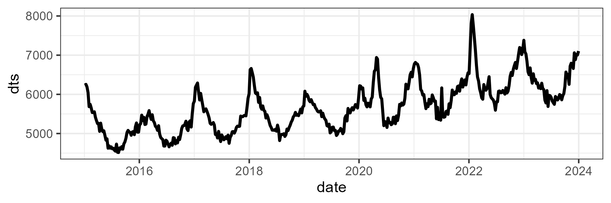
Excess mortality in the context of COVID-19
Practical example: COVID-19 in Canada
Weekly deaths from the STMF since 2015 for all sexes and ages

Slide 8
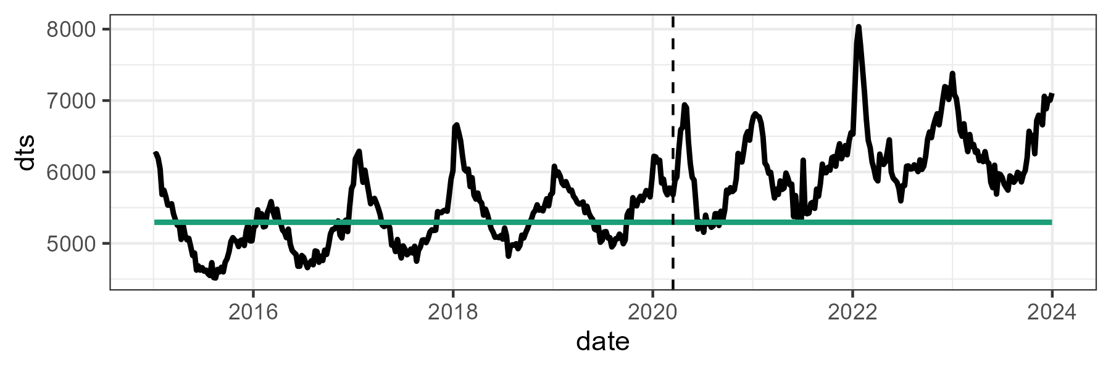
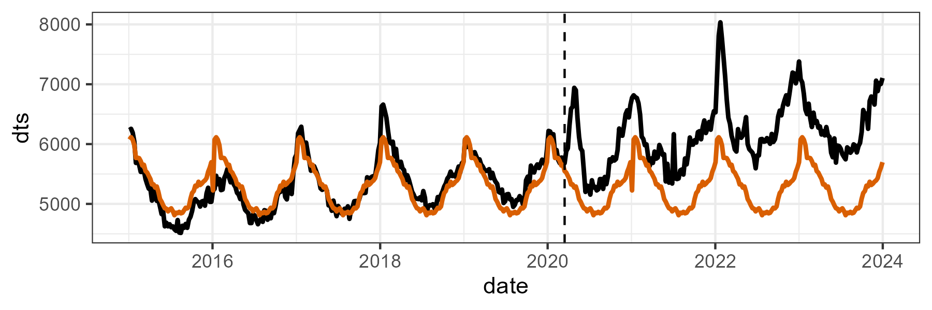

A few approaches for excess mortality estimation
Weekly-average
The easiest one! Just compute average weekly deaths during the whole training period
1 value
$$d_{av}={\sum_{w=1}^{n_{w}}{d_{t}}}/{n_{w}}$$
Week-specific average
Compute average deaths for each of the 52 weeks of the year
52 values, one for each week
$$d_{av}^{w}={\sum_{y=1}^{n_{y}}{d_{t}}}/{n_{y}}$$

Slide 9
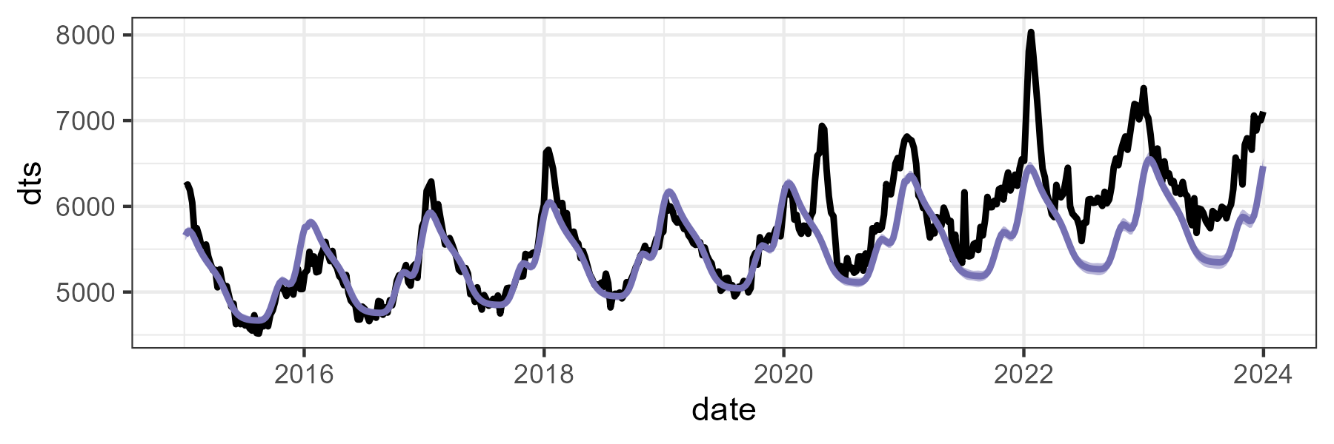
A few approaches for excess mortality estimation
Serfling-like models
Fitting weekly deaths in a Poisson model that accounts for secular trends, seasonality, and changes in exposures over time
As many values as weeks to predict (e.g., 156 values for 2020-2022)
$$log⁡({deaths}_{t})=β_{0}+β_{1}(t)+CS(w)+log⁡({exposure}_{t})$$
Secular trend comp.
Seasonal comp.
Population comp.

Slide 10
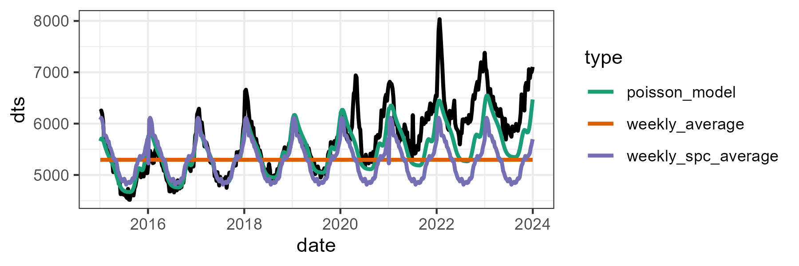
Excess mortality in the context of COVID-19
Practical example: COVID-19 in Canada
Fitting the three types of baselines: average mortality, weekly-specific averages, and the Poisson model
How do these baseline differences translate in excess differences?

Slide 11
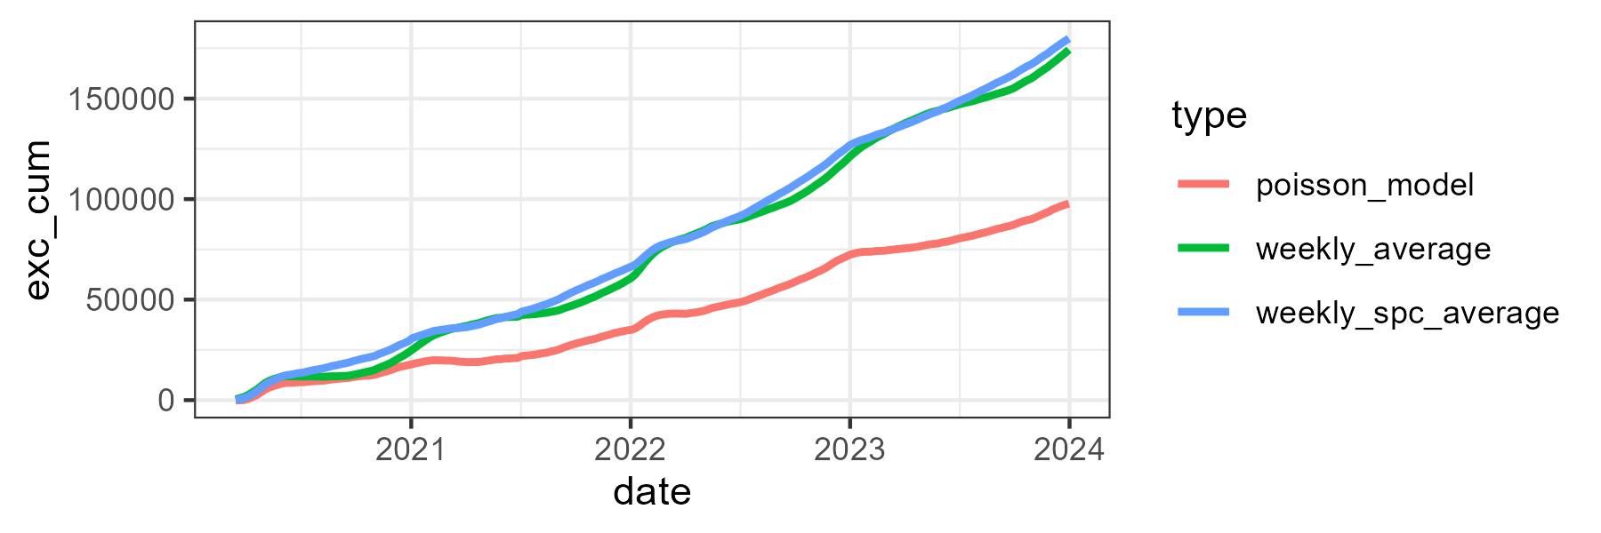
Excess mortality in the context of COVID-19
Practical example: COVID-19 in Canada
Cumulative excess deaths over time by approach

Slide 12
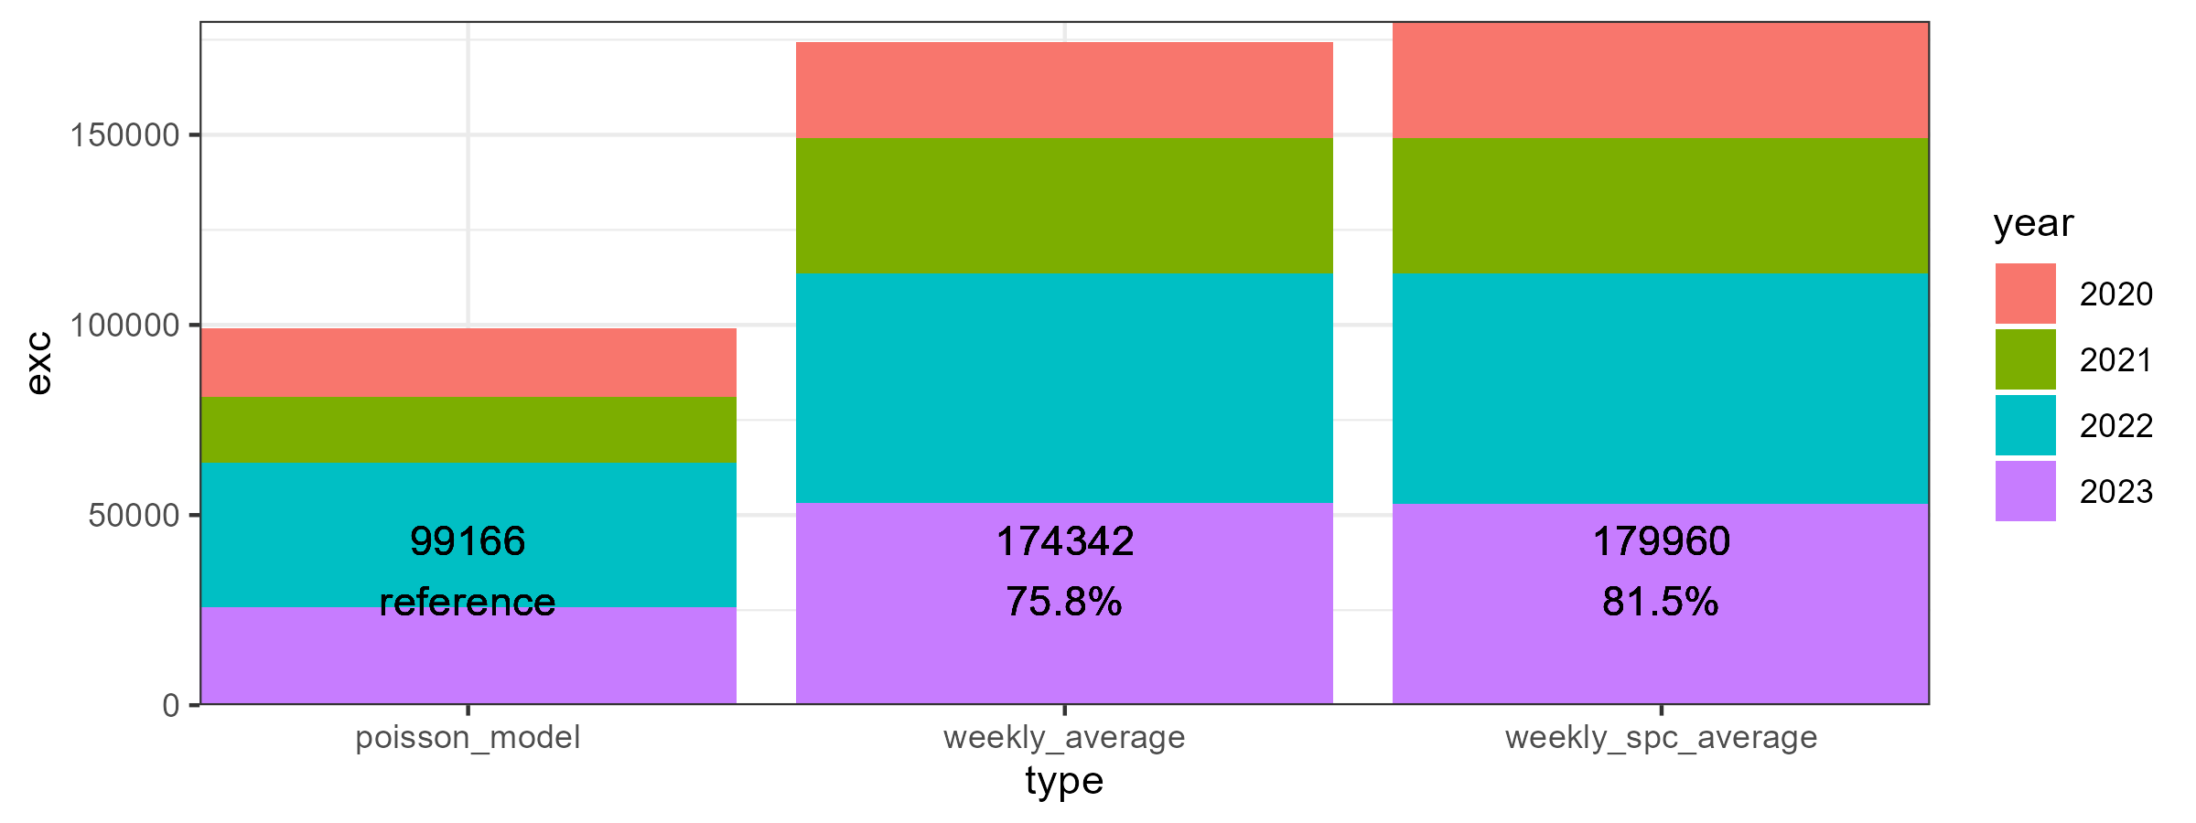
Excess mortality in the context of COVID-19
Practical example: COVID-19 in Canada
Total by year

Slide 13
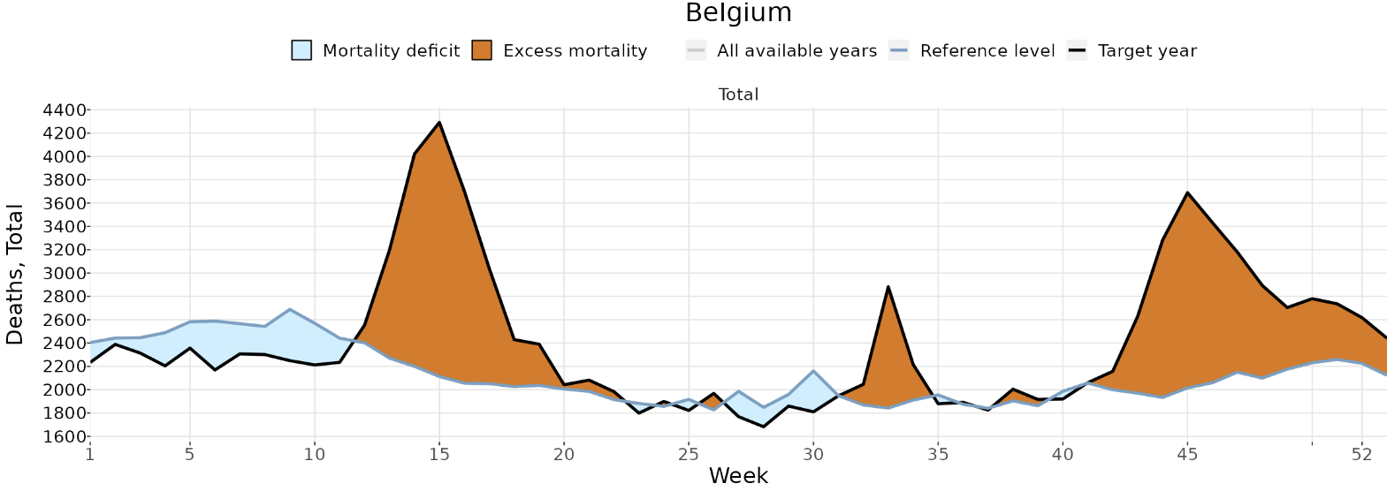
A few conceptual challenges in measuring excess mortality
Avoided mortality:
Expected deaths that did not occur
E.g., during the C19 pandemic, influenza circulation was very low. However, the baseline is built under “normal” circumstances, which include typical influenza mortality.
Should we include influenza deaths in the baseline?
Example: Belgium excess estimates in 2020
Source: STMF

Slide 14
A few conceptual challenges in measuring excess mortality
Mortality displacement (aka., harvesting effect):
Deaths of frail or sick people that were expected to occur during the observation period, but were brought forward by COVID-19
Result in a temporary surplus in mortality followed by a deficit
Issue: These deaths are ignored when calculating cumulative excess deaths!!
Example: Belgium excess estimates in 2020
Source: STMF

Slide 15
A few conceptual challenges in measuring excess mortality
Accounting or not for processes as avoided mortality and mortality displacement?
Not straightforward answer… it depends what we want to measure:
COVID-related mortality?
Possible solution: remove/ignore negative excess estimates
If we are interested in knowing the severity and fatality of the disease
Mortality changes relative to a “regular” year?
Include negative excess in the cumulative total excess
If we are interested in looking at mortality disturbances or adjusting population estimates
Most of the available “COVID mortality estimates” in literature follow the second approach
We might be underestimating C19 mortality

Slide 16
A few methodological challenges in measuring excess mortality
Time resolution
Does it make a difference to use annual, monthly, weekly mortality?
Not too much, unless you want to:
Adjust for avoided and displaced mortality
Analyze the temporal dynamic of the crisis
Training period
How many years to take in consideration for constructing the baseline? How to define the “normal” periods? Only those before the crisis?
Estimates are highly sensitive to this, depending on the trend, of course
Cross-validation of the model is a good idea
Exposures
How exposures to risk change over the course of a long period shock of mortality as the COVID-19 pandemic? How do we account for excess deaths in the denominator? Kind of circularity… (?)

Slide 17

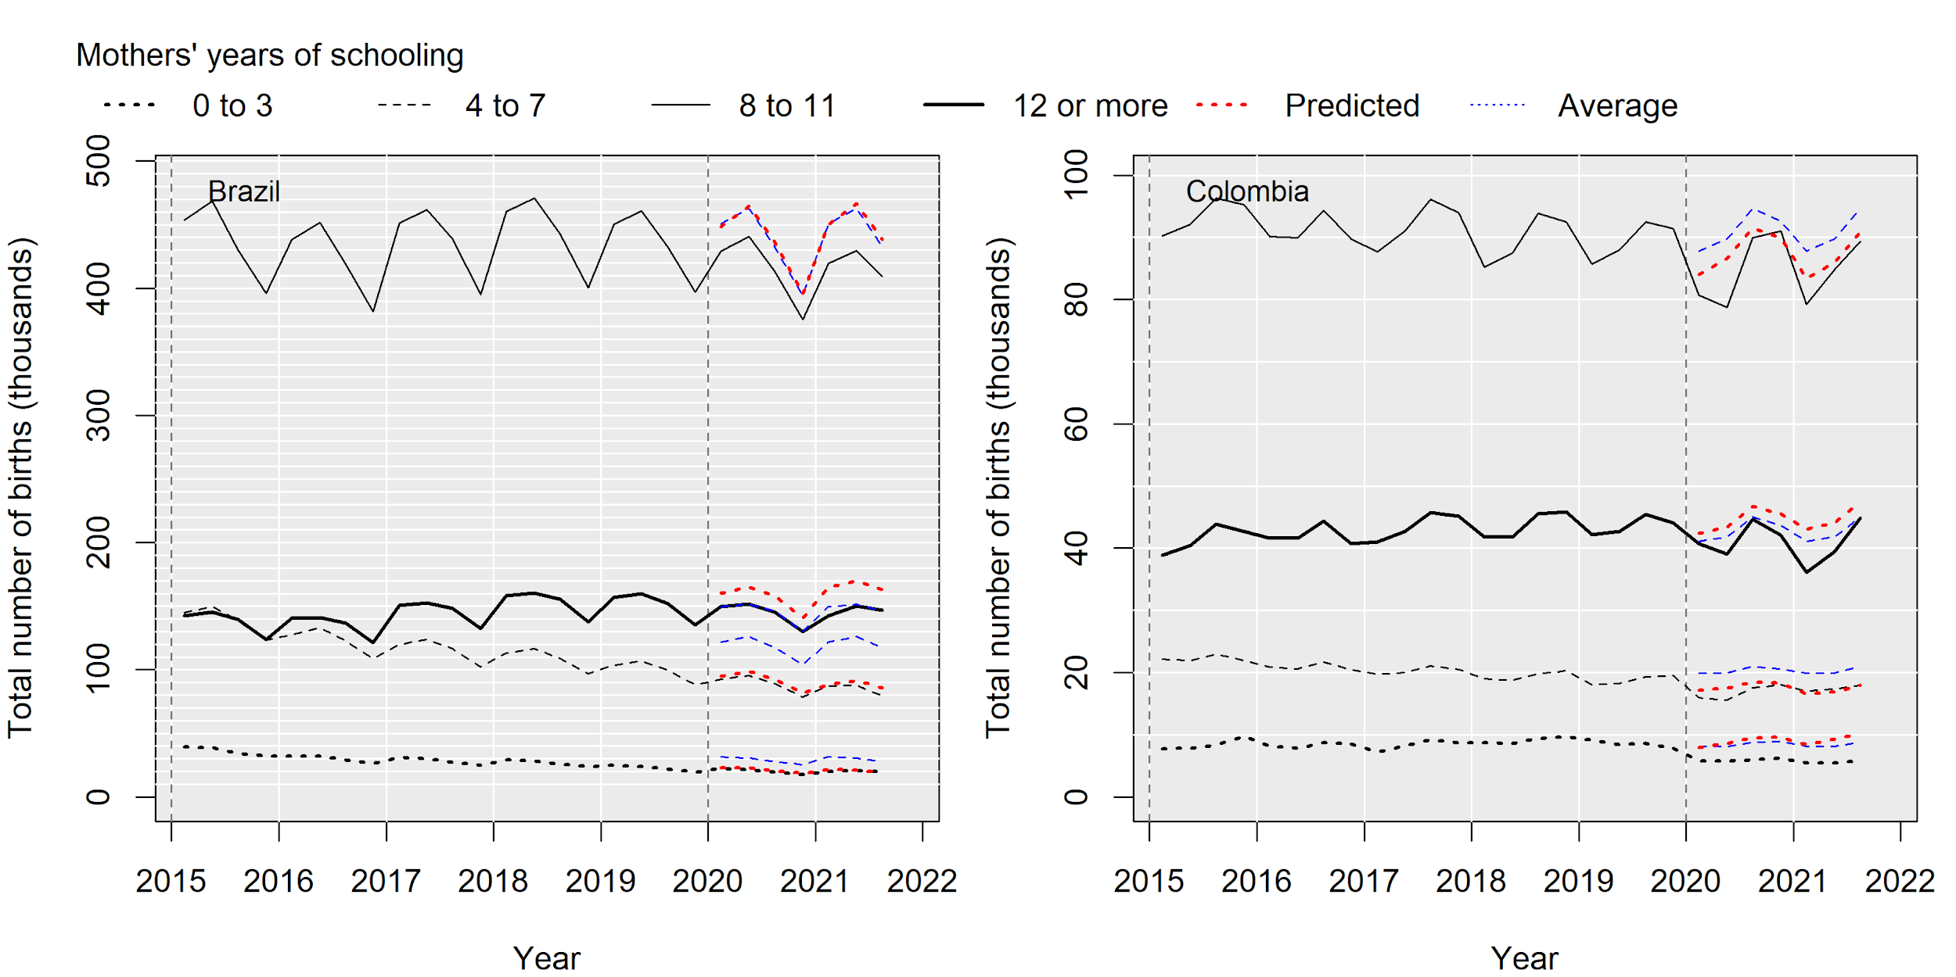
Other potential applications
Not limited to mortality
Extendible to other demographic phenomena, like fertility
● predicted births based on trimester averages
● predicted births based on Poisson model

Slide 18
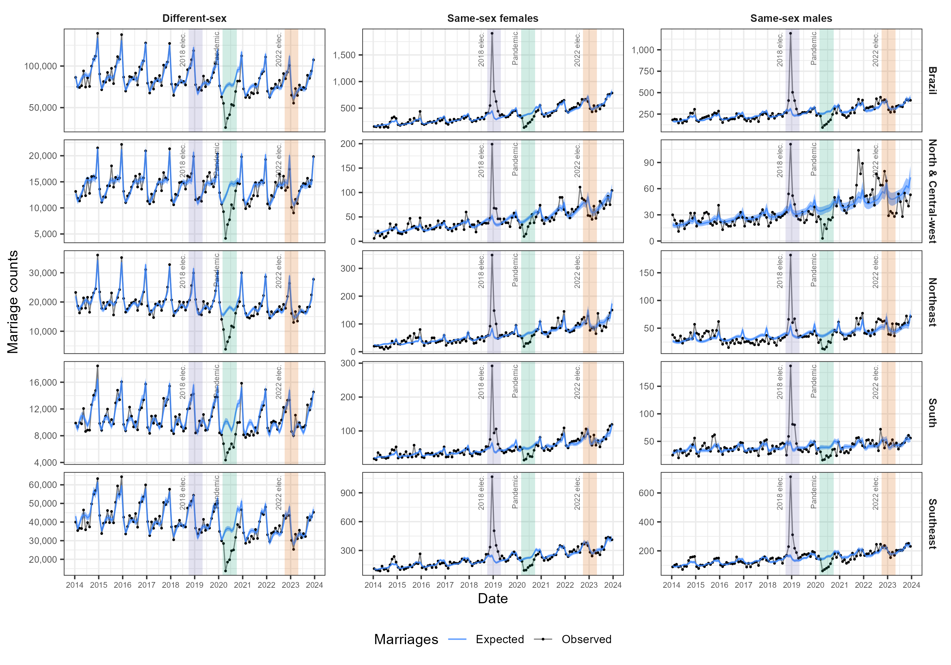
Other applications
Different- and same-sex marriages in Brazil
The Bolsonaro effect
Fortes et al. (2026)

Slide 19
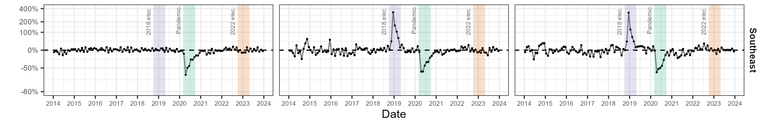
Other applications
Different- and same-sex marriages in Brazil
The Bolsonaro effect
Up to 400% increases in same-sex marriages in months between election and presidential inauguration
No changes for different-sex marriages

Slide 20
Excess mortality estimation
Let’s play in R!

