Slide 1

Enunciemos los patrones
Eolic Event Consumer
Enrique Brazález Segovia

Slide 2
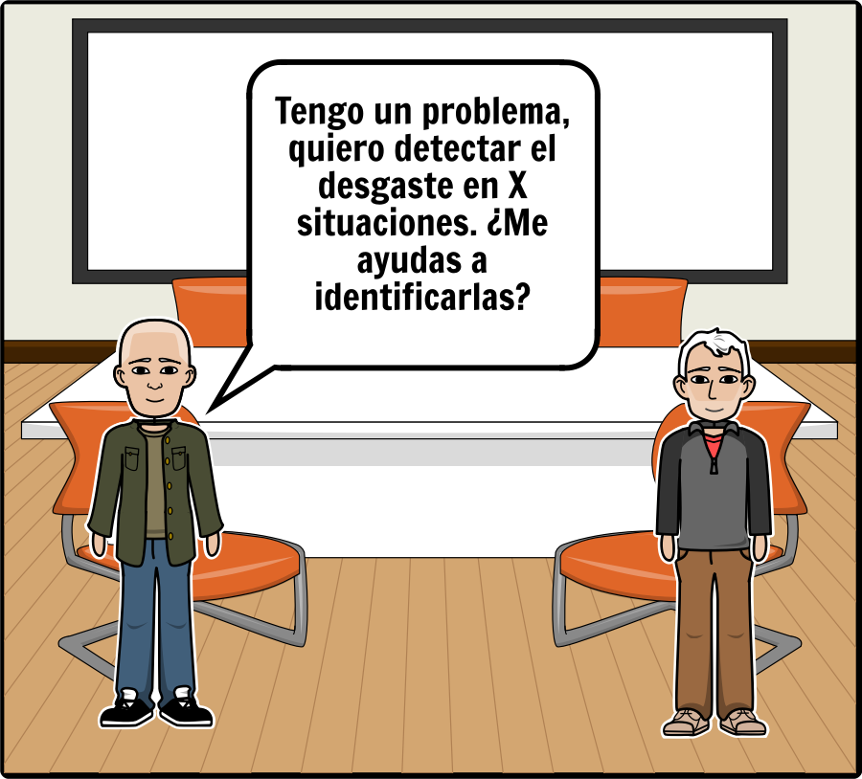
Add Text Here

Slide 3
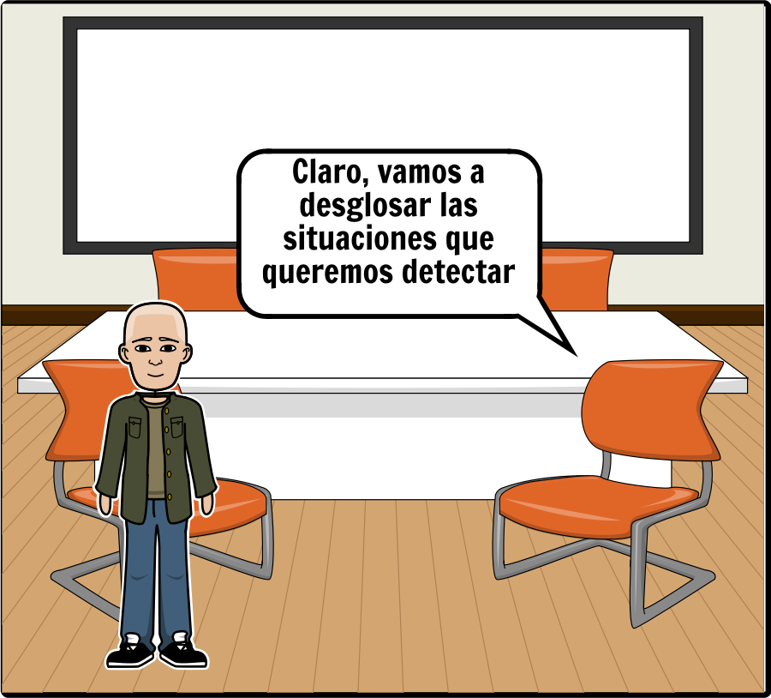
Add Title Here
Add Text Here

Slide 4
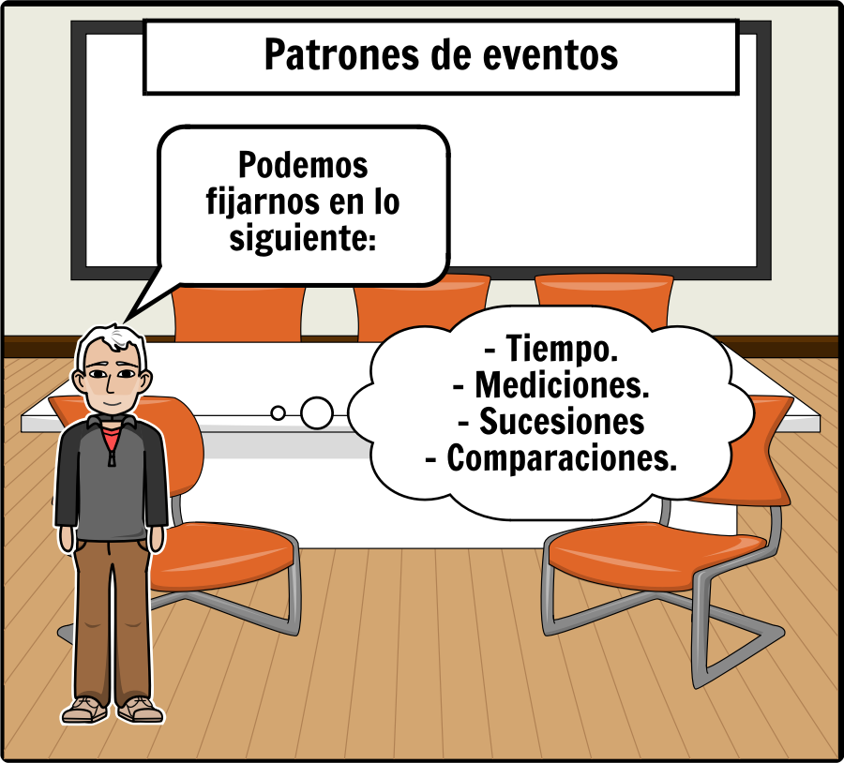
Add Title Here
Add Text Here

Slide 5
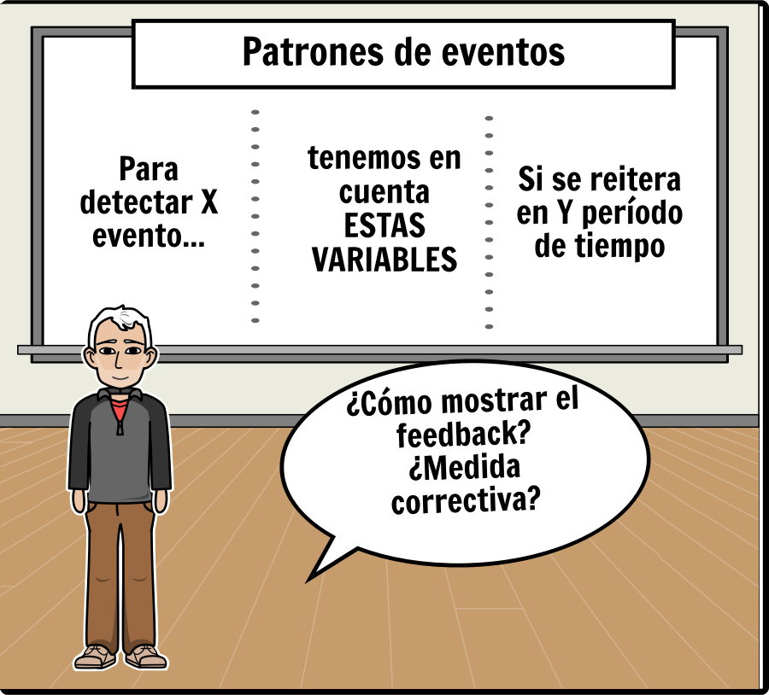
Add Title Here
Add Text Here

Slide 6
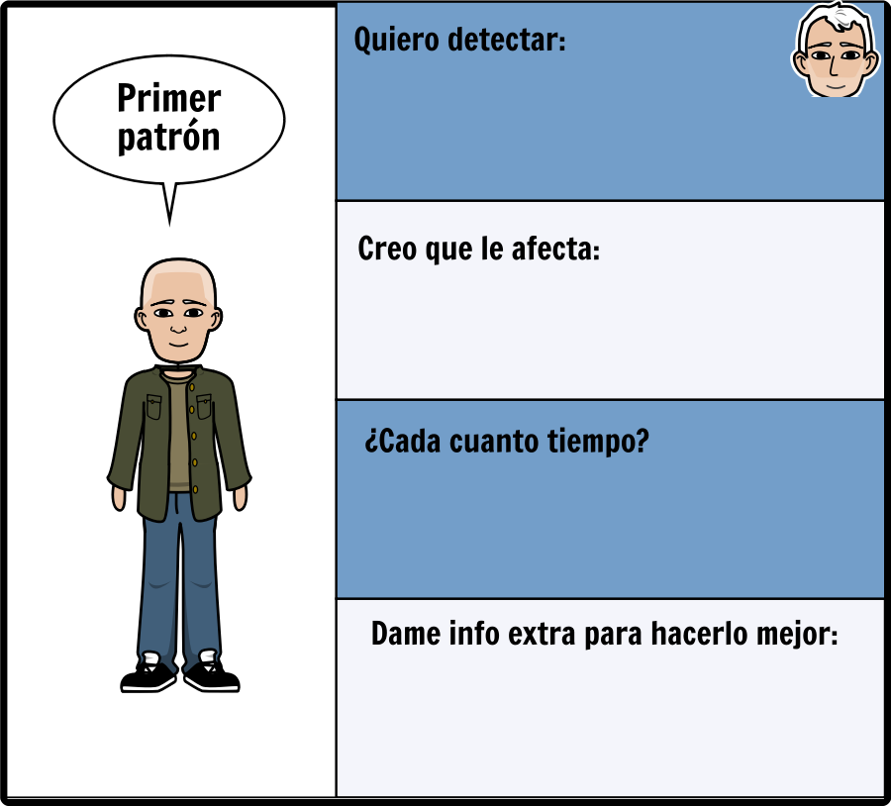

Slide 7
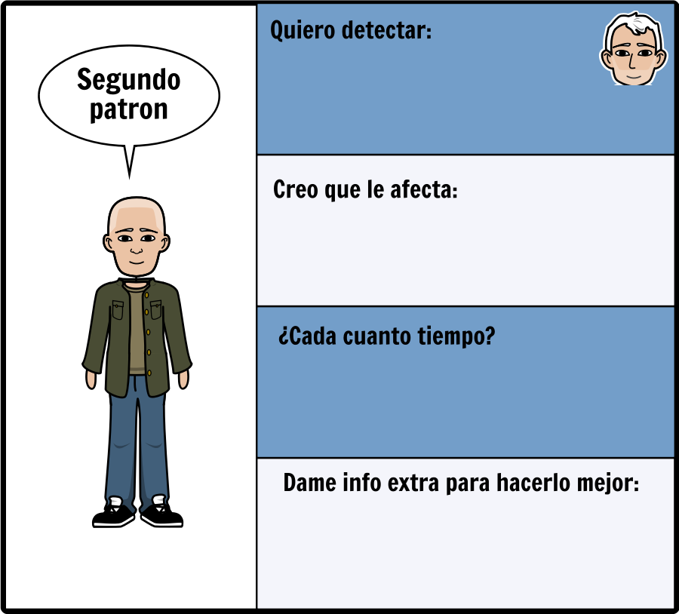
Add Title Here
Add Text Here

Slide 8
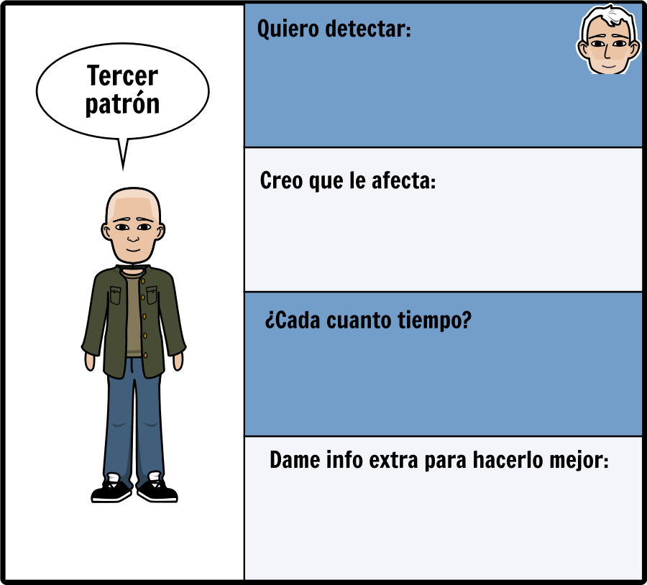
Add Title Here
Add Text Here

Slide 9
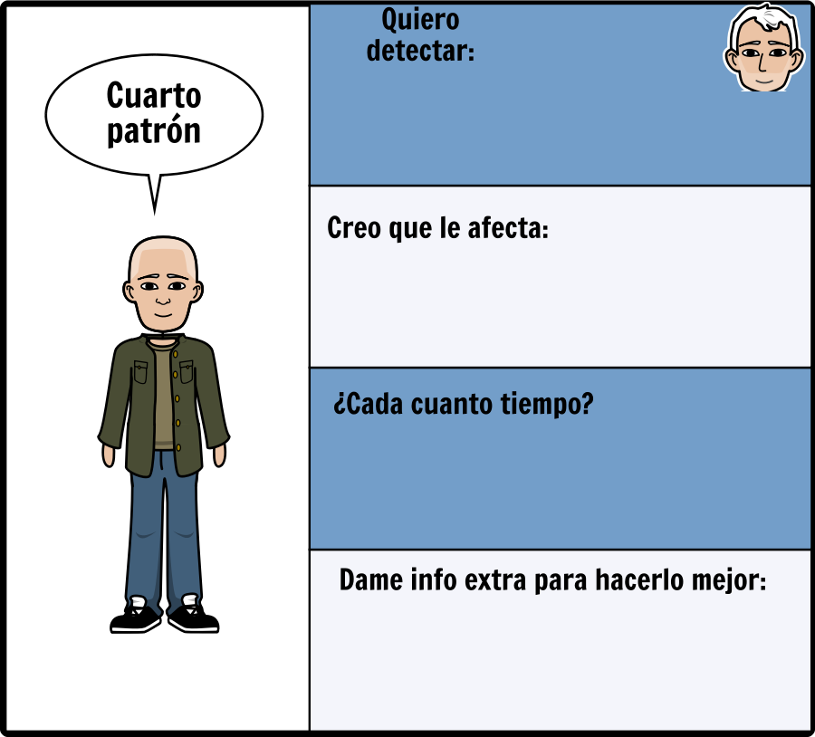
Add Title Here
Add Text Here

Slide 10
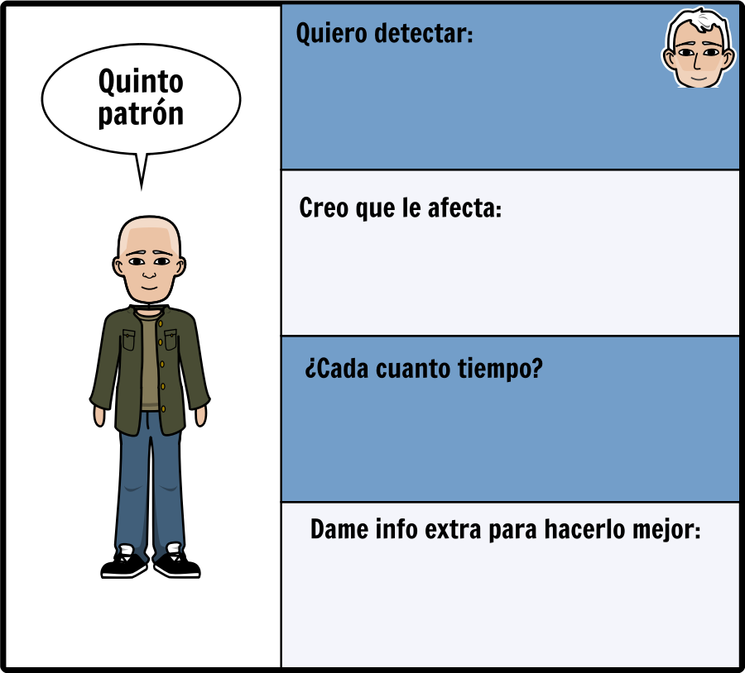
Add Title Here
Add Text Here

Slide 11
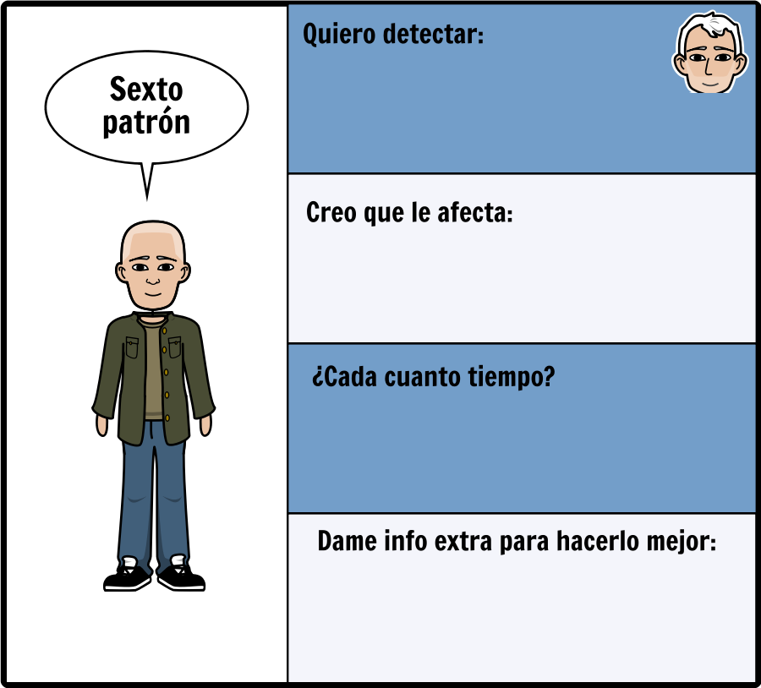
Add Title Here
Add Text Here

Slide 12
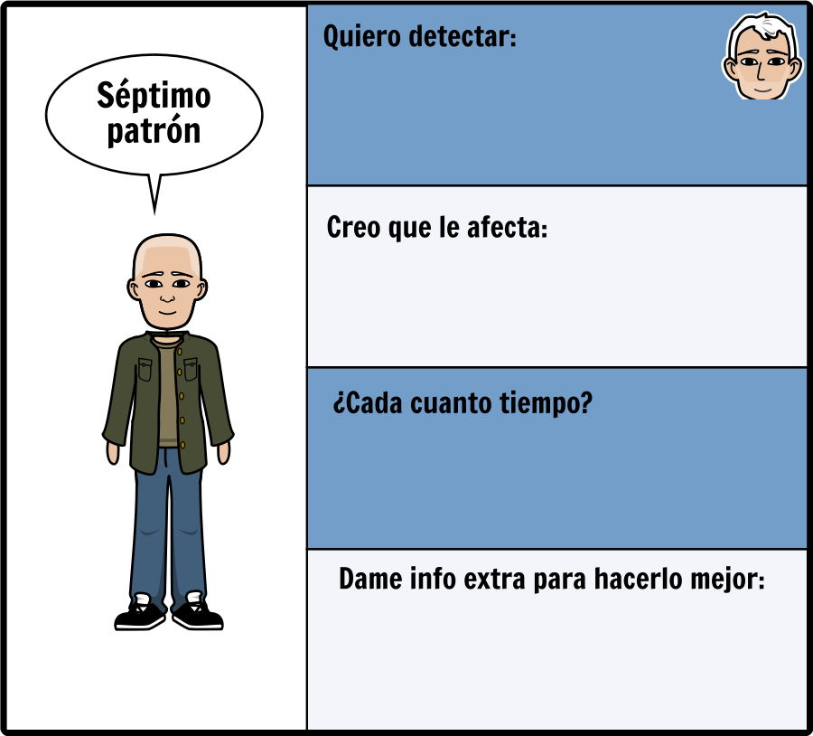
Add Title Here
Add Text Here

Slide 13
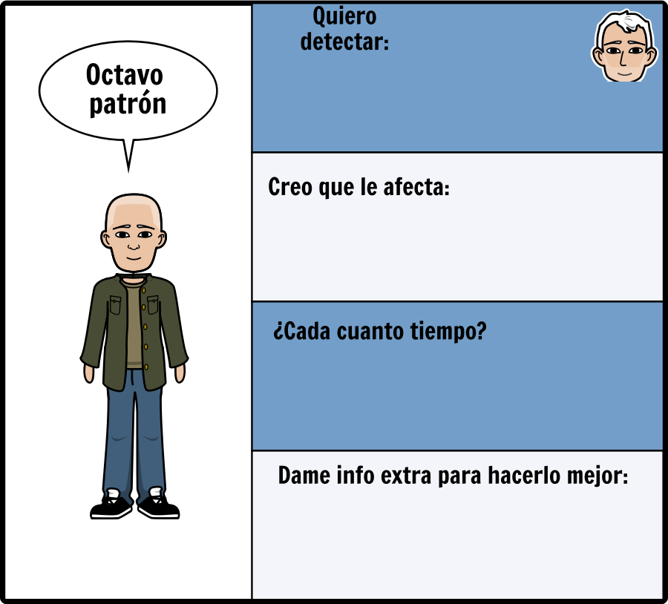
Add Title Here
Add Text Here

Slide 14
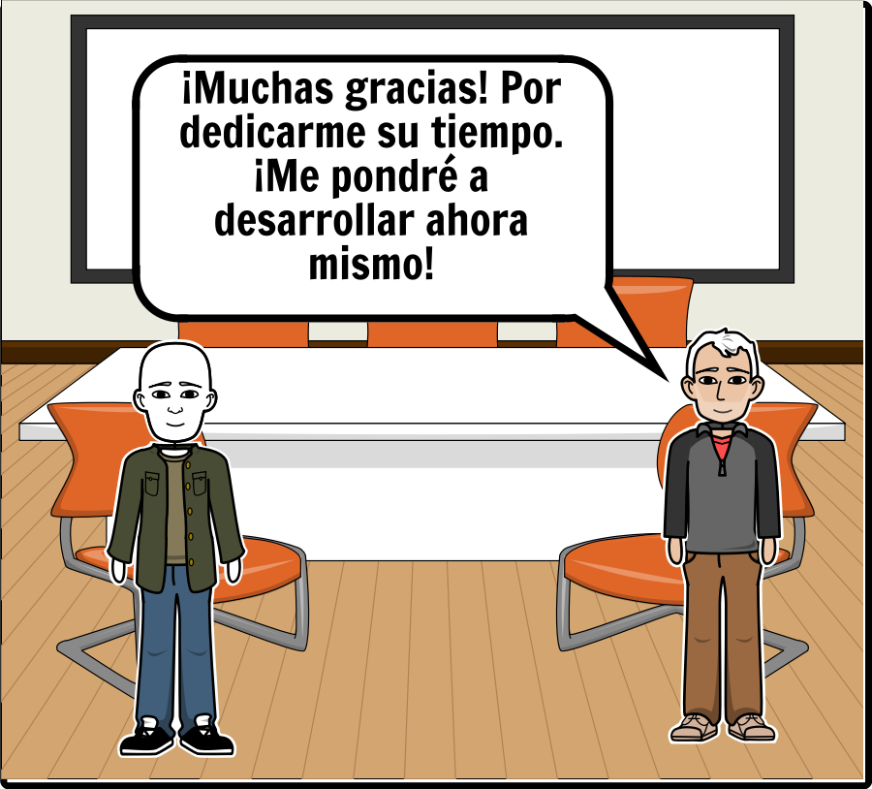
Add Title Here
Add Text Here

Slide 15
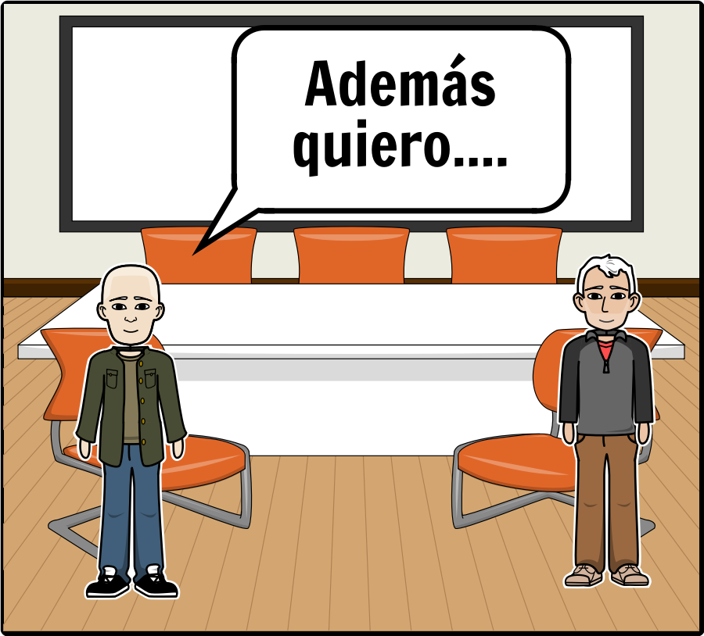
Add Title Here
Add Text Here

Slide 16
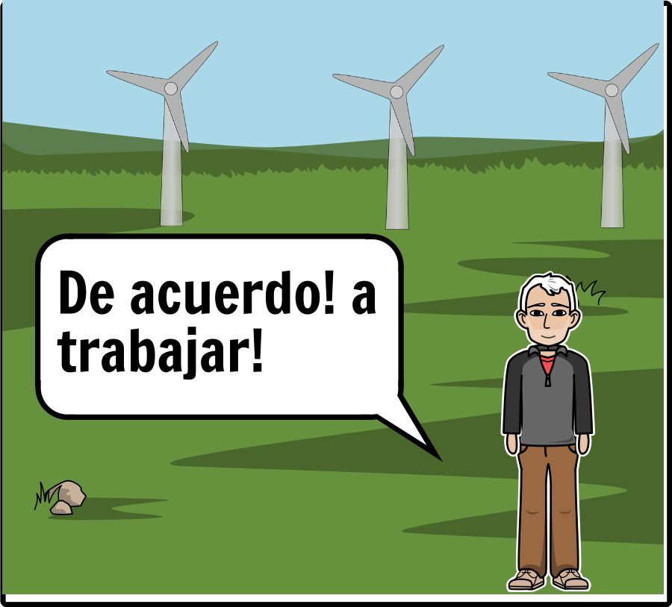
Add Title Here
Add Text Here

Slide 17
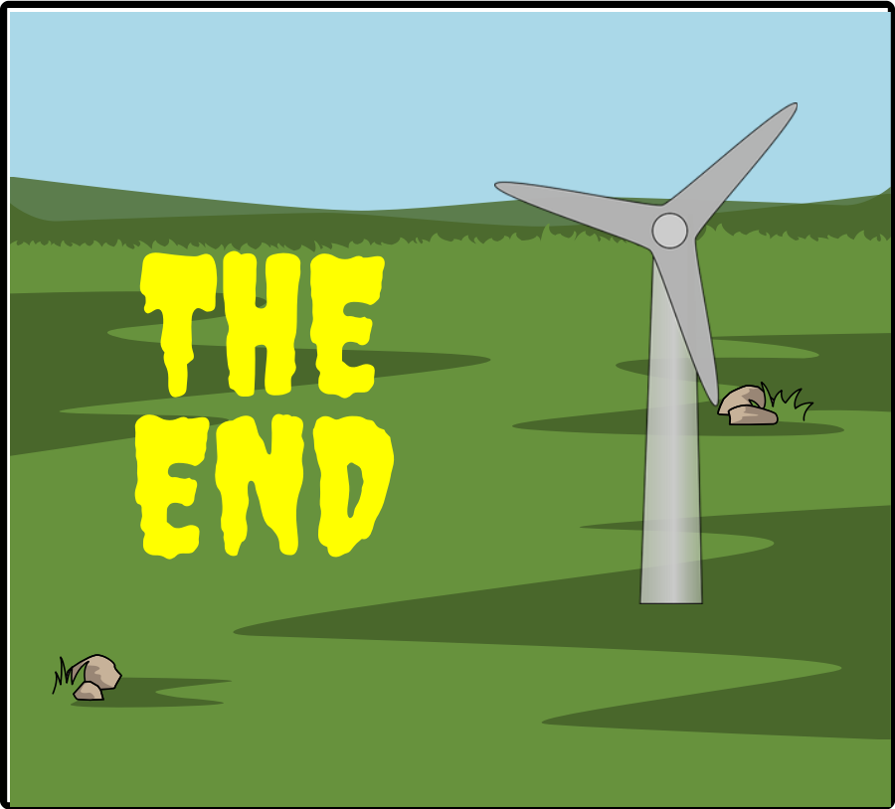
Add Title Here
Add Text Here

