Slide 1
DSC5001 Statistical Machine Learning
Hong Kong AQHI High-Risk Hour Early Warning:
A Comparative Study of Classification Models on Hourly Monitoring Data
Team-XX
[Student Name 1] (UID) | [Student Name 2] (UID) | [Student Name 3] (UID) | [Student Name 4] (UID)
October 2025

Slide 2
Research Question & Motivation
Core Question
Motivation
Can we reliably predict whether next-hour AQHI will reach high-risk level (>=7) using past observations?
How do different classifiers trade off between catching high-risk hours vs. controlling false alarms?
Three models compared: Logistic Regression, Random Forest, XGBoost
Why classification, not regression?
Public health advice is risk-level-based, not numeric -> classification matches real application
EPD publishes AQHI hourly but forecasts only 3x/day (00:30, 10:30, 16:30)
Hourly-level early warning has room for improvement during rapid pollution spikes
AQHI time series has temporal dependency + severe class imbalance (<2% high-risk)
Scientific value: not chasing best accuracy, but analyzing model trade-offs
Missed alerts (FN) vs. false alarms (FP) have different real-world costs
DSC5001 Project | Hong Kong AQHI High-Risk Hour Early Warning
2 / 10

Slide 3
Data Sources & Feature Engineering
Data Sources
Feature Engineering (27 features)
AQHI Hourly Data (EPD / data.gov.hk)
18 stations: 15 general + 3 roadside (Causeway Bay, Central, Mong Kok)
Period: Jan 2021 - Dec 2024 (48 months, avoiding 2025 methodology change)
Total: 617,799 samples after preprocessing
Weather Data (HKO / data.gov.hk)
Daily mean temperature, relative humidity, rainfall, wet bulb temp
Merged by date with AQHI records
Lagged AQHI: lag-1, 2, 3, 6, 12, 24 hours
Rolling stats: 3h/6h mean, 6h std
AQHI differences: 1-step and 3-step
Time encoding: hour, day-of-week, month (sin/cos)
Weather: temperature, humidity, rainfall, wet bulb
Station type: roadside vs. general (binary)
Target: next-hour AQHI >= 7 -> binary (1.60% positive)
DSC5001 Project | Hong Kong AQHI High-Risk Hour Early Warning
3 / 10

Slide 4
Methodology
Three Classification Models
Evaluation Strategy
1. Logistic Regression (baseline)
L2 regularization, class_weight='balanced'
2. Random Forest
200 trees, max_depth=15, class_weight='balanced'
3. XGBoost (Gradient Boosting)
300 rounds, max_depth=6, scale_pos_weight
TimeSeriesSplit CV (5 folds)
Prevents future data leakage
Uses only past data to predict future
Class imbalance handling:
Threshold optimization via PR curve
No SMOTE (preserves temporal structure)
Key metrics:
Recall (catch high-risk hours)
Precision (control false alarms)
F1, PR-AUC, Confusion Matrix
Cost analysis: FN cost = 5x FP cost
DSC5001 Project | Hong Kong AQHI High-Risk Hour Early Warning
4 / 10

Slide 5
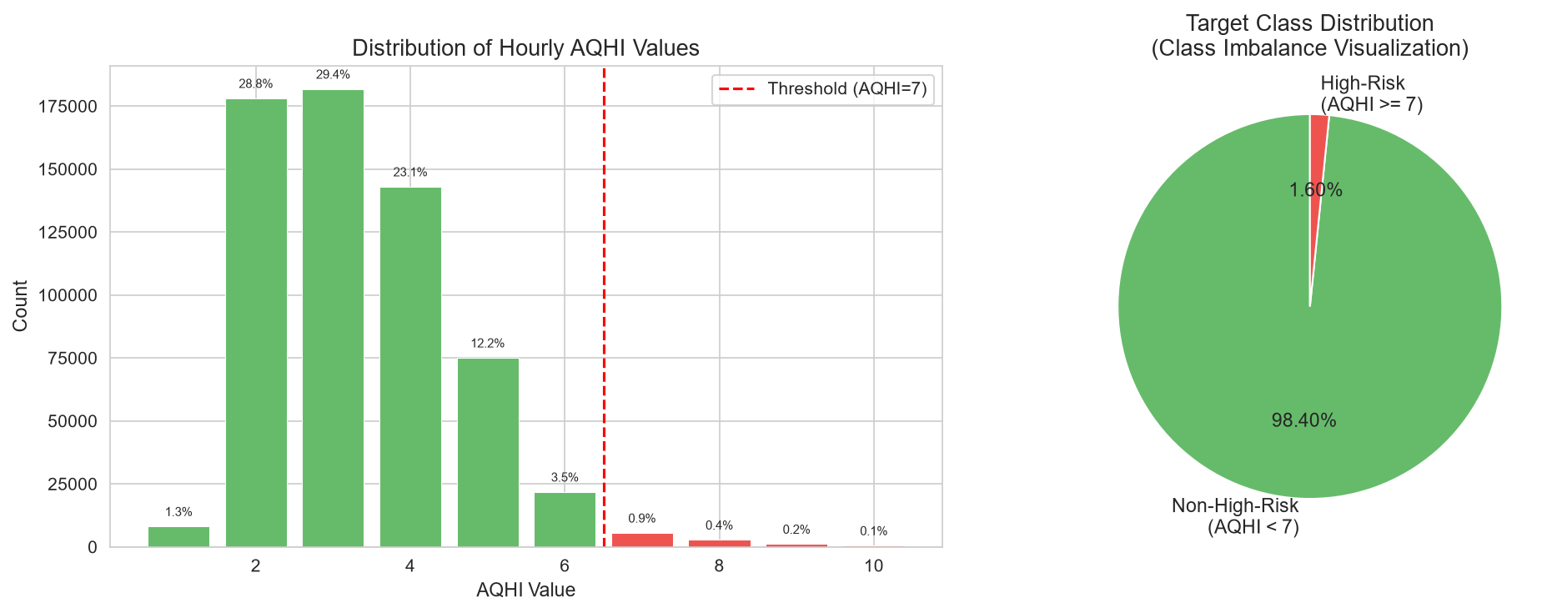
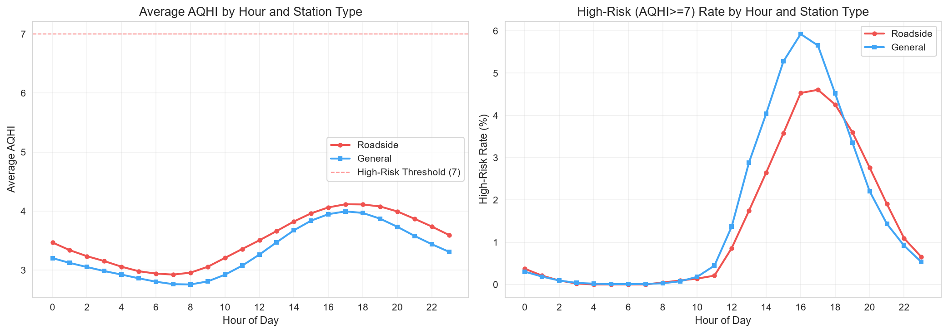
Data Exploration: AQHI Distribution & Patterns
Key findings: AQHI is right-skewed with only 1.60% high-risk (>=7). Roadside stations show consistently higher AQHI than general stations. High-risk hours peak during afternoon (12:00-19:00) across both station types.
DSC5001 Project | Hong Kong AQHI High-Risk Hour Early Warning
5 / 10

Slide 6
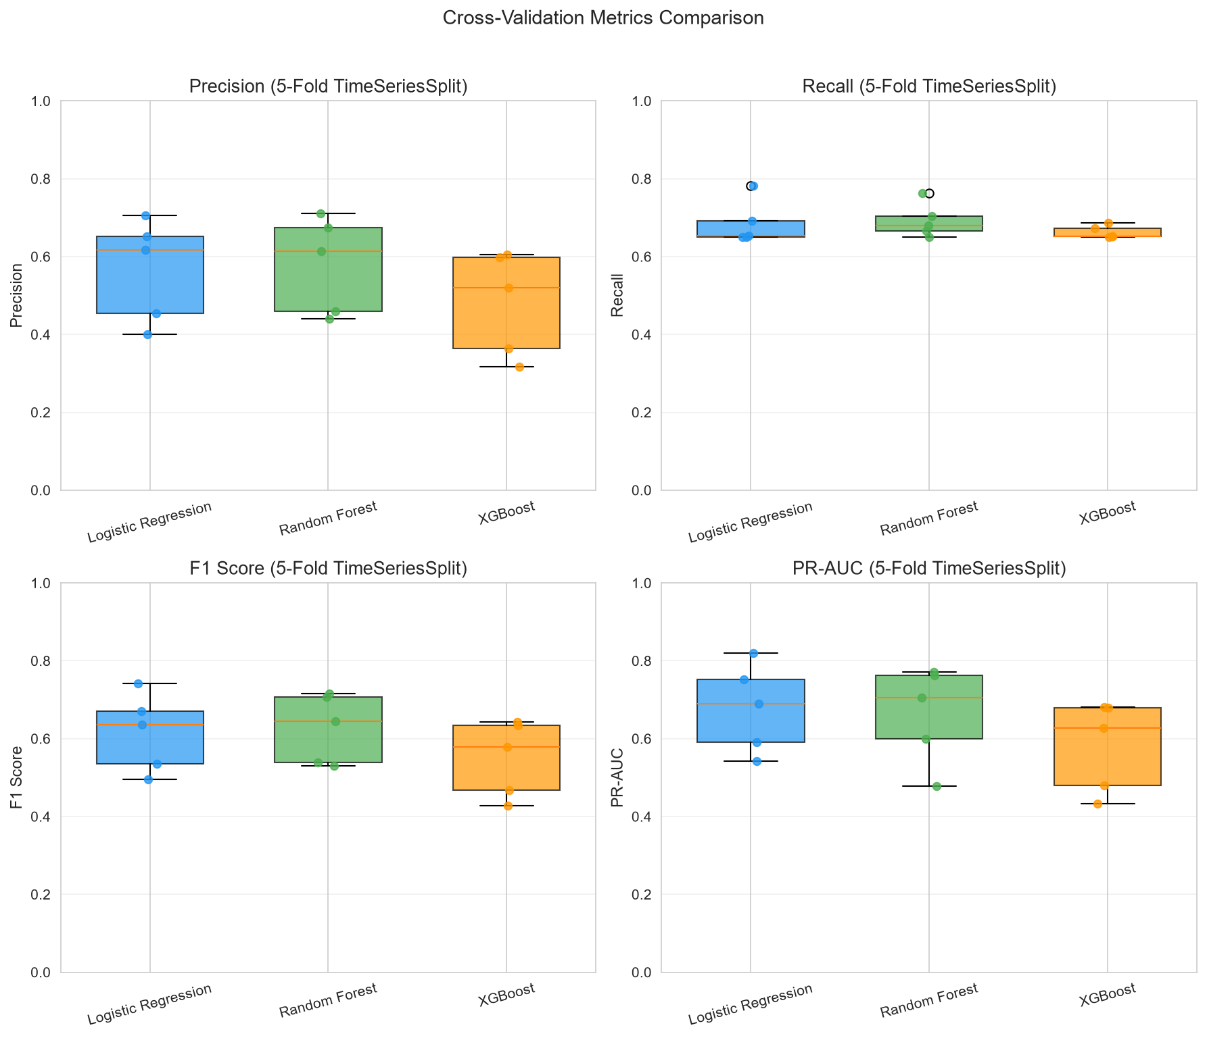
Cross-Validation Results (5-Fold TimeSeriesSplit)
CV Summary (mean +/- std)
Model | Prec. | Recall | F1 | PR-AUC
Log. Reg. | 0.566 +/-0.118 | 0.686 +/-0.051 | 0.616 +/-0.090 | 0.679 +/-0.101
Rand. Forest | 0.580 +/-0.111 | 0.693 +/-0.039 | 0.627 +/-0.080 | 0.663 +/-0.111
XGBoost | 0.481 +/-0.119 | 0.663 +/-0.015 | 0.550 +/-0.088 | 0.580 +/-0.104
Logistic Regression and Random Forest perform comparably. XGBoost shows lower precision but more stable recall across folds.
DSC5001 Project | Hong Kong AQHI High-Risk Hour Early Warning
6 / 10

Slide 7
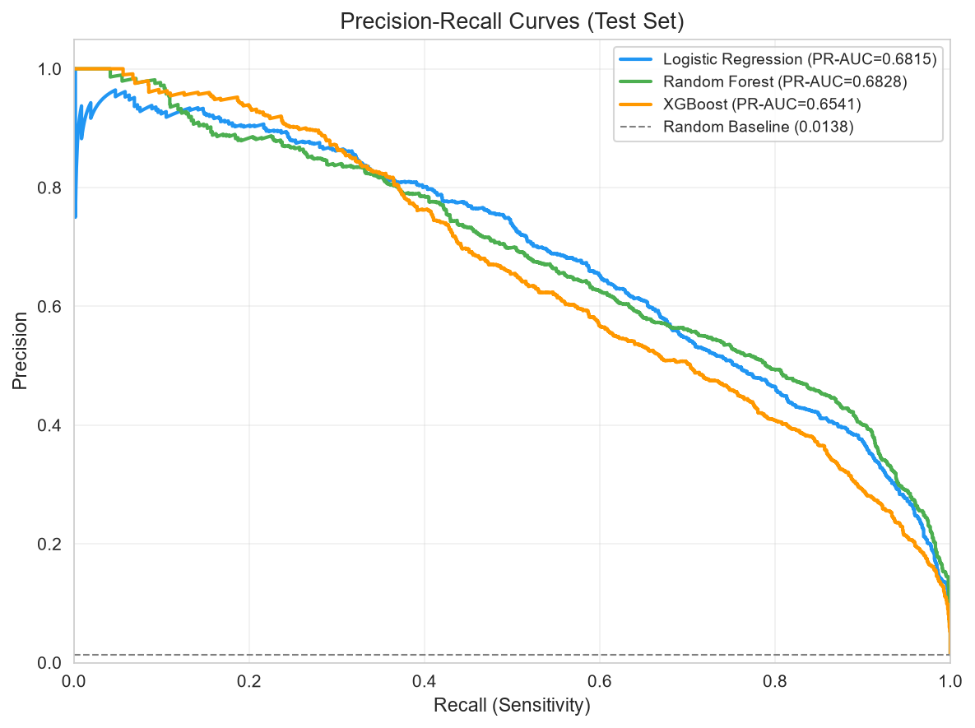
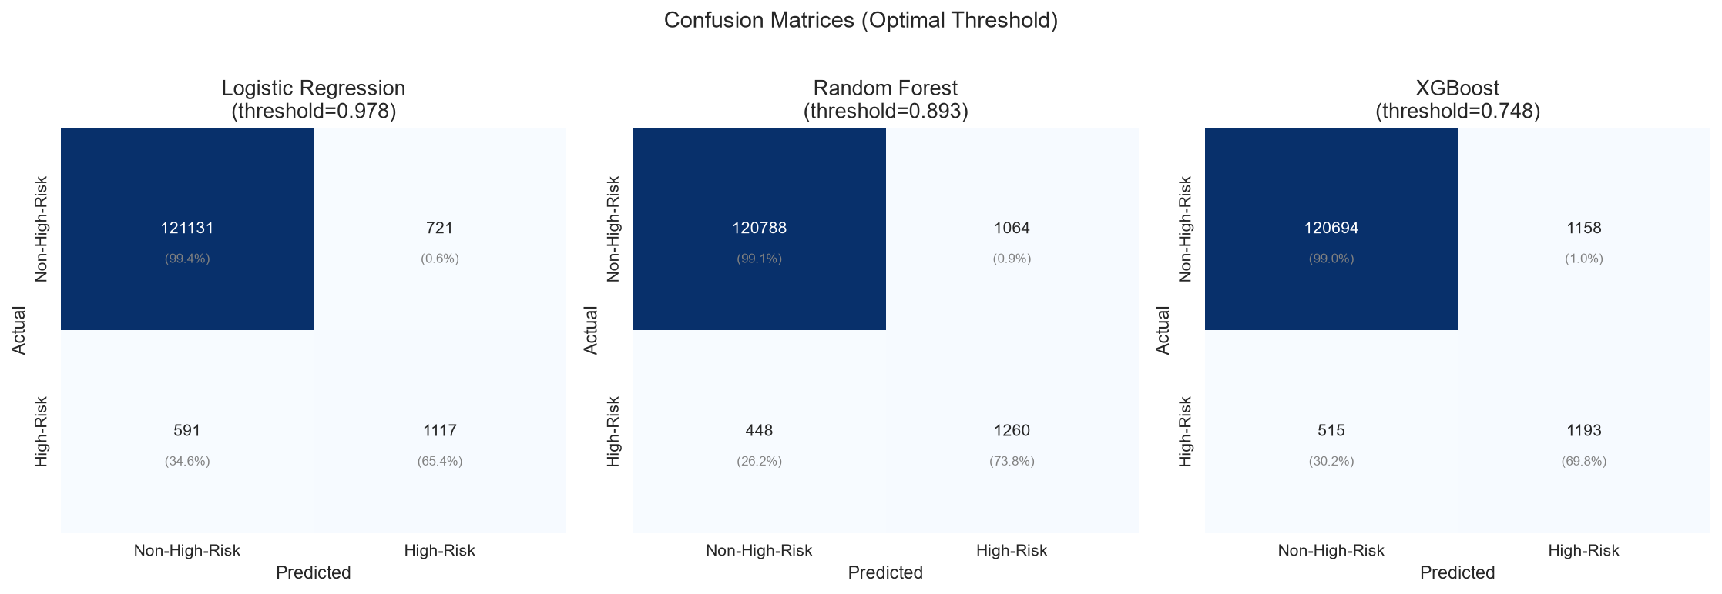
Test Set Results: PR Curves & Confusion Matrices
DSC5001 Project | Hong Kong AQHI High-Risk Hour Early Warning
7 / 10

Slide 8
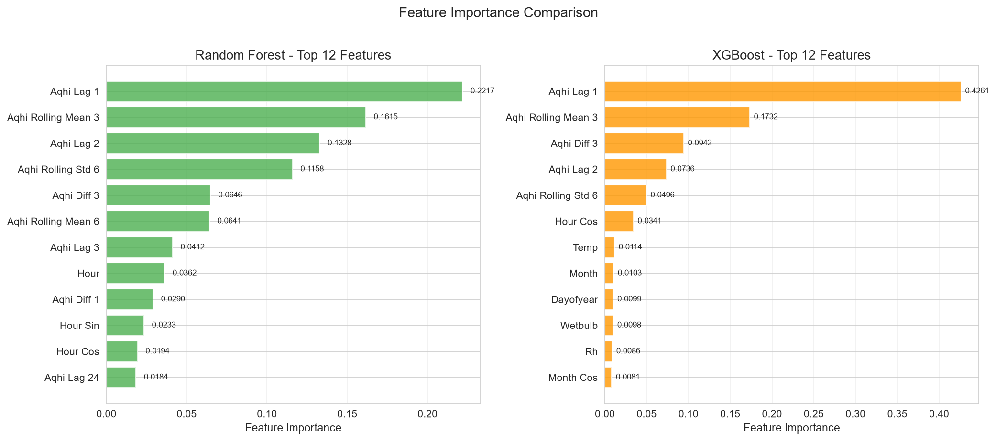
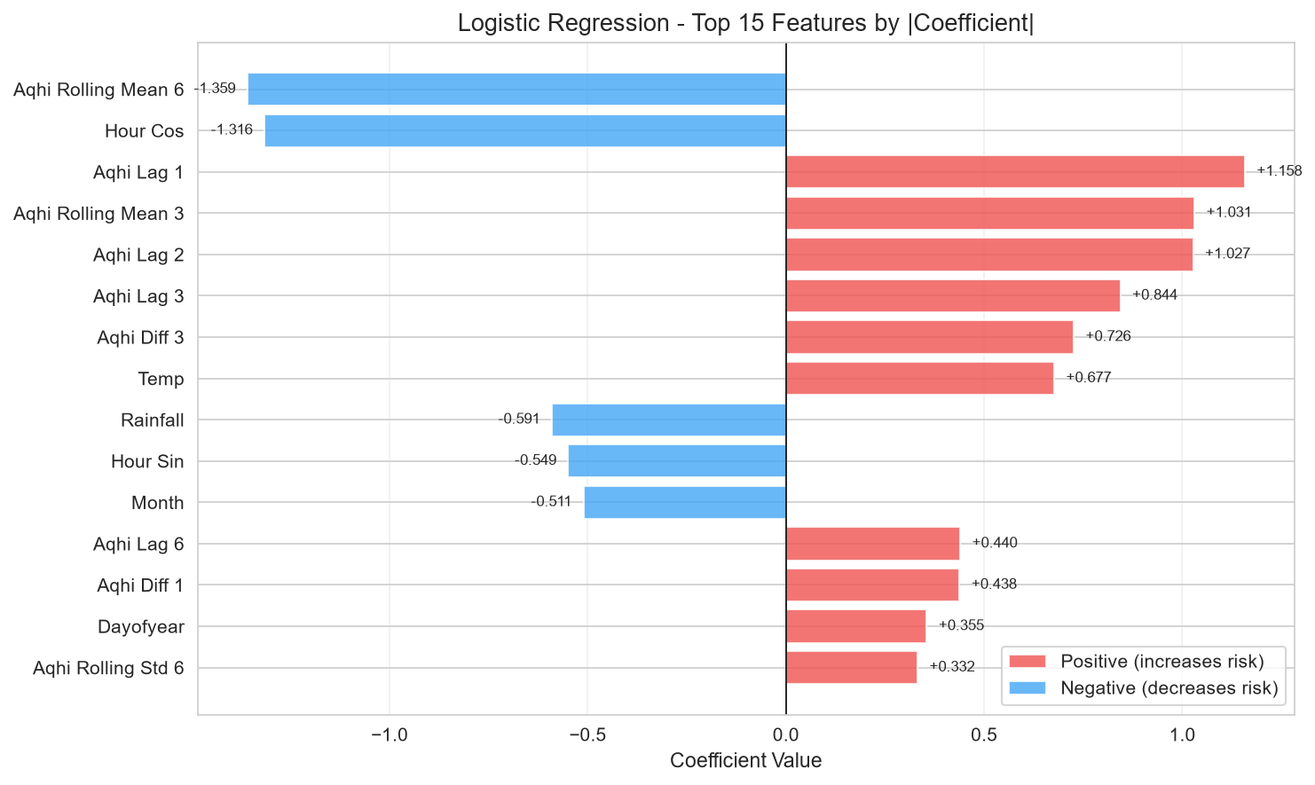
Feature Importance Analysis
Key Findings
AQHI_lag_1 dominates all models
Most recent observation is strongest predictor
Rolling mean (3h) is 2nd most important
Recent trend captures momentum
Rolling std (6h) matters for RF
Volatility signals impending risk
Hour-of-day patterns are significant
Afternoon hours (12-19) show higher risk
Temperature has positive coefficient in LR
Higher temp -> more high-risk hours
Rainfall has negative coefficient
Rain washes pollutants from air
DSC5001 Project | Hong Kong AQHI High-Risk Hour Early Warning
8 / 10

Slide 9
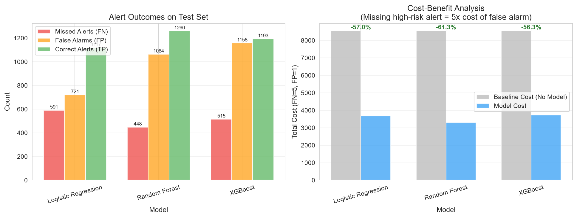
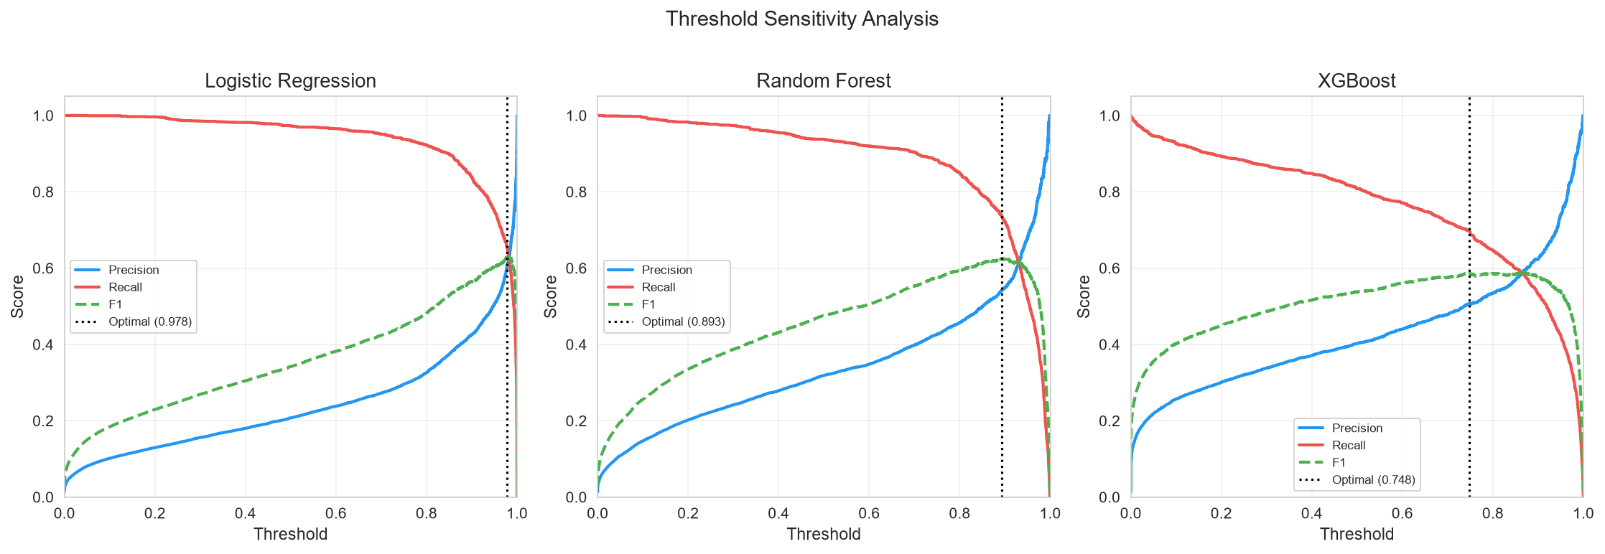
Cost-Benefit Analysis & Threshold Optimization
Assumption: missing a high-risk alert (FN) costs 5x a false alarm (FP). Random Forest achieves the highest cost reduction (61.3%), with the fewest missed alerts (448) despite more false alarms. Optimal thresholds are model-specific: LR=0.978, RF=0.893, XGB=0.748.
DSC5001 Project | Hong Kong AQHI High-Risk Hour Early Warning
9 / 10

Slide 10
Conclusions & Limitations
Conclusions
Limitations & Future Work
Classification framework is viable for AQHI early warning
Binary prediction matches public health advice structure
Random Forest: best recall (73.8%) & cost reduction (61.3%)
Recommended when missing high-risk hours is most costly
Logistic Regression: best precision (60.8%) & highest PR-AUC
Recommended when false alarms must be minimized
XGBoost: balanced but lower overall performance
May benefit from more hyperparameter tuning
Key predictor: AQHI_lag_1 (most recent observation)
Simple lagged features outperform meteorological variables
Weather data is daily, not hourly
Limits temporal resolution of meteorological features
Station spatial mismatch
EPD stations and HKO weather stations don't co-locate
AQHI methodology changed in March 2025
Used 2021-2024 data to avoid distribution shift
Class imbalance is severe (1.60%)
Even with weighting, precision remains moderate
Future: hourly weather data, multi-station spatial models
Deep learning (LSTM/Transformer) for sequence prediction
DSC5001 Project | Hong Kong AQHI High-Risk Hour Early Warning
10 / 10

