Slide 1
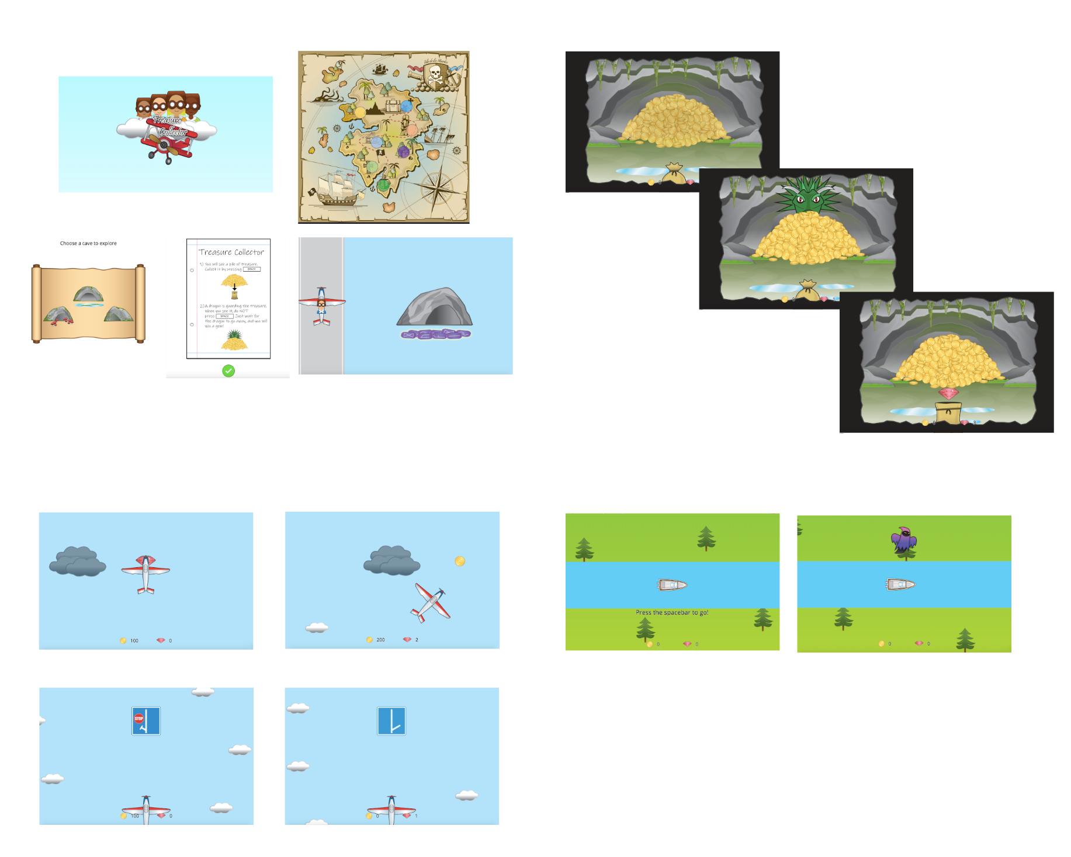
a
b
Treasure collect mini game
Game narrative
c
AB driving mini game
d
HR driving mini game

