Slide 1
DE project summary
Alex

Slide 2
Overview of this summary
ETL process
Manual process with redshift
Automation pipeline with redshift
Manual process with hive
Reporting

Slide 3
Manual processing with redshift
Process raw data with python script, upload processed data (csv) to S3
Use redshift query editor to populate the data warehouse
Load data to redshift

Slide 4
Process data
Raw data
Video_data.csv:
DateTime, VideoTitle, Events
Processed data
Dim_time.csv: timeid, DateTime, year, month, day, hour, minute
Dim_title.csv: titleid, title
Dim_site.csv: siteid, site
Dim_platform.csv: platformed, platform
Fact.csv: factid, DateTime, title, site, platform
python

Slide 5
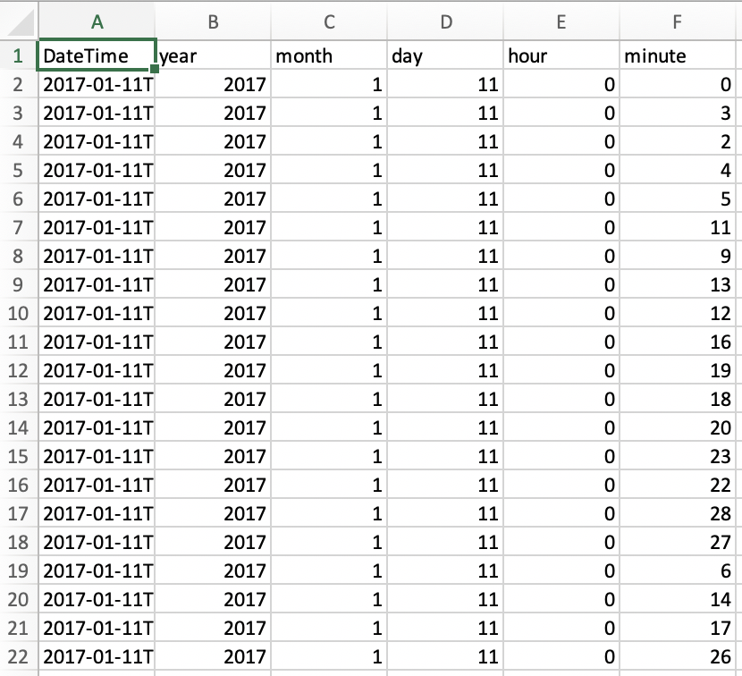
Processed data example (facts to be loaded to staging table)

Slide 6
SQL to populate data warehouse on redshift dimension tables
create table time(
timeid int not null identity(0,1),
DateTime char(16),
year smallint,
month smallint,
day smallint,
hour smallint,
minute smallint);
create table title(
titleid int not null identity(0,1),
title varchar(200));
create table site(
siteid int not null identity(0,1),
site varchar(200));
create table platform(
platformid int not null identity(0,1),
platform varchar(50));

Slide 7
SQL to populate data warehouse on redshift staging and fact tables
create table staging(
factid int not null identity(0,1),
DateTime char(16) not null,
title varchar(200) not null,
site varchar(200) not null,
platform varchar(50) not null);
create table fact(
factid int not null identity(0,1),
timeid int not null,
titleid int not null,
siteid int not null,
platformid int not null);

Slide 8
Load data from S3 to redshift
Load dimension table data to dimension table, fact table data to staging table:
COPY time ("timeid", "DateTime", "year", "month", "day", "hour", "minute")
FROM 's3://jr-demo/processed-1.csv'
credentials 'aws_iam_role=<rold arn>'
CSV
EXPLICIT_IDS
IGNOREHEADER 1;

Slide 9
Load data from staging table to fact table
insert into fact (timeid, titleid, siteid, platformid)
select a.timeid, b.titleid, c.siteid, d.platformid
from staging e
left join time a
on e.DateTime = a.DateTime
left join title b
on e.title = b.title
left join site c
on e.site = e.site
left join platform d
on e.platform = d.platform;
Truncate staging;

Slide 10
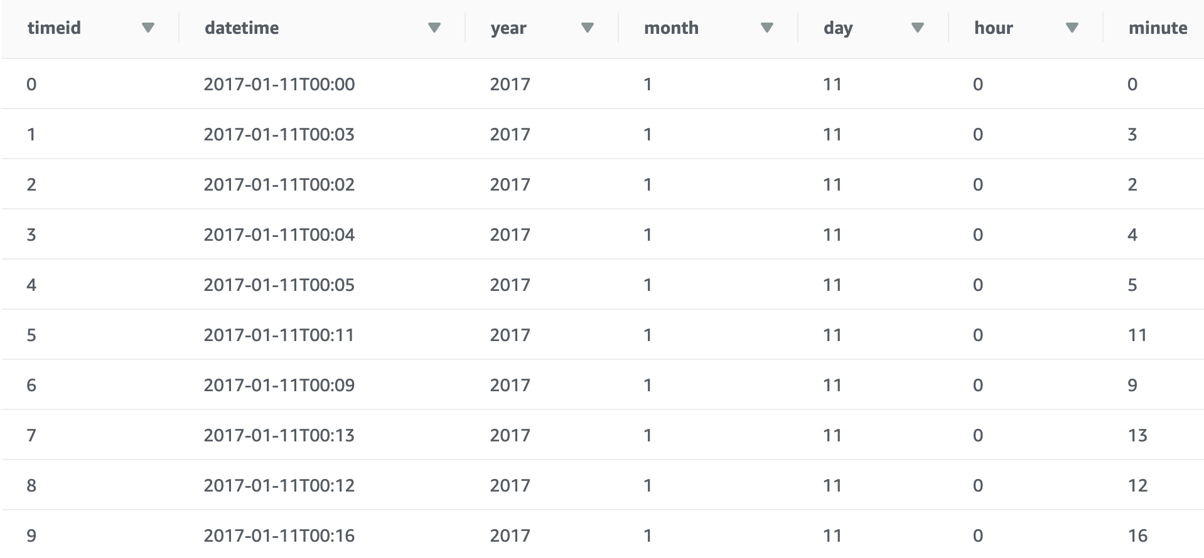
Dimension table (time for example)

Slide 11
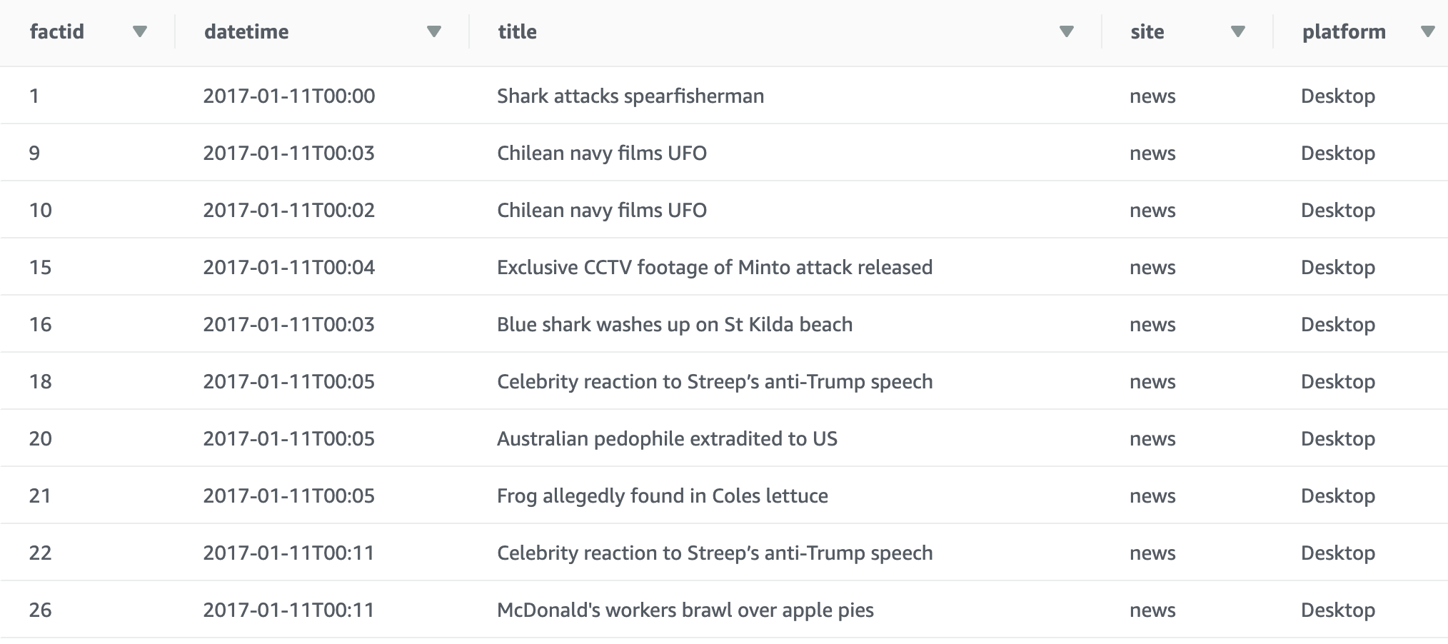
Staging table

Slide 12
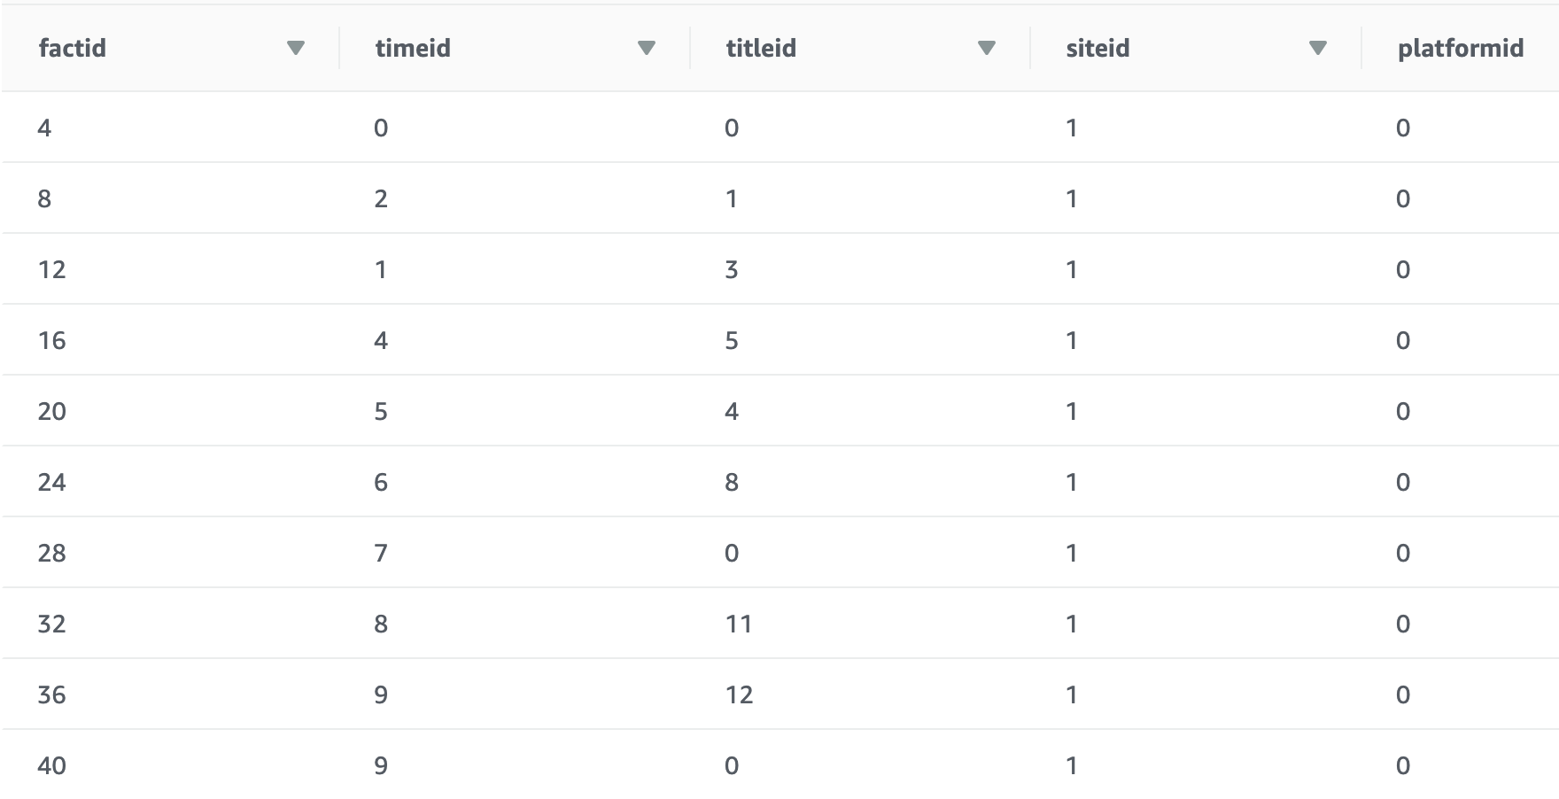
Fact table
Factid, used as surrogate key, auto-generated with IDENTITY column

Slide 13
Automation pipeline with redshift
Source files uploaded to S3
Lambda function calls python script, output processed data to S3
Lambda function calls python script, check if all required (processed) data is uploaded, use pgql connection to load data to redshift data warehouse
Append new batch of data to redshift

Slide 14
Append new batch of data to redshift
1. use COPY command to directly append new batch of data to redshift
2. use following pgql command to remove duplicate value (performance of this command?):
delete from time where timeid > (select min(timeid) from time a where time.datetime = a.datetime);
3. load data from staging table to fact table
4. truncate staging table

Slide 15
remarks
To include python packages in the lambda deployment package, we need to activate virtual environment, download package (https://medium.com/@korniichuk/lambda-with-pandas-fd81aa2ff25e , different from normal pip install process), zip, and upload to S3
Question: how to debug and test zip file lambda function more easily?

Slide 16
Manual processing with hive
To be continue

