Slide 1



DEVSTACK
With Vagrant

Slide 2
openstack-dev/devstack
Easy to use:
# apt-get update && apt-install –y git
# git clone https://github.com/openstack-dev/devstack.git
# cd devstack
# ./stack.sh
Time between 50 minutes and 2 hours
Depend on Internet download speed

Slide 3

Aaa
Aa
World domination

Slide 4
Vagrantup.com

Slide 5
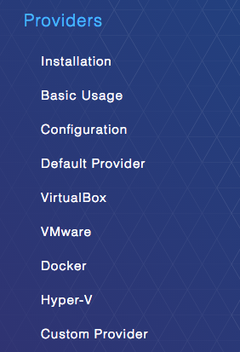
What Vagrant is / does
Aaa
Divide by 0
Count to infinite and back and then /0

Slide 6
Devstack (reminder)
Easy to use:
# apt-get update && apt-install –y git
# git clone https://github.com/openstack-dev/devstack.git
# cd devstack
# ./stack.sh
How do we automate this?

Slide 7
Vagrantfile for devstack
Vagrant.configure("2") do |config|
config.vm.box = "ubuntu/trusty64"
config.vm.network :private_network, ip: "172.16.0.2"
config.vm.network "forwarded_port", guest: 80, host: 8080
config.vm.network "forwarded_port", guest: 5000, host: 5000
config.vm.provision :shell, privileged: false, :inline => "bash /vagrant/scripts/provision.sh"
config.vm.provider :virtualbox do |vb|
vb.customize ["modifyvm", :id, "--cpus", "2"]
vb.customize ["modifyvm", :id, "--memory", "10240"]
end
end

Slide 8
Provision.sh script for devstack (20 lines)
#!/bin/bash sudo apt-get -y update || sudo yum update -qy sudo apt-get install -y git || sudo yum install -qy git sudo mkdir -p /opt/stack sudo chown -R vagrant: /opt/stack pushd /opt/stack [ -d devstack ] || git clone https://git.openstack.org/openstack-dev/devstack.git pushd /opt/stack/devstack | echo '[[local|localrc]]' > local.conf echo ADMIN_PASSWORD=password >> local.conf echo MYSQL_PASSWORD=password >> local.conf echo RABBIT_PASSWORD=password >> local.conf echo SERVICE_PASSWORD=password >> local.conf echo SERVICE_TOKEN=tokentoken >> local.conf ./stack.sh echo OFFLINE=True >> local.conf popd

Slide 9
Devstack plus nova-plugin
Easy to use:
# apt-get update && apt-install –y git
# git clone https://github.com/openstack-dev/devstack.git
# git clone https://awesome_url/awesome_nova_plugin.git
# install plugin pre-req’s and do some work
# cd devstack
# ./stack.sh

Slide 10
Devstack plus nova-docker plugin
Easy to use:
# apt-get update && apt-install –y git
# git clone https://github.com/openstack-dev/devstack.git
# git clone https://git.openstack.org/stackforge/nova-docker.git
# sudo pip install --upgrade . && contrib/devstack/prepare_devstack.sh
# cd devstack
# ./stack.sh

Slide 11
Vagrantfile for devstack + docker (the same)
Vagrant.configure("2") do |config|
config.vm.box = "ubuntu/trusty64"
config.vm.network :private_network, ip: "172.16.0.2"
config.vm.network "forwarded_port", guest: 80, host: 8080
config.vm.network "forwarded_port", guest: 5000, host: 5000
config.vm.provision :shell, privileged: false, :inline => "bash /vagrant/scripts/provision.sh"
config.vm.provider :virtualbox do |vb|
vb.customize ["modifyvm", :id, "--cpus", "2"]
vb.customize ["modifyvm", :id, "--memory", "10240"]
end
end

Slide 12
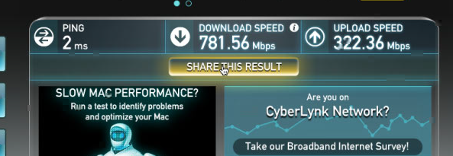
Time (on a very fast internet)
Create VM Ubuntu update Ubuntu upgrade Ubuntu dist-upgrade Docker install Devstack Install OS packages Clone git repos Configure openstack 64m37.259s | From a basic install To get new upstream packages info To upgrade installed packages To upgrade OS to current version The provisioner we will be using Install devstack Time consuming Time consuming The important part

Slide 13
Speeding up our devstack + docker
Time consuming task that can be moved into the base box
OS Update
OS Upgrade
OS DistUpgrade
Git Clone
$ time git clone git://git.openstack.org/openstack/nova.git
..
Receiving objects: 100% (335461/335461), 100.50 MiB | 559.00 KiB/s, done.
Resolving deltas: 100% (262138/262138), done.
Checking connectivity... done
real 4m23.165s

Slide 14
Packer.io

Slide 15
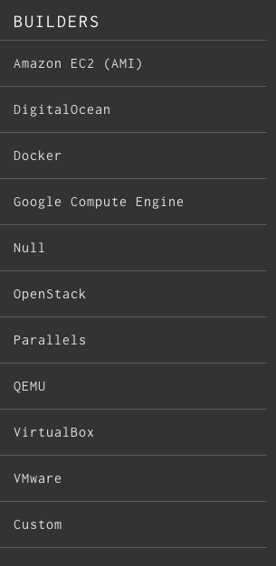
What Packer is / does
Aaa
Bbb
skynet

Slide 16
Collecting information about git repos
Have the git repos to be used already there git pull vs git clone # for x in */.git ; do X=${x%.git}; du -sk $X ; done 39240 cinder/ 59956 devstack/ 16164 glance/ 119552 horizon/ 27936 keystone/ 54588 neutron/ 832 nova-docker/ 147104 nova/ 13056 noVNC/ 1168 requirements/ 202400 tempest/ | 14m for Git clone (parallel) 40m for Git clone (serial) git clone git://git.openstack.org/openstack/cinder.git & git clone https://git.openstack.org/openstack-dev/devstack.git & git clone git://git.openstack.org/openstack/glance.git & git clone git://git.openstack.org/openstack/horizon.git & git clone git://git.openstack.org/openstack/keystone.git & git clone git://git.openstack.org/openstack/neutron.git & git clone https://git.openstack.org/stackforge/nova-docker.git & git clone git://git.openstack.org/openstack/nova.git & git clone https://github.com/kanaka/noVNC.git & git clone git://git.openstack.org/openstack/requirements.git & git clone git://git.openstack.org/openstack/tempest.git & wait

Slide 17
Collecting information about OS packages
sudo dpkg --get-selections | grep -iv mysql > /vagrant/scripts/installed-software
grep -iv mysql /vagrant/scripts/installed-software| sudo dpkg --set-selections
Note: we exclude mysql since at installation requires a password,
so we let this package for ./stack.sh to take care of

Slide 18
Testing
Vagrant up –no-provision
1m
Vagrant provision
30m for OS packages
14m for Git clone (parallel)
14m for ./stack.sh run

Slide 19
Packer template and packer push

Slide 20
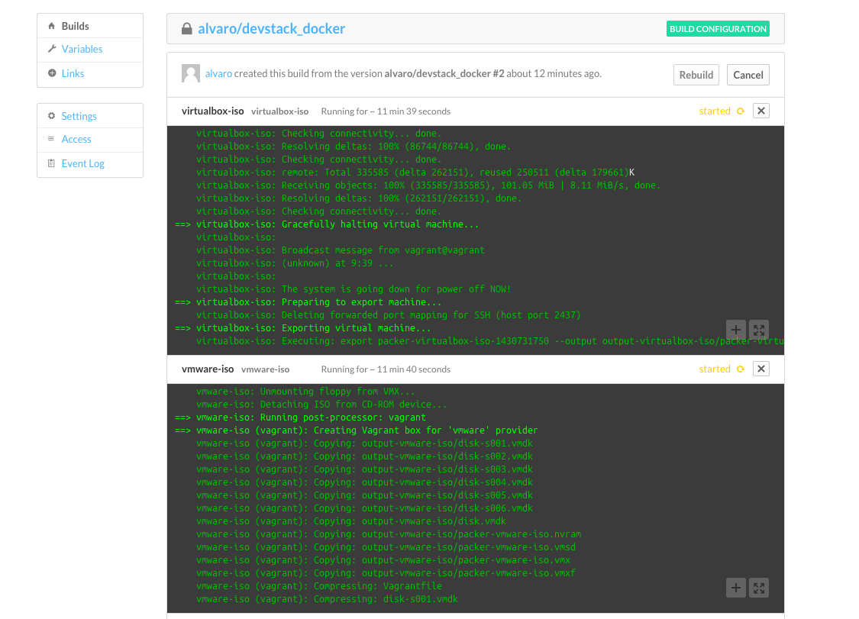
Packer build service

